Slide 1
Chlamydia, Gonorrhea & Syphilis
Prof. Hanan Habib & Dr.Khalifa Binkhamis
Department of Pathology
College of Medicine

Slide 2
Objectives
Recall the causative agents of syphilis, gonorrhea and Chlamydia infections.
Describe the pathogenesis of syphilis, gonorrhea and Chlamydia infection.
Describe the clinical features of Chlamydial infections
Recall the different genera, species and serotypes of the family Chlamydophila.
Describe the laboratory diagnosis of Chlamydia
Describe the clinical features of gonorrhea that affect only men, only women and those ones which affect both sexes.

Slide 3
Objectives
Describe the different laboratory tests for the diagnosis of gonorrhea
Describe the clinical feature of the primary, secondary tertiary syphilis and complications.
Recall the different diagnostic methods for the different stages of syphilis.
Recall the treatment regimens of syphilis, gonorrhea and Chlamydia infections.
Recall that there are no effective vaccines against all these three diseases.

Slide 4
Chlamydia
An obligate intracellular bacteria with elements of bacteria but no rigid cell wall.
Fail to grow on artificial media
Uses host cell metabolism for growth and replication.

Slide 6
Chlamydia species
Chlamydia serotype
Disease
C. trachomatis
A,B,C
D - K
L1, L2, L3
C.psittaci
C.pneumoniae
Trachoma
Inclusion conjunctivitis, genital infection
Lymphogranuloma venerum (LGV)
Psittacosis
Respiratory infections

Slide 7
Epidemiology
C.trachomatis is a common cause of sexually transmitted disease (STD).
Spread by genital secretions , anal or oral sex.
Wide spread, 5-20 % among STD clinic in USA.
Human are the sole reservoir .
1/3 of male sexual contacts of women with C.trachomatis cervicitis develop urethritis after 2-6 weeks incubation period.

Slide 8
Pathogenesis of Chlamydia
Chlamydia have tropism for epithelial cells of endocervix and upper genital tract of women, urethra, rectum and conjunctiva of both sexes.
LGV can enter through skin or mucosal breaks
Release of pro-inflammatory cytokines, lead to tissue infiltration by inflammatory cells, progress to necrosis, fibrosis then scaring.

Slide 9
Genital infections caused by C.trachomatis
In men: urethritis ( non gonococcal urethritis (NGU)) , epididymitis & proctitis.
In women: cervicitis, salpingitis, urethral syndrome, endometritis & proctitis.
Urethritis presents as dysuria and thin urethral discharge in 50 % of men.
Uterine cervix infection may produce vaginal discharge but is asymptomatic in 50-70% of women.
Salpingitis and pelvic inflammatory disease can cause sterility and ectopic pregnancy.

Slide 10
50% of infants born to mothers excreting C.trachomatis during labor show evidence of infection during the first year of life. Most develop inclusion conjunctivitis, 5-10% develop infant pneumonia syndrome.
LGV caused by C.trachomatis strains L1,L2,L3
LGV is common in South America and Africa.
Papule and inguinal lymphadenopathy.
Chronic infection leads to abscesses, strictures and fistulas.

Slide 11
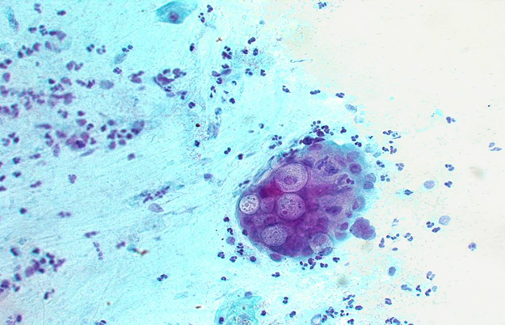
Diagnosis of Chlamydia genital infections
Polymerase chain reaction (PCR) :
the most sensitive methods of diagnosis. Performed on vaginal ,cervical , urethral swabs, or urine .
Isolation on tissue culture ( McCoy cell line) : C.trachomatis inclusions can be seen by iodine or Giemsa stained smear.
Rarely done

Slide 12
Treatment & Prevention
Azithromycin : single dose for non- LGV infection.
Erythromycin : for pregnant women.
Doxycycline : for LGV.
Prevention and control through early detection of asymptomatic cases , screening women under 25 years to reduce transmission to the sexual partner.

Slide 13
Gonorrhea: Clinical Aspects
A STD disease acquired by direct genital contact. It is localized to mucosal surfaces with infrequent spread to blood or deep tissues. Caused by N.gonorrheae.
Clinical manifestations: 2-5 days IP .
Men: acute urethritis and acute profuse purulent urethral discharge.
Women: mucopurulent cervicitis, urethritis with discharge.
In both sexes: urethritis & proctitis.
Symptoms are similar to Chlamydia infection.
Pharyngitis may occur.
Pelvic inflammatory disease ( PID) in women.
Conjunctivitis in neonates born to infected mothers

Slide 14
Pelvic Inflammatory Disease (PID)
PID occurs in 10-20% of cases, include fever, lower abdominal pain, adnexal tenderness, leukocytosis with or without signs of local infection.
Salpingitis and pelvic peritonitis cause scarring and infertility.
Disseminated Gonoccocal Infection ( DGI) due to spread to the bloodstream.

Slide 15
Disseminated Gonococcal Infection (DGI)
Due to spread of the bacteria to the blood stream.
Clinically : Fever, migratory arthralgia and arthritis. Purulent arthritis involving large joints. Petechial and maculopapular rash.
Metastatic infections such as Endocarditis , Meningitis & Perihepatitis may develop.

Slide 16
Epidemiology of Gonorrhea
Rates among adolescents are high, about 10% increase per year in USA .
Inability to detect asymptomatic cases such as women and patient fail to seek medical care hampers control .
Major reservoir for continued spread are asymptomatic cases.
Non-sexual transmission is rare.

Slide 17
Neisseria gonorrheae
A Gram negative diplococci grows on chocolate agar and on selective enriched media and CO2 required. Not a normal flora.
Pathogenesis: mainly a localized infection of epithelium ,leads to intense inflammation.
Posses pili and outer membrane proteins that mediate attachment to non-ciliated epithelium.

Slide 18
Diagnosis of Gonorrhea
Transport media required unless transfer to the lab. is immediate.
Direct smear for Gram stain of urethral specimens to see Gram negative diplococci within a neutrophil (intracellular) .
Culture on Thayer-Martin or other selective medium.
Confirmation : fermentation of glucose only ( does not ferment maltose or sucrose) or Co-agglutination test.
Nucleic acid amplification tests (e.g PCR) is an option for diagnosing genital infections.

Slide 19
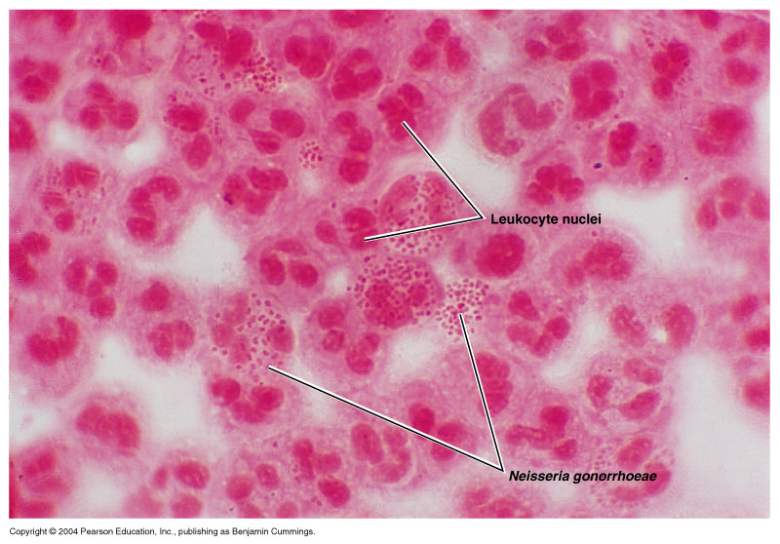
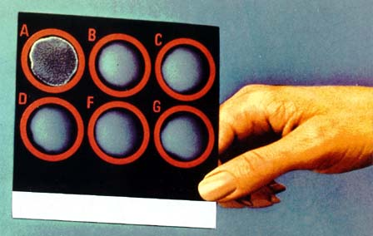

Slide 20
Treatment of Gonorrhea
Guided by local resistance pattern and susceptibility testing. Partner should be treated as well.
Ceftriaxone IM (or oral Cefixime ) recommended.
Combination with Azithromycin recommended
Alternatives:
Ciprofloxacin or Ofloxacin
Azithromycin, Doxycycline ( orally for 7 days) both cover C.trachomatis infection as well .
Counseling.
Notes:
Combination recommended due to emerging cephalosporin resistance and potential for C. trachomatis co-infections

Slide 21
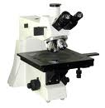
Syphilis
A chronic systemic infection , sexually transmitted , caused by a spiral organism called Treponema pallidum subsp.pallidum .
The organism grow on cultured mammalian cells only , NOT stained by Gram stain but readily seen only by immunoflurescence (IF), dark filed microscopy or silver impregnation histology technique.

Slide 22
Epidemiology of Syphilis
An exclusively human pathogen.
Transmission by contact with mucosal surfaces or blood, less commonly by non-genital contacts with a lesion, sharing needles by IV drug users, or transplacental transmission to fetus.
Early disease is infectious.
Late disease is not infectious .

Slide 23
Pathogenesis
Bacteria access through inapparent skin or mucosal breaks.
Slow multiplication , endarteritis & granulomas.
Ulcer heals but spirochete disseminate.
Latent periods may be due to surface binding of host components.
Injury is due to delayed hypersensitivity responses to the persistence of the spirochetes.

Slide 24
Clinical Manifestations: Stages of Syphilis
Primary syphilis: chancre is a painless, indurated ulcer with firm base and raised margins on external genitalia or cervix ,anal or oral site, appear after an IP of about 2-6 weeks .
Enlarged inguinal lymph nodes may persist for months.
Lesion is infectious
Lesion heals spontaneously after 4-6 weeks.

Slide 25
Secondary Syphilis
Develops 2-8 weeks after primary lesion healed.
Characterized by symmetric mucocutaneous rash , mouth lesions ( snail track ulcers) and generalized non-tender lymph nodes enlargement ( full of spirochete) with bacteremia causing fever, malaise and other systemic manifestations.
Skin lesion distributed on trunk and extremities often palms, soles and face.
1/3 develop Condylomata Lata: which are painless mucosal warty erosions on genital area and perineum.

Slide 26
Secondary lesion resolve after few days to many weeks but disease continue in 1/3 of patients. Disease enter into a latent state.
Lesions are infectious.
Latent syphilis: a stage where there is no clinical manifestations but infection evident by serological tests. Relapse cease.
Risk of blood-borne transmission from relapsing infection or from mother to fetus continue.

Slide 27
Tertiary syphilis
Occurs in 1/3 of untreated cases. Manifestations may appear after 15-20 years or may be asymptomatic but serological tests positive.
Neurosyphilis: chronic meningitis, with increased cells and protein in CSF, leads to degenerative changes and psychosis. Demylination causes peripheral neuropathies. Most advanced cases result in paresis (personality, affect , reflexes, eyes, senorium, intellect, speech) due to the effect on the brain parenchyma and posterior columns of spinal cord and dorsal roots.

Slide 28
Cardiovascular Syphilis
Due to arteritis, leads to aneurysm of aorta and aortic valve ring.
Localized granulomatous reaction called gumma on skin, bones, joints or other organs leads to local destruction .
Congenital syphilis :develop if the mother not treated ,fetus susceptible after 4th month of gestation. Fetal loss or congenital syphilis result. Rhinitis ,rash and bone changes ( saddle nose, saber shine) anemia ,thrombocytopenia, and liver failure.

Slide 31
Laboratory Diagnosis of Syphilis
Direct microscopic examination of a smear of a smear from primary or secondary lesions using dark field microscopy rarely used. Has many limitations. If positive it confirms the diagnosis.
Serologic tests commonly used:
Specific treponemal tests: used initially for diagnosis and for confirmation.
Non specific treponemal tests : used for screening and follow up of therapy.

Slide 32
Syphilis Serology
Nontreponemal tests: Non specific ,directed against lipoidal antigens released as a consequence of cell damage .becomes positive 6 weeks after infection:
Rapid Plasma Reagin (RPR)
Venereal Disease Research Laboratory ( VDRL).
Become positive during the primary stage ( possible exception HIV) ,antibody peak in secondary syphilis. Negative following effective therapy .
Used for screening and staging the disease & follow up therapy.

Slide 33
Syphilis Serology
Treponemal tests :
Specific to treponemal antigens . Detect IgG and IgM directed against treponema membrane lipoproteins.
Becomes positive after 3 weeks after infection. Used for confirmation of RPR & VDRL. Remain positive even after effective therapy .Commonly used tests are:
FTA-ABS ( Flu0rescent treponemal antibody-absorption)
TP -PA( T. palladium particle agglutination)
EIA ( Enzyme Immuonoassay)

Slide 34
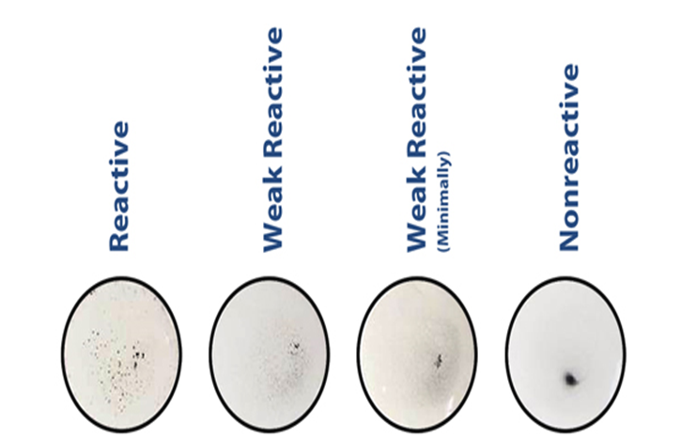
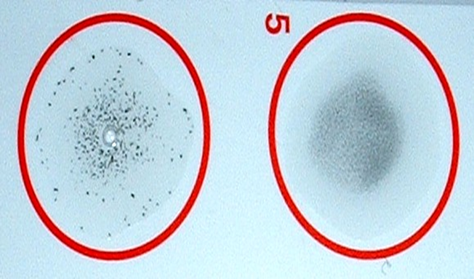
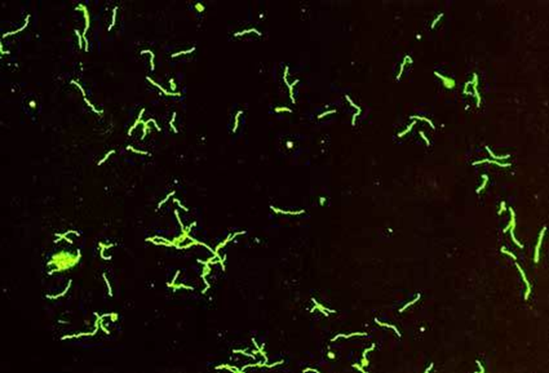
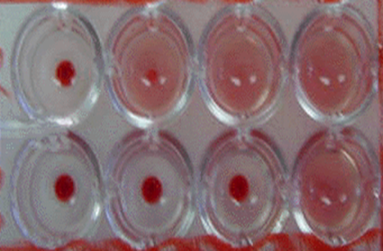
SYPHILIS SEROLOGY& IF

Slide 37
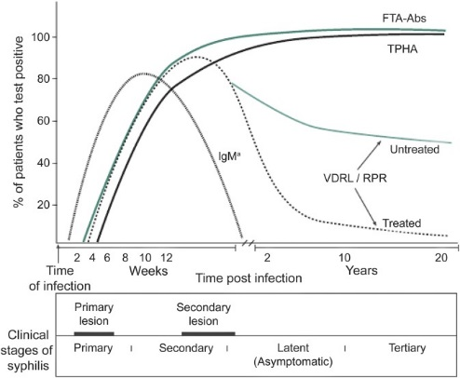

Slide 38
Summary of Syphilis Serology Reverse Sequence Syphilis Serology
Test
Stage
Treponemal tests
FTA-ABS , MP PA , EIA
Non-treponemal tests ( RPR or VDRL)
IgM antibody
Positive at all stages , confirm RPR & VDRL
Positive during primary & secondary stages .Used for screening ,staging and follow up effective therapy.
Congenital syphilis

Slide 39
Treatment and Prevention
Treponema is sensitive to Penicillin.
Hypersensitive patients treated with Tetracycline, Erythromycin or Cephalosporins
Prevention: counseling.

Slide 40
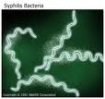
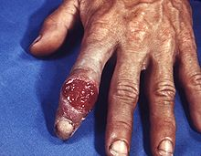
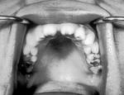
Syphilis

Slide 41
Take Home Message
Syphilis, Chlamydia and Gonorrhea are main STDs ,caused by delicate organisms ,cannot survive outside the body.
Infection may not be localized.
Clinical presentation may be similar ( urethral or genital discharge, ulcers ).
One or more organisms ( Bacteria, virus, parasite ) may be transmitted by sexual contact.
Screening for HIV required .
If not treated early may end in serious complications .

Slide 42
Reference book
Ryan, Kenneth J. Sherris Medical Microbiology. Latest edition.
Mc Graw –Hill education

