Slide 1
Systemic Manifestations of AIDS
Dr. Maria A. Arafah
Assistant Professor – Department of Pathology
http://fac.ksu.edu.sa/mariaarafah/courses
Notes:
Faded picture background with full-color overlay
(Intermediate)
Tip: For best results with the picture overlay on this slide, use a picture that is the same dimensions as the slide: 7.5” high and 10” wide. If the picture is not the same height and width, resize or crop to those dimensions before following the instructions below.
To reproduce the background effects on this slide, do the following:
On the Home tab, in the Slides group, click Layout, and then click Blank.
Right-click the slide and then click Format Background.
In the Format Background dialog box, click Fill in the left pane. In the Fill pane, select Picture or texture fill, and then under Insert from, click File.
In the Insert Picture dialog box, select a picture, and then click Insert.
Also in the Format Background dialog box, in the Fill pane, in the Transparency box, enter 50%.
Also in the Format Background dialog box, click Picture Color in the left pane. In the Picture Color pane, under Recolor, click the button next to Presets, and then click Tan, Background color 2 Light (third row, first option from the left).
On the Insert tab, in the Images group, click Picture.
In the Insert Picture dialog box, select the same picture chosen for the background, and then click Insert.
Select the picture. Under Picture Tools, on the Format tab, in the bottom right corner of the Size group, click the Size and Position dialog box launcher. In the Format Picture dialog box, resize or crop the image so that the height is set to 7.5” and the width is set to 2.25”.
To crop the picture, click Crop in the left pane, and in the Crop pane, under Crop position, enter values into the Height, Width, Left, and Top boxes.
To resize the picture, click Size in the left pane, and in the Size pane, under Size and rotate, enter values into the Height and Width boxes.
Also in the Format Picture dialog box, click Glow and Soft Edges in the left pane, and then in the Glow and Soft Edges pane, under Soft Edges, in the Size box enter 10 point.

Slide 2
Objectives
Understand the pathogenesis of the AIDS syndrome.
Recognize the systemic manifestations of AIDS syndrome with a special emphasis on Kaposi sarcoma and opportunistic infections that could be encountered in AIDS patients.

Slide 3
Introduction
Human immunodeficiency virus (HIV) is the causative agent for AIDS.
HIV is caused by a retrovirus of the lentivirus family that contains only RNA.
It was unknown until the early 1980's, but since then it has spread around the world to infect millions of people.
All HIV infected persons are at risk for illness and death from development of opportunistic infections and tumors and the inevitable manifestations of AIDS.

Slide 4
Introduction
The most common type of HIV infection is known as HIV-1 and is the type that has led to the worldwide AIDS epidemic.
There is also an HIV-2 that is much less common.
The result of HIV infection is the destruction of the immune system.

Slide 5
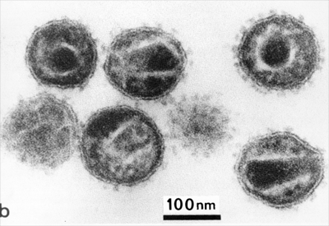
HIV Structure
The mature virus consists of an electron dense core containing the viral genome consisting of the 2 short strands of RNA (ribonucleic acid).
It also contains enzymes: reverse transcriptase, protease, ribonuclease, and integrase.
All are encased by an outer lipid envelope.

Slide 6
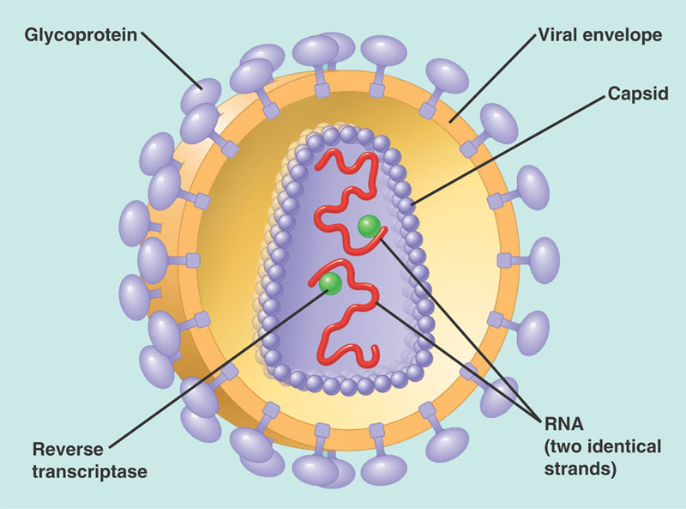

Slide 7
Pathogenesis of HIV Infection
The HIV virion expresses a cell surface protein/antigen called gp120.
gp120 aids in the binding of the virus to the target cells. Once the virus enters the human body it attaches itself to the target cell via the CD4 receptors on the surface of the target cell and therefore gains entry into the target cell.
gp120 is responsible for tropism/attraction to CD4+ receptors. This function helps in entry of HIV into the host cell.

Slide 8
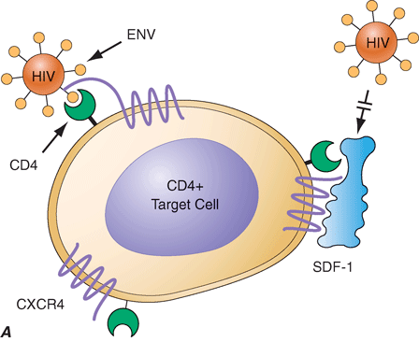
Pathogenesis of HIV Infection
In addition, gp120 also binds to two co-receptors CXCR4 and CCR5 on the host cell surface. They also assist in the entry of the virus into the host cell.
The T-lymphocytes have surface CD4 receptors (CD4+ T lymphocytes) to which HIV can attach to promote entry into the cell.

Slide 9
Pathogenesis of HIV Infection
HIV is shown crossing the mucosa of the genital tract to infect CD4+ T lymphocytes.
The probability of infection depends on both the number of infective HIV virions in the body fluid which contacts the host as well as the number of cells with CD4 receptors available at the site of contact.

Slide 10
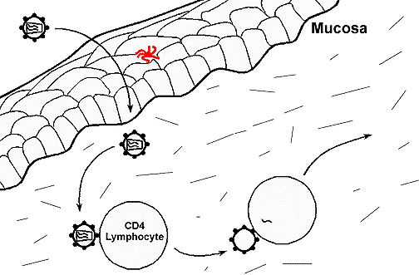
Pathogenesis of HIV Infection
A Langerhans cell in the epithelium is shown in red in this diagram

Slide 11
Pathogenesis of HIV Infection
Retroviruses are unable to replicate outside the living host cells because they only contain RNA and do not contain DNA.
Therefore once HIV infects a cell, it must use its reverse transcriptase enzyme to transcribe/convert its RNA to host cell proviral DNA for replication.
The enzyme, reverse transcriptase in the HIV helps in the reverse transcription (i.e. conversion) of RNA to proviral DNA. The proviral HIV DNA is then inserted into host cell genomic DNA by the integrase enzyme.

Slide 12
Pathogenesis of HIV Infection
Once the HIV proviral DNA is within the infected cell's genome, the HIV provirus is replicated by the host cell to produce additional HIV virions which are released by surface budding.
Alternatively the infected cells can undergo lysis with release of new HIV virions which can then infect additional cells.

Slide 13
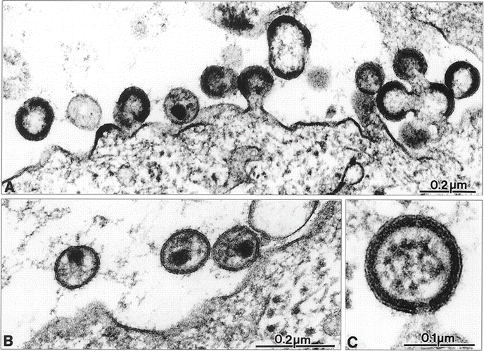
Pathogenesis of HIV Infection
HIV viral particles are seen adjacent to the cell surface in this electron micrograph

Slide 14
HIV Life Cycle

Slide 15
HIV Infection
Macrophages and Langerhans cells are both important as reservoirs and vectors for the spread of HIV in the body including the CNS.
Both macrophages and Langerhans cells can be infected by HIV but are not destroyed themselves. HIV can then be carried via these cells elsewhere in the body.
Once the infection extends to the lymph nodes, the HIV virions are trapped in the processes of follicular dendritic cells (FDC's), where they provide a reservoir and infect CD4+ T lymphocytes that are passing through the lymph node. The FDC's themselves become infected, but are not destroyed.

Slide 16
HIV Infection
The target cells are: blood monocytes and tissue macrophages, T lymphocytes, B lymphocytes, natural killer (NK) lymphocytes, dendritic cells (i.e. the Langerhans cells of epithelia and follicular dendritic cells in lymph nodes), hematopoietic stem cells, endothelial cells, microglial cells in brain, and gastrointestinal epithelial cells.
In addition, HIV has the ability to mutate easily. This high mutation rate leads to the emergence of HIV variants within the infected person's cells that are more toxic and can resist drug therapy. Over time, different tissues of the body may harbor differing HIV variants

Slide 17
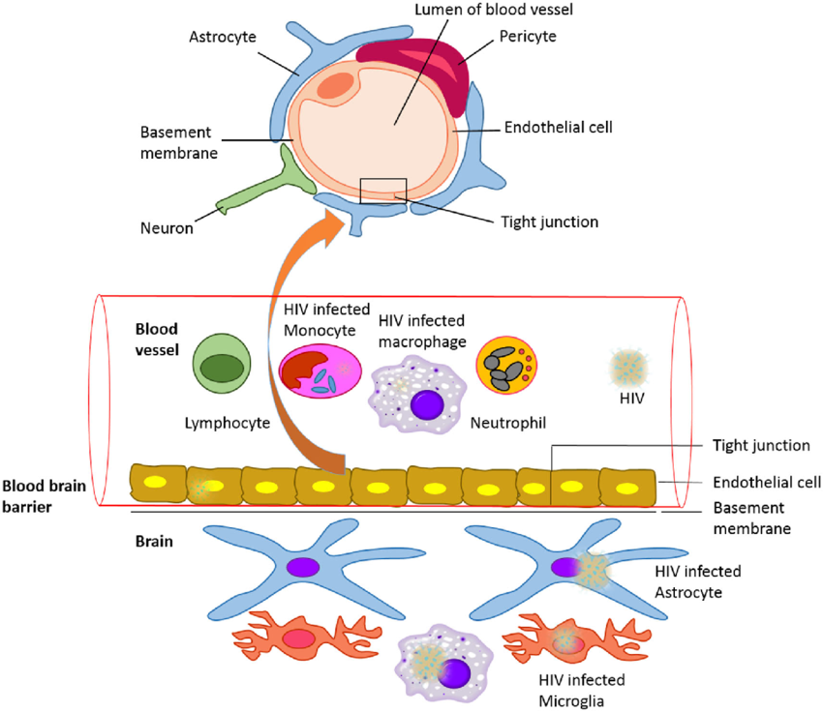

Slide 18
Modes of Transmission of HIV
HIV can be present in a variety of body fluids and secretions. They include genital secretions, blood, breast milk, saliva, urine, tears, and sweat.
However, saliva, urine, tears, and sweat are of no major clinical importance, as transmission of HIV through these fluids does not routinely occur because of the low concentration of HIV in these fluids.

Slide 19
Modes of transmission of HIV (the high risk population)
HIV is primarily spread as a sexually transmissible disease.
Transmission of HIV can occur from male to male, male to female, and female to male. Female to female transmission remains extremely rare.
HIV can be transmitted through parenteral routes
IV drug users sharing infected needles. Less common practices like the use of instruments such as tattoo needles that are not properly disinfected also carry a potential risk.
Health care workers with percutaneous exposures (needle puncture) to HIV-containing blood.
Persons receiving multiple blood transfusions e.g. hemophiliacs. Screening of blood products for HIV has significantly reduced HIV transmission by this means.

Slide 20
Modes of transmission of HIV (the high risk population)
HIV infection can also be acquired as a congenital infection either perinatally or in infancy. Mothers with HIV infection can pass the virus:
transplacentally i.e. in utero
at the time of delivery through the birth canal
through breast milk.
HIV infection is not spread by casual contact in public places, households, or in the workplace. HIV is not spread by insect vectors.
There is no vaccine to prevent HIV infection.

Slide 21
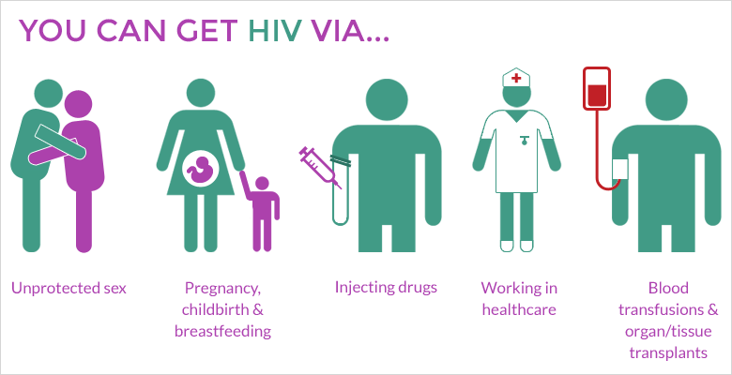
Modes of transmission of HIV (the high risk population)

Slide 22
Diagnosis of HIV
Test for HIV antibodies is done with a rapid test using an enzyme-linked immunosorbent assay (ELISA) technique.
If rapid test is positive, then the next step is to:
Confirm HIV infection with Western blot or immunofluorescence assay (IFA)

Slide 23
Diagnosis of HIV
The average HIV-infected person may take up to several weeks to become seropositive, and then may live up to 8 or 10 years, on average, before the development of the clinical signs and symptoms of AIDS.

Slide 24
Clinical Presentation
Primary HIV infection may go unnoticed in at least half of cases, produce a mild disease which quickly subsides, or produce an acute HIV infection, followed by a long clinical "latent" period lasting years.
Primary acute HIV infections may include fever, generalized lymphadenopathy, pharyngitis, rash, arthralgia and diarrhea. These symptoms diminish over 1 to 2 months.

Slide 25
Pathogenesis of AIDS/clinical AIDS
The primary target of HIV is the immune system, which is gradually destroyed.
Clinically, HIV infection may appear "latent" for years. During this period there is ongoing immune system destruction but still enough of the immune system remains intact to provide immunity and prevent most infections.
Eventually, when a significant number of CD4+ T lymphocytes have been destroyed and when production of new CD4+ cells cannot match destruction, failure of the immune system leads to the appearance of clinical AIDS.

Slide 26
Pathogenesis of AIDS/clinical AIDS
The progression to clinical AIDS is also marked by the appearance of syncytia-forming (SI) variants of HIV in about half of HIV infected patients. These SI variants are associated with more rapid CD4+ cell decline.
The development of signs and symptoms of AIDS correlates with the CD4+ lymphocyte count. When the CD4+ lymphocyte count drops below 200/microliter, then the stage of clinical AIDS has been reached. This is the point at which the characteristic opportunistic infections and neoplasms of AIDS appear. The CD4+ T-cells to CD8+ T-cells ratio is also greatly reduced, often to less than 1.0.

Slide 27
Acquired Immunodeficiency Syndrome (AIDS)
The stage of clinical AIDS is reached years after the initial infection and is marked by the development of one or more of the typical opportunistic infections or neoplasms common to AIDS.
Following are some of the more common complications seen in AIDS:
Infections e.g. pneumocystis jiroveci, CMV, mycobacteria, fungi.
Neoplasms
Miscellaneous e.g. lymphoid interstitial pneumonitis which is a condition involving the lung that can be seen in AIDS in children.

Slide 28
Infections
Pneumocystis Jiroveci
Pneumocystis jiroveci (P. carinii) is the most frequent opportunistic infection seen in AIDS. It commonly produces a pulmonary infection.
The diagnosis is made histologically by finding the organisms in cytologic (bronchoalveolar lavage) or biopsy (transbronchial biopsy) material from lung.
In the lung, there is soap bubble like intra-alveolar exudate and the organism appears as cyst like structures that are positive with silver stain.
Cytomegalovirus
CMV infection is seen in AIDS. It causes pneumonia and it can also cause serious diseases in the brain and gastrointestinal tract.
It is also a common cause for retinitis and blindness in persons with AIDS.

Slide 29
Pneumocystis Jiroveci
H&E Stain
Silver Stain

Slide 30
CMV Infection

Slide 31
Infections
Mycobacterial infections
Mycobacterium tuberculosis.
Mycobacterium avium complex (MAC) infection.
Definitive diagnosis of mycobacterial disease is made by culture and PCR.
Fungal Infections
Candidiasis of the esophagus, trachea, bronchi, or lungs.
Cryptococcus neoformans (produces pneumonia and meningitis), Histoplasma capsulatum, and Coccidioides immitis.

Slide 32
Infections
Toxoplasmosis caused by Toxoplasma gondii is a protozoan parasite that most often leads to infection of the brain with AIDS.
Herpes simplex infection in the mucosa
Aspergillosis especially in the lung
Cryptosporidium and Microsporidium produce voluminous watery diarrhea in patients with AIDS.
Viral HIV encephalitis
Syphilis (primary, secondary and tertiary)

Slide 33
Neoplasms
Kaposi's sarcoma (KS) produces reddish purple patches or nodules over the skin and can be diagnosed with skin biopsy. Visceral organs can also be involved with KS. It is a sarcoma of the blood vessels. It is associated with HHV-8 and on histology, it shows malignant spindle cells of vascular origin.
Malignant lymphomas are seen with AIDS. They are commonly B-cell non-Hodgkins lymphoma. They are typically of high grade and often in the brain. They are very aggressive and respond poorly to therapy.

Slide 34
Kaposi Sarcoma
Clinically
Microscopically

Slide 35
Reference
Kumar V, Abbas AK, Aster JC. Robbins Basic Pathology. 10th ed. Elsevier; 2018. Philadelphia, PA.

Slide 36
End of Lecture
Thank You

