Slide 1
Prostate pathology
Dr. Maria A. Arafah
Assistant Professor – Department of Pathology
http://fac.ksu.edu.sa/mariaarafah/courses

Slide 2
objectives
Understand the basic anatomical relations and zones of the prostatic gland.
Know the epidemiology, pathogenesis and histopathologic features of benign prostatic hyperplasia and carcinoma of the prostate.

Slide 3
Introduction
The prostate weighs 20 grams in a normal adult male.
It is a retroperitoneal organ, encircling the neck of bladder and urethra.
It is devoid of a distinct capsule.
Microscopically the prostate is a tubulo-alveolar organ. The prostate glands are lined by two layers of cells, basal cells and columnar secretory cells

Slide 4
Prostate histology

Slide 5
Introduction
The prostate is divided into different zones: central, peripheral and transitional zones.
The transition zone is the middle area of the prostate, between the peripheral and central zones. It surrounds the urethra as it passes through the prostate.
The majority of prostate cancers are found in the peripheral zone and benign nodular hyperplasia in the transitional zone.

Slide 6
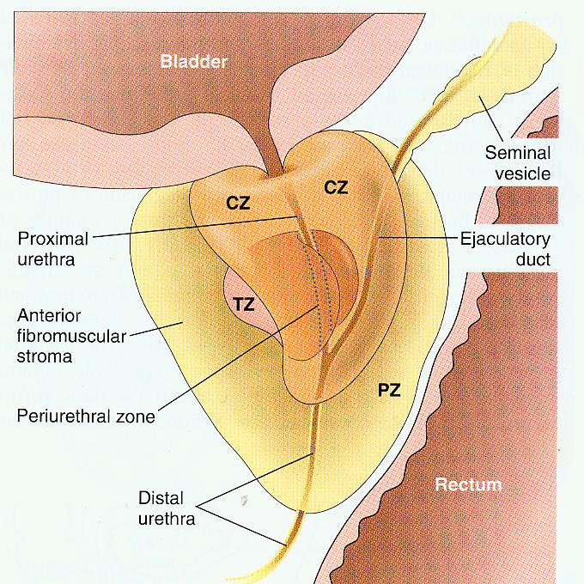
Prostate zones

Slide 7
Benign Prostatic Hyperplasia
Benign prostatic hyperplasia (BPH) is also known as benign nodular hyperplasia.
It is extremely common in men over the age of 50 years.
About 20% men have BPH by age 40
About 70% men have BPH by age 60
About 90% men have BPH by age 80
BPH is not a premalignant lesion.

Slide 8
Benign Prostatic Hyperplasia
Hyperplasia of glands and stroma results in large nodular enlargement in the periurethral region of the prostate.
Once the nodules become large they compress the prostatic urethra causing either partial, or complete obstruction of the urethra.
The essential cause of BPH is unknown but the pathogenesis is related to the action of androgens.
Prepubertal castration prevents BPH.

Slide 9
Pathogenesis of bph
Dihydrotestesterone (DHT) is the ultimate mediator for prostatic growth. It increases the proliferation of stromal cells and inhibits epithelial cell death. Therefore DHT is implicated in the pathogenesis of both benign prostatic hyperplasia and prostate cancer.
Testosterone is converted to dihydrotestosterone by the 5-alpha reductase enzyme.
Drugs that act as inhibitors of 5-alpha reductase, therefore have an important role in the prevention and treatment of BPH and prostate cancer.

Slide 10
Pathogenesis of bph

Slide 11
Gross morphology
The prostate weighs between 60 and 100 grams.
The hallmark of BPH is nodularity due to glandular and fibro-muscular proliferation.
Nodular hyperplasia begins in the inner aspect of the prostate gland, the transition zone.
Cut-section shows nodules which vary in size, color and consistency depending on which element is proliferating more (glandular or fibro-muscular).
It compress the wall of the urethra resulting in a slit-like orifice.

Slide 12
Gross morphology

Slide 13
Microscopic features
The main feature of BPH is nodularity, the nodules can be one of the following:
purely stromal nodules composed mainly of fibromuscular elements
fibroepithelial with both glandular and fibromuscular component. There is aggregation of small to large to cystically dilated glands, lined by two layers of epithelium surrounded by fibromuscular stroma.
Needle biopsies do not sample the transitional zone where BPH occurs, therefore the diagnosis of BPH cannot be made on needle biopsy.

Slide 14
Microscopic features

Slide 15
Clinical presentation
The nodule compress the prostatic urethra → uretheral obstruction → retention of urine in the bladder → bladder hypertrophy
The inability to empty the bladder completely leads to increase volume of residual urine → therefore infection
Increased urinary frequency
Nocturia
Difficulty in starting and stopping the stream of urine
Dysuria
Some patients present with acute urinary retention.

Slide 16
treatment
Mild cases of BPH may be treated with α-blockers and 5-α-reductase inhibitors.
Moderate to severe cases require transurethral resection of the prostate (TURP).

Slide 17
Prostate adenocarcinoma
It is a common form of cancer in men over the age of 50 years.
It is more prevalent among African Americans.
Risk factors include: age, race, family history, hormone level (androgens) and environmental influences.
Androgens are believed to play a major role in the pathogenesis.
Tumor can spread by direct local invasion and through blood vessels and lymphatics.
Local extension most commonly involves the periprostatic tissue, seminal vesicles and the base of the urinary bladder (leading to ureteral obstruction).

Slide 18
Gross morphology
70% of tumors arise in the peripheral zone in the posterior part of the gland.
The tumor is firm and gritty and is palpable on rectal exam.

Slide 19
Gross morphology

Slide 20
Microscopic features
Most lesions are adenocarcinomas that produce well-defined gland patterns.
The malignant glands are lined by a single layer of cuboidal or low columnar epithelium with large nuclei and one or more large nucleoli though nuclear pleomorphism is not marked.
The outer basal cell layer typical of benign glands is absent.
Perineural invasion is common.

Slide 21
Microscopic features

Slide 22
Grading prostate cancer
Gleason system is a histological grading and scoring system for prostatic adenocarcinoma done on the microscopic level.
There are five grades (1 to 5) depending on the degree and pattern of differentiation as seen microscopically (in which they range from, grade 1= well-differentiated to grade 5= very poorly differentiated).
On biopsies, prostate carcinomas usually have more than one type of grade in the tumor mass. The most common type and the most aggressive of grades seen in the are added and the final sum is called the Gleason Score (most common & second most common on resection).
Gleason grading and scoring in prostate cancer is very useful in predicting the prognosis of a patient.

Slide 23
Staging prostate cancer
Staging in prostate cancer depends on the TNM system.
It is the most important indicator of prognosis.

Slide 24
Clinical presentation
Microscopic (or very small size) cancers are asymptomatic and are discovered incidentally.
Most tumors arise in the peripheral zone, away from urethra and therefore urinary symptoms occur late.
Occasionally patients present with back pain caused by vertebral metastases.
Careful digital rectal examination may detect some early cancers.
PSA (Prostate Specific Antigen) levels are important in the diagnosis and management of prostate cancer. However, a minority of prostate cancers may have low PSA.
PSA is organ-specific but not cancer specific because it could be increased in BPH and prostatitis.
A transrectal needle biopsy is required to confirm the diagnosis.

Slide 25
Clinical presentation

Slide 26
Treatment
Surgery, radiotherapy and hormonal therapy are used for treatment and 90% of treated patients are expected to live for 15 years.
Currently the most acceptable treatment for clinically localized cancer is radical surgery.
Locally advanced cancers can be treated by radiotherapy and hormonal therapy. Hormonal therapy (anti-androgen therapy) can induce remission.
Advanced, metastatic carcinoma is treated by androgen removal treatment, either by orchiectomy or by hormonal anti-androgen therapy.
The prognosis depends on the Gleason score and stage of tumor.
Metastases first spread via lymphatics: initially to the obturator nodes and eventually to the para-aortic nodes
Hematogenous extension occurs chiefly to the bones. The bony metastasis are typically osteoblastic in nature.

Slide 27
Prostatic intra-epithelial neoplasia
Prostatic intraepithelial neoplasia (PIN) is the precursor lesion for invasive carcinoma.
It can be low grade PIN or high grade PIN (carcinoma in situ).
PIN like prostatic carcinoma occurs in the peripheral zone.

Slide 28
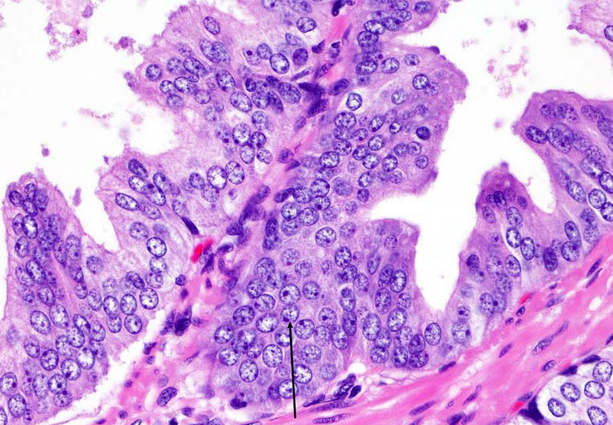
Prostatic intra-epithelial neoplasia

Slide 29
References
Kumar V, Abbas AK, Aster JC. Robbins Basic Pathology. 10th ed. Elsevier; 2018. Philadelphia, PA.

Slide 30
Thank you
End of Lecture

