Slide 1
Testicular pathology
Dr. Maria A. Arafah
Assistant Professor – Department of Pathology
http://fac.ksu.edu.sa/mariaarafah/courses

Slide 2
objectives
Have a working knowledge of the normal histology of the testis and epididymis.
Know the predisposing factors and pathology of epididymitis.
Epididymitis and orchitis
Non specific Epididymitis and orchitis
Granulomatous/Autoimmune Orchitis
Gonorrhea
Tuberculosis
Be familiar with the basic classification and pathology of testicular tumors.
Testicular tumors
seminoma
yolk sac tumor
embryonal carcinoma
Teratoma
choriocarcinoma.

Slide 3
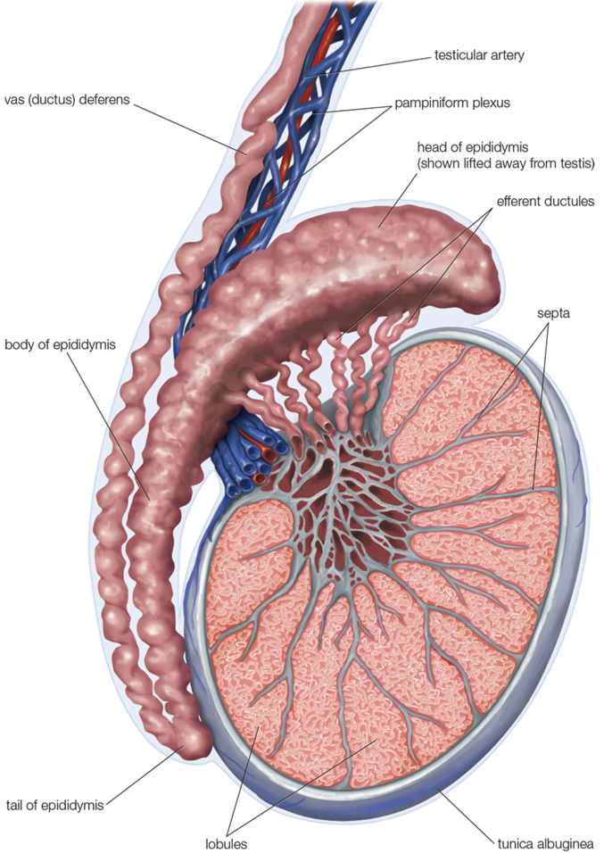
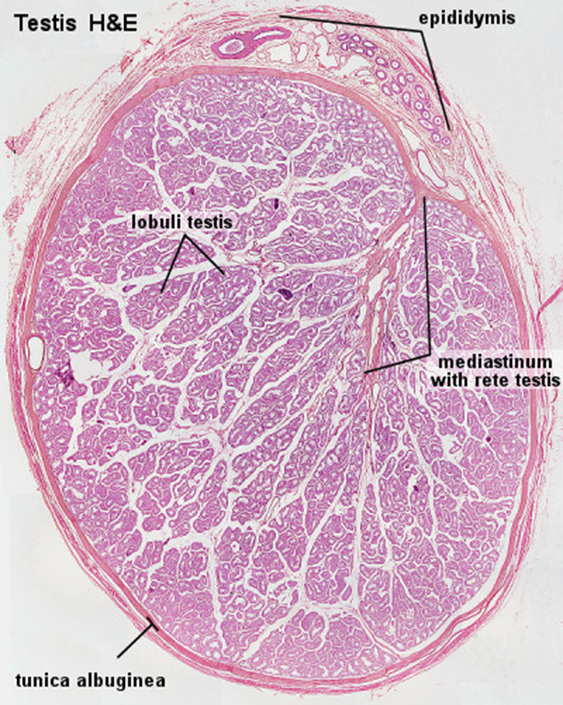
introduction

Slide 4
introduction
Testis
Epididymis

Slide 5
Epididymitis and orchitis
Epididymitis: inflammation of epididymis.
Orchitis: inflammation of testis.
Inflammatory conditions are generally more common in the epididymis than in the testis.
However, some infections, notably syphilis, may begin in the testis with secondary involvement of the epididymis.

Slide 6
Epididymitis and orchitis
A. Non specific epididymitis and orchitis:
They are commonly related to infections in the urinary tract (cystitis, urethritis and genitoprostatitis).
Infections reach the epididymis/testis through the vas deference or the lymphatics of the spermatic cord.
Causative organisms vary with age:
Children: it is uncommon. Usually associated with a congenital genitourinary abnormality and infection with Gram –ve rods.
In men younger than 35 years: Chlamydia trachomatis and Neisseria are common causative organisms.
In men older than 35 years: E.Coli and Pseudomonas.

Slide 7
Epididymitis and orchitis
A. Non specific epididymitis and orchitis:
Microscopic findings:
Congestion, edema and infiltration by neutrophils, macrophages and lymphocytes.
It initially involves the interstitium but later involves the seminiferous tubules.
They may progress to frank abscess.
The infections heals by fibrous scarring.
Leydig cells are not usually destroyed.

Slide 8
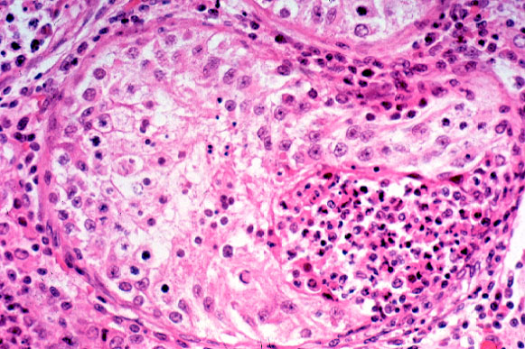
orchitis

Slide 9
Epididymitis and orchitis
B. Gonorrhea:
Gonoccocal infection can spread from urethra to prostate, seminal vesicles and then to epididymis and testis leading to suppurative orchitis and even abscess.
C. Tuberculosis:
It begins in the epididymis and spreads to the testis.
There is associated tuberculous prostatitis and seminal vesiculitis.
Microscopy: caseating granulomas.

Slide 10
Epididymitis and orchitis
D. Granulomatous (autoimmune) epididymitis & orchitis:
It affects middle–aged men and present with a unilateral testicular mass.
It mimics a testicular tumor.
Microscopy: granulomatous inflammation with plasma cells and lymphocytes.
May be in response to disintegrated sperm, post-infectious, due to trauma or sarcoidosis.

Slide 11
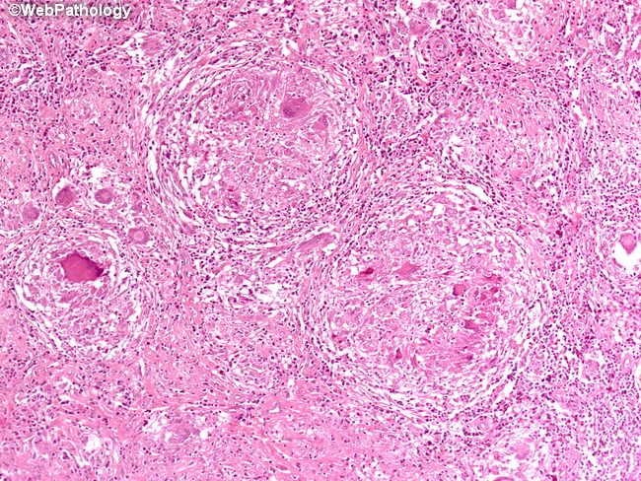
Granulomatous orchitis

Slide 12
Testicular tumors
Testicular tumors are the most important cause of a firm, painless enlargement of testis.
The peak incidence is between the ages of 20 and 34 years.

Slide 13
Classification of testicular tumors
Testicular tumors are divided into germ cell tumors and sex cord stromal tumors:
1) GERM CELL TUMORS (95% of testicular tumors)
Tumors with One Histologic Pattern (pure form)
Seminomatous germ cell tumors:
Seminoma
Spermatocytic seminoma
Non-Seminomatous germ cell tumors (NSGCT):
Embryonal carcinoma
Yolk sac (endodermal Sinus) tumor
Choriocarcinoma
Teratoma: they can be mature, immature or with malignant transformation
Tumors with more than one Histologic Pattern: mixed germ cell tumor (mixed form)
2) SEX CORD STROMAL TUMORS.
Leydig cell tumor
Sertoli cell tumor
In adults, 95% of testicular tumors are germ cell tumors, and all are malignant.
Sertoli or Leydig cells (sex cord/stromal tumors) are uncommon and are usually benign.

Slide 14
Germ cell tumor
They occur between 15-30 years of age, these are the most common tumor in men.
Most gem cell tumors are highly aggressive cancers, capable of extensive dissemination.
Germ cell tumors may have
a single component
or as in 60% of cases a mixture of components e.g. mixtures of seminomatous and non-seminomatous components.
Most GCTs originate from precursor lesions called intratubular germ cell neoplasia (it is like carcinoma-in-situ).

Slide 15
Germ cell tumor
Risk factors:
Cryptorchidism: there is a 3 to 5 fold increase in the risk of cancer in the undescended testis and in the contralateral descended testis. About 10% cases of testicular cancer have cryptorchidism.
Testicular dysgenesis.
Genetic factors.
Strong family predisposition: brothers, fathers and sons of testicular cancer patients are at risk.
There is a high risk of developing cancer in one testis if the contralateral testis has cancer.
Testicular tumors are more common in whites than in blacks.

Slide 16
seminoma
It is the most common type of testicular tumors.
It is also the most common type of testicular GCT (50%).
It almost never occurs in infants.
The peak incidence is in the 30s.
An identical tumor occurs in the ovary (called dysgerminoma).
Classic seminoma is highly sensitive to radiation therapy, and the overall 5-year survival is 90 to 95%.

Slide 17
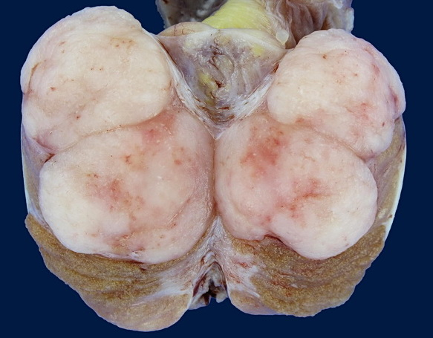
Gross morphology
Bulky masses, sometimes very large
Homogenous ,gray-white, lobulated cut surface
No necrosis or hemorrhage

Slide 18
Morphologic features
Sheets of uniform cells divided into lobules by delicate fibrous septa containing lymphocytes.
Cells are large and round with large nucleus and prominent nucleoli.
The cytoplasm of tumor cell contains glycogen.
Tumor cells are positive for PLAP, OCT4 and c-kit (CD117).

Slide 19
Morphologic features

Slide 20
Spermatocytic tumor
It was called previously spermatocytic seminoma.
Uncommon: 1-2 % of testicular GCTs
It affects men over the age of 65 years.
It is not associated with intratubular germ cell neoplasia.
It is slowly growing tumor that does not metastasize.
The prognosis is excellent.

Slide 21
Embryonal carcinoma
They account for about 15 to 35% of testicular GCTs.
The age group: 20 to 30 years.
They are more aggressive than seminomas.
They metastasizes early via both lymphatic and hematogenous routes.
They are not radiosensitive, they are chemosensitive. New chemotherapeutic agents are very effective and greatly improve prognosis.
They are smaller than seminomas and poorly demarcated.
They have variegated surfaces with foci of necrosis and hemorrhage.
They can be seen combined with other GCTs (in mixed GCTs).
Tumor cells are positive for cytokeratin (CK) and CD30 stain.

Slide 22
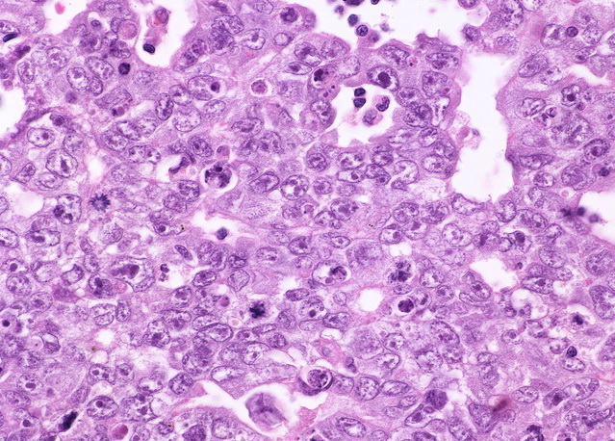
Embryonal carcinoma

Slide 23
Yolk sac tumor
Yolk sac tumor is also called endodermal sinus tumor.
Testicular yolk sac tumors occur in two forms:
as a pure form seen in young children (pure YST of the adult testis is rare)
as in combination with other NSGCTs seen in adults.
It is the most common tumor in infant and children up to 3 years of age and it has a very good prognosis in infants and children.
In adults it occurs as a part or component of mixed GCT (commonly mixed with embryonal carcinoma)
Patients have elevated serum alpha fetoprotein (AFP). AFP may be used as a marker of disease progression in the patient's serum and also aid in diagnosis.
The biologic behavior of YST is similar to that of embryonal carcinoma.

Slide 24
Yolk sac tumor
Gross morphology:
Non encapsulated, homogenous, yellow white, mucinous.
Microscopic features:
Tumor shows structures resembling endodermal sinuses called as Schiller-Duval bodies.
Hyaline–pink globules.
Tumor cell are positive for AFP and alpha-1-antitrypsin stain.

Slide 25
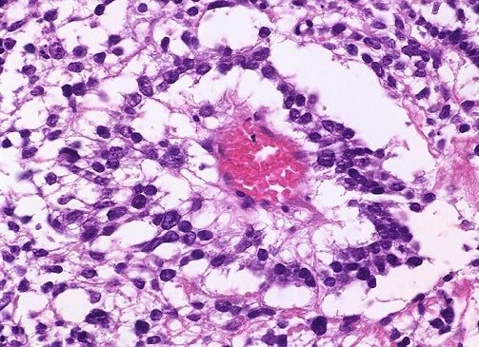
Morphologic features

Slide 26
choriocarcinoma
It is a highly malignant tumor.
Patients have elevated serum human chorionic gonadotropin (HCG).
They are small sized lesions.
They are made up of malignant trophoblastic (placental) tissue (cyto-trophoblastic and syncytio-troblastic cells) with prominent hemorrhage and necrosis.
Tumor cells are positive for HCG stain.
Pure choriocarcinoma of the testis is extremely rare, and the tumor is much more common as a component of mixed GCT.

Slide 27
teratoma
It is a tumor composed of various different types of cells or organ components.
They can occur at any age (from infancy to adult life).
In its pure form it is common in infants and children second to yolk sac tumor (in this age group).
In adults, the pure form is rare. It occurs usually as part of a mixed GTC.

Slide 28
Gross morphology
It is usually large (5 -10 cm).
Heterogenous appearance with solid and cystic areas. Can show bone, cartilage and teeth grossly.
Composed of bizzarely distributed collection of different type of cells or organ structures (heterogenous)

Slide 29
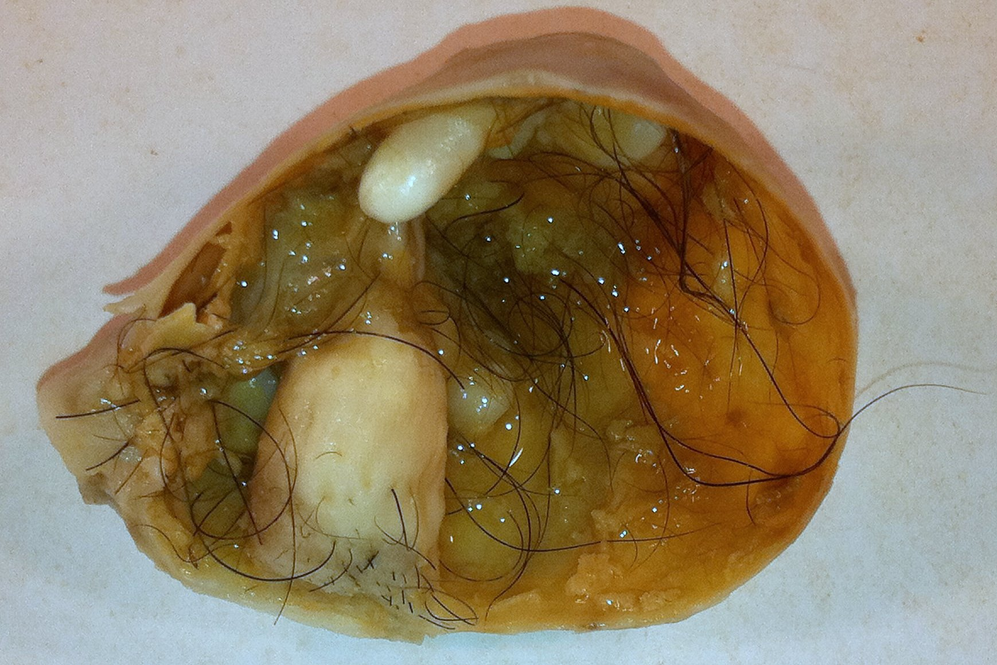
teratoma

Slide 30
Morphologic features
Any of the following cell types of various organs can be present: neural/brain, cartilage, bone, squamous epithelium, hair, glandular cells, smooth muscle, thyroid tissue, bronchial epithelium of lung, pancreatic tissue etc.
If the cells/tissue is mature looking; it is called as mature teratoma.
If some of the cells/tissue component is immature; it is called as immature teratoma.
If any of the cells/tissue undergoes non germ cell type of malignant tranformation it is called as teratoma with malignant transformation (rare) e.g squamous cells develop squamous cell carcinoma or the glandular cells develop adenocarcinoma.

Slide 31
teratoma

Slide 32
prognosis
In prepubertal males, teratomas are benign, whereas the majority of teratomas in postpubertal males are malignant, being capable of metastasis regardless of whether they are composed of mature or immature elements.

Slide 33
Mixed gcts
Mixed Germ Cell Tumors are quite common.
About half of testicular tumors are composed of a mixture of GCTs.
The common combinations/mixtures are:
Teratoma + embryonal carcinoma +/- yolk sac tumor
Seminoma + embyronal carcinoma

Slide 34
Clinical features of gct
Painless enlarging mass in the testis. Generally any solid testicular mass should be considered neoplastic.
They secrete hormones and enzymes that can be detected in blood (HCG, AFP, and lactate dehydrogenase)
A biopsy of a testicular tumor is associated with a risk of tumor spillage therefore it is not recommended.
The standard management of solid testicular tumors is radical orchiectomy.
GCTs can spread by direct extension to the epididymis, spermatic cord, or scrotal sac.
Lymphatic spread is common. Retroperitoneal and para-aortic nodes are first to be involved.
Hematogenous spread to Lung, liver, Brain, and bones can occur.
Seminomatous tumors are radiosensitive.
Non-seminomatous tumors are chemosensitive and respond very well to chemotherapy.

Slide 35
Prognosis of gct
More than 95% of patients with seminoma can be cured.
90% of patients with non-seminomatous tumors can achieve complete remission with aggressive chemotherapy, and most can be cured.
The rare pure choriocarcinoma is the most aggressive non-seminomatous tumor. Pure choriocarcinoma has a poor prognosis.

Slide 36
Differences between gcts

Slide 37
References
Kumar V, Abbas AK, Aster JC. Robbins Basic Pathology. 10th ed. Elsevier; 2018. Philadelphia, PA.

Slide 38
Thank you
End of Lecture

