Slide 1
Ectopic Pregnancy, Spontaneous Abortion And Gestational Trophoblastic Disease.
Dr. Maria A. Arafah
Assistant Professor – Department of Pathology
http://fac.ksu.edu.sa/mariaarafah/courses

Slide 2
Objectives
At the end of this lecture, the student should be able to:
Understand the pathology and predisposing factors of ectopic pregnancy and spontaneous abortion.
Know the clinical presentation and pathology of hydatidiform mole and choriocarcinoma.

Slide 3
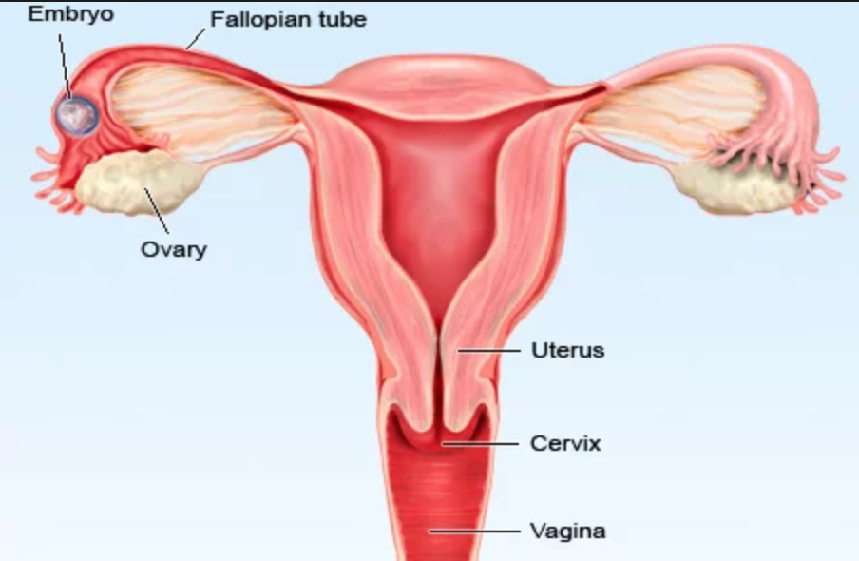
Ectopic Pregnancy
Ectopic pregnancy is defined as implantation of a fertilized ovum in any site other than the endometrium of the uterine cavity.
About 1% of all pregnancies are ectopic.
Sites:
Over 90% of ectopic pregnancies occur in the fallopian tubes (tubal pregnancy).
Other sites include: ovaries, abdominal cavity and cervix.

Slide 4
Clinical Features
A woman with an ectopic tubal pregnancy may present with pelvic pain or abnormal bleeding following a period of amenorrhea.
Many present as an emergency with tubal rupture, severe acute abdominal pain and hemorrhagic shock.
The diagnosis is usually confirmed by an abdominal/pelvic ultrasound → gestational sac within fallopian tube or other location and a positive HCG levels
Microscopically: placental tissue or fetal parts within the tube.

Slide 5
Clinical Features

Slide 6
Risk Factors
Any factor that retards passage of the ovum through the tubes predisposes to tubal ectopic pregnancy.
In about half of the cases, it is due to chronic inflammation and scarring in the oviduct.

Slide 7
Risk Factors
Pelvic inflammatory diseases/infections/salpingitis: is the most common cause. The inflammation can damage the ciliary activity and cause tubal obstruction, pelvic adhesions with scarring and distortion of the fallopian tubes. Women who have had pelvic infections have a five times greater risk of ectopic pregnancy (infection is usually by Neisseriae gonorrhea & chlamydia).
Abdominal/pelvic surgery or tubal ligation surgery.
Intrauterine tumors and endometriosis.
Smoking can decreas tubal motility by damaging ciliated cells or it may predispose them to pelvic inflammatory diseases (due to the impaired immunity in smokers).

Slide 8
Risk Factors
Congenital anomaly of the tubes.
In-utero diethylstilbestrol (DES) exposure increases the risk of ectopic pregnancy due to abnormal tubal morphology.
History of previous ectopic pregnancy.
History of multiple sexual partners → increases the chance of pelvic inflammatory diseases and therefore are high risk for ectopic pregnancies.
Intrauterine device users are at higher risk of having an ectopic pregnancy should pregnancy occurs.

Slide 9
Risk Factors
History of infertility: there is higher risk of ectopic pregnancy in the infertile population. This may be due to the underlying infertility related issues or fertility drugs and treatments. In vitro fertilization has been associated with an increased risk of ectopic pregnancy including cervical pregnancies.
Please note that in many tubal pregnancies, no anatomic cause is evident.
Ovarian pregnancies probably result from rare instances in which the ovum is fertilized just as the follicle ruptures.
Gestation within the abdominal cavity occurs when the fertilized egg drops out of the fimbriated end of the oviduct and implants on the peritoneum.

Slide 10
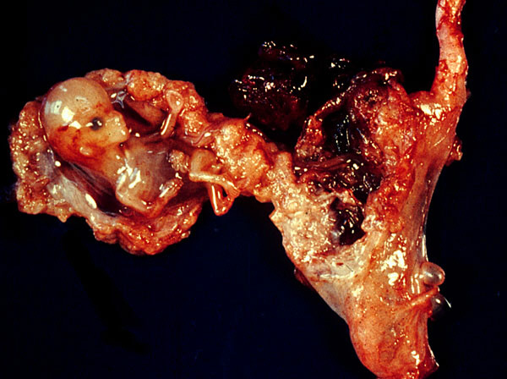
Ectopic Pregnancy

Slide 11
Spontaneous Abortion/Miscarriage
It is the spontaneous end of a pregnancy at a stage where the embryo or fetus is incapable of surviving.
Miscarriages that occur:
before the 6th week of gestation are called early pregnancy loss or chemical pregnancy.
after the 6th week of gestation are called clinical spontaneous abortion.
About 10-25% of all pregnancies end in miscarriage.
Most miscarriages occur during the first 13 weeks of pregnancy.

Slide 12
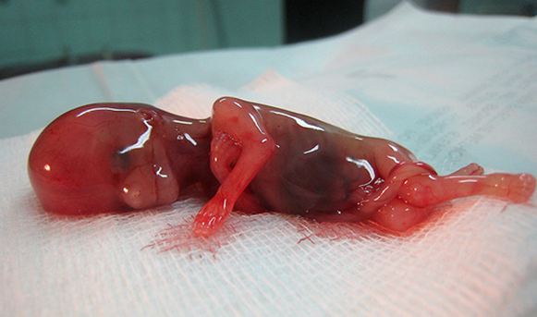
Causes of Spontaneous Abortions/Miscarriages
Most miscarriages occur during the first trimester.
The cause of a miscarriage cannot always be determined.
Miscarriages can occur for many reasons.
Chromosomal abnormalities of the fetus are the most common cause of early miscarriages.

Slide 13
Causes of Spontaneous Abortions/Miscarriages
Chromosomal abnormalities:
Half of the 1st trimester miscarriages have abnormal chromosomes.
Chromosomal abnormalities also become more common with aging, and women over the age of 35 have a higher rate of miscarriage than younger women.
A pregnancy with a genetic problem has a 95% probability of ending in miscarriage.

Slide 14
Causes of Spontaneous Abortions/Miscarriages
Hormonal problems: there is an increased risk of miscarriage with:
Cushing’s Syndrome
Thyroid disease
Polycystic ovary syndrome
Diabetes: good control of blood sugars during pregnancy is important. If the diabetes is not well controlled, there is an increase risk of miscarriages and also of the baby of having birth defects.
Inadequate function of the corpus luteum in the ovary (which produces progesterone necessary for maintenance of the very early stages of pregnancy) leads to progeterone deficiency which may lead to miscarriage.

Slide 15
Causes of Spontaneous Abortions/Miscarriages
Infections: by Listeria monocytogenes, Toxoplasma gondii, parvovirus B19, rubella, herpes simplex, cytomegalovirus and lymphocytic choriomeningitis virus etc are associated with an increased risk of pregnancy loss.
Maternal health problems can predispose to miscarriages e.g. systemic lupus erythematosus and antiphospholipid antibody syndrome

Slide 16
Causes of Spontaneous Abortions/Miscarriages
Lifestyle: smoking, drug use, malnutrition and exposure to radiation or toxic substances.
Maternal age: SABs increase after the age of 35 due to ovum abnormalities.
Maternal trauma.

Slide 17
Causes of Spontaneous Abortions/Miscarriages
Abnormal structural anatomy of the uterus can also cause miscarriages e.g. septate or bicornate uterus affect placental attachment and growth. Therefore, an embryo implanting on the septum would be at increased risk of miscarriage. Uncommonly uterine fibroids can interfere with the embryo implantation and blood supply, thereby causing miscarriage.
Others: surgical procedures in the uterus during pregnancy e.g amniocentesis and chorionic villus sampling.

Slide 18
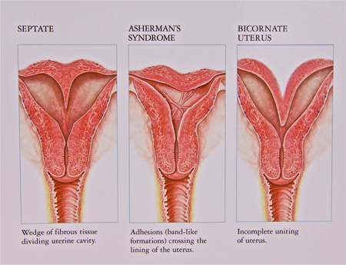
Causes of Spontaneous Abortions/Miscarriages

Slide 19
Diagnosis of Spontaneous Abortions/Miscarriages
A miscarriage can be confirmed:
By ultrasound study
By the examination of the passed tissue microscopically for products of conception. The products of conception include chorionic villi, trophoblasts, fetal parts and changes in the endometrium (hypersecretory).
Genetic tests may also be performed to look for chromosomal anomalies.

Slide 20
Products of Conception

Slide 21
Products of Conception

Slide 22
Normal Placenta

Slide 23
Normal Fertilization
Normal fertilization: a single sperm of 23 chromosomes fertilizes a normal egg of 23 chromosomes

Slide 24
Types of Gestational Trophoblastic Diseases
Benign non-neoplastic trophoblastic lesions — diagnosed as an incidental finding on an endometrial curettage or hysterectomy specimen. They are:
Exaggerated placental site
Placental site nodule
Hydatidiform mole — result from abnormalities in fertilization. They are essentially benign, but these patients carry an increased risk of subsequently developing choriocarcinoma. They are:
Complete hydatidiform mole
Partial hydatidiform mole
Invasive mole/chorioadenoma destruens
Gestational trophoblastic neoplasia (GTN) — are a group of tumors. They have potential for local invasion and metastases. They are:
Choriocarcinoma
Placental site trophoblastic tumor
Epithelioid trophoblastic tumor

Slide 25
Hydatidiform Mole
It is an abnormal placenta due to the excess of paternal (from father) genes.
It is caused by abnormal gametogenesis and fertilization.
It is the most common form of gestational trophoblastic disease; occurs in 1/1,000-2,000 pregnancies.
It results in the formation of enlarged and odematous placental villi, which fill the lumen of the uterus.
Passage of tissue fragments, which appear as small grapelike masses, is common. The serum HCG concentration is markedly elevated, and are rapidly increasing.

Slide 26
Hydatidiform Mole
Risk factors:
maternal age: girls younger than 15 years of age and women over 40 are at higher risk.
Ethnic background: high in Asian women.
Women with a prior hydatidiform mole have a 20-fold greater risk of a subsequent molar pregnancy than the general population.
There are 2 types of hydatidiform mole (HM).
Complete HM
Partial HM

Slide 27
Complete HM
It results from the fertilization of an empty ovum that lacks maternal DNA → as a result all chromosomal material is derived from the sperm. There is complete lack of maternal chromosomes. All the chromosomes come from the male/paternal side i.e. it is an androgenetic pregnancy with no maternal DNA.
90% of complete moles are 46 XX, arising from duplication of the chromosomes of a haploid sperm after fertilization of an empty ovum. 10% of cases are 46 XY as a result of fertilization of an empty ovum by 2 sperm (dispermy).

Slide 28
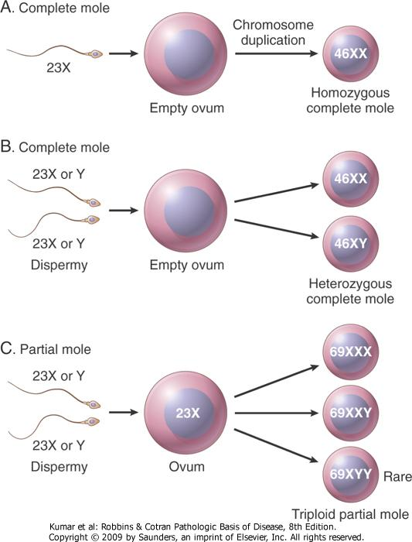
Complete HM

Slide 29
Complete HM
The uterus is distended and filled with swollen/large villi with prominent trophoblastic cell proliferation. No embryo, or fetal tissue is present. Grossly it looks like a bunch of grapes.
It is a genetically abnormal placenta with hyperplastic trophoblasts, without fetus or embryo.

Slide 30
Complete HM

Slide 31
Complete HM
Symptoms: rapid abdominal swelling (due to rapid increase in uterine size) mistaken for normal pregnancy but the uterus is disproportionately large for that stage of pregnancy. In addition patient may have vaginal bleeding, severe nausea and vomiting. HCG levels are elevated.
Ultrasound: it shows a “cluster of grapes” appearance or a “snowstorm” appearance, signifying an abnormal placenta.

Slide 32
Complete HM

Slide 33
Complete HM
Complications: uterine hemorrhage, uterine perforation, trophoblastic embolism, and infection. Few patients develop an invasive mole. The most important complication is the development of choriocarcinoma, which occurs in about 2% of patients after the mole has been evacuated.
Treatment: Evacuation of uterus by curettage and sometimes chemotherapy. With appropriate therapy cure rate is very high.

Slide 34
Partial HM
Partial HM results from fertilization of a normal ovum (that has not lost its maternal chromosome) by 2 normal sperms. This results in a triploid cell having 69 chromosomes (triploidy gestation), of which one haploid set (23X) is maternal and two haploid (23+23=46) sets are paternal in origin (58% are 69XXY, 40% are 69XXX, 2% are 69XYY).
It almost never evolves into choriocarcinoma.

Slide 35
Partial HM

Slide 36
Partial HM
It is a genetically abnormal placenta with a resultant mixture of large and small villi with slight hyperplasia of the trophoblasts, filling the uterus. In contrast to a complete mole, embryo/fetal parts may be present. But the fetus associated with a partial mole usually dies after 10 weeks' gestation and the mole (~pregnancy) is aborted shortly thereafter.
Grossly the genetically abnormal placenta has a mixture of large chorionic villi and normal-appearing smaller villi.

Slide 37
Partial HM
It makes up to 15–35% of all moles
The uterine size is usually small or appropriate for gestational age
Serum HCG levels are high but not as high as complete mole.
Chromosomal analysis of partial moles shows 69XXY in majority of cases (i.e. 3 haploid sets also called as triploidy).

Slide 38
Partial HM
Treatment: Evacuation of uterus by curettage and sometimes chemotherapy.
Prognosis: The risk for development of choriocarcinoma is very low but follow-up is mandatory.

Slide 39
FEATURE | CM | PM
Karyotype | Usually diploid 46XX | Usually triploidy 69XXY (most common)
Villi | All villi are hydropic; no normal villi seen | Normal villi may be present
Fetal tissue | Not present | Usually present
Trophoblasts | Marked proliferation | Mild proliferation
Serum HCG | Markedly elevated | Less elevated
Invasive mole | Occurs in about 15% of CMs | Very rare
Behavior | 2% progress to choriocarcinoma | Very rarely progress to choriocarcinoma

Slide 40
Invasive Mole
Invasive mole is when the villi of a hydatidiform mole extends/infiltrates into the myometrium of the uterus.
The mole sometime enter into the veins in the myometrium, and spreads via the vascular channels to distant sites, mostly the lungs (note: death from such spread is unusual).
It occurs in about 15% of complete moles and rarely in partial mole.
It can cause hemorrhage and uterine perforation.

Slide 41
Choriocarcinoma
Definition: It is a malignant tumor of placental tissue, composed of a proliferation of malignant cytotrophoblast and syncytiotrophoblast, without villi formation.
It is an aggressive malignant neoplasm.
It is characterized by very high levels of serum HCG.
Choriocarcinomas are aneuploidic.

Slide 42
Choriocarcinoma
It spreads early via blood to the lungs and other organs.
It responds to chemotherapy.
About half of choriocarcinoma cases are preceded by complete hydatidiform mole. Others can be preceded by a partial mole (rare), abortion, ectopic pregnancy and occasionally a normal term pregnancy.

Slide 43
Choriocarcinoma

Slide 44
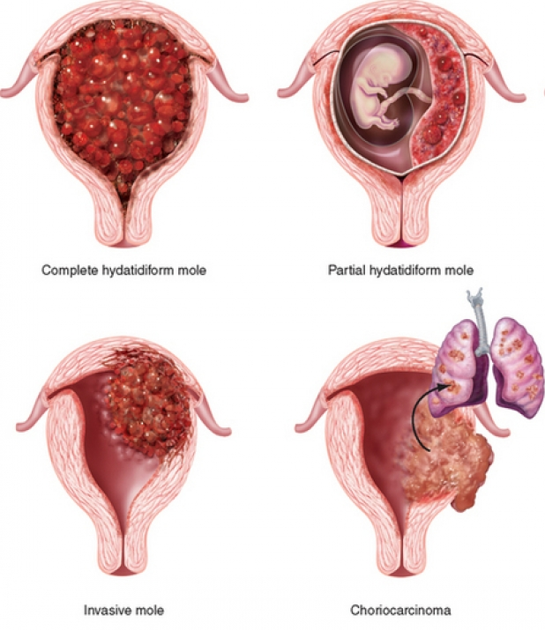

Slide 45
Reference
Kumar V, Abbas AK, Aster JC. Robbins Basic Pathology. 10th ed. Elsevier; 2018. Philadelphia, PA.

Slide 46
Thank You
End of Lecture

