Slide 1
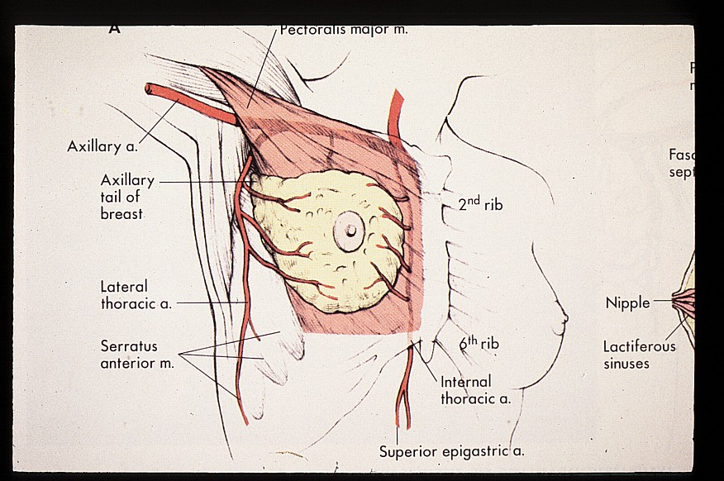
Breast Pathology
SUFIA HUSAIN/ AFAF ALSOLAMI
Pathology
KSU, Riyadh
2017
Reference: Robbins & Cotran Pathology and Rubin’s Pathology

Slide 2
Objectives
Pathology of benign breast diseases.
At the end of this lecture, the student should be able to:
Know the ways that benign breast conditions can clinically present.
Know the common inflammatory conditions of breast (mastitis and abscesses).
Understand the pathology of fibrocystic change.
Know the common benign breast tumours with special emphasis on fibroadenoma and phyllodes tumour.
Know the risk of subsequent breast cancer in women with diagnosed benign breast lesions.
Breast cancer.
At the end of this lecture, the student should be able to:
Know the risk factors for the development of breast cancer.
Know the classification of breast cancer.
Understand the behavior and spread of breast cancer.
Know the prognostic indicators of breast carcinoma.

Slide 3
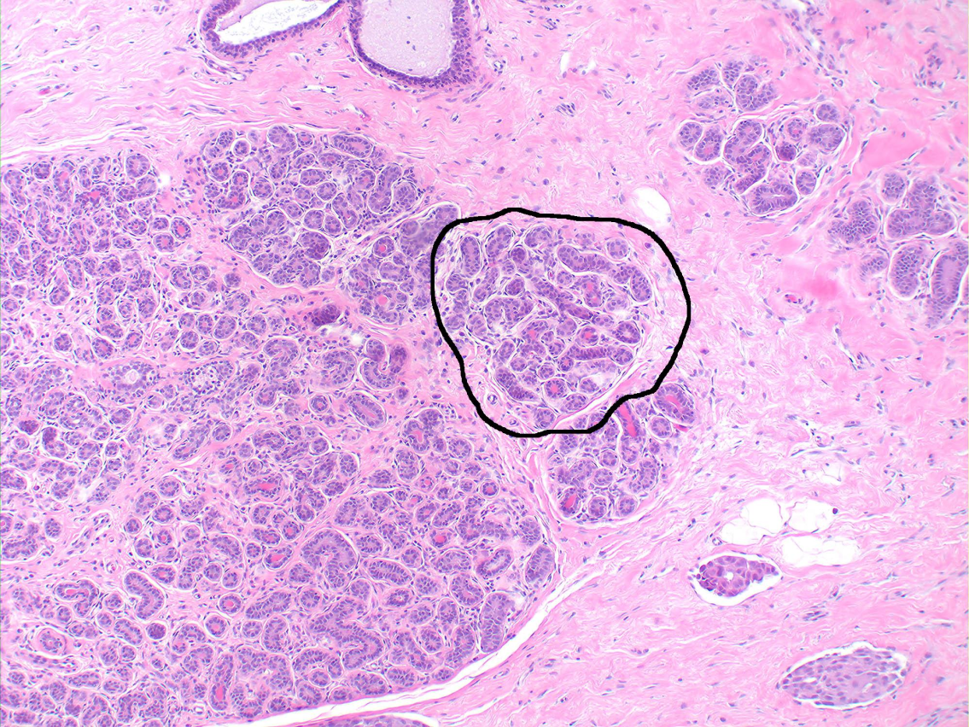
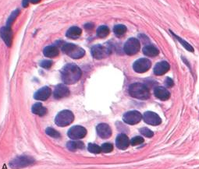
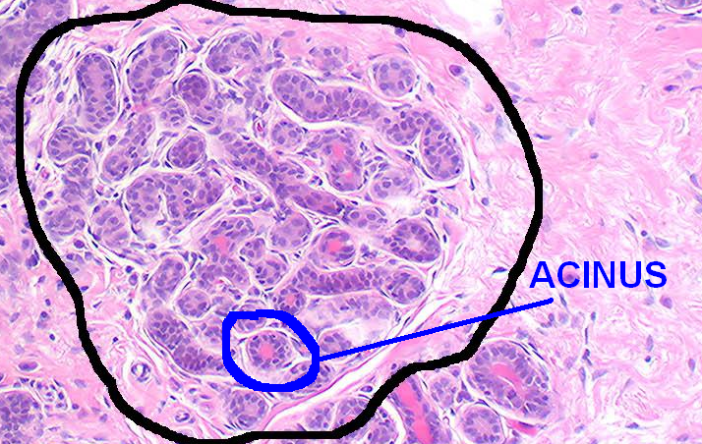
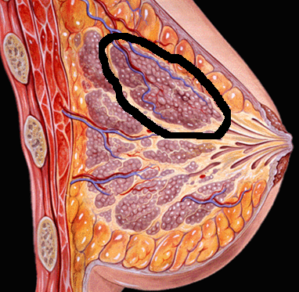
lobule
lobe
LOBES (about 10 in whole breast):
LOBULE:
ACINUI/ALVEOLI: Each acinus is
lined by a bilayered epithelial and
myoepithelial cells.
DUCTS..

Slide 4
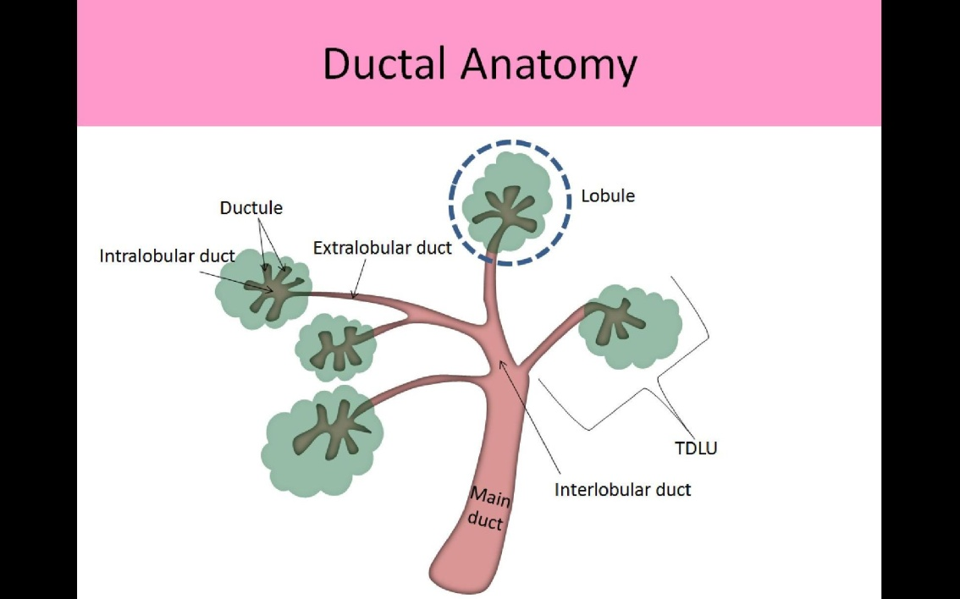
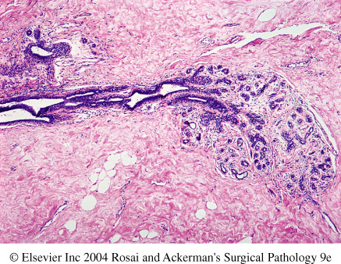
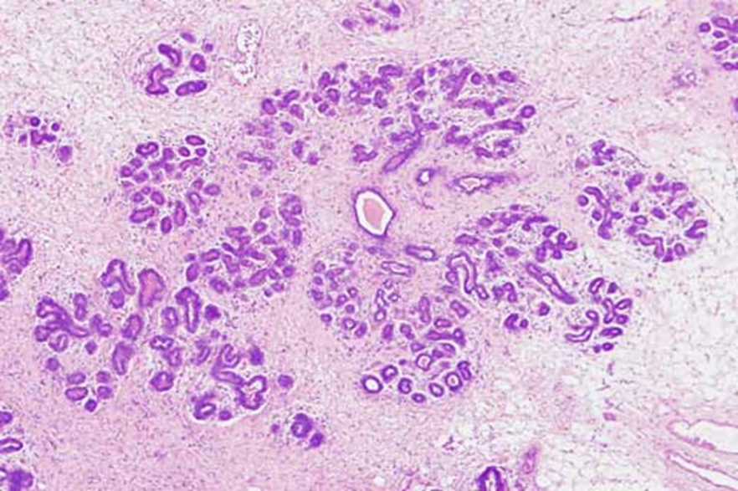
DUCTS..
Six to ten major ductal systems originate at the nipple.
Branching of the large ducts leads to the Terminal Duct Lobular Units (TDLU).
The TDLU branches into grapelike clusters of small acini to form the lobule.
http://www.breastpathology.info/Carcinoma%20in%20situ.html

Slide 6
Clinical Presentation of Breast Diseases
1)Pain (mastalgia): is the most common breast symptom. May be cyclical (with menses) or noncyclical. Diffuse
cyclical pain has no pathologic significance. Non-cyclical pain can be caused by ruptured cysts or areas of prior injury or
infection, or nospecific cause. Although the great majority of painful masses are benign, about 10% of breast cancers
present with pain.
2) Palpable mass: 2-3 cm, epithelial or stromal cells, mostly benign, borders (round or irregular)
3) Nipple discharge: a) Milky discharge: not associated with malignancy.
b) Bloody or serous discharges: commonly associated with benign lesions but can rarely be due to malignancy.
4) Inflammation: rare, due to infection, breastfeeding, erythema and edema, mimic inflammatory breast carcinoma.
5) Lumpiness (diffuse nodularity): normal glandular tissue, imaging studies.
6) Gynecomastia: male, imbalance between estrogen and androgens, increase in stroma and epithelial cells.

Slide 7
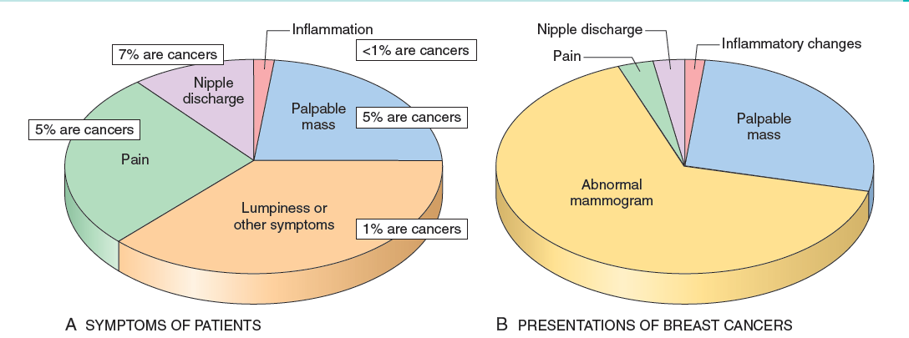

Slide 8
Mammographic screening
Mammographic screening was introduced in the 1980s as a means to detect small, nonpalpable, asymptomatic breast carcinomas. The value of mammography lies in its ability to identify small, nonpalpable cancers (average size of 1 cm).
The principal mammographic findings of breast carcinoma are densities/masses and calcifications.
  Densities(mass): Most tumors appear radiologically denser than the normal breast. Fibroadenomas, cysts etc. can also present as densities.
  Calcifications: Calcium gets deposited in secretions, necrotic debris, or hyalinized stroma. It can be seen in benign and malignant conditions
    Calcifications in malignancy are usually small, irregular, numerous, and clustered.
    Ductal carcinoma in situ (DCIS) is most commonly detected as mammographic calcifications. Mammographic screening has increased the diagnosis of DCIS.
  Mamographic screening is generally recommended to start after age 40.

Slide 9
Breast lesions
Inflammatory lesions:…
    Acute mastitis: staphylococcus aureus infection most common..
    Periductal mastitis..
    Mammary duct ectasia means dilated ducts disease
    Fat necrosis is usually due to mechanical trauma, surgical or otherwise
    Lymphocytic mastopathy (sclerosing lymphocytic lobulitis) seen in diabetics
    Granulomatous mastitis sarcoid, TB, etc., but mostly idiopathic
Benign epithelial lesions:
    Non proliferative breast changes (fibrocystic changes)
    Proliferative breast disease without atypia
    Proliferative breast disease with atypia /Atypical hyperplasia
Carcinoma in situ: 1) DCIS 2) LCIS
Invasive carcinoma: 1) Ductal carcinoma 2)Lobular carcinoma
Others/stromal tumors: e.g. fibroadenoma, phyllodes tumors, sarcomas etc.

Slide 10
Mastitis
Acute mastitis:
Almost all cases of acute mastitis occur during the first month of breastfeeding. Staphylococcus aureus is the most common causative organiasm. The breast is erythematous and painful, and fever is often present.
Periductal mastitis:
This condition is not associated with lactation. There is strong association with cigarette smoking.

Slide 11
Benign epithelial lesions of breast are divided into 3 basic types
Non proliferative breast changes (fibrocystic changes)
Proliferative breast disease without atypia
Proliferative breast disease with atypia (Atypical hyperplasia)

Slide 12
1- Non proliferative Breast Changes (Fibrocystic Change/disease)
Most common disorder of the breast. Age: 20-55yrs, decreases progressively after menopause.
The cause is not known, thought to be caused by hormonal imbalances.
Can produce palpable breast mass, mammographic densities, calcifications, or nipple discharge. May also present with cyclical pain.
No increased risk for cancer
Histology, Three patterns seen :
  Cysts formation with apocrine metaplasia: cysts are lined by benign flattened to columnar epithelium with focal apocrine metaplasia. In apocrine metaplasia the cells become large and have abundant eosinophilic cytoplasm. The cysts can rupture and cause inflammation
  Fibrosis: contribute to the palpable firmness of the breast
  Adenosis: Increase in the number of acini per lobule (adenosis can also be seen in pregnancy).

Slide 13
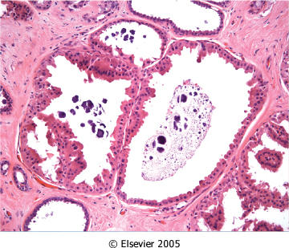
Figure 23-7 : Apocrine cysts. Cells with round nuclei and abundant granular eosinophilic cytoplasm, resembling the cells of normal apocrine sweat glands, line the walls of a cluster of small cysts. Secretory debris, frequently with calcifications, is often present. Groups of cysts are common findings associated with clustered mammographic calcifications.
Downloaded from: Robbins & Cotran Pathologic Basis of Disease (on 11 November 2007 08:05 PM)
© 2007 Elsevier

Slide 14
2- Proliferative Disease without Atypia
Rarely form palpable masses
Detected as small mammographic densities.
Incidental finding
Risk for cancer is 1.5 – 2 times normal
The following entities are included in this category:
  Epithelial hyperplasia
  Sclerosing adenosis
  Complex sclerosing lesions/radial scar
  Papillomas
  Proliferative variant of fibrocystic disease.

Slide 15
2- Proliferative Disease without Atypia contd…
Epithelial Hyperplasia (usual epithelial hyperplasia):
Normal breast has a 2 layers of cells (epithelial and myoepithelial cells). Epithelial hyperplasia is defined as the presence of more than 2 layers.
Hyperplasia can range from mild, moderate to severe/florid.
Both epithelial and myoepithelial cells proliferate.
It can be seen in the ducts and the lobules.
When it is seen in fibrocystic disease: it is called as proliferative type/variant of fibrocystic disease.

Slide 16

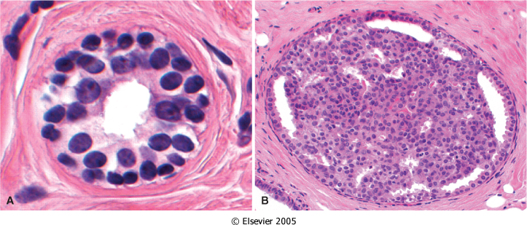
Figure 23-8 A, Normal. A normal duct or acinus has a single basally located myoepithelial cell layer (cells with dark, compact nuclei and scant cytoplasm) and a single luminal cell layer (cells with larger open nuclei, small nucleoli, and more abundant cytoplasm).
B, Epithelial hyperplasia. The lumen is filled with a heterogeneous population of cells of different morphologies, often including both luminal and myoepithelial cell types. Irregular slitlike fenestrations are prominent at the periphary.
Downloaded from: Robbins & Cotran Pathologic Basis of Disease (on 11 November 2007 08:05 PM)
© 2007 Elsevier

Slide 17
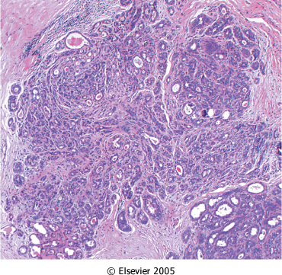
2- Proliferative Disease without Atypia contd…
Sclerosing Adenosis:
Commonly seen as an incidental microscopic finding but may occasionally present as a palpable mass that is mistaken clinically for cancer.
Calcification is commonly seen in the lesion, so even on mammography it can mimic cancer.
It is almost always associated with other forms of fibrocystic change.
Microscopically: adenosis and stromal fibrosis in the lobule which leads to compression and distortion of the lobule.
The involved terminal duct lobular unit is enlarged, and the acini are compressed and distorted by the surrounding dense stroma.

Slide 18
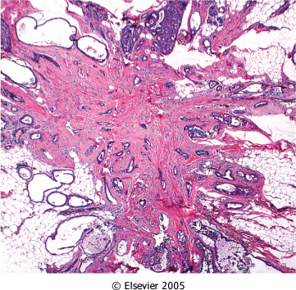
2- Proliferative Disease without Atypia contd…
Complex Sclerosing Lesion (Radial Scar)
Radial scars are stellate lesions characterized by a central nidus of entrapped glands in a hyalinized stroma
They typically present as an irregular mammographic density and closely mimic an invasive carcinoma both mammographically and grossly.
The word "scar" refers to the morphologic appearance, and not a prior inflammation, trauma or surgery.
There is a central nidus consisting of small tubules entrapped in a densely fibrotic stroma surrounded by radiating arms of epithelium with varying degrees of cyst formation and hyperplasia.

Slide 19
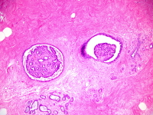
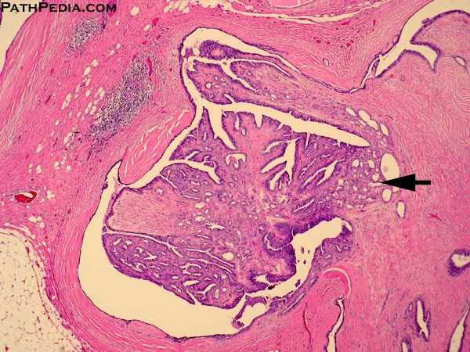
2- Proliferative Disease without Atypia contd…
4. Papillomas:
Is a papillary tumor that arises from the ductal epithelium. It is more common in the large lactiferous ducts (present in the central part of the breast at the nipple) but can also occur in the small ducts in any quadrant of the breast.
Large duct papillomas (central papillomas):
usually solitary and situated in the lactiferous duct at the nipple. Patients present with bloody nipple discharge and sometimes a subareolar palpable mass.
Small duct papillomas:
commonly multiple and located deeper within the ductal system. Small duct papillomas have been shown to increase the risk of subsequent carcinoma.

Slide 20
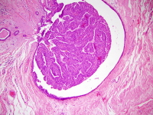
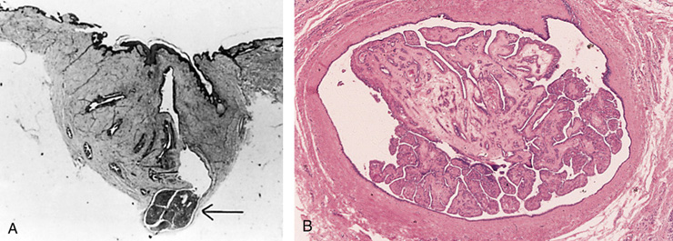
Intraductal papilloma

Slide 21
3- Proliferative breast disease with atypia (Atypical hyperplasia)
Risk for cancer is 4-5 times normal
Atypical hyperplasia is a cellular proliferation resembling ductal carcinoma in situ (DCIS) or lobular carcinoma in situ (LCIS) but lacking sufficient qualitative or quantitative features for a diagnosis of carcinoma in situ.
Include two entities:
    1) Atypical Ductal Hyperplasia (ADH)
    2) Atypical Lobular Hyperplasia (ALH)
Atypical hyperplasia has some of the architectural and cytologic features of carcinoma in situ but lack the complete criteria for that diagnosis and is categorized as ductal or lobular in type

Slide 22
Pathologic lesion | Relative risk of development of invasive carcinoma | comments
1-NONPROLIFERATIVE BREAST CHANGES (Fibrocystic changes) | do not have an increased risk. | Cysts Fibrosis Adenosis
2-PROLIFERATIVE DISEASE WITHOUT ATYPIA | 1.5 to 2 times normal | Epithelial hyperplasia Sclerosing adenosis Complex sclerosing lesions/radial scar Papillomas Proliferative fibrocystic disease.
3-PROLIFERATIVE DISEASE WITH ATYPIA | 4.0 to 5.0 times normal | ADH ALH
CARCINOMA IN SITU (CIS) | 8.0 to 10.0 times normal | DCIS LCIS

Slide 23


Breast Cancer

Slide 24
Breast Carcinoma
Carcinoma of the breast is one of the most common cancer in women.
Women who live to age 90 have a one in eight chance of developing breast cancer
Mammographic screening has dramatically increased the detection of small invasive cancers.
DCIS by itself is almost exclusively detected by mammography, so the incidence of DCIS is increased with the use of mammography.
Therefore number of women with invasive/advanced cancer is markedly decreased.
The mortality rate have started to decline. Currently only 20% of the women with breast cancer are expected to die of the disease.

Slide 25
Breast Cancer: Risk Factors
The etiology of breast cancer in most women is unknown but most likely is due to a combination of genetic, hormonal and environmental risk factors.
The major risk factors being hormonal and genetic (family history).
Breast carcinomas can, therefore, be divided into sporadic cases, possibly related to hormonal exposure, and hereditary cases, associated with family history or germ-line mutations
Hereditary Breast Cancer:
A family history of breast cancer in a first-degree relative.
About 25% of familial cancers (or around 3% of all breast cancers) can be attributed to two autosomal-dominant genes: BRCA1 and BRCA2
Sporadic Breast Cancer:
The major risk factors for sporadic breast cancer are related to hormone exposure, gender, age at menarche and menopause, reproductive history, breast-feeding, and exogenous estrogens. The majority of these cancers occur in postmenopausal women and in overexpression of estrogen.

Slide 26
Breast Cancer: Risk Factors..
Age: increase incidence in older women. Breast cancer is rare before 25 yrs, except in familial forms. Majority of cases occur in women >50 yrs of age.
Estrogen Exposure: Factors associated with exposure to increased levels of estrogen have been shown to increase a woman’s risk for breast cancer. These factors include:
  early age at menarche: the younger the age at menarche, the higher her risk of breast cancer
  late age at menopause
  nulliparity
  late age at first child-birth: the earlier a woman has her first birth, the lower her lifetime risk for breast cancer. A woman who has her first birth after 30 years has an increased risk.
  Also postmenopausal hormone replacement slightly increases the risk
First Degree relative with Breast Cancer:
  Women with history of cancer in first degree relative (mother, sister, aunt or daughter) are at higher risk of breast cancer. The risk increases with the number of affected first degree relatives.
  At least two genes that predispose to breast cancer have been identified—BRCA 1 and 2
  NOTE: majority of cancers occur in women without such history.
Race and Geographic influence : incidence of breast cancer is lower in African American women . Generally Caucasians have the highest rate of breast cancers. Breast cancer is more common in Western industrialized countries than in developing countries.

Slide 27
Breast Cancer: Risk Factors
Radiation exposure: Higher rate of breast cancer
History of breast cancer: Women who have had a breast cancer or have cancer in the other breast are at increased risk of developing a second primary breast cancer.
History of Other Cancer: women who have a history of ovarian or endometrial cancer are at high risk.
Certain Breast Disease: As noted previously women with certain types of benign breast disease are at risk. Especially a breast biopsy diagnosis of atypical hyperplasia increases the risk for breast cancer
Dietary factors: e.g. high fat intake and excessive alcohol consumption have also been proposed as risk factors
Obesity: may play a role
Exercise: some studies showed decreased risk with excercise
Breast feeding: the longer the women breast feed, the lower the risk.
Environmental toxins: pesticides .
Tobacco: Not associated with breast cancer, but associated with the development of peri-ductal mastitis, or sub-areolar abscess.

Slide 28
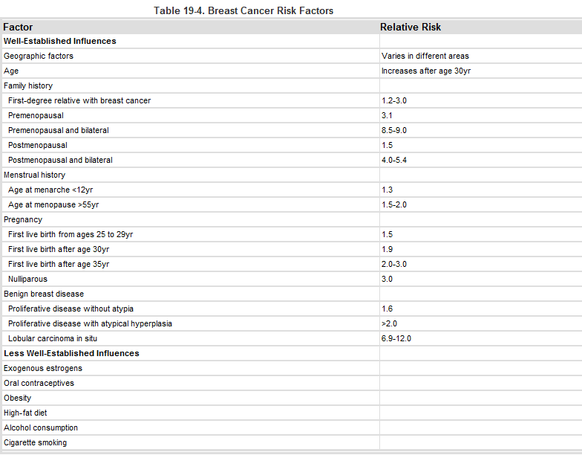

Slide 29
CLASSIFICATION

Slide 30
Based on expression of hormonal receptors (clinically useful classification)
Based on expression of hormonal receptors and Her2:
ER positive/HER2 negative; 50-65% of cancer)
HER2 positive (ER positive or negative; 10%–20% of cancers)
Triple negative (ER, PR, and HER2 negative; 10%–20% of cancers)
striking differences in patient characteristics, pathologic features, treatment response, metastatic patterns, time to relapse, and outcome

Slide 31
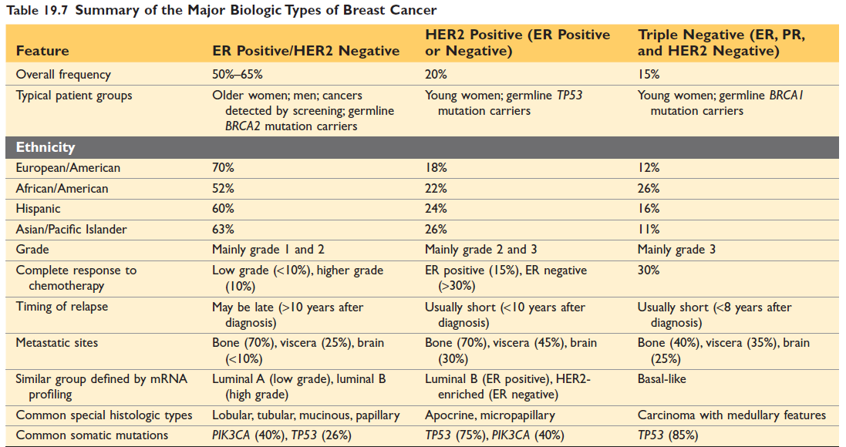

Slide 32
Alternative classification (relies on gene expression)….research
Luminal A. The majority are lower-grade ER-positive cancers that are HER2 negative
Luminal B. The majority are higher-grade ER-positive cancers that may be HER2 positive
HER2-enriched. The majority overexpress HER2 and do not express ER
Basal-like. The majority by gene expression profiling resemble basally located myoepithelial cells and are ER-negative, HER2-negative

Slide 33
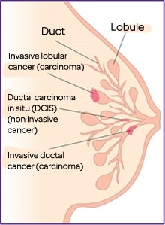
Breast Carcinoma: Classification
Almost all (majority) are adenocarcinoma
There are two major types:
  Ductal (in-situ and invasive)
  Lobular (in-situ and invasive)
http://iam-amother.blogspot.com/2013/09/types-of-breast-cancer.html

Slide 34
CARCINOMA IN SITU (CIS)

Slide 35
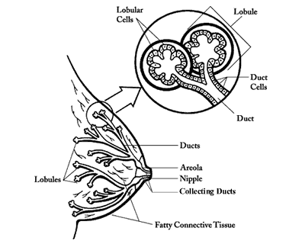
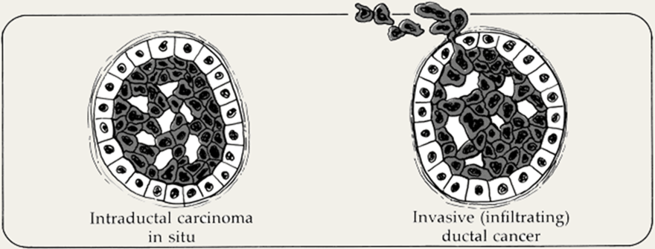

Carcinoma in situ
This is epithelial proliferation that is still
confined to the TDLU, has not invaded
beyond the basement membrane and is
therefore incapable of metastasis.
There are two subtypes:
Ductal carcinoma in situ (DCIS) or intraductal carcinoma (80%).
Lobular carcinoma in situ (20%).

Slide 36

Ductal Carcinoma In Situ (DCIS)
DCIS is the non-invasive proliferation of malignant cells within the duct system without breaching the underlying basement membrane
They have a very high risk of development of subsequent invasive carcinoma.
The tumor distends and distorts the ducts.
Age range: same age range of invasive breast carcinoma.
Often multifocal—malignant cells can spread widely through the ductal system without breaching the basement membrane
Women with DCIS are at risk of recurrent DCIS following treatment.
http://www.dslrf.org/images/f12_02.gif

Slide 37
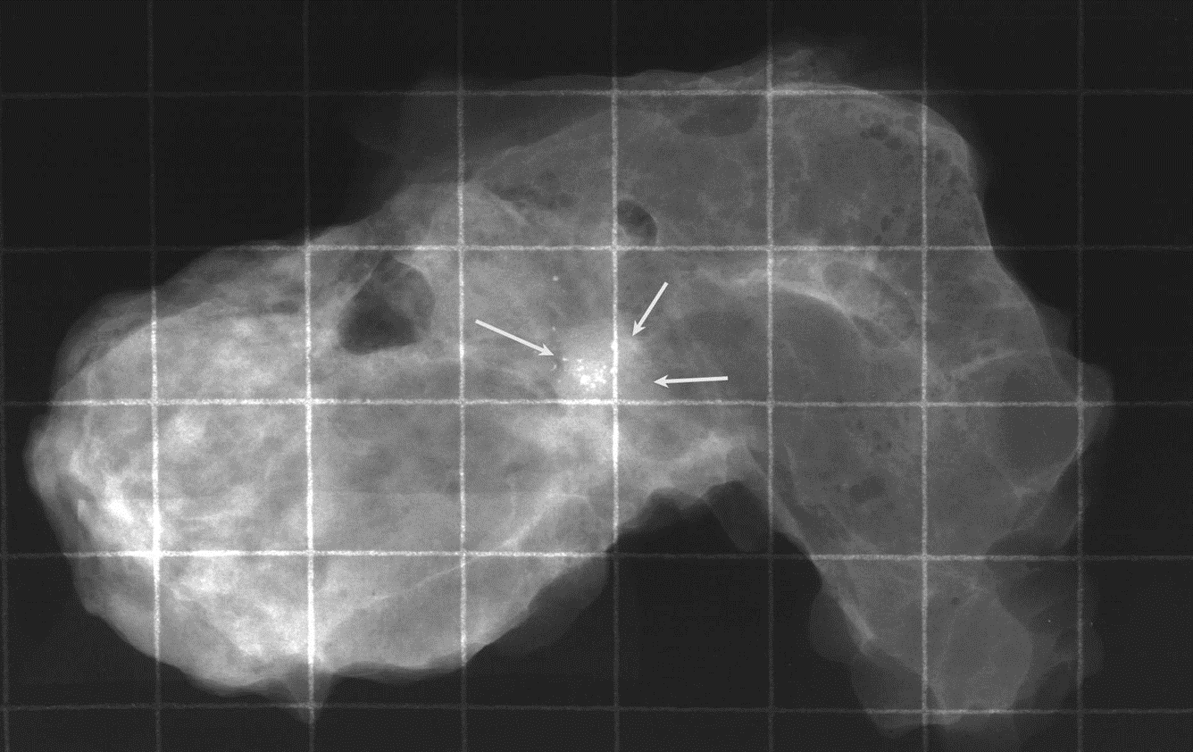
DCIS ( Ductal Carcinoma In Situ)
On mammography DCIS frequently shows micro-calcifications. Mammography is a very sensitive diagnostic procedure for detecting DCIS since majority of DCIS are not palpable. Less frequently they can present as a mammographic density or a vaguely palpable mass or nipple discharge.
Because of mammography there has been a marked increase the detection and diagnosis of DCIS in the last two decades.
Different patterns/subtypes of DCIS can be seen e.g.
  comedo (central necrosis)
  cribiform (cells arranged around “punched-out” spaces)
  papillary
  micropapillary and
  solid (cells fill spaces)
DCIS can be of different grades i.e. low, intermediate and high grade
Microcalcification of DCIS

Slide 38
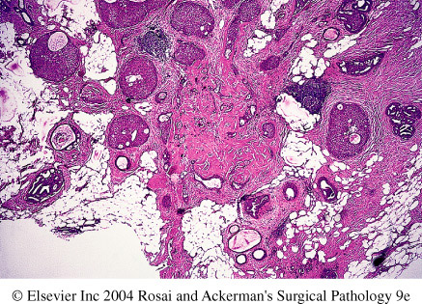
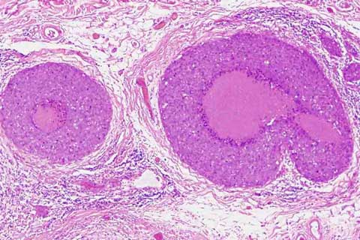
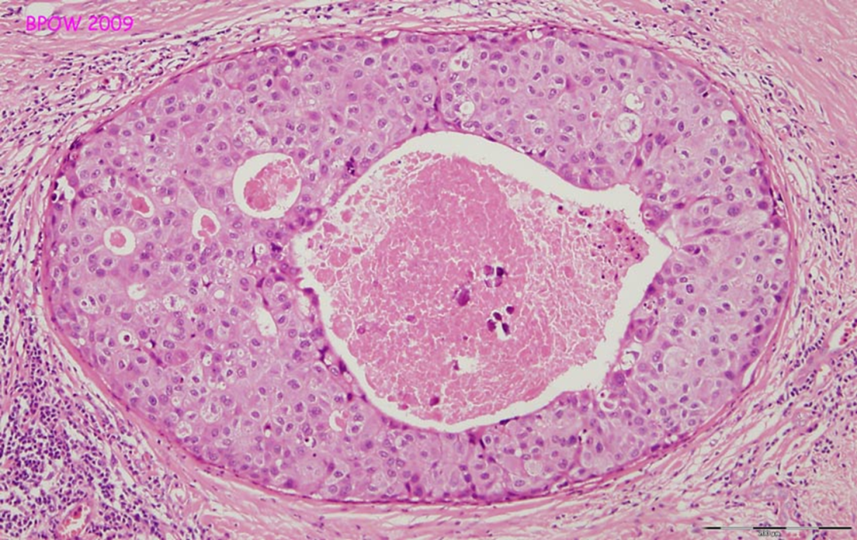
DCIS
http://www.breastpathology.info/Carcinoma%20in%20situ.html

Slide 39
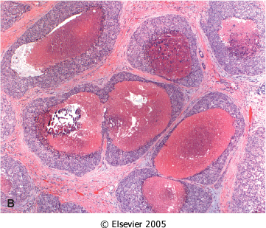
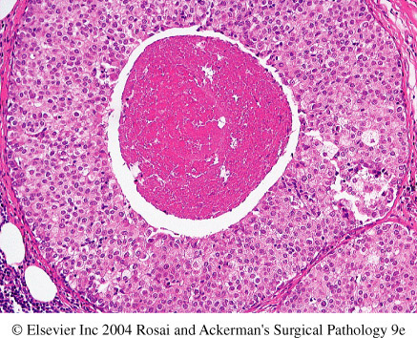
Comedo DCIS: is characterized by large central zones of necrosis with calcified debris. This type of DCIS is most frequently detected as radiologic calcifications. Less commonly, the surrounding desmoplastic response results in an ill-defined palpable mass or a mammographic density.
© 2007 Elsevier
Downloaded from: Robbins & Cotran Pathologic Basis of Disease (on 28 April 2008 09:47 AM)

Slide 40
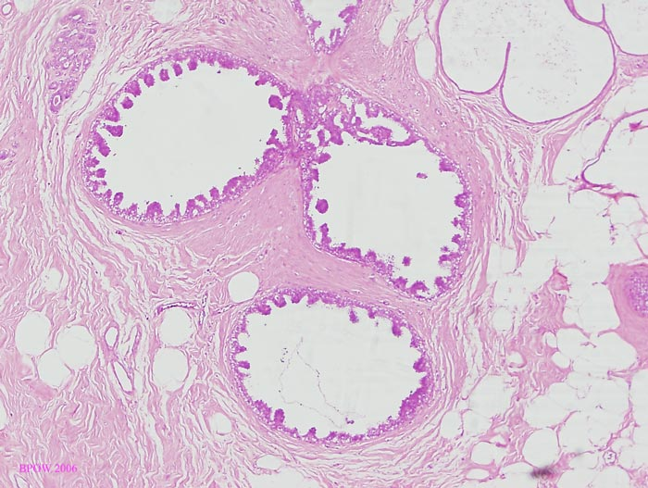
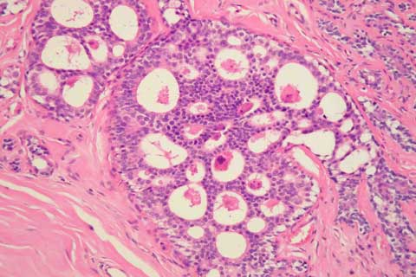
DCIS
Micropapillary DCIS.
Cribriform DCIS comprises cells forming round, regular ("cookie cutter") spaces. The lumens are often filled with calcifying secretory material.
http://www.breastpathology.info/Carcinoma%20in%20situ.html#images

Slide 41
DCIS
Clinical behavior: may vary depending on the subtype and the grade
  Comedocarcinoma has essentially a 100% chance of becoming invasive if left untreated.
  Pure cribriform/micropapillary carries only a 30% chance of becoming invasive carcinoma.
Treatment:
  Wide local excision
  mastectomy

Slide 42
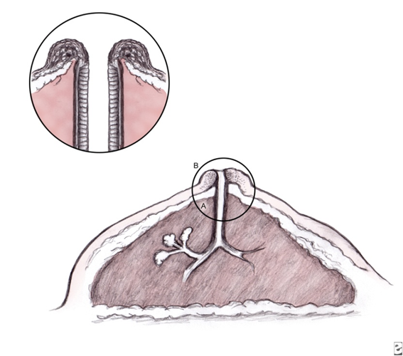
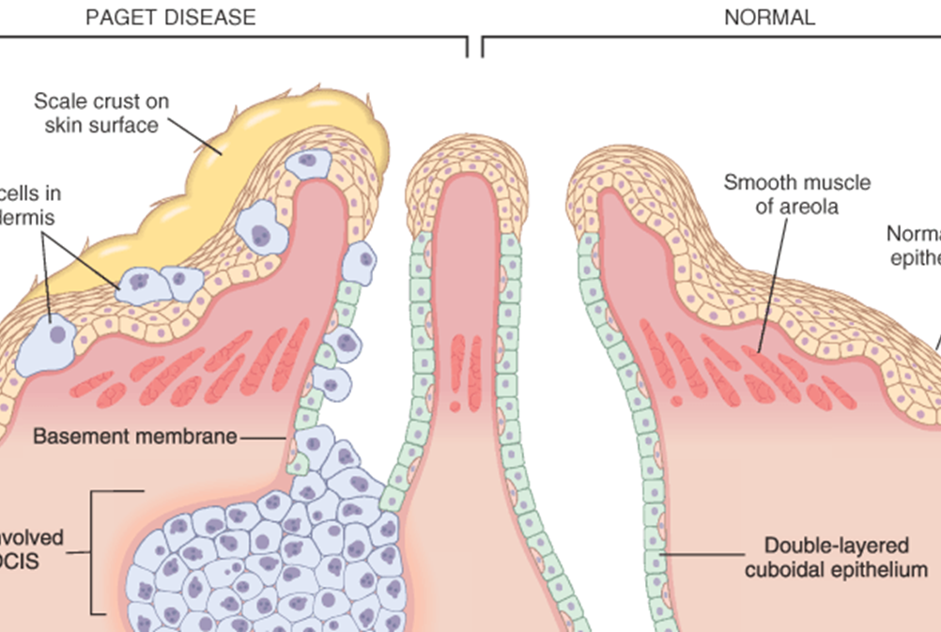
Paget’s Disease
http://img.medscape.com/pi/emed/ckb/dermatology/1048885-1101235-854tn.jpg
Paget's disease of the breast is a rare type of breast cancer that is characterized by a red, scaly eczematous lesion on the nipple and surrounding areola.
Paget’s disease may be subtle or appear as an eroded and weeping erythematous eruption. Pruritus is common and it might be mistaken for eczema.
Malignant cells are called Paget cells and are found scattered in the epidermis.

Slide 43
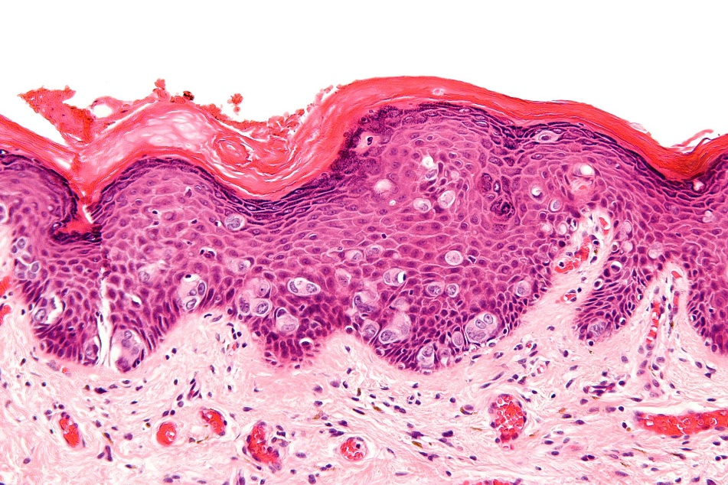
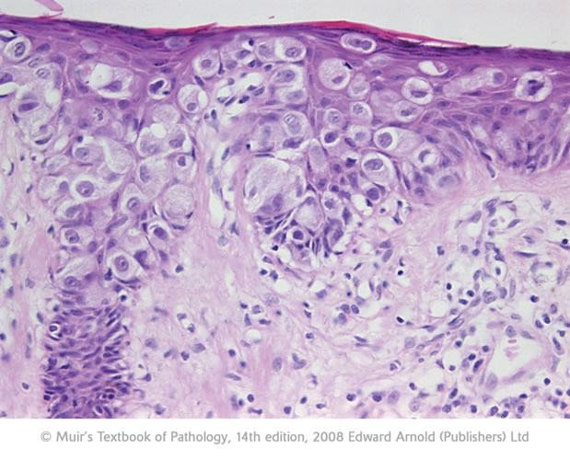
Pagets disease
The histologic hallmark of Paget’s disease of the nipple is the infiltration of the epidermis by large neoplastic ductal cells with abundant cytoplasm, pleomorphic nuclei and prominent nucleoli. The cells usually stain positively for mucin.
Paget cells extend from DCIS within the ductal system into nipple skin without crossing the basement membrane
Palpable mass can be seen in 50% of women with Paget disease indicating an underlying invasive carcinoma nearby.
"Extramammary Paget disease - high mag" by Nephron - Own work. Licensed under CC BY-SA 3.0 via Wikimedia Commons - http://commons.wikimedia.org/wiki/

Slide 44
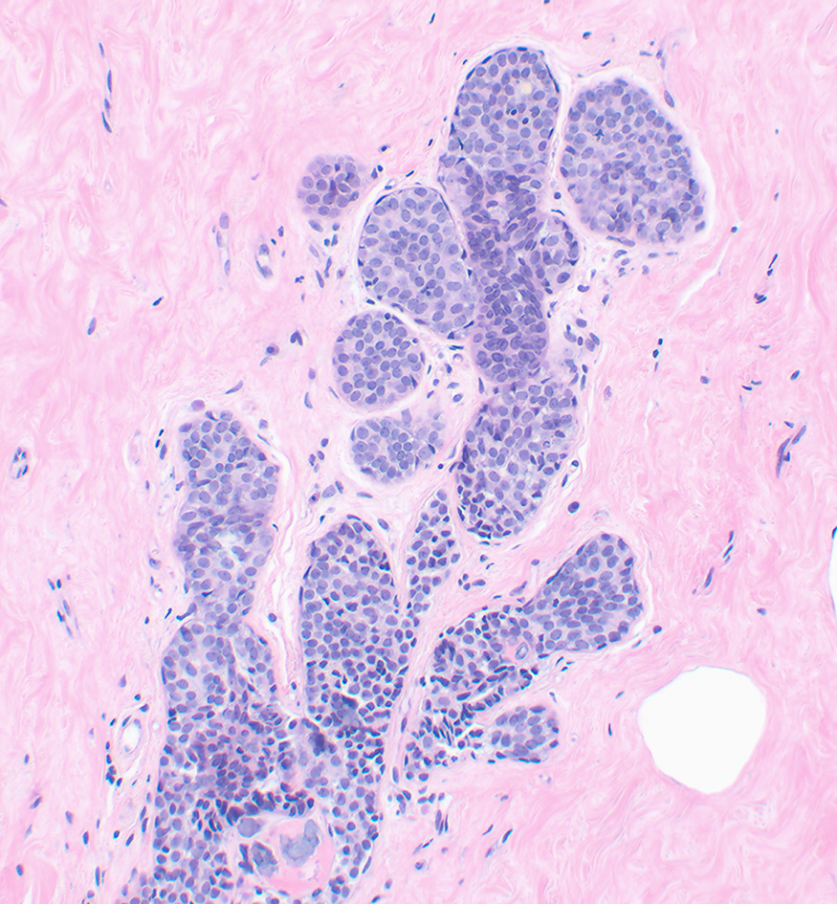
Lobular Carcinoma in Situ (LCIS)
NORMAL
LCIS alone is always an incidental finding in breast biopsy performed for another reason.
LCIS is uncommon.
LCIS tends to be multicentric and bilateral and therefore subsequent carcinomas can occur both breasts.
LCIS does not form a palpable mass and cannot be detected clinically on palpation or on gross pathological examination.
Microcalcifications in LCIS are infrequent and so mammography is not useful for detection.
Histology: monomorphic population of small, rounded cells fills and expands the acini of lobules. The underlying lobular architecture can still be recognized.
Clinical behavior
If LCIS is left untreated, about 30% of women develop an invasive cancer within 20 years of diagnosis. The invasive cancer that develops is usually lobular (but can be ductal too).
LCIS is a marker of increased cancer in both breasts
LCIS

Slide 45
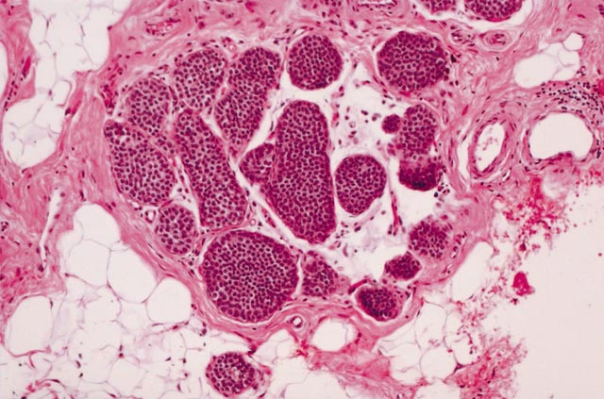
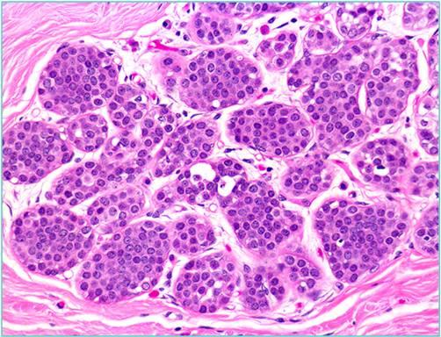
LCIS
FROM: Lobular Carcinoma In Situ Diagnosed By Core Needle Biopsy: When Should It Be Excised?
Lavinia P Middleton, Shakeitha Grant, Tanya Stephens, Carol B Stelling, Nour Sneige and Aysegul A Sahi.Mod Pathol 2003;16(2):120–129n http://www.nature.com/modpathol/journal/v16/n2/images/3880726f2.jpg
https://classconnection.s3.amazonaws.com/890/flashcards/648890/jpg/lcis1327370365127.jpg

Slide 46
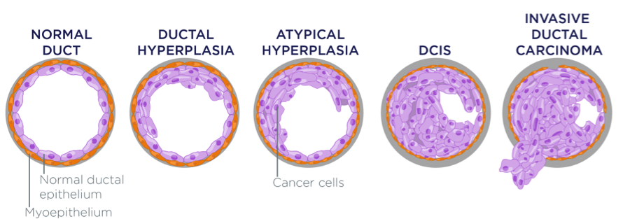
INVASIVE BREAST CARCINOMA

Slide 47
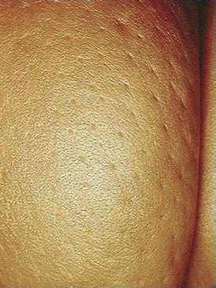
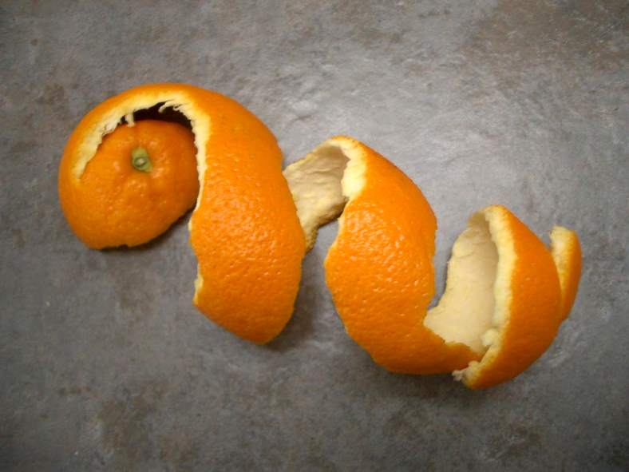
CLINICAL FEATURES OF INVASIVE BREAST CANCER
Palpable mass.
About half of the patients will have axillary lymph node metastases.
Larger carcinomas may be fixed to the chest wall or cause dimpling of the skin.
Lymphatics may become involved and the lymphatic drainage of that area and the overlying skin gets blocked causing lymphedema and thickening of the skin, a change referred to as peau d'orange.
When the tumor involves the central portion of the breast, retraction of the nipple may develop.
On mammography, invasive carcinomas commonly present as a density.
Invasive carcinomas presenting as mammographic calcifications without an associated density are usually very small in size.
The term "inflammatory carcinoma" refers to the clinical presentation of a carcinoma extensively involving dermal lymphatics, resulting in an enlarged erythematous breast. The diagnosis is made on clinical grounds and does not correlate with a specific histologic type of carcinoma

Slide 48
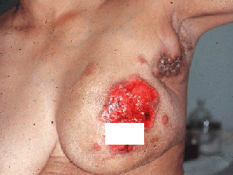
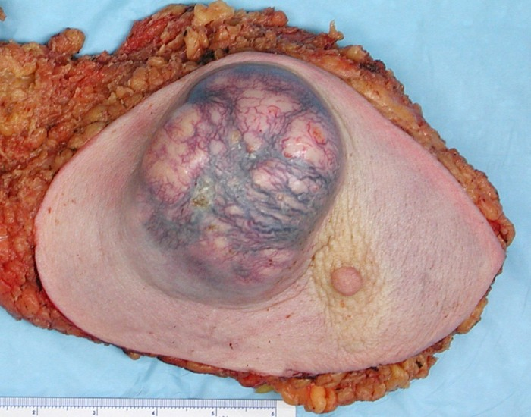
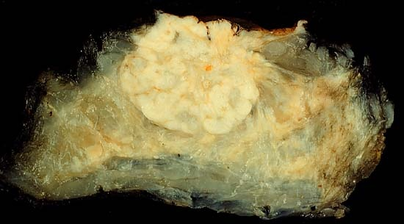
Invasive carcinoma
http://upload.wikimedia.org/wikipedia/commons/3/3f/BreastCancer.jpg

Slide 49
Invasive Breast Carcinoma: Classification
Invasive breast carcinoma is tumor that has extended across the
basement membrane. This permits access to lymphatics and vessels and
therefore the potential to metastasize. Invasive breast carcinoma is
subdivided into:
NOS Ductal 80% (NOS= No Otherwise Specified)
Lobular 10%
Tubular 6%
Mucinous(Colloid) 2%
Medullary 2%
Papillary 1%
Metaplastic Carcinoma 1%

Slide 50
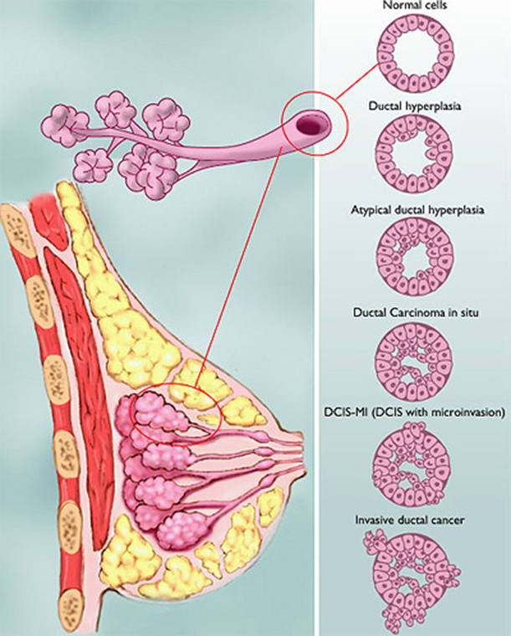
1- Invasive Ductal Carcinoma, NOS
Invasive Ductal Carcinoma, NOS is the commonest type of breast cancer, forming up to 80% of these cancers.
Most of these tumors induce a marked fibroblastic (desmoplastic) stromal reaction to the invading tumor cells producing a palpable mass with hard consistency (scirrhous carcinoma). And therefore a palpable mass is the most common presentation.
The tumor shows an infiltrative attachment to the surrounding structures and may cause dimpling of the skin (due to traction on suspensory ligaments) or nipple retraction.

Slide 51
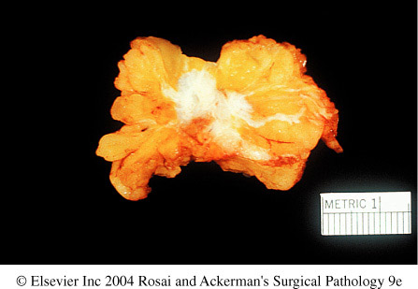
1- Invasive Ductal Carcinoma, NOS:
Grossly: tumor is firm, hard, with an irregular border.
Cut surface: gritty and shows irregular margins with stellate infiltration (sometimes it can be soft and well demarcated!) and in the center there are small foci of chalky white stroma and occasionally calcifications
Characteristic grating sound when cut or scraped
Accompanied by varying amounts of DCIS
50% to 65% of ductal carcinomas are ER positive, 20% are HER2 positive, and 15% are negative for both ER and HER2

Slide 52
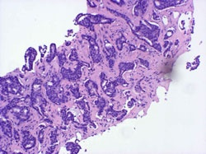
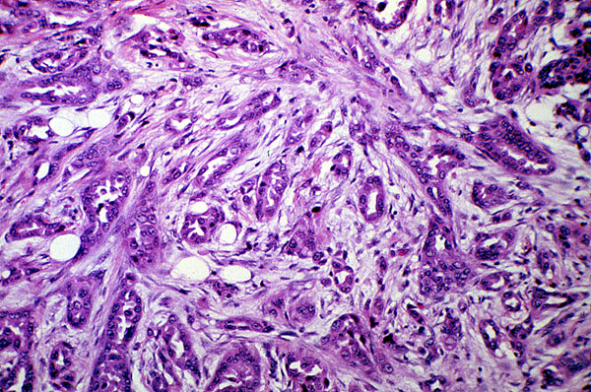
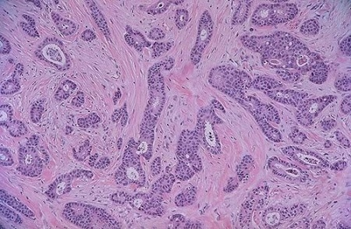
1- Invasive Ductal Carcinoma, NOS: histology
Histology: the tumor cells are large and pleomorphic usually within a dense stroma. They are adenocarcinomas and so they show glandular formation but can also be arranged in cords or sheets of cells.
The tumors range from well differentiated to moderate or poorly differentiated.
Carcinomas associated with a large amount of DCIS require large excisions with wide margins to reduce local recurrences

Slide 53
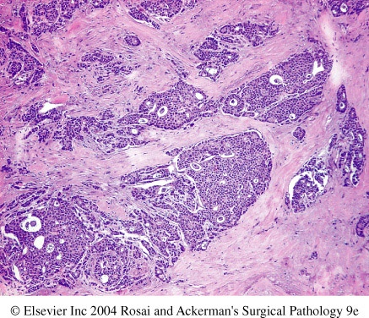
1- Invasive ductal carcinoma, NOS

Slide 54
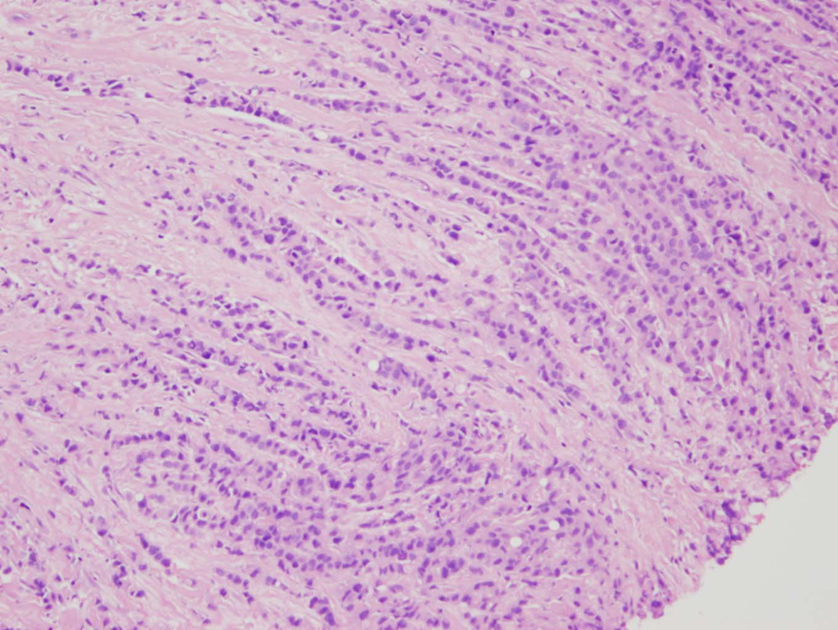
2- Invasive Lobular Carcinoma
Almost all express hormone receptors, whereas HER2 overexpression is rare.
It is the second most common type of invasive breast cancer forming up to 10% of breast cancers.
The tumor may occur alone or in combination with ductal carcinoma.
It tends to be bilateral and multicentric.
The amount of stromal reaction to the tumor varies from marked fibroblastic (desmoplastic) response to little reaction and therefore the presentation varies from a discrete mass to a subtle, diffuse indurated area. Most are firm to hard with irregular margins
Histology: single infiltrating malignant cells, forming a line often one cell width (so called as indian file pattern). No tubules or papillary formation.

Slide 55


Invasive lobular carcinoma with area of lobular carcinoma in situ also
http://www.breastpathology.info/Special%20Types.html
http://www.breastpathology.info/Special%20Types.html

Slide 56

3- Medullary Carcinoma…
Special type of triple-negative cancer
This subtype of breast cancer presents as a well circumscribed mass.
May be mistaken clinically and radiologically for fibroadenoma
It does not produce any fibroblastic (desmoplastic) reaction and therefore is soft and fleshy.
Histology: the tumor is composed of solid sheets of malignant cells surrounded by many lymphocytes and plasma cells. There is scant fibrous stroma.
http://tgmouse.ucdavis.edu/JENSEN-MAMM2000/BRCA-3/BRCA-3.HTML

Slide 57

4- Colloid Carcinoma/ Mucinous carcinoma….
ER-positive/HER2-negative
Tends to occur in older women.
It is sharply circumscribed, lacks fibrous stroma and is slow growing.
Is soft and gelatinous and has a glistening cut surface.
It may be in pure mucinous or mixed with another type of invasive breast carcinoma.
The tumor is composed of small islands of tumors cells and single tumor cells floating in pools of extracellular mucin
http://tgmouse.ucdavis.edu/JENSEN-MAMM2000/BRCA-3/BRCA-3.HTML

Slide 58

5- Tubular carcinoma
ER-positive/HER2-negative
detected on mammography as a small irregular mass
Well-formed tubules and have low-grade nuclei
Lymph node metastases are rare, and the
prognosis is excellent.

Slide 59





Treatment
Wide local excision
Radical mastectomy

Slide 60
Breast Carcinoma, Major Prognostic Factors
Invasive or In situ disease: Invasive carcinoma has poorer prognosis as it can metastasize. In-situ carcinoma is confined to the ductal/lobular system and cannot metastasize, so it has better prognosis.
Distant Metastasis: Once distant metastases is present, cure is unlikely, although long-term remissions and palliation can be achieved. Favored sites for dissemination are the lungs, bones, liver, adrenals, brain, and meninges.
Lymph Node metastasis: Axillary lymph node status is the most important prognostic factor for invasive carcinoma. The clinical assessment of nodal involvement is very inaccurate, therefore, biopsy is necessary for accurate assessment.
Tumor Size: The size of the carcinoma is the second most important prognostic factor. The risk of axillary lymph node metastases increases with the size of the carcinoma.
Note: all the above parameters are used to stage the tumor. Stage is a combination of size, lymph node status and distant metastasis. Tumor size less than 2 cm is associated with a favorable prognosis. The single most important prognostic indicator is the lymph node status. Negative lymph nodes have the best prognosis. Involvement of 1 to 3 lymph nodes has an intermediate prognosis and 4 or more positive nodes have the worse prognosis.

Slide 61
Breast Carcinoma, Major Prognostic Factors…cont
Locally advanced disease: Tumors invading into overlying skin or underlying skeletal muscle are frequently associated with concurrent or subsequent distant disease. With increased awareness of breast cancer detection, such cases have fortunately decreased in frequency and are now rare at initial presentation.
Inflammatory Carcinoma: Women presenting with the clinical appearance of breast swelling and skin thickening have a poor prognosis.

Slide 62
Breast Carcinoma , Minor Prognostic Factors
Histologic Subtype: Infiltrating ductal and lobular carcinomas have the worst prognosis. Medullary and mucinous have intermediate prognosis. And tubular and cribriform have the most favorable prognosis
Tumor Grade: it is calculated using a grading system called modified Scarff-Bloom-Richardson (SBR) grading system. There are three grades: 1, 2 and 3. Grade 1 has better prognosis and grade 3 has poorer prognosis. This SBR grading system is based on the estimation of the amount of well formed glands, the degree of nuclear pleomorphism, and the mitotic rate, on microscopic examination. It is calculated by the pathologist.
Tumor cells with estrogen and progesterone positive receptors: majority of breast carcinoma cells express estrogen and progesterone receptors. Such hormone positive cancers have better prognosis. They respond well to specific drugs e.g. Tamoxifen. Therefore it is mandatory to identify which tumors are ER/PR positive as they respond well to treatment and have better prognosis when compared to ER/PR negative tumors.
HER2 (human epidermal growth factor receptor 2): is a glycoprotein overexpressed in about 30% of breast carcinomas. Many studies have shown that overexpression of HER2 is associated with a poor prognosis. In addition, ongoing studies have shown that HER2-overexpressing tumors respond very well to a chemotherapy drug named Trastuzumab (Herceptin). Therefore, it is mandatory to determine the HER2 status of the tumor when reporting breast cancer in order to help decide the chemotherapy plan.
Lymphovascular invasion: is strongly associated with the presence of lymph node metastases and is a poor prognostic factor.
Proliferative rates: ki67 index (the higher the ki67 proliferative index, the more aggressive the tumor is)

Slide 63

Metastasis to vertebra

Slide 64
STROMAL TUMORS

Slide 65
Two basic stromal tumors are:
Fibroadenoma
Phyllodes tumor

Slide 66


Fibroadenoma (FA)
The most common benign tumor of the female breast.
It is composed of benign proliferation of both epithelial and stromal elements (biphasic).
Any age, most common before age 30
Classic presentation: firm/rubbery, mobile lump (“breast mouse”).
It may increase in size during pregnancy. It may stop growing and regress after menopause.
The tumor is usually solitary but may be multiple and involve both breasts.
The tumor is completely benign. FA are almost never malignant.
Grossly: spherical nodules, sharply demarcated and circumscribed from the surrounding breast tissue and so is freely movable and can be shelled out. Size vary (1cm to 10 cm in diameter). Cut surface: pearl-white and whorled.
Histology: tumor is composed of a mixture of ducts and fibrous/myxoid connective tissue
Treatment: lumpectomy (only the lump is removed)

Slide 67

The lesion consists of a proliferation of intralobular stroma surrounding and often pushing and distorting the associated epithelium. The border is sharply delimited.
Downloaded from: Robbins & Cotran Pathologic Basis of Disease (on 28 April 2008 09:47 AM)
© 2007 Elsevier

Slide 68
Phyllodes tumor (Greek for leaflike)
Phyllodes tumors can occur at any age, but most present in the 40s and 50s, that is 10 to 20 years later than the average presentation of a fibroadenoma
These tumors are much less common than fibroadenomas
Most present as large palpable masses (usually 3 to 4 cm in diameter)
They are fibro-epthelial tumors, have a leaf like pattern and a cellular stroma.
Phyllodes tumors are classified as:
  Benign phyllodes tumors: most (75%) phyllodes tumors are benign.
  Low-grade phyllodes tumors: they tend to recur locally and a rarely metastasize.
  High-grade phyllodes tumors: are uncommon and they behave aggressively with frequent local recurrences and can have distant metastases to lung, bone, CNS. They have better prognosis than invasive ductal carcinoma.

Slide 69

Phyllodes tumors. Proliferating stromal cells distort the glandular tissue, forming cleftlike spaces, and bulge into surrounding stroma.

Slide 70
Breast pathology
Inflammation:
-acute mastitis
-periductal mastitis
-duct ectasia
-fat necrosis
-lymphocytic mastopathy
-granulomatous mastopathy
Benign lesions:
1-nonproliferative (cysts, fibrosis, adenosis)
2-proliferative without atypia (hyperplasia, scl.adenosis,radial scar, papilloma)
3-proliferative with atypia (ADH, ALH)
Stromal tumors:
1-fibroadenoma
2-phyllodes
Other rare:
-hemangioma
-lipoma
-angiosarcoma
CIS:
1-ductal (comedo, cribriform, papillary, micropapillary, solid)
*(PAGET)
2-lobular
Invasive carcinoma:
1-Ductal (NOS)
2-lobular
3-tubular
4-mucinous (colloid)
5-medullay
6-papillary
7-metaplastic
*(inflammatory)

Slide 71


