Slide 1

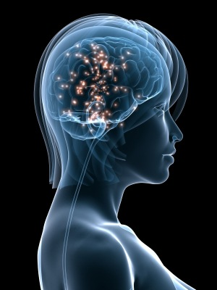
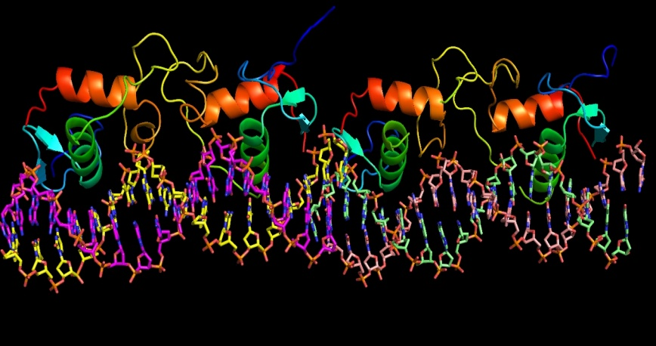
HORMONE REPLACEMENT THERAPY

Slide 2
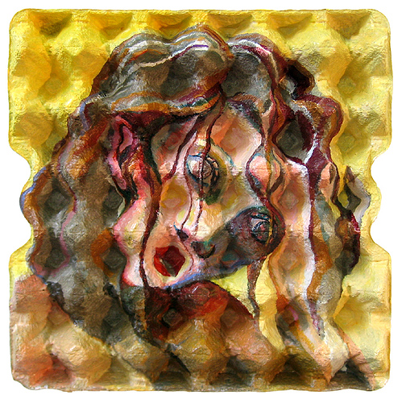
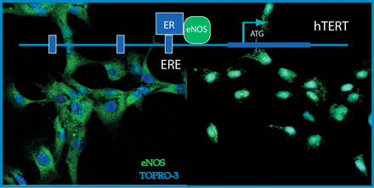
ILOs
By the end of this lecture you will be able to:
Recognize menopausal symptoms & consequences
Classify drugs used to alleviate such symptoms that
are used as Hormonal Replacement Therapy [HRT]
Expand on the mechanism of action, indications,
preparations, side effects & contraindications of
such agents.
Notes:
Menopause is confirmed 1 year (12 months) after the final menstrual period.
Postmenopause is all the years beyond menopause.

Slide 3
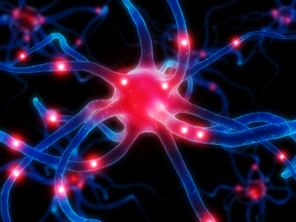

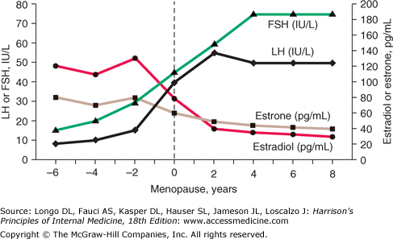
HRT
Is a system of medical treatment that is designed to artificially boost female hormones, in hope to alleviate symptoms caused by  in their circulating levels
MENOPAUSE
The physiological changes that occur at the time when the last period ends generally as women get older and lose fertility (age late 40s)
Estrogen & Progesterone
◉ Androgens
 FSH & LH
Insulin Resistance
' menos'( month)
'pausis'(cessation)
Notes:
HRT: treatments for relief of menopausal symptoms caused by lower levels of estrogen at menopause, include hot flashes, sleep disturbances, and vaginal dryness. HRT is also approved for the prevention of osteoporosis. Today, clinicians prescribe much lower doses for much shorter terms (3-5 years) than before 2002.

Slide 4

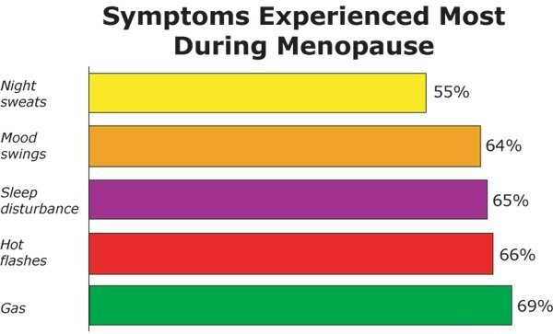
HRT
SYMPTOMS & CONSEQUENCES of MENOPAUSE
Immediate
    Intermediate
        Long Term
Hot Flushes / Night Sweats (vasomotor symptoms)
Insomnia, Anxiety, Irritability
Mood Disturbances
Reduction In Sexuality & Libido
Poor Concentration
20% no symptoms, 60% some symptoms, 20% severe symptoms
Osteoporosis
CVS Risks; LDL/HDL ratio,
CHD, stroke,..
CNS deficits; Alzheimer's,
dementia
Dyspareunia & vaginal dryness
Urethral syndrome
(dysuria, urgency & frequency)
Incontinence, difficulty in voiding
Increased bruising
Generalized aches and pains

Slide 5
HRT
Menopausal Symptoms
Estrogen
Replace the Estrogen
◉
Alleviate
Estrogen Some undesirable side effects

add Progestins; but not if there is hystrectomy
Selective ER-Modulators [SERMs]
Phytoestrogens
Androgens  responsible for sexual arousal  given only if
there is loss of libido & orgasm
HRT
Given for short term; never exceed 5 years to control meno-pausal symptoms without allowing ample time for malignant transition that might be induced by estrogen
Long-term administration was only indicated in osteoporosis & CVS protection but now better drugs are available
No more preferred

Slide 6
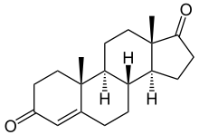
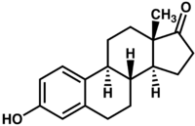
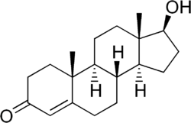
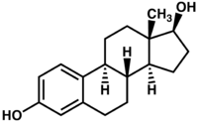
HRT
ESTROGEN
1.
In NATURE
Aromatase
Ovaries & adrenals pre-menopausal
Adrenals in menopause
Androstenedione
Estrone
Dehydrogenase
Aromatase
Ovaries in pre-menopause
Testosterone
Estradiol
As Therapy
  Estradiol; Oral bioavailability is low due to its rapid oxidation in the liver so used only in transdermal patch, subcutaneous implant, ….
Conjugated estrogens  mixture of Na salts of sulfate esters of estrone & equilin.
Esterified estrogens
Notes:
Equilin is an estrogen from horses

Slide 7
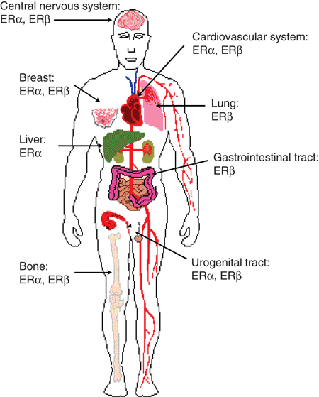
?
ESTROGEN
What does estrogen do
It binds to its receptors
Distribution of ER
Types of Estrogen Receptors [ER]
ER α 
> mediates female hormonal functions
Endometrium, breast, ovaries, hypothalamus,…
ER β 
> mediates other hormonal functions
  brain, bone, heart, lungs, kidney, bladder, intestinal mucosa, endothelial cells,….

Slide 8
ESTROGEN
INDICATIONS
A. In Menopause
Not given unless presence of symptoms; alone only after hysterectomy or with progestin as HRT
(never exceed 5 yrs administration)
Improves hot flushes & night sweats
Controls sleep disturbance & mood swings by acting on NE, DA & 5HT at reticular formation
Improves urethral & urinary symptoms by  epithelial thickness & vascularity, collagen content at urethra & NE transmission that contract sphincters & relax detrusal muscles
Improves vaginal dryness by  epithelial thickness & vascularity, collagen content (topical and systemic estrogens prep are effective)
Increases bone density by  calcitonin release from thyroid to  osteoclastic activity.
Progestins act synergestic by blocking cortico- steroid induced bone resorption. (Decrease incidence of hip fracture)
Notes:
ET is prescribed for women without a uterus due to a hysterectomy.
EPT means combined estrogen plus progestogen therapy. Progestogen is added to ET to protect women with a uterus against uterine (endometrial) cancer from estrogen alone.

Slide 9

ESTROGEN
Protects CVS; enhance vasodilatation via  NO production, &  HDL & LDL thus  atherosclerosis & ischemic insults (HRT started at the beginning of menopause will prevent CVS problems) HRT increases CVs problems (long term)
Improves insulin resistance & glycaemic control in diabetics
Improves cognitive function via  expression of ER in brain & by  amyloid deposition thus preventing Alzehimer ‘s.
Delays parkinsonism by acting on DA system in midbrain
B. Other Uses
Contraception
Primary ovarian failure
Amenorrhea & Hirsutism caused by excess androgens

Slide 10
Prescription of HRT: ROUTES
Transdermal: patch or gel
Oral
Subcutaneous
(implant)
Intramuscular (depot)
Intra-vaginal (pessaries, ring or cream)

Slide 11
ESTROGEN
Administration
Oral: -
  Conjugated equine
  Estradiol valerate
  Estrial succinate
Transdermal (estradiol);
Patches 24 hour twice weekly.
  Gel 24 hours daily.
Subcutaneous implant (estradiol)  6 monthly.
Vaginal cream as such or as rings pessaries
ADRs
Irregular vaginal bleeding (patients discontinue HRT).
Nausea.
Vaginal discharge.
Fluid retention, Weight gain.
Breast tenderness (patients discontinue HRT)..
Spotting or darkening of skin (on face)

Slide 12
ESTROGEN
Contraindications
Absolute;
Undiagnosed vaginal bleeding
Severe liver disease
Thromboembolic manifestations
Cancer; endometrial, breast (hormone sensitive), ovarian
Interactions
See contraception
NB. If given with
SERMs additive side effects for both drugs
Aromatase inhibitors  efficacy
Corticosteroids  side effects

Slide 13
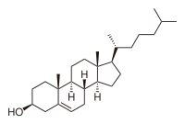
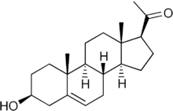
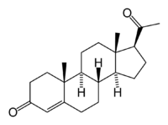
HRT
Estrogen and progestin combinations (pills or tablets)
PROGESTINs
2.
In NATURE
Produced by; Adrenal glands, Gonads, Brain, Placenta
Synthesis;
Induced by LH
Cholesterol
Pregnenolone
Progesterone
Are precursor to estrogens, androgens, and adrenocortical steroids.
As Therapy
Progesterone is degraded in GIT, so can be given only parentally
Progestins are synthetic progestogens that have effects similar to progesterone but are not degraded by GIT.
Progestin preparations; as in contraceptive pills
Binds to its receptors
What does progesterone do?
Two types of progesterone receptors [PR] PR-A & PR-B
They could exist cytoplasmic mediating genomic long term effects or membranous mediating non-genomic rapid effects

Slide 14
Estrogen and progestin combinations (pills or tablets)
INDICATIONS
PROGESTIN
A. In Menopause
As HRT, usually given in combination with estrogen Some use it alone in risk of cancer but does not  all menopausal symptoms
Protects against possibility of estrogen induced endometrial cancer
Estrogen  cell growth. If unopposed endometrial cell lining can show (atypical hyperplasia)
Progesterone beneficially matures endometrial cell lining ( become differentiated) &  apoptosis of atypical cells.
Progesterone (natural) protects against breast cancer development by
anti-inflammatory & apoptotic mechanisms, but this effect is not as
clear with synthetic progestins. Mammography recommended every 6ms.
Confers neuroprotection, mild effect
Controls insomnia & depression  little effect
Counteract osteoporosis, directly +ve osteoblasts

Slide 15
Estrogen and progestin combinations (pills or tablets)
PROGESTIN
B. Other Uses
Contraception (Estradiol + Progestins)
2. Dysmenorrhea
Menpauasal symptoms (Estradiol + Progestins given together)
Administration
Oral; Micronized progesterone or progestins
IU; as Levonorgestrel or Progestasert
Vaginal - natural progesterone gel / pessary.
Transdermal - sequential / continuous patch.
ADRs
Mood changes, as anxiety, irritability
Headache, dizziness or drowsiness
Nausea, vomiting, abdominal pain or bloating (distention).
Hirsutism , masculinization (Not with new preparations)

Slide 16
Benefits and Risks of HRT
Definite benefits
Alleviates symptoms of menopause (vasomotor, genitourinary)
Osteoporosis (Definite increase in bone mineral density; probable decrease in risk of fractures)
Definite risks
Endometrial cancer (estrogen only)
Venous thromboembolism (long term)
Breast cancer (long term 5 yrs)
Uncertain benefits
Cognitive functions
Note: the risk of CVS problems and breast cancer with HRT is more than their benefits)

Slide 17
HRT
Estrogen and progestin combinations (pills or tablets)
SERMs
3.
Tamoxifen, Raloxifene (oral and non-hormonal)
Raloxifen antagonist in breast and uterus and agonist in bone
Tamoxifen Antagonist in breast and partial agonist in bone and endometrium.
An ideal SERM for use as HRT should be agonistic in brain, bone, CV system (not necessarily the liver), vagina & urinary system but antagonistic in breast & uterus
 | Brain | Uterus | Vagina | Breast | Bone | CVS
Estradiol | ++ | ++ | ++ | ++ | ++ | ++
Ideal SERM | ++ | — | ++ | — | ++ | ++
Tamoxifen | — | + | — | — | + | +
Raloxifene | — | — | — | — | ++ | +
+ = agonist
- = antagonist
Not Ideal
Tamoxifen risk of venous thrombosis & tends to precipitate vaginal atrophy & hot flushes
Raloxifene  has no effect on hot flushes or increases hot flushes (very effective preventing vertebral bone fracture and CVs problems less compared to Estrogen) for osteoprosis use of bisphosphonate is better than SERMs

Slide 18
HRT
Estrogen and progestin combinations (pills or tablets)
PHYTOESTROGENS
5.
supplements from plants; containing isoflavones (soya beans, flaxseeds) or lignans (whole grains). Avoid in esterogen dependent breast cancer
They mimic action of estrogen on ER-β alleviate symptoms related to hot flushes, mood swings, cognitive functions & possess CVS protective actions. (data limited on their efficacy)
They block actions mediated by ER-α in some target tissues  lower risks of developing endometrial & breast cancer.
HRT
Estrogen and progestin combinations (pills or tablets)
ANDROGENS
6.
Testosterone is responsible for sexual arousal in females. It is given as the sole therapy to menopausal women in whom their menopausal symptoms are focused on lack of sexual arousal. It is given as adjuvant to combined estrogen & progestin if all other menopausal symptom exist.
N.B. Tibolone, is a synthetic steroid drug with estrogenic, progestogenic, and weak androgenic actions . (androgens use is not approved by FDA in women)

Slide 19
The Women’s Health Initiative (WHI) and HRT
The Women’s Health Initiative (WHI), a 15-year research program launched in 1991, addressed the most common causes of death, disability, and poor quality of life in postmenopausal women.
The research program examined the effectiveness of hormone replacement therapy in women. In 2002, findings from two WHI clinical trials examined:
The use of estrogen plus progestin in women with a uterus
The use of estrogen only in women without a uterus.
In both studies, women were randomly assigned to receive either the hormone medication or placebo.
In both studies, when compared with placebo, the hormone medication (whether estrogen plus progestin or estrogen only) resulted in an increased risk of stroke and blood clots. In addition, the estrogen plus progestin medication resulted in an increased risk of heart attack and breast cancer.
These concerns are one reason that many women are turning to mind and body practices and natural products to help with menopausal symptoms.

Slide 20
Non-hormonal agents used in management of menopausal symptoms
Fluoxetine (SSRI) reduces vasomotor symptoms
Clonidine (centrally acting antihypertensive, alpha 2 agonist) helps with vasomotor symptoms.
Gabapentin (anticonvulsant) reduces severity and frequency of hot flushes
Physical activity: exercise, smoking cessation and relaxation of mind will improve symptoms of menopause (e.g. hot flushes) and fall preventing strategies prevents chances of fracture.

