Slide 1
Lecture 5
Physiology of androgens and control of male sexual functions
Dr. Laila Al Dokhi
Assistant Professor
Department of Physiology

Slide 2
Objectives
By the end of this lecture, you should be able to:
Understand the functions of the male reproductive organs and glands
Describe the synthesis, secretion, metabolism and effects of testosterone
Explain how the hypothalamus and anterior pituitary gland regulate male reproductive function
Describe the major testicular abnormalities
Discuss the normal mechanism of the male sexual act
Keywords: Leydig cell, Sertoli cell, dihydrotestosterone, cryptorchidism

Slide 3
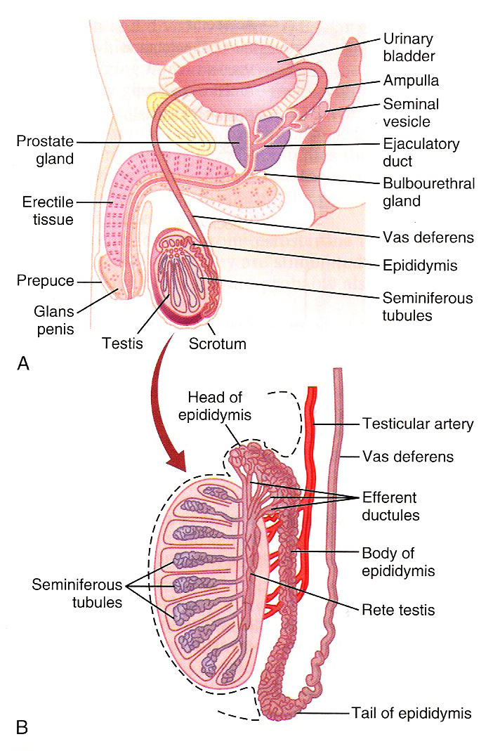

Slide 4
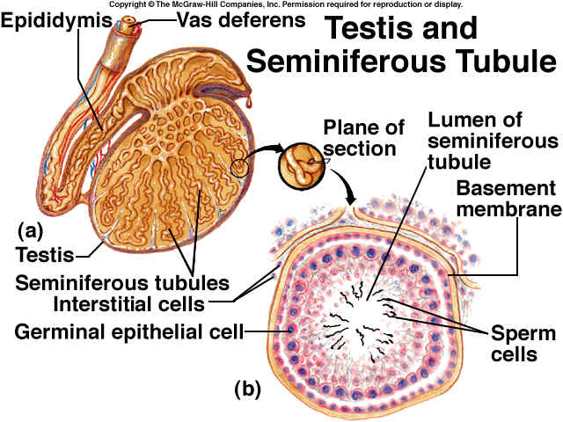
Cross section of the seminiferous tubule

Slide 5
Spermatogenesis:
Formation of sperm
Occur in the seminiferous tubules during active sexual life due to stimulation by AP-GnHs,
Begin at age of 13 years ,
Continue throughout life & decrease in old age.
Sertoli cells:
Large with overflowing cytoplasmic envelopes
Surround the developing spermatogonia around the central lumen of the seminiferous tubules.
Leydig cell:
Lie within the interstices between the seminiferous tubules.
They are non-existent in the testis during childhood when the testis secrete almost no testosterone,
Numerous in the newborn male infants for the first few months of life
Active at puberty & throughout adult life & secrete testosterone.

Slide 6
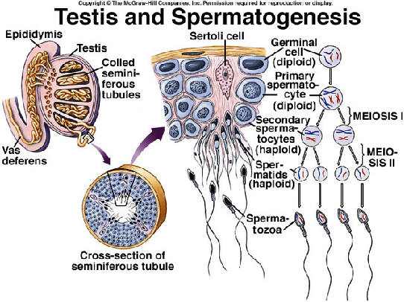

Slide 7
Maturation of sperm in the epididymis:
After formation in the seminiferous tubules, the sperm require several days to pass through the epididymis (still non-motile).
After the sperm have been in the epididymis for 18 to 24 hour, they develop the capability of motility
Some inhibitory proteins in the epididymal fluid prevent final motility until after ejaculation.
Physiology of mature sperm:
Mature sperm are motile & capable of fertilizing the ovum
Their activity is enhanced in a neutral & slightly alkaline medium & depressed in mildly acidic medium.
The life expectancy of ejaculated sperm in the female genital tract is only 1 to 2 days

Slide 8
Hormonal factors that stimulate spermatogenesis:
1-Testosterone: secreted by the leydig cells which located in the interstitium of the testis, is essential for the growth and division of the testicular germinal cells.
2-Luteinizing hormone (LH) secreted by the anterior pituitary gland, stimulates the leydig cells to secrete testosterone.
3-Follicle stimulating hormone: FSH also secreted by the anterior pituitary gland, stimulates the sertoli cells, stimulate the conversion of spermatids to sperm (also important for spermatogenesis).
4-Estrogen: formed from testosterone by the sertoli cell under FSH stimulation also essential for spermatogenesis.
5-Growth hormone (also other body hormones) is necessary for controlling metabolic functions of the testis. GH promotes early division of spermatogonias in its absence (pituitary dwarfs), the spermatogenesis is severely deficient or absent → infertility.

Slide 9
Storage of sperm:
The 2 testis of adult human formed up to 120 million sperm each day.
Small amount stored in the epididymis
The majority stored in the vas deferens, maintaining their fertility for at least a month.
The sperm are kept inactive state by multiple inhibitory substances in the secretion of the ducts.
After ejaculation
The sperm become motile & capable of fertilizing the ovum called maturation.
The sertoli cells and epithelium of the epididymis secrete nutrient fluid which contains (testosterone & estrogens), enzymes & nutrients essential for sperm maturation.

Slide 10
Function of the seminal vesicles:
Secrete mucoid material containing fructose, citric acid & nutrient substances & large quantities of prostaglandins & fibrinogen.
The prostaglandins are important help in fertilization:
  By reacting with the female cervical mucus making it more receptive to sperm movement.
  By causing backward reverse peristaltic contractions of the uterus & fallopian tubes to move the ejaculated sperm toward the ovaries.

Slide 11
Function of the prostate gland:
The prostate gland secretes thin milky fluid contains Ca2+ ion, citrate ion, phosphate ion, a clotting enzyme & profibrinolysin.
The alkaline prostatic fluid is important for successful fertilization of the ovum.
Function of alkaline prostate fluid :
1-Successful fertilization of the ovum
2-Help to neutralize the slightly acidic fluid of the vas deferens (due to the presence of citric acid and metabolic product of the sperm that inhibit sperm fertility).
3-Helps to neutralize the acidity of other seminal fluids during ejaculation & enhances motility & fertility of sperm

Slide 12
Semen:
Ejaculated semen during sexual act is composed of the fluid & sperm
From the vas deferens (~10%)+
Fluid from the prostate gland (~30%),+
Fluid from the seminal vesicles (~60%) +
Small amounts from the mucous glands the bulbourethral glands.
The average pH is about 7.5, the alkaline prostatic fluid help to neutralize the mild acidity of other portions of the semen
& gives the semen a milky appearance
Fluid from the seminal vesicles & mucous glands give the semen mucoid consistency.
.

Slide 13
Effect of sperm count on fertility:
The quantity of ejaculated semen during coitus about 3.5 ml
Each milliter contains about 120 million sperm (normal male count vary between 35 million to 200 million sperm).
Sperm count below 20 million leads to infertility.
Effect of sperm morphology and motility on fertility:
Abnormal shape
Sometimes sperm count is normal but still infertile when about one half of the sperm have abnormal shape.
Abnormal motility
Sometimes the shape of the sperm is normal but they either relatively non-motile or entirely non-motile which causes infertility

Slide 14
Capacitation of the spermatozoa:
Making it possible for them to penetrate the ovum:
Sperm in the epididymis is kept inactive by multiple inhibitory factors secreted by the genital duct epithelia &
They will be activated in female genital tract, for the processes of fertilization. These activation changes are called capacitation of the spermatozoa (require 1 to 10 hrs).
Uterine & fallopian fluids wash away the inhibitory factors which suppress the sperm activity in the male genital ducts.
Cellular membrane covering the acrosome is covered with cholesterol which prevent the release of its enzyme. After ejaculation the sperm removed from the cholesterol vesicles & this makes the membrane of the sperm head becomes weaker.
The sperm membrane becomes more permeable to Ca2+ ion which increase their movements & help to release the proteolytic enzymes from acrosome which aid in penetrating the ovum.

Slide 15
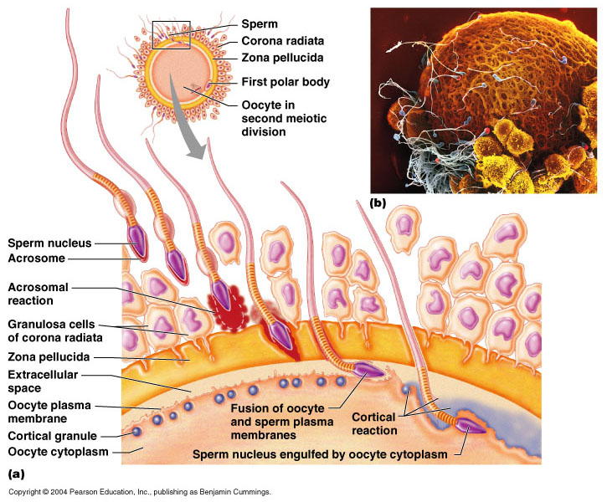
Acrosome enzymes, the “Acrosome Reaction” and penetration of the ovum:
The acrosome of the sperm store large quantities of hyaluronidase and proteolytic enzymes.
Hyaluronidase depolarizes hyaluronic acid polymers in the intracellular cement that hold the ovarian granulosa cells together.
Also the proteolytic enzymes digest the proteins.

Slide 16
Male sexual act.
Stages of male sexual act:
1-Penile erection.
Erection is caused by parasympathetic impulses that pass from the sacral portion of the spinal cord through the pelvic nerves to the penis.
2-Lubrication,
Parasympathetic impulses cause the urethral glands &bulbourethral glands to secrete mucous.
3-Emission and ejaculation.
Function of the sympathetic nerves.
Emission begins by contraction of the vas deferens & ampulla to cause expulsion of the sperm in the internal urethra.
Contraction of the prostate &seminal vesicles to expel their fluid in the urethra.
All these fluids mix in the internal urethra with the mucous secreted by the bulbourethral glands to form the semen. This process at this point is called emission.
Filling of the internal urethra with semen causes sensory impulses through pudendal nerves to the sacral region of the cord.
Fullness of the internal urethra causes rhythmical contractions of the internal genital organs which increases their pressure to ejaculate the semen to the outside called ejaculation.

Slide 17
Testosterone and other male sex hromones: secretion, metabolism and chemistry of the male sex hormone:
Secretion of testosterone by the interstitial cell of leydig in the testis.
The testis secrete several male sex hormone called androgens including testosterone, dihydrotestosterone and androstenedione.
Testosterone is the most abundant form while dihydrotestosterone is most active and testosterone converted into dihydrotestosterone in the target cells.
Secretion & chemistry of androgens in the body:
From the testes and adrenal glands
It is synthesized either from cholesterol or directly from acetylcoenzyme A.
Metabolism of testosterone:
Testosterone bound with beta globulin and circulate in the blood for 30 minutes to several hours .
Converted to estrogen in the liver.
Excreted either into the gut through liver bile or into the urine through the kidneys.

Slide 18
Functions of testosterone:
It is responsible for the characteristic masculine body.
During fetal life the testis are stimulated by placenta chorionic gonodotropin to produce testosterone throughout fetal life & the 10 weeks after birth
During childhood there is no more testosterone production
At puberty under the anterior pituitary gonadotropic hormones stimulation and throughout life
Beyond 80 years it decline to 50%.

Slide 19
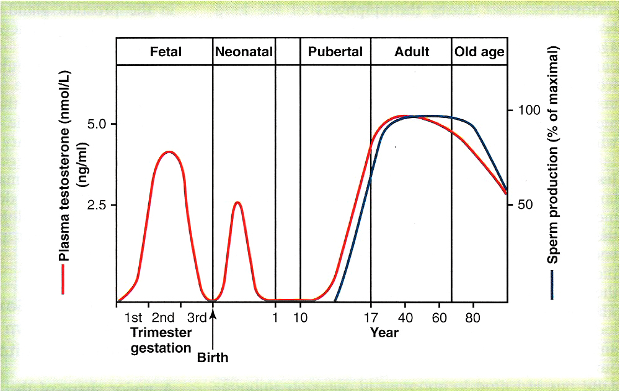

Slide 20
Function of testosterone during fetal development:
Testosterone secreted by the genital ridges.
Later by the fetal testis
It is responsible for development of the male body characteristics including the formation of
Penis & scrotum.
Prostate gland, seminal vesicles
Male genital ducts .
Suppressing the formation of female genital organs.
Effect of testosterone to cause descent of the testis:
The testis descend into the scrotum during the last 2 to 3 months of gestation when the testis begin secreting reasonable quantities of testosterone.

Slide 21
-Effect pf testosterone on development of adult primary and secondary sexual characteristics:
1-After puberty, the increasing amounts of testosterone cause enlargement of the penis, scrotum & testis & secondary sexual characteristics.
2- Effect on the distribution of body hair:
Testosterone causes growth of hair:
  Over the pubis (upward along the linea alba of the abdomen to the umbilicus)
  On the face;
  On the chest;
  Less often on other regions such as the back.

Slide 22
3-Baldness:
Testosterone decreases the growth of hair on the top of the head
Two factors causes baldness:
1) Genetic background
2) Large quantities of androgenic hormones.
4-Effect on voice:
It causes hypertrophy of the laryngeal mucosa, enlargement of the larynx (typical adult masculine voice)
5-Testosterone increases thickness of the skin and contribute to development of acne:
Testosterone increases the thickness of skin over the body & subcutaneous tissues.
It also increases the secretion of the sebaceous glands & sebaceous glands of the face causing acne

Slide 23
6-Testosterone increased protein formation and muscle development:
Testosterone have anabolic effect by:
  Increasing muscular development after puberty by 50% in muscle mass over that in female.
  Increasing protein content in non-muscle parts of the body.
7- Testosterone increases bone matrix and causes Ca2+ retention:
Bones grow thicker & deposit additional Ca2+thus it increases the total quantity of bone matrix
causes Ca2+ retention (anabolic effect).
Testosterone has specific effect on the pelvis:
Narrow the pelvic outlet;
Lengthen it;
Cause the funnel-like shape instead of the broad ovoid shape of the female pelvis. I
t causes the epiphyses of the long bones to unite with the shafts of the bones & early closure of the epiphyses.

Slide 24
8-Testosterone increases basal metabolism:
It increases the basal metabolic rate by about 15% (indirectly as a result of the anabolic effect).
9-Effect on red blood cells:
It increases red blood cells/ml (due to increase metabolic rate).
10-Effect on electrolyte and water balance:
It increase the reabosorption of Na+ in the distal tubules of the kidneys.

Slide 25
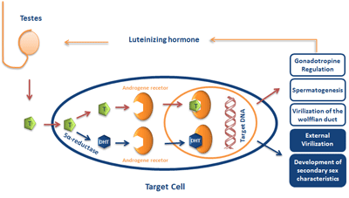
The basic intracellular mechanism of action of testosterone:
It increases the rate of protein synthesis in target cells.
Testosterone converted by the intracellular enzyme 5 α reductase to dihydrotestosterone, then it binds with cytoplasmic “receptor protein”.
This combination moves to the nucleus where it binds a nuclear protein and induces protein formation.

Slide 26
Abnormalities of male sexual function:
Prostate gland and its abnormalities
Benign prostatic fibroadenoma in older age due to overgrowth of prostate tissue (not caused by testosterone).
Cancer of the prostate gland caused by stimulation of cancerous cells by testosterone.

Slide 27
Hypogonadism in male:
During fetal life when the testis are non-functional, none of the male sexual characteristics develop in the fetus. Instead female organs are formed.
If the boy loses his testis before puberty, a state eunuchism (he have infantile sex organs & infantile sexual characteristics) & the height of an adult eunuch is slightly greater than normal because of slow union of the epiphyses.
If a man is castrated after puberty, sexual organ regress in size and voice regress - loss of the thick musculine bones- loss of masculine hair production -loss of musculature of the virile male.
Adiposogenitial syndrome, Frohlich’s syndrome or hypothalamic eunuchism: -hypogonadism due to genetic inability of the hypothalamus to secrete normal amount of GnRH & abnormality of the feeding center of the hypothalamus result in obesity with eunuchism.

Slide 28
Cryptorchidism
Failure of the testes to descend in the scrotum which normally occur during fetal life.
10% of newborn males and it falls to 2% at age 1 year
0.3% after puberty
They should be treated before puberty because of higher incidence of malignant tumors.
Testicular tumors and hypergonadism in male:
Interstitial leydig cell tumors (rare), over production of testosterone. In children, causes rapid growth of the musculature and bones and early union of the epiphyses and causes excessive development of male sexual organs.
Tumor of the germinal epithelium (more common).

