Slide 1
Hormones affecting the breast Dr. Hana Alzamil

Slide 2
Objectives
Physiological anatomy of the breast
Physiological changes during breast development (Mamogenesis)
Physiological changes during lactation (Lactogenesis) and their physiological action
Phases of lactogenesis.
Physiological changes during Galactopoeisis.
Endocrine and autocrine control.
Involution (the termination of milk production).

Slide 3
Small group activity
What is the structure of human breast?

Slide 4
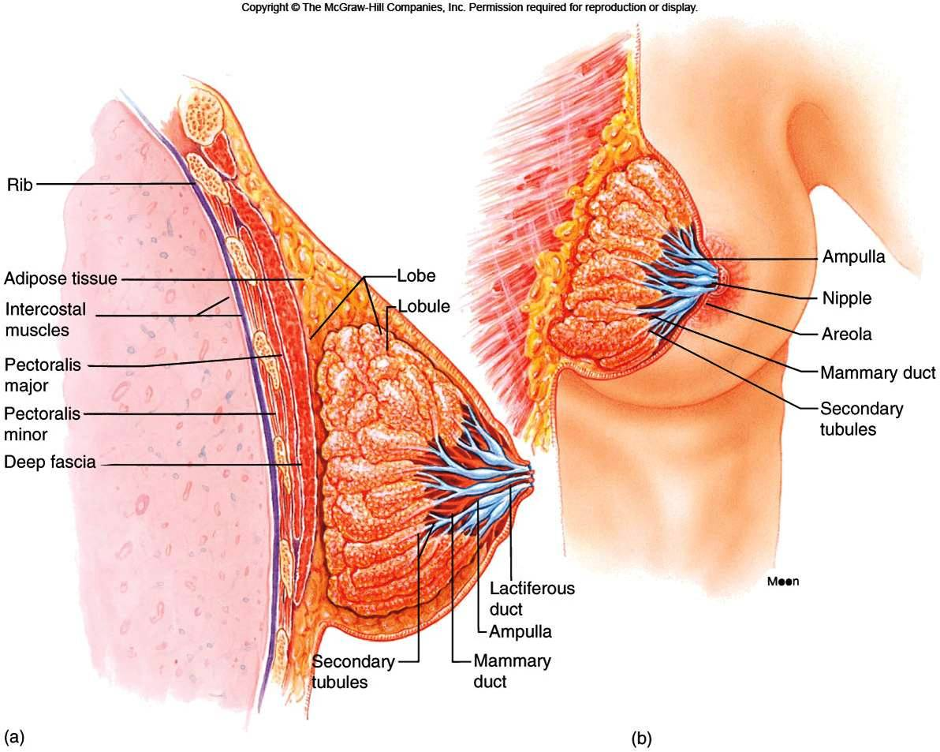

Slide 5
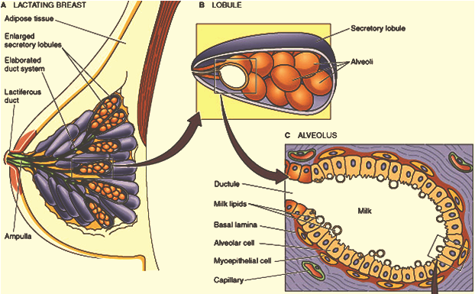

Slide 6
Small group activity
Where does milk come from?

Slide 7
Theories
Uterine milk theory: Vessel connecting the uterus to the breast (diversion of menstrual blood to the breast)
Chyle theory: Milk is derived directly from chyle (milky fluid of emulsified fat absorbed from the intestinal tract into lymphatic system).
Synthesis theory: Milk is formed from substrates carried to the gland in the blood

Slide 8
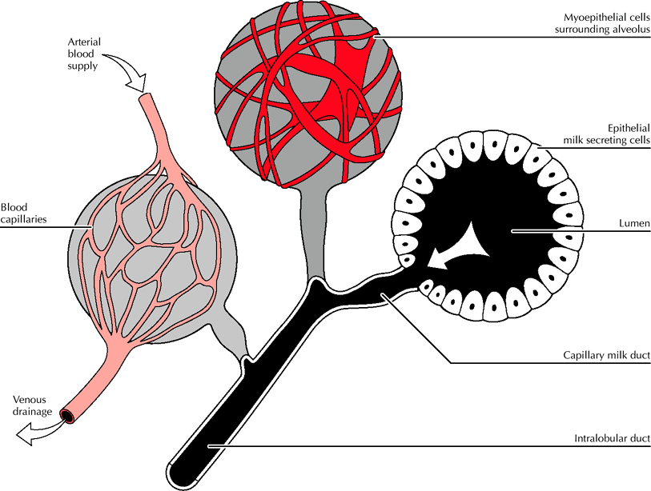
Where does milk come from?
Notes:
Milk produced in mammary epithelium within lobules
With nursing, oxytocin triggers contraction of myoepithelial cells and transfer to sinuses

Slide 9
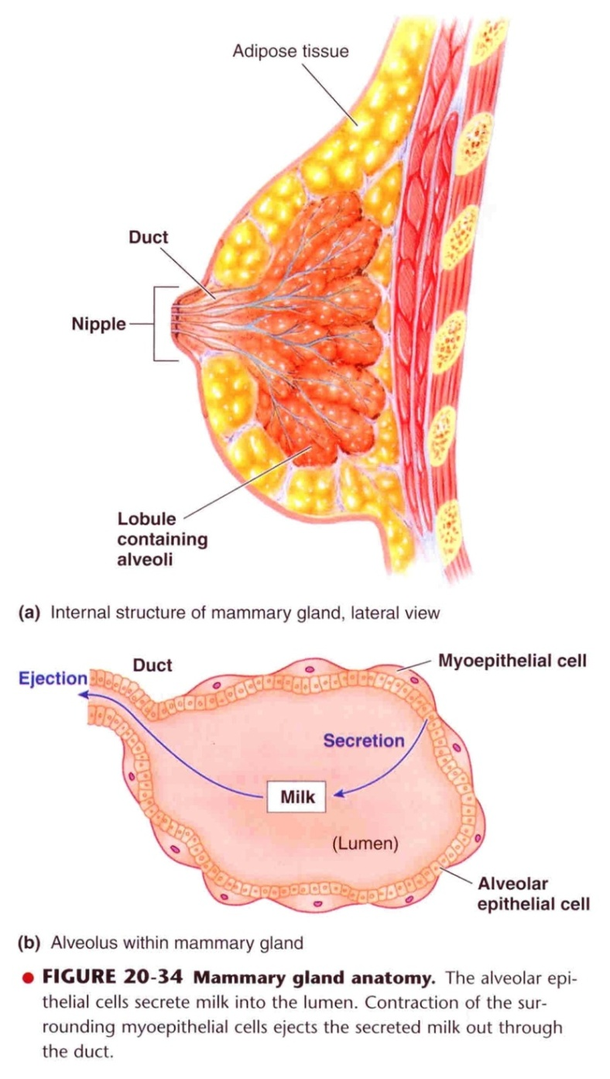

Slide 10
Mamogenesis

Slide 11
Fig. 1. Mammary gland development. The postnatal development of female mammary tissue occurs in several steps regulated by hormones. At birth, the mammary epithelium consists of limited ducts. At puberty, high levels of circulating hormones stimulate both the proliferation of the mammary epithelial cells (MECs) and the enlargement of the surrounding fat pad. At the onset of pregnancy, epithelial ducts elongate, branch and alveoli develop. During lactation, the mammary epithelium reach its maximal development containing numerous alveoli, which produce huge amounts of milk. Upon weaning, milk production ceases, the mammary alveoli regress (involution) and the mammary epithelium returns to a non-pregnant state.

Slide 12
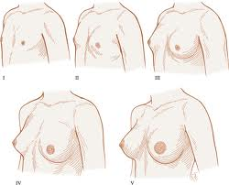
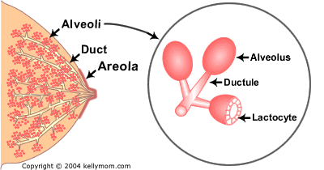
Breast development (mamogenesis)
During puberty
Estrogen stimulate proliferation of ducts and deposition of fat
Progesterone stimulate development of lobules

Slide 13
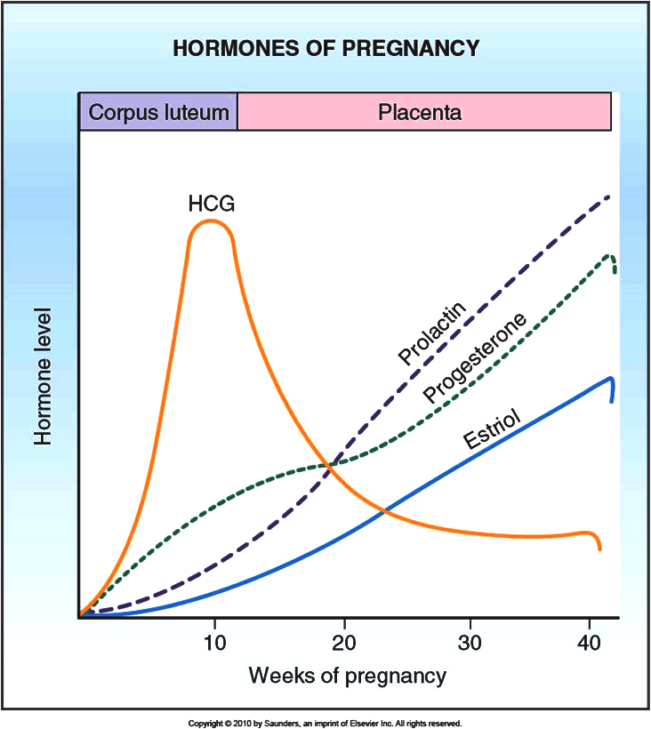
Breast development (mamogenesis)
During pregnancy
Complete development of glandular tissue

Slide 14
Breast development (mamogenesis)
Endocrine system plays a major role in synchronizing development (mamogenesis) and function (lactogenesis) of mammary gland with reproduction
Three categories of hormones:
Reproductive hormones (endocrine)
Estrogen, progesterone, prolactin, oxytocin and hPL
Metabolic hormones (endocrine)
GH, corticosteroids, thyroxin, PTH and insulin
Mammary hormones (autocrine)
GH, prolactin, parathyroid hormone-related protein (PTHrP) and leptin

Slide 15
Size of the breast & lactation

Slide 16
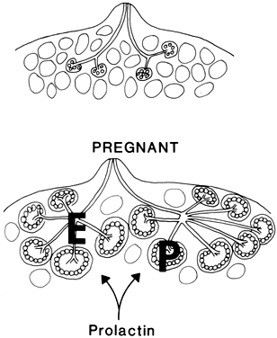
Breast development (mammogenesis)
Reproductive hormones (direct effect)
Estrogen (placenta)
Growth & branching of ductal system (with GH)
Fat deposition in the stroma
Progesterone (placenta)
Growth of lobule-alveolar system(budding of alveoli and secretory changes in epithelial cells )
Although estrogen and progesterone are essential for physical development of the breasts, they inhibit actual secretion of milk

Slide 17
Breast development (mamogenesis)
Prolactin (anterior pituitary)
Its level increases during pregnancy (10-20 times)
Its main function is milk production
Sudden drop in E & P after delivery allows milk production
It is controlled mainly by hypothalamic hormone
PIH (Dopamine)
Human placental lactogen (placenta)
Facilitate mammogenesis
Delay milk production

Slide 18
Lactogenesis

Slide 19
Lactogenesis
Lactogenesis: cellular changes by which mammary epithelial cells are converted from a non secretory state to a secretory state: 2 stages
Lactogenesis 1: (Cytologic and enzymatic differentiation of alveolar epithelial cells).
Starts in mid pregnancy and characterized by expression of many genes involved in synthesis of milk components (increase in the uptake transport systems for amino acids, glucose, and calcium required for milk synthesis).
Hormones involved:
Progesterone (suppresses milk secretion)
Prolactin and/or placental lactogen
Growth hormone
Glucocorticoids (Cortisol)

Slide 20
Lactogenesis
Lactogenesis 2: (Copious secretion of all milk components).
Around parturition withdrawal of progesterone + high level of prolactin leads to:
Further increase in expression of milk protein genes
Glands absorb increased quantities of metabolic substrates from the blood.
Movement of cytoplasmic lipid droplets and casein into alveolar Lumina
Transfer of immunoglobulins
Secretion of colostrum followed by milk

Slide 21
Lactogenesis
Lactogenesis 2:
Suckling stimulates further increase in expression of genes involved in milk secretion with expansion of alveolar epithelium
Lactation is maintained by removal of milk
2 hormones involved
Prolactin (milk production)
Oxytocin (milk let-down)

Slide 22
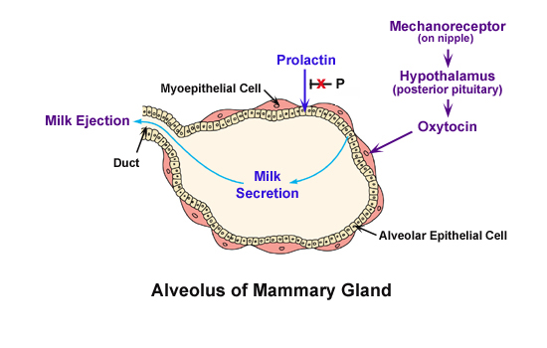

Slide 23
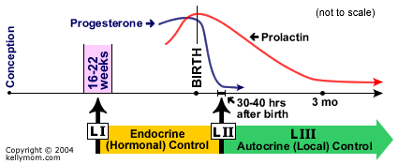
Stages of lactogenesis
Mamogenesis Lactogenesis Galctopoesis

Slide 25
Hormonal regulation of lactogenesis
Metabolic hormones (direct effect)
GH
Can be produced locally
Its secretion is stimulated by progesterone
Increases production of IGF-1 by the liver and locally.
Mediate cell survival and ductal growth
Corticosteroids
Increases during pregnancy (five fold)
Involved in breast development (permissive action on milk protein synthesis)

Slide 26
Hormonal regulation of lactogenesis
Thyroxin
Essential for milk production
Thyroxin & TSH level decreases during lactation
TRH increases leading to stimulation of PRL (nasal administration to treat inadequate lactation )
Insulin
Low during lactation
Shunt of nutrients from storage depots to milk synthesis

Slide 27
Hormonal regulation of lactogenesis
Mammary hormones
GH
Progesterone stimulates its secretion
Leptin
Increases during pregnancy (increase adipose tissue)
Decreases with lactation
PTHrP
Increases during lactation
Mobilizes bone calcium
Increase in alkaline phosphatase

Slide 28
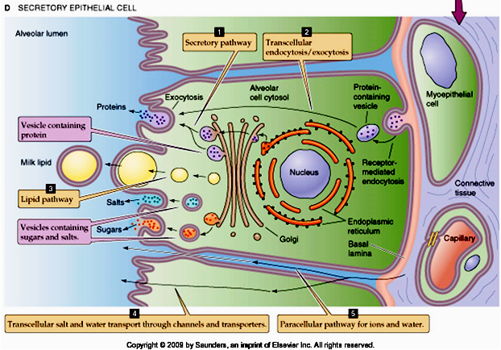

Slide 29
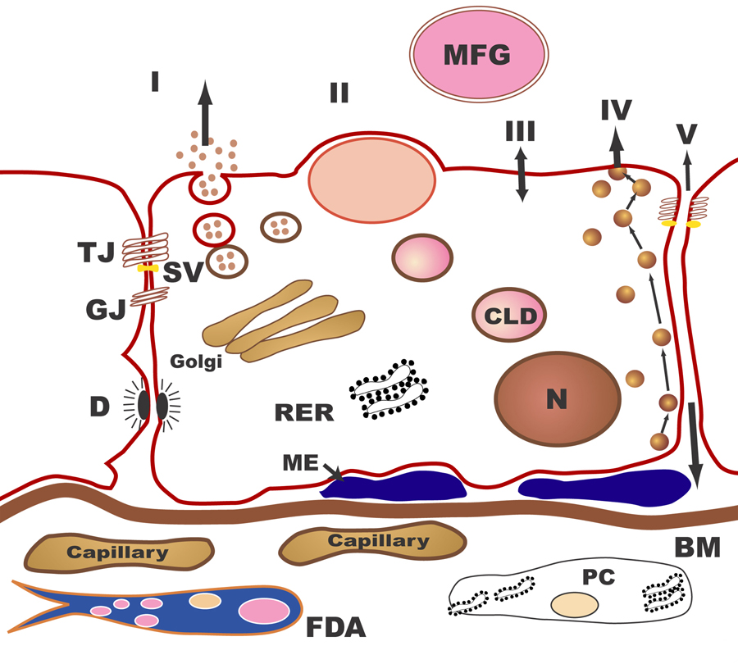
The pathways for milk secretion and synthesis by the mammary epithelial cell. I: Exocytosis of milk protein, lactose, and other components of the aqueous phase in Golgi-derived secretory vesicles. II: Milk fat secretion via the milk fat globule. III: Direct movement of mono valent ions, water, and glucose across the apical membrane of the cell. IV: Transcytosis of components of the interstitial space. V: The paracellular pathway for plasma components and leukocytes. Pathway V is open only during pregnancy, involution, and in inflammatory states such as mastitis. SV = Secretory vesicle; RER = Rough endoplasmic reticulum; BM = Basement membrane; MFG = Milk fat globule; CLD = Cytoplasmic lipid droplet; N = Nucleus; PC = Plasma cell; FDA = Fat-depleted adipocyte; TJ = Tight junction; GJ = Gap junction; D = Desmosome; ME = Myoepithelial cell.

Slide 31
Galactopoeisis
Definition: Galactopoeisis is defined as the maintenance of lactation once lactation has been established.
Role of Hormones
Prolactin: milking-induced surge is a direct link between the act of nursing (or milk removal) and the galactopoeitic hormones involved in maintaining lactation.
Growth Hormone: support increase in synthesis of lactose, protein, and fat in the mammary gland
Glucocorticoids: galactopoeitic in physiological doses

Slide 32
Thyroid Hormones: galactopoeitic
Ovarian Hormones :
Estrogen in very low doses is galactopoietic
Progesterone alone has no effect on galactopoeisis because there are no progesterone receptors in the mammary gland during lactation

Slide 33
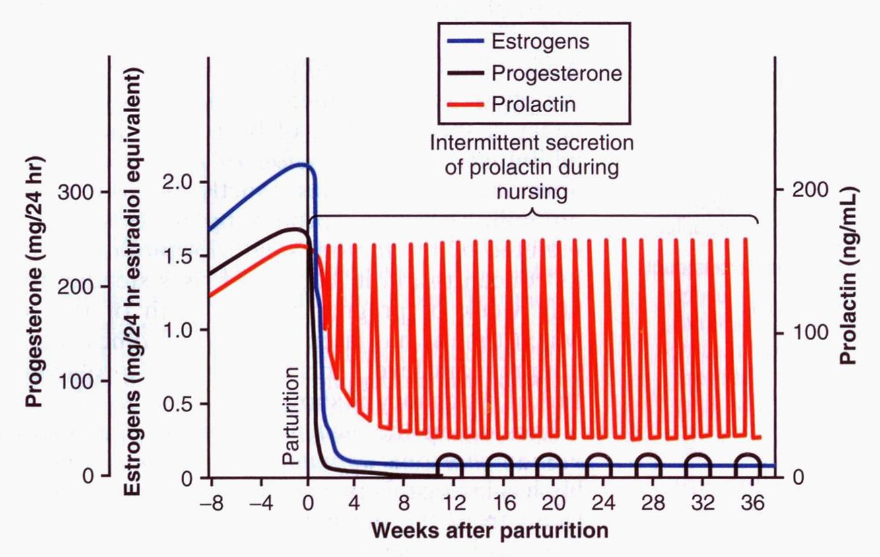

Slide 34
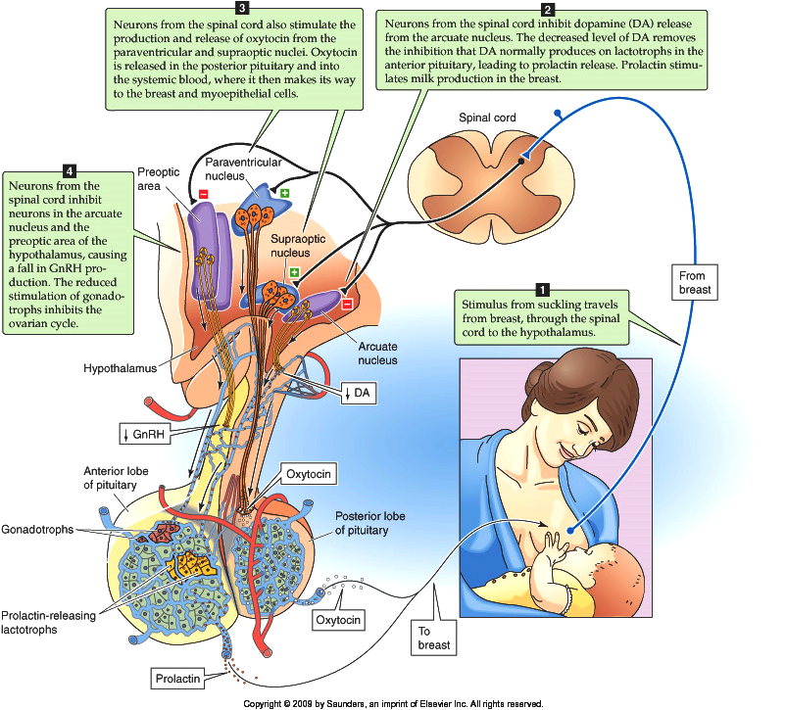
Suckling reflex

Slide 35
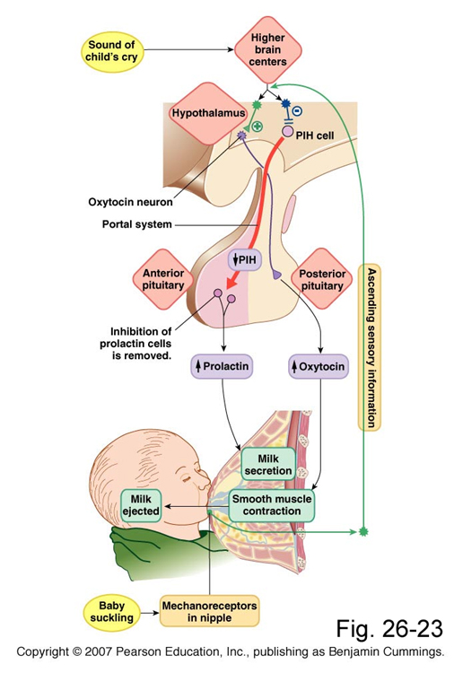
Suckling reflex

Slide 36
Milk production is a
"use it or lose it" process. The more often and effectively the baby nurses, the more milk will be produced
Milk production <100 ml/day in day 1 postpartum
Milk production by day 3 reaches 500 ml/day
Milk composition changes dramatically(↓Na⁺²& Cl⁻ ) due to closure of tight junctions that block paracellular pathway

Slide 37
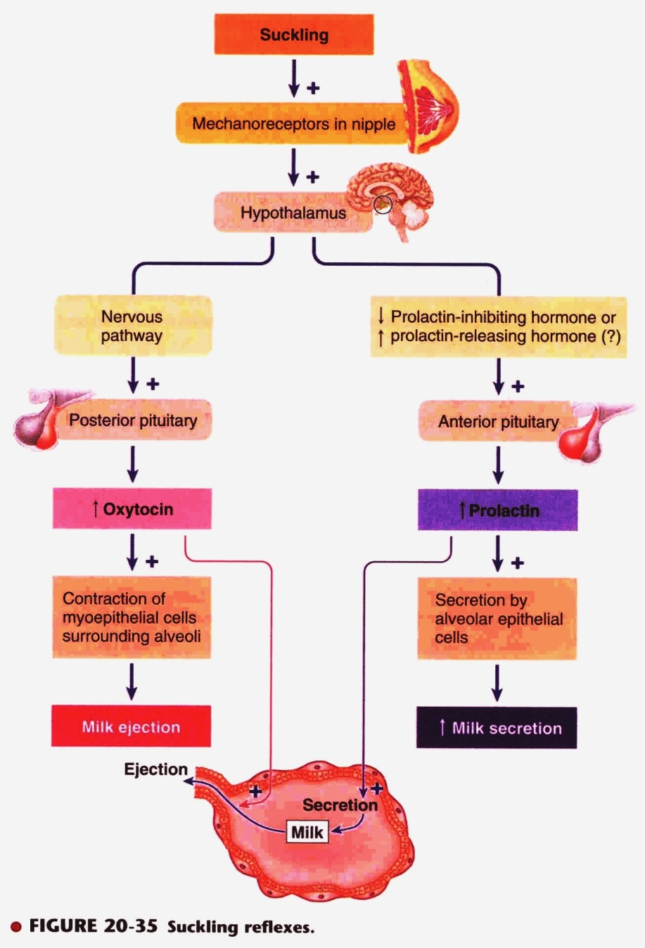

Slide 38
يقول تعالى(والوالدات يرضعن أولادهن حولينِ كاملين لمن أراد أن يُتمَّ الرضاعة) [البقرة :233] .
وفي إشارة علمية دقيقة أخرى للقرآن الكريم نراه يحدد مدة الرضاعة بما يقرب من الحولين ، في الآية رقم (14) في سورة لقمان: (ووصينا الإنسان بوالديه حملته أمه وهنـًا على وهن وفصاله في عامين) ،
والآية (15) في سورة الأحقاف] : حملته أمه كرهـًا ووضعته كرهـًا وحمله وفصاله ثلاثون شهرا)
ويُفهم من هذا أن إرضاع الحولين ليس حتمـًا ، بل هو التمام ، ويجوز الاقتصار على ما دونه ، كما أشارت الأحكام الإسلامية الخاصة بالرضاعة إلى ذلك ، اعتماداً على قوله تعالى(فإن أرادا فصالاً عن تراضٍ منهما وتشاورٍ فلا جناح عليهما) الآية 233 البقرة .

Slide 39
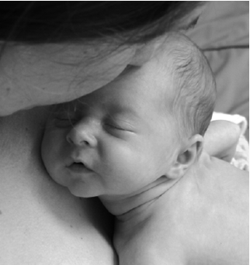
AAP Recommendations
Exclusive breast feeding for the first six months of life
Continued breast feeding for at least one year, ‘As long as is desired by mother and child’.
American Academy of Pediatrics (2005). "Breastfeeding and the Use of Human Milk." Pediatrics 115(2): 496-506.

Slide 40
Failure of breast feeding

