Slide 2
Objectives
At the end of the lecture, students should be able to:
Boundaries of the perineum.
Division of perineum into two triangles.
Boundaries & Contents of anal & urogenital triangles.
Lower part of Anal canal.
Boundaries & contents of Ischiorectal fossa.
Innervation, Blood supply and lymphatic drainage of perineum.

Slide 3
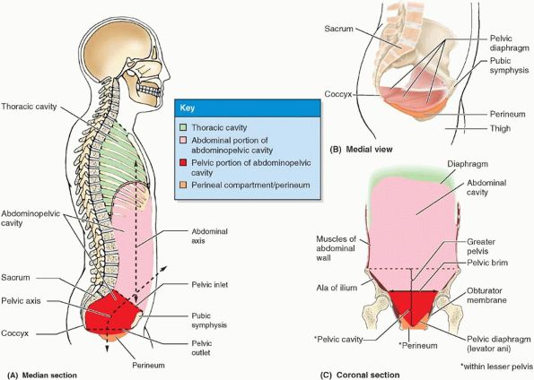
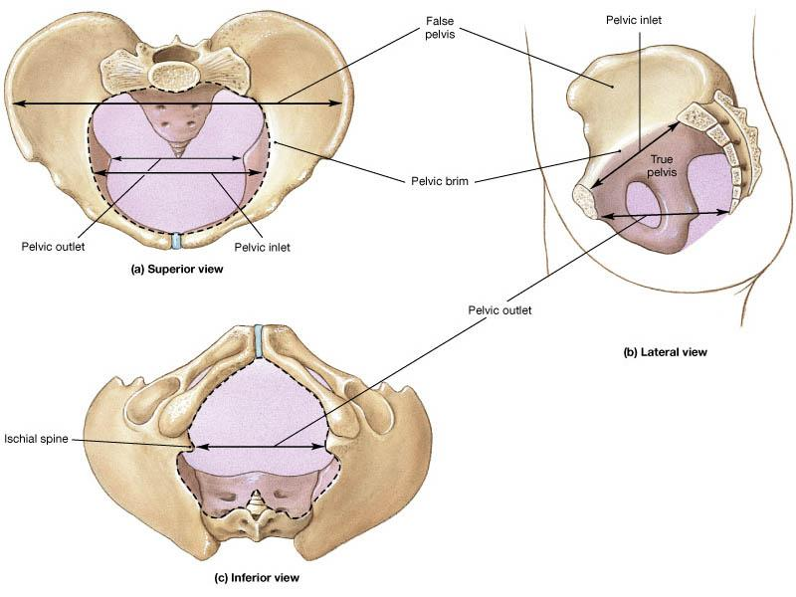
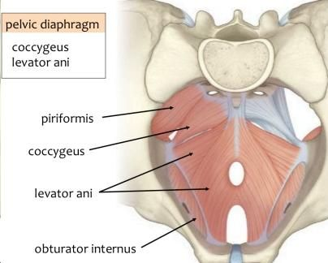
From team437
Introduction
The trunk is divided into 4 main cavities: thoracic, abdominal, pelvic, and perineal. (see image 1)
The pelvis has an inlet and an outlet. (see image 2) The lowest part of the pelvic outlet is the perineum.
The perineum is separated from the pelvic cavity superiorly by the pelvic floor.
The pelvic floor or pelvic diaphragm is composed of muscle fibers of the levator ani, the coccygeus muscle, and associated connective tissue. (see image 3) We will talk about them more in the next lecture.
Image (1)
Image (2)
Image (3)
Note: this image is seen from ABOVE

Slide 4
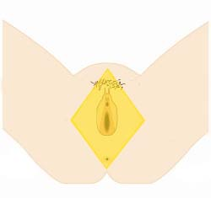
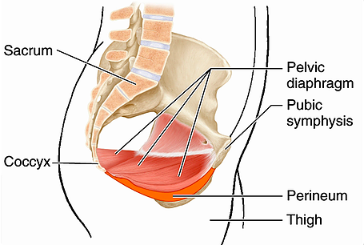
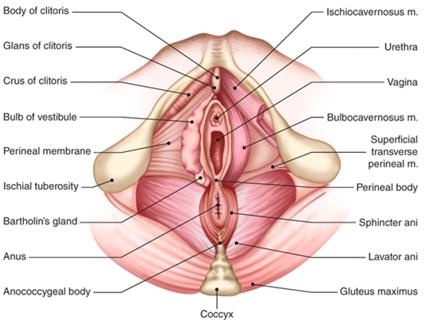
Perineum
It is the region of the body below the pelvic diaphragm (The outlet of the pelvis) It is a diamond shaped area between the thighs
External Boundaries | Anterior → Mons pubis Posterior → Intergluteal folds Lateral → Medial surfaces of the thighs
bony boundaries | Anterior → Symphysis pubis Posterior → Coccyx Lateral → Ischiopubic rami, ischial tuberosities & sacrotuberous ligaments* *ligament between sacrum & ischial tuberosity
Contents | Perineal body, Anococcygeal body & External genitalia Lower ends of urethra, vagina & anal canal
Division | By an imaginary line passing through two ischial tuberosities, it is divided into: Anterior → Urogenital triangle contain: vulva, urethra & vagina Posterior → Anal triangle contain: anal canal

Slide 5
Perineal Body
It is an irregular fibromuscular mass of variable size and consistency
Located at midpoint of the line between the ischial tuberosities
Lies in the subcutaneous tissue, posterior to vaginal vestibule and anterior to the anal canal & anus
Forms the central point of the perineum & blends anteriorly with the perineal membrane
Function:
Gives attachment to perineal muscles
Plays an important role in visceral support especially in female
It is a complex musculotendinous (more tendinous) structure
Located between the anterior aspect of the coccyx & the posterior wall of the anorectal canal
Function: Receives insertion of fibers of levator ani muscle
Anococcygeal Body

Slide 6
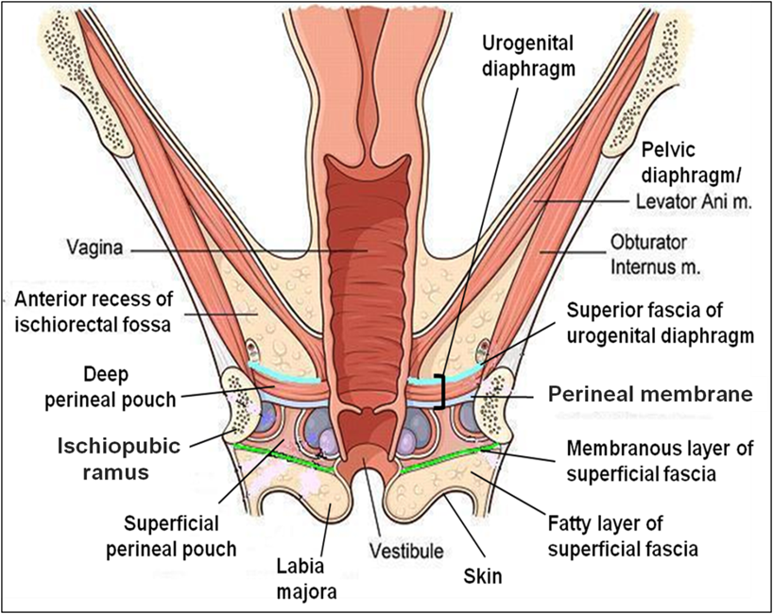
Urogenital Triangle
Bony Boundaries | Anterior → Symphysis pubis SAME anterior boundary of perineum Posterior → Transverse line passing through the 2 ischial tuberosities Lateral → Ischiopubic rami & ischial tuberosities
Contents | External genitalia (vulva), Lower ends of urethra & vagina
Urogenital Diaphragm | located in the anterior part of the perineum (in the urogenital triangle) Fills in the gap between the pubic arch Composed of: Sphincter urethrae and the deep transverse perineal muscles enclosed within the superior and inferior layers* of fascia of the urogenital diaphragm *inferior layers formed by the perineal membrane
Fascia of Urogenital Triangle (Perineal Fascia) | It is continuous anteriorly with the fascia of abdomen and consists of two layers: Superficial perineal fascia, consists of: Superficial fatty layer (Camper’s fascia) makes up the substance of mons pubis & labia majora and extends into the anal region Deep membranous layer (Colle’s fascia) Does NOT extend to anal region Becomes fused with the posterior margin of the perineal membrane Deep perineal fascia invests the muscles in the superficial perineal pouch
Sphincter urethrae

Slide 7
IMPORTANT
Perineal Pouches
Pouches= space
Superficial Perineal Pouch
It is the space between the deep membranous layer of superficial fascia of perineum (Colle’s fascia) and the perineal membrane
Boundaries | Superior → perineal membrane Inferior → membranous layer of superficial fascia (Colle’s fascia) Lateral → ischiopubic rami
Contents (Important) | Bulbs of vestibule: on each side of vaginal orifice Crura of clitoris Superficial perineal muscles: Bulbospongiosus muscle, surrounds orifice of vagina and covers vestibular bulb Ischiocavernosus muscle, covers crus of clitoris on each side Superficial transverse perineal muscles Greater vestibular glands: on each side of vaginal orifice Perineal branch of pudendal nerve supplying muscles & skin
Sphincter urethrae

Slide 8
Perineal Pouches
Pouches= space
Deep Perineal Pouch
It is a completely closed space deep to the perineal membrane
Boundaries | Superior → Superior fascia of the urogenital diaphragm Inferior → Inferior fascia of the urogenital diaphragm (Perineal membrane) Lateral → Inferior portion of obturator internus fascia
Contents | Part of urethra Part of vagina Sphincter urethrae and Sphincter vaginae muscles, which is pierced by urethra & vagina Deep transverse perineal muscles Internal pudendal vessels Dosal nerve of clitoris (branch of Pudendal nerve)
Sphincter urethrae

Slide 9
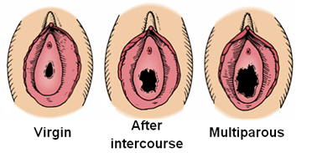
IMPORTANT
External Genitalia (Vulva)
The external genital organs of the female are collectively known as the vulva (also called the pudendum) is comprised of many different structures:
Mons pubis : a collection of fat overlying the pubes
Labia majora & Labia minora (Labia=flaps) | Clitoris
Vestibule of vagina: The interval or area between the two labia minora
Vagina & urethra open into the vestibule through urethral orifice anteriorly and vaginal orifice posteriorly
The vagina is a muscular canal that leads from the lower part of uterus to the external orifice of the genital canal
It measures about 3 in (8 cm) long while Anal canal 1.5 in
It serves as the excretory duct for the menstrual flow & forms part of the birth canal
The vaginal orifice in a virgin (بِكر=عذراء) possesses a thin mucosal fold called the hymen (غشاء البكاره), which is perforated (مثقب=مخرم) at its center to allow the menstrual blood to flow out, it lies posterior to the urethral orifice
Arteries:
Vaginal artery, a branch of the internal iliac artery
Vaginal branch of the uterine artery
Veins: drain into the internal iliac veins
Vagina

Slide 10
Anal Triangle
Boundaries | Anterior → Transverse line passing through the 2 ischial tuberosities Posterior → coccyx Lateral → ischial tuberosity & sacrotuberous lig
Contents | Lower part of Anal canal, Ano-coccygeal body & Ischiorectal fossa on each side (Ischiorectal fossa for dilation of anal canal)
Anal Canal
It is about 1.5 in long, descending from the rectal ampulla to the anus
Relations | Anterior → Perineal body, urogenital diaphragm, and lower part of vagina Posterior → Anococcygeal body Lateral → Ischiorectal fossae
Division | Upper half: derived from hindgut (endoderm) Lower half: derived from the proctodeum (ectoderm) The two parts have DIFFERENT blood supply, nerve supply and lymphatic

Slide 11
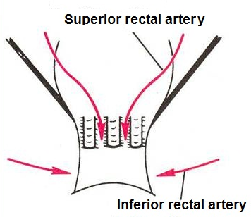
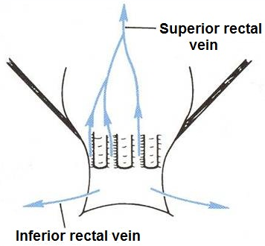
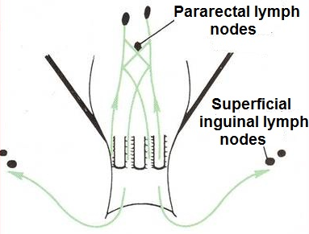
IMPORTANT
Anal canal (SUPPLY)
 | Arterial supply | Venous drainage | Lymphatic drainage | Nerves
Upper half hindgut (endoderm) | Superior rectal artery (continuation of the inferior mesenteric artery) | Superior rectal vein drained into the inferior mesenteric vein (portal circulation) | Para-rectal nodes drained into inferior mesenteric lymph nodes | (sensitive to stretch) Visceral motor (Inferior Hypogastric Plexus) (sympathetic & parasympathetic)
Lower half proctodeum (ectoderm) | Inferior rectal artery (branch of internal pudendal artery) | Inferior rectal vein drained into the internal pudendal vein (Systemic circulation) | Superficial inguinal lymph nodes | (sensitive to pain) Somatic motor & sensory nerves -(Inferior rectal nerve branch of pudendal nerve) supplies external sphincter muscle of the anus and the skin of the anal region

Slide 12
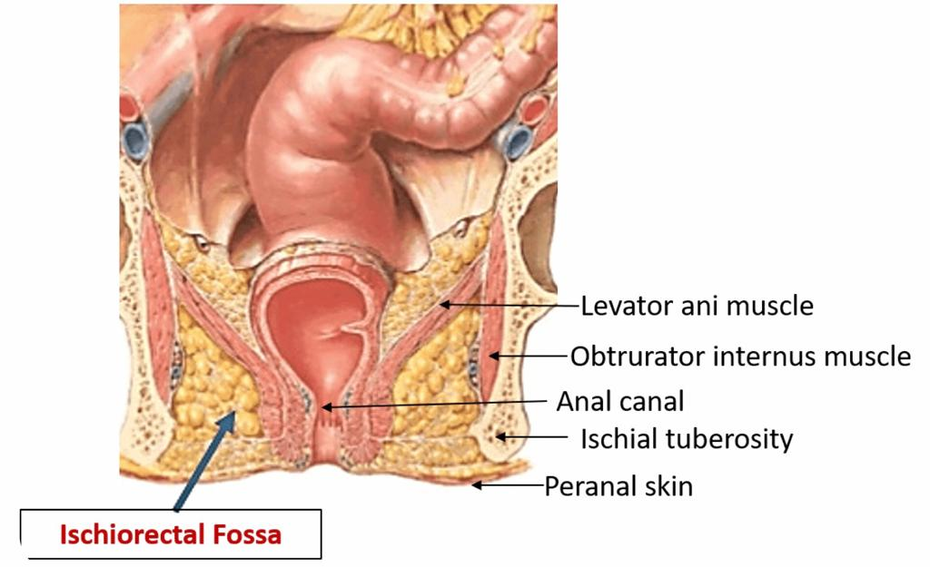
Anal Triangle
Ischiorectal Fossa
A fascial lined wedge-shaped space on each side of the anal canal
Boundaries | Base → Skin of the perineum Medial wall → Levator ani & anal canal Lateral wall → Obturator internus, covered with fascia
Contents | Dense fat Pudendal nerve & internal pudendal vessels within the pudendal canal Inferior rectal nerve & vessels crossing the fossa to reach anal canal
Pudendal Canal
A fascial canal formed by obturator fascia, located on the lateral wall of the ischiorectal fossa
Contents | Pudendal nerve Internal pudendal vessels

Slide 13
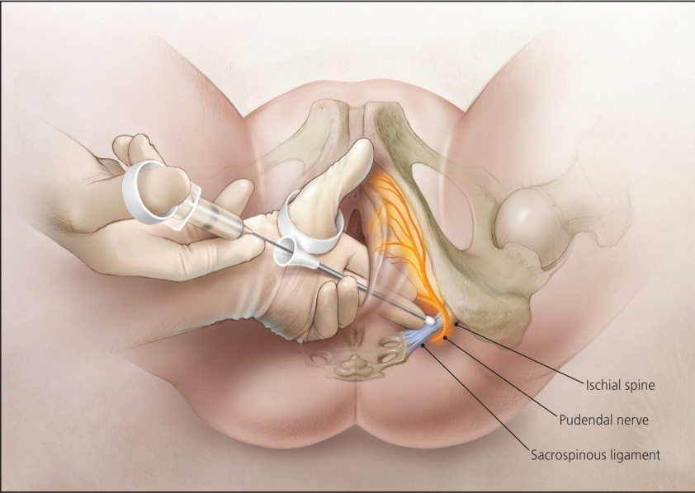
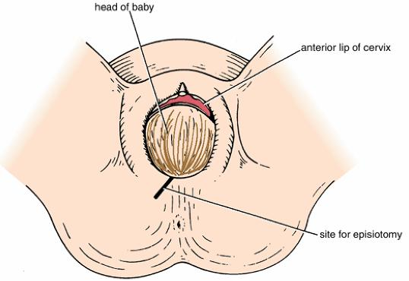
IMPORTANT
Pudendal Nerve Block
It is used in providing analgesia for the second stage of labour to provide anesthesia of the perineum in order to create and repair an episiotomy (surgically planned incision on the perineum and the posterior vaginal wall during second stage of labor to prevent perineal tear).
Can be done by transvaginally OR through perineal approach:
Transvaginal method: The needle is passed through the vaginal mucous membrane toward the ischial spine. After the needle is passed through the sacrospinous ligament, the anesthetic solution is injected around the pudendal nerve
Perineal method: The ischial tuberosity is palpated subcutaneously through the buttock. The needle is inserted on the medial side of the ischial tuberosity to a depth of about 1 in (2.5 cm) from the free surface of the tuberosity. The anesthetic is injected around the pudendal nerve.
REMEMBR! From Superficial to Deep
Skin
Superficial fatty layer (Camper’s fascia)
Deep membranous layer (Colle’s fascia)
Superficial Perineal Pouch
Perineal membrane
Deep Perineal Pouch
REMEMBR! From Anterior to Posterior
Clitoris
Urethra
Vagina
Perineal body
Anus
Anococcygeal body
Coccyx
The cut is made in an oblique line so we don’t cut the perineal body

Slide 14
From team437
Q1: All the following are contents of urogenital tringle except:
A) Urethra B) Vagina
C) Valva D) Anus
Q2:Which one of the following structures forms the center point of perineum?
A) Perineal body B) Ischial tuberosities
C) Anococcygeal body D) Coccyx
Q3: Which one of the following structures lie anterior to Urogenital Triangle?
A) Ischiopubic rami B) Ischial tuberosities.
C) External genitalia D) Symphysis pubis
Q4: Which of the following is a content of superficial perineal pouch?
A) Dosal nerve of clitoris
B) Perineal branch of pudendal nerve
C) Pudendal vein D) Pudendal artery
Q5: Which of the following is a lateral boundary to deep perineal pouch?
A) Inferior portion of obturator internus fascia
B) Superior portion of obturator internus fascia
C) Ischiopubic rami
D) Superior fascia of the urogenital diaphragm
Q6: Vaginal branch originates from which of the following arteries?
A) Internal iliac artery B) Ovarian artery
C) Uterine artery D) Inferior mesenteric artery
Q7: Which of the following vein drain the inferior rectal vein?
A) Uterine vein B) Internal pudendal vein
C) Superior mesenteric vein D) Inferior mesenteric vein
Q8: The fascia canal of pudendal canal formed by which of the following?
A) Deep perineal fascia B) Superficial perineal fascia
C) Obturator fascia D) Superior fascia of urogenital
1. D 2. A 3. D 4. B 5. A 6. C 7. B 8. C

