Slide 2
Objectives
At the end of the lecture, students should be able to:
Describe the anatomy of the pelvic wall, bones, joints & muscles.
Describe the boundaries and subdivisions of the pelvis.
Differentiate the different types of the female pelvis.
Describe the pelvic walls & floor.
Describe the components & function of the pelvic diaphragm.
List the arterial & nerve supply
List the lymph & venous drainage of the pelvis.

Slide 3
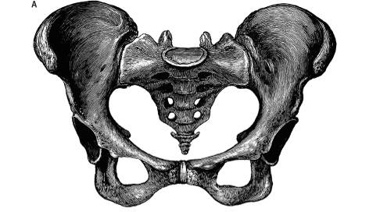
Introduction
The bony pelvis is composed of four bones:
Two hip bones, which form the anterior and lateral walls.
Sacrum and coccyx, which form the posterior wall.
These 4 bones are connected by 4 joints and lined by 4 muscles.
The bony pelvis with its joints and muscles form a strong basin-shaped (حوض) structure (with multiple foramina),
The pelvis contains and protects the:
(1) lower parts of the alimentary &
(2) urinary tracts &
(3) internal organs of reproduction.
The four joints are:
2- Two Sacroiliac joints. (Synovial joints)
Posteriolateraly
3- Sacrococcygeal joint (2ry Cartilaginous joint)
Posteriorly
Between sacrum & coccyx
1- Symphysis pubis (2ry Cartilaginous joint)
Anteriorly

Slide 4
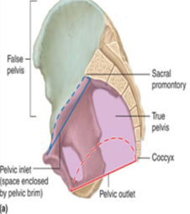
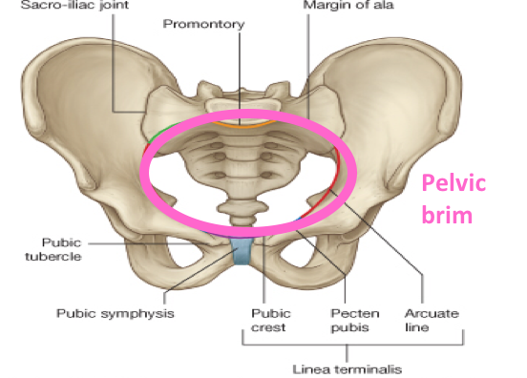
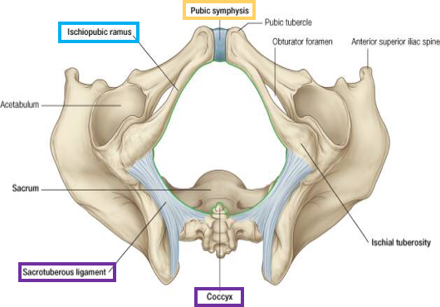
IMPORTANT
Pelvis
The pelvis is divided into two parts by the pelvic brim (inlet):
False or greater pelvis ABOVE the brim (part of the abdominal cavity) | It supports the abdominal contents Bounded by: Anteriorly → Lower part of the anterior abdominal wall Posteriorly → Lumbar vertebrae Laterally → Iliac fossae and the iliacus muscle
True or lesser pelvis BELOW the brim (3 parts) | 1. A Cavity: The cavity is a short, curved canal, with a shallow anterior wall and a deeper posterior wall (It lies between the inlet and the outlet)
 | 2. Inlet (Oval/circular shape): Anteriorly →Symphysis pubis (upper border) Posteriorly →Promontory & ala of sacrum Laterally → Ileopectineal (arcuate) lines
 | 3. Outlet (Diamond shape): Anteriorly →Symphysis pubis (lower border) Posteriorly →Tip of Coccyx Anterolaterally → ischiopubic ramus Posterolaterally →Sacrotuberous ligament

Slide 5
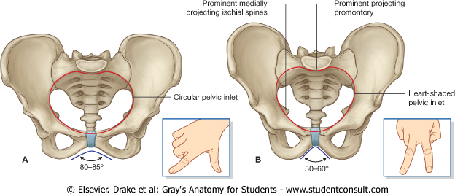
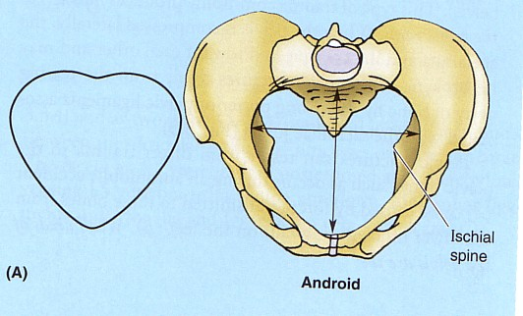
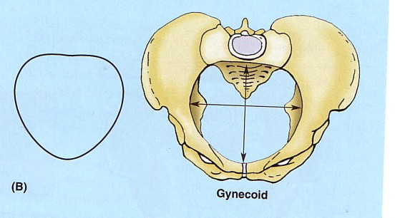
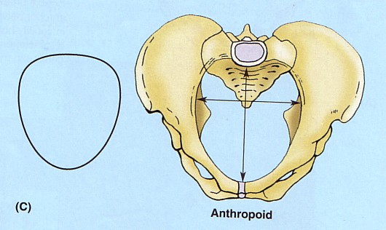
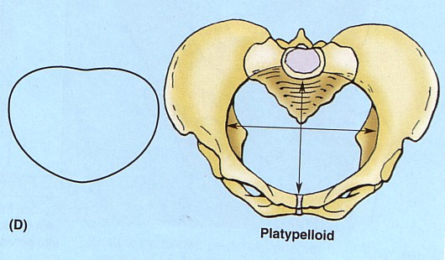
Pelvis
Main difference between male & female pelvis
In female:
The Sacrum is usually wider and shorter
The Angle of the pubic arch is wider
The promontory and the ischial spines are less projecting
In male:
The Sacrum is usually long, narrowest and curved
The promontory and the ischial spines are inverted
Types of Female Bony Pelvis:
Android (resembles male pelvis)
Gynecoid (typical female type)
Anthropoid (has both male and female characteristics)
Platypelloid (least common)
Information of the shape and dimensions of the female pelvis is of great importance for obstetrics
Why? because it is the bony canal through which the child passes during birth
Gynecoid is the only type that can give normal birth , the other three types can’t.
Female
Male

Slide 6
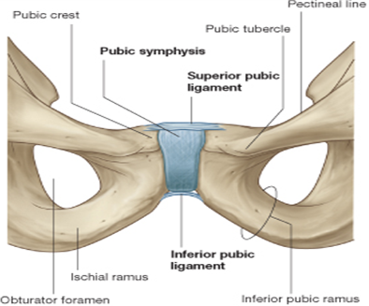
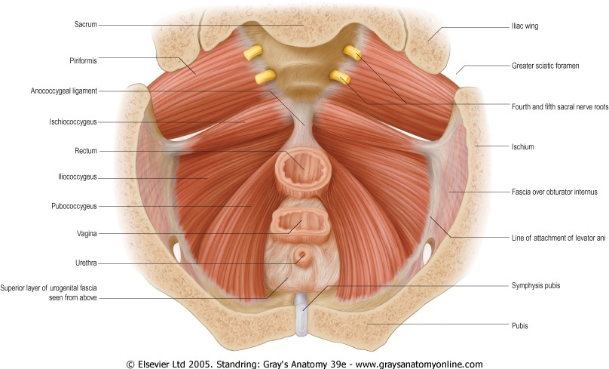
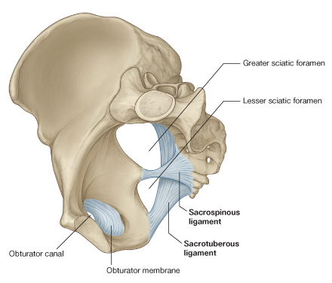
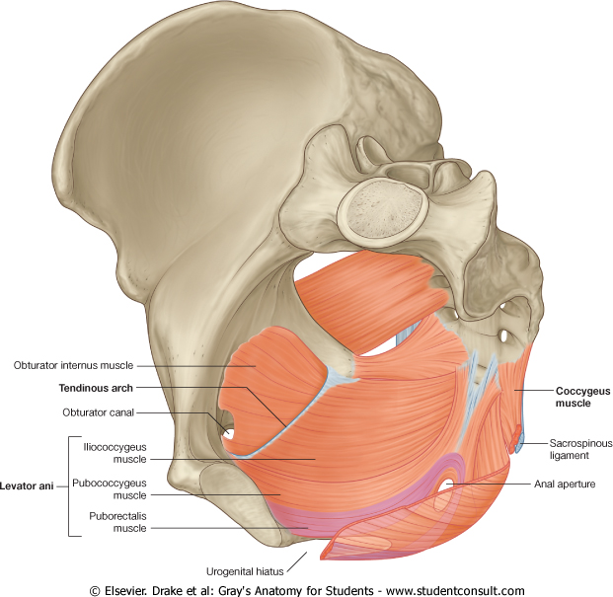
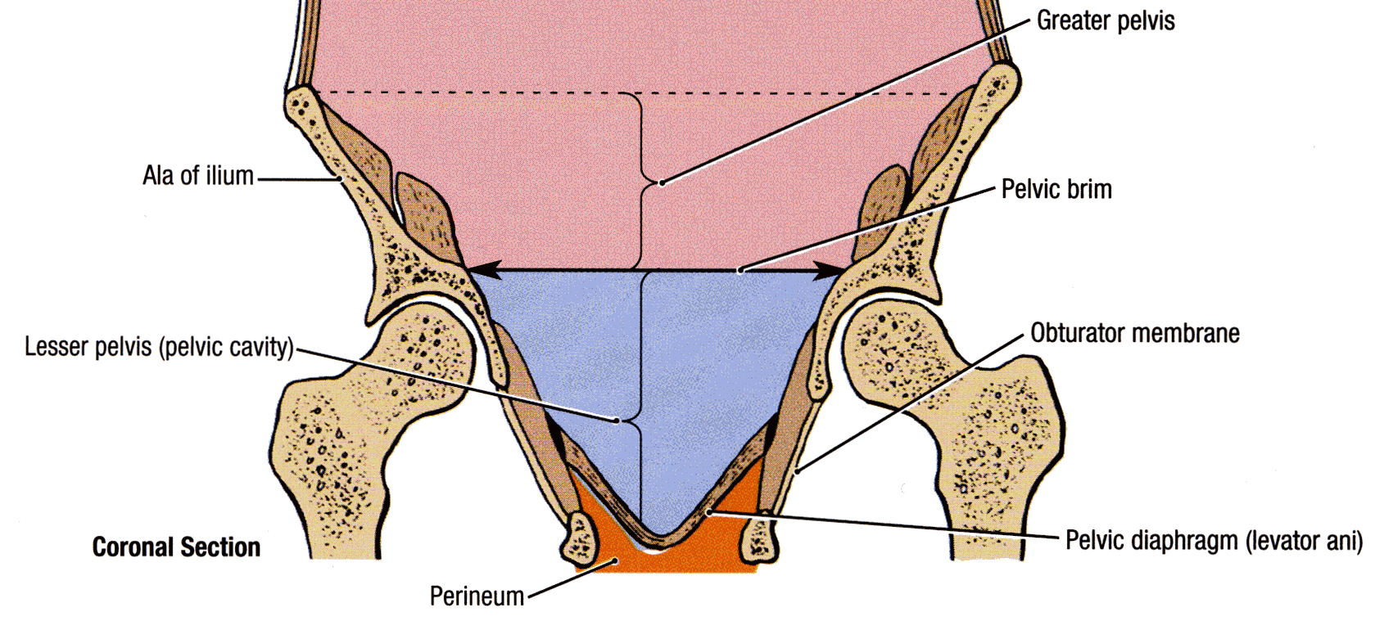
Pelvic Walls
10:26
The walls are formed by bones and ligaments that are lined with muscles covered with fascia and parietal peritoneum
2. Posterior pelvic wall deep & wide | 1. Anterior pelvic wall very narrow
It is large and deeper, Formed by: (1) Sacrum (2) Coccyx (3) Piriformis muscles (right and left) (4) Their covering of parietal pelvic fascia | It is the shallowest wall and is formed by only bones: (1) The posterior surfaces of the bodies of the pubic bones (2) The 2 pubic rami (3) The symphysis pubis
4. Inferior pelvic wall (floor) | 3. Lateral pelvic wall
Basin-like structure which supports the pelvic viscera and is formed by the pelvic diaphragm, It stretches across the lower part of the true pelvis and divides it into: Main (true) pelvic cavity above contains the pelvic viscera Perineum below which carries the external genital organs | It is formed by: (1) Part of the hip bone below the pelvic inlet (the arrow) (2) Obturator internus and its covering (obturator fascia) (3) Sacrotuberous ligament (4) Sacrospinous ligament

Slide 7
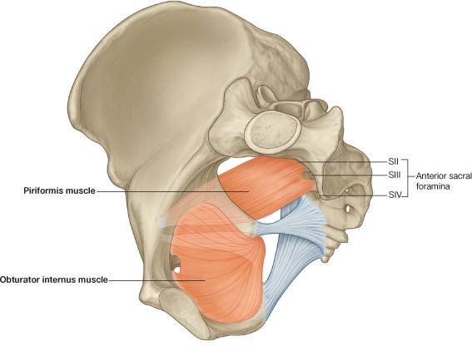
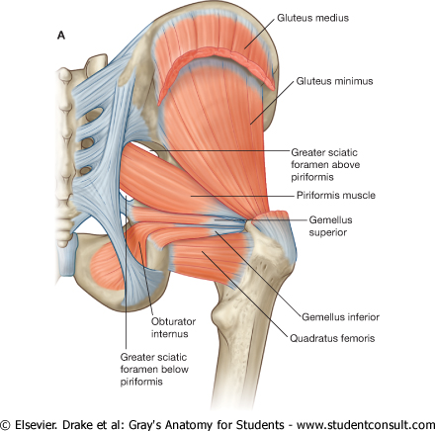
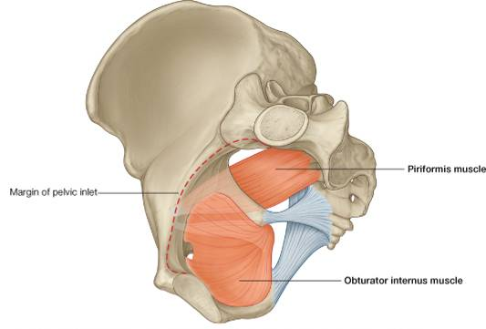
Pelvic Walls Muscles
Piriformis muscle (part of posterior pelvic wall)
Origin | Pelvic surface (in front of) the middle 3 sacral vertebrae S2,4 & 4 It leaves the pelvis through the greater sciatic foramen
Insertion | Greater trochanter of the femur
Action | Lateral rotator of the femur at the hip joint
Innervation | Sacral plexus (lies in front of the muscles)
Obturator internus muscle (part of lateral pelvic wall)
Origin | Inner surface of the obturator membrane and the hip bone It leaves the pelvis through the lesser sciatic foramen
Insertion | Greater trochanter of the femur
Action | Lateral rotator of the femur at the hip joint
Innervation | Nerve to obturator internus (from sacral plexus)

Slide 8
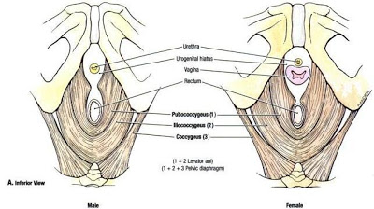
Pelvis Diaphragm
02:54
It is formed by the levator ani and the coccygeus muscles and their covering fasciae
It is incomplete anteriorly to allow passage of:
Urethra in males
Urethra and vagina in females
Posteriorly the muscles of each side meet together
LEVATOR ANI MUSCLE (wide thin sheet-like muscle that has a linear origin)
Origin (look at the dotted yellow line) | Back of the body of the pubis Tendinous arch of the obturator fascia Spine of the ischium (ischial spine)
Action | The muscles of the two sides form an efficient muscular sling that supports and maintains the pelvic viscera in position. (so if it is injured rectal or vaginal prolapse may occur) They resist the rise in intra pelvic pressure during the straining and expulsive efforts of the abdominal muscles (as in coughing) They have a very important role in maintaining fecal continence (puborectalis) by acting as a sphincter at the anorectal junction They serve as a vaginal sphincter in the female. (The most important muscle in labour is levator ani: should be relaxed so the vaginal sphincter isn’t closed)
Innervation | perineal branch of the fourth sacral nerve (S4) → upper surface perineal branch of the pudendal nerve → lower surface *The importance of the different supplies is if one of these nerves is affected, the other is still intact

Slide 9
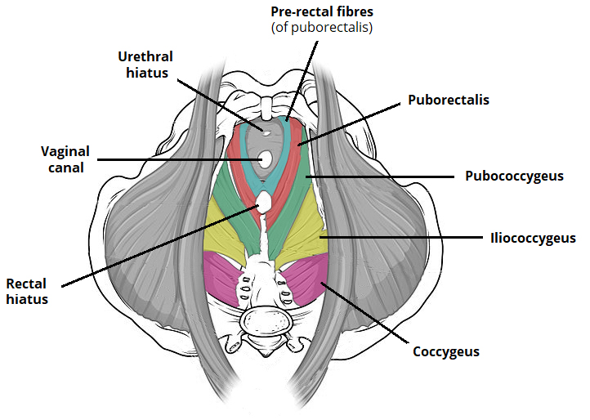
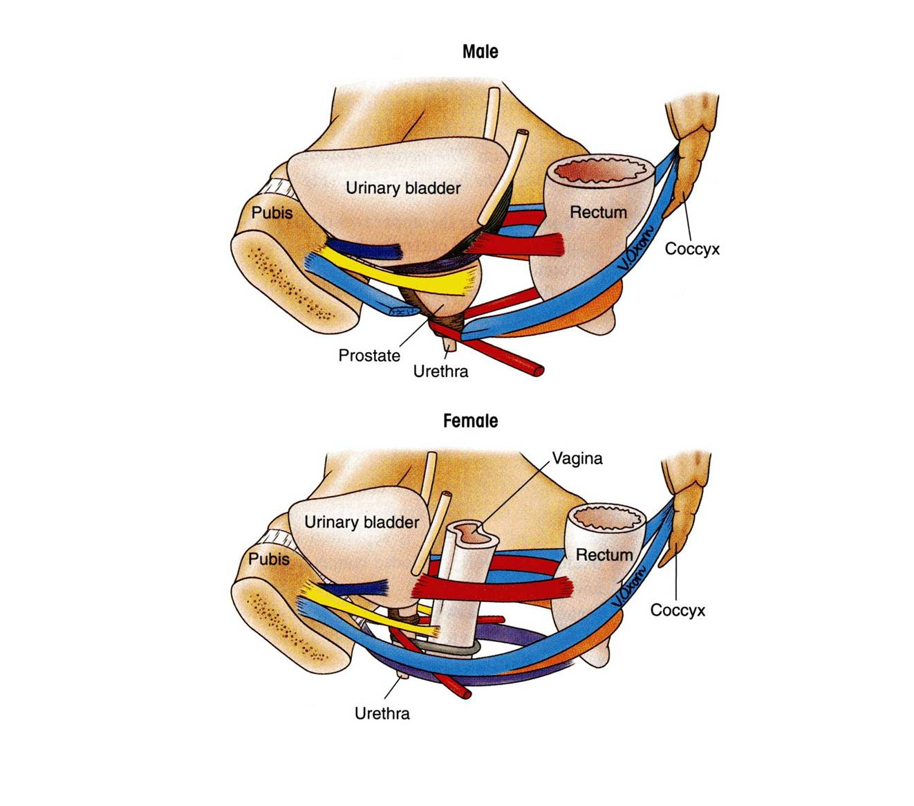
IMPORTANT
Levatores Ani Muscles
Its fibers are divided into 3 parts: According to direction
Pubococcygeus
Puborectalis
Iliococcygeus (Ischiococcygeus)
Pubococcygeus (Anterior Fibers)
Origin: originates from the posterior surface of the body of the pubis and passes downward & medially.
Insertion: inserted into the perineal body, anococcygeal body and coccyx.
Action: forms a sling around the prostate or the vagina*:
Extra
levator prostatae
Pubococcygeus
In males
Levator prostate:
Supports prostate.
Stabilizes perineal body.
In females
Sphincter vaginae:
Supports vagina.
Stabilizes perineal body.
*While the muscle goes from origin to insertion it surrounds these 2 organs (prostate or vagina) and supports them.
sphincter vaginae

Slide 10
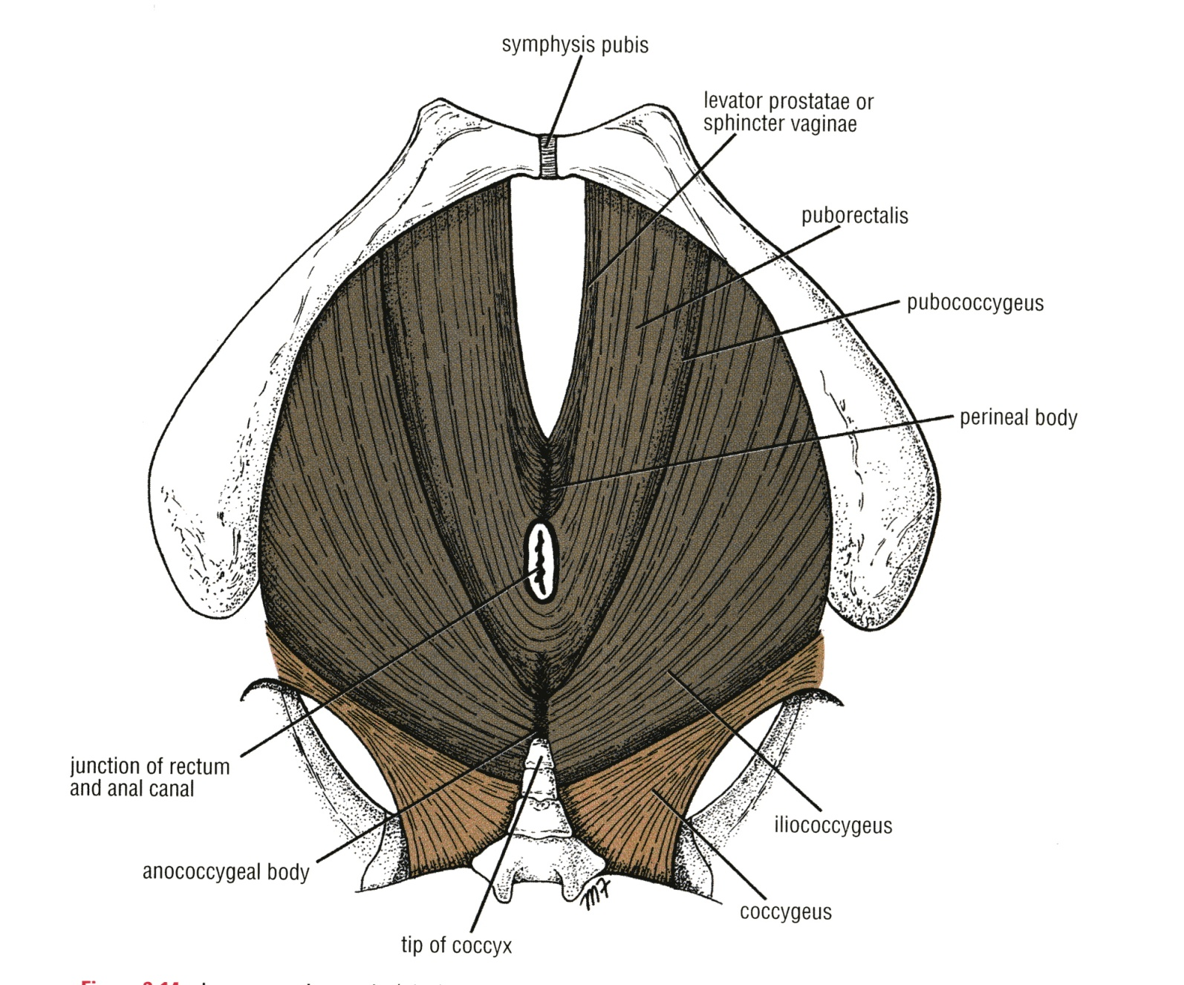
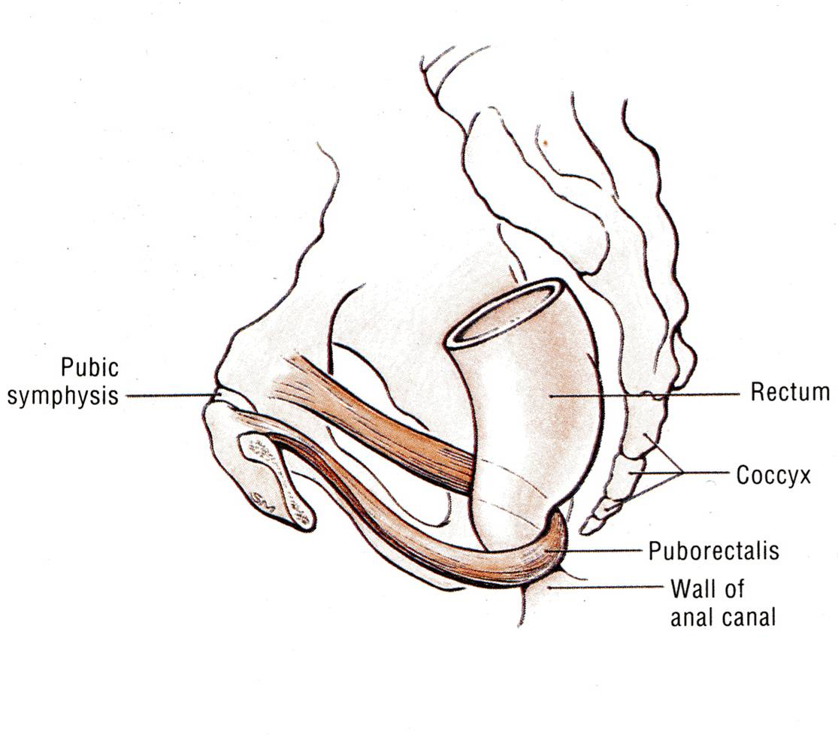
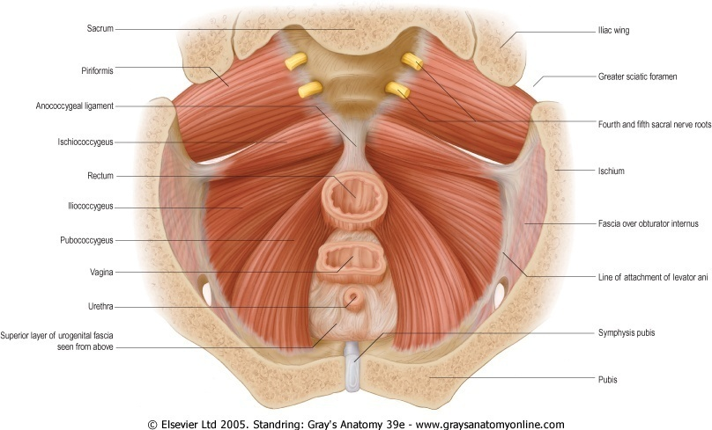
Levatores Ani Muscles
Intermediate Fibers:
2. Puborectalis ((شكلها زي لجام الخيل
forms a sling around the recto-anal Junction.
It has a very important role in maintaining fecal continence (تقسم البراز).
Its tone is important to maintain the angle between rectum & anal canal. When it relaxes, the angle is gone and defecation can occur
Posterior Fibers:
3. Iliococcygeus
Insertion: Inserted into the anococcygeal body and the coccyx
4. Ischiococcygeus
Origin: Arises from the ischial spine
Insertion: inserted into the anococcygeal body & coccyx.

Slide 11
Pelvis Diaphragm
COCCYGEUS MUSCLE*: small triangular muscle
Origin | Ischial spine | Coccygeus muscle has the same attachment as the sacrospinous ligament!
Insertion | Lower end of sacrum and coccyx
Action | Assist the levator ani in supporting the pelvic viscera
Innervation | branches of the 4th and 5th sacral nerves (S4 & S5)
*This muscle is bigger in animals because they have tails.

Slide 12
*Posterior division Supplies: (supplies only walls): Posterior abdominal wall | Posterior pelvic wall | Gluteal region
*Anterior division supplies: (supplies wall & viscera)
Gluteal region | Perineum | Pelvic viscera | The fetus (through the umbilical arteries)
Medial (adductor) region of thigh (by obturator artery)
Supply of the Pelvis
08:29
Arterial supply
Internal iliac artery (IIA): One of the 2 terminal branch of the Common iliac artery
Course |  | Arises in front of the sacroiliac joint It descends downward & backwards over the pelvic inlet It divides at the upper border of the greater sciatic foramen into: Anterior & Posterior divisions
Branches
Posterir division | Parietal |  | Iliolumbar artery Lateral sacral arteries (2 branches) Superior gluteal artery
Anterior division |  |  | Obturator artery Inferior Gluteal artery
 | Visceral |  | Umbilical artery : gives the superior vesical artery: the distal part of this artery fibrosed and forms the medial umbilical ligament. Inferior Vesical artery in male or vaginal in female: In the male it supplies the Prostate and the Seminal Vesicles. It also gives the artery of the Vas Deferens. Middle rectal artery Internal pudendal artery: It is the main arterial supply to the perineum
 | Visceral (In Female) |  | Vaginal artery: Replaces the inferior vesical artery Uterine artery*: Crosses the Ureter superiorly and supplies the uterus & uterine tube
Ovarian artery (in female): Arises from the abdominal aorta
*recall the arteries that have tortuous course:
Facial artery
Splenic artery
Uterine artery
*may be wrongly ligated (cut) in hysterectomy
* Supplies urinary bladder:
In male (superior and inferior vesical arteries)
In female (superior vesical & vaginal artery)
The abdominal aorta divides into 2 common iliac arteries. Then at the sacroiliac joint the common iliac divides into external and internal iliac arteries. The external iliac continues as the femoral artery, while the internal iliac supplies the pelvis and perineum. Then at the greater sciatic foramen the internal iliac divides into anterior and posterior divisions.

Slide 13
Supply of the Pelvis
Venous drainage The veins correspond to the arteries
Internal iliac veins | It collect tributaries corresponding to the branches of the internal iliac artery joins the external iliac vein in front of the sacroiliac joint to form the common iliac vein (the common iliac veins join at the level of L5 to give the inferior vena cava)
Ovarian vein | Right vein drains into IVC Left vein drains into left renal Vein
Lymphatic drainage
The lymph nodes and vessels are arranged in a chain along the main blood vessels Thus, there are external iliac nodes, internal iliac nodes, and common iliac nodes Lymph from Common iliac nodes & the (Ovaries, uterine tubes & fundus of uterus) passes to Lateral aortic (paraortic) nodes
Nerve Supply
Somatic | Sacral plexus: from ventral (anterior rami) of L4 & L5 (lumbosacral trunk) + S1, S2, S3 and most of S4 It gives pudendal nerve to perineum
Autonomic | Sympathetic (Pelvic part of sympathetic trunk): It is the continuation of the abdominal part of sympathetic trunk. It descends in front of the ala of the sacrum The 2 sympathetic trunks unite inferiorly in front of the coccyx and form a single ganglion (Ganglion Impar) Superior & Inferior Hypogastric plexuses Parasympathetic (Pelvic splanchnic nerves) (From S2, 3 & 4): preganglionic fibers to pelvic viscera & hindgut
which then passes to cisterna chyli (thoracic duct)

Slide 14
1- The bony pelvis is composed of four bones :
A-are connected by 3 joints and lined by 4 muscles.
B-are connected by 4 joints and lined by 3 muscles.
C-are connected by 4 joints and lined by 4 muscles.
D-are connected by 2joints and lined by 8 muscles.
6- A 28 year old women ,school teacher from Dublin had a positive pregnancy test. Her obstetrician informed her that it is impossible for her to deliver normally because of the type of her bony pelvis ,which of the following types of pelvis can have normal vaginal delivery?
A- Gynecoid Pelvis
B- Android Pelvis
C- Anthropoid Pelvis
D- Platypelloid Pelvis
2- The Sacroiliac joints is:
A- Anteriolateral cartilaginous join
B-posteriomedial cartilaginous joint
C- posteriolateral Synovial joint
D- Anteriomedial Synovial joint
7- No muscles are found in:
A- The anterior pelvic wall B- The posterior pelvic wall
C- The lateral pelvic wall D- The medial pelvic wall
3- The False pelvis is bounded by:
A- T11 B-C6 C-L1 D-S2
8- Which of the following is true about the piriformis muscle :
A- Origin from the Inner surface of the obturator membrane and the hip bone.
B- inserted in the pelvic surface of the middle 3 sacral vertebrae.
C- Supplied by the lumber plexus.
D- leaves the pelvis through the greater sciatic foramen.
4- Which of the following is true about the PELVIC INLET:
A- Bounded Posteriorly by the Coccyx
B- Bounded Anteriorly by the Ileopectineal (arcuate) lines.
C- Bounded lateraly by the Promontory of sacrum
D-Bounded posteriorly by the ala of sacrum.
9- Which of the following is true about the PELVIC DIAPHRAGM :
A- It is incomplete posteriorly to allow
passage of the anal canal.
B- it forms the INFERIOR PELVIC WALL.
C- Main (true) pelvic cavity below it.
D- formed by the levator ani and the coccygeus muscles without their covering
fasciae.
5- Which of the following is a female of the pubic arch angle:
A- 45 B- 65 C-75 D- 85
1-C 2-C 3-C 4-D 5-D 6-A 7-A 8-D 9-B

Slide 15
MCQs
10- Which one the following fibers of Levatores Ani muscles considered as the intermediate part?
Pubococcygeus
Ischiococcygeus
Iliococcygeus
14- The right ovarian vein drains into:
Renal vein
Common iliac vein
Inferior vena cava
15- The relaxation of which of the following muscle fibers lead to defecation?
Pubococcygeus
Puborectalis
Coccygeus
11- The Nerve supply to the Coccygeus muscle:
Branches of 4th and 5th sacral nerves
Branches of pudendal nerve
both
12- The medial umbilical ligament results from?
Fibrosed umbilical vein
Fibrosed umbilical artery
Superior vesical artery
16- The ovarian artery originate from:
Uterine artery
Abdominal aorta
Internal iliac artery
17- Woman is undergoing hysterectomy and during the ligation of uterine artery which of the following will be endanger:
Ureter
Urinary bladder
Ovarian artery
13- Which of the following arteries supply the urinary bladder in female :
Uterine artery
Inferior vesical artery
Vaginal artery
10-C 11-A 12-B 13-C 14-C 15-B 16-B 17-A

