Slide 2
Objectives
At the end of the lecture, students should be able to:
List the different components of the male reproductive system.
Describe the anatomy of the primary and the secondary sex organs regarding: (location, function, structure, blood supply & lymphatic drainage).
Describe the anatomy of the male external genital organs
Great videos by AnatomyZone that give overview of the lecture →
03:45
07:10
03:46

Slide 3
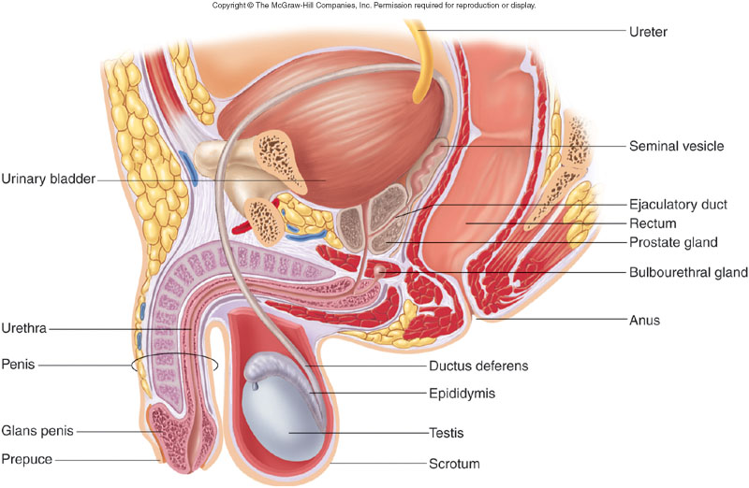
Components of male reproductive system:
1. Primary Sex Organ:
Testis.
2. Reproductive Tract:
Epididymis.
Vas Deferens also called Ductus Deferens.
Spermatic cord (vas deferens passes through it).
3. Accessory Sex Glands:
Seminal vesicles.
Prostate gland. biggest
Bulbourethral glands (cowper’s glands).
4. External Genitalia:
Penis
Urethra
You should know that:
Ejaculation is stimulated by the sympathetic
Erection is stimulated by the parasympathetic branch of the sacral plexus

Slide 4
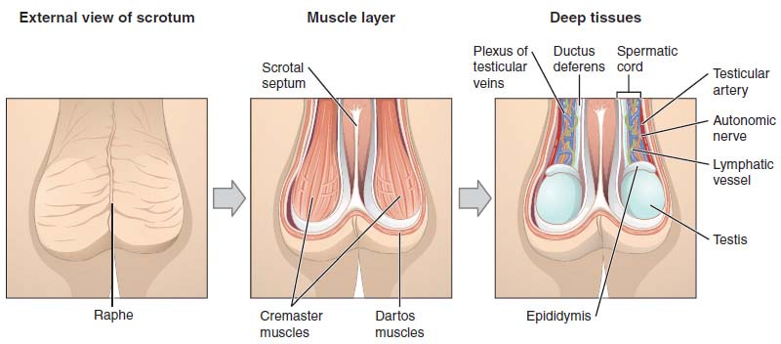
*Two reasons why the left testis is lower than the right one:
Because veins of left testicle drain into the left renal vein (which is small) and this will lead to engorgement, while veins of the right testicle drain into IVC ( which is big) and this will make the drainage much easier.
Sigmoid colon is located in the left side ( it contains feces) and therefore this disturbs the venous drainage.
Scrotum
An out pouching of loose skin & superficial fascia.
The left scrotum is slightly lower than the right*.
Function:
Houses and protects the testis.
Regulates testicular temperature (no superficial fat) → so the heat loss is fast.
It has thin skin with sparse hairs and sweat glands.
The Dartos muscle (regulates temperature of sperms) lies within the superficial fascia and replaces Scarp’s fascia of the anterior abdominal wall.
Testis or Testicle (singular), Testes (plural).
Paired almond-shape gonads that suspended in the scrotum by the spermatic cord.
Volume: about 20-25 ml / Length: 4 - 5 cm long / Weigh (10.5 – 14 g.).
Function: exocrine & endocrine
Spermatogenesis (primary sex organ).
Hormone production: (Androgens “testosterone”).
Testes
Contents of spermatic cord:
Vas deferens
Genital branch of genitofemoral nerve
3 arteries (testicular artery, cremasteric artery and artery of the vas)
Vein ( pampiniform plexus)
Sympathetic fibers
lymphatics
Cremasteric muscle
vestige of process vaginalis

Slide 5
Factors that allow the testes to descend:
The upper half of the body grows faster than the lower half, which will help with the descending
The growing viscera ( liver, intestine) increases the abdominal pressure and helps with the descending
Fibrous band connecting the skin of the scrotum and the lower pool of the testis ( it shrinks, and the shrinkage pulls the testis downward (gubernaculum)
tunica vaginalis
Testes
Covering | 1. Tunica Vaginalis | Peritoneal covering, formed of parietal and visceral layers. It surrounds testis & epididymis. It allows free movement of testis within the scrotum. |  | 2. Tunica albuginea: | It is a whitish fibrous capsule.
Internal structure | -Fibrous septae extend from the capsule, dividing the testis into (200-300) lobules (average 250). -Each lobule contains, (1-3) seminiferous tubules. -Seminiferous tubules: (Each is a 60 cm coiled tubule). -They are the site of spermatogenesis. -They form the bulk of testicular tissue. -In between the seminiferous tubules lies the Interstitial cells of Leydig which secret Testosterone. -Rete testis: A network of tubules. It is the site of merging of the Seminiferous tubules.
SUPPLY | Arterial supply |  | Testicular artery (arises from the abdominal aorta at the level of L3)
 | Venous drainage |  | Pampiniform plexus of veins: About dozen veins which forms a network within the spermatic cord. They become larger as they approached the inguinal canal and converge (join) to form the Testicular vein: Right Vein drains into IVC | Left Vein drains into left renal vein.
 | Lymphatic drainage |  | Testicular Lymphatics: follow arteries and veins of the testis, End in Lumbar (par aortic) nodes. Scrotum, Penis and Prepuce : Terminate in Superficial inguinal nodes.
الجلده اللي يقطعونها في الختان

Slide 6
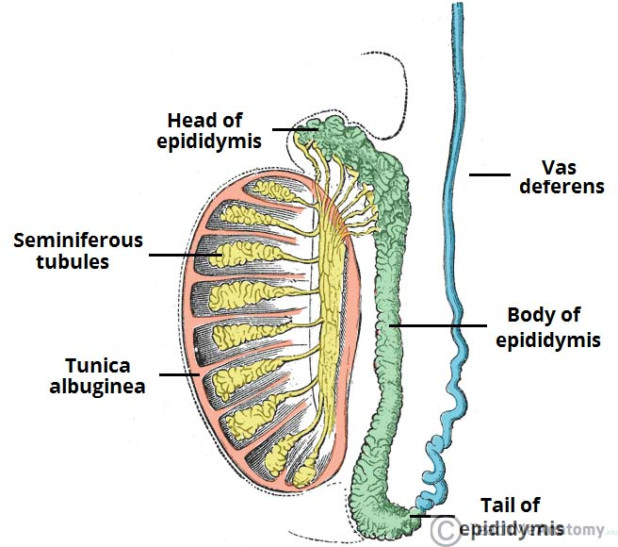
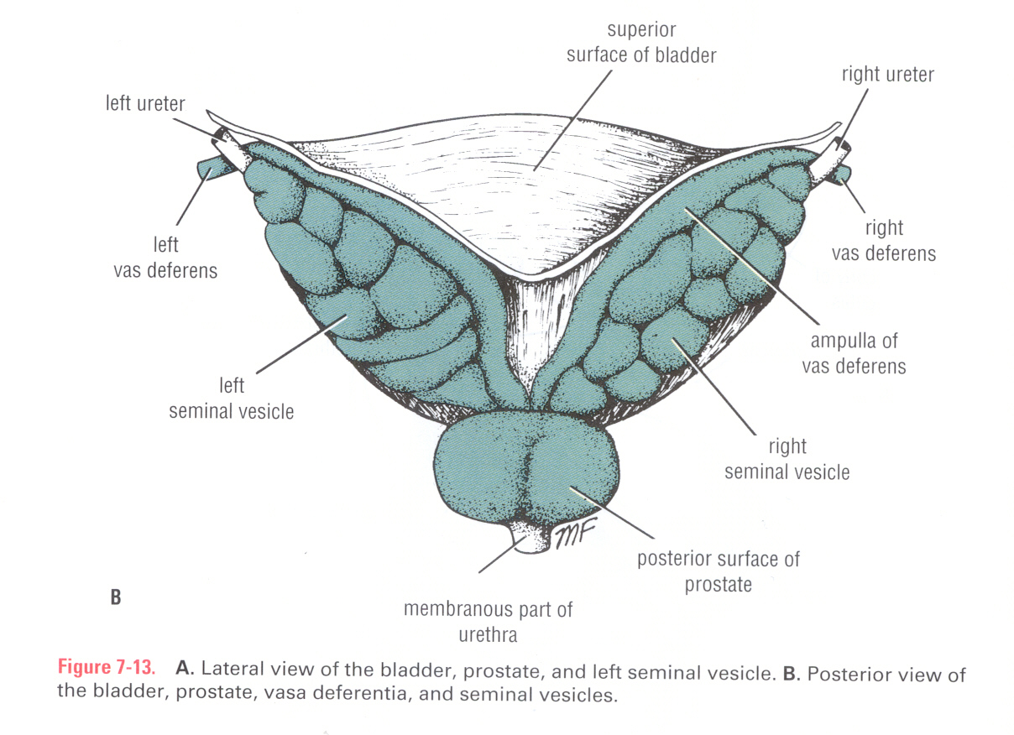
It joins the urethra in the prostate
Epididymis
Shape | It is a single coiled tubule (6 Meters long)
Location | superior and posterior margins of the testis
Parts | Head receives efferent ductules from the testis (rete testis) Body (It’s posterior with respect to Testis) |Tail is continuous with Vas Deferens
Functions | Secretes and absorbs the nourishing fluid Recycles damaged spermatozoa Stores spermatozoa up to 2 weeks to allow for physiological maturation of sperms
Vas Deferens
Shape | It is a muscular tube )45 cm long(
Function | Carries sperms from the epididymis to the pelvis (ejaculatory duct)
Course | Passes through the inguinal canal as one of the contents of the spermatic cord It crosses the lower end of the ureter Its terminal part is dilated to form the Ampulla of the vas deferens on the base of the urinary bladder. It joins the duct of the seminal vesicle to form ejaculatory duct which opens into the prostatic urethra. ( the posterior aspect)

Slide 7
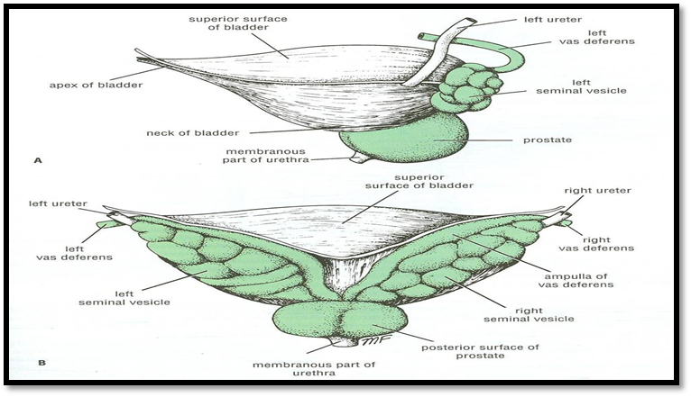
Ejaculatory Duct
Formed by the union of the lower end of the vas deferens and the duct of the seminal vesicle.
Its length is about 2.5cm.
The 2 ejaculatory ducts open into the prostatic urethra on both sides of the seminal colliculus.
They drain the seminal fluid into the prostatic urethra.
Seminal vesicle | Bulbourethral or Cooper’s glands | Prostate
Function:
Secretion of the seminal fluid.
Nourishing, activation & Protection of the sperms.
Remember: parts of male urethra
Prostatic → 3cm
Membranous → 1cm
Penile (spongy) → 16cm
Accessory Glands
 | Seminal Vesicles | Bulbourethral or Cooper’s glands
Shape | Paired elongated glands (SV). | Small paired glands
Location | posterior & inferior to the urinary bladder Lies lateral to the vas deference | At the base of the penis
Functions | Secrete (60% of seminal fluid) | Secrete alkaline mucus for Neutralization of urinary acids & Lubrication

Slide 8
Accessory Glands
 | Prostate Gland
Definition | The Largest male accessory gland, fibromuscular glandular tissue & walnut (عين الجمل) size
Shape CONICAL | Base | (superior): Attached to neck of urinary bladder
 | Apex | (Inferior): rests on the Urogenital diaphragm
 | Surfaces | Anterior, posterior and 2 lateral (right & left)
Location | Located at the neck of bladder Houses prostatic urethra
Functions | It secretes (20-30% of seminal fluid) remember Seminal Vesicles Secrete (60% of seminal fluid) It secretes enzymes (acid phosphatase) which has the following functions: Aid in activating sperm motility Mucus degradation Antibiotic Neutralize the acidity of urine & female reproductive tract (Alkaline fluid)
Capsule | Internally → it has a dense fibrous capsule (prostatic capsule) Externally → surrounded by a fibrous prostatic sheath The later (sheath) is continuous with the puboprostatic part of the levator ani muscle, (levator prostate). In between the prostatic capsule and the prostatic facial sheath lies the prostatic venous plexus (goes to internal vertebral venous plexus, cancers of prostate may metastasize to vertebrae, spinal cord and brain)

Slide 9
Accessory Glands
 | Prostate Gland
Relations | Anterior → Symphysis pubis Posterior → Rectum (important for per rectal examination) Superior →Neck of the bladder Inferior → Urogenital diaphragm Lateral → Medial margins of levator ani muscles (levator prostate)
Lobes (related to urethra) | Anterior lobe without secretion (isthmus) → Lies anterior to the urethra (fibromuscular) Posterior lobe → Posterior to the urethra and inferior to the ejaculatory ducts Lateral lobes (2) → On each side of the urethra Middle (median) → Between the urethra and ejaculatory ducts & closely related to neck of urinary bladder. Usually it projects into lumen of the bladder it elevates fold of mucous membrane (uvulae vesicae) distorting the internal urethral sphincter, after the age of 40 years. *The median & the 2 lateral lobes are rich in glandular tissue.
Urologists & Sonographers | They divide the prostate into Peripheral and Central (Internal) zones. The Central zone is represented by the Middle lobe. Within each lobe are four lobules, which are defined by the ducts and connective tissue

Slide 10
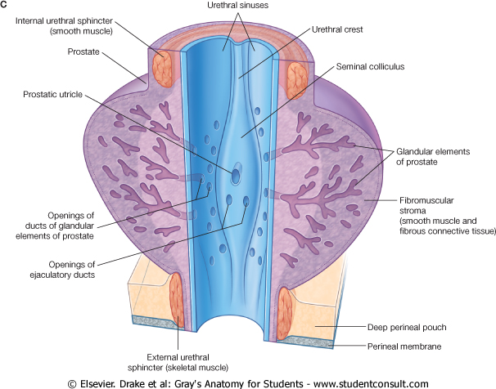
Accessory Glands
 | Prostate Gland
SUPPLY | Arterial supply | Inferior vesical artery from Internal Iliac Artery
 | Venous plexus | Lies between the prostatic fibrous capsule and the prostatic sheath. It drains into the internal iliac veins. It is continuous superiorly with the vesical venous plexus (VVS) of the urinary bladder and posteriorly to the internal vertebral venous plexus (IVVP).
 | Lymphatic drainage | Internal iliac lymph nodes
Prostatic Urethra* | Urethral crest | longitudinal elevated ridge
 | Prostatic sinus (Urethral sinus) | Groove on each side of the crest The prostatic gland opens into the prostatic sinus
 | Prostatic utricle | A depression on the summit of the urethral crest The ejaculatory ducts open on the sides of the utricle Seminal colliculus: rounded eminence that opens into the prostatic utricle
*Structures seen on the posterior wall of the prostatic urethra

Slide 11
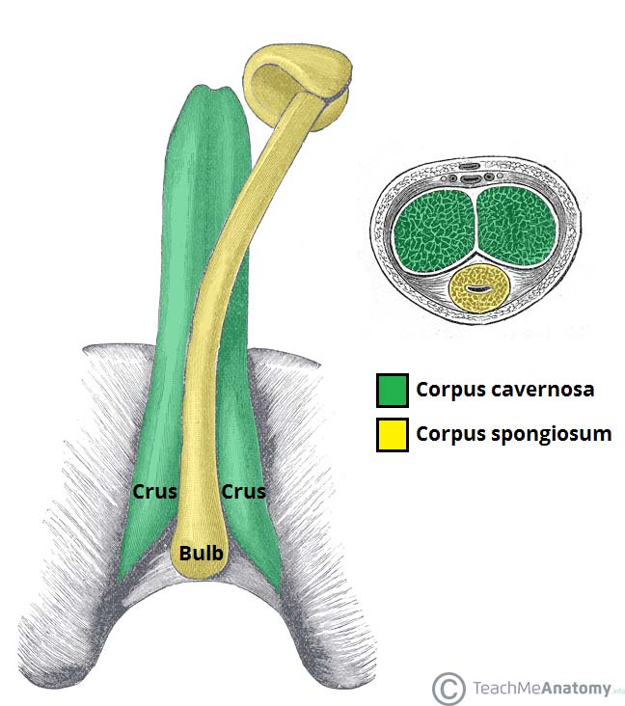
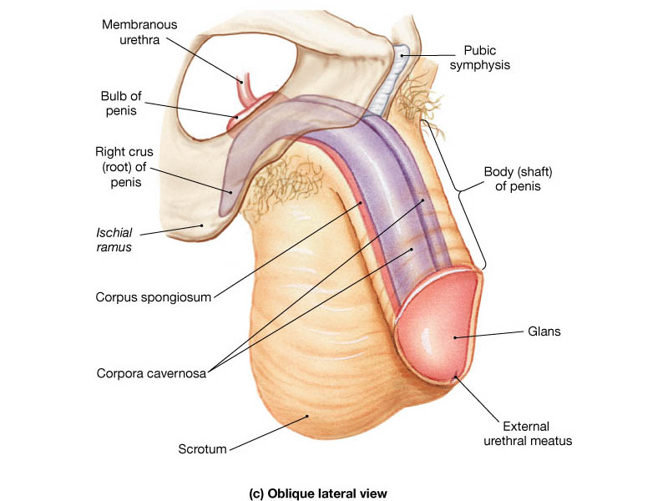
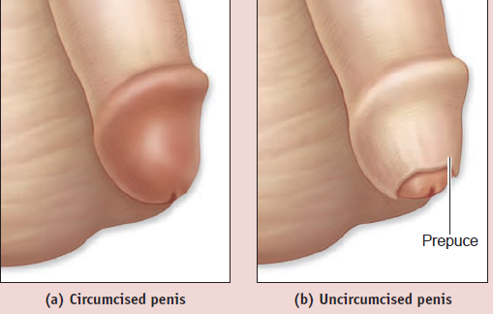
Penis
Copulatory |  | Has (3) cylindrical masses of erectile tissue Two Corpora Cavernosa One Corpus spongiosum
Excretory |  | Penile urethra transmits urine & seminal fluid
Erectile tissue | Corpora cavernosua | Two superior (right & left) masses of (Primary erectile tissue) They Provide the majority of rigidity & length of penis Their posterior expansions, forms the 2 Crurae (anchor tissue) against pelvic bone
 | Corpus spongiosum | The single inferior mass (Secondary erectile tissue) It is traversed by the penile urethra Its Anterior expansion forms the Glans penis Its posterior expansion forms the bulb of the penis
Prepuce or foreskin: Fold of skin covering glans penis (before circumcision=الختان)

Slide 12
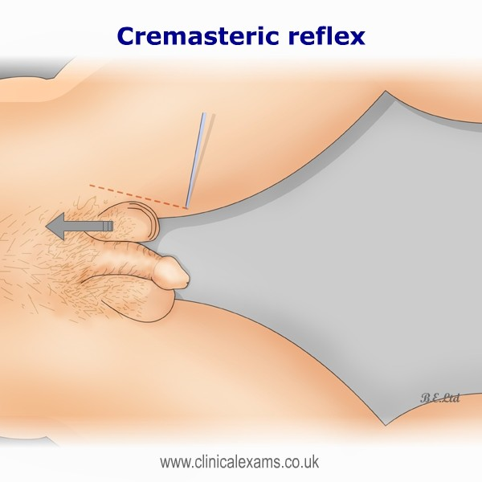
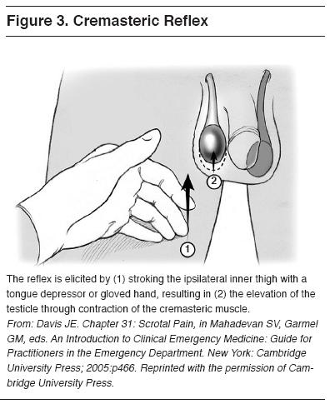
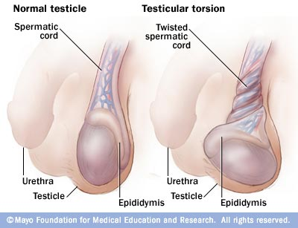
Cremasteric reflex
Indication | Evaluation of testicular pain in case of (Testicular Torsion).
Technique | Examiner strokes OR pinches the skin in the upper medial thigh. It causes contraction of the cremasteric muscle
Observation | Rise of the Testicle on same side (normal)
Interpretation | NORMAL: It is present with Epididymitis.
 | ABSENT: (no Testicle rise), Is Suggestive of TESTICULAR TORSION. (Also ABSENT in 50% of boys under age 30 months)
Efficacy | Test Sensitivity for Testicular Torsion: 99% Assumes age over 30 months
Nerve involved | Genitofemoral (GFN), ( L 1, 2)
 | Sensory: Femoral branch of (GFN) & Ilioinguinal | Motor: Genital branch of (GFN).
*Do not use this test under age of 30 months (as the muscle has not fully developed yet).
*Epididymitis & testicular torsion have similar presentation so to differentiate between them we test the cremasteric reflex. If present = epididymitis & if its absent then = testicular torsion.
Testicular torsion occurs when the spermatic cord twists, cutting off the testicle's blood supply.

Slide 13
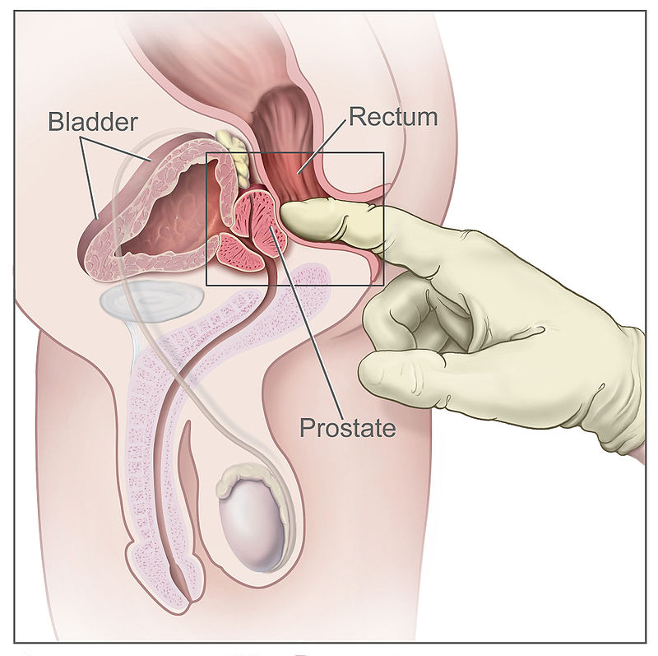
Hypertrophy of the Prostate
 | Benign | Malignant (prostatic carcinoma)
Age | Common after middle age | common after the age of 55
Metastasis | Does not metastasize | Lymphatic spread: metastasize first to internal iliac & sacral lymph nodes Venous spread: Later to distant nodes , bone & brain through (IVVP)
Relation to urethra | An enlarged prostate projects into the urinary bladder and distorts the prostatic urethra | It can cause obstruction to urine flow because of its close relationship to the prostatic urethra
Notes | The middle lobe often enlarges and obstructs the internal urethral orifice, this leads to Nocturia, Dysuria, Frequency and Urgency | The malignant prostate is felt hard & irregular in Per- rectal examination (PR)

Slide 14
1. The lymphatic drainage of the scrotum is?
A- Superficial inguinal nodes
B- Deep inguinal nodes
C- Paraaortic nodes
D- Testicular nodes
2. What is the male primary sex organ?
A- Vas deference
B- Penis
C- Testes
D- Prostate
3. ________ Of the epididymis receives efferent ductules from the testis?
A- Head B- Body
C- Tail D- Vas deferens
4. Which of the following lies lateral to the vas deferens?
A- Cowper's glands
B- Prostate
C- Seminal vesicle
D- Rectum
5. Which of the following related anteriorly to the prostate gland?
A- Neck of the bladder
B- Symphysis pubis (sp).
C- Urogenital diaphragm
D- Rectum
6. The ejaculatory duct drained into which of the following?
A- Prostatic utricle
B- Prostatic cleft
C- Prostatic sinus
D- Urethral cleft
7. Testicular artery arises from?
A- Ascending aorta
B- Arch of aorta
C- Abdominal aorta at the level of l3
D- Abdominal aorta at the level of l5
8. Cremasteric reflex is used to diagnose?
A- Testicular torsion
B- Seminoma
C- Prostatitis
D- Benign prostatic hyperplasia
1. A 2. C 3. A 4. C 5. B 6. A 7. C 8. A

