Slide 2
Objectives
At the end of the lecture, students should be able to:
Describe the shape and position of the female breast.
Describe the structure of the mammary gland.
List the blood supply of the female breast.
Describe the lymphatic drainage of the female breast.
Describe the applied anatomy in the female breast.

Slide 3
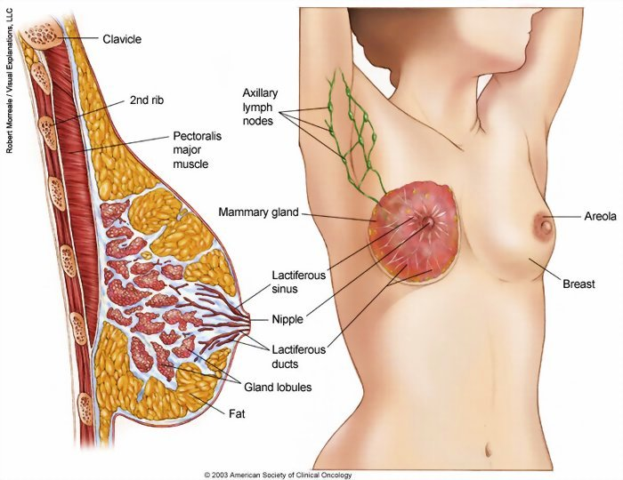
Breast
The breast (consists of mammary glands + associated skin & connective tissue) is a gland made up of lobes arranged radially around the nipple.
Shape |  | - It’s a specialized accessory gland of the skin & conical (مخروط) in shape - NOT have capsule (that’s why the cancer spread quickly)
Location |  | It lies in superficial fascia of the front / pectoralis region of chest
Parts | Apex (Nipple) | - Conical eminence that projects forwards from the anterior surface of the breast - It lies opposite 4th intercostal space in non lactating women, may change after breastfeeding - It carries 15-20 narrow pores of the lactiferous ducts - It surround by Areola (dark pink brownish* circular area of skin) - The subcutaneous tissues of nipple & areola are devoid of fat
 | Base (3 muscles) | - 2/3 of it in Pectoralis region (Pectoralis major muscle)** - 1/3 of it in Inferolateral region (Serratus anterior & External oblique muscles) Vertically It extends from 2nd to 6th ribs Horizontally It extends from sternum (lateral margin) to midaxillary line
 | Tail (Axillary tail) | Superolateral region (Axillary tail or axillary process) : sends a process into the axilla deep to pectoralis major muscle (deep part of the gland)
Conical shape
*In women before pregnancy, after 2nd trimester of 1st pregnancy it will become brown and never come back
**The majority of the breast lies on pectoralis major (IMPOERTANT)

Slide 4
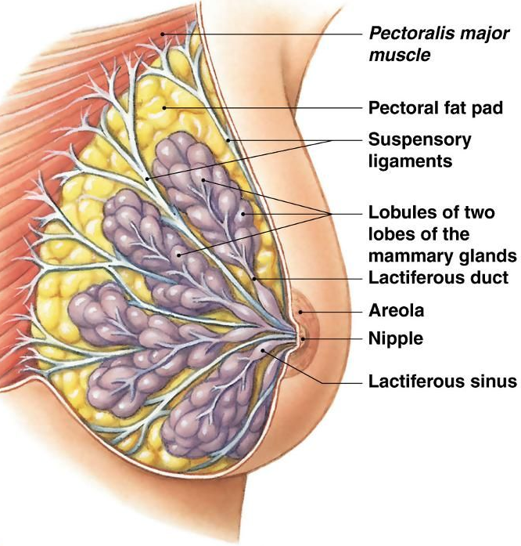
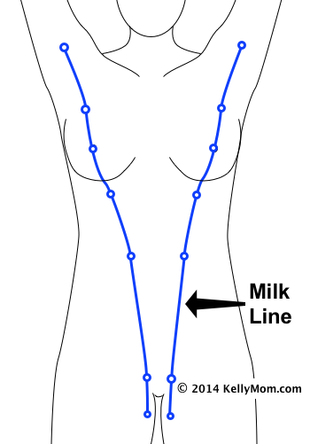
Mammary gland
04:09
It consists of 15-20 lactiferous ducts which open by the same number of openings on the summit of the nipple
It consists of 15-20 lobes, each lobe is formed of a number of lobules which are embedded in the subcutaneous fatty tissue of superficial fascia
It has ligaments of Cooper = suspensory (fibrous stands & fatty tissue) gives the breasts SUPPORT
In between skin & deep fascia of pectoralis major muscle
In between lobes & lobules* of mammary gland
* Here the ligaments named interlobar and interlobular ligaments of Cooper
It has Retromammary space (loose areolar tissue) allows the breast MOVE freely
In between mammillary gland & deep fascia of pectoralis major muscle
Surgery to increase breast size do in this space
Extends from the axilla to the inguinal region
In Human → the ridge disappears EXCEPT for a small part in the pectoral region (only 1 nipple on each breast)
In Animals → several mammary glands are formed along this ridge (have multiple nipples)
Mammary ridge
Animal
Human

Slide 5
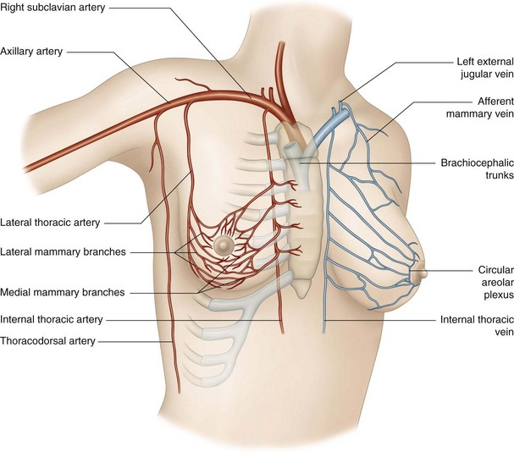
IMPORTANT
Breast SUPPLY
(Arterial supply & venous drainage)
Arterial supply | - Perforating branches & Medial mammary branches of internal thoracic (internal mammary) artery from subclavian artery "1st branch“ (SUPPLY medial pert of breast) - lateral mammary branches of lateral thoracic artery from axillary artery (SUPPLY lateral pert of breast) - Mammary branches of Intercostal arteries
Venous drainage | (Veins are corresponding to the arteries) Circular venous plexus are found at the base of nipple → drain into axillary vein & internal thoracic vein (final drainage)
Axillary vein

Slide 6
Breast SUPPLY
(Lymphatic Drainage: Axillary Lymph Nodes MAINLY)
Lymphatic drainage | Axillary Lymph Nodes | Pectoral (Anterior) | lies on the pectoralis minor along lateral thoracic vessels
 |  | Subscapular (Posterior) | lies on posterior wall of axilla on lower border of subscapularis ; along subscapular vessels
 |  | Brachial (Lateral) | lies on lateral wall of axilla along 3rd part of axillary vessels
 |  | Central | lies in axillary fat at the base of axilla
 |  | Apical | lies at apex of axilla
 |  | All of them will go to Subclavian lymph trunk (It is formed by union of efferent lymph vessels of apical group) Right side: usually opens in subclavian vein | Left side: usually opens into thoracic duct

Slide 7
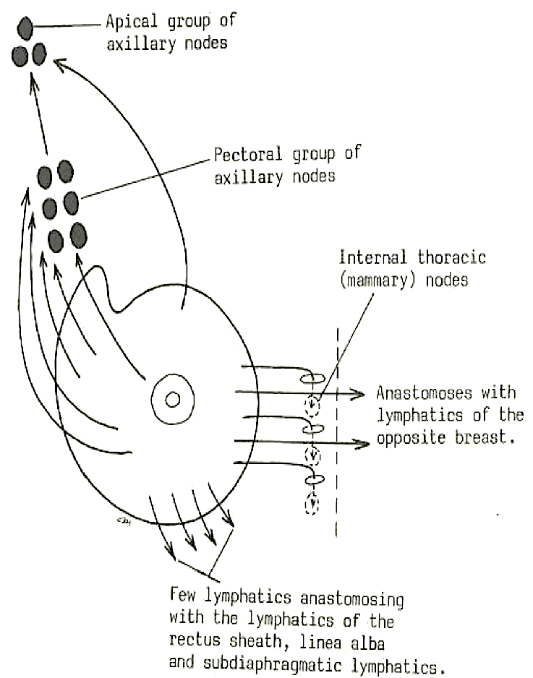
IMPORTANT
Breast SUPPLY
(Lymphatic Drainage: Lymphatic Plexus & Gland Parts)
Lymphatic drainage | Plexus | Subareolar lymphatic | Lies beneath the areola
 |  | Deep lymphatic | Lies on the deep fascia covering pectoralis major muscle
 |  | Both plexuses radiate in many directions and drain into different lymph nodes (75% Axillary groups + 25% Internal thoracic lymph nodes = parasternal)
Lymphatic drainage | Parts | Central | 75% drain into axillary lymph nodes (pectoral group)
 |  | Lateral
 |  | Upper | drains into axillary lymph nodes (apical group)
 |  | Medial | drains into internal thoracic lymph nodes (parasternal) FORMING a CHAIN along the internal thoracic vessels & some of them PASS ACROSS the front of sternum to anastomose with that of opposite side (cancer could go to the other side by this way)
 |  | Inferomedial | anastomose with lymphatics of rectus sheath, linea alba and (deeply) subdiaphragmatic lymphatics

Slide 8
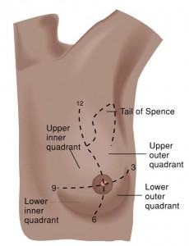
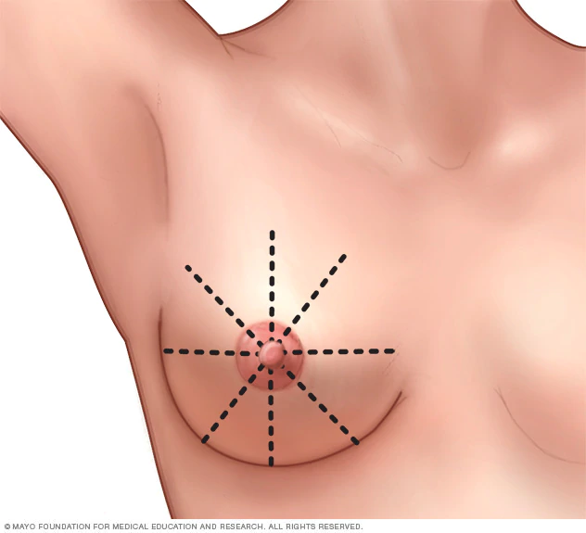
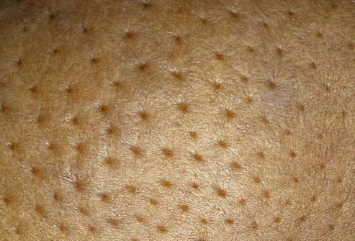
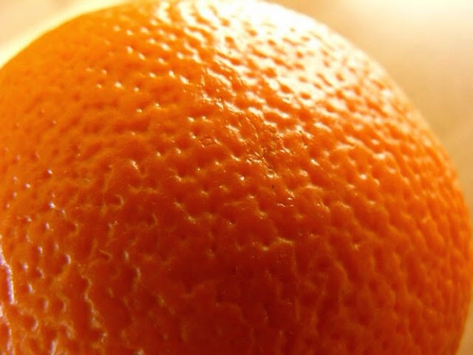
Breast Cancer
It is a common surgical condition
60% of carcinomas of breast occur in the upper lateral quadrant (lateral=outer)
75% of lymph from the breast drains into the axillary lymph nodes
In case of carcinoma of one breast, the other breast & the opposite axillary lymph nodes are affected BECAUSE of the anastomosing lymphatics between both breasts
Treatment choice In patients with LOCALIZED cancer breast: simple mastectomy (surgery to remove the breast) followed by radiotherapy to the axillary lymph nodes
The lactiferous ducts are radially arranged from the nipple, SO incision of the gland SHOULD BE made in a radial direction to avoid cutting through the ducts
Infiltration of the ligaments of Cooper = suspensory leads to its shortening & giving breast dimpling appearance تنقير= peau de’orange appearance (French word meaning skin of orange)
Peau de’orange appearance →
Orange (fruit) appearance →

Slide 9
1. Where is the circular venous plexus are found? A. At the apices of nipple
B. At the base of nipple
C. At the base of the breast
D. Lateral to thoracic lymph nodes
2. Along lateral thoracic vessel located the pectoral group of axillary lymph nodes which lies on which of the following structure?
A. Serratus anterior
B. Subscapularis C. Pectoralis minor
D. Pectoralis major
3. Most of the carcinoma of breast occur in which quadrant?
A. Upper lateral
B. Lower lateral
C. Upper medial
D. Lower medial
4. The appearance of peadu’orange is caused by infiltration of what?
A. Lactiferous duct
B. Mammary ridge
C. Retromammary space
D. Ligament of cooper
5. The left subclavian trunk usually open into?
A. Internal thoracic vein
B. Internal jugular vein
C. Thoracic duct
D. Subclavian vein
6. The lactiferous ducts of mammary gland are?
A. Less than 10
B. From 10‐15
C. From 15‐20
D. More than 20
7. 2/3 of the breast’s base lies in which one of the following muscles?
A. Serratus anterior
B. External oblique
C. Pectoralis minor
D. Pectoralis major
8. The nipple of the breast lies opposite of?
A. 3rd costal cartilage
B. 3rd intercostal space
C. 4th intercostal space
D. 4th costal cartilage
1. B 2. C 3. A 4. D 5. C 6. C 7. D 8. C

