Slide 2
At the end of this lecture, the student should be able to describe the microscopic structure of:
Testis and epididymis.
2. Vas deferens.
3. Seminal vesicles.
4. Prostate.

Slide 3
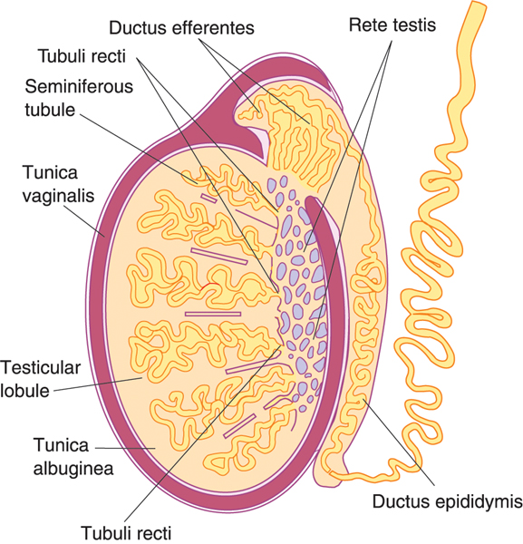
TESTIS
Stroma
Tunica vaginalis
Tunica albuginea
Parenchyma
Seminiferous tubules
Tunica vasculosa
Interstitial cells of Leydig
Septa
Interstitial tissue
Formed of:
Note:
The Exocrine part of the parenchyma is Seminiferous tubules
The Endocrine part of the parenchyma is Interstitial cells of Leydig

Slide 4
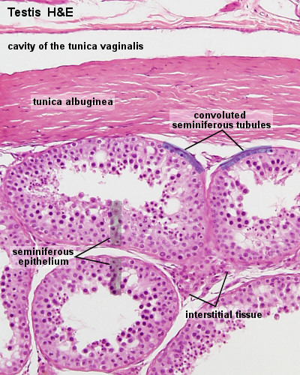
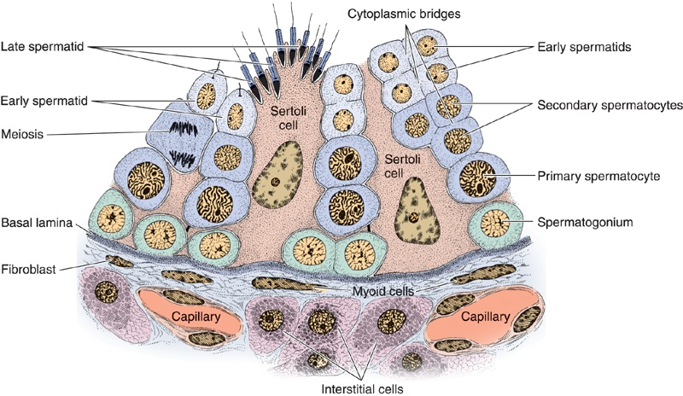
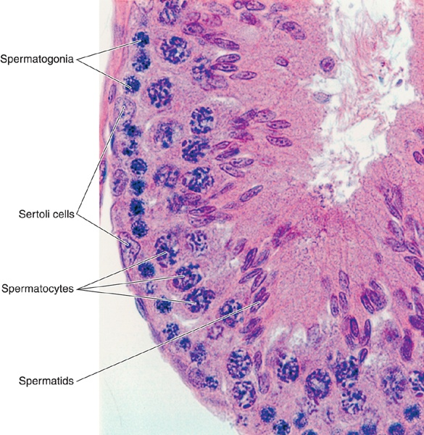
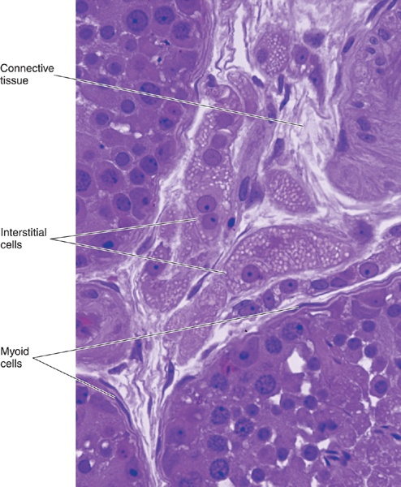
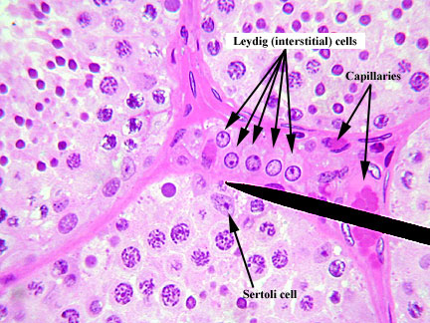
TESTIS
Stroma:
TUNICA VAGINALIS | TUNICA ALBUGINEA | TUNICA VASCULOSA | Septa of the Testis | Interstitial Tissue
It is formed of mesothelial cells | Dense irregular collagenous C.T. | It is formed of loose highly vascular C.T. lining tunica albuginea & speta from inside. | Dense irregular collagenous C.T. Divide the testis into about 250 intercommunicating compartments (testicular lobules = lobuli testis). | Loose vascular C.T. in between the seminiferous tubules. Contents: 1- Loose vascular C.T. 2- Interstitial cells of Leydig
Parenchyma:
Endocrine part: interstitial cells of Leydig which produce testosterone. | Exocrine part: The seminiferous tubules which produce spermatozoa.
Interstitial Cells of Leydig Are rounded or polygonal cells with central rounded nucleus. Cytoplasm: acidophilic & vacuolated. Function: Secrete testosterone. | Seminiferous Tubules Each tubule is lined with a stratified epithelium called seminiferous epithelium which is formed of 2 types of cells: 1- Spermatogenic cells. 2- Sertoli cells. Each tubule is surrounded by a basement membrane.

Slide 5
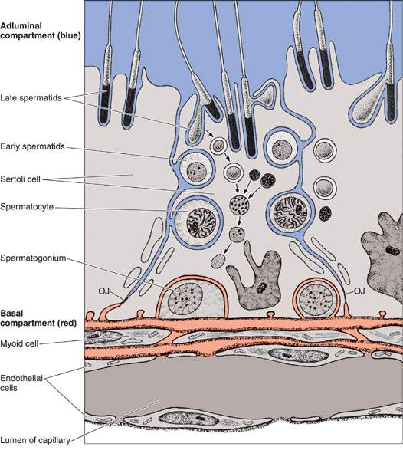
Seminiferous Tubules (seminiferous epithelium) cells
Spermatogenic Cells | Sertoli Cell
A series of cells lining the seminiferous tubules extending from the BM to the lumen. Include: Spermatogonia. 1ry spermatocytes. 2ry spermatocytes. Spermatids. Spermatozoa. | Are columnar or pyramidal cells. Nucleus: Basal, vesicular, irregular with prominent nucleolus. Functions: 1- Support & Nutrition of spermatogenic cells. 2- Phagocytosis of cytoplasmic remnants of spermatogenesis. 3- Secretion: 4- Formation of blood-testis barrier.
Testicular fluid
Androgen Binding Protein (ABP)
Inhibin hormone
Testicular fluid: nutritive medium for transport of immotile spermatozoa.
Androgen-binding protein (ABP): combines with testosterone and concentrate it inside the seminiferous tubules.
Inhibin: inhibits FSH thus controlling rate of spermatogenesis.
Blood-Testis Barrier
It is formed by the tight junctions between the basal parts of the lateral borders of adjacent Sertoli cells.
It divides the seminiferous tubule into 2 compartments:
1- Basal compartment: contains spermatogonia.
2- Adluminal compartment: contains the other spermatogenic cells.
Function:
1- It protects the developing spermatogenic cells from drugs and toxic materials.
2- It prevents autoimmune infertility.
The barrier separates the tissue fluid outside the seminiferous tubule from the spermatogenic cells inside the seminiferous tubule.
Isolation: and protection of the sensitive developing spermatogenic cells from any harmful substance in the blood stream.
Prevention of autoimmune reaction: prevents the passage of any autoantibodies against the developing gametes into the seminiferous tubule.
It isolates the adluminal compartment from connective tissue influences, thereby protecting the developing gametes from the immune system. Because spermatogenesis begins after puberty, the newly differentiating germ cells would be considered "foreign cells" by the immune system.

Slide 6
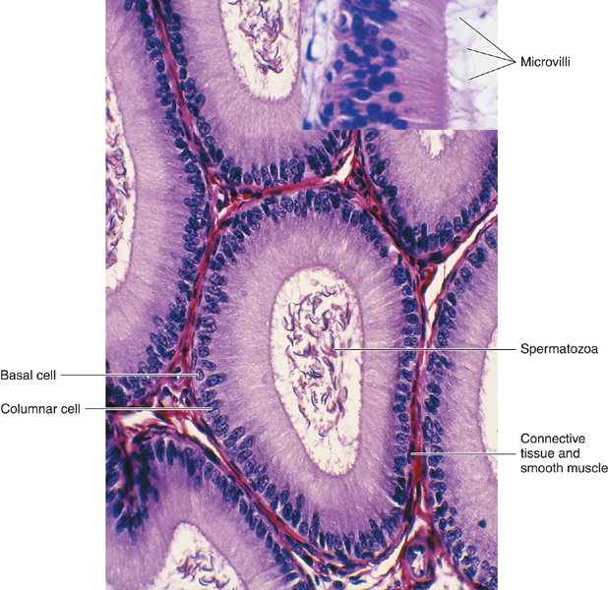
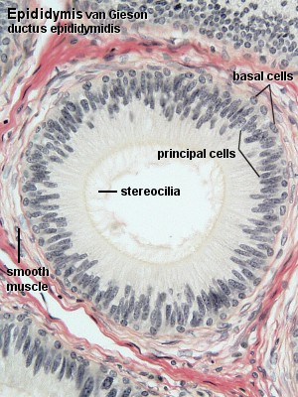
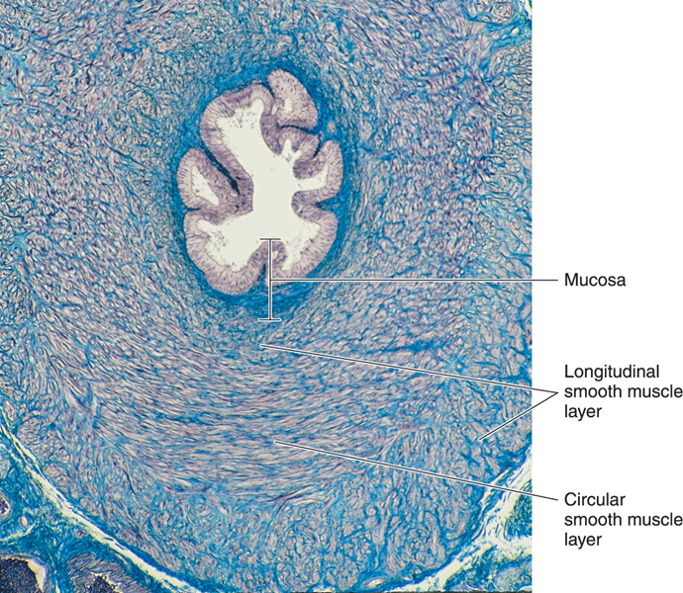
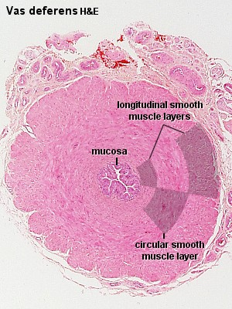
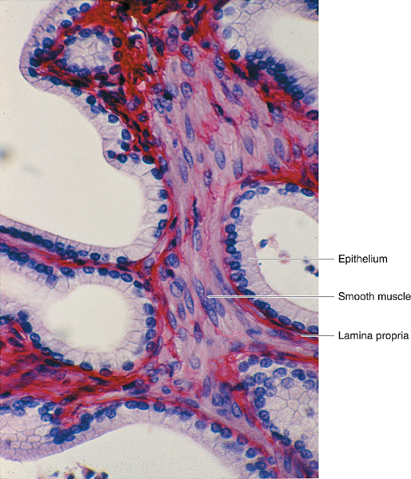
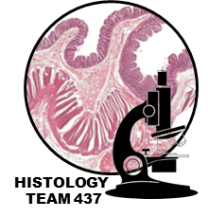
SEMINAL VESICLES | DUCTUS DEFERENS (VAS DEFERENS) | EPIDIDYMIS (DUCTUS EPIDIDYMIS)
(1) Mucosa: is highly folded. - Epithelium: pseudostratified columnar epithelium - Lamina propria of C.T. (2) Musculosa: - Inner circular layer - Outer longitudinal layer (3) Adventitia: C.T. | It is a muscular narrow tube with irregular lumen. Structure: (1) Mucosa: pseudostratified columnar epithelium with stereocilia (immotile cilia) on a corium of loose C.T. (2) Musculosa (thick;3 layers): -Inner longitudinal layer -Middle circular layer -Outer longitudinal layer (3)Adventitia: loose C.T. | Epithelium: pseudostratified columnar epithelium with stereocilia Basal lamina. (3) Loose C.T. (4) Layer of circularly-arranged smooth muscle cells. | Structure
Secretion of most of seminal fluid, rich in fructose & vit. C. which are the main nutrients for spermatozoa. | Propelling of spermatozoa by strong peristalsis. | a) Storage & maturation of spermatozoa. b) Propelling spermatozoa to the vas deferens. | Function
They are two highly convoluted tubes | starting at the tail of the epididymis, enters the abdomen through the inguinal canal to join the duct of the seminal vesicle to form the ejaculatory duct. Length is about 30 cm. | A single tubule; 4-6 m in length. Highly convoluted to form a compact organ 7.5 cm long. Divided into head, body & tail. The tail gives rise to the vas deferens. | Notes

Slide 7
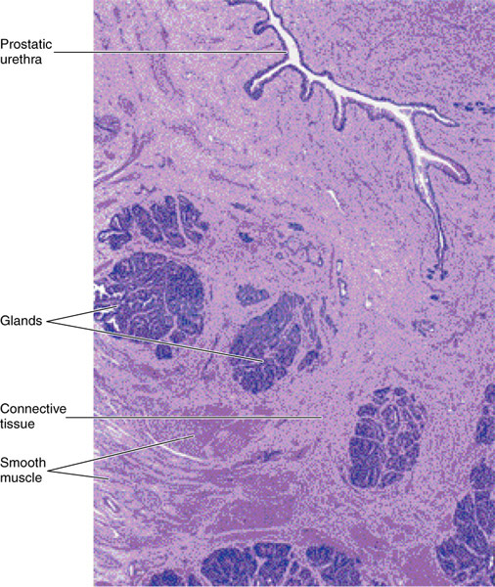
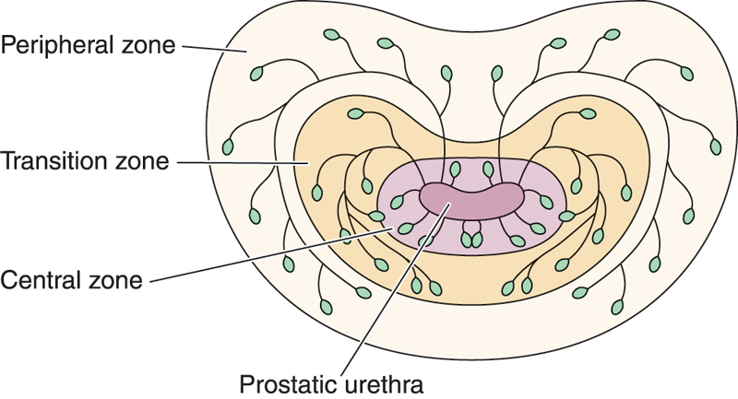
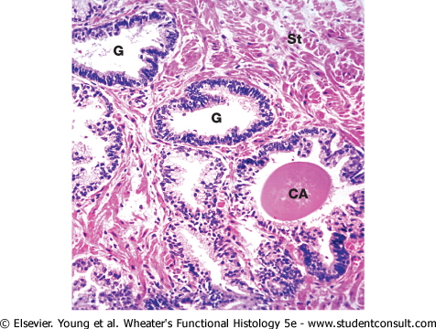
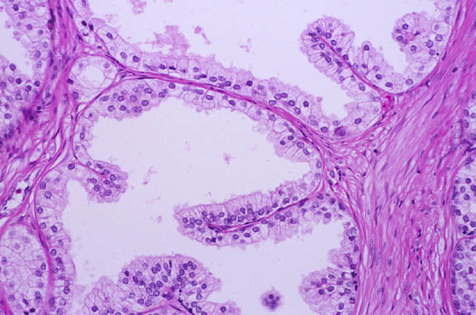
PROSTATE
Prostatic concretions (corpora amylacea) | Acini and ducts | Parenchyma | Stroma
Round or oval masses of glycoprotein in the lumen of some glands. Increase with advancement of age & become calcified. | are lined with simple columnar or pseudostratified columnar epithelium according to activity of the glands. | 30-50 glands in 3 concentric groups around the prostatic urethra: Mucosal group: small. Submucosal group: medium-sized. Main group: Large, 70% of all glands. | fibromuscular capsule & trabeculae
Function: participates in the secretion of the seminal fluid. Its secretion is rich in acid phosphatase & proteolytic enzymes.

Slide 8
Q1: Which of the following is formed of mesothelial cells?
A) Tunica Vaginalis B) Tunica Albuginea C) Tunica Vasculosa D) all of them
Q2: the seminiferous epithelium is formed of?
A) 1 types of cells B) 2 types of cells C) 3 types of cells D) 4 types of cells
Q3: Which one is the function of interstitial cells of leydig?
A) Produce spermatozoa B) Secrete testosterone C) Supporting cells D) Formation of blood-testis barrier
Q4: the Cytoplasm of interstitial cells of Leydig is?
A)pale-stained B) deep basophilic C)slightly Basophilic D) acidophilic
Q5: What is the type of Epithelium is founded in DUCTUS EPIDIDYMIS?
A) Simple columnar B) pseudostratified columnar epithelium without stereocilia C)stratified squamous D) pseudostratified columnar epithelium with stereocilia
A
B
B
D
D

Slide 9
Q6: What type of epithelium is founded in Acini and ducts of the prostate?
A) pseudostratified columnar epithelium B) Simple columnar
C) pseudostratified columnar epithelium with stereocilia D) A & B
Q7: Which structure Secrete most of seminal fluid, rich in fructose & vit. C?
A) EPIDIDYMIS B) DUCTUS DEFERENS C) SEMINAL VESICLES D) PROSTATE
Q8: Propelling of spermatozoa by strong peristalsis is Function of:
A) EPIDIDYMIS B) DUCTUS DEFERENS C) SEMINAL VESICLES D) PROSTATE
Q9: Which of the following is component of basal compartment in blood-testis barrier?
A) Spermatogonia B) Spermatids C) Spermatogenic cell D)Non of them
6. D
7. C
8. B
9. A

Slide 10
ختامأ نتوجه بالشكر والتقدير للأعضاء الذين ساهموا في نجاح هذا العمل لما قدموه من تضحية بوقتهم وجهدهم, وايضاً الشكر موصول لقائدة الفريق السابقة (روان بنت محمد الحربي) لجهودها المبذولة مع الفريق, ولا ننسى ان نشكر القادة الأكاديميين السابقين والحاليين على ما قدموه من عمل ملخص ومتقن

