Slide 1
Introduction to Patients Safety

Slide 2
Outline
Introduction and defining patient safety
The key dimensions of healthcare quality
Harm Versus error
Sources of System Error
Patient safety culture
Types of clinical incident
Seven levels of safety
The physician’s role in patient safety
Case scenario

Slide 3
Objectives
After completing this lecture you should:
Recognize the magnitude and the importance of patient safety
Define and describe the key elements of healthcare quality
Summarize the differences between error and harm
Recognizing characteristics of a just culture
Differentiate between the different types of clinical incidence
Describe several specific behaviors you can practice to foster a culture of safety in your workplace

Slide 4
Defining patient safety
The reduction of risk of unnecessary harm associated with health care to an acceptable minimum. (WHO, World Alliance for Patient Safety 2009).

Slide 5
Introduction
Significant numbers of patients are harmed due to their health care, either resulting in permanent injury, increased length of stay (LOS) in health-care facilities, or even death.
44 – 98,000 deaths annually caused by medical error.
There are more deaths annually as a result of health care than from road accidents, breast cancer and AIDS combined.

Slide 6
Defining patient safety-Video
https://www.youtube.com/watch?v=BJP2rvBchnE

Slide 7
Why is it a problem?
Hospital/Country | Years in which data was collected | Number of hospital admissions | Number of adverse event | Adverse event rate (%)
US(Harvard Medical Practice Study) | 1984 | 30195 | 1133 | 3.8
Australian (Quality in Australian healthcare study ) | 1992 | 14179 | 2353 | 16.6
UK | 1999-2000 | 1014 | 119 | 11.7
Denmark | 1998 | 1097 | 176 | 9
KKUH | 2014 | 47211 | 2950 | 6.2
Source: World Health Organization. Executive board 109th session, provisional agenda item3,4,5, 2001,EB 109/9

Slide 8
Family-centered
Timely
Effective
Safe
Key Elements of Professionalism
Equal
Efficient

Slide 9
The 6 key dimensions of healthcare quality
Safe: Avoiding injuries to patients from the care that is intended to help them.
Effective: Providing services based on scientific knowledge to all who could benefit and refraining from providing services to those not likely to benefit (avoiding underuse and overuse). Doing the right thing for the right person at the right time.

Slide 10
The 6 key dimensions of healthcare quality
Timely: Reducing waits and sometimes unfavorable delays for both those who receive and those who give care.
Family-centered: Providing care that is respectful of and responsive to individual patient preferences, needs and values, and ensuring that patient values guide all clinical decisions.

Slide 11
The 6 key dimensions of healthcare quality
Efficient: Avoiding waste, in particular waste of equipment, supplies, ideas and energy.
Equal: Providing care that does not vary in quality because of personal characteristics such as gender, ethnicity, geographic location and socio-economic status

Slide 12
Sources of System Error
All errors can be divided into two main groups:
Active errors or human error are committed by frontline staff and tend to have direct patient consequences.
Example, giving the wrong medication, treating the wrong patient or the wrong anatomical site, or not following the correct policies and procedures.
Latent or system errors are those errors that occur due to a set of external forces and indirect failures involving management, protocols/ processes, organizational culture, transfer of knowledge, and external factors
Example : understaffed wards or inadequate equipment.

Slide 13
Error in medicine
Errors in health care can be caused by ‘‘active failures’’ or ‘‘latent conditions.’’
Most errors are not a result of personal error or negligence, but arise from system flaws or organizational failures

Slide 14
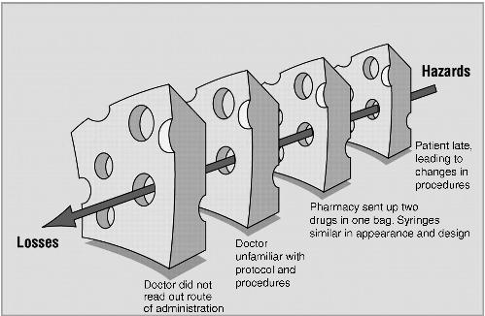
"Swiss cheese" model of accident causation

Slide 15
"Swiss cheese" model of accident causation
The systems have many holes: some from active failures and others from latent conditions.
These holes are continuously opening, shutting, and shifting their location. In any one slice, they do not normally cause harm, because the other intact slices prevent hazards from reaching the potential victim.
Only when the holes in many layers momentarily line up does the trajectory of accident opportunity reach the victim causing the damage

Slide 16
Definition of patient safety culture
An integrated pattern of individual and organizational behavior, based on a system of shared beliefs and values, that continuously seeks to minimize patient harm that may result from the process of care delivery.

Slide 17
Defining patient safety-Video
https://www.youtube.com/watch?v=jGlsCLvN5cI

Slide 18
Patient safety culture
If a patient is found to have received the wrong medication and suffered a subsequent allergic reaction,
Blame culture: we look for the individual student, pharmacist, nurse or doctor who ordered, dispensed or administered the wrong drug and blame that person for the patient’s condition care at the time of the incident and hold them accountable
Just Culture: we look for the system defect such as communication , protocols and processes for medication management , in addition to investigate the negligence or recklessness of the worker

Slide 19
The concept of Clinical incident:
Definition:
Examples:
A clinical incident is an event or circumstance resulting from health care which could have, or did lead to unintended harm to a person, loss or damage, and/or a complaint. (deviation from standard of care and safety )
Medication errors (e.G. Wrong medication, omission, overdose);
Patient falls;
Intended self harm or suicidal behaviour;
Therapeutic equipment failure;
Contaminated food;
Problems with blood products;
Documentation errors;
Delayed diagnosis;
Surgical operation complications;
Hospital acquired infection;

Slide 20
Types of Clinical incident
Clinical Incidence
Adverse Event
Near Miss
Sentinel Event
Adverse Drug reaction

Slide 21
Types of Clinical incident
Sentinel events:
A sentinel event is an unexpected occurrence involving death or serious physical or psychological injury, or the risk thereof. Serious injury specifically includes loss of limb or function.
Example:
Hemolytic transfusion reaction involving administration of blood or blood products having major blood group incompatibilities

Slide 22
Types of Clinical incident
Near miss:
Is any situations that did not cause harm to patients (that did not reach the patient) , but could have done.

Slide 24
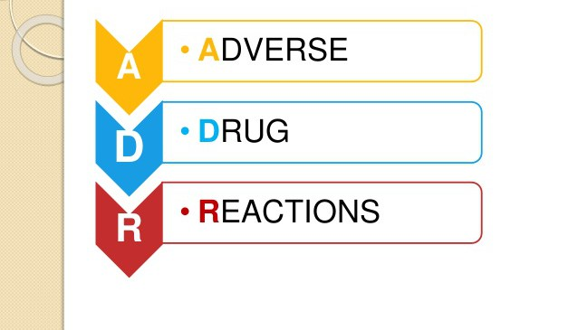
Types of Clinical incident
Adverse Drug Reaction:
A response to a drug which is noxious and unintended, and which occurs at doses normally used in man for the prophylaxis, diagnosis, or therapy of disease, or for the modifications of physiological function'.( WHO,1972)

Slide 25
How to maintain safety in clinical incident ?
Adhere and follow the National Patient Safety Goals/ ROP(Required Organization Practice )
Adverse reporting
Client verification
Medication reconciliation
Dangerous abbreviations
Transfer of client information at transition points
Control of concentrated electrolytes
Infusion pumps training
High-alert medications
Hand hygiene
Antibiotic prophylaxis during surgery
Falls prevention strategy
Pressure ulcer prevention
Venous thromboembolism prophylaxis
Safe injection practices
Safe surgical practices
Preventive maintenance program

Slide 27
A 38-year-old woman comes to the hospital with 20 minutes of itchy red rash and facial swelling; she has a history of serious allergic reactions
A nurse draws up 10 mls of 1:10,000 adrenaline (epinephrine) into a 10 ml syringe and leaves it at the bedside ready to use (1 mg in total) just in case the doctor requests it
Meanwhile the doctor inserts an intravenous cannula
The doctor sees the 10 ml syringe of clear fluid that the nurse has drawn up and assumes it is normal saline

Slide 28
Continue….
There is no communication between the doctor and the nurse at this time
The doctor gives all 10 mls of adrenaline (epinephrine)through the intravenous cannula thinking he is using saline to flush the line.
The patient suddenly feels terrible, anxious, becomes tachycardia and then becomes unconscious with no pulse
She is discovered to be in ventricular tachycardia, is resuscitated and fortunately makes a good recovery
Recommended dose of adrenaline (epinephrine) in anaphylaxis is 0.3 - 0.5 mg IM, this patient received 1mg IV

Slide 29
Can you identify the contributing factors for this error?

Slide 30
Can you identify the contributing factors to this error?
Lack of communication
Inadequate labeling of syringe
Giving a substance without checking and double checking what it is
Lack of care with a potent medication

Slide 31
Conclusion
Patient safety is the avoidance, prevention and amelioration of harm from healthcare.
Two approaches to the problem of human fallibility exist:
The person approach focuses on the errors of individuals, blaming them
The system approach concentrates on the conditions under which individuals work
Some errors cause harm but many do not.
Blaming and then punishing individuals is not an effective approach for improving safety within the system
Adverse events often occur because of system breakdowns
Standardizing and simplifying clinical processes is a powerful way of improving patient safety

Slide 32
Bibliography
Maamoun J,An Introduction to Patient Safety. Journal of Medical Imaging and Radiation Sciences 40 (2009) 123-133
Reason J.Human error: models and management. BMJ. 2000 Mar 18;320(7237):768-70.
Sutker WL The physician's role in patient safety: What's in it for me?. Proc (Bayl Univ Med Cent).2008 Jan;21(1):9-14.
Sutker WL. The physician's role in patient safety: What's in it for me? Proc (Bayl Univ Med ‎Cent). 2008 Jan;21(1):9-14‎
Goode LD1, Clancy CM, Kimball HR, Meyer G, Eisenberg JM. When is "good enough"? The role and responsibility of physicians to improve patient safety. Acad Med. 2002 Oct;77(10):947-52.

