Slide 1
Patient Safety
Understanding Systems and Effect of Complexity of Patient Care
Nada AL-Khamis ,RN,MSN
Lecturer
Department of Nursing Education & Administration
College of NURSING SCIENCE
King Saud University

Slide 2
Objectives
Explain the terms system and complex system as they relate to health care.
Explain why a systems approach to patient safety is superior to the traditional approach.
Apply Reason’s “Swiss cheese” model & defenses to identify possible causes of error in a clinical scenario.
Identify the principles of HROs which can be applied in health systems

Slide 3
Contents
Definition of “system” & related concepts
Two schools of thought regarding iatrogenic injury (Traditional, Systems)
Reason’s “Swiss cheese” model of accident causation
Reason’s – Defenses
Characteristics of high reliability organizations (HROs)
Key principles from HRO theory health care can learn from HROs

Slide 4
What is a system?
• The word system describes any collection of two or more interacting parts or “an interdependent group of items forming a unified whole”.
• A complex system is one in which there are so many interacting parts that it is difficult, if not impossible, to predict the behaviour of the system based on knowledge of its component parts. The delivery of health care fits this definition of a complex system.

Slide 5
Health Services
Health services present as a system—buildings, people, processes, desks, equipment, telephones—yet unless the people involved understand the common purpose and aim, the system will not operate in a unified fashion.
People are the glue that binds and maintains the system.

Slide 6
Why Health Care is Complex?
o The diversity of tasks involved in the delivery of patient care;
o The dependency of health-care providers on one another;
o The diversity of patients, clinicians and other staff;
o The huge number of relationships between patients, carers, health-care providers, support staff, administrators, family and community members;
o The vulnerability of patients;

Slide 7
Why Health Care is Complex?
o Variations in the physical layout of clinical environments;
o Variability or lack of regulations;
o Implementation of new technology;
o The diversity of care pathways and organizations involved;
o Increased specialization of health-care professionals—while specialization allows a wider range of patient treatments and services, it also provides more opportunity for things to go wrong and errors to occur.

Slide 8
A Systems Approach
A systems approach requires us to look at health care as a whole system, with all its complexity and interdependence, shifting the focus from the individual to the organization.
It forces us to move away from a blame culture towards a systems approach.

Slide 9
A Systems Approach
A systems approach examines the organizational factors that lead to dysfunctional health care and accidents/errors (poor processes, poor designs, poor teamwork, financial constraints and institutional factors);
Rather than focus on the people who are blamed for an error.
This type of approach helps to move away from blaming, towards understanding and improving the transparency of the processes of care.

Slide 10
The Traditional Approach when Things go Wrong
  This approach is to blame and shame the health-care professionals most directly involved in caring for the patient at the time of an adverse event or error.

Slide 11
The Traditional Approach when Things go Wrong. Why is not accepted?
Health-care professionals do not deliberately (Intentionally) harm a patient (deliberate action is called a violation).
A health-care professional involved in an adverse event /error can inadvertently be destroyed and become the “second victim”.
Health-care professionals are hesitant to report incidents/errors if they will be blamed.

Slide 12
The Traditional Approach when Things go Wrong. Why is not accepted?
Operating in a culture of blame, a health-care organization will have great difficulty in learning from errors and thus decreasing the chance of future adverse incidents.
A systems approach emphasises the importance of understanding the underlying factors that caused an adverse event without diminishing the responsibilities or accountability of health professionals.

Slide 13
Accountability
All health professionals have ethical and legal responsibilities for which they are accountable.
They aim to give confidence to the community that the health professionals can be trusted to have the knowledge, skills and behaviours set by the relevant professional body.
Accountability is a professional obligation and no one believes that health-care providers should not be held accountable.

Slide 14
The New Approach “a systems approach” when Things go Wrong
Experts say that although it is hard to change aspects of complex systems, it is even harder to change the behaviour of human beings, in terms of errors.
Therefore, the foremost response to health-care errors should be making changes to the system using a systems approach.
A systems approach requires an understanding and action on the multiple factors involved in each of the areas that make up the health-care system.
The intention of a systems approach is to improve the design of the system so that errors are prevented from occurring and/or their consequences minimized.

Slide 15
The elements of the system that should be considered as part of a “systems-thinking” approach
J. Reason outlined these elements:
o Patient factors
o Provider factors
o Task factors
o Technology and Tool factors
o Team factors
o Environmental factors
o Organizational factors

Slide 16
SWISS CHEESE MODEL IN HEALTH CARE
https://youtu.be/NWL4kbiWypk
7:00min

Slide 17
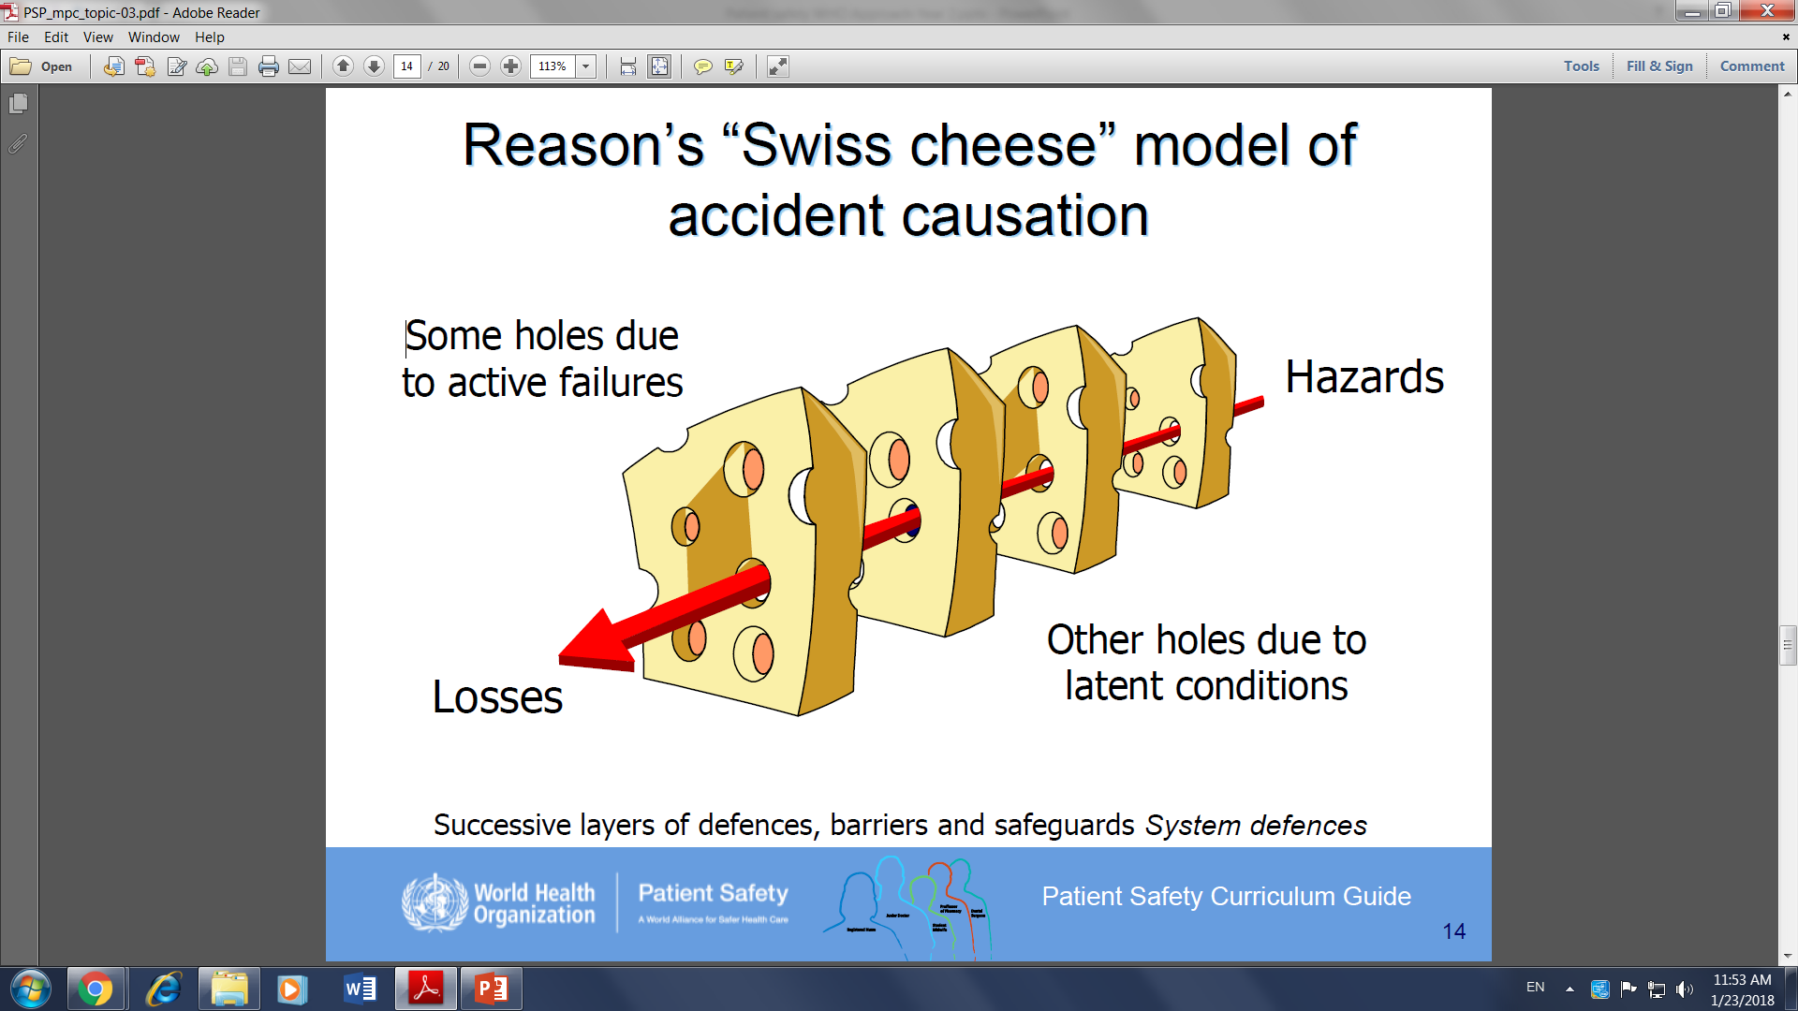

Slide 18
Swiss Cheese Model
J. Reason created this model to explain how faults in different layers of a system lead to adverse events and medical errors.
This model shows how a fault in one layer of a system of care is usually not enough to cause an accident.
Adverse events usually occur when a number of faults occur in a number of layers (e.g. fatigued workers + inadequate procedures + faulty equipment).

Slide 19
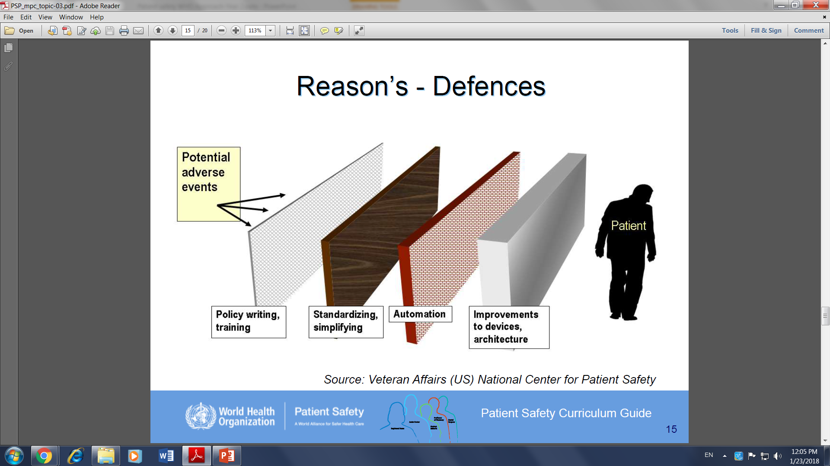

Slide 20
HIGH RELIABILITY ORGANIZATION(HRO)
https://www.youtube.com/watch?v=PbKtzWHOOxA

Slide 21
Understanding the term High Reliability Organization (HRO)
HRO refers to organizations that operate under hazardous conditions, but manage to function in a way that is almost completely “failure-free”.
They have very few adverse events.
Some examples of HROs include
Air traffic control systems,
Nuclear power plants and
Naval aircraft carriers.

Slide 22
Characteristics of HROs
o Preoccupation with failure: acknowledge and plan for the possibility of failure due to the high-risk, error-prone nature of their activities;
o Commitment to resilience: proactively seek out unexpected threats and contain them before they cause harm;
o Sensitivity to operations: pay close attention to the issues facing workers at the frontline;
o Establishing and maintaining a culture of safety in which individuals feel comfortable drawing attention to potential hazards or actual failures without fear of criticism.

Slide 23
The key Principles from HRO theory
are:
o Maintain a powerful and uniform culture of safety
o Use optimal structures and procedures
o Provide intensive and continuing training of individuals and teams
o Conduct thorough organizational learning and safety management.

Slide 24
Conclusion
A systems approach helps us to understand and analyze the multiple factors underpinning adverse events.
Therefore, using a systems approach to evaluate the situation—as distinct from a person approach—will have a greater chance of resulting in the establishment of strategies to decrease the likelihood of recurrence of an error and the promotion of a culture of safety in health care.

Slide 25
APPLICATION: For the following videos;
Provide a summary of the case or scenario presented
Identify and discuss (use handout 1 to guide you )
TWO human factors
OR
TWO characteristics of HRO
OR
TWO Reason’s “Swiss cheese” model of accident causation
3. Summaries the Lesson learned

Slide 26
System Approach to Safety Culture
https://youtu.be/TLeHkU34_Ho

Slide 27
“ Swiss Cheese Model “Application
https://youtu.be/cipFuDxiF2Y
https://youtu.be/CspIrlJ2bd49

Slide 28

THANK YOU

