Slide 1
Learning From Error
Ruaim Muaygil, MD, MBE, HEC-C, PhD
Assistant Professor, Health Care Ethics
Consultant, Clinical Ethics

Slide 2
A 21-year-old male was being treated for non- Hodgkin’s lymphoma. A syringe containing vincristine for another patient had been accidentally delivered to the patient’s bedside. A physician administered vincristine via a spinal route, believing it was a different medication. The error was not recognized and the patient died three days later.

Slide 3
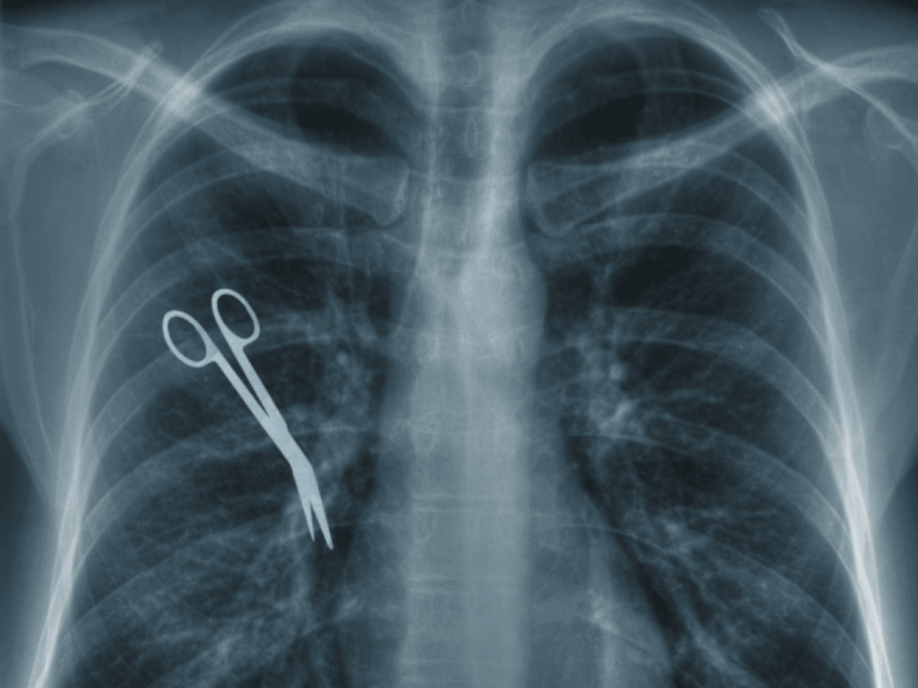
Objectives
Understand the nature of error.
Explain the terms: error, violation, near miss, hindsight bias.
Learn from errors through:
Analyzing adverse events.
Practicing strategies to reduce errors.
Understand how learning from error improves patient safety.

Slide 4
What do we mean by “error”?
Non-deliberate deviation from what was intended:
When someone is trying to do the right thing, but actually does the wrong thing.
“Fancy definition”: A planned sequence of mental or physical activities that fails to achieve its intended outcome, when this failure cannot be attributed to a systematic failure.

Slide 5
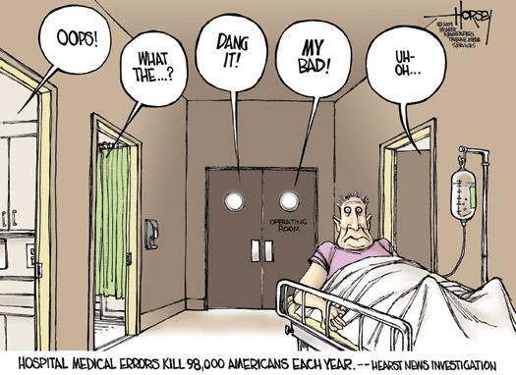
Errors may occur through:
Commission: doing the wrong thing
Omission: failing to do the right thing.
Violations: errors caused by a deliberate deviation from an accepted protocol or standard of care.

Slide 6
Errors and Outcomes
Errors and outcomes are not always linked:
A patient may have a bad outcome without human error (e.g. well-recognized complications.)
Some errors do not result in bad outcomes (e.g. not severe, caught in time.)
Near miss: an incident that did not cause harm.
Still, bad outcomes usually draw attention to errors.
Hindsight bias: the nature of the outcome influences perception of the error.
Knowing an error has occurred negatively affects our perception of the standard of care before and during the incident in question.

Slide 7
Silly Mistakes?
We often commit “silly mistakes” in our daily lives (forget our keys, text the wrong person.)
These same mental processes that lead to silly mistakes are in play in the health care setting.
The consequences, however, are very different: it is the patient who suffers.
Culture of infallibility: medical culture often denies the prevalence of error.

Slide 8
Patterns of Error
Errors occur as a result of two main types of failures:
Error of execution: actions do not go as intended:
Slip: if this action is observable (e.g. accidently pressing wrong button.)
Lapse: if it is not (e.g. forgetting to administer a medication.)
“Mistakes”: a failure of planning:
Rule based: a “wrong” rule is applied. (e.g. wrong diagnosis leads to wrong treatment plan.)
Knowledge based: the clinician does not know the correct course of action. (e.g. in new situations.)

Slide 9
Situations That Increase the Risk of Error
Unfamiliarity with a task:
Students/ junior doctors performing a procedure for the first time
Should be practiced on an educational aid.
If performed on a patient, must be closely supervised.
Shortage of time:
Might result in cutting corners and taking shortcuts (e.g. not washing hands properly.)

Slide 10
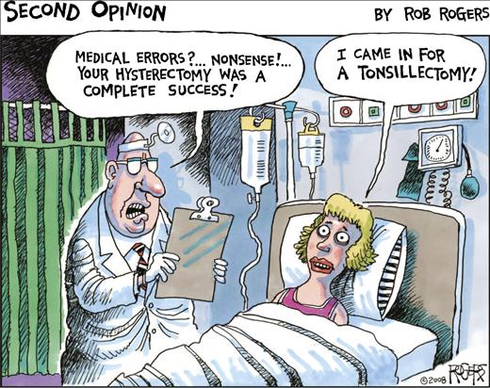
Situations That Increase the Risk of Error
3. Inadequate checking:
Proper checking techniques ensure patients receive the correct medications.
4. Poor procedures:
Inadequate preparation (sterilization, equipment.)
Inadequate staffing.
Inadequate attention to the particular patient.

Slide 11
Individual Factors That Predispose to Error
1. Limited Memory Capacity:
Guidelines and protocols assist clinicians to provide care following the best available evidence.
Checklists not memory.
2. Fatigue:
Known factor in errors. Many countries are reforming the excessive hours worked by doctors.
2004 study: measured the effects of sleep deprivation on medical errors, interns working in the MICU and CCU made substantially more serious mistakes when they worked frequent shifts of 24 hours or more than when they worked shorter shifts.

Slide 12
Individual Factors That Predispose to Error
3. Stress, hunger, illness:
Clinicians must monitor their own well being.
4. Language or cultural factors:
Communication errors caused by language and cultural factors.
Many patient–doctor interactions occur without an interpreter or understanding of the language.
5. Hazardous attitudes:
E.g. being more interested in practicing or getting experience than having concern for the patient’s well-being.

Slide 13
Learning From Error
Incident reporting:
Collecting and analyzing information about any event that harmed or could have harmed a patient.
An incident-reporting system allows the health organization to identify and eliminate “error traps”.
Organizations with a strong reporting culture learn from errors because staff report problems without fear of ridicule or reprimand.
Successful reporting strategies:
Anonymous reporting.
Timely feedback.
Open acknowledgement of successes resulting from reporting.

Slide 14
2. Root cause analysis:
A highly structured system approach to incident analysis that is generally reserved for the most serious patient harm episodes.
Goal is to evaluate, analyze and develop system improvements for the most serious adverse events.
Triages the reported incidents to ensure those indicating the most serious risk to the organization are dealt with first.
Prevention- not blame or punishment.
Systems level vulnerabilities, not individual performance.
Multiple factors: communication, training, fatigue, scheduling, rostering, environment, equipment, rules, policies and barriers.

Slide 15
Root Cause Analysis
Defining characteristics:
Review by an interprofessional team knowledgeable about the processes involved in the event.
Analysis of systems and processes rather than individual performance.
Deep analysis using “what” and “why” probes until all aspects of the process are reviewed and contributing factors are considered.
Identification of potential improvements that could be made in systems or processes to improve performance and reduce the likelihood of such adverse events or close calls in the future

Slide 16
Practice Strategies to Reduce Errors
Know yourself (eat well, sleep well and look after yourself).
Know your environment.
Know your task(s).
Preparation and planning (What if...).
Build checks into the routine.
Ask if you do not know.

Slide 17
Practice Strategies to Reduce Errors
Assume that errors will be made. Be prepared for them.
Identify those circumstances most likely to lead to errors.
Have contingencies in place to cope with problems, interruptions and distractions.
Always mentally rehearse complex procedures or if it is the first time you are doing an activity involving a patient.

Slide 18
Helpful Tips
Avoid reliance on memory.
Simplify processes.
Standardize common processes and procedures.
Routinely use checklists.
Decrease the reliance on vigilance.

Slide 19
A 78 year old woman who is blind and deaf without speech is admitted to the hospital clutching her abdomen and moaning. She had been like that for a couple of hours and had also vomited a few times. On examination she had some epigastric tenderness, her heart and lungs were normal, and her blood pressure was slightly low. Routine blood investigations were normal. She is given anti-spasmodic drugs but a few hours later she is still in severe pain. An ultrasound scan ruled out problems with the patient's gallbladder. An endoscopy on the following day produced negative results. On the fifth day, the patient died: the causes undiagnosed, her suffering unrelieved. As the resident prepares to write a case summary, he discovers the patient’s ECG- performed on the date of admission but never checked by the team- showing textbook signs of an extensive acute myocardial infarction. Horrified, the resident shows the tracing to the consultant who says “making a fuss about this won't bring her back.”

