Slide 1
Introduction to Quality Improvement Methods

Slide 2
Learning objective
To describe the principles of quality improvement.
To introduce the basic methods and tools for improving the quality of health care.
To understand the benefits of using quality improvement methods.
To apply the principles and use the tools to undertake their own improvement project.

Slide 3
The purpose of Quality improvement methods
Identify a problem;
Measure the problem;
Develop a range of interventions designed to fix the problem;
Test whether the interventions worked

Slide 4
The science of improvement
The role of measurement in improvement
Measurement (collect and analyze data )is an essential component of quality Improvement.
There is strong evidence to show that when people use the appropriate measures to measure change, significant improvements can be made.
All quality improvement methods rely on measurement

Slide 5
The science of improvement
Three main types of measures
Outcomes Measures
Are results of overall process or system performance , reflect the impact of the health care service
Example: The 30-day mortality rate
Processes Measures:.
Example: Bed occupancy rate
Structure Measures:
Measures of infrastructures, capacity and system
Example: Nursing to patient ratio in the ICU
They measure if parts of steps in the system are performing as planned

Slide 6
Picturing the Data
There are many valuable tools for interpreting and presenting data eg. pie chart, bar chart ,line chart
Type of graph :
Bar chart
Pie chart
Line chart

Slide 7
Bar chart
Bar charts are one of the most commonly used types of graph.
The bar chart displays data using a number of bars, each representing a particular category
useful for looking at a set of data and making comparisons

Slide 8
Pie chart
A pie chart is a circular graph that shows the relative contribution that different categories contribute to an overall total.

Slide 9
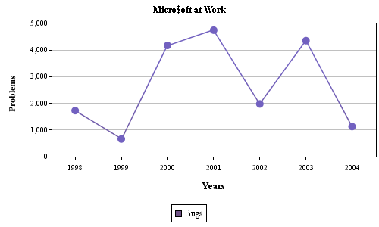
Line chart
A line graph, also known as a line chart, is a type of chart used to visualize the value of something over time

Slide 10
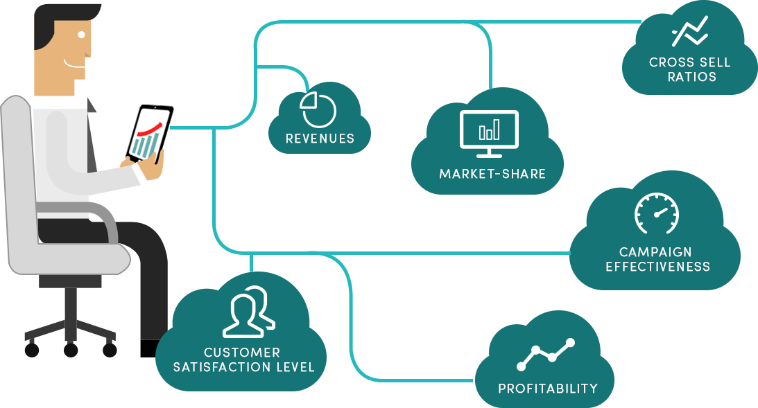
Performance Improvement methods
FOCUS
PDCA
RCA
QIP
BRAIN
STORMING

Slide 11
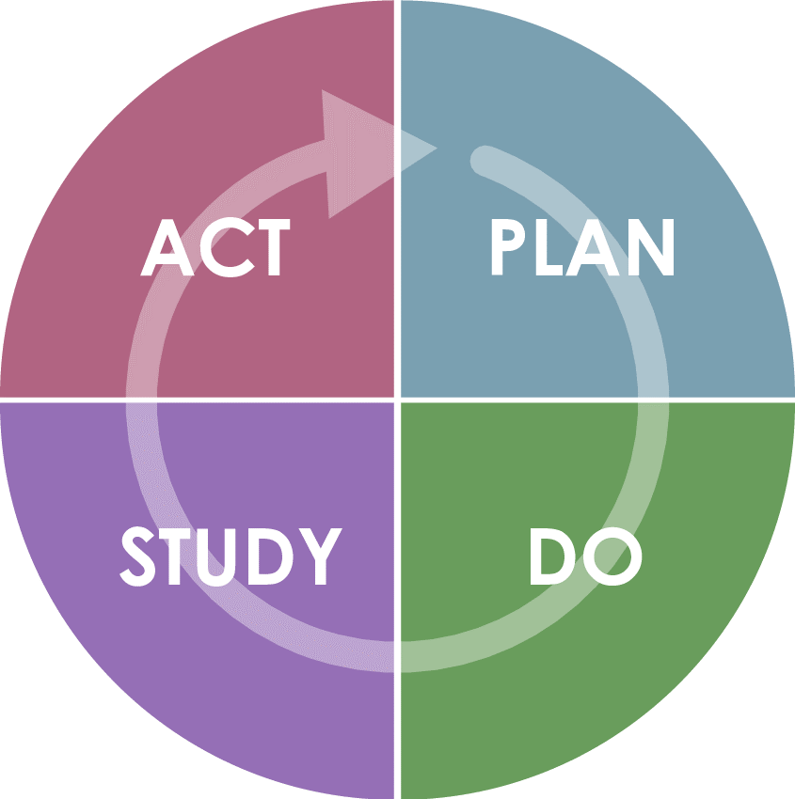
improvement model- (Plan-do-study-act cycle)
The IHI model has two parts:
Three fundamental questions, which can be addressed in any order
The PDSA cycle to test and implement changes in real work settings—the PDSA cycle guides the test of a change to determine if the change is an improvement.

Slide 12
PDSA
Plan: Define the problem to be addressed, collect relevant data, and ascertain the problem's root cause.
Do: Develop and implement a solution; decide upon a measurement to gauge its effectiveness.
Study: Confirm the results through before-and-after data comparison.
Act: Document the results, inform others about process changes, and make recommendations for the problem to be addressed in the next PDCA cycle.

Slide 13
improvement model-(Plan-do-study-act cycle)

Slide 14
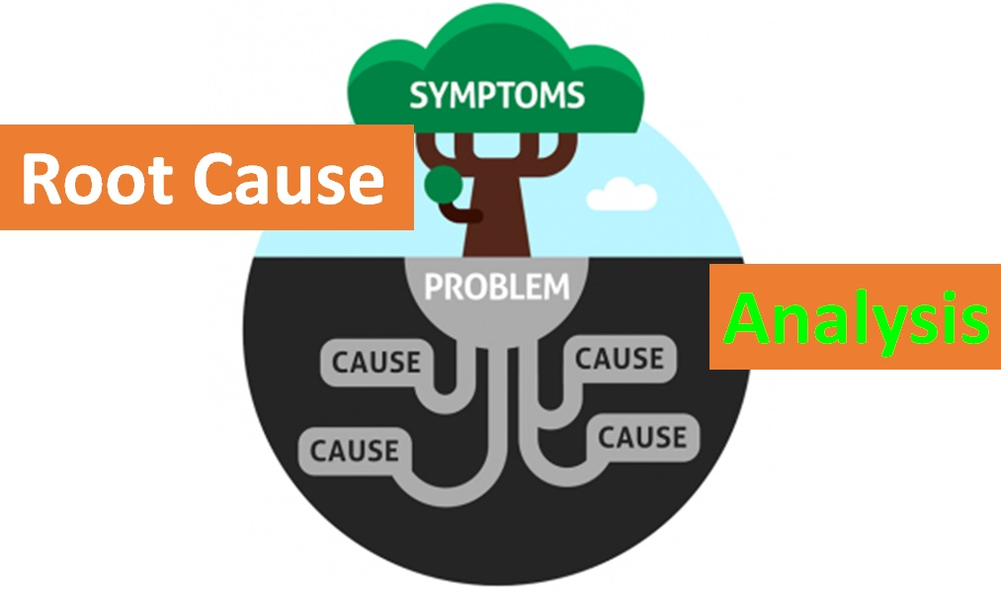
Root cause analysis (RCA) (ishikawa/fishbone)
Is a defined process that seeks to explore all of the possible factors associated with an incident by asking what happened, why it occurred and what can be done to prevent it from happening again.
A tool for solving problems. The diagram is used to explore and display the possible causes of a certain effect

Slide 15
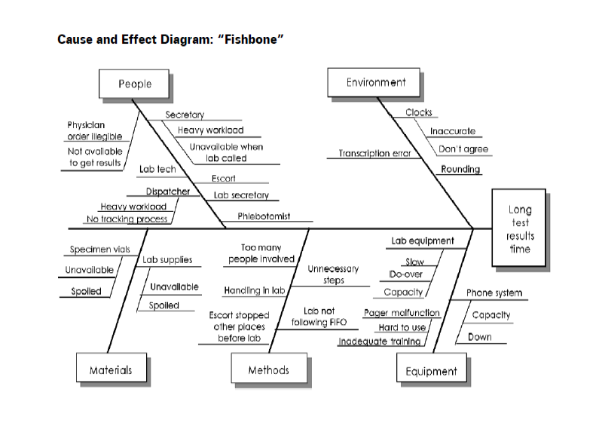
Root cause analysis (RCA) (ishikawa/fishbone)

Slide 16
An effective root cause analysis requires the following components
Multidisciplinary team
The team develops a problem statement

Slide 17
Root cause analysis effort is directed towards finding out what happened
Documentation and review (medical records, incident forms, hospitals guidelines, literature review
Site visit—to examine the equipment, the surroundings and observe the relationships of the relevant staff

Slide 18
improvement model- Root cause analysis (RCA)
Establishing the contributing factors or root causes are accomplished through A brainstorming process of all possible factors:
Environmental factors: e.g. The work environment; medico-legal issues
Organizational factors: e.g. Staffing levels; policies; workload and fatigue
Team staff factors: e.g. Supervision of junior staff; availability of senior doctors
Individual staff factors: e.g. Level of knowledge or experience
Task factors: e.g. Existence of clear protocols and guidelines
Patient factors: e.g. Distressed patients; communication and cultural barriers between patients and staff; multiple co-morbidities.

Slide 19
QUALITY IMPROVEMENT PLAN (QIP)
A Quality Improvement Plan is a detailed work plan intended to enhance an organization’s quality in a specific area
Quality Improvement Plan includes essential information about how your organization will design, implement, manage, and assess quality.

Slide 20
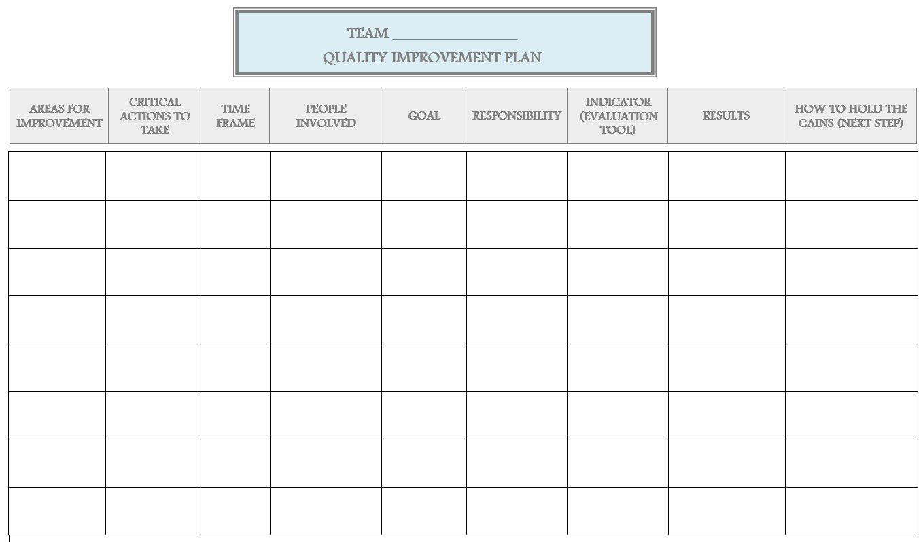
QUALITY IMPROVEMENT PLAN (QIP)

Slide 21
Brain storming
Brainstorming is a technique by which a group attempts to find a solution(s) to a specific problem by amassing ideas spontaneously
It is a highly effective technique for maximizing group creative potential

Slide 22
thanks!
Any questions?

