Slide 1
Engaging with Patients and Carers
Ruaim Muaygil, MD, MBE, HEC-C, PhD
Assistant Professor and Consultant of Health Care Ethics

Slide 2
A 29 year old woman gave birth to a baby boy after an uneventful delivery. Both mom and baby were stable an hour after delivery. The mother began to breastfeed six hours later but encountered some difficulties. She reported the baby looked “too sleepy” but was reassured by the nurse. Both mom and baby were discharged 36 hours later per hospital protocol. Before discharge, the baby was noted to have mild jaundice but the mother was assured it will disappear in a few days. While at home, breastfeeding difficulties continued and the baby’s jaundice increased. The mother took him to the ED 72 hours later. A bilirubin test was ordered and found to be within normal. The ED doctor dismissed the mother: “Your baby is OK, do not be fearful. I know what I’m saying, I’m the doctor”. At 10 days old, the mother took the baby for his clinic visit. His weight had decreased 20% and his bilirubin test was high, during clinical examination the baby presented clear signs of bilirubin encephalopathy.

Slide 3
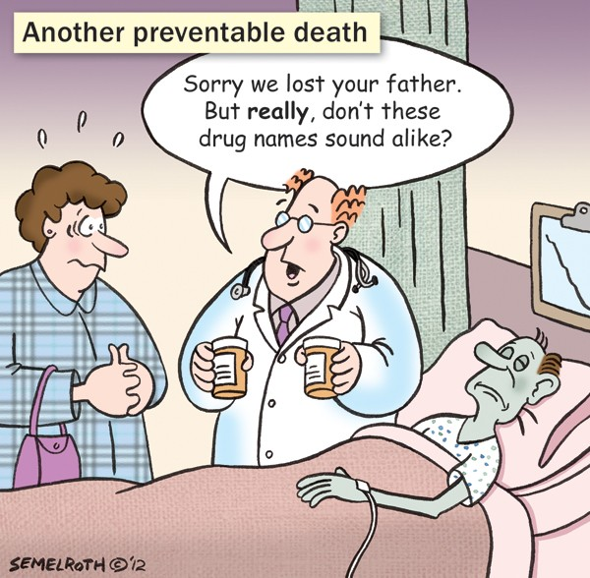
Objectives
Understand the ways in which patients and carers can be partners in health care:
Preventing harm.
Learning and healing from an adverse event.
Understand basic communication techniques.
Learn informed consent procedures.
Recognize the basics of open disclosure.

Slide 4
Engaging with patients and carers is important
Every patient has the right to receive information about the care they are receiving.
Through informed consent, patients-in collaboration with health-care providers- make decisions about interventions.

Slide 5
Ways to Engage Patients
Actively encourage patients and carers to share information.
Show empathy, honesty and respect for patients and carers.
Communicate effectively.
Obtain informed consent.
Show respect for cultural and religious differences.
Understand the basic steps in an open disclosure process.
Apply patient engagement thinking in all clinical activities.
Recognize the place of patient and carer engagement in good clinical management.

Slide 6
Benefits of Patient and Carer Engagement
Patient stories are inspiring:
Patient stories about adverse events are powerful message.
Health care provides must engage with these stories and incorporate new understanding in their practice.
Patients’ experiences play a role in:
Diagnosis.
Treatment decisions
Care provider decisions.
Proper treatment administration.
Identifying adverse events.

Slide 7
SPIKES A Communication Tool
Used to guide in communicating bad news in “end-of-life” situations, but may also be used more generally.
Setting:
Privacy, significant others, sit down, listen.
Perception:
Ask patients what they think is going on.
Invitation:
Ask patients how much they want to now about their diagnosis and treatment.
Knowledge:
Help patients anticipate disturbing news.
Empathy:
Listen for and identify the emotions, identify the source, acknowledge emotion, be quiet.
Strategy and Summary:
Summarize key information, encourage questions, assess understanding, share plan.

Slide 8
Communications Techniques Helpful Statements
How can we ask patients to describe their feelings?
I imagine this is difficult news.
You appear to be angry. Can you tell me what you are feeling?
Does this news frighten you?
Tell me more about what you are feeling about what I have just said.
I’ll try and help you.
Is there anyone you would like me to call?

Slide 9
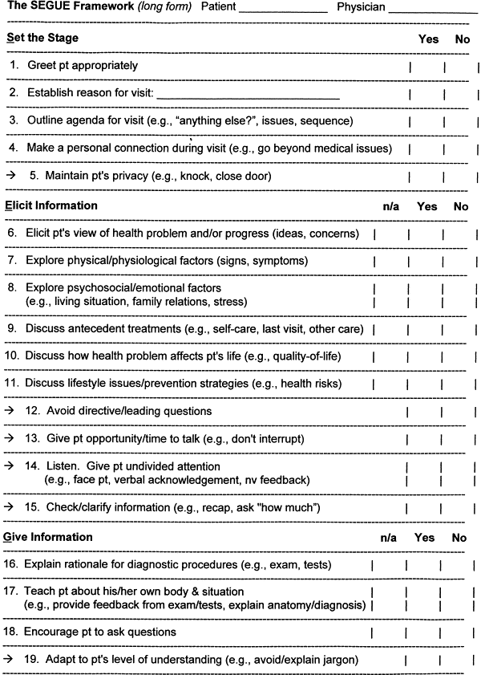
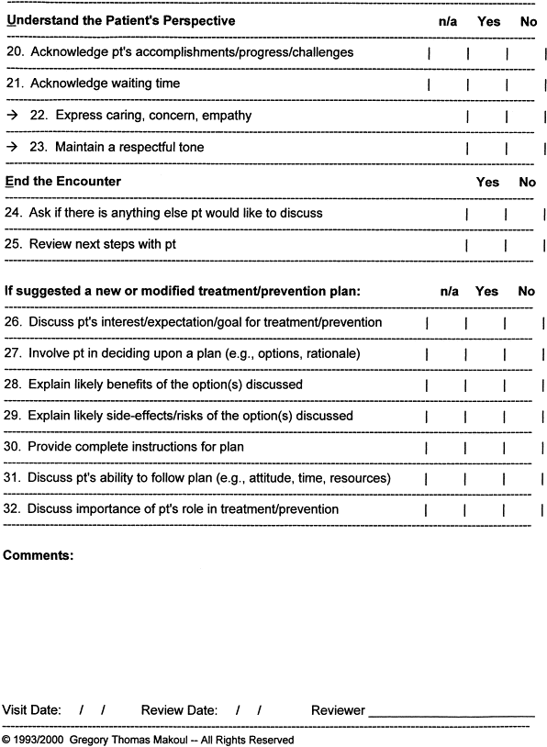
Aiding Good Communication SEGUE Framework
Set the stage
Elicit information
Give information
Understand the patient perspective
End the encounter.

Slide 10
Aiding Good Communication Cultural Competence
Cultural competence: knowledge, skills and attitudes necessary to provide care in a way that respects and honors cultural values:
Be aware and accept cultural differences.
Be aware of one’s own cultural values.
Recognize that people have different ways of interpreting the world.
Recognize that cultural beliefs impact how patients perceive their health, treatment options, and health practitioners.
Be willing to fit in with the patient’s cultural or ethnic background.

Slide 11
Gaining Informed Consent
Consent is more than a signature on a form.
The consent process enables the patient or carer to consider all options.
Information exchange is a process not an event.
Elements of informed consent:
Elements which inform the patient:
Disclosure of information by the health-care practitioner.
Understanding or comprehension of the information by the patient.
Elements that enable the patient to make a decision:
Free and voluntary choice by the patient.
Competence. Ethical terminology: “Decision making capacity.”

Slide 12
What information do patients need?
The diagnosis.
The degree of uncertainty in the diagnosis.
Risks involved in the treatment.
Benefits of the treatment.
Information on recovery time.
Name, position, qualifications and experience of health workers who are providing the care and treatment.
Availability and costs of any service required after discharge from hospital.

Slide 13
Open Disclosure
Informing patients and their families of bad outcomes of health-care treatment, as distinguished from bad outcomes that are expected from the disease or injury being treated. This includes:
Expressing regret for what has happened.
Providing feedback on investigations.
Providing any information arising from the incident or its investigation that would lead to improved patient safety.

Slide 14
Key Principles of Open Disclosure
Open timely communication.
Acknowledgement of the incident.
Expression of regret/apology.
Recognition of the reasonable expectations of the patient and their carer.
Support for staff.
Confidentiality.

Slide 15
The Harvard Framework for Disclosure
Preparing:
Review facts, identify and involve participants, choose appropriate setting.
Initiating conversation:
Determine patient and family readiness, level of medical understanding.
Presenting the facts:
Simple description, speak slowly, explain current outcome, describe next steps.
Sincerely acknowledge the patient's and family’s suffering.
Active listening:
Allow ample time for questions, do not monopolize the conversation.
Acknowledging what you have heard.
Responding to any questions.
Concluding the conversation:
Summarize, repeat key questions raised, establish the follow-up.
Documentation:
Describe the event, describe the discussion.

Slide 16
Do patients want disclosure of adverse events?
Studies have shown that a majority of patients want:
An explanation of what happened.
An admission of responsibility.
An apology.
The assurance of prevention of similar events to others in the future.
Punishment and compensation.
Common barriers to disclosing adverse events:
Want to avoid confrontation.
Causing more distress to patients
Loss of reputation, job, insurance.
Fear legal action.

Slide 17
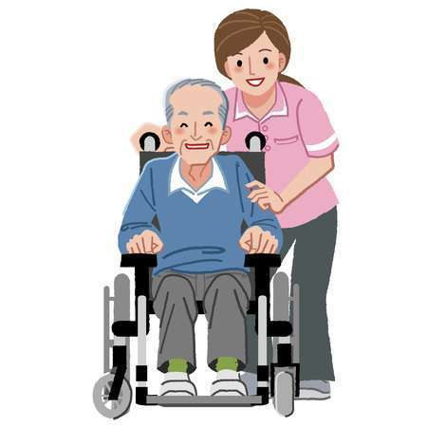
Promoting patients’ Involvement in Their Own Care
Patients who play active roles in the management of chronic health conditions enjoy better outcomes.
Patients and their families can be made aware of opportunities to engage in adverse event prevention by:
Awareness raising about the risks of preventable harm.
Encouragement to speak up to providers about safety concerns.

Slide 18
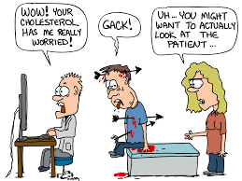
What do you think?
Are these checklists and tools helpful or do they dehumanize the clinical encounter?
Is this a “scientification” of the moral aspect of medicine?

