Slide 1
Professionalism Orientation ,Overview Key Elements Accountability ,Integrity and Altruism
Prof. Hanan Habib
College of Medicine

Slide 2
Professionalism Course
Course title : Professionalism
Code : SKL 221
Target : Second year medical students
Course duration : First semester
Credit hours : Two

Slide 3
Professionalism Orientation and Introduction to the Course
Aim and objectives of the professionalism course
Teaching and learning strategies
Student’s assessment and evaluation
References

Slide 4
Aims of the course
The aim of the course is to have a graduate medical students with commitment to highest standards of excellence in the future practice of medicine and to sustain the interest ,welfare and safety of the patients.
To display adequate responsibility towards the needs of the society.

Slide 5
Objectives of the course
Define the attribute of professionalism
Practice effectively in teamwork during an inter-professional activity
Demonstrate the attributes and behavior of a professional medical student
Recognize and mange conflicts at work place
Demonstrate commitment of life long learning and professional development and the capacity for reflection and self –evaluation
Work effectively with patients , their families, colleagues and other health professionals.
Practice as a volunteer for the community services in collaboration with health societies and agencies.

Slide 6
Professionalism course: Topics / Sessions
Eight topics :
One hour each EXCEPT THREE topics given in two sessions ( 2 hours),other topics one hour
For details about the course ,read the guide for tutors and students.

Slide 7
Teaching methods
Interactive lecture/group discussion
Student led seminar/team based learning
Inter-professional team
Preparation of volunteering works and awareness campaigns
Attending seminars in collaboration with health education.
Others.

Slide 8
Teaching methods student led seminar, projects , projects & other activities
Includes assignments and projects. Students at each group will be divided into 3 subgroups at the beginning of the academic year.
Each subgroup shall participate in one topic/session ( preparation, discussion and presentation).
Materials of the topic , summary handouts and references and instructions will be given to involved group earlier at the start of the course and before the day of the session to help in preparing the topic.
Students in the presenting group will be evaluated after presentation and discussion.
Evaluation of the involved group will be counted with continuous assessment ( 40 marks)
All students must attend all activities.

Slide 9
Student’s Evaluation & Assessment
CA: seminar ,activities, projects, tutor evaluation and mini-OSCE , total 40 marks
Participation in group discussion and activities will also be evaluated even for one session topics.
No repeat of evaluation for absence from a session.
FINAL: MCQs & SAQs = 60 marks
Total mark = 100

Slide 10
Professionalism course SKL-221 Overview

Slide 11
Professionalism & Key elements contents:
-Definitions of professionalism
-Why professionalism is important?
-Professionalism in medicine
-Concepts of professionalism
-Key elements
-Importance of accountability, integrity& altruism
-Practical examples during discussion
-References

Slide 12
Definitions of Professionalism
Profession is an occupation whose core elements is work, based on the mastery of a complex body of knowledge and skills.
Oxford English Dictionary
Professionalism “constituting those attitude and behaviors that serve to maintain patient interest above physician self-interest.”
American Board of Internal Medicine
Professionalism is exhibited by one of the professional character, spirit , methods or the standing practice , or methods of a professional as distinguished from an amateur’’. American College Dictionary
Professionalism and ethics are different.
Professionalism :are skills, competence and conduct displayed by an individual at certain profession.
Ethics: are guides for an individual which clearly states the dos and don’t’s.

Slide 13
Why Professionalism Is Important?
There is a great increase in interest in developing medical professionalism of the students.
The ethical demands upon medical profession have increased due to changes in the traditional modes of health care delivery, increased complexity in the methods of reimbursement, and developing national trends toward managed care.
Most patients desire to be treated by a physician ,who is in addition to be competent, care deeply about his/her patients.
Professionalism denote the way of behaving in accordance to certain normative values
Professionalism is not about competent and skillful ,it is about behaving in an ethical way
Effective management of relationships.

Slide 14
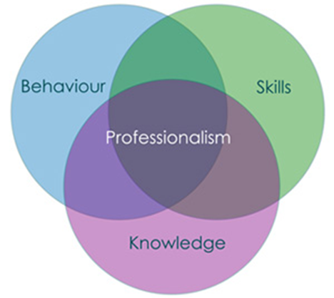
Professionalism In Medicine
Professionalism embodies the relationship between medicine and society as it forms the basis of patient –physician trust. It attempts to make tangible certain attitudes, behaviors , and characteristics that are desirable among the medical profession.
University of Ottawa,2012
Medical professionalism is the ‘heart and soul of medicine.’ more than adherence to a set of medical ethics , it is the daily expression of what originally attracted them to the field –a desire to help people and to help society as a whole by providing quality health care.
Advancing medical professionalism to improve health care. ABIM Foundation , 2013

Slide 15
Concepts of Professionalism
Professionals have codes, guidelines, creeds, oaths, commitments statements, belief statement such as statement on ethics.
Professionals in many professions are licensed, certified and specific initial and advanced education, many require both initial and ongoing testing for admission and maintaining membership.
Examples of professionals : medical doctors, engineers, pilots, etc,..

Slide 16
Professionalism :Key elements

Slide 17
Professionalism
Key elements of professionalism
Bases of professionalism
Excellence
Humanism
Respect
Accountability
Altruism
Integrity
Ethical and legal boundaries
Communication skills
Continuing learning
Clinical competence

Slide 18
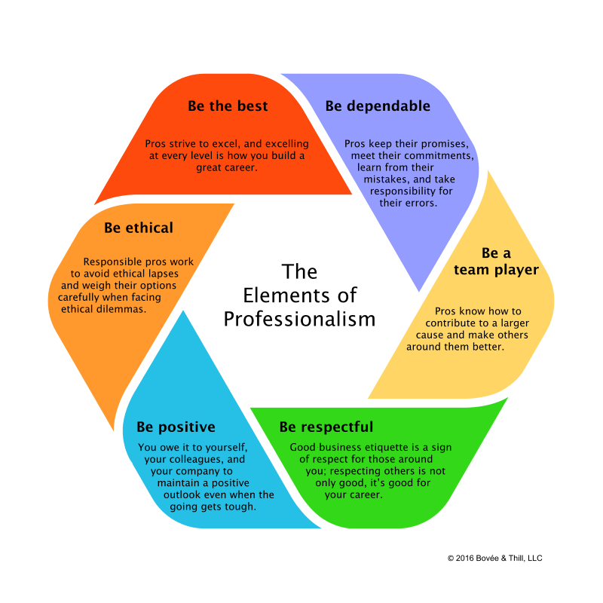

Slide 19
Key Elements
Excellence: ( a talent or quality that is unusually good and surpasses ordinary standards)
Time management /Punctuality
Positive attitude ( enjoy work).
Commitment to life long learning, to exceed ordinary expectations.
Confidentiality.
Consider the language and culture of work.
Give the best of your talents and skills.

Slide 20
Key Elements
Humanism: is the way of being, manifested as :
Compassion, empathy
Encouragement.
Support.
Love and care.
Positive attitude.
Respect
Values and integrity.

Slide 21
Key Elements
Respect:
Respect patients, their families, colleagues, and other healthcare professionals.
Treat patients with dignity and respect.
Demonstrated good attitude and effective communication.
Respect all patients in the same way regardless to their social status and differences.
Respect for feeling of others
Respect for rules
Self-respect

Slide 22
Key Elements
Accountability : Accept responsibility
Definition : procedures and processes by which one party justifies and takes responsibility for its activities.
It comprises: responsibilities to patients
patient-physician relationship
responsibilities to colleagues
responsibilities to the profession
responsibilities to the society and public
5 levels of accountability: personal accountability
individual accountability
team accountability
organizational accountability
stakeholder accountability

Slide 23
Meanings of accountability
1- Responsibility :
To become responsible ( accountable) to patients, their families, society, and community.
To become accountable for quality of care, resolving conflicts, and upholding principles
Avoid business of blaming others
Always consider confidentiality
Honoring patient-physician relationship
Addressing health needs of public
Adhering to medicine percepts and upholding principles

Slide 24
Meanings of accountability, cont.
2-Self regulation in activities: physician’s actions and behaviors should reflect good ethical conduct, and no financial conflict in their performance.
3-Standard setting for current and future members of the profession: to maintain professional standards in our day- to -day practices
4-Ability to resolve conflicts: conflicts may be financial or pharmaceutical. There is a need to disclose any conflict that could damage doctor’s accountability.
5-Free acceptance of duties to serve public: doctors accountable for improving standards of health care of their community , their country and worldwide.
6- Explain and give reason for actions that could have caused harm to the patient, colleagues and community.

Slide 25
Why Accountability is important?
Accountability is the key for providing optimal health care services
Accountability enables continuing improvement in healthcare system
Accountability helps in protecting the rights of patients
Accountability is essential in resolving conflicts
Accountability is essential for building trust and ensuring that workplace environment is safe and healthy
Accountability reflects behavior and attitude of responsible people.

Slide 26
Social Accountability Of A Medical Doctor
Enhancing the community health through education and other community related services
Contributing by research on community health problems and working with team conducting such studies
Committing self to volunteer work that help in improving health care and awareness about diseases in community.

Slide 27
Key Elements
Altruism:
Put the patient first.
Avoid any conflict between your needs and the patients’ rights.
Give full commitment to your patient.
Avoid any financial or relationship biases that could have any negative impact on the patient-doctor relationship

Slide 28
Elements of Altruism
Donate time to humanitarian causes (eg. doctors with no borders)
Help to treat patients who are poor or cannot afford the cost of the service.
Going beyond the call of duty to help patients
Show selfless behavior and the willingness to serve others, particularly those in need.
Unselfish concern for the welfare of others
Subordinate your own interest to the interest of others.

Slide 29
Key Elements
Integrity :
Be a principle-based person.
Be honest, and stand by your words.
Be fair.
Do not abuse your position/authority.
Do what you say.
Behave in a good manner whether you are watched or not.
Adhere to good work-place ethics.

Slide 30
Integrity
Integrity is about demonstrating the values you hold and applying in your day-to day practice
Highest standards of behavior.
Refusal to violate one’s personal professional codes.
Being fair, honest and truthful.
Avoidance of relationships that allow personal gain to supersede the best interest of patients.
Not working in the darkness or involved in any behavior that aims at harming others or taking their rights without their knowledge.

Slide 31
Integrity ..cont.
Keeping one’s word.
Avoidance of relationships that allow personal gain to supersede the best interest of patients.
Not working in the darkness or involved in any behavior that aims at harming others or taking their rights without their knowledge

Slide 32
References
Feldman. M , Christensen. J. behavioral medicine . A guide for clinical practice(latest edition).New York. McGraw- Hill Medical
Spandorfer. J, Pohl.CA , Rattner .SL, Nasca.TJ. professionalism in medicine. A case-based guide for medical students ( latest edition).Cambridge University Press.UK.
Stern. DT. Measuring medical professionalism ( latest edition).Oxford University Press.UK
References recommended by tutors.

