Slide 1
Continuous Professional Development
Prof. Hamza Muhammad Abdulghani
&
Dr. Kamran Sattar
Dept. of Medical Education
College of Medicine
King Saud University

Slide 2
عن عائشة رضي الله عنها أن رسول اله صلى الله عليه وسلم قال:
” إن الله يحب إذا عمل أحدكم عملا أن يتقنه“
“Allah loves when one of you to do it well”
رواه الطبراني

Slide 3
http://www.healthandsafetyatwork.com/hsw/risk-assessment/competence

Slide 4
Objectives
At the end of this session the students should be able to;
Describe Competence
Identify different levels of Competence?
Practice the Continuous Prof: Devp: (CPD)
Apply the Reflective Learning in day to day learning

Slide 5
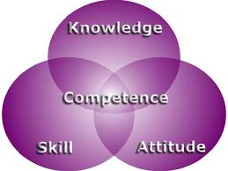
WHAT MEDICAL COLLEGES WANT?
http://teresachinn.co.uk/is-nursing-competence-evident-online/

Slide 6
WHAT MEDICAL COLLEGES WANT? Competence Cont:
Proficiency
Communication skills
Interpersonal skills
Confidence
Critical thinking & problem solving skills
Flexibility
Self motivation
Leadership
Teamwork

Slide 7
Deanship of all Medical Colleges In Saudi Arabia, a national call to define the competencies of medical graduates has been given a higher priority with the expansion of medical education in the Kingdom (BinAbdulrahman 2008, 2011).
Saudi-Med
Documents

Slide 8
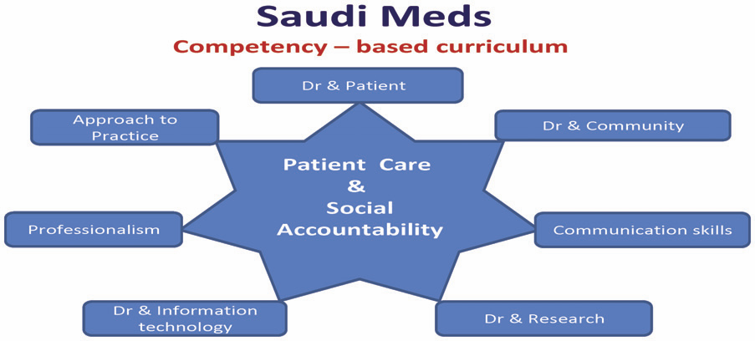
Core competencies
The national competence framework that has been developed by medical schools in the Kingdom of Saudi Arabia (SAUDI MEDS)
Saudi Meds: A competence specification for Saudi medical graduates
RANIA G. ZAINI, KHALID A. BIN ABDULRAHMAN, ABDULAZIZ A. AL-KHOTANI, ABDOL MONEM A. AL-HAYANI, IBRAHIM A. AL-ALWAN & SADDIG D. JASTANIAH Medical Teacher, 2011; 33: 582–584

Slide 10
KSU Medical College Outcomes
Communication and consultation skills
Clinical care
Health promotion and disease prevention
The family and community context of healthcare
Personal professional development
Use of technology and information gathering
Attitudes, ethics and professionalism
Research

Slide 11
Think, Pair & Share
Every five of you.
Why We Are Here?
TO HELP

Slide 12
Levels of competence:
Consultant
Intern
Medical student
Registrar
Resident

Slide 13
Levels of competence
Medical student
Intern
Resident
Consultant
Registrar
Novice
Advanced beginner
Competent
Proficient
Expert

Slide 14
Think, Pair & Share
Every five of you.
What is your definition of COMPETENCE ?

Slide 15
Definition of competence:
“ The ability to perform a specific task in a manner that yields desirable outcomes”.
Notes:
The last objective is kept here that we are ready to apply it in our daily work.

Slide 16
Different Aspects of Competence
Knowledge
Skills
Abilities
Competence develops over time and is nurtured by reflection on experience

Slide 17
Attitudes
Skills
Does
Shows how
Professionalism
Knows how
Knowledge/
Cognition
Knows
Miller’s Pyramid
Notes:
Psychologist Miller's Pyramid/Prism of Clinical Competence (1990) ... George Miller proposed a framework for assessing levels of clinical competence back in 1990.

Slide 18
Bloom’s Taxonomy
Evaluation
Synthesis
Analysis
Application
Comprehension
Knowledge
Notes:
Bloom's Taxonomy was created in 1956 under the leadership of educational psychologist Dr Benjamin Bloom in order to promote higher forms of thinking in education such as analyzing and evaluating, rather than just remembering facts (rote learning).

Slide 19
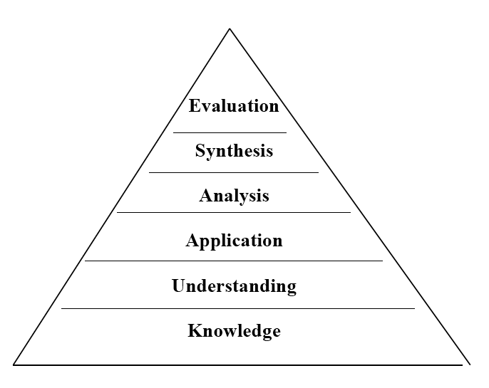
Hierarchy of Knowledge Bloom’sTaxonomy, 1956
Knowledge - What is the most common cause of...?
Understand - If you see this, what must you consider…?
Application - In this patient, what is causing…?
Analysis,synthesis,evaluation - critical thinking?

Slide 20
Think, Pair & Share
Every five of you.
What is your definition of
Skills ?

Slide 21
Skills
Skill is the capacity to perform specific actions
A person’s skill is a function of both knowledge and the particular strategies used to apply knowledge.

Slide 22
Abilities
The power or capacity to do something or act physically, mentally, legally, morally, etc.

Slide 23
Ability is the generic make up of an individual either perceptual or motor in nature that can be inherited from one's parents.
Skill is something that can be learned or acquired through training and can be cognitive, perceptual and motor

Slide 24
Ability (Innate) is performance, or what you are able to do.
Skill (Acquired )
can be taught and/or learned

Slide 25
Skill + Ability
What you have learned to do
and
What you can actually do!

Slide 26
How is competence acquired:
It is gained in the healthcare professions through:
pre-service education
in-service training
work experience
Continuous Professional Development (CPD).
(CPD).

Slide 27
Think Pair & Share
Every five of you
Are you involved in CPD ?

Slide 28
Continuing Professional Development (CPD)

Slide 29
What is CPD?
The conscious updating of professional knowledge and the improvement of professional competence throughout a person's working life.

Slide 30
What is CPD? Cont:
It is a commitment to being professional, keeping up to date and continuously seeking to improve.
It is the key to optimizing a person's career opportunities, both today and for the future.

Slide 31
Why CPD?
Requirement by the governing bodies of the profession
This is only a ostensible reason
Notes:
Superficial

Slide 32
Why CPD?
Cardinal reasons:
Half-life of what we learn is very short.
If we do not update, we will practice obsolete medicine.
There is a high chance that patients will not get optimal care.
Notes:
Main

Slide 33
Why CPD?
Cardinal reasons: cont:
Because as PROFESSIONALS
We as
Students, Teachers, Doctors & Leaders
We all are helping others /dealing with patients

Slide 34
How is CPD different?
CPD is for professionals but not in a formal educational setting
There are no class rooms, prescribed curricula, prescribed learning events, etc.
Therefore, the learner needs to learn from whatever he/she does in the workplace
Also, there are no formal examinations
Motivation to learning comes from the necessity to improve practice.

Slide 35
How can we achieve CPD?
.

Slide 36
Lecture programs
Conferences
Workshops
CME courses
Others …..

Slide 37
How can we achieve CPD?
Many methods have been tried in the past
Currently, Reflective Practice/Learning is the most favoured

Slide 38
What is the Reflective Learning

Slide 39
Reflection
Reflection relates to a complex and deliberate process of thinking about and interpreting experience, in order to learn from it.
Reflection : stages e.g.
An awareness of uncomfortable feeling
Examination of situation
Exploration of alternative actions
Reflective thoughts results in action

Slide 40
What is
Reflective Learning? Cont:
Systematic revisiting of a learning
experience with a view to learning from it
Key to become a lifelong learner – if not most learning opportunities are lost
Why reflection?

Slide 41
Reflective log:
a simplified version
1. What is the learning event?
2. What did I learn?
3. What more do I have to learn?
4. How can I learn it?
5. Evidence for further learning / change of practice?

Slide 42
A scenario (3) :
A 55 year old man came to clinic with complaint of low back pain (LBP).
You have examined his back which was ok. His height was 160 cm, and weight is 100 kg.
You would like to manage this patient’s LBP contributed due to his excess body weight.

Slide 43
Example (LBP)
1. Learning experience – This obese person who needed to reduce weight.
2. What did I learn? Learned how the patient’s activities have been affected by obesity.
3. What do I have to learn more? Did not know the advice that should be given to the patient with a given BMI. Are there guidelines for interpreting BMI?
4. How do I learn it? Refer a book/article. Talk to the dietician.
5. Evidence / change of practice – BMI was accurately interpreted. Patient was advised about the dietary/lifestyle changes and referred to an obesity clinic. References of books referred.

Slide 44
Reflective practice
1. Reflection-in action
2. Reflection-on action

Slide 45
Reflection - cyclical process
Kolb’s cycle
Concrete experience
Reflective observation
Active experimentation
Abstract conceptualisation

Slide 46
Reflection
What is the event?
Evidence for learning / change of practice
Concrete experience
Reflective observation
Active experimentation
What did I learn?
How can I learn?
What more do I have to learn?
Abstract conceptualisation

Slide 47
Experiential Learning
Experience
Plan for Action
Reflect
Make Sense

Slide 48
Constraints on Development
Development is a continuous process
but sometimes
it happens to be a broken continuity
Time
Budgets
Life Cycle Issues
Motivation
Lack of Trust and Real Leadership

Slide 49
Summary:
Competence
Acquired through
Continuous Professional Development
Acquired through
Reflection & Reflective Practice

Slide 50
CPD FINAL THOUGHT
Because we all wish to Help others
But
for that we shall first
Help Ourselves
(Competence CPD Reflective Learning)
to make us able to help

Slide 51
References
Bin Abdulrahman KA. 2011. Saudi Arabia does not need an Abraham
Flexner. Med Teach 33:74–75.
Bin Abdulrahman KA. 2008. The current status of medical education in the
Gulf Cooperation Council countries. Ann Saudi Med 28(2):83–88
Saudi Meds: A competence specification for Saudi medical graduates RANIA G. ZAINI, KHALID A. BIN ABDULRAHMAN, ABDULAZIZ A. AL-KHOTANI, ABDOL MONEM A. AL-HAYANI, IBRAHIM A. AL- ALWAN & SADDIG D. JASTANIAH Medical Teacher, 2011; 33: 582–584

Slide 53
THANK YOU VERY MUCH
& &

