Slide 1
Viral infections of CNS
(CNS Block , Microbiology : 2019)
By: Dr.Malak M. El-Hazmi
Associate professor
Consultant Virologist
College of Medicine &
King Saud University Medical City

Slide 2
Virus neurological diseases:
Acute viral infections of the CNS.
Chronic virus neurological diseases.
Neurological diseases precipitated by viral infections.

Slide 3
OBJECTIVES;
Acute viral infections of the CNS.
Aseptic meningitis , Paralysis &Encephalitis
;
Enteroviruses & polioviruses.
Herpes simplex virus 1.
Rabies virus.
Arboviruses (West Nile virus).
structure
Epidemiology
Pathogenesis
clinical presentations
Lab diagnosis
Treatment & prevention

Slide 4
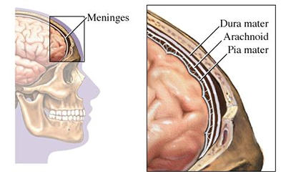
Meningitis
Caused by:
Infectious agents ;
    bacteria
    viruses
    fungi
    protozoa
Non-infectious agents.

Slide 5
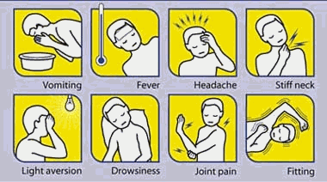
Viral Meningitis
Bacterial Meningitis
Caused by bacteria
Quite severe and may result in
a) brain damage
b) hearing loss
c) learning disability
It would also causes death!
Aseptic meningitis
Caused by virus.
Less severe
Resolves without specific
treatment within a week or two

Slide 6
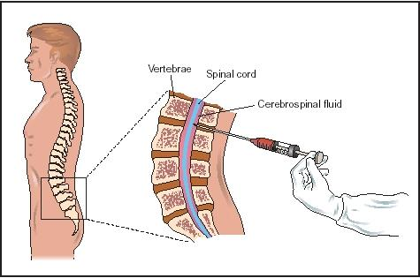
Cerebrospinal fluid (CSF) analysis ;
 | Normal | Aseptic meningitis | Septic meningitis
Colour | Clear | Clear | Cloudy
Cells/mm³ | < 5 | increase 100-1000 Lymphocytes | High/v. high 200-20,000 Neutrophils
Glucose mg/dl | 45-85 | Normal* | Low<45
Protein mg/dl | 15-45 | Normal/high 50-100 | High>100
Causes |  | Viruses* , others | Bacteria

Slide 7
Viral Meningitis (Aseptic meningitis)
Etiological Agents:
  Enteroviruses .**
  Other :
    Mumps virus .
    Arboviruses.
    Herpes viruses.
    Human Immunodeficiency Virus.
    …..

Slide 8
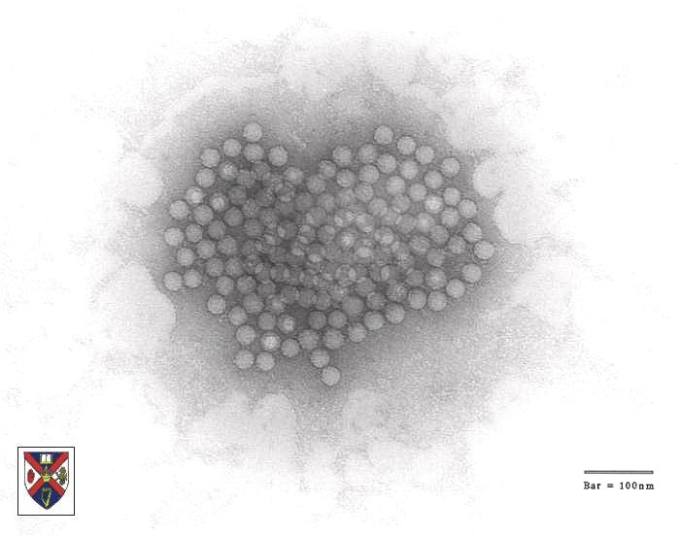
Enteroviruses
- Picornaviridae
Include ;
Poliovirus(1, 2&3 types)
Coxsackieviruses (A&B)
Echoviruses
Enteroviruses (68-71)
Nonenveloped , icosahedral , ss (+) RNA

Slide 9
Epidemiology
Reservoir : Human
Spread :
  Fecal - oral route (mainly)
  Inhalation of Infectious aerosols
  (Crowded, Poor hygiene & Sanitation)
Age : children > adults
Seasonal distribution:
summer & fall

Slide 10
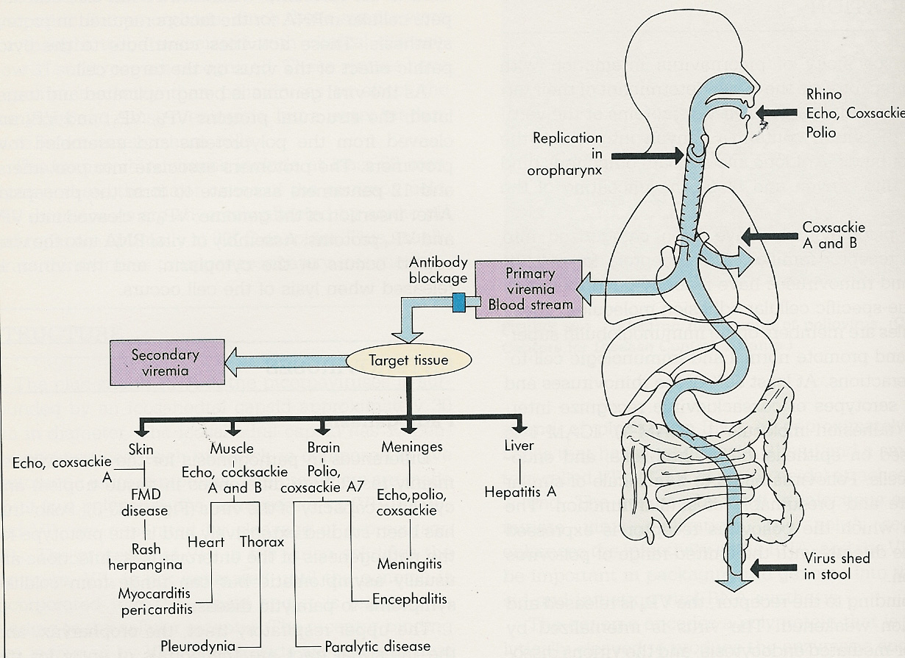
Pathogenesis
HFM
Echo,cox

Slide 11
Enteroviral infections
Asymptomatic Infections*
Diseases;
Neurologic Diseases | Poliovirus Types 1-3 | GP A COX. Types 1-22 | GP B COX. Types 1-6 | Echovirus Types 1-28 | Enterovirus Types 68-71
Aseptic meningitis Paralysis Encephalitis | 1-3 1-3 | Many 7,9 2,5-7,9 | 1-6 2-5 1-5 | Many 2,4,6,9,11, 2,6,9,19 | 71 70,71 70,71
    NON-Neurologic Diseases ;
    Skin and mucosa infections
    Respiratory tract infections
    Cardiac infections
    Acute hemorrhagic conjunctivitis
    Others

Slide 12
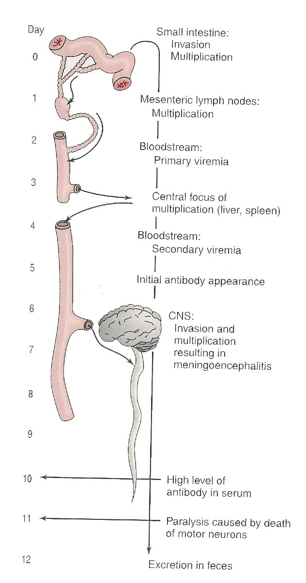
Pathogenesis of polio:
Pathway to CNS by:
  Blood
  Peripheral nerves
Causing destruction of
  motor neurons of AHCs
Rarely affects brain stem
  (bulber poliomyelitis)
Immunity: IgA & IgG
Lifelong type-specific immunity
Immunity: IgA & IgG
Lifelong type-specific immunity

Slide 13
Poliovirus Infections
90-95%
No illness
Asymptomatic
4-8%
Minor Illness
1-2%
Abortive poliomyelitis (No CNS involvement)
Major Illness
1- Nonparalytic poliomyelitis (Aseptic meningitis)
2- Paralytic poliomyelitis: (Flaccid paralysis)

Slide 14
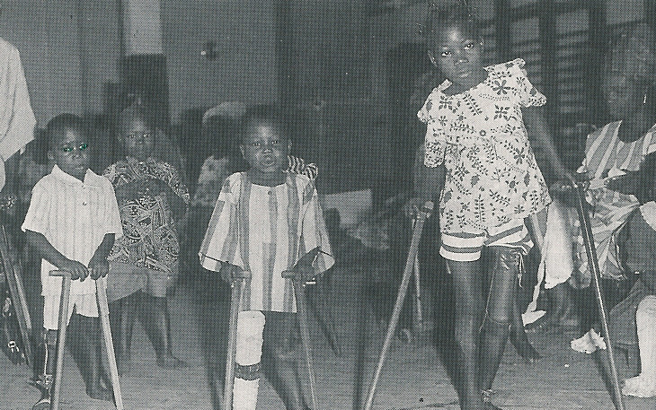

Slide 15
Lab Diagnosis of Enteroviruses
Virus isolation*:
  Samples: Stool (best) .Rectal, throat swabs & CSF
  Inoculate in cell cultures
  All EVs grown except some strains of Cox A viruses
  Observe for CPE
  Identify the type
  CSF in aseptic meningitis; lymphocytosis
  Glucose level N to slightly , Protein level N or slightly
  Isolation rate is variable
  EV RNA detected in CSF by RT-PCR*
Serology (limited value)

Slide 16
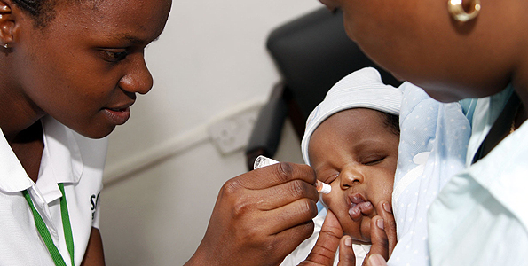
Management
Rx:
  No antiviral Rx
Prevention:
  Sanitation & Hygienic measures
  Poliovirus vaccines
  a- Inactivated polio vaccine
  (IPV)
  (Salk, Killed) (S/C or IM)
  b- Live-attenuated polio vaccine
  (OPV)
  (Sabin, oral)

Slide 17
Important Features of Polio Vaccines
Attribute Killed (IPV) Live (OPV)
3 types (trivalent) Yes Yes
Prevents disease Yes Yes
Induces humoral IgG Yes Yes
Route of administration Injection Oral
Transmission to others No Yes
Affords 2º protection by No Yes spread to others
Reverts to virulance No Yes (rarely)
Causes disease in the immun ed No Yes

Slide 18
Poliovirus Vaccine
Adverse reactions ;
  local reactions (IPV)
  Vaccine -Associated Paralytic Poliomyelitis (OPV)
  adult , immuno ed
4 doses of PV; 2, 4 , 6-18 ms
& 4 - 6 yrs
Combination vaccine ; IPV, DTaP ,Hib & HB vaccines
Polio Vaccination of Adults
Indications:
  Travelers to polio-endemic countries
  HCW
IPV

Slide 19
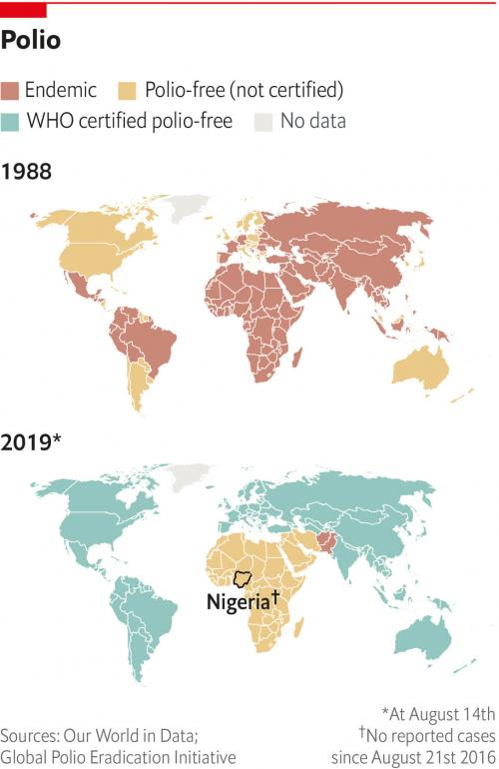

Slide 20
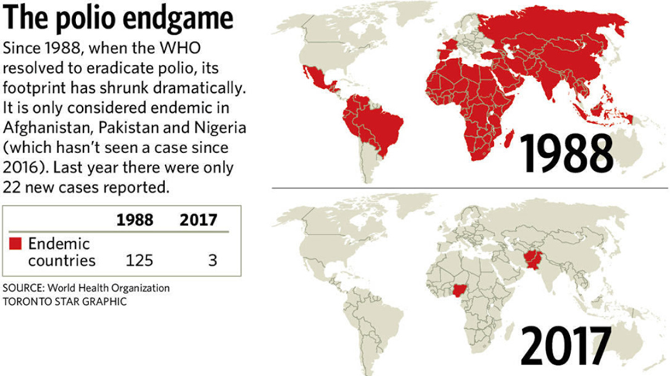

Slide 21
OBJECTIVES;
Acute viral infections of the CNS.
Aseptic meningitis , Paralysis &Encephalitis
;
Enteroviruses & polioviruses.
Herpes simplex virus 1.
Rabies virus.
Arboviruses (West Nile virus).
structure
Epidemiology
Pathogenesis
clinical presentations
Lab diagnosis
Treatment & prevention

Slide 22
Viral Encephalitis
  Enteroviruses
  Herpes viruses.
  Rabies virus
  Arboviruses.
  Others

Slide 23
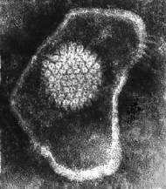
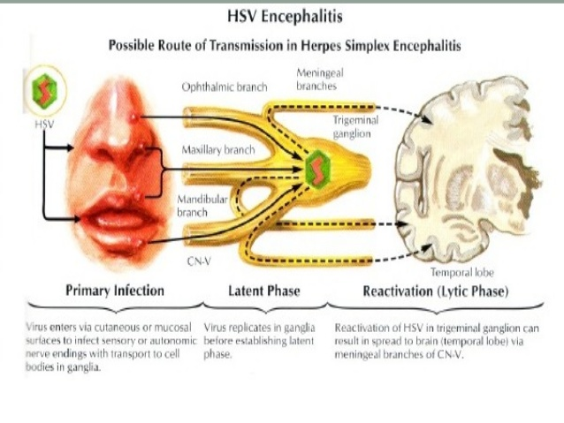
Herpes Simplex Encephalitis
Caused by;
  Herpes simplex virus -1(HSV-1)
  dsDNA , Enveloped , Icosahedral Virus

Slide 24
Herpes Simplex Encephalitis
Caused by;
  Herpes simplex virus -1(HSV-1)
  dsDNA , Enveloped , Icosahedral Virus
C/F;
  F,H,V ,Seizures & altered mental status.
  High mortality rate
Dx;
  MRI(temporal lesion)
  CSF---Lymph, glucose-N & Protain-
  ---detection of HSV-1 DNA by PCR.
Rx;
  Acyclovir.

Slide 25
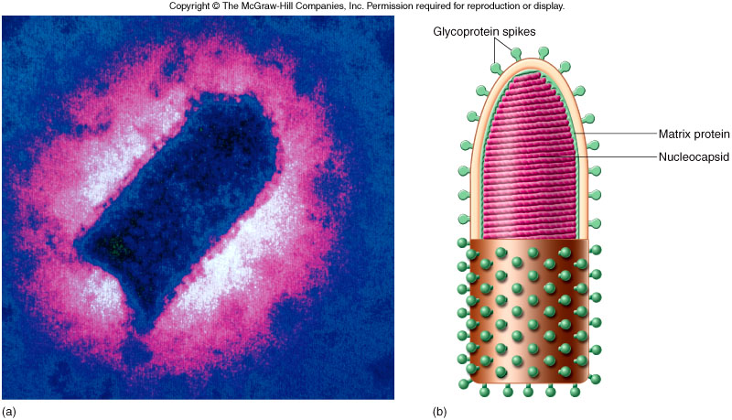
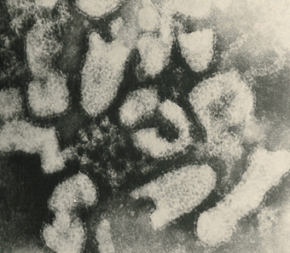
Rabies encephalitis
Rabies virus ;
Rhabdoviridae.
s.s (-)RNA genome,
Helical nucleocapsid,
Enveloped virus.
Bullet shaped virus

Slide 26
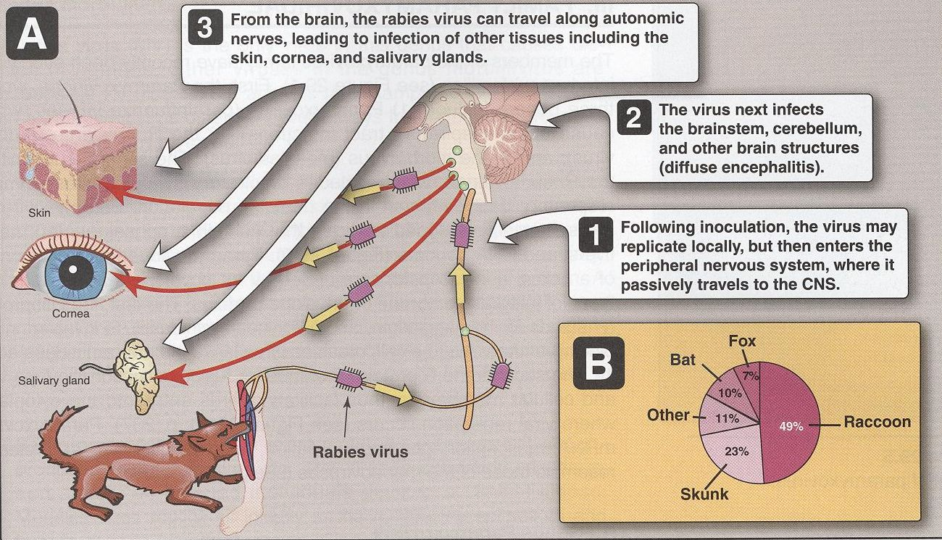
Pathogenesis;
Epidemiology;
Reservoir;
Major;
Raccoons , Foxes,
Wolves & bats.
Imp ; cats & dogs
Transmission;
Common route
Bite of a rabid animal
Uncommon route
Inhalation
while in a bat infested cave.
Corneal transplant

Slide 27
Rabies; A fatal acute encephalitis
zoonotic disease .
1-The incubation period: 1-3 m > longer
2-The prodromal phase:
      F, H , M , A, N &V.
      Abnormal sensation around the wound.
3-Neurological phase ;
1- encephalitis
    Nervous , Lacrimation , salivation,
    Hydrophobia ,
    Convulsion ,coma & death .
2-Paralytic illness ; Ascending , Death , Bat.
4- Recovery; Extremely rare

Slide 28
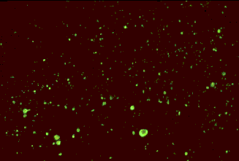
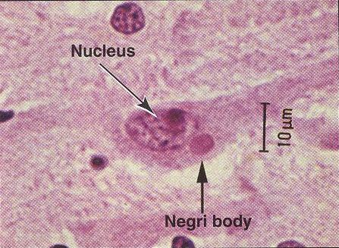
Laboratory Diagnosis
PCR; R. RNA in saliva
Rapid virus antigen detection ( IF )
Neck skin biopsy
Corneal impressions
Brain tissue
Histopathology
Virus cultivation
serology
Rabid brain stained with
Fluorescent rabies antibody
neuronal brain cells
intracytoplasmic inclusions
(Negri bodies)
Negri bodies are diagnostic of rabies.

Slide 29
Prevention
Control measures against canine rabies include;
  Stray animals control.
  Vaccination of domestic animals.
Pre-exposure prophylaxis (Vaccine)
  Persons at increased risk of rabies
  e.g. vets, animal handlers etc.
Post-exposure prophylaxis
  Wound treatment
  Passive immunization;
  human anti-rabies immunoglobulin
  around the wound & I M.
  Active immunization;
    Human Diploid Cell Vaccine (HDCV)**
  5 - 6 doses

Slide 30
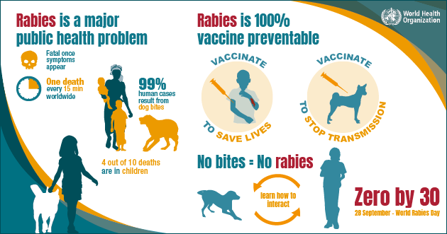

Slide 31
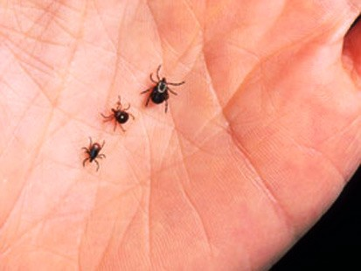

Arthropod –borne Viruses
Arboviruses > 500 Vs
Epidemiology:
  Reservoir: Wild birds & Mammals
  Vector: Mosquito, ticks& Sandfly
  Transmission: bite of infected vector
Infections
  Asymptomatic Infections*
  Diseases
  Fever, Rash & arthralgia
  Hemorrhagic fever ± hepatitis
  CNS disease
  (meningitis & encephalitis)

Slide 32
ArboVs associated with CNS disease:
Virus | Vector | Reservoir | Distribution
Eastern equine encephalitis EEEV | Mosquito | Birds | America
Western equine encephalitis WEEV | Mosquito | Birds | America
Venezuelan equine encephalitis VEEV | Mosquito | Rodent | America
Japanese encephalitis V | Mosquito | Birds Pigs | Orient
Murray Valley encephalitis V | Mosquito | Birds | Australia
West Nile V | Mosquito | Birds | Europe, Africa Middle East Asia, America

Slide 33
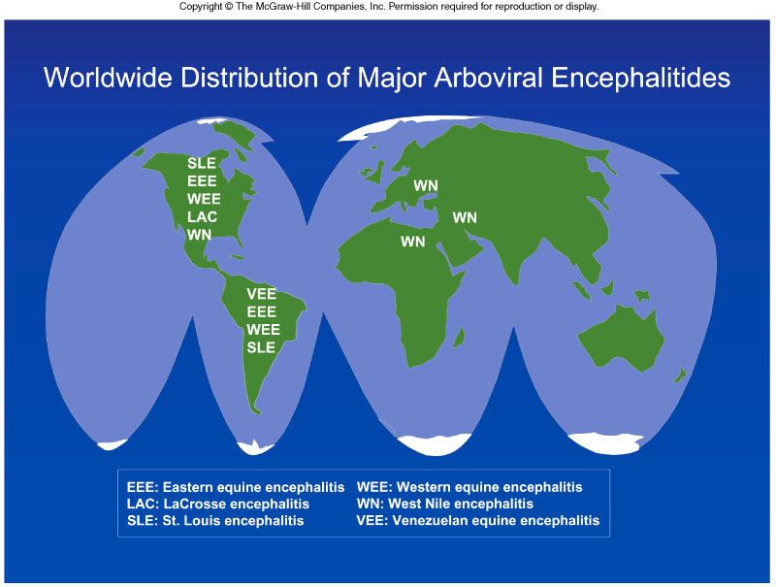

Slide 34
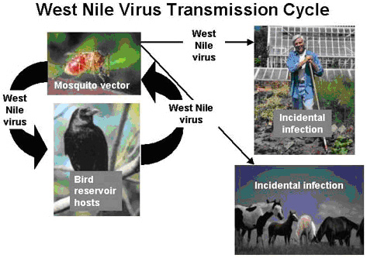
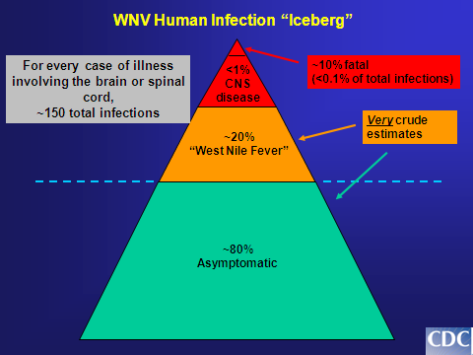
West Nile virus
Flaviviridae
Febrile illness meningitis , encephalitis

Slide 35
Laboratory Diagnosis
  Isolation (Gold standard ) (Reference Lab)
  B - IgM -AB* - ELISA, IF: (most used)
  C - Arbovirus RNA by RT-PCR

Slide 36
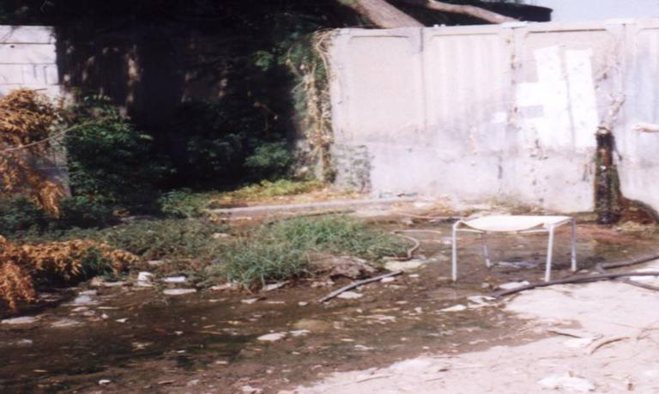
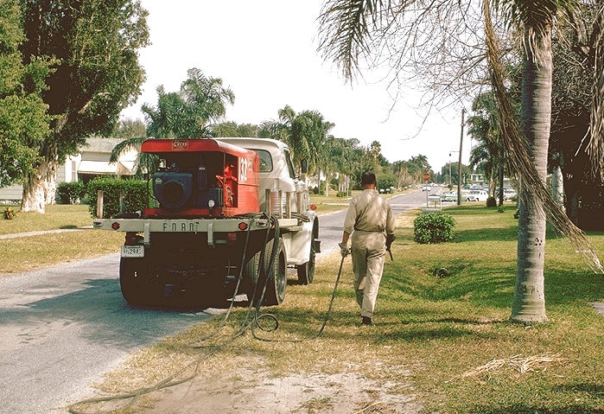
Prevention
  Vector Control:
    Elimination of
    vector breading sites
    using insecticides
    Avoidance contact
    with vectors
    ( repellants , net )
  Vaccines:
  Tick-borne encephalitis vaccine
  Japanese encephalitis vaccine

Slide 37
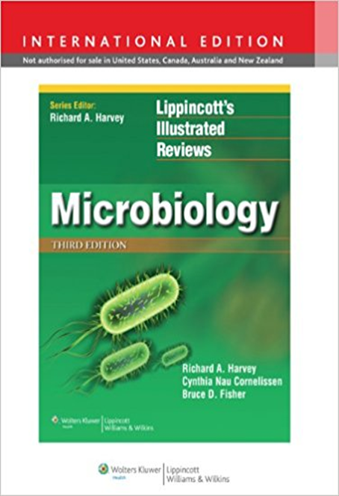
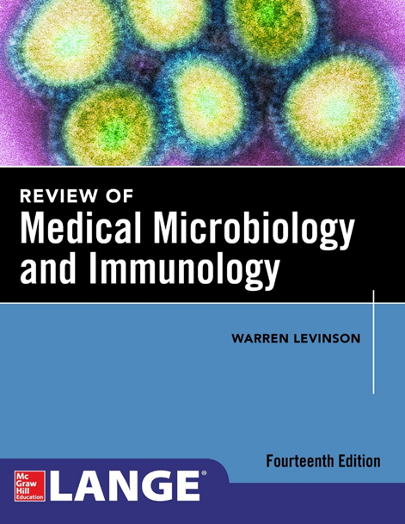
Reference books

