Slide 1
Congenital malformations and hydrocephalus
CNS 2019
Pathology
Maha Arafah
Congenital malfomation
Page: 860 to 862
Hydrocephalus
Page: 851

Slide 2
Objectives:
1. CNS congenital malformation
- Know the common types of congenital malformations of the CNS
- Correlate CNS normal development with the classification of congenital CNS malformations.
Appreciate the role of folate deficiency as an etiological factor in neural tube defects and understand the role of Alpha feto-protein measurement and ultrasound in antenatal diagnosis of neural tube defects.
2. Hydrocephalus
- Understand the various mechanisms that lead to the development of hydrocephalus.
- List and classify the main causes of hydrocephalus

Slide 3
Key principles to be discussed:
Incidence and introduction to the basic concepts behind the pathogenesis. These include genetic and environmental factors and the role of the stage of gestation development.
Definition and pathological changes in neural tube defects:
Meningomyelocele
Spina bifida
Anencephaly and encephalocele
Pathogenesis of neural tube defect with special emphasis on the
role of folate and alpha fetoproteins and their clinical significance.
Definition and pathological changes in forebrain anomalies:
Megalencephaly.
Microencphaly and its causes.
Lissencephaly
Definition and pathological changes in posterior fossa anomalies:
Arnold Chiari malformation.
1. CNS congenital malformation

Slide 4
1. CNS congenital malformation
The incidence of CNS malformations is estimated at 1% to 2%
Malformations of the brain are more common in the setting of multiple birth defects
Causes:
1. Prenatal or perinatal insults give rise to mental retardation, cerebral palsy or neural tube defects
Various chemicals and infectious agents
Timing is important
May lead to failure of normal CNS development or tissue destruction
2. Mutations affecting genes that regulate the differentiation, maturation, or intercellular communication of neurons or glial cells

Slide 5
Definition and pathological changes in neural tube defects:
1. CNS congenital malformation
1. Spina bifida
2. Meningomyelocele 3. Anencephaly and encephalocele

Slide 6
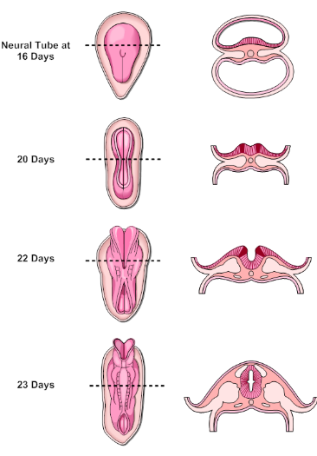
1. CNS congenital malformation

Slide 7
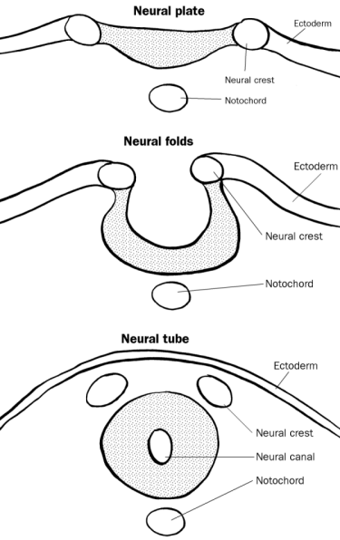
1. CNS congenital malformation
Among the earliest stages in brain development is the formation of the neural tube
The inside of which will become the ventricular system and the wall of which will become the brain and spinal cord

Slide 8
I. Neural tube defect
1. CNS congenital malformation
The most frequent CNS malformations
Failure of a portion of the neural tube to close, or reopening after successful closure, may lead to one of several malformations.
All are characterized by abnormalities involving some combination of neural tissue, meninges, and overlying bone or soft tissues

Slide 9
Neural tube defect
Increased maternal α-fetoprotein (AFP) in serum and/or amniotic fluid in anencephaly, meningocele, or myelomeningocele but not spina bifida occulta
1. CNS congenital malformation
Folate deficiency during the initial weeks of gestation is a risk factor;
prenatal vitamins are aimed as administration of folate to women of child-bearing age reduces the incidence of neural tube defects by up to 70%
The combination of ultrasound and maternal screening for elevated α-fetoprotein has increased the early detection of neural tube defects
The overall recurrence risk in subsequent pregnancies is 4% to 5%
Increased maternal α-fetoprotein (AFP) in serum and/or amniotic fluid in anencephaly, meningocele, or myelomeningocele but not spina bifida occulta

Slide 10
Neural tube defect
1. CNS congenital malformation
The most common defects involve the posterior end of the neural tube, from which the spinal cord forms.
These can range from asymptomatic bony defects (spina bifida occulta) to spina bifida, a severe malformation consisting of a flat, disorganized segment of spinal cord associated with an overlying meningeal outpouching.

Slide 11
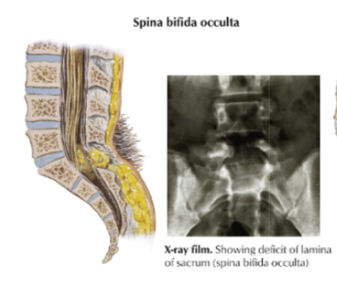
Neural tube defect 1. Spina bifida occulta
1. CNS congenital malformation
Asymptomatic bony defects

Slide 12
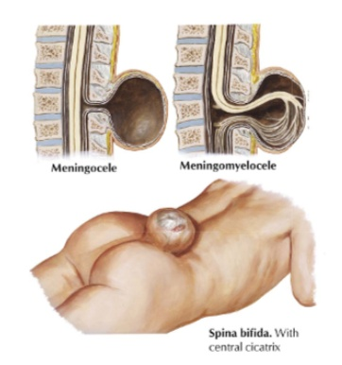
Neural tube defect Spina bifida
1. CNS congenital malformation

Slide 13
Neural tube defect: 2. Meningomyelocele
1. CNS congenital malformation
Myelomeningocele is an extension of CNS tissue through a defect in the vertebral column
Occur most commonly in the lumbosacral region
Patients have motor and sensory deficits in the lower extremities and problems with bowel and bladder control
The symptoms derive from the abnormal spinal cord in this region, often compounded by infections extending from thin or ulcerated overlying skin

Slide 14
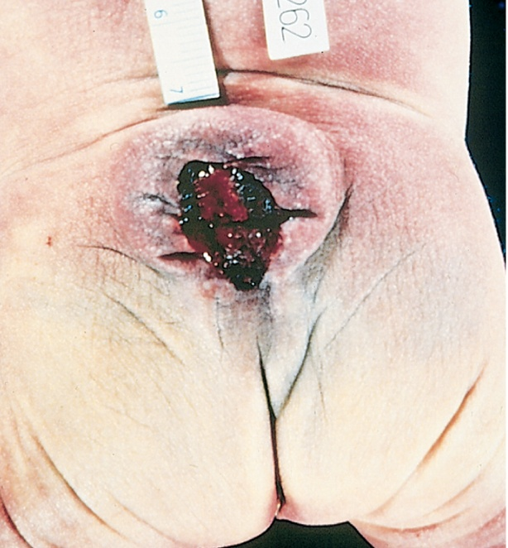
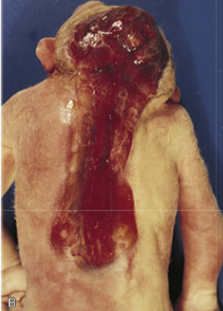
1. CNS congenital malformation

Slide 15
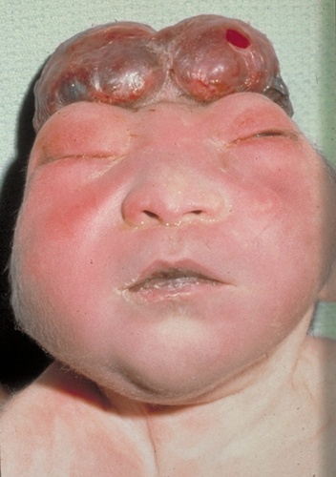
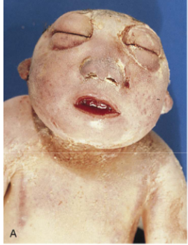
Neural tube defect: 3. Anencephaly and encephalocele
1. CNS congenital malformation
is a malformation of the anterior end of the neural tube, with absence of the brain and top of skull

Slide 16
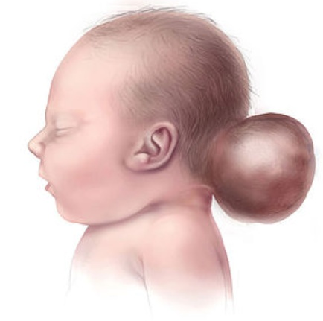
Neural tube defect: 3. Anencephaly and encephalocele
1. CNS congenital malformation
An encephalocele is a diverticulum of malformed CNS tissue extending through a defect in the cranium
It most often involves the occipital region or the posterior fossa
Encephalocele

Slide 17
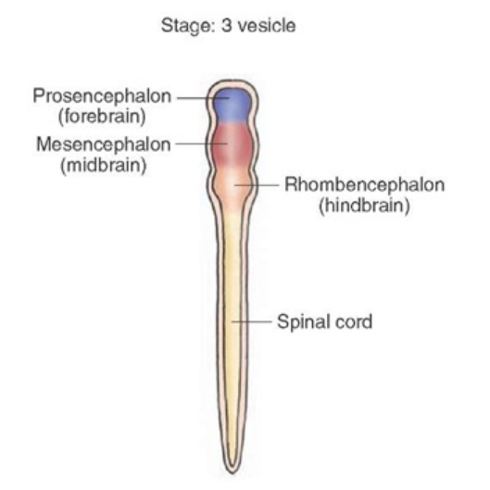
II. Forebrain Malformations:
1. CNS congenital malformation
Megalencephaly
Microcephaly
Lissencephaly

Slide 18
II. Forebrain Malformations Megalencephaly and Microcephaly
1. CNS congenital malformation
The volume of brain may be abnormally large (megalencephaly: rare genetic disorders) or small (microencephaly, more common). Microencephaly, is usually associated with a small head

Slide 19
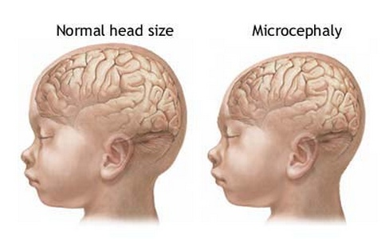
II. Forebrain Malformations Microcephaly
1. CNS congenital malformation
Microencephaly occurs in a wide range of clinical settings, e.g.:
- chromosome abnormalities
- fetal alcohol syndrome
- human immunodeficiency virus 1 (HIV-1) and Zika virus infection acquired in utero
All causes are associated with a decreased number of neurons destined for the cerebral cortex.
Disruption of normal neuronal migration and differentiation during development can lead to a disruption of the normal gyration and
the six-layered neocortical architecture

Slide 20
Six-layered neocortical architecture

Slide 21
II. Forebrain Malformations Lissencephaly
1. CNS congenital malformation
Lissencephaly (agyria) or, in case of more patchy involvement, pachygyria is characterized by an absence of normal gyration and a smooth-surfaced brain
The cortex is abnormally thickened and is usually only four-layered
Single-gene defects have been identified in some cases of lissencephaly

Slide 22
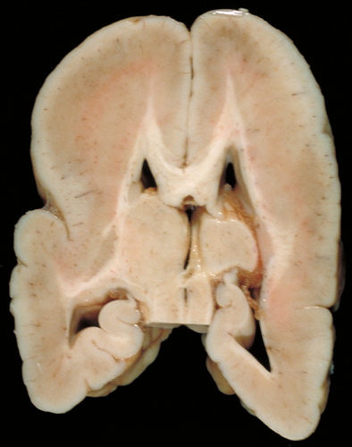
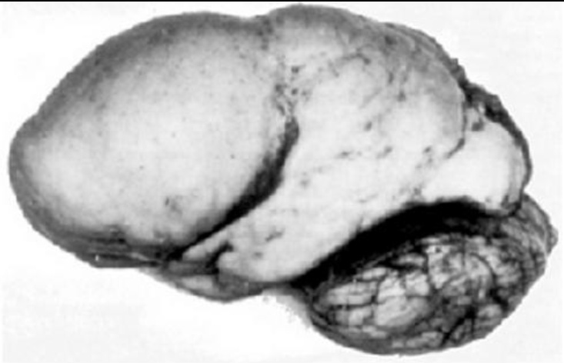
Forebrain Malformations: Lissencephaly
1. CNS congenital malformation
- Cortical sulci are absent except for the Sylvian fissure
- The cortex is thick and consists of the molecular and three neuronal layers
- The deepest of these layers is also the thickest and most cellular, presumably comprised of neurons that migrated a certain distance from the ventricles but failed to reach their normal destinations
- There is a small amount of myelinated white matter between the abnormal cortex and the ventricles

Slide 23
III. Posterior Fossa Anomalies:
1. CNS congenital malformation
Arnold-Chiari malformation

Slide 24
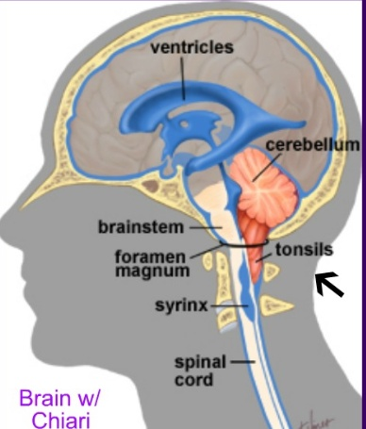
III. Posterior Fossa Anomalies
1. CNS congenital malformation
The most common malformations in this region of the brain result in either misplaced or absent cerebellum
Typically, these are associated with hydrocephalus
The Arnold-Chiari malformation (Chiari type II malformation) consists of:
A small posterior fossa
A misshapen midline cerebellum
Downward extension of vermis through the foramen magnum
Hydrocephalus
A lumbar myelomeningocele
Notes:
In the Chiari I malformation, low-lying cerebellar tonsils extend through the foramen magnum at the base of the skull. This can lead to obstruction of CSF flow and compression of the medulla, resulting in symptoms of headache or cranial nerve deficits. Increasing the space for the tissue through neurosurgery can alleviate the symptoms

Slide 25
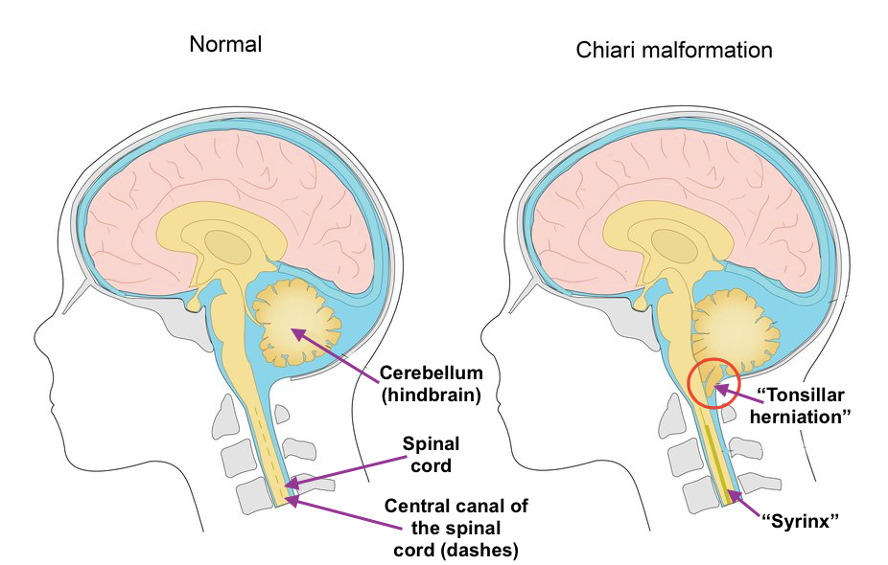
The Arnold-Chiari malformation
1. CNS congenital malformation

Slide 26
2. Hydrocephalus
- Definitions of normal pressure
Hydrocephalus:
noncommunicating vs. communicating hydrocephalus
- Pathophysiology and etiology.

Slide 27
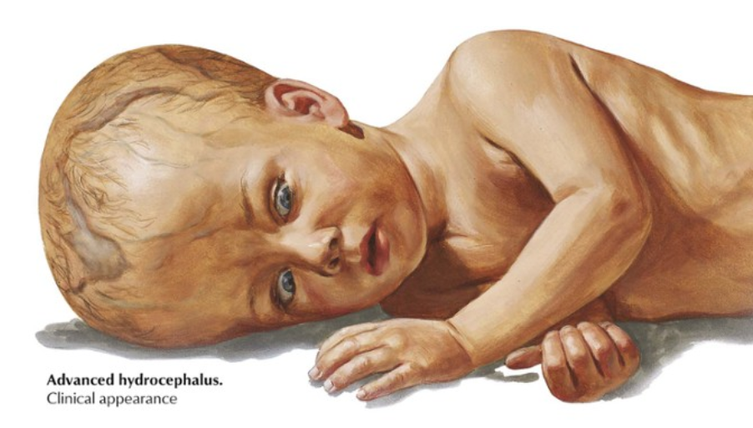
2. Hydrocephalus
Hydrocephalus refers to an increase in the volume of the CSF within the ventricular system.

Slide 28
2. Hydrocephalus
When hydrocephalus develops in infancy before closure of the cranial sutures → enlargement of the head
Hydrocephalus developing after fusion of the sutures →expansion of the ventricles and increased intracranial pressure, without a change in head circumference

Slide 29
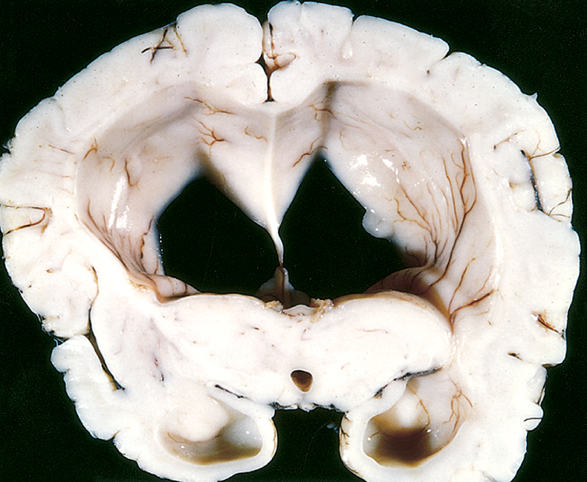
2. Hydrocephalus

Slide 30
Cerebrospinal fluid (CSF)
2. Hydrocephalus
CSF is produced by the choroid plexus within the ventricles, it circulates through the ventricular system and exits through the foramina of Luschka and Magendie
CSF fills the subarachnoid space around the brain and spinal cord, contributing to the cushioning of the nervous system within its bony confines

Slide 31
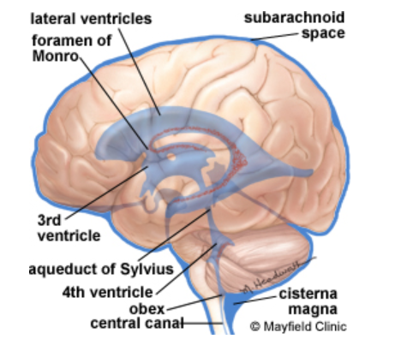
Cerebrospinal fluid (CSF)
Arachnoid granulations: responsible for the resorption of CSF
Choroid plexus preduce CSF
The balance between CSF generation and resorption keeps the volume of this fluid stable
foramina of Luschka and Magendie

Slide 32
2. Hydrocephalus
Causes:
Most cases occur as a consequence of impaired flow or impaired resorption of CSF
In rare instances (e.g., tumors of the choroid plexus), overproduction of CSF may be responsible

Slide 33
2. Hydrocephalus
Two types:
communicating and non communicating
If there is an obstacle to the flow of CSF within the ventricular system, then a portion of the ventricles enlarges while the remainder does not → noncommunicating hydrocephalus
most commonly seen with masses at the formamen of Monro or aqueduct of Sylvius
In communicating hydrocephalus all of the ventricular system is enlarged; here the cause is most often reduced resorption of CSF

Slide 34
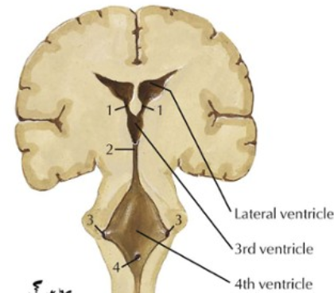
What can cause hydrocephalus?
2. Hydrocephalus
1. Hypersecretion of CSF: e.g. choroid plexus tumor
2. Obstructive hydrocephalus
3. Defective filtration of CSF: postulated for low-pressure hydrocephalus
Notes:
ventricles are enlarged - severe dementia, inability to walk, and incontinence - despite very low intracranial pressure.
trauma, tumour, haemorrhage, meningitis, whole brain radiation, as well as other brain pathology that affects the compliance of the brain parenchyma.

Slide 35
Causes of Obstructive hydrocephalus
2. Hydrocephalus
Obstruction of the foramina of Monro e.g. colloid cyst
Obstruction of the third ventricle e.g. pilocytic astrocytoma
Obstruction of the aqueduct e.g. aqueductal stenosis or atresia and posterior fossa tumors
Obstruction of the foramina of Luschka or impairment of flow from the fourth ventricle (Chiari malformation, meningitis, subarachnoid hemorrhage, posterior fossa tumors)
Fibrosis of the subarachnoid space e.g. meningitis, subarachnoid hemorrhage, meningeal dissemination of tumors

Slide 36
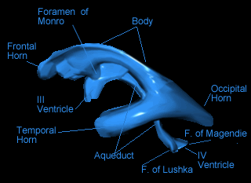

Slide 37
Take home messages:
- Malformations of the brain can occur because of genetic factors or external insults.
- The timing of the injury will determine the pattern of the injury, based on the type of developmental processes occurring at the point of injury.
- Patterns of malformation include alterations in the closure of the neural tube, proper formation of the separate portions of the neural tissue, and migration of neurons to the appropriate locations.
- Hydrocephalus is an increase in CSF volume within all or part of the ventricular system.

Slide 38
HOMEWORK
Define: meningocele.
Define: polymicrogyria.
What is the difference between microcephaly and microencephaly?
Define: hydrocephalus ex vacuo.
A compensatory increase in CSF volume (hydrocephalus ex vacuo) may occur secondary to a loss of brain volume from any underlying cause (e.g., infarction, neurodegenerative disease)

