Slide 1
Pathogenesis and risk factors of cerebrovascular accidents – Part 1
Dr. Maria A. Arafah
Assistant Professor – Department of Pathology
http://fac.ksu.edu.sa/mariaarafah/courses

Slide 2
Objectives
Explain the concepts of brain “hypoxia”, “ischemia” and “infarction”.
Understand the pathogenesis of thrombotic and embolic strokes and be able to identify the clinical risk factors.
Identify the causes and consequences of subarachnoid and intracerebral hemorrhage.
Build a list of the different causes that can lead to a cerebrovascular accident.
CNS Block
10/6/19

Slide 3
Introduction
Cerebrovascular diseases are brain disorders caused by pathologic processes involving blood vessels:
Thrombotic occlusion
Embolic occlusion
Vascular rupture
CNS Block
10/6/19

Slide 4
Introduction
They are a major cause of death in the developed world and are the most prevalent cause of neurologic morbidity.
Stroke is the clinical designation applied to all of these conditions when symptoms begin acutely.
CNS Block
10/6/19

Slide 5
Introduction
Thrombosis & embolism have similar consequences for the brain: loss of oxygen & metabolic substrates, resulting in infarction or ischemic injury of regions supplied by the affected vessel.
Hemorrhage accompanies rupture of vessels and leads to direct tissue damage as well as secondary ischemic injury.
CNS Block
10/6/19

Slide 6
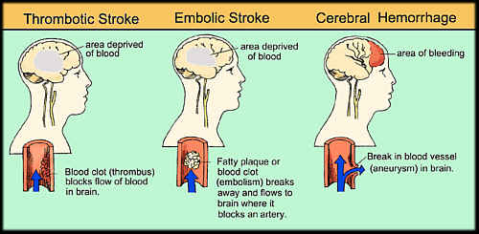
Introduction
CNS Block
10/6/19

Slide 7
Hypoxia, Ischemia, Infarction
The brain may be deprived of oxygen by two general mechanisms:
Functional hypoxia
Ischemia (transient or permanent), due to tissue hypoperfusion, which can be caused by hypotension, vascular obstruction, or both.
CNS Block
10/6/19

Slide 8
Hypoxia, Ischemia, Infarction
Functional hypoxia:
Low partial pressure of oxygen (e.g. high altitude)
Impaired oxygen-carrying capacity (e.g. severe anemia, carbon monoxide poisoning)
Toxins that interfere with oxygen use (e.g. cyanide poisoning).
CNS Block
10/6/19

Slide 9
Hypoxia, Ischemia, Infarction
Ischemia (transient or permanent), due to tissue hypoperfusion, which can be caused by:
Hypotension
Vascular obstruction
Both
CNS Block
10/6/19

Slide 10
Thrombotic & Embolic Stroke
Overall, embolic infarctions are more common than thrombotic infarctions.
The territory of distribution of the middle cerebral arteries (branches from the internal carotid arteries) are most frequently affected by embolic infarctions.
Emboli tend to ledge where vessels branch or at stenotic areas caused by atherosclerosis.
CNS Block
10/6/19

Slide 11
Thrombotic & Embolic Stroke
Sources of emboli include:
Cardiac mural thrombi (frequent)
myocardial infarct
valvular disease
atrial fibrillation
Arteries; (often atheromatous plaques within the carotid arteries or the aortic arch).
Paradoxical emboli, particularly in children with cardiac anomalies (e.g. patent foramen ovale).
Emboli associated with cardiac surgeries.
Emboli of other material (tumor, fat, or air).
CNS Block
10/6/19

Slide 12
Thrombotic & Embolic Stroke
The majority of thrombotic occlusions causing cerebral infarctions are due to atherosclerosis.
Thrombotic occlusions are usually superimposed on atherosclerotic plaques, accompanied by anterograde extension, fragmentation, and distal embolization.
CNS Block
10/6/19

Slide 13
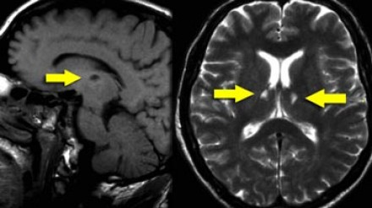
Thrombotic & Embolic Stroke
Thrombotic occlusions causing small infarcts of only a few millimeters, so-called “lacunar infarcts”, occurs when small penetrating arteries are occluded.
CNS Block
10/6/19

Slide 14
Thrombotic & Embolic Stroke
The most common sites of primary thrombosis:
The bifurcation of the carotid artery
The origin of the middle cerebral artery
Either end of the basilar artery
CNS Block
10/6/19

Slide 15
Clinical Presentation of Stroke
Strokes can be asymptomatic or painless, however they may also present with symptoms depending on which part of the brain is injured, and how severely it is injured.
It is very important to recognize the warning signs of a stroke and to get immediate medical attention if they occur.
CNS Block
10/6/19

Slide 16
Clinical Presentation of Stroke
The most common is weakness or paralysis of one side of the body with partial or complete loss of voluntary movement or sensation in a leg or arm.
Headache
Speech problems and weak facial muscles, causing drooling
Numbness or tingling
A stroke involving the base of the brain can affect balance, vision, swallowing, breathing and even lead to unconsciousness.
In cases of severe brain damage there may be deep coma, paralysis of one side of the body, and loss of speech, followed by death or permanent neurological disturbances after recovery.
CNS Block
10/6/19

Slide 17
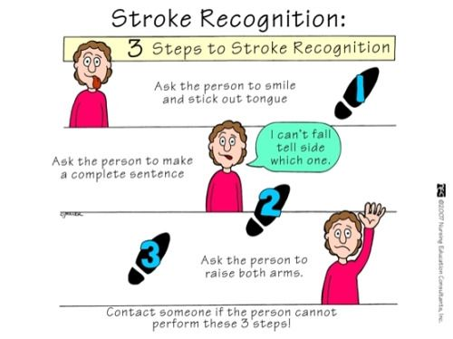
Clinical Presentation of Stroke
CNS Block
10/6/19

Slide 18
Clinical Presentation of Stroke
If the brain damage sustained is slight, there is usually complete recovery, but most survivors of stroke require extensive rehabilitation.
CNS Block
10/6/19

Slide 19
Global Cerebral Ischemia
Widespread ischemic/hypoxic injury occurs when there is a generalized reduction of cerebral perfusion, usually below systolic pressures of 50mmHg.
Causes include:
cardiac arrest
severe hypotension or shock
The clinical outcome varies with the severity of the insult.
CNS Block
10/6/19

Slide 20
Global Cerebral Ischemia
When the insult is mild, there may be only a transient postischemic confusional state, with eventual complete recovery.
In severe global cerebral ischemia, widespread neuronal death, and patients who survive often remain severely impaired neurologically & in a persistent vegetative state.
CNS Block
10/6/19

Slide 21
Global Cerebral Ischemia
Other patients meet the clinical criteria for "brain death," including evidence of diffuse cortical injury (isoelectric, or "flat," electroencephalogram) and brain stem damage, including absent reflexes and respiratory drive.
When patients with this irreversible form of injury are maintained on mechanical ventilation, the brain gradually undergoes autolysis, results in the so-called “respirator brain”.
CNS Block
10/6/19

Slide 22
Histopathological Features
Neurons are more susceptible to hypoxic injury than other glial cells.
The most susceptible neurons are:
Pyramidal cells of the hippocampus and neocortex.
Purkinje cells of the cerebellum.
CNS Block
10/6/19

Slide 23
Histopathological Features
Macroscopically:
The brain is swollen, with wide gyri and narrowed sulci.
The cut surface shows poor demarcation between gray and white matter.
CNS Block
10/6/19

Slide 24
Histopathological Features
Microscopically:
Early changes (12 – 24 hours):
Red neurons; characterized initially by microvacuolization, cytoplasmic eosinophilia, and later nuclear pyknosis and karyorrhexis.
Similar changes occur later in glial cells.
CNS Block
10/6/19

Slide 25
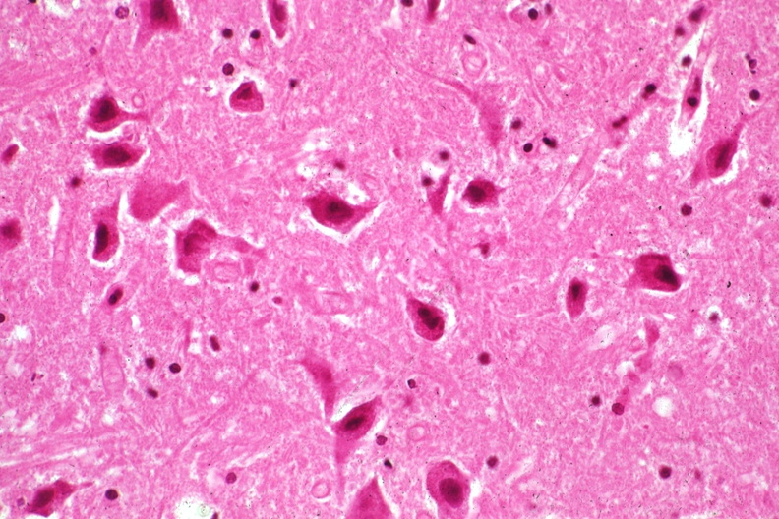
Red Neurons
CNS Block
10/6/19

Slide 26
Histopathological Features
Microscopically:
Subacute changes (24 hours – 2 weeks):
The reaction to tissue damage begins with the infiltration by neutrophils.
Necrosis of tissue, influx of macrophages, vascular proliferation and reactive gliosis.
CNS Block
10/6/19

Slide 27
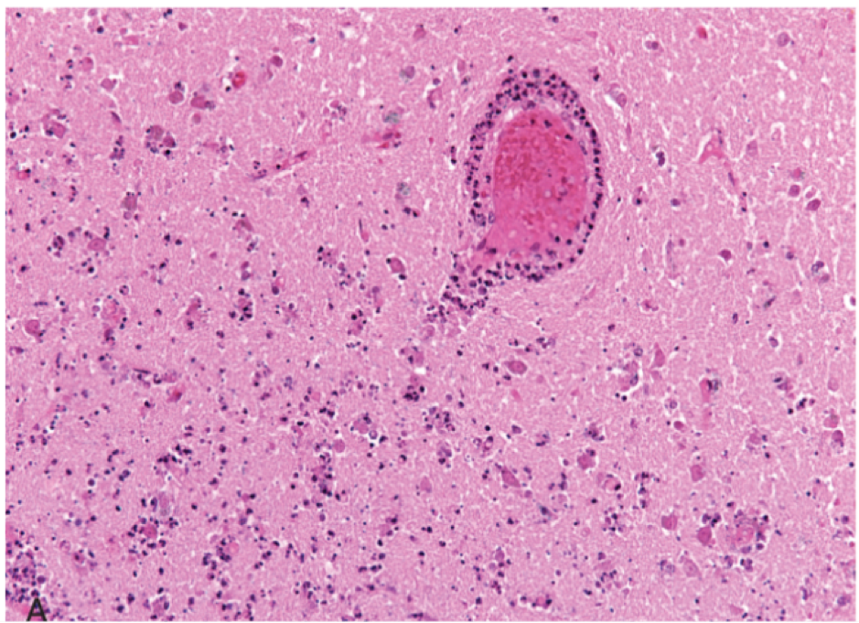
Infiltration of a cerebral infarction by neutrophils begins at the edges of the lesion where the vascular supply is intact.
CNS Block
10/6/19

Slide 28
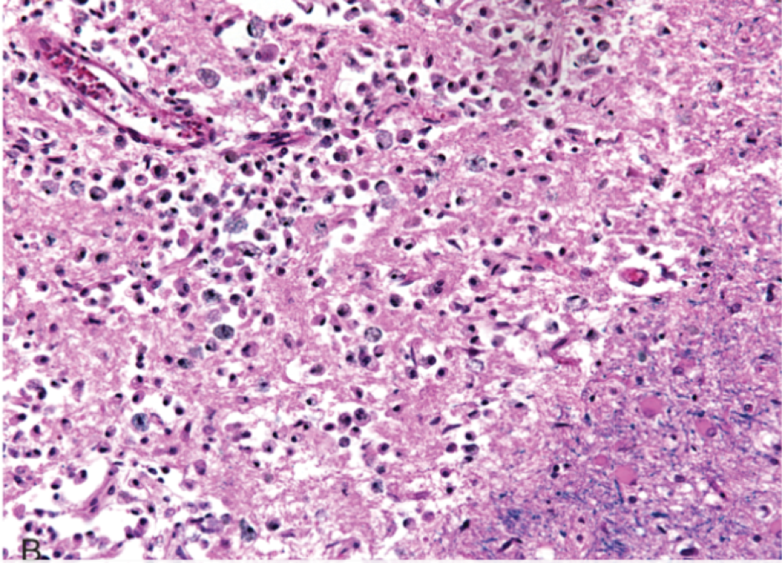
By day 10, an area of infarction shows the presence of macrophages and surrounding reactive gliosis.
CNS Block
10/6/19

Slide 29
Histopathological Features
Microscopically:
Repair (after 2 weeks):
Removal of all necrotic tissue
Loss of the organized CNS structure
Gliosis
CNS Block
10/6/19

Slide 30
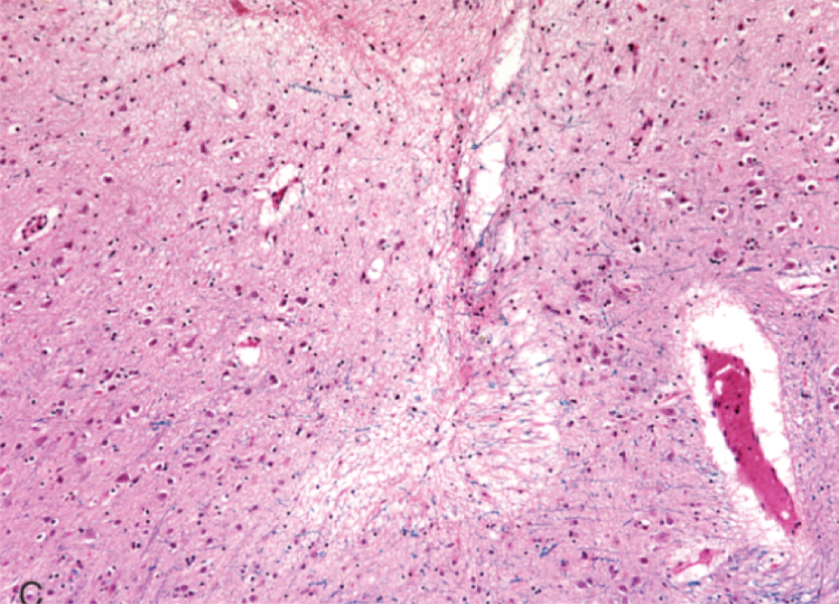
Old intracortical infarcts are seen as areas of tissue loss with a modest amount of residual gliosis.
CNS Block
10/6/19

Slide 31
Focal Cerebral Ischemia
Cerebral arterial occlusion leads first to focal ischemia then an infarction in the distribution of the compromised vessels.
The size, location and shape of the infarct and the extend of tissue damage may be modified by collateral blood flow.
CNS Block
10/6/19

Slide 32
Focal Cerebral Ischemia
The major source of collateral blood flow is the circle of Willis.
Partial collateralization is also provided over the surface of the brain through cortical-leptomeningeal anastomoses.
In contrast, there is little if any collateral flow for the deep penetrating vessels supplying structures such as:
Thalamus
Basal Ganglia
Deep white matter
CNS Block
10/6/19

Slide 33
Focal Cerebral Ischemia
Infarcts can be divided into two broad groups based on their macroscopic and corresponding radiologic appearance:
Non hemorrhagic infarcts; which result from acute vascular occlusions.
Hemorrhagic infarcts; which result from reperfusion of ischemic tissue, either through collaterals or after dissolution of emboli, and often produce multiple, sometimes confluent petechial hemorrhages.
CNS Block
10/6/19

Slide 34
Histopathological Features of Non-Hemorrhagic Infarcts
Macroscopically:
During the first 6 hours, the tissue is unchanged in appearance.
By 48 hours, the tissue becomes pales, soft and swollen.
CNS Block
10/6/19

Slide 35
Histopathological Features of Non-Hemorrhagic Infarcts
Macroscopically:
From days 2 to 10, the tissue becomes gelatinous, friable and the boundary between normal and abnormal tissue becomes more distinct as edema resolves in the adjacent viable tissue.
From day 10 to week 3, the tissue liquifies leaving a fluid-filled cavity which gradually expands as dead tissue is resorbed.
CNS Block
10/6/19

Slide 36
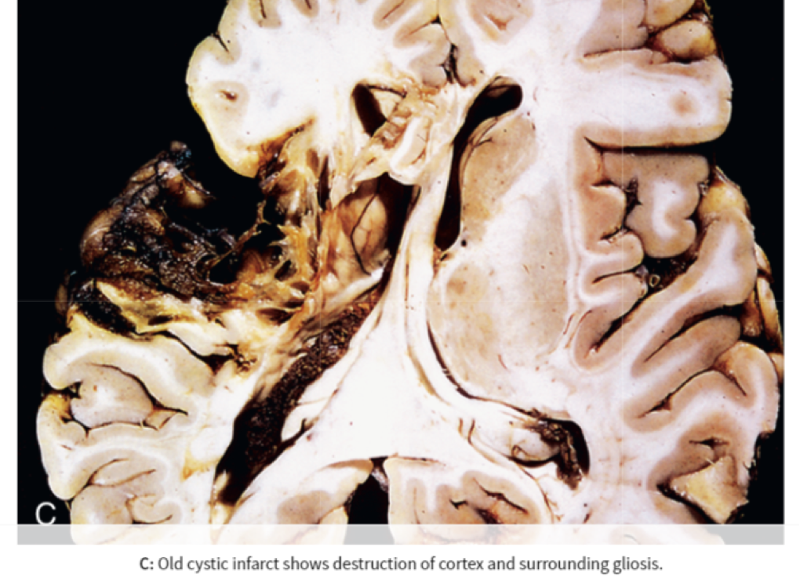
Old cystic infarct shows destruction of cortex and surrounding gliosis
CNS Block
10/6/19

Slide 37
Histopathological Features of Non-Hemorrhagic Infarcts
Microscopically:
After the first 12 hours:
Ischemic neuronal change (red neurons) and edema.
Endothelial & glial cells swell & myelinated fibers begin to disintegrate.
Loss of the usual characteristics of white and gray matter structures
During the first several days neutrophils infiltrate the area of injury.
CNS Block
10/6/19

Slide 38
Histopathological Features of Non-Hemorrhagic Infarcts
Microscopically:
Until 48 hours, there is some neutrophilic emigration followed by mononuclear phagocytic cells in the ensuing 2 to 3 weeks.
Macrophages containing myelin breakdown products or blood may persist in the lesion for months to years.
As the process of phagocytosis and liquefaction proceeds, astrocytes at the edges of the lesion progressively enlarge, divide, and develop a prominent network of protoplasmic extensions.
CNS Block
10/6/19

Slide 39
Histopathological Features of Non-Hemorrhagic Infarcts
Microscopically:
After several months the striking astrocytic nuclear and cytoplasmic enlargement recedes.
In the wall of the cavity, astrocyte processes form a dense feltwork of glial fibers admixed with new capillaries and a few perivascular connective tissue fibers.
In the cerebral cortex the cavity is delimited from the meninges and subarachnoid space by a gliotic layer of tissue, derived from the molecular layer of the cortex.
The pia and arachnoid are not affected and do not contribute to the healing process.
CNS Block
10/6/19

Slide 40
Histopathological Features of Hemorrhagic Infarcts
Hemorrhagic infarcts usually manifest as multiple, sometimes confluent petechial hemorrhages.
The microscopic picture and evolution of hemorrhagic infarction parallel those of ischemic infarction, with the addition of blood extravasation & resorption.
CNS Block
10/6/19

Slide 41
Histopathological Features of Hemorrhagic Infarcts
In individuals with coagulopathies or receiving anti-coagulants, hemorrhagic infarcts may be associated with extensive intracerebral hematomas.
CNS Block
10/6/19

Slide 42
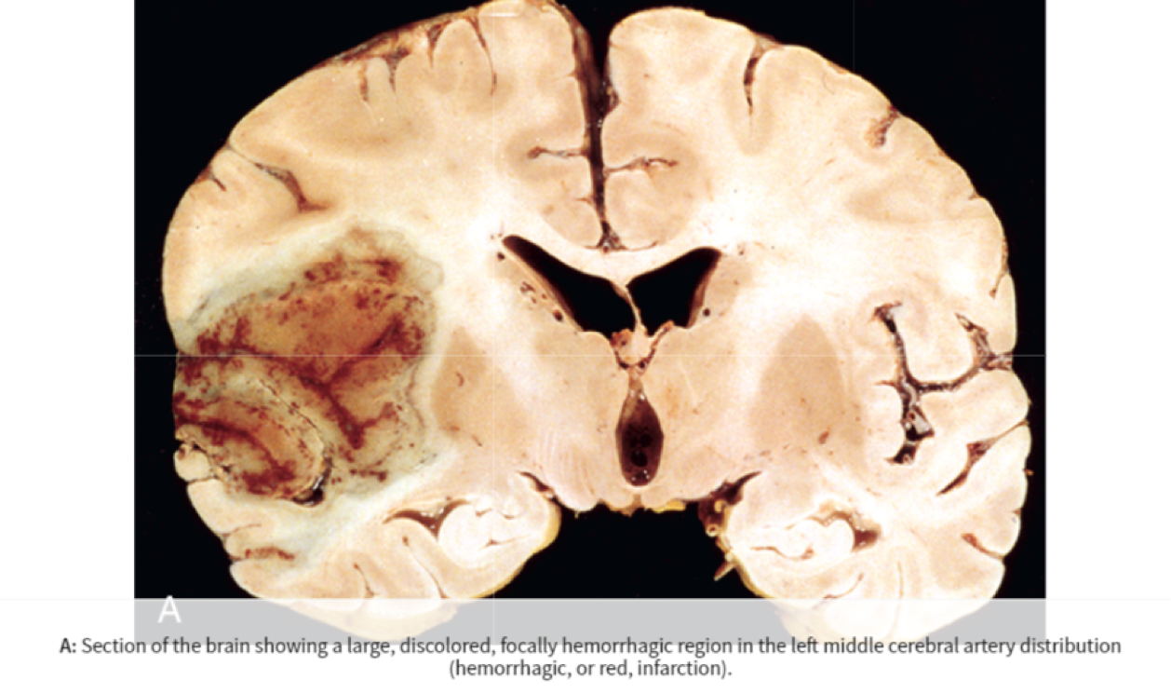
A section of the brain showing a large discolored focally hemorrhagic region in the left middle cerebral artery distribution (hemorrhagic or red infarction).
CNS Block
10/6/19

Slide 43
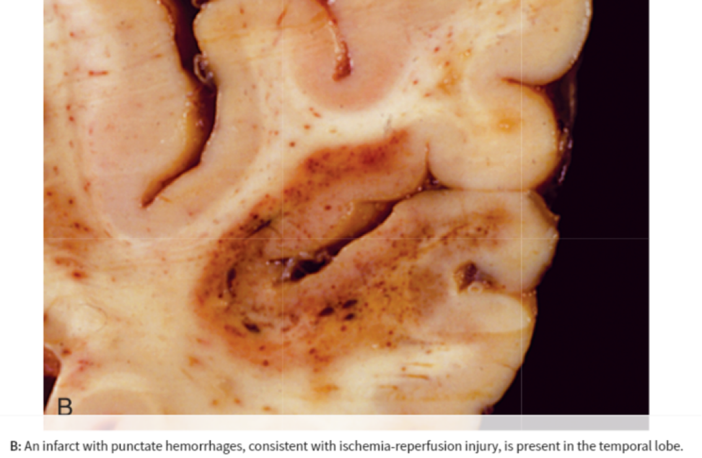
An infarct with punctate hemorrhages, consistent with ischemia-reperfusion injury, is present in the temporal lobe.
CNS Block
10/6/19

Slide 44
Border Zone (Watershed) Infarcts
Wedge-shaped areas of infarction that occur in those regions of the brain & spinal cord that lie at the most distal fields of arterial perfusion.
In the cerebral hemispheres, the border zone between the anterior and the middle cerebral artery distributions is at greatest risk.
CNS Block
10/6/19

Slide 45
Border Zone (Watershed) Infarcts
Damage to this region produces a wedge-shaped band of necrosis over the cerebral convexity.
Border zone infarcts are usually seen after hypotensive episodes.
CNS Block
10/6/19

Slide 46
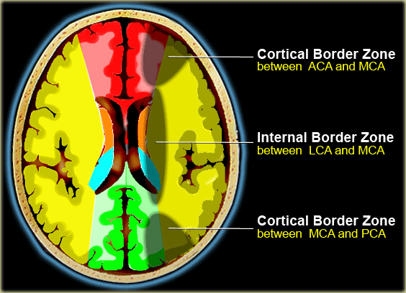
Border Zone (Watershed) Infarcts
CNS Block
10/6/19

Slide 47
Reference
Kumar V, Abbas AK, Aster JC. Robbins Basic Pathology. 10th ed. Elsevier; 2018. Philadelphia, PA.
CNS Block
10/6/19

Slide 48
Thank You
End of Lecture
CNS Block
10/6/19

