Slide 1
Pathogenesis and risk factors of cerebrovascular accidents – Part 2
Dr. Maria A. Arafah
Assistant Professor – Department of Pathology
http://fac.ksu.edu.sa/mariaarafah/courses

Slide 2
Objectives
Explain the concepts of brain “hypoxia”, “ischemia” and “infarction”.
Understand the pathogenesis of thrombotic and embolic strokes and be able to identify the clinical risk factors.
Identify the causes and consequences of subarachnoid and intracerebral hemorrhage.
Build a list of the different causes that can lead to a cerebrovascular accident.

Slide 3
Intracranial hemorrhage
Hemorrhages within the brain (intracerebral) can occur secondary to:
Hypertension
Other forms of vascular wall injury (e.g. vasculitis)
Arteriovenous malformation
An intraparenchymal tumor
Cerebral amyloid angiopathy
Subdural or epidural hemorrhages usually are associated with trauma.

Slide 4
Subarachnoid Hemorrhage
Causes of subarachnoid hemorrhage:
rupture of a saccular (berry) aneurysm (The most frequent clinically significant cause).
vascular malformation
trauma
rupture of an intracerebral hemorrhage into the ventricular system
hematologic disturbances
tumors

Slide 5
Subarachnoid Hemorrhage
Rupture can occur at any time, but in about one-third of cases it is associated with acute increases in intracranial pressure.
The patient experiences a sudden, excruciating headache and rapidly lose consciousness.

Slide 6
Subarachnoid Hemorrhage
Between 25% and 50% of individuals die with the first rupture.
Recurring bleeding is common in survivors; it is currently not possible to predict which individuals will have recurrences.
The prognosis worsens with each episode of bleeding.

Slide 7
Subarachnoid Hemorrhage
In the early period after a subarachnoid hemorrhage, there is a risk of additional ischemic injury from vasospasm involving other vessels.
In the healing phase of subarachnoid hemorrhage, meningeal fibrosis and scarring occur, sometimes leading to obstruction of CSF flow as well as interruption of the normal pathways of CSF resorption.

Slide 8
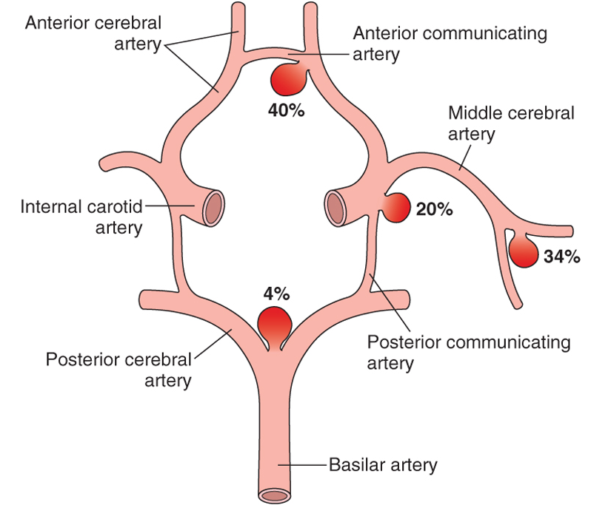

Slide 9
Subarachnoid Hemorrhage
About 90% of saccular aneurysms occur in the anterior circulation near major arterial branch points.
Multiple aneurysms exist in 20% to 30% of cases. Although they are sometimes referred to as congenital, they are not present at birth but develop over time because of underlying defects in the vessel media.

Slide 10
Subarachnoid Hemorrhage
The probability of aneurysm rupture increases with the size of the lesion, such that aneurysms greater than 10 mm have a roughly 50% risk of bleeding per year.

Slide 14
Hypertensive Cerebrovascular Disease
The most important effects of hypertension on the brain include:
Massive hypertensive intracerebral hemorrhage (most important)
Lacunar infarcts
Slit hemorrhages
Hypertensive encephalopathy

Slide 15
Hypertensive Cerebrovascular Disease
Hypertension affects the deep penetrating arteries and arterioles that supply the basal ganglia and hemispheric white matter and the brain stem.
It causes several changes, including hyaline arteriolar sclerosis in arterioles → weaker than normal vessels and are more vulnerable to rupture.
In some instances, chronic hypertension is associated with the development of minute aneurysms in vessels that are less than 300 μm in diameter → Charcot-Bouchard microaneurysms, which can rupture.

Slide 16
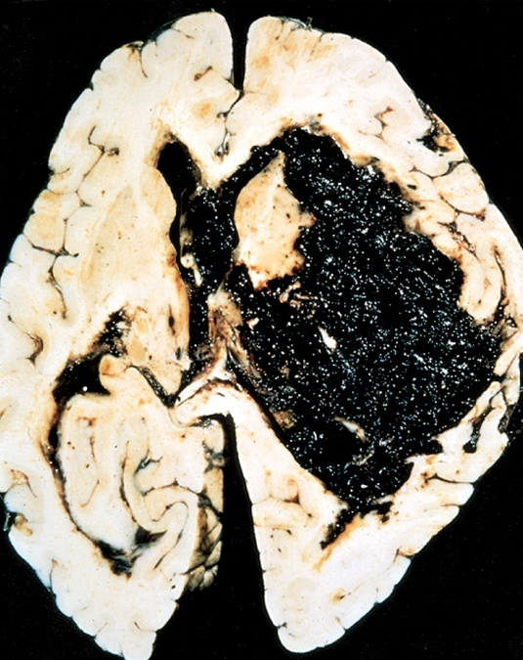
Cerebral hemorrhage. Massive hypertensive hemorrhage rupturing into a lateral ventricle.

Slide 17
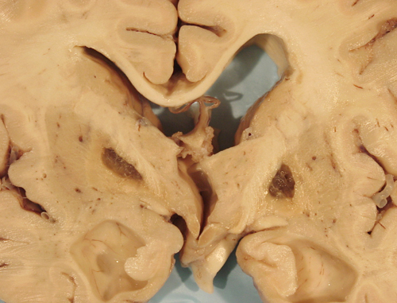
Hypertensive Cerebrovascular Disease
Lacunar infarcts:
Small cavitary infarcts
Thy are most commonly in the deep gray matter (basal ganglia and thalamus), internal capsule, deep white matter, and pons.

Slide 18
Hypertensive Cerebrovascular Disease
Lacunar infarcts consist of cavities of tissue loss with scattered lipid-laden macrophages and surrounding gliosis.
Depending on their location in the CNS, lacunas can either be clinically silent or cause significant neurologic impairments.

Slide 19
Hypertensive Cerebrovascular Disease
Slit hemorrhages:
They are the rupture of small-caliber penetrating vessels and the development of small hemorrhages.
In time, these hemorrhages are resorbed, leaving behind a slit-like cavity surrounded by brownish discoloration.

Slide 20
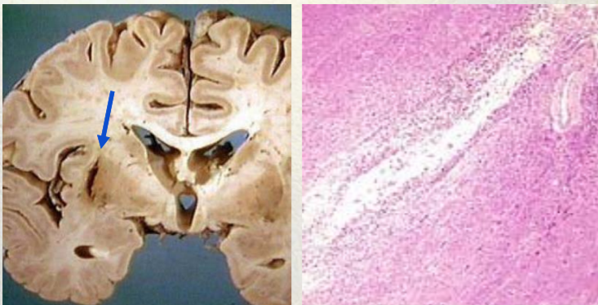
Slit hemorrhages

Slide 21
Hypertensive Cerebrovascular Disease
Acute hypertensive encephalopathy:
Diffuse cerebral dysfunction, including headaches, confusion, vomiting, and convulsions, sometimes leading to coma.
Does not usually remit spontaneously.
May be associated with an edematous brain, with or without transtentorial or tonsillar herniation.
Petechiae and fibrinoid necrosis of arterioles in the gray and white matter may be seen microscopically.

Slide 22
Vasculitis
Infectious arteritis of small and large vessels:
Previously seen in association with syphilis and tuberculosis.
Now more commonly occurs in the setting of immunosuppression and opportunistic infections (such as toxoplasmosis, aspergillosis, and CMV encephalitis).
Systemic forms of vasculitis, such as polyarteritis nodosa, may involve cerebral vessels and cause single or multiple infarcts throughout the brain.

Slide 23
Vasculitis
Primary angiitis of the CNS:
An inflammatory disorder that involves multiple small to medium-sized parenchymal and subarachnoid vessels.
Affected individuals manifest a diffuse encephalopathic clinical picture, often with cognitive dysfunction.
Improvement occurs with steroid and immunosuppressive treatment.

Slide 24
Vascular Malformations
They are classified into four principal types based on the nature of the abnormal vessels:
arteriovenous malformations (AVMs)
cavernous malformations
capillary telangiectasias
venous angiomas
AVMs, the most common of these, and affect males twice as frequently as females.

Slide 25
Vascular Malformations
They most commonly manifest between the ages of 10 and 30 years with seizures, an intracerebral a subarachnoid hemorrhage.
The risk of bleeding makes AVM the most dangerous type of vascular malformation.
Multiple AVMs can be seen in the setting of hereditary hemorrhagic telangiectasia, an autosomal dominant condition often associated with mutations affecting the TGFβ pathway.

Slide 26
Arteriovenous Malformation

Slide 27
So what can cause or contribute to a stroke?
Hypertension
Athersclerosis
Thrombophilia, e.g. Sickle cell anemia
Embolic diseases
Systemic hypoperfusion/ Global hypoxia, e.g. shock
Vascular malformations
Vasculitis
Tumors
Venous thrombosis
Amyloid angiopathy (leptomeningeal and cortical vessels)

Slide 28
Did you know !!
Brain tissue ceases to function if deprived of oxygen for more than 60 to 90 seconds and after approximately three hours, will suffer irreversible injury possibly leading to death of the tissue.

Slide 29
Reference
Kumar V, Abbas AK, Aster JC. Robbins Basic Pathology. 10th ed. Elsevier; 2018. Philadelphia, PA.

Slide 30
Thank You
End of Lecture

