Slide 1
Meningitis
Pathology

Slide 2
Objectives
Define meningitis, and describe its location and character
List possible routes of access of infectious organisms into the CNS
Describe the clinical presentation and pathology of acute bacterial meningitis, and its sequelae
Define the relationship between patient age and the most common etiologic organisms for bacterial meningitis.
Describe the CSF findings in various causes of meningitis.
Define the conditions that predispose to the development of a brain abscess, and describe the clinical and pathologic features.
Describe the clinical and pathologic findings in tuberculosis of the central nervous system.
List the common causes of viral encephalitis, and describe the pathologic changes in encephalitis due to herpes simplex virus.
Recognize the importance of lumbar puncture and its role in the diagnostic process of some CNS infections.
Contrast the CSF findings characteristic of bacterial meningitis, aseptic (viral) meningitis, and chronic meningoencephalitis (tuberculous meningitis).

Slide 3

Ref:
Meningitis
Page : 862- 866

Slide 4
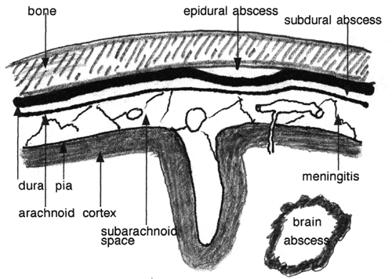
Define meningitis, and describe its location and character
Meningitis is an inflammatory process involving the leptomeninges and CSF within the subarachnoid space
Meningoencephalitis is infection spreads into the underlying brain
Epidural space
Subdural space
Subarachnoid space
chemical meningitis
carcinomatous meningitis

Slide 5
Infectious meningitis
Could be:
Acute pyogenic
Aseptic (usually viral)
Chronic (usually tuberculous, spirochetal, or fungal) subtypes
Pattern of infection:
Bacterial infections may cause meningitis, cerebral abscesses or a chronic meningoencephalitis.
Viral infections can cause meningitis or meningoencephalitis

Slide 6
CNS Infections
List possible routes of access of infectious organisms into the CNS
Portals of entry of infection into the CNS:
  Hematogenous spread
    the most common
  Direct implantation
    traumatic or in congenital CNS malformation
  Local extension
    occurs secondary to an established infection in a near by organ (air sinus, an infected tooth or middle ear)
  Through the peripheral nervous system into the CNS
    certain viruses, such as rabies and herpes zoster.

Slide 7
CNS Infection: Pyogenic meningitis
Define the relationship between patient age and the most common etiologic organisms for bacterial meningitis.
Medical emergency
The causative microorganisms
(10th edition, Robbins):
  Neonates :
    Escherichia coli and group B streptococci
  Adolescents and young adults:
    Neisseria meningitidis (Meningococcal meningitis)
  Elderly and older adults:
    Listeria monocytogenes and Streptococcus pneumoniae

Slide 8
Pyogenic meningitis
Clinical features
Describe the clinical presentation and pathology of acute bacterial meningitis, and its sequelae
Systemic signs of infection along with meningeal irritation and neurologic impairment, including:
  Headache
  Photophobia
  Irritability
  Clouding of consciousness
  Neck stiffness.
  Lumbar puncture reveals an increased pressure

Slide 9
CNS Infections
Pyogenic meningitis
CSF Findings in spinal tap:
  cloudy or frankly purulent CSF
  as many as 90,000 neutrophils /mm
  raised protein level
  markedly reduced glucose content
  bacteria may be seen on a Gram stained smear or can be cultured, sometimes a few hours before the neutrophils appear

Slide 10
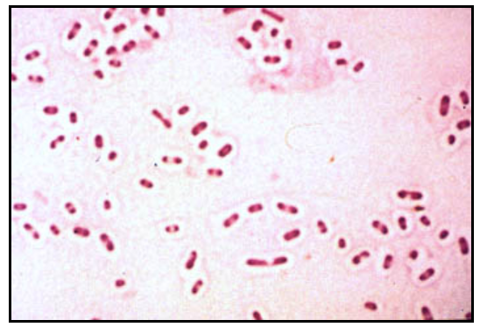
CNS Infections
Pyogenic meningitis
CSF Gram stain -
e.g. this gram stain shows multiple gram-positive diplococci, is characteristic of Streptococcus pneumoniae

Slide 11
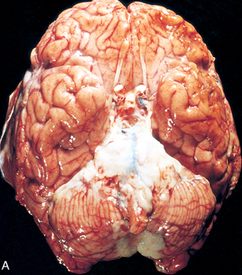
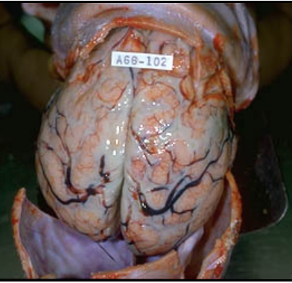
Pyogenic meningitis: Acute meningitis
Describe the clinical presentation and pathology of acute bacterial meningitis, and its sequelae
purulent gray-white exudate over the meningeal surface of the brain

Slide 12
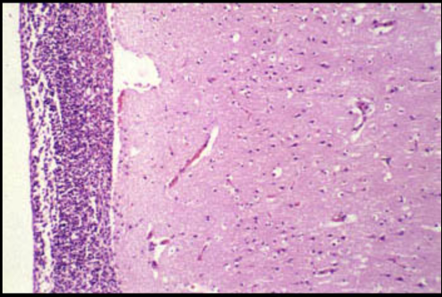
Pyogenic meningitis: Acute meningitis
Arachnoid
Pia
The exudate expands the meningeal space between the pia and arachnoid and may extend into the perivascular Virchow-Robin spaces. However, direct extension into the brain is rare

Slide 13
Pyogenic Meningitis: outcome
Describe the clinical presentation and pathology of acute bacterial meningitis, and its sequelae
Untreated, pyogenic meningitis can be fatal
Effective antimicrobial agents markedly reduce mortality associated with meningitis

Slide 14
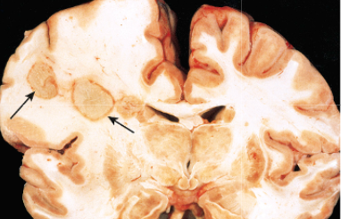
Pyogenic meningitis: Complications
Describe the clinical presentation and pathology of acute bacterial meningitis, and its sequelae
Phlebitis may → venous occlusion → hemorrhagic infarction of the underlying brain
Leptomeningeal fibrosis → hydrocephalus
Septicemia → hemorrhagic infarction of the adrenal glands and cutaneous petechiae (known as Waterhouse-Friderichsen syndrome, particularly common with Neisseria meningitidis and pneumococcal meningitis)
Focal cerebritis & seizures
Cerebral abscess
Cognitive deficit
Deafness
What is this complication →

Slide 15
Brain abscess

Slide 16
Brain abscess
Define the conditions that predispose to the development of a brain abscess, and describe the clinical and pathologic features
Brain abscesses are most often caused by bacterial infections.
These can arise by:
  direct implantation of organisms
  local extension from adjacent foci (mastoiditis, paranasal sinusitis)
  hematogenous spread (usually from a primary site in the heart, lungs, or distal bones, or after tooth extraction)

Slide 17
CNS Infections
Brain abscess
Predisposing conditions:
    Acute bacterial endocarditis: usually give multiple microabscesses
    Cyanotic congenital heart disease: There is a right-to-left shunt and Loss of pulmonary filtration of organisms
    Chronic pulmonary infections: e.g, bronchiectasis
  Causative agent:
  Streptococci and Staphylococci are the most common organisms identified in non-immunosuppressed populations

Slide 18
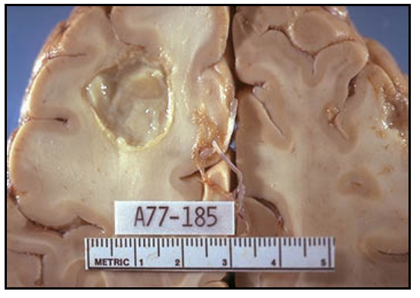
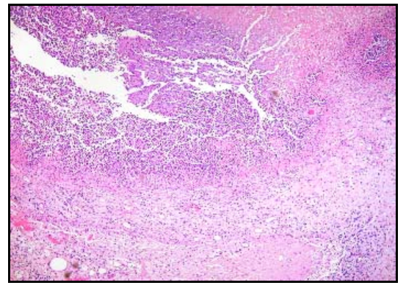
CNS Infections: Brain abscess
Morphology
Most common on cerebral hemispheres
An area of necrosis within a brain abscess
  Liquefactive necrosis
  The surrounding brain is edematous , congested & contains reactive astrocytes & perivascular inflammatory cells

Slide 19
CNS Infections
Brain abscess
Present clinically with progressive focal neurologic deficits in addition to the general signs of raised intracranial pressure
The CSF
  Contains only scanty cells
  ↑ protein
  Normal level of glucose
Complications of Brain abscess:
  Herniation
  Rupture of abscess into subarachnoid space or ventricle

Slide 20
Epidural and Subdural Infections

Slide 21
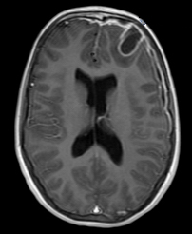


Slide 22
Epidural and Subdural Infections
These spaces can be involved with bacterial or fungal infections, usually as a consequence of direct local spread
Epidural abscess, commonly associated with: osteomyelitis, arises from an adjacent focus of infection, such as sinusitis or a surgical procedure
When the process occurs in the spinal epidural space, it may cause spinal cord compression and constitute a neurosurgical emergency

Slide 23
Empyema
Infections of the skull or air sinuses may also spread to the subdural space, producing subdural empyema
  The underlying arachnoid and subarachnoid spaces are usually unaffected, but a large subdural empyema may produce a mass effect
  Thrombophlebitis may develop in the bridging veins that cross the subdural space, resulting in venous occlusion and infarction of the brain

Slide 24
Empyema
Symptoms:
  most patients are febrile, with headache and neck stiffness, and if untreated may develop focal neurologic signs, lethargy, and coma
Prognosis:
  With treatment, including surgical drainage, resolution of the empyema occurs from the dural side and resolution is complete, a thickened dura may be the only residual finding.
  With prompt treatment, complete recovery is usual

Slide 25
CNS Infections
Tuberculous meningitis

Slide 26
CNS Infections
Tuberculous meningitis
usually manifests with generalized signs and symptoms of headache, malaise, mental confusion, and vomiting.
Morphology:
  The subarachnoid space contains a fibrinous exudate, most often at the base of the brain
  On microscopic examination, there is usually a central core of caseous necrosis surrounded by a typical tuberculous granulomatous reaction

Slide 27
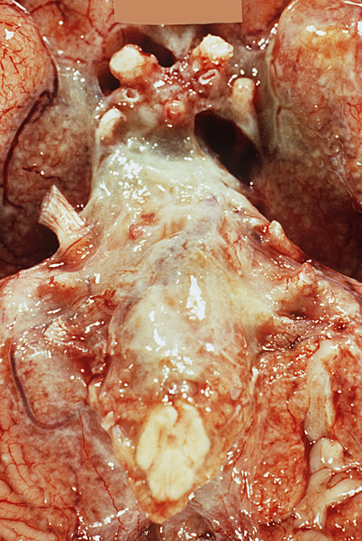
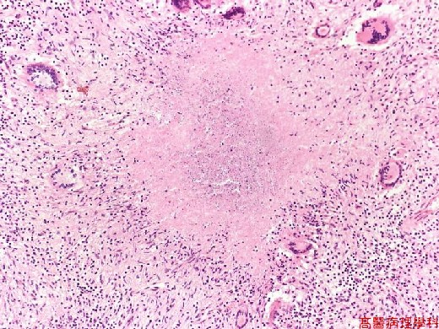
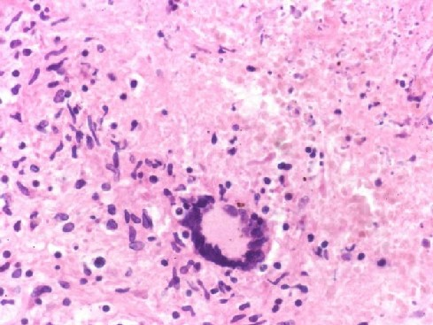
TB meningitis
Exudate at the base of the brain

Slide 28
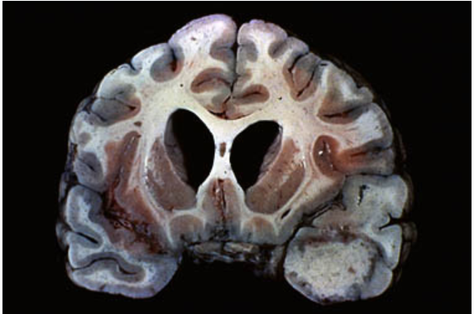
Tuberculoma
  is well-circumscribed intraparenchymal mass
  Rupture of tuberculoma into subarachnoid space results in tuberculus meningitis
  A tuberculoma may be up to several centimeters in diameter, causing significant mass effect
  Always occurs after hematogenous dissemination of organism from primary pulmonary infection
A tuberculoma is shown in the temporal lobe. It is seen as a well-circumscribed intraparenchymal mass that may have effects similar to those caused by any other intracranial mass, and may therefore mimic a tumor.
It is a destructive lesion.
Notes:
.

Slide 29
CNS Infections
CSF in TB
There is only a moderate increase in cellularity of the CSF (pleiocytosis) made up of mononuclear cells, or a mixture of polymorphonuclear and mononuclear cells
The protein level is markedly elevated
The glucose content typically is moderately reduced or normal

Slide 30
CNS viral infections
Viral (aseptic) Meningitis
Encephalitis
Brain stem and spinal cord syndromes

Slide 31
CNS viral infections
The nervous system is particularly susceptible to certain viruses such as rabies virus and poliovirus.
Other viral infections could affect CNS such as HSV, Enteroviruses, Measles or Influenza virus
Intrauterine viral infection following transplacental spread of rubella and CMV may cause destructive lesions, and Zika virus causes developmental abnormalities of the brain.
CNS can be injured by immune mechanisms after systemic viral infections.
CNS viral infections could lead to meningitis, encephalitis or brain stem and spinal cord syndromes

Slide 32
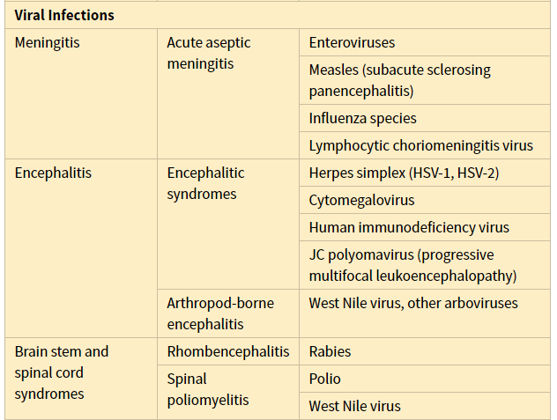
CNS viral infections

Slide 33
Aseptic Meningitis (Viral Meningitis)
Aseptic meningitis is a misnomer
It is a clinical term for an illness comprising:
  meningeal irritation
  fever
  alterations of consciousness
  These are relatively acute onset without recognizable organisms
The clinical course is less fulminant than in pyogenic meningitis (is usually self-limiting)
It is most often treated symptomatically

Slide 34
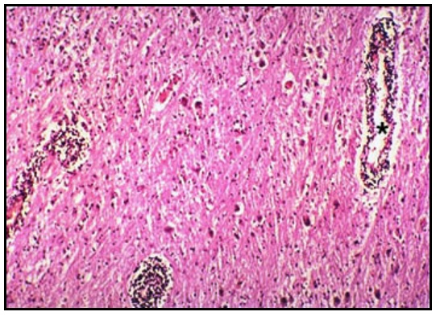
Aseptic Meningitis (Viral Meningitis)
In viral meningitis, clusters of lymphocytes surround cerebral blood vessels

Slide 35
Aseptic Meningitis (Viral Meningitis)
CSF:
  increased number of lymphocytes (pleiocytosis)
  protein elevation is only moderate
  glucose content is nearly always normal
In approximately 70% of cases, a pathogen can eventually be identified, most commonly an enterovirus
There are no distinctive macroscopic characteristics except for brain swelling, seen in only some instances
On microscopic examination, there is either no recognizable abnormality or a mild to moderate infiltration of the leptomeninges with lymphocytes.

Slide 36
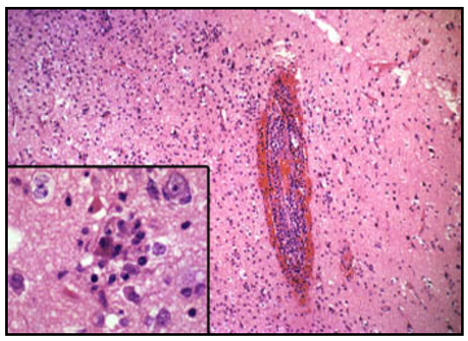
Herpes simplex virus (HSV)
HSV produces a hemorrhagic meningoencephalitis with inflammation in both the meninges and the brain parenchyma.
The hemorrhage surrounding the perivascular lymphocytic infiltrate.
The virus directly infects cells in the cerebral cortex, causing necrosis and a glial reaction.
This reaction produces a microglial nodule.

Slide 37
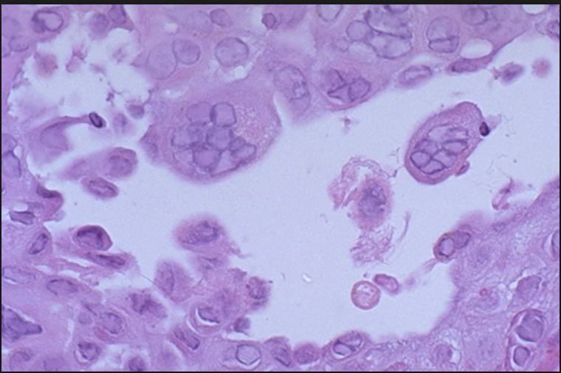
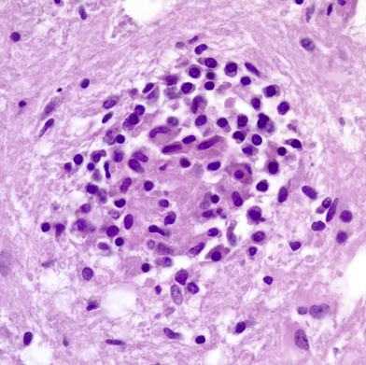
Herpes simplex virus
Virus may be identified by H&E stain as viral inclusion, culture or polymerase chain reaction amplification.
Microglial nodule: Activated microglial cells encircle degenerating neurons (neuronophagia) and form clusters around small foci of necrotic brain tissue.
Such nodules can be seen also in HIV encephalitis.

Slide 38
Varicella-zoster virus (VZV) Meningitis
Varicella-zoster virus (VZV) causes chickenpox during primary infection, usually without any evidence of neurologic involvement.
The virus establishes latent infection in neurons of dorsal root ganglia.
Reactivation in adults manifests as a painful, vesicular skin eruption in the distribution of one or a few dermatomes (shingles).
This usually is a self-limited process, but there may be a persistent pain syndrome in the affected region (postherpetic neuralgia)

Slide 39
Rabies
Rabies is a fatal encephalitic infection transmitted to humans from rabid animals, usually by a bite.
The virus enters the CNS by ascending along the peripheral nerves
Contracture of the pharyngeal musculature may create an aversion to swallowing even water (hydrophobia)
It progress to coma and eventually death

Slide 40
Homework
Create a table of CSF findings in Meningitis, aseptic meningitis, TB meningitis, Brain abscess and multiple sclerosis!

