Slide 1
Drugs Used In Management Of Pain
Dr. Aliah Alshanwani
Medical Pharmacology
October 2018

Slide 2
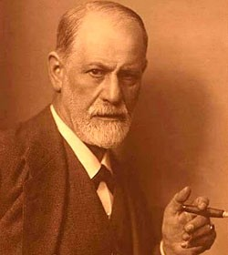
Drugs Used In Management Of Pain
A CASE OF OVERDOSE
Sigmund Freud, the father of psychoanalysis
His cancer of the jaw was causing him increasingly severe PAIN & agony
He begged his friend and doctor, Max Schur to relieve him.
His doctor administered increasing doses of MORPHINE that resulted in Freud's death on 23 September 1939
What effect of morphine caused the death of Sigmund Freud?
Euthenasia
Notes:
Agony: extreme physical or mental pain or suffering, or a period of such suffering
A famous neurologist
He became a Cocaine addict to forget his pain
Then he ended his life by euthanasia: intentionally ending a life to relieve pain & suffering

Slide 3
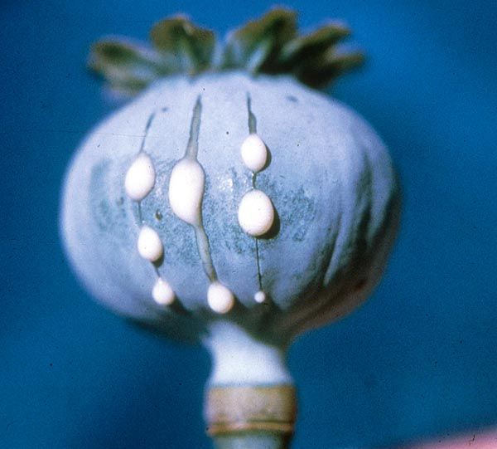
Drugs Used In Management Of Pain
ilos
Categorize the different classes of drugs used to relieve pain
Detail on the mechanism of action, pharmacokinetics & pharmacodynamic effects of morphine & its synthetic derivatives
Hints on the properties & clinical uses of morphine antagonists.

Slide 4
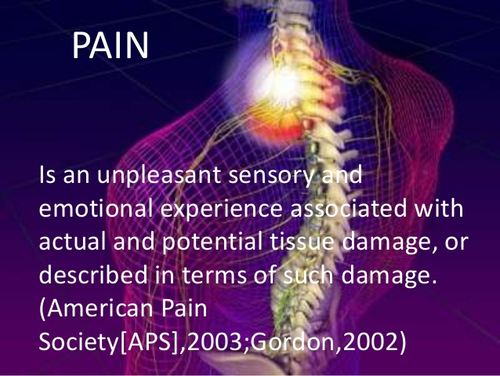
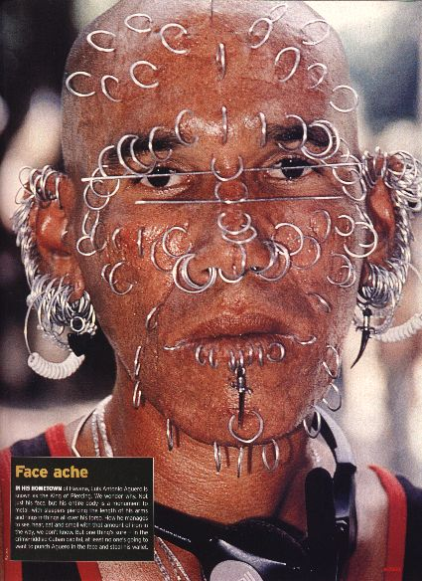
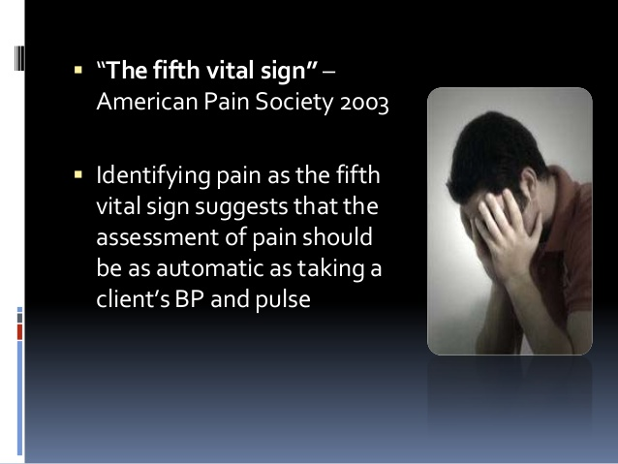
Drugs Used In Management Of Pain
Why should we treat pain?
Pain is a miserable experience
Pain is the most common reason patient seek medical advice
Impairs the patient functional ability & psychological well being
Pain increases sympathetic output
-Increases myocardial oxygen demand
-Increases BP, HR
Pain limits mobility
-Increases risk for DVT/PE
What is pain?
Notes:
Damage: neuropathic pain
Like asking the site of pain, type of pain and its severity

Slide 5
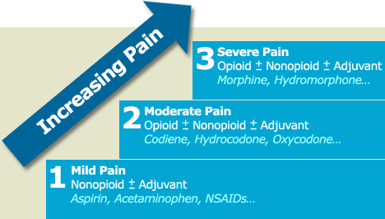

Classes of Drugs Used In Management Of Pain
Side-effects
NSAIDs
Analgesia
Opioids
Adjuvant drugs
WHO Pain Ladder
Notes:
Acetaminophen = Paracetamol
We usually use a combination of pain medication. The harder we push down for analgesia the greater the degree of side effects.

Slide 6
NSAIDS
Generally the 1st class of drugs used for controlling pain
Work at site of tissue injury to prevent the formation of the nociceptive mediators
Can decrease opioid use by ~30% therefore decreasing opioid-related side effects
They neither cause tolerance or dependence
Has a ceiling effect to analgesia.
Notes:
Cyclooxygenase inhibitors (AA to PG)
EX. Aspirin, diclofenac, ibuprofen, indomethacin.
Nociceptive mediators: histamine, bradykinin, and prostaglandins in the damaged area
Ceiling effect: maximum effect, which have no further effect on pain above a particular dosage level . The drug reaches a maximum effect, so that increasing the drug dosage does not increase its effectiveness.“ Has limit effect so not effective in severe cases

Slide 7
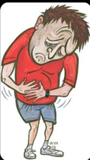
Adjuvant drugs
e.g. Anxiolytics, Neuroleptics,
Antidepressants
Antiepileptics
May modify the perception of pain & remove the concomitants of pain such as anxiety, fear, depression
Notes:
An adjuvant analgesic is a medication that is not primarily designed to control pain
Anxiolytics: antipanic or antianxiety, work on the CNS to relieve anxiety, aid sleep, or have a calming effect (BDZ & Barbiturates)
Neuroleptics= antipsychotics

Slide 8


OPioids
Opium is derived from the juice of the opium poppy, Papaver somniferum
The natural products include morphine, codeine, papaverine & thebaine
Opiates are drugs derived from opium & semisynthetic & synthetic derivatives
Endogenous opioid peptides,
e.g. Endorphins, enkephalins & dynorphins.
Notes:
The term opioid describes all compounds that work at opioid receptors.

Slide 9
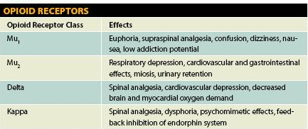
OPIOID RECEPTORS
Anatomical distribution in brain, spinal cord, & the periphery
μ
δ
k
ORL-1 receptor
Nociceptin ligand
All of them are typical G-protein coupled receptors
Notes:
three major classes of opioid receptors (μ, δ, and κ) have been identified in various nervous system sites and in other tissues, All are members of the G protein-coupled family of receptors
(mu)-opioid receptor, the major analgesic opioid receptor
delta) and j (kappa) receptors
Orphanin: opioid-receptor-like subtype 1 (ORL1). the fourth and most recently discovered member of the opioid receptor superfamily. Its endogenous ligand has been termed nociceptin. Nociceptin is structurally similar to dynorphin except for the absence of an N-terminal tyrosine; it acts only at the ORL1 receptor.
Nociceptin is a peptide related to the opioid class of compounds (ex. morphine and codeine), but it does not act at the classic opioid receptors (namely, mu, kappa, and delta opioid receptors) which typically act as pain relievers. Nociceptin is widely distributed in the CNS and dorsal horns of the spinal cord. This receptor-ligand system modulates a variety of biological functions and neurobehavior, including stress responses and anxiety behavior, learning and memory, locomotor activity, and inflammatory and immune responses
G protein–coupled receptors (GPCRs) which are also known as seven-transmembrane domain receptors, 7TM receptors (because they pass through the cell membrane seven times), heptahelical receptors, and G protein–linked receptors (GPLR), constitute a large protein family of receptors, that detect molecules outside the cell and activate internal signal transduction pathways and, ultimately, cellular responses.
The majority of currently available opioid analgesics act primarily at the μ-opioid receptor. Analgesia and the euphoriant, respiratory depressant, and physical dependence properties of morphine result principally from actions at μ receptors. In fact, the μ receptor was originally defined using the relative potencies for clinical analgesia of a
series of opioid alkaloids.

Slide 10
CLASSIFICATION OF OPOIDs
According to their source
Natural
Morphine, Codeine
Semisynthetic
Heroin
Synthetic
Pethidine, Methadone
According to agonistic/antagonistic actions
Agonists; Morphine, Codeine, Pethidine, Methadone
Mixed agonist /antagonist; Pentazocine
Pure antagonist; Nalaxone, Naltraxone
Notes:
Are they all the same?
Good choice of Opiods depend on
Analgesic efficacy
& Side effects profile

Slide 11
CLASSIFICATION OF OPOIDs
According to their specificity of
action on receptors
Morphine, codeine, heroin → μ-receptor agonists
Pentazocine agonist at k –receptors & antagonist at µ-receptors.

Slide 12
Mechanism of action
Binding to presynaptic opioid receptors coupled to Gi   AC & cAMP   voltage-gated Ca²⁺ channels   excitatory transmitter.
Binding to postsynaptic receptors   opening of K channels   neuronal excitability.
Notes:
Opioid agonists produce analgesia by binding to specific G protein-coupled receptors that are located in brain and spinal cord regions involved in the transmission and modulation of pain. Some effects may be mediated by opioid receptors on peripheral sensory nerve endings.
The primary afferent neuron (like here in the hand) originates in the periphery and carries pain signals to the dorsal horn of the spinal cord.
The opioids have two well-established direct Gi/0 protein-coupled actions on neurons: (1) they close voltage-gated Ca2+ channels on presynaptic nerve terminals and thereby reduce transmitter release, and (2) they open K+ channels and hyperpolarize and thus inhibit postsynaptic neurons.

Slide 13
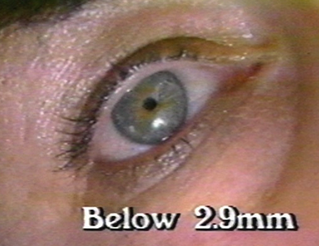
Pharmacodynamic Actions of Morphine
Analgesia [in acute & chronic pain]
Euphoria & sedation
Respiratory depression
Depression of cough reflexes
Nausea & vomiting → ↑CRTZ
Pin point pupil (miosis)
Releases histamine from mast cells
Effects on GIT:-↑in tone ↓ motility → severe constipation.
Constriction of biliary sphincter → ↑pressure in the biliary tract & biliary colic.
Depress renal function & contract gall bladder .
Notes:
Pain consists of both sensory and affective (emotional) components, In contrast, nonsteroidal anti-inflammatory analgesic drugs, eg, ibuprofen, have no significant effect
on the emotional aspects of pain.
Euphoria: intravenous morphine experience a pleasant floating sensation with lessened anxiety and distress.
Miosis is due to stimulation of oculomotor center in the CNS
No tolerance to pin point & constipation
Histamine: flushing and warming of the skin.
Opioids have also other functions on neurotransmitters and other organs but these are the most important.

Slide 14
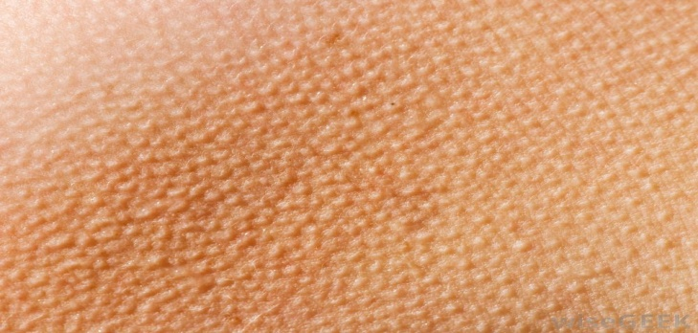
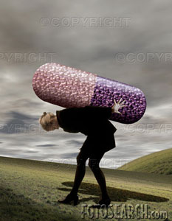
Morphine
TOLERANCE & DEPENDENCE
TOLERANCE
Tolerance occurs rapidly with opioids (with morphine 12–24 hours)
Tolerance develops to respiratory depression, analgesia, euphoria & sedation
DEPENDENCE
Physical dependence (abstinence)
Withdrawal manifestations develops upon stoppage.
Lasting for a few days (8-10 days) in form of ↑ body ache, insomnia, diarrhea, gooseflesh, lacrimation
Psychological dependence lasting for months / years → craving
Notes:
With frequently repeated therapeutic doses of morphine or its surrogates, there is a gradual loss in effectiveness; this loss of effectiveness is termed tolerance. To reproduce the original response, a larger dose must be administered.
Along with tolerance, physical dependence develops. Physical dependence is defined as a characteristic withdrawal or abstinence
syndrome when a drug is stopped or an antagonist is administered
Gooseflesh is contraction of the muscle underneath the skin (bumpy skin) like what happen in cold or fear.
Lacrimation: the secretion of tears
However, despite the loss of physical dependence on the opioid, craving (strong feeling to consume ..) for it may persist

Slide 15
Morphine
Pharmacokinetics
t ½ is 2-3h
It is slowly & erratically absorbed orally (bioavailability 20-40%).
-Medically given by SC, IM or IV injection.
Metabolized by conjugation with glucuronic acid
Undergoes enterohepatic recycling,
-crosses BBB
-crosses placenta.
Notes:
Well absorbed by injection. However, because of the first pass effect, the oral dose of the opioid (eg, morphine) to elicit a therapeutic effect may need to be much higher than the parenteral dose.
We have to give morphine frequently (every 4 h) to mainintain therapeutic efficacy.
First pass metabolism is what occurs when a drug is absorbed from the GI tract. When a drug is taken orally it is absorbed into the portal circulation (the blood vessels of the liver). Many of these drugs are very efficiently metabolized (altered for elimination) as they pass through the portal circulation during this first time. It reduces the amount of active drug that gets into the general circulation.
Enterohepatic cycling is where: Unmetabolized drugs as well as drug metabolites go through the liver and biliary tract for excretion and proceed to make their way out of the body through the intestinal tract. In other words, this is the body's way of putting them in the trash and getting rid of them.
Here's the catch. . .on the way out through the intestines (the entero part of the word enterohepatic) some of the discarded active drug gets reabsorbed back into the blood stream where it is again available to the body for use. In other words, it's being recycled.
RESULT: The half life and duration of action of a drug is increased.
The glucoronides metabolites are usually inactive, but this is exception (6) part of it can be active and go again to the brain.
The opioids are converted in large part to polar metabolites (mostly glucuronides), which are then readily excreted by the kidneys

Slide 16
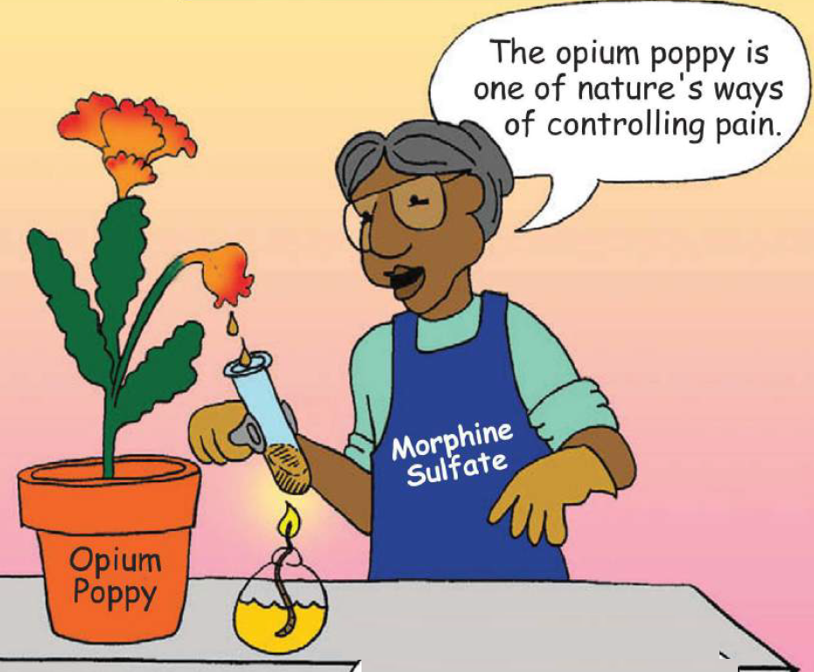
Morphine
Clinical Indications
CONTROL PAIN; cancer pain, severe burns, trauma, Severe visceral pain (not renal/biliary colics, acute pancreatitis)
Acute pulmonary edema
Myocardial ischemia
Non painful conditions e.g. heart failure (to relieve distress)
Pre-anesthetic medication.
Notes:
Visceral pain is pain that results from the activation of nociceptors of the thoracic, pelvic, or abdominal viscera (organs).
Sphincter of oddy is sharing between biliary and pancreas
PE: Morphine dilates the vein & reduce edema
MI: morphine reduce stress & pain & decrease preload
The relief produced by intravenous morphine in patients with dyspnea from pulmonary edema associated with left ventricular heart failure is remarkable. Proposed mechanisms include reduced anxiety (perception of shortness of breath) and reduced cardiac preload (reduced venous tone) and afterload (decreased peripheral resistance). However, if respiratory depression is a problem, furosemide may be preferred for the treatment of pulmonary edema. On the other hand, morphine can be particularly useful when treating painful myocardial ischemia with pulmonary edema.
Distress: extreme anxiety, sorrow, or pain.

Slide 17
Morphine
adrs
constipation
Respiratory depression
Cvs: HYPOTENSION (DECREASE SYSTOLE & DIASTOLE bp) ON LONG TERM USE
itching
Nauseia, vomiting
Constricted pupil
Sedation.

Slide 18
Morphine
Contraindications
HEAD INJURY
BRONCHIAL ASTHMA or impaired pulmonary function
Biliary colic & pancreatic pain
Elderly are more sensitive; metabolism, lean body mass & renal function
With MAOIs
Not given infants, neonates or during child birth  conjugating capacity  accumulate   respiratory
Notes:
Carbon dioxide retention caused by respiratory depression results in cerebral vasodilation and intracranial pressure & this will increase bleeding
Biliary colic: the drug-induced increase in smooth muscle tone may cause a paradoxical increase in pain secondary to increased spasm.
due to CYP450 enzyme inhibition by the MAOI.
In general, the rate of drug elimination by biotransformation in neonates and infants is much slower than in adults. phase II reactions involve conjugation pathways (e.g., acetylation, glucuronidation, sulfation, and methylation).

Slide 19
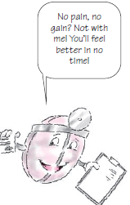

codeine
Natural opioid, μ agonist
Dependence < morphine
Used in mild & moderate pain, cough, diarrhea.

Slide 20
TRAMADOL
Synthetic, μ agonist , less potent than morphine
Inhibits also NE & 5HT reuptake
Can be given orally; more oral bioavailability
Indications
-Mild - moderate acute & chronic visceral pain
-During labor
ADRs
-Seizures (not in epileptics), Nausea, Dry mouth, Dizziness, Sedation
-Less adverse effects on respiratory & C.V.S.

Slide 21
Pethidine (mepridine)
Synthetic, more effective κ agonist
actions
LESS analgesic, constipating, depressant on faetal respiration than morphine
No cough suppressant effect
Has atropine –like action (Smooth muscle relaxant)
Notes:
Pethidine is metabolized by alkylation so no respiratory depression in newborn
Atropine: urinary retention.

Slide 22
Pethidine (mepridine)
adrs
Tremors, Convulsions, Hyperthermia, Hypotension
Blurred vision, Dry mouth, Urine retention
Tolerance & Addiction
indications
As in morphine but not in cough & diarrhea
Preanaesthetic medication (better)
Used in obstetric analgesia (No  resp.)
Used in severe visceral pain; renal & biliary colics (sm. relaxant).

Slide 23

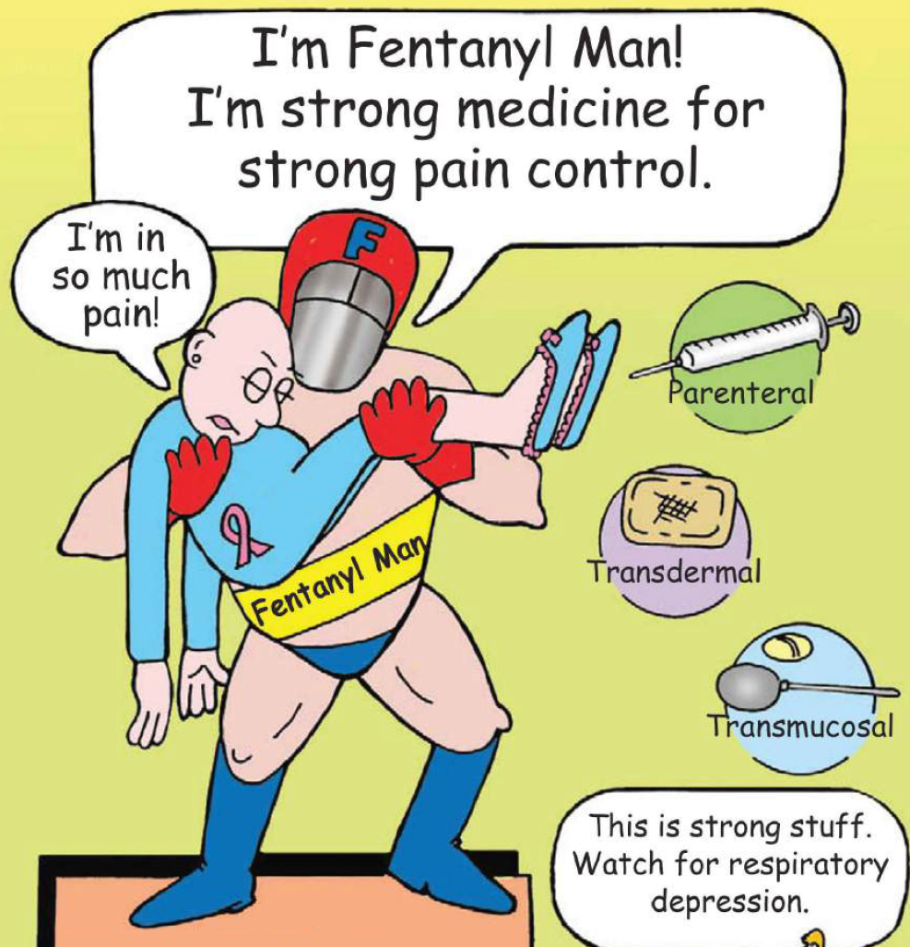
Fentanyl
Synthetic, μ agonist, more potent than pethidine & morphine
Clinical uses
Analgesic supplement during anesthesia, (IV or intrathecal)
To induce & maintain anesthesia in poor-risk patients [stabilizing heart]
In combination with droperidol as NEUROLEPTANALGESIA
In cancer pain & severe postoperative pain; (transdermal patch changed every 72 hrs).
Notes:
100 times stronger than morphine
Very strong drug, small dose can be given encapsulated in an arrow to sedate the animals in hunting.
spinal anesthesia into CSF
fentanyl can induce chest wall (and laryngeal) rigidity, thereby acutely impairing mechanical ventilation.
Available as Transdermal patches
It doesn’t harm the heart
The word neuroleptic originates from the Greek word lepsis ("seizure" or "fit"). Antipsychotics (neuroleptics or tranquilizers). neuroleptanalgesia, an anesthetic process that involves combining a major neuroleptic tranquilizer/antipsychotic (typically the potent D2 receptor antagonist droperidol) and the potent opioid analgesic fentanyl to produce a detached, pain-free state.

Slide 24
Fentanyl
ADRS
Respiratory depression (most serious)
CV effects are less
Bradycardia may still occur.

Slide 25
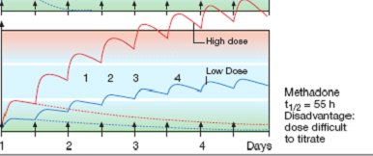
METHADONE
Weaker synthetic μ- agonist
In non addicts, it causes tolerance & dependence but not as severe as that of morphine
t½ 55 h
Notes:
Lower 2 lines are single doses
The response id not proportional with the dose
55 h: long acting opioid, given po OD
Weak opioid effect, duration is longer & prevent bind of opioids so reduce craving

Slide 26
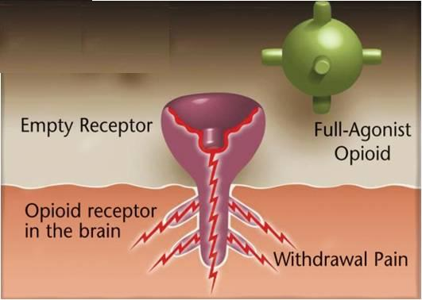
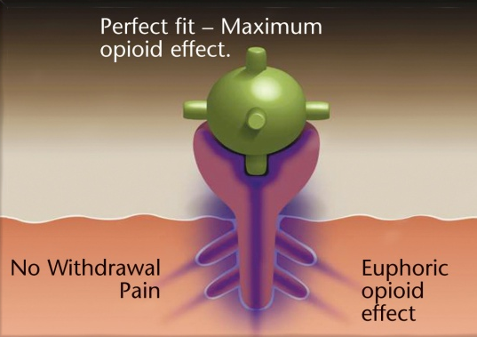
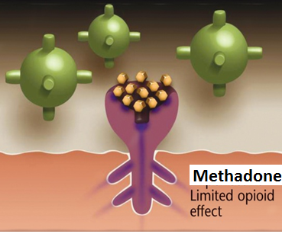
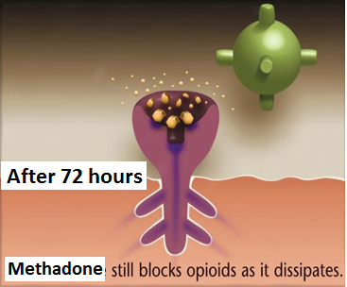
Used to treat opioid withdrawal
An ADDICT

Slide 27
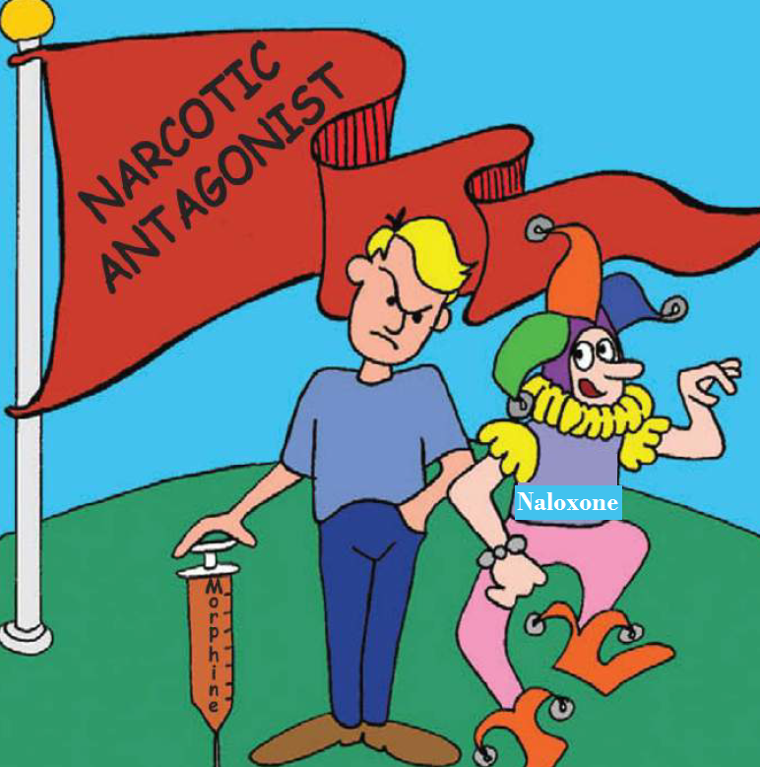
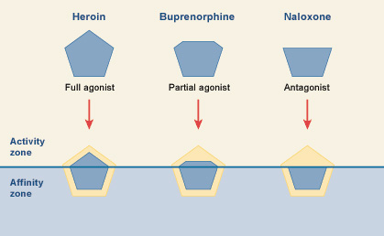
Opioid antagonists
Morphine
Nalorphine
Naloxone

Slide 28
Naloxone
Pure opioid antagonist
Used to treat respiratory depression caused by opioid overdose
To reverse the effect of analgesia on the respiration of the new born baby
Effect lasts only for 2-4 hours
Precipitates withdrawal syndrome in addicts
Naltrexone
Very similar to naloxone but with longer duration of action [t½=10h].
Notes:
Used in diagnosis & to tr overdose (antidote)
Ppt withdrawal syndrome because it displaces agonist opioids from the mu receptors

