Slide 1
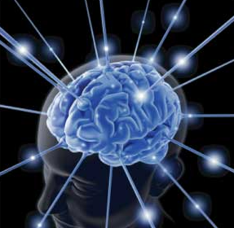
DRUGS USED IN
HEADACHE & MIGRAINE
Dr. Aliah Alshanwani
Dr. Ishfaq Bukhari
Oct 2019

Slide 2
ILOs
Differentiate between types of headache regarding their symptoms, signs & pathophysiology.
Recognize drugs used to prevent migraine
Identify drugs used to rescue & abort migraine
Elaborate on the pharmacokinetics, dynamic & toxic profile of some of these drugs.

Slide 3
HEADACHE
Pain anywhere in the region of the head or neck
It is caused by disturbance of the
Pain – Sensitive Structures around the brain
Within the cranium
Outside the cranium
(blood vessels, meninges, cranial nerves)
(muscles, nerves, arteries, veins, subcutaneous tissues, eyes, ears & other tissues).
Notes:
cranium : skull

Slide 4
Recurrent attacks of throbbing headache
Unilateral / or on both sides
Lasting from > 2 up to 72 hrs.
+ Preceded (or accompanied) by AURA
MIGRAINE
Perceptual disturbance of motor < sensory nature
visual [ Photophobia (↑sensitivity to light) ]
auditory [ Phonophobia (↑ sensitivity to sound) ]
olfactory unpleasant smell ….
Sensory; abnormal sensation at face, extremities.
Develops over 5-20 min & last fewer than 60 min.
Aura: flashes of light, blind spots or tingling in your arm.
Migraine pain is usually on one side of head with facial & neck pain, nausea & vomiting.
Notes:
Pulsating headache is a common feature of a migraine where the person wakes up in the morning feeling a sharp & throbbing headache
Aura: a distinctive atmosphere surrounding a given source, sensation experienced
Perception: Relating to the ability to interpret or become aware of something through the senses.

Slide 5
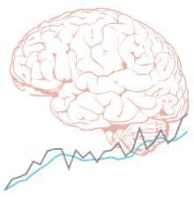
Phases of Migraine
1. Prodrom Phase; a change in mood or behavior (irritability, neck stiffness) that starts hours or days before headache. It is experienced by 60% of migraineurs.
2. Aura Phase; Sensory > motor symptoms starts 5-20 min before the migraine attack. It is experienced by 20% of migraineurs.
3. Headache Phase; moderate to severe pain,  with activity + anorexia, vomiting,
Intolerance to light, sounds, odors
Blurry vision /Blocked nose /Pale face Sensations of heat or coldness /Sweating /Tenderness of the scalp
4. Postdrom Phase: still not normal, either;
More likely fatigued → irritability /impaired concentration /scalp tenderness /mood changes / GIT symptoms, ……

Slide 6
Migraine Triggers
Diet
Aged cheese, Alcohol, Chocolate, Caffeine, Hot dogs, Avocado, Fermented or pickled foods, Yeast or protein extracts.
Stresses
Hormonal changes: Menstrual migraine
Climate
Diseases
Therapy
Antibiotics, Antihypertensives, H₂ blockers, Vasodilators, Oral contraceptives.
Life Style

Slide 7
Migraine Causal Theories
Vascular
Cortical Spreading Depression
Neurovascular theory ?
Mediators [ Serotonin ]
Dopaminergic Hypersensitivity
Triggers
↓
Intracranial vasoconstriction → migraine aura
↓
focal ischemia → ↑ mediators → rebound vasodilatation → ↑ permeability & leak → inflammatory reaction → activates perivascular nociceptive nerves → migraine headache
↓
It throbs as blood flow at these sensitive area with each heart beat
Notes:
Serotonin is an important neurotransmitter, a local hormone in the gut, a component of the platelet clotting process, & is thought to play a role in migraine headache. Brain serotonergic neurons are involved in numerous diffuse functions such as mood, sleep, appetite, & temperature regulation, as well as the perception of pain, the regulation of BP, & vomiting. Serotonin is clearly involved in psychiatric depression & also appears to be involved in conditions such as anxiety & migraine.

Slide 8
Migraine Causal Theories
Vascular
Neurovascular theory ?
Mediators [ Serotonin ]
Dopaminergic Hypersensitivity
Triggers
↓
Release K / glutamates
↓
Creates a slowly well-defined depolarizing wave → depolarize adjacent tissues → propagating at a rate of 2-6 mm/min → vasoconstriction → migraine aura
↓
→ activate trigeminovascular complex → vasodilation → migraine headache.

Slide 9
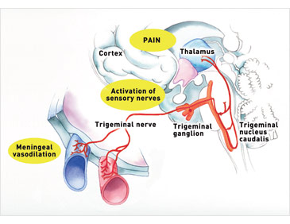
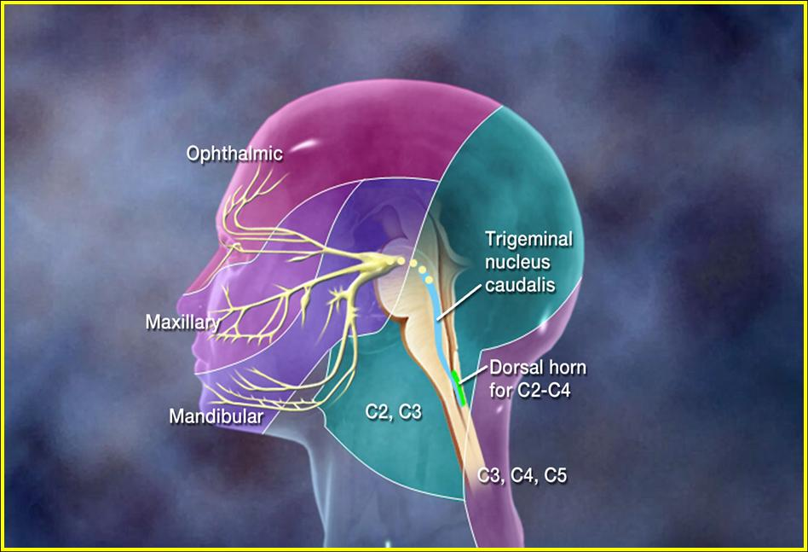
Stimulation of the trigeminal nerve causes the release of vasoactive peptides; this is responsible for the head pain, as well as the facial & neck pain, experienced during migraine.
Notes:
Here we can see that the meninges is inflamed & dilated, this can increase pressure …….
The trigeminovascular system (TVS) is thought to comprise neurons located in the trigeminal ganglion that innervate the cerebral vasculature.
Migraine involves the trigeminal nerve distribution to intracranial (& possibly extracranial) arteries. These nerves release peptide NTs, especially calcitonin gene-related peptide (CGRP), an extremely powerful vasodilator. Substance P & neurokinin A may also be involved. Extravasation (leaking) of plasma & plasma proteins into the perivascular space appears to be found in biopsy specimens from migraine patients. This effect probably reflects the action of the neuropeptides on the vessels. The mechanical stretching caused by this perivascular edema may be the immediate cause of activation of pain nerve endings in the dura.
Activation of trigeminal ganglion causes the release of several vasoactive neuropeptides that are associated with neurogenic inflammation such as substance P, CGRP, & neurokinin A. Vasodilatation & extravasation of protein are the two main mechanisms of neurogenic inflammation, which prolongs & worsens the migraine headache.

Slide 10
TREATMENT STRATEGY
ACUTE ATTACK
PREVENT RECURRENCE
Controls attack.
recurrence frequency, severity, duration & / or disability
responsiveness to abortive therapy
RESCUE THERAPY
ABORTIVE THERAPY
N.B. Full effect of therapy needs several weeks to manifest
& should continue for 6 m.
& can be repeated
Non-specifically target individual symptoms i.e. alleviating
pain, emesis & associated symptoms
They specifically target pathways of migraine by ⬇ meningeal dilatation & ⬇ neural activation via 5HT₁ agonism ➔ i.e. stopping headache as it is evolving.
Abortive medications > effective if taken early, just before the pain starts, losing effectiveness once the attack has begun
So they must be rapidly acting
Mild-Moderate
Severe/ Disabling
Notes:
Rescue to tr mild-moderate
& the abortive therapy is used to tr severe /disabling symptoms.

Slide 11
TREATMENT of Acute Attack
RESCUE THERAPY
➔ Analgesics
NSAIDs / Aspirin< Acetaminophen
(ibuprofen, naproxen for mild to moderate attack with no nausea & vomiting)
Opioid-like drugs: μ agonist; e.g. Tramadol.
➔ Antiemetics
Dopamine Antagonists
+ Gastro-prokinetic
Domperidone
↑ Absorption & bioavailability
of abortive therapy
Phenothiazines
Dopamine antagonists
+ Sedation
Promethazine
5HT₃ antagonists (for severe nausea & vomiting)
Ondanseteron
Granisetron
 H₁ antagonist
Antihistamine +sedation Anticholinergic
Meclizine, diphenhydramine
Notes:
Tramadol in moderate-severe pain
Phenothiazines discussed with antipsychotic drugs & it is not highly recommended because of the sedating
Ondanseteron is the best drug for V
The mechanism by which meclizine exerts its antiemetic, anti–motion sickness, & anti-vertigo effects is not precisely known but may be related to its central anticholinergic actions. It diminishes vestibular stimulation & depresses labyrinthine function. An action on the medullary CRTZ may also be involved in the antiemetic effect.

Slide 12
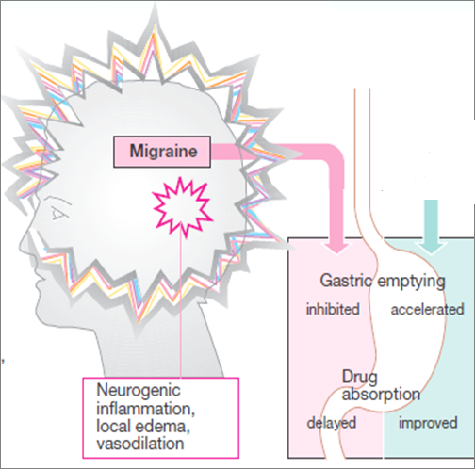
TREATMENT of Acute Attack
Prokinetics;
Domperidone
Help
Absorption

Slide 13
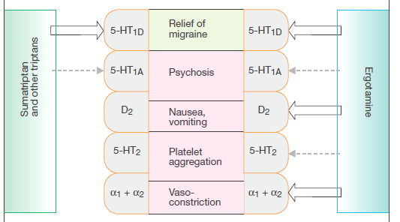
TREATMENT of Acute Attack
ABORTIVE THERAPY
5HT₁
AGONISTS ➔ TRIPTANS
> selective
PARTIAL AGONISTS ➔ ERGOTS
non-selective
Notes:
All arrows are Agonists
Ergots are hard to tolerate.

Slide 14
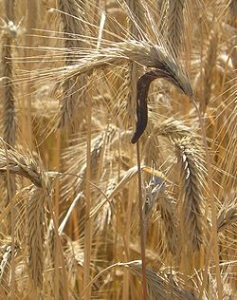
TREATMENT of Acute Attack
ABORTIVE THERAPY
ERGOTS
Product of Claviceps purpurea; a fungus growing on rye/ grains
Non-Selective
Partial agonism at 5HT₁ receptors (5HT-1D/1B found in cereberal & menigeal vessels)
↓release of vasodilating peptides
↓excessive firing of nerve endings
At blood vessels → ↓vasodilation & stretching of the pain endings
Partial agonist effect on α-adrenoceptors → vasoconstriction
Ergotamine tartarate (resticted use)
Dihydroergotamine (DHE)
Oral, sublingual, rectal suppository, inhaler
Nasal spray, inhaler & injectable forms (good to use if patient is vomiting)
Caffeine
Cafergot
Notes:
The triptans, the ergot alkaloids, & antidepressants may activate 5-HT1D/1B receptors on presynaptic trigeminal nerve endings to inhibit the release of vasodilating peptides, & antiseizure agents may suppress excessive firing of these nerve endings. Second, the vasoconstrictor actions of direct 5-HT agonists (the triptans and ergot) may prevent vasodilation & stretching of the pain endings. It is possible that both mechanisms contribute in the case of some drugs. The remarkably specific antimigraine action of the ergot derivatives was originally thought to be related to their actions on vascular serotonin receptors.
Restricted : used with caution. Erg Tart is also available with Caffeine (like Panadol extra/plus) Caffeine is added in low dose like 1 mg can get relieve of headache.

Slide 15
ERGOTS
Ergotamine tartarate (rare clinical use due to severe adverse effects
Oral absorption Incomplete (erratic) + slow → low bioavailability
Despite t_{1/2} nearly 2 hours, ergotamine produces vasoconstriction → 24 hours or longer due to high & long tissue binding ability.
Ergotamine tartrate has significant side effects, & may worsen the nausea & vomiting associated with migraine.
DHE (preferred in clinical setting)
Given parenterally, DHE is eliminated more rapidly than ergotamine, presumably due to its rapid hepatic clearance & has less adverse effects.
Indications
They are only used to abort the attacks [Exception DHE can be given for severe, recurrent attacks not responding to other drugs]
Their use is restricted to patients with frequent, moderate attack or infrequent but severe attacks.
Notes:
Used only if the patient is not responding to other medications.

Slide 16
ADRs
ERGOTS
GIT upset
Feeling of cold & numbness of limbs, tingling
Anginal pain due to coronary spasm, & disturbed cardiac rhythm (tachycardia or bradycardia )
Prolong use → rebound headache due to vasodilatation followed by vasoconstriction.
Prolong use & high dose → paraesthesia (tingling or burning sensation).
Contraindications
Pregnancy; fetal distress & miscarriage (ergot is uterine stimulant & vasoconstrictor)
Peripheral & coronary vascular diseases
Hypertension
Liver & kidney diseases
prophylaxis of migraine
In concurrent use with triptans (at least 6 hrs from last dose of triptans or 24 hrs from stopping ergotamine & β-blockers.
Notes:
With β-blockers this can cause reflex tachycardia or arrhythmia.

Slide 17
TREATMENT of Acute Attack
ABORTIVE THERAPY
TRIPTANS
Selective
Agonism at 5HT₁ receptors
Same as discussed for ergotamine except that triptans are more selective as serotonergic agonist.
No α₁, α₂, β –adrenergic , dopamine or muscarinic receptors.
Triptans inhibit the release of vasoactive peptides, promote vasoconstriction, & block pain pathways in the brainstem. Triptans inhibit transmission in the trigeminal nucleus caudalis.
SUMATRIPTAN
Present in →oral, nasal spray, & injectable forms
Oral bioavailability low / Subcutaneous (SC) bioavailability is 97%, peaks after 2 min & t_{1/2} nearly 2 hours (fast action with Sc, good for patient with vomiting)
ZOLMITRIPTAN
Present in →nasal spray, & injectable forms
Oral bioavailability 40%, peaks after 2 hrs & t_{1/2} nearly 3 hours
NARATRIPTAN
Present in addition → + Oral preparations
Oral bioavailability 70%, peaks after 2 hrs & t_{1/2} nearly 6 hours (slower onset, less side effects).
Notes:
Only PK difference

Slide 18
Indications
TRIPTANS
To abort attacks in patients with frequent, moderate
or infrequent but severe attacks.
In cluster headache
ADRs
most of ADRs are the same as with ergot but triptans are better tolerated.
Mild pain & burning sensation at the site of injection.
Vasospasm, Ischemic heart; Angina & Arrhythmias
ZOLMITRIPTAN
Chest & neck tightness
Coronary vasospasm
Somnolence.
Contraindications
Peripheral vasospastic diseases
Uncontrolled hypertension
History of ischemia
Cerebrovascular disorders
In concurrent use with ergots or others inducing vasospasm
In concurrent use with MAOIs, lithium, SSRIs, ….→(5HT increased to toxic level)
Renal or hepatic impairment.
Notes:
Cluster headache: Generalized headache like with trauma or sinnusitis,.
lithium carbonate oral and sumatriptan succinate both increase affecting serotonin levels in the blood. Too much serotonin is a potentially life-threatening situation. Severe signs & symptoms include high BP & increased HR that lead to shock.

Slide 19
DECIDING WHETHER BETTER WITH A TRIYPTAN OR WITH DHE.
For patients with headache episodes lasting 2 or 3 days at a time, DHE is often the optimal choice because it has longer t_{1/2}
For patients with migraines a day or less & need rapid relief of pain, Triptans are often a better choice
For pregnant women: paracetamol or intranasal sumitriptan & or diphenhydramine, meclizine are safe to be used.
The form of drug preparation could influence the choice
Injectable sumatriptan reaches T_{max} the fastest followed by DHE nasal spray & rizatriptan.
Notes:
Sumatryptan & its congeners are currently first-line therapy for acute migraine attacks in most patients. HE, they should not be used in patients at risk for coronary artery disease. Anti-inflammatory analgesics such as aspirin & ibuprofen are often helpful in controlling the pain of migraine. Rarely, parentral opioids may be needed in refractory cases.

Slide 20
CHOOSING A TRIPTAN
Differences in the time to peak blood concentration T_{max}, equates with faster relief of pain.
Differences in t_{1/2} → a clinical effect in terms of recurrence of headache

Slide 21
CHOOSING A TRIPTAN
For extremely fast relief within 15 min. injectable sumatriptan is the only choice.
If expected re-dosing is needed & / or recurrence of headache Naratriptan, frovatriptan, have slower onset, fewer side effects, & a lower recurrence rate
Menstrual migraine: Frovatriptan (longer half life (26 hrs) 2.5 mg twice per day beginning 2 days before the anticipated onset of menstrual migraine & continuing for 6 days.

Slide 22
TREATMENT STRATEGY
ACUTE ATTACK
PREVENT RECURRENCE
Antiepileptics;
Block Na channel & augment GABA at GABA-A receptors
e.g. Topiramate;
Valproic;
Antidepressants
TCA; amitriptyline & nortryptyline
Antihypertensives
-blockers
e.g. propranolol
Propranolol is commonly used in prophylaxis of migraine attack.

