Slide 1
SCHIZOPHRENIA
Mohammed Aljaffer, MD
Assistant Professor-Medical Collage
Consultant of Forensic, Psychosomatic medicine and Neuropsychiatry
KSU, Riyadh

Slide 2
Nasser is a 28 year-old single male
Emergency room by his family
gradual changes in his behavior 9 months
Eat only canned food but not cooked food made by his family
He talks to himself and stares occasionally on the roof of his room.
agitated
Afraid of being poisoned

Slide 3
What are the main symptoms & signs?
What are the possible etiological reasons ? DDX?

Slide 4
SCZ
Not single disease
Prevalence & incidence worldwide.
Prevalence 0.6– 1.9 %
Annual incidence of 0.5 – 5.0 per 10,000
Age of onset
10-25 ♂
Vs
25-35 ♀

Slide 5
Features of SCZ
Positive Symptoms
Negative Symptoms
Disorganization
Cognitive Deficits
Mood Symptoms
Function

Slide 6
Unknown

Slide 7
Stress-Diathesis Model:
Biological, Psychosocial and Environmental
Neurobiology
Areas of the brain
Dopamine
Other
Neuropathology
structures or connections
Basal ganglia
Cerebellum
Genetic Factors
Family studies
Twin studies
Chromosome.
Symptoms → Vulnerability
Limbic system

Slide 8
Symptoms → Vulnerability
Biological, Psychosocial and Environmental
Areas of the brain
Dopamine
Other
Stress-Diathesis Model:
Neurobiology
structures or connections
Limbic system
Basal ganglia
Cerebellum
Family studies
Twin studies
Chromosome.
Neuropathology
Genetic Factors

Slide 9
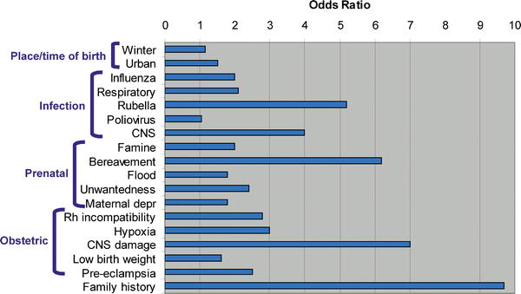
PLOS Medicine
Notes:
Its also important to keep in mind as you read about the risk factors, that most of these risk factors are associated with approximately a doubling of risk (also called the "Odds Ratio") - which might sound high, but that means that overall for someone with no family history of schizophrenia, that the risk goes from about 1% to 2% (with risk of not getting schizophrenia declining from 99% to 98%). Therefore, for the average person with no family history of schizophrenia or mental illness most of these risk factors may not make a significant difference in terms of total risk of schizophrenia which remains low. At the same time good healthcare, nutrition and a positive emotional environment for women during pregnancy are always important factors for the health of a baby and always recommended by doctors. Research also suggests that nurturing, sensitive child care is also important for the healthy emotional development of children
Image: Some of the Schizophrenia Environmental Risk Factors - Source; PLOS Medicine (Note: different studies suggest different risk factors - so you will see some variance in the risk number that we quote below for some environmental factors).
The factors listed below matter most significantly for people who have a history of schizophrenia or other mental illness in their family which suggests that a person may have some of the genes that are associated with schizophrenia risk. At this time little is known about exactly how the environmental exposures identified below increase risk in those with some sort of genetic vulnerability - so don't get too worried if you have in the past experienced a given environmental factor, as its impossible to know for sure how that environmental factor might impact you or your child. Focus on the environmental factors that you still have some influence over.
The take home message is that if you have a family history of mental illness it would probably be beneficial to take some reasonable steps to reduce or avoid exposure to the risk factors -- especially those factors involved in pregnancy, prenatal care and early child care. For teens interested in lowering their risk of schizophrenia, the avoidance of street drugs, maintenance of healthy friendships, and early treatment for any depression, sadness and anxiety is likely to be valuable. At the same time, all of the actions below are likely to help the mental health of any child or person - so the more steps you can take, the better your (or your child's) mental health is likely to be.

Slide 10
Symptoms → Vulnerability
Biological, Psychosocial and Environmental
Areas of the brain
Dopamine
Other
Stress-Diathesis Model:
Neurobiology
structures or connections
Limbic system
Basal ganglia
Cerebellum
Family studies
Twin studies
Chromosome.
Neuropathology
Genetic Factors

Slide 11
Notes:
http://www.schizophrenia.com/prevention.htm
Before going into the specific risk reduction strategies its important to know the initial risks that a person may face of getting schizophrenia. In the general population, for someone who has no family history of mental illness, the average risk is estimated at approximately 1% (and therefore a 99% probability that the person will not get schizophrenia). If someone who is genetically related to a person in the extended family that does have schizophrenia, then the risk is higher - and the chart below provides a rough estimate of that risk. If, for example, you have an aunt or uncle who developed schizophrenia, then your risk (on average) is estimated at approximately 3% (and therefore there is a 97% probability you won't get schizophrenia). Even for the situation where one parent has schizophrenia the risk is estimated at 13% for a child, which means there is an 87% probability that the person will not develop schizophrenia. If a family has a history of more than one person developing schizophrenia then the risk goes up. People who have a strong history of mental illness in their family may want to consider genetic counseling in addition to the schizophrenia prevention tactics identified below

Slide 12
Symptoms → Vulnerability
Biological, Psychosocial and Environmental
Areas of the brain
Dopamine
Other
Stress-Diathesis Model:
Neurobiology
structures or connections
Limbic system
Basal ganglia
Cerebellum
Family studies
Twin studies
Chromosome.
Neuropathology
Genetic Factors

Slide 13
http://www.medscape.org/viewarticle/585155

Slide 14
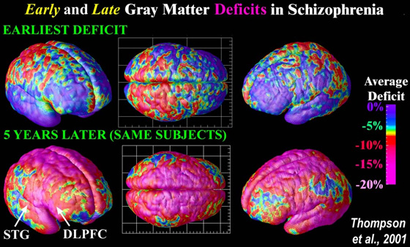
http://www.schizophrenia.com/disease.htm
Notes:
Image Source: UCLA Laboratory of Neuro Imaging, UCLA, Derived from high-resolution magnetic resonance images (MRI scans), the above images were created after repeatedly scanning 12 schizophrenia subjects over five years, and comparing them with matched 12 healthy controls, scanned at the same ages and intervals. Severe loss of gray matter is indicated by red and pink colors, while stable regions are in blue. STG denotes the superior temporal gyrus, and DLPFC denotes the dorsolateral prefrontal cortex. Note: This study was of Childhood onset schizophrenia (defined as schizophrenia diagnosed in children under the age of 13 or so) which occurs in approximately 1 of every 40,000 people and is frequently a significantly more aggressive form of schizophrenia (than regular schizophrenia that typically begins when people are aged 15 to 25 (slightly later for women) - and impacts approximatley 1 of every 100 people).

Slide 15
Diagnosis
# DSM-5 Diagnostic Criteria for Schizophrenia:
A- ≥ two characteristic symptoms for one month, at least one of them is (1),(2) or (3)
1- Delusions
2- Hallucinations
3- Disorganized speech (frequent derailment or incoherence)
4- Grossly disorganized or catatonic behavior
5- Negative symptoms ( diminished emotional expression or lack of drive (avolition))

Slide 16
B- Social, Occupation or self-care dysfunction
C- Duration of at least 6 months of disturbance (include at least one month of active symptoms that meet Criterion A; in addition of periods of prodromal and residual symptoms).
D- Schizoaffective & mood disorder exclusion
E- The disturbance is not due to Substance or another medical condition.
F- If there is history of autism spectrum disorder or a communication disorder of childhood onset, schizophrenia diagnosis is made only if delusion or hallucinations plus other criteria are present.

Slide 17
Clinical Features
No single clinical sign or symptom is pathognomonic for schizophrenia
Patient's history & mental status examination are essential for diagnosis.
Premorbid history includes schizoid or schizotypal personalities, few friends & exclusion of social activities.
Prodromal features include obsessive compulsive behaviors , attenuated positive psychotic features.

Slide 18
Mental Status Examination
- Appearance & behavior
- Mood, feelings & affect
- Perceptual disturbances
- Thought: Thought content
Form of thought
Thought process ( thought blocking, poverty of thought content, poor abstraction, perseveration )
- Impulsiveness, violence, suicide & homicide
- Cognitive functioning
- Poor insight and judgment

Slide 19
Prognosis
Good P.F | Poor P.F
Late age of onset Acute onset Obvious precipitating factors Presence of mood component Good response to Tx Good supportive system | Young age of onset Insidious onset Lack of P.F. Multiple relapses Low IQ Poor premorbid personality Negative symptom Positive family history

Slide 20
Differential Diagnosis
Secondary psychiatric disorders:
-Substance-induced disorders
-Psychotic disorders due to another medical disorder :
Epilepsy ( complex partial)
CNS diseases
Trauma
Others
Primary Psychiatric disorders:
Schizophreniform disorder
Brief psychotic disorder
Delusional disorder
Schizoaffective disorder
Mood disorders
Personality disorders
(schizoid, schizotypal & borderline personality)
Factitious disorder
Malingering

Slide 21
Brief psychotic disorder
Schizophreniform disorder
Schizoaffective
Delusional disorder
DIP
MIP
MMD with Psychotic features
Other Psychotic Disorders

