Slide 1
BRACHIAL PLEXUS & LUMBOSACRAL PLEXUS
Prof. Ahmed F. I. El Fouhil
Professor of Anatomy
College of Medicine
King Saud University
E-mail: ahmedfathala@gmail.com

Slide 2
OBJECTIVES
At the end of the lecture, students should:
Describe the formation of brachial, lumbar & sacral plexus (site & root value).
List the main branches of brachial, lumbar & sacral plexus.
List the motor distribution of the branches of the brachial plexus.
Describe the deformities caused by lesions of brachial plexus and its main branches.
Describe, in brief, the course of femoral & sciatic nerves.
List the motor and sensory distribution of femoral & sciatic nerves.
Describe the main motor & sensory effects in cases of lesion of femoral & sciatic nerves.

Slide 3
Formation the Brachial Plexus
V
E
N
T
R
A
L
R
A
M
I
Anterior
Anterior
Posterior
Posterior
Posterior
Anterior

Slide 4
Relations between the Brachial Plexus and: 1) the clavicle & 2) the Axillary Artery?
Roots & Trunks are above the clavicle (in the posterior triangle of Neck)
Divisions are behind the clavicle
Cords are below the clavicle (in the axilla)
Lateral Cord is lateral
Medial Cord is medial to Axillary Artery
Posterior Cord is posterior

Slide 5
Pectoralis major
Supra- &
Infraspinatus
Rhomboideus & Levator scapulae
Deltoid
& Teres minor
Subscapularis
Latissimus dorsi
Subscapularis & Teres major
Pectoralis major & minor
Serratus anterior

Slide 6
The most important branches of the Brachial Plexus & their supply
Anterior compartment of arm (Flexors of shoulder & elbow)
Deltoid (Abductor of shoulder)
Anterior compartment of forearm & hand (Flexors of wrist & fingers)
Posterior compartment of arm & forearm & hand (Extensors of elbow, wrist & fingers)

Slide 7
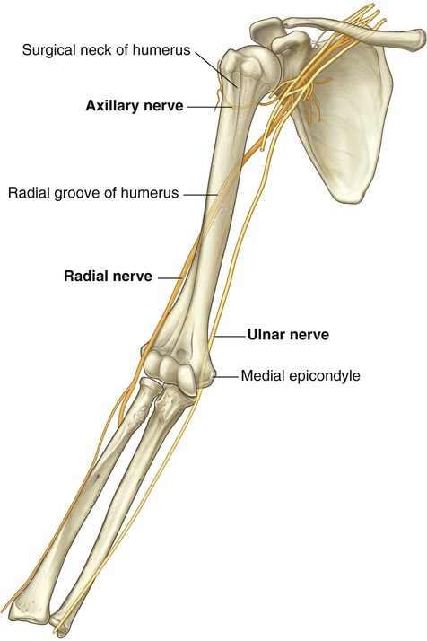
Nerves directly related to the humerus
(The most vulnerable nerves in cases of humeral fractures)

Slide 8
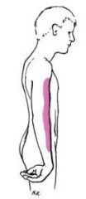
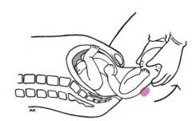
What part of the brachial plexus is injured?
What are the consequences?
Upper trunk of brachial plexus (C5, C6)
Erb’s palsy or Waiter’s tip position:
Arm is adducted, forearm is extended & pronated

Slide 9
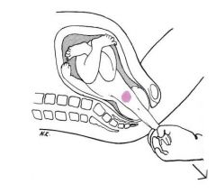
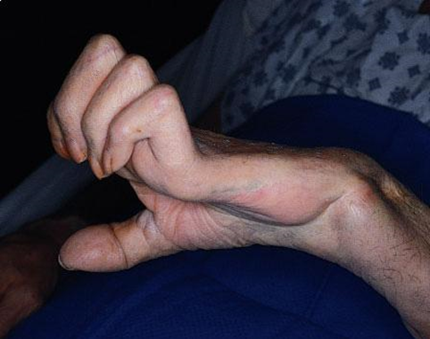
What part of the brachial plexus is injured?
Lower trunk injury C8, T1
What are the consequences?
Klumpke’s paralysis:
Paralysis of muscles of the hand leading
to a picture of complete claw hand
(combined Median & Ulnar nerve injuries)

Slide 10
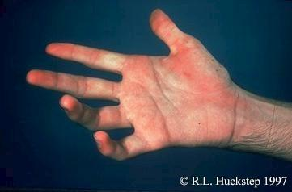
What is the name of this deformity?
What is the name of the lesion that causes this deformity?
What is the cause of this deformity?
Partial claw hand
Ulnar nerve lesion
Due to partial paralysis of muscles of the hand

Slide 11
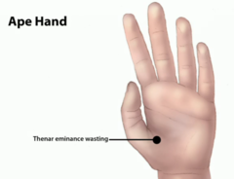
What is the name of the nerve lesion that causes these 2 deformities?
Median nerve lesion
WHY?
Loss of flexion & opposition of thumb
Weak abduction of thumb
Loss of flexion of index finger
(due to paralysis of both FDS & FDP)

Slide 12
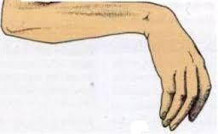
What is the name of the deformity?
What is the name of the nerve lesion that causes this deformity?
Why it is the cause of the deformity
Wrist drop
Radial nerve lesion
Paralysis of extensors of wrist & fingers

Slide 13
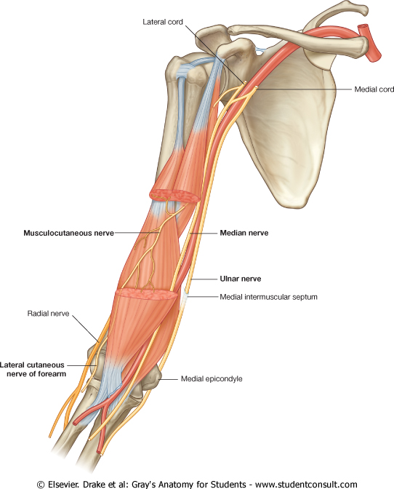
FOR PRACTICAL USE
(In the cubital fossa)
(Behind the medical epicondyle)
(In front of lateral epicondyle)

Slide 14
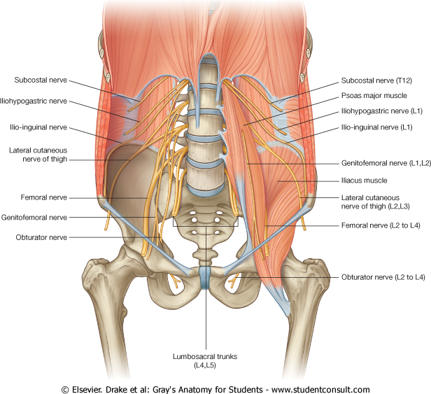
LUMBAR PLEXUS
Formation: by ventral (anterior) rami of L1,2,3 and most of L4.
Site: in substance of psoas major muscle.
Main branches:
Iliohypogastric & ilioinguinal: to anterior abdominal wall.
Obturator: to medial (adductor) compartment of thigh.
Femoral: to anterior compartment of thigh.

Slide 15
SACRAL PLEXUS
Formation: by ventral (anterior) rami of a part of L4 & whole L5 (lumbosacral trunk) + S1,2,3 and most of S4.
Site: in front of piriformis msucle.

Slide 16
SACRAL PLEXUS
Main branches:
Pelvic splanchnic nerve: preganglionic parasympathetic to pelvic viscera & hindgut.
Pudendal nerve: to perineum.
Sciatic nerve: to lower limb.

Slide 17
LUMBOSACRAL PLEXUS

Slide 18
FEMORAL NERVE
Origin: from lumbar plexus (L2,3,4).
Course:
Descends lateral to psoas major & enters the thigh behind the inguinal ligament.
Passes lateral to femoral artery & divides into anterior & posterior divisions.

Slide 19
BRANCHES OF FEMORAL NERVE
Muscular:
In abdomen: To iliacus (flexor of hip joint).
In lower limb: To anterior compartment of thigh:
To flexors of hip joint: sartorius & pectineus.
To extensors of knee joint: quadriceps femoris.

Slide 20
BRANCHES OF FEMORAL NERVE
Cutaneous:
To antero-medial aspects of the thigh.
To medial side of knee, leg and foot (saphenous nerve).

Slide 21
FEMORAL NERVE INJURY
MOTOR EFFECT:
Wasting of quadriceps femoris.
Loss of extension of knee.
Weak flexion of hip (psoas major is intact).
SENSORY EFFECT:
loss of sensation over areas supplied antero-medial aspect of thigh & medial side of leg & foot.

Slide 22
SCIATIC NERVE
It is the largest nerve of the body.
Origin: from sacral plexus (L4,5, S1, 2,3).
Course:
Leaves the pelvis through greater sciatic foramen, below piriformis & passes in the gluteal region (between ischial tuberosity & greater trochanter) then to posterior compartment of thigh.
Divides into tibial & common peroneal (fibular) nerves.
Ischial tuberosity

Slide 23
TIBIAL NERVE
Course:
Descends through popliteal fossa to posterior compartment of leg, accompanied with posterior tibial vessels.
Passes deep to flexor retinaculum (behind medial malleolus) to reach the sole of foot where it divides into 2 terminal branches.

Slide 24
COMMON PERONEAL (FIBULAR) NERVE
Course:
Leaves popliteal fossa & turns around the lateral aspect of neck of fibula. Then divides into:
Superficial peroneal: descends into lateral compartment of leg.
Deep peroneal: descends into anterior compartment of leg.

Slide 25
BRANCHES OF SCIATIC NERVE
MUSCULAR:
To Hamstrings (flexors of knee & extensors of hip).
To all muscles in the leg & foot:
Common peroneal: Muscles of anterior & lateral compartments of leg (dorsiflexors of ankle, extensors of toes, evertors of foot).
Tibial: Muscles of posterior compartment of leg & intrinsic muscles of sole (planterflexors of ankle, flexors of toes, invertors of foot).

Slide 26
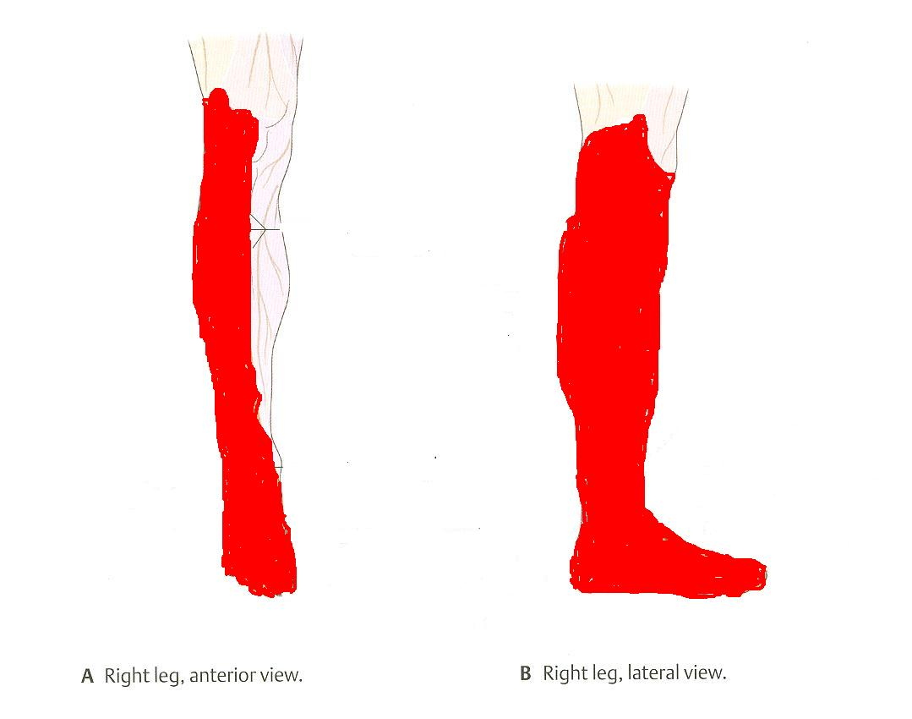
BRANCHES OF SCIATIC NERVE
CUTANEOUS:
To all leg & foot EXCEPT: areas supplied by saphenous branch of femoral nerve.
C. Right leg: posterior view

Slide 27
INTRAMUSCULAR INJECTION IN GLUTEAL REGION
Gluteal region is one of the site of choice for an intramuscular injection.
To avoid injury of the sciatic nerve in this region, the safest place to inject is the upper outer quadrant of either gluteal region.

Slide 28
SCIATIC NERVE INJURY
MOTOR EFFECT:
Marked wasting of the muscles below the knee.
The foot assumes the position of Foot Drop (planter flexed position) by its weight.
SENSORY EFFECT:
Loss of sensation below knee (EXCEPT medial side of leg & foot).

Slide 29
QUESTION 1
Which one of the following deformities is the cause of median nerve lesion?
Waiter’s tip position.
Partial claw hand.
Ape hand.
Wrist drop.

Slide 30
QUESTION 2
Which one of the following movements is affected in case of common peroneal nerve lesion?
Dorsiflexion of ankle.
Inversion of foot.
Extension of knee.
Flexion of toes.

Slide 31
THANK YOU

