Slide 1
Biochemical Aspects of Alzheimer’s Disease

Slide 2
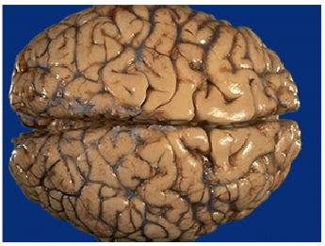
Objectives
Upon completion of this lecture, the students should be able to:
Define neurodegenerative disorders
Identify the clinical picture and diagnostic criteria of Alzheimer’s disease
Understand the different ways of processing of amyloid precursor protein leading to amyloid generation and accumulation
Differentiate between the neuritic plaques, neurofibrillary tangles and tau protein and their role in the pathogenesis of the disease
Understand the genetics of Alzheimer’s disease
Discuss ongoing research and therapeutic approach to treat these disorders

Slide 3
Neurodegenerative Diseases
Diseases of gray matter characterized principally by the progressive loss of neurons
The pattern of neuronal loss is selective affecting one or more groups of neurons leaving the others intact
The diseases arise without any clear inciting event in patients without previous neurological deficits

Slide 4
Neurodegenerative Diseases
A common theme is the development of protein aggregates that are resistant to normal cellular mechanisms of degradation
The aggregated proteins are generally cytotoxic

Slide 5
Alzheimer’s Disease
A degenerative disease with the prominent involvement of the cerebral cortex
Its principal clinical manifestation is dementia
Dementia is the progressive loss of cognitive function independent of the state of attention
Patients rarely become symptomatic before 50 yr. of age but the incidence of disease rises with age

Slide 6
Alzheimer’s Disease
The disease becomes apparent with:
Gradual impairment of higher intellectual function
Alterations in mood and behavior
Progressive disorientation
Memory loss
In 5-10 yrs, the patient becomes profoundly disabled, mute and immobile
Most cases are sporadic
At least 5-10% are familial

Slide 7
Diagnosis
Combination of clinical assessment and radiologic methods
Pathologic examination of brain tissue is necessary for definitive diagnosis
Major microscopic abnormalities include: neuritic (or senile) plaques, neurofibrillary tangles and amyloid angiopathy

Slide 8
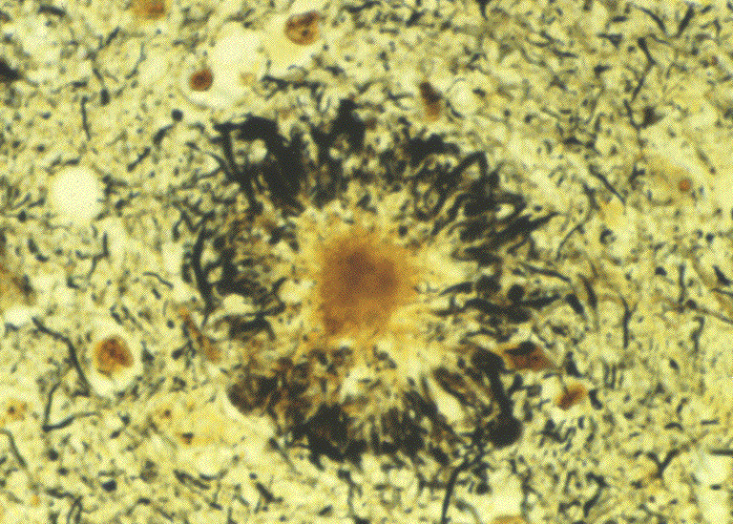
Neuritic Plaques
Spherical with 20-200 μm in diameter
Contain paired helical filaments as well as synaptic vesicles and abnormal mitochondria
The amyloid core contains several abnormal proteins
The dominant component of the plaque core is Aβ, a peptide derived from a larger molecule, amyloid precursor protein (APP)

Slide 9
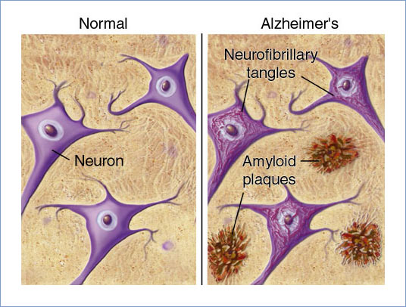
Neuritic Plaques contd..
The two dominant species of Aβ, called Aβ₄₀ and Aβ₄₂ share an N-terminus and differ in length by two amino acids.
Other less abundant proteins in the plaque:
Components of the complement cascade
Proinflammatory cytokines
α₁-Antichymotrypsin
Apolipoproteins

Slide 10
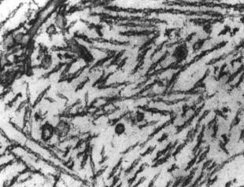
Neurofibrillary Tangles
Bundles of filaments in the cytoplasm of neurons that displace or encircle the nucleus
These filaments mainly contain:
Hyper-phosphorylated forms of the tau protein
A protein that enhances microtubule assembly

Slide 11
Amyloid Angiopathy
Amyloid proteins build up on the walls of the arteries in the brain
The condition increases the risk of hemorrhagic, stroke and dementia
An almost invariable accompaniment of Alzheimer’s disease but not specific for Alzheimer’s

Slide 12
Pathogenesis of Alzheimer’s
Still being intensively studied
Strong correlation of number of neurofibrillary tangles with degree of dementia than neuritic plaques
Biochemical markers correlated to degree of dementia include:
Loss of choline acetyltransferase
Synaptophysin immunoreactivity
Amyloid burden

Slide 13
Pathogenesis of Alzheimer’s
Loss of synapses best correlates with severity of dementia
The Aβ peptide forms β-pleated sheets and aggregates
Resistant to degradation
Elicits a response from astrocytes and microglia
Can be directly neurotoxic

Slide 14
Aβ is a critical molecule in the pathogenesis of Alzheimer’s disease

Slide 15
Aβ Peptides
Derived from the processing of APP
APP is a protein of uncertain cellular function
It is synthesized with a single transmembrane domain and expressed on the cell surface

Slide 16
Two pathways for APP processing
β α γ
β-peptide (Aβ)
Alpha-secretase
pathway
TM
Beta-secretase
pathway
APP_{Sα}
neurotrophic
α-stub
APP_{Sβ}
β-stub
γ-secretase
γ-secretase
γ-secretase
p3
Aβ40
Aβ42
neurotoxic
Notes:
6

Slide 17
Mechanism of amyloid generation
APP has potential cleavage sites for three distinct enzymes (α, β, and γ-secretases)
The Aβ domain extends from the extracellular side of protein into the transmembrane domain
When APP is cleaved by α-secretase, subsequent cleavage by γ-secretase does not yield Aβ

Slide 18
Mechanism of amyloid generation
Cleavege by β-secretase followed by γ-secretase results in production of Aβ
Aβ can then aggregate and form fibrils

Slide 19
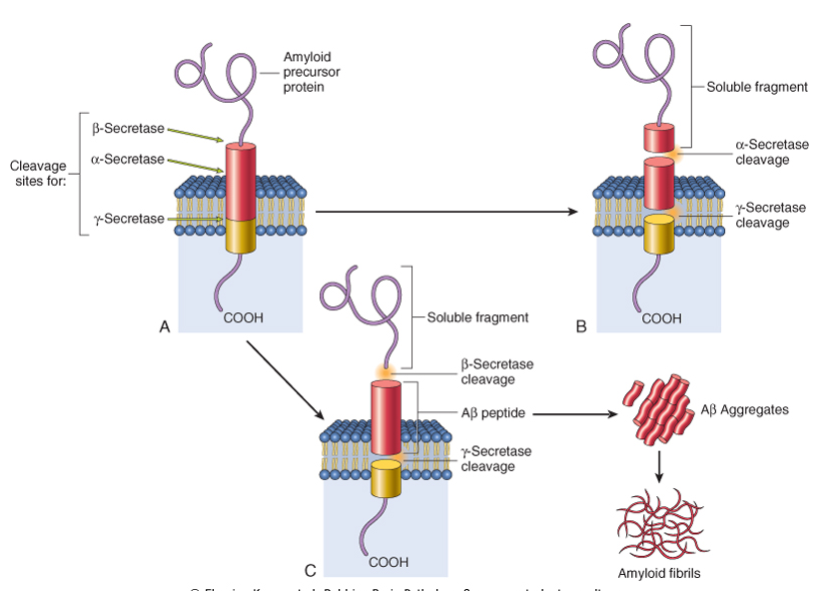

Slide 20
Accumulation of Aβ protein
Accumulation of Aβ protein affects neurons and neuronal function:
Small aggregates of Aβ alters neurotransmission
Aggregates can be toxic to neurons and synaptic endings
Larger deposits (plaques) also cause neuronal death
Elicit a local inflammatory response leading to further cell injury

Slide 21
The Tau Protein
Presence of Aβ causes hyper-phosphorylation of tau protein in neurons
This leads to redistribution and aggregation of tau protein into tangles in neurons (from axon into dendrites and cell body)
The process results in neuronal dysfunction and cell death

Slide 22
Aβ and Tau may both contribute to the pathogenesis of Alzheimer’s Disease
??
Factors that
elevate Aβ
Aβ Tau
Fibril assembly
Filament assembly
Nerve cell mis-function
and death?
Nerve cell
mis-function
and death?

Slide 23
Genetics of Alzheimer’s
Mutations in APP gene
Mutations in γ-secretase (presenilin-1 or presenilin-2)
Both lead to early onset of familial Alzheimer’s disease due to high rate of Aβ accumulation
Alzheimer’s occurs in most patients with Down syndrome (trisomy 21) beyond 45 years of age
The gene encoding APP is located in chromosome 21
Due to APP gene dosage effects

Slide 24
Genetics of Alzheimer’s
Genes associated with typical, sporadic Alzheimer’s disease are being identified
This may provide new clues to pathogenesis of the disease

Slide 25
Genetics of Alzheimer’s
Chromosome | Gene | Consequences
21 | Amyloid Precursor Protein (APP) | Early onset FAD Increased Aβ production
14 | Presenilin-1 (PS1) | Early onset FAD Increased Aβ production
1 | Presenilin-2 (PS2) | Early onset FAD Increased Aβ production
19 | Apolipoprotein E (ApoE) | Increased risk for development of AD Decreased age at onset of AD

Slide 26
Treatment of AD
Currently no effective treatment for AD
Regulating neurotransmitter activity (enhancing cholinergic function improves symptoms)
Epidemiology shows NSAIDs decrease the risk for developing AD.
Clinical trials of NSAIDs in AD patients are not very fruitful

Slide 27
Treatment of AD
Polyphenols such as flavonoids reduce proinflammatory responses
Flavonoid supplements may be a new therapeutic approach for AD

Slide 28
Treatment of AD contd..
Stem cell therapy offers:
Cellular replacement and/or provide environmental enrichment to attenuate neurodegeneration
Neurotrophic support to remaining cells
Prevent the production or accumulation of toxic factors that harm neurons

Slide 29
Continued Research on AD
The small aggregates of Aβ and larger fibrils are directly neurotoxic
They can elicit oxidative damage and alterations in calcium homeostasis
How Aβ is correlated to neurodegeneration in AD? How it is linked to tangles and hyperphosphorylation of tau protein?
All remain open questions

Slide 30
Take home message
Neurodegeneration is the progressive loss of structure or function of neurons, including death of neurons
Extracellular deposition of normally soluble proteins in certain tissues in the form of insoluble fibrous aggregates known as amyloid. The deposition of amyloid interferes with normal cellular function, resulting in cell death and eventual organ failure
The dominant component of amyloid plaque that accumulates in Alzheimer’s disease is amyloid β 42(Aβ42) peptide

Slide 31
References
Stem Cell Technology for Neurodegenerative Diseases. Ann Neurol. 2011 September ; 70(3): 353–361.
A Review: Inflammatory Process in Alzheimer’s Disease, Role of Cytokines. The Scientific World Journal, Volume 2012, Article ID 756357,

