Slide 1
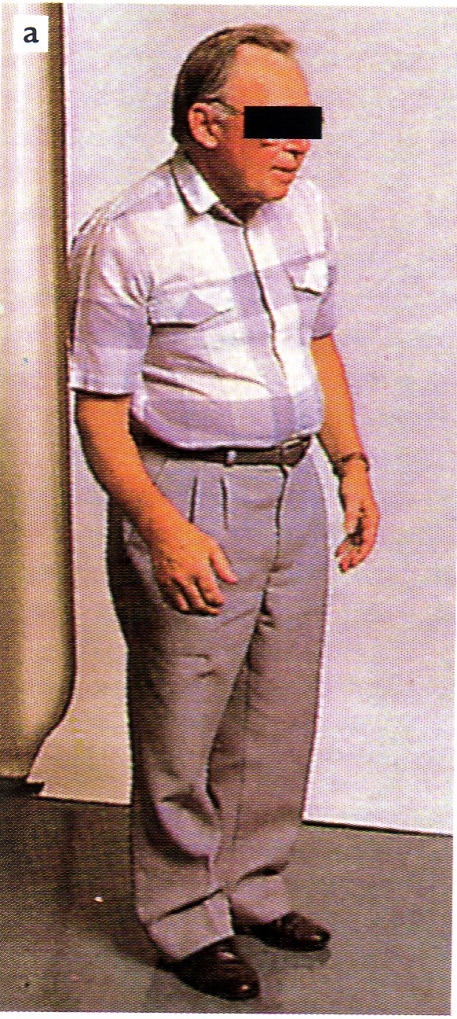
Drugs in parkinsonism
ilos
Describe the pharmacological approach for treatment of Parkisonism
Detail on the pharmacokietic aspects and pharmacodynamic effects of drugs used to treat Parkisonism

Slide 2
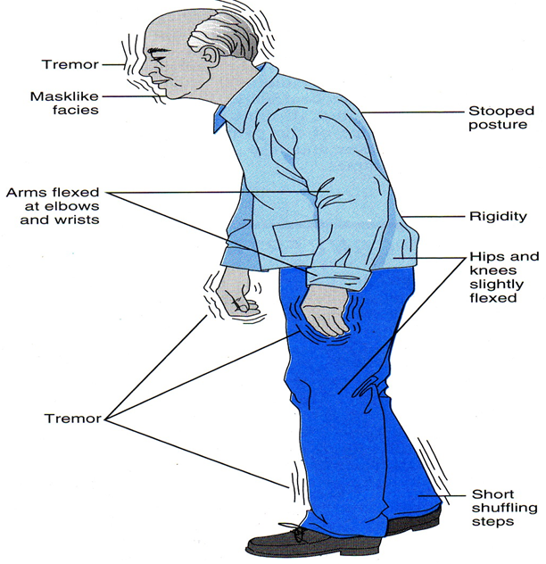
Drugs in parkinsonism
A progressive disorder that occur mainly in the elderly
Tremor at rest
Muscle rigidity
Hypokinesia
Postural instability

Slide 3
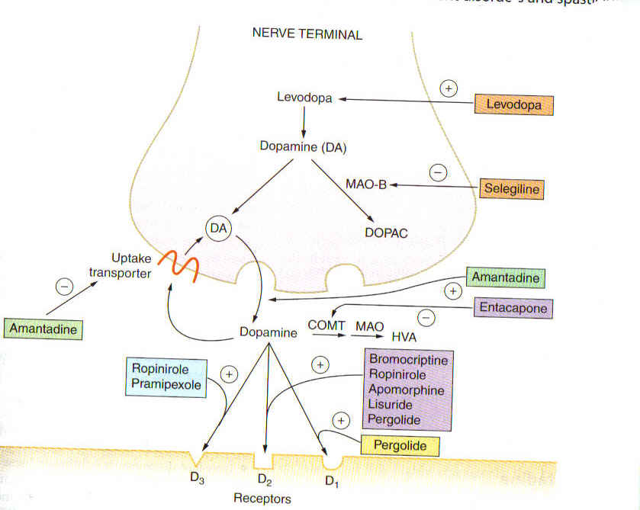
Approach for treatment
Replacement of dopamine by levodopa
Drugs that mimic the effects of dopamine at D2& D3-receptors
MAO-B inhibitors e.g. selegiline
Drugs that release dopamine e.g. amantadine
Muscarinic acetylcholine antagonists e.g. benzatropine

Slide 4
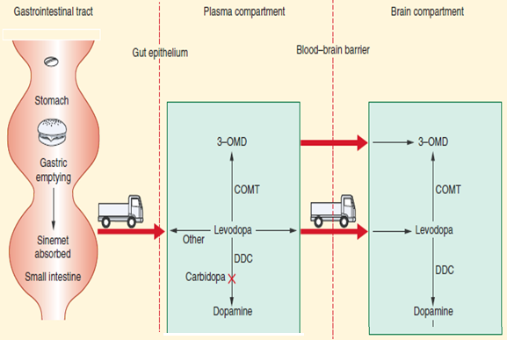
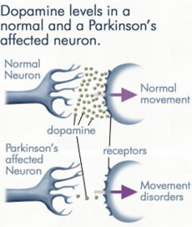
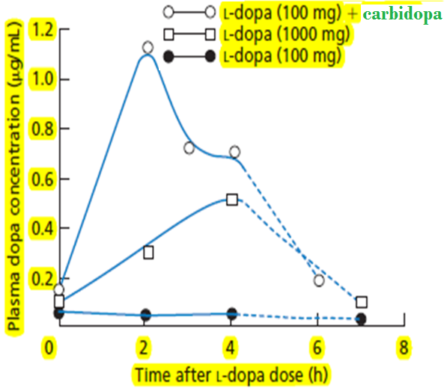
levodopa
Combined with peripheral dopa decarboxylase inhibitors (carbidopa, benserazide)
Absorbed from the small intestine & crosses BBB by active transport, t½=2h
Effective against all types of parkinsonism except those associated with antipsychotic drug therapy.

Slide 5
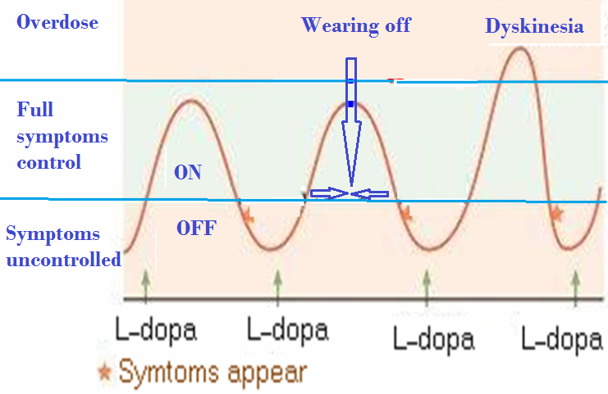
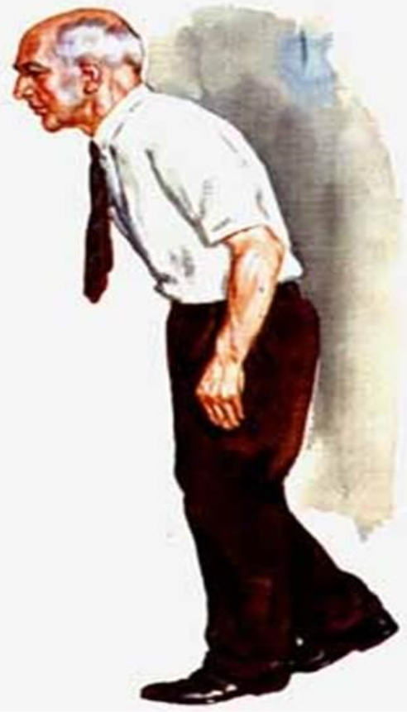
Motor fluctuations
wearing-off effect
on-off effect
Dyskinesias

Slide 6
ADRs
Orthostatic hypotension
Cardiac arrhythmias
CNS ADRs
vivid dreams, delusions, hallucinations, confusion and sleep disturbances

Slide 7
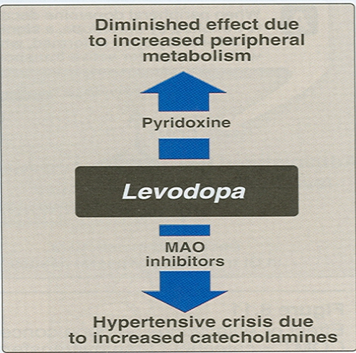
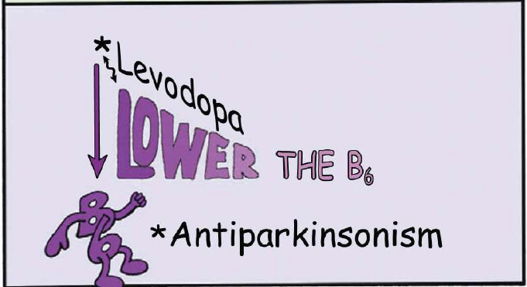
contraindications
Nonselective MAO inhibitors (phenelzine, tranylcypromine)
Pyridoxine
Adrenomimetic amines
Cardiac arrhythmias or recent cardiac infarction
Proteins ingested with meals

Slide 8
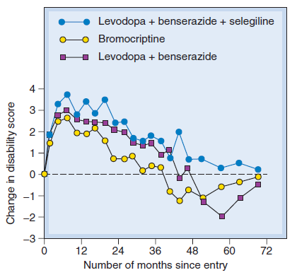
Dopamine receptor agonists
Long duration of action ,less likely to cause dyskinesias than levodopa
As monotherapy, they are less effective than levodopa
Combined with levodopa in advanced stages →clinical improvement +↓levodopa dosage needs

Slide 9
classification
Ergot derivatives
bromocriptine, pergolide
synthetics
pramipexole , ropinirole

Slide 10
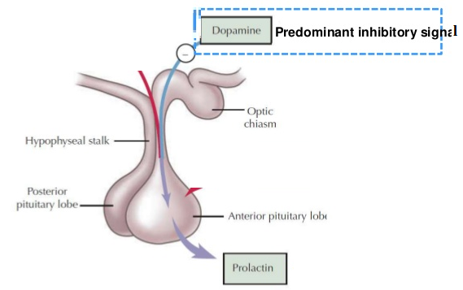
bromocriptine
An agonist at the D2-receptors and a partial D1-antagonist
adrs
Absorbed to a variable extent from the GIT ; peak plasma levels are reached within 1–2 hours after an oral dose.
Postural hypotension, nausea, somnolence
Confusion, hallucinations, delusions
Excreted in the bile and feces.
Dyskinesias
Used for hyperprolactinemia

Slide 11
contraindications
History of psychotic illness
Recent myocardial infarction
Active peptic ulceration
Best avoided in patients with peripheral vascular disease

Slide 12
pramipexole
Has preferential affinity for the D3 family of receptors
Rapidly absorbed, reaching peak plasma concentrations in approximately 2 hours, excreted largely unchanged in the urine
Renal insufficiency may necessitate dosage adjustment

Slide 13

amantadine
Modest effectiveness
adrs
Nausea, dizziness, insomnia, confusion, hallucinations
Useful in the early stages of parkinsonism or as an adjunct to levodopa therapy
Livedo reticularis
Ankle edema, and livedo reticularis
Affects dopamine release and reuptake,
antagonist at muscarinic and NMDA receptors
contraindications
Anticholinergics
t½=2-4h, most of the drug being excreted unchanged in the urine
In patients with a history of seizures or heart failure

Slide 14
Selegiline
An irreversible inhibitor of MAO-B
Blockade of dopamine metabolism makes more dopamine available for stimulation of its receptors.
As monotherapy, may be effective in the newly diagnosed patient
In later-stage, it is used in conjunction with levodopa-carbidopa →reduces levodopa dosage requirements
Minimize or delay the onset of dyskinesias and motor fluctuations that accompany treatment with levodopa

Slide 15
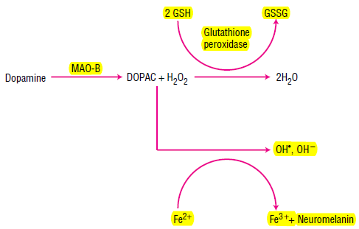
Selegiline, rasagiline
It slows the progression of the disease by ↓the formation of toxic free radicals produced during the metabolism of dopamine.
Metabolized to desmethylselegiline, Which is antiapoptotic

Slide 16
Selegiline
adrs
At higher doses may inhibit MAO-A
May cause insomnia when taken later during the day
May ↑the adverse effects of levodopa
contraindications
Should not be co administered with TCA, meperidine or SSRIs

Slide 17
Anticholinergic Drugs
Efficacy is due to blockade of muscarinic receptors in the striatum
Modest efficacy, used during the early stages of the disease or as an adjunct to levodopa
Anticholinergics can provide benefit in drug- induced parkinsonism
e.g. Benztropine, Trihexyphenidyl.

Slide 18
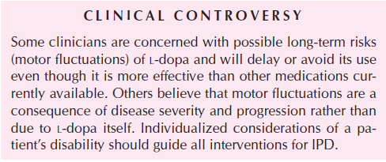
adrs
Cycloplegia, dry mouth, urinary retention, and constipation
Confusion, delirium, and hallucinations may occur at higher doses
Trihexyphenidyl may cause withdrawal symptoms in patients receiving large doses.

Slide 19


Case
M. S. is a 60-year old architect who designs buildings. His drawings are very detailed and they must be drawn to a specific scale. During the past month he has developed a slight tremor in his right hand that causes some embarrassment but does not interfere with function. He has, however, noticed that his writing and drawing have gotten much smaller, causing problems with his work. His primary care physician has referred him to a neurologist for evaluation. On examination, the neurologist notes some motor rigidity in the right arm. He also observes a slight slowing in the patient’s walk and a reduction in the swing of his arms as he walks. What is the diagnosis, and how should the patient be treated?
Notes:
<The patient is in early-stage parkinsonism,
most likely idiopathic (Parkinson’s disease).
Clinically, the disease is very mild and the
neurologist might consider not treating him at this
point, but because the micrographia interferes with
his work, the neurologist decides to prescribe
medication. Several drugs can be used to treat
early-onset parkinsonism.The most commonly used
are the dopamine receptor agonists (pramipexole,
ropinirole, pergolide; amantadine is also a
possibility, and some people get an acceptable
response to selegiline, the MAO inhibitor).
Levodopa–carbidopa could also be used; however,
most clinicians prefer to delay its use until
absolutely needed because of the adverse effects,
such as motor fluctuations and dyskinesias, that
accompany long-term use of levodopa.

Slide 20

Quiz 1?
Great caution must be exercised in the use of this drug in parkinsonian patients who have prostatic hypertrophy :-
(A) Benztropine
(B) Carbidopa
(C) Levodopa
(D) Bromocriptine
(E) Selegiline

Slide 21
Quiz 2?
A drug that is used in the treatment of parkinsonism and will also attenuate reversible extrapyramidal side effects of neuroleptics is
(A) Amantadine
(B) Levodopa
(C) Pergolide
(D) Selegiline
(E) Trihexyphenidyl

