Slide 1
Stretch Reflex& Golgi Tendon Reflex
By :Dr. Salah Elmalik
Dept. of Physiology
Email: saelmalik@Ksu,Edu.sa Ext 71608

Slide 2
Neuropsychiatry Block
Chapter 55
Motor Functions of the Spinal Cord, The cord Reflexes
(Guyton & Hall)
Reference book/Ganong review of
medical physiology

Slide 3
Objectives
By the end of this lecture students are expected to:
Describe the components of stretch reflex and its function
Describe the structure , innervations and function of the muscle spindle .
Explain the roles of alpha and gamma motor neurons in the stretch reflex
Describe and explain muscle tone
Discuss the spinal and supraspinal regulation of stretch reflex
Describe the inverse stretch reflex and its function

Slide 4
What is a Stretch Reflex?
It is a reflex contraction of a muscle when it is moderately stretched
It is a monosynaptic reflex (also known as myotatic reflex)
It has two components:
dynamic stretch reflex (patellar-tendon or knee jerk reflex)
static stretch ( muscle tone)

Slide 5
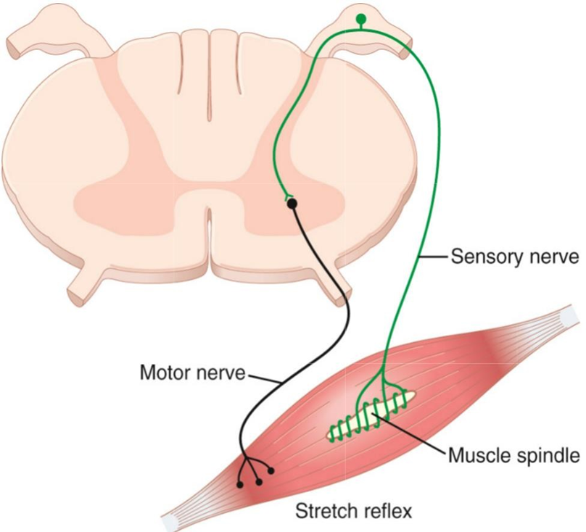
Pathway of Stretch Reflex (Reflex Arc)
Sensory receptor (muscle spindles)
Afferent neuron (fast-conducting Ia and (II)nerve fibers )
Integrating center (spinal cord) AHC
alpha motor neurons synapse with the afferent sensory neurons in the spinal cord ( secrete glutamate)
Efferent (motor) neurons
alpha motor efferent arise from alpha motor neurons to supply extrafusal muscle fibers
Effector : extrafusal muscle fibers
Effect: Muscle contraction
-Aim: To maintain muscle length

Slide 6
Pathway of Stretch Reflex

Slide 7
Muscle Spindles-1
Is located in the fleshy part of the muscle
Consists of 3-12 small intrafusal fibers within a capsule
Each intrafusal fiber has a central (non-contractile) area (receptor), and a contractile area on each side.
Intrafusal (spindle)
Capsule
muscle fibers
Extrafusal (“ordinary”) muscle fibers
Contractile end of intrafusal fiber
Alpha motor neuron axon
Gamma motor neuron axon
Non-contractile central portion of intrafusal fiber
Secondary (flower- spray) endings of afferent fibers (type II)
Primary (annulospiral) endings of afferent fibers (type Ia)
Amani El Amin

Slide 8
Muscle Spindle-2
There are 2 types of intrafusal muscle fibers:
1)Nuclear bag fibres;
Have a dilated central area filled with nuclei.
Are 1-3 of these fibres per spindle.
2)Nuclear chain fibres;
Have nuclei which are arranged as a chain in the receptor area.
Are 4-9 of these fibres per spindle.

Slide 9
Muscle Spindle-3

Slide 10
Sensory ( Afferent ) Innervation of the Muscle Spindle
A/The primary ( annulospiral ) ending;
Group Ia endings(17 micrometers in diameter) encircle receptor areas of nuclear bag fibers mainly, but also nuclear chain fibres
Send sensory signals to the CNS at the highest conduction velocity of 70 to 120 m/sec
Discharge most rapidly if the muscle is suddenly stretched (dynamic response) and less rapidly (or not) during sustained stretch (static response)
Measures the rate & or velocity of change -
in muscle length .

Slide 12
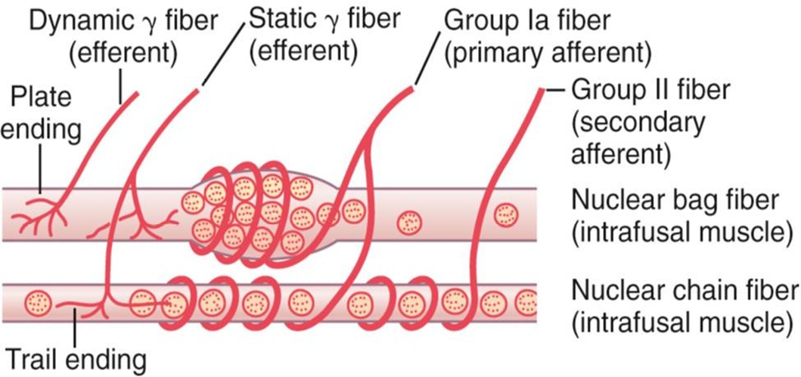
Sensory ( Afferent ) Innervation of the Muscle Spindle-2
B/ Secondary ( Flower-spray ) Afferents
Group II fibers ( 8 micrometers in diameter), innervate ONLY the nuclear chain receptor
Discharge at an increased rate throughout the period during which the muscle is being stretched , directly proportion to the degree of stretch (measure only muscle length , Static Response).

Slide 13
Efferent Innervation of Muscle Spindle
Gamma (γ) efferent endings terminate on the peripheral contractile parts of the intrafusal muscle fibres as:
Plate endings: end mainly on the nuclear bag fibres (called dynamic gamma efferent)
Trail endings: end mainly on nuclear chain fibres ( called static gamma efferent)
The function of γ- motor neurons is to regulate the sensitivity of the intrafusal muscle fibers, but HOW?

Slide 14
Efferent Innervation of Muscle Spindle-2
They adjust ms spindle sensitivity
↑ γ-MNs cause contraction of the peripheral parts of intrafusal fibers → stretch of central parts of ms spindle → ↑es the sensitivity of the ms spindle to stretch i.e. ms spindle needs a small amount of passive stretch to be stimulated

Slide 15
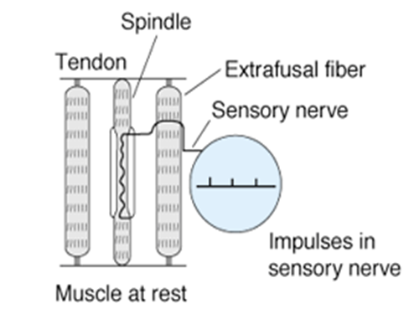
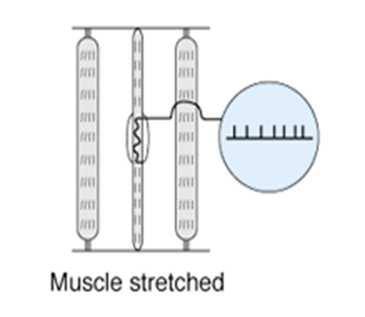
How Are Muscle Spindles Stimulated?-1
1. Passive stretch of the whole muscle:
It causes stretch of the muscle spindle which lies parallel to muscle fibers.

Slide 16
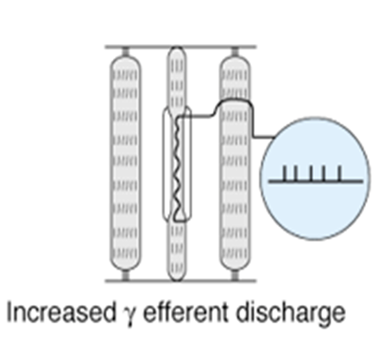
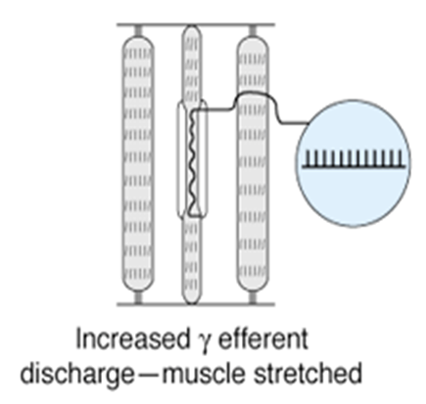
How Are Muscle Spindles Stimulated?-2
2)Activation of the γ-MNs:
By supraspinal centers
It causes contraction of the peripheral part the intrafusal fibres→ stretch of receptor area

Slide 17
How Are Muscle Spindles Stimulated?-3
3).Co-activation of α- and γ- Motor Neurons:
Signals from the motor cortex to the alpha motor neurons, mostly transmitted to the gamma motor neurons simultaneously, an effect called coactivation
What is the significance of this coactivation?
Is to keep the length of the central of reception portion of the muscle constant
Oppose sudden changes in muscle length

Slide 18
Extrafusal skeletal muscle fiber
Intrafusal
Muscle spindle fiber
Contractile end
Spinal cord
Afferent input from sensory endings of muscle spindle fiber Alpha motor neuron output to regular skeletal-muscle fiber
Stretch reflex pathway (Arc)
γ-motorneuron output to the contractile end of spindle fiber
Descending pathways cAoma-nai Ecl Atmiivn ate α- and γ- motor neurons ???

Slide 19
Dynamic stretch reflex
Sudden (phasic ) rapid stretch of a muscle causes synchronous strong burst of excitatory discharges in annulospiral afferents to the alpha motor neuron
This causes the latter to send strong motor excitatory impulses to extrafusal fibers →
Causing sudden , jerky ( brief) muscle contraction
( jerky movement)
As the muscle shortens → the spindle becomes lax
→ and ceases to discharge → no more stimulation of alpha motor neuron → no more excitatory impulses from alpha motor neuron to the extrafusal fibers → muscle relaxes
This is the basis of Tendon Jerks ( dynamic stretch reflexes ) .

Slide 20
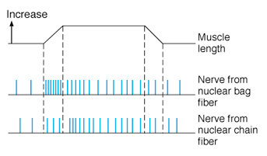
Types of Responses of Ms spindle to Stretch
(Types of Stretch Reflex)
Dynamic response
Basal discharge
Nuclear bag (1ry)
Nuclear chain (1ry & 2ry endings
Static response

Slide 21
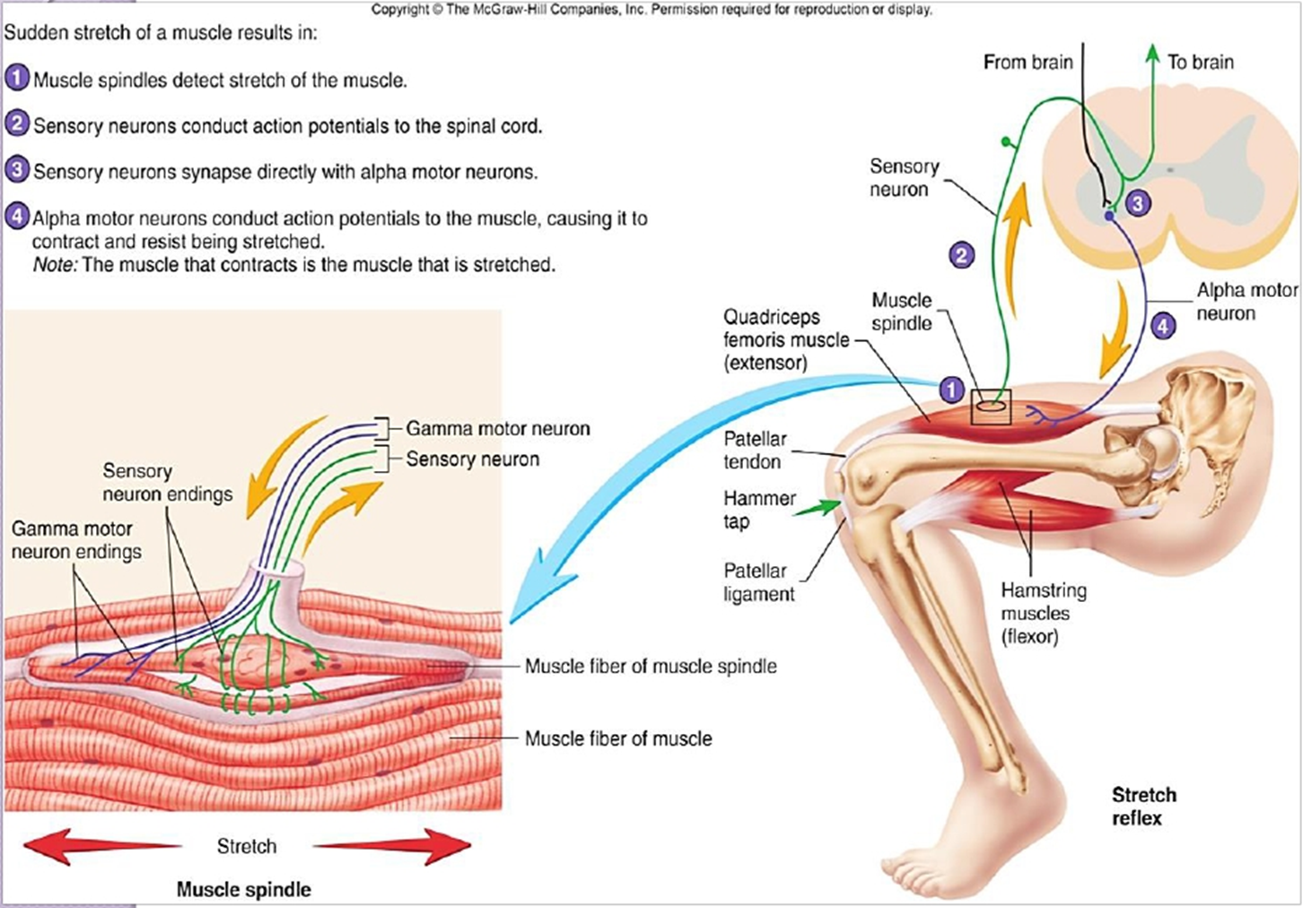

Slide 22
Static stretch reflex
Maintained ( tonic ) stretch of muscle →
Impulses from muscle spindle travel through spindle afferents (mainly along secondary ending) to alpha motor neuron , stimulating it to produce →muscle contraction
Causing sustained ( continuous ) contraction of the muscle as long as it is stretched
The Static Stretch Reflex is the basis of muscle tone which is defined clinically as resistance to muscle stretch

Slide 23
Types of Responses of Ms spindle to Stretch
(Types of Stretch Reflex)
 | Dynamic Response | Static Response
Stimulus | Sudden stretch | Maintained (steady) stretch
Receptors | nuclear bag | nuclear chain
Afferents | 1ry endings | primary and secondary endings
Center | Spinal cord | Spinal cord
Response | Rapid contraction followed by rapid relaxation | Maintained subtetanic contraction
Examples | e.g. tendon jerk | e.g. muscle tone

Slide 24
Muscle Tone
Is defined as a state of continuous partial contraction of skeletal ms during rest.
It is present in all skeletal ms but specially in the antigravity msmuscle (extensors of LL, back, neck, flexor of UL, muscle of abdominal wall and elevator of mandible )
Functions of Muscle Tone
A)Postural control
b) Help in heat production and maintain of body temperature
c) It helps both the venous return & lymph flow
d) Keeps viscera in position

Slide 25
Functions of stretch Reflex
They function to oppose sudden changes in muscle length
They help maintain a normal posture
Damping or smoothing of muscle contraction
Generation of muscle tone

Slide 26
Damping or Smoothing Function of Stretch Reflex
Stretch reflex prevents oscillations or jerkiness of body movements
Motor signals from the motor areas are transmitted to the ms in an unsmooth form (↑ for few Sec and ↓ for another Sec)
This causes irregularities or oscillations of movements
The signals discharged from the ms spindles cause partial activity of αMNs of the ms
So, the motor signals find αMNs in state of partial activity, so they cause continuous activation of them → cause smooth ms contraction

Slide 28
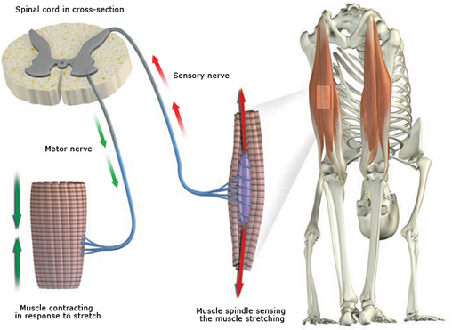
Static stretch reflex
AHCs
1ry and 2 ry endings
Alpha MNs
Nuclear chain
maintained stretch e.g. gravity

Slide 29
Clinical application of stretch reflex: Knee Jerk Reflex
Contraction of the muscle being stretched (quadriceps)
Reciprocal inhibition of the antagonistic muscle (hamstring) through reciprocal innervation
inhibitory

Slide 30
Knee Jerk Reflex & Reciprocal Inhibition
Antagonistic muscle is inhibited
Significance of reciprocal Inhibition:
Vital in coordinating body movements
Amani El Amin

Slide 31
What is the Clinical Significance of Tendon Reflexes ?
They are carried out clinically to test the integrity of reflex arc.
A-reflexia or hypo-reflexia (hypo-tonia) indicates that the reflex arc is interrupted at one of its components by:
Lesions of lower motor neuron e.g. poliomyelitis
Peripheral nerve lesions e.g. peripheral neuropathy
Neuromuscular junction disorder e.g. myasthenia gravis
Primary muscle disorder e.g. myopathy
Hyper-reflexia (hyper-tonia): exaggerated deep reflexes.
Upper motor neuron lesion.
Anxiety

Slide 32
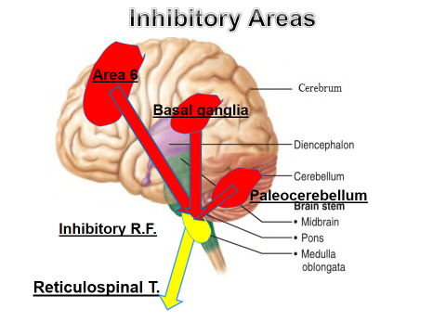
Supraspinal control of Stretch Reflex-2

Slide 33
Factors that Influence Stretch Reflex
Facilitation | Inhibition
Supraspinal factors: motor area 4 Vestibular nucleus Pontine Reticular Formation Neocerebellum | 1. Supraspinal factors: suppressor area 4 and area 6 Basal ganglia , Red Nucleus . Medullary Reticular formation . Paleocerebellum )
2. Noxious painful stimulus 3. Anxiety 4. Jendrassik-manuver | 2. Excessive muscle stretch ( stimulation of Golgi tendon organ ). 3. Muscle contraction

Slide 34
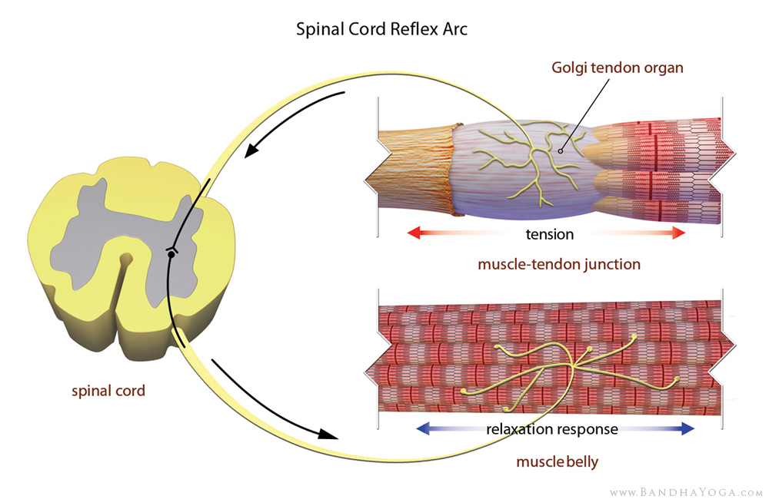
Golgi Tendon Reflex (Inverse Stretch Reflex)
It is a reflex in which there is a reflex relaxation (or lengthening) of a muscles in response to excessive stretch or contraction of that muscles.

Slide 35
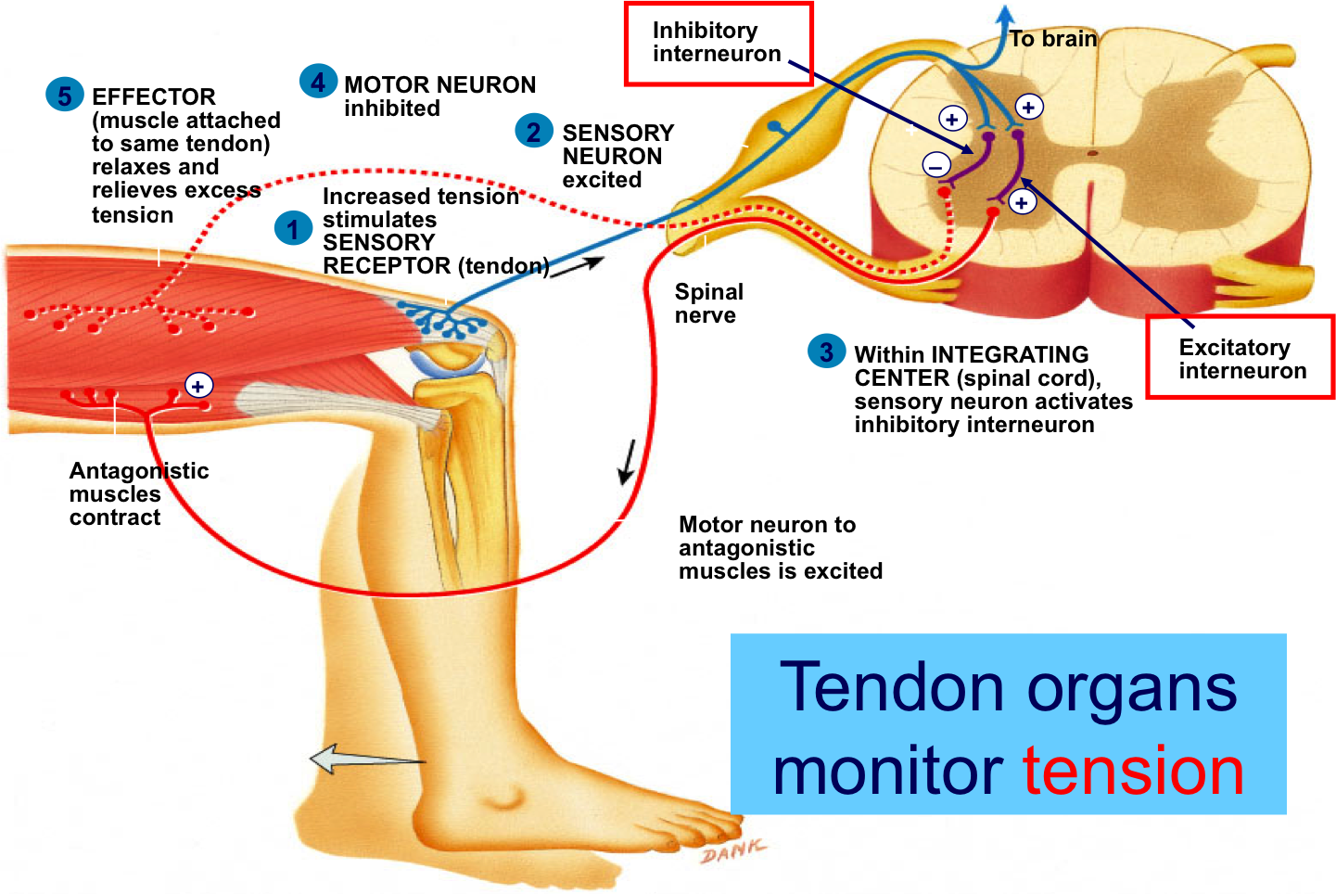
Inverse Stretch Reflex

Slide 36
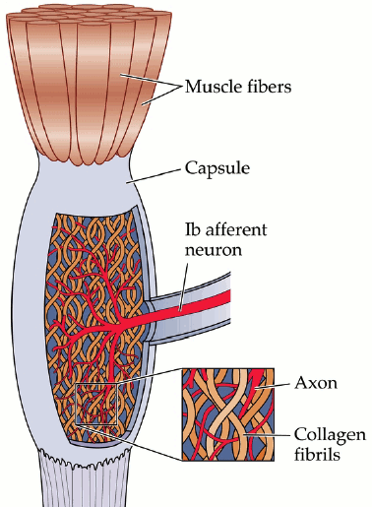
Inverse Stretch Reflex-2
Neural pathway:
Stimulus: ↑ed muscle tension by;
Overstretch or
Severe contraction
Receptors: Golgi tendon organs
1) Site:
tendons of skeletal ms in series with ms fibers
2) Structure:
Are encapsulated sensory receptor
6-20 elastic fibers
3) Innervations:
Type Ib afferent fibres

Slide 37
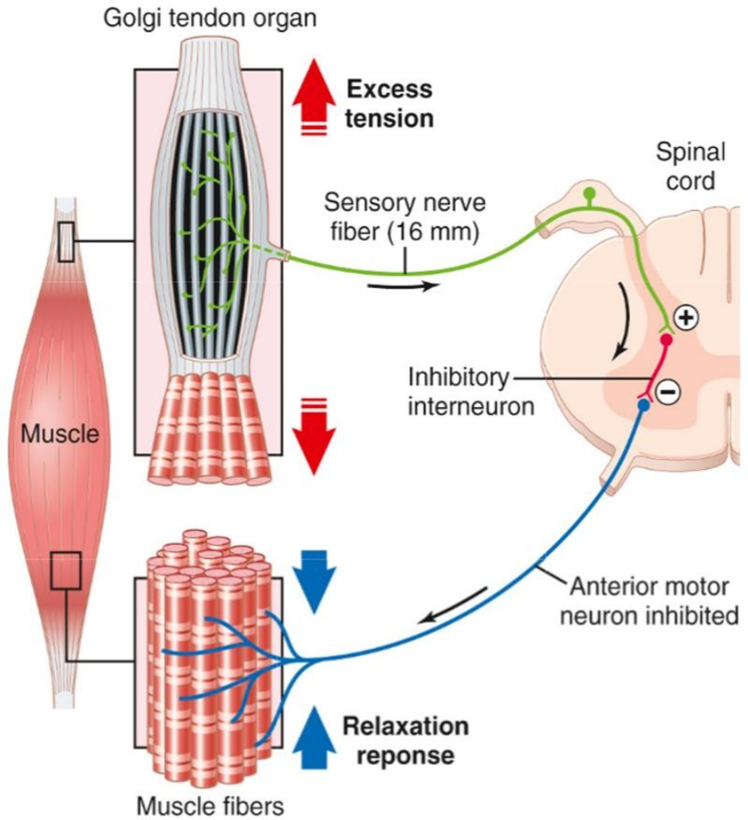
Golgi Tendon Organs (GTOs)
Receptors: GTOs
Stimulated by ↑ed muscle tension caused by passive overstretch or active contraction of the muscle
Afferents:
Ib fibers
Center (spinal cord) :
a)inhibitory interneurons→ inhibit the α-MNs supplying the same muscle
b)excitatory interneurons→ excite the α-MNs supplying the antagonistic muscle
Response:
Relaxation of the same muscle
Contraction of antagonistic group of muscles.

Slide 38
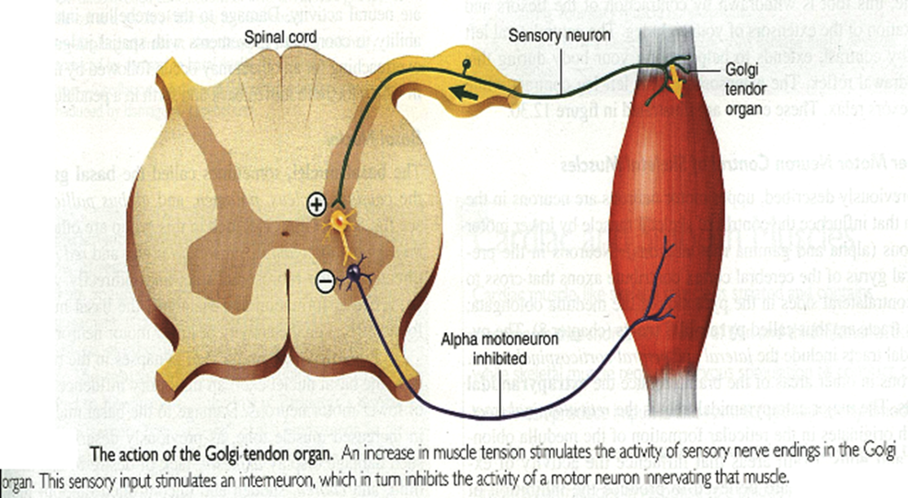
Significance
This reflex protects muscle from rupture & tendon from avulsion and tear.

Slide 39
Comparison Between Stretch & Inverse Reflexes-1
 | Stretch reflex | Inverse stretch reflex
STIMULUS | Increased muscle length | Increased muscle tension
RESPONSE | Muscle contraction | Muscle relaxation
RECEPTORS | Muscle spindles | Golgi tendon organs
AFFERENTS | Type Ia & II fibers | Type Ib fibers

Slide 40
Comparison Between Stretch & Inverse Reflexes-2
 | STRETCH REFLEX | INVERSE STRETCH REFLEX
SYNAPSES | Mono-synaptic | polysynaptic
RECEPROCAL INNERVATION | Inhibit antagonists through inhibitory interneurons | Excites antagonistic muscles through excitatory interneurons
PHYSIOLOGICAL SIGNIFICANCE | Regulation of muscle length Genesis of muscle tone | Regulation of muscle tension Prevent excessive increase in muscle tension & tendon avulsion (protective role)
CLINICAL ASSESSMENT | Sudden tap of muscle causes brisk contraction muscle jerk | Overstretch of muscle- sudden muscle relaxation (lengthening reaction)

Slide 41
THANK YOU

