Slide 1
NERVE CONDUCTION STUDIES and EMG

Slide 2
NERVE CONDUCTION STUDIES
Application of a depolarizing electrical pulses to the skin over a peripheral nerve producing:
(1) a propagated nerve action potential (NAP) recorded
at a distant point over the same nerve, and
(2) a compound muscle action potential (CMAP) arising from the activation of muscle fibers in a target muscle supplied by the nerve.
Notes:
Nerve conduction studies and needle EMG are commonly performed to assess the ability of the nervous system to conduct electrical impulses and to evaluate nerve/muscle function to determine if neuromuscular disease is present. Each electrical stimulation is recorded as a waveform on a computer and analyzed by the electromyographer performing the test.

Slide 3
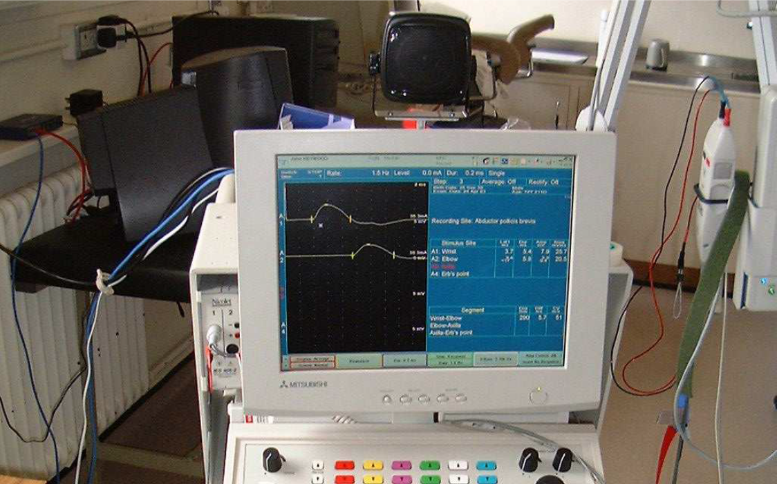
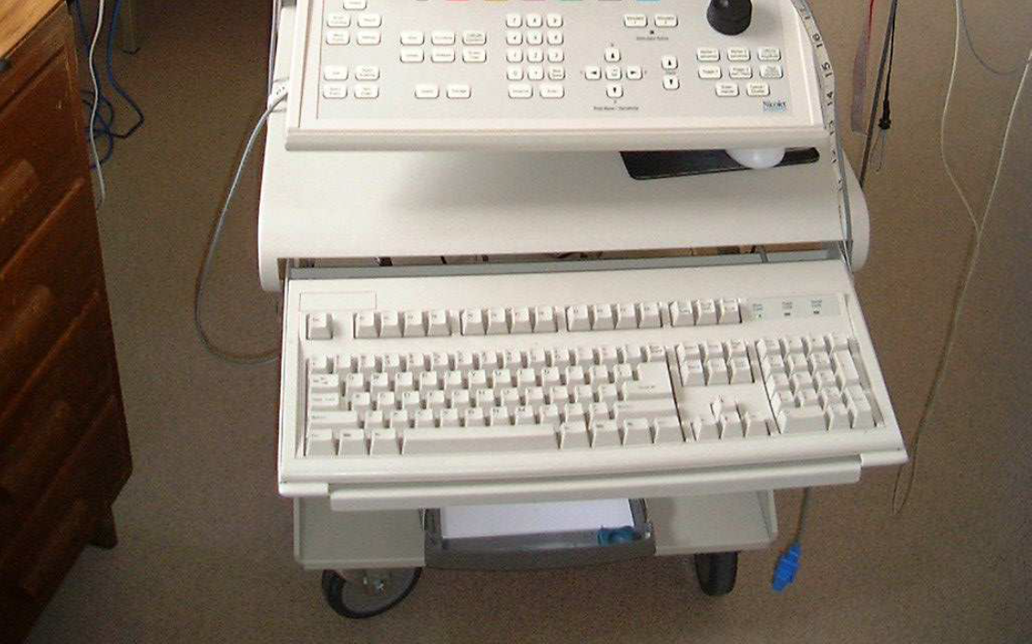

Slide 4
NERVE CONDUCTION STUDIES
The aim of the NCS
Peripheral nerves contain many nerve fibres of different diameters, degrees of myelination, and afferent or efferent connections. (The NCS studies the fastest 20% of these fibers).
Aim of the investigation is to document focal or continuous abnormalities in the length of the mixed, motor or sensory nerve.
Particular attention is paid to the following questions as the test progresses:
  Is the fastest conduction velocity normal?
  Is the CMAP normal in size and shape?

Slide 5
Nerve Conduction studies
Standard nerve conduction studies typically include motor nerve conduction, sensory nerve conduction.
Sensory and motor nerve conduction studies involve analysis of specific parameters, including latency, conduction velocity, and amplitude.
Notes:
Standard nerve conduction studies typically include motor nerve conduction, sensory nerve conduction, F waves, and H reflexes. Sensory and motor nerve conduction studies involve analysis of specific parameters, including latency, conduction velocity, and amplitude. Onset latency is the time it takes for the stimulus to initiate an evoked potential and reflects the conduction along the fastest fibers. Peak latency is the latency along the majority of axons and is measured at the peak amplitude. Both are affected by the state of the myelination of the nerve.

Slide 6
Nerve conduction studies
Based on the nature of conduction abnormalities principal types of peripheral nerve lesions can be identified:
  Axonal degeneration / segmental demyelination.
  Focal/ multifocal/ generalized
  Purely / predominantly sensory or motor
  the severity
Site of pathology
• Nerve (cell body, nerve root, peripheral nerves)
• Muscle
• NMJ
Notes:
In motor nerve conduction studies, motor nerves are stimulated and the compound muscle action potential from the muscle is recorded. This corresponds to the integrity of the motor unit. Results of this study can be affected by any process that damages the anterior horn cell body or axon, Schwann cells, the neuromuscular junction, or the muscle cell itself. Also analyzed are the size, shape, and morphology of the compound muscle action potential to determine the state of myelination, the number of functioning muscle fibers, and the function of the neuromuscular junction. Since the cell body of motor nerves is located in the anterior horn of the spinal cord, the motor nerve conduction is abnormal in both preganglionic and postganglionic injuries.

Slide 8
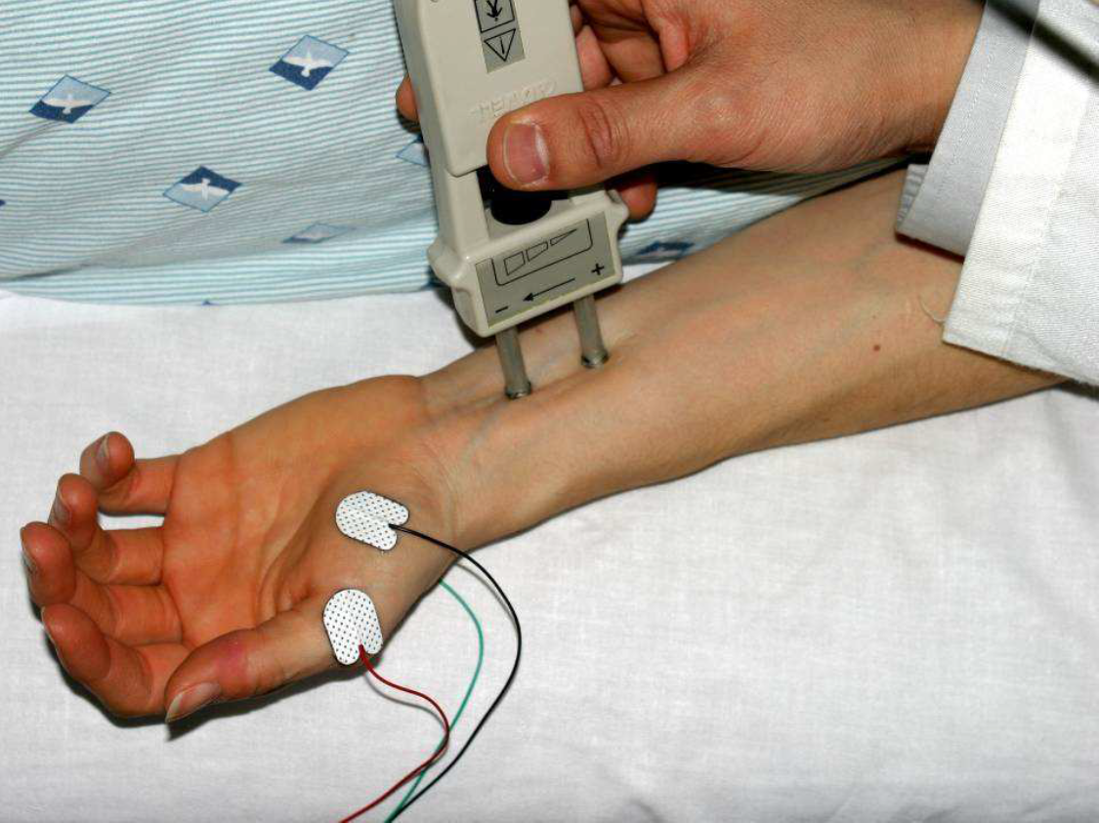
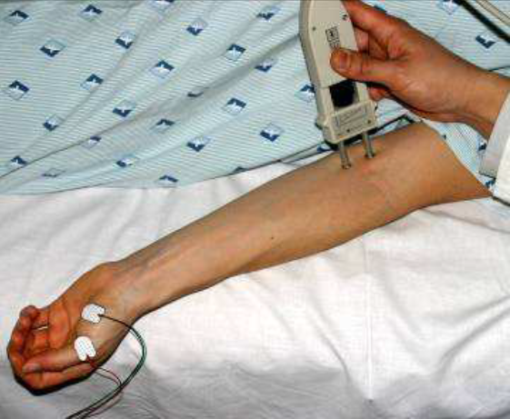

Slide 9
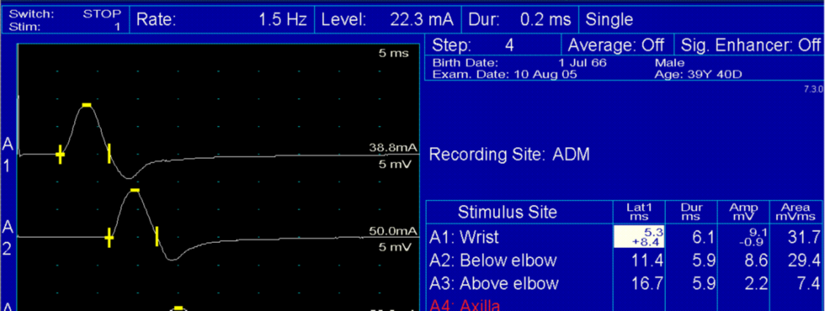

Slide 10
Abnormal features
Axonal degeneration neuropathy features | Demyelinating Neuropathy features
Low amplitudes | Normal amplitudes
Normal / slight delay in latency | Significant delay in latency
Normal / slightly low conduction velocity | Significantly low conduction velocity

Slide 11
Comparing results
Compare nerves same limb (hand median vs ulnar or radial)
Compare left and right limb
Compare upper and lower limbs
Compare to previous results in same subject
Compare to ‘normal’ reference values

Slide 12
Normal values for conduction velocity
In arm
  50 – 70 m / sec.
In leg
  40 – 60 m / sec.

Slide 13

• MNCV will appear.
• It can also be calculated by formula
• MNCV (m/sec)=
• L1 = latency at elbow.
• L2 = latency at wrist

Slide 14
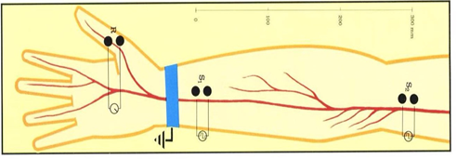
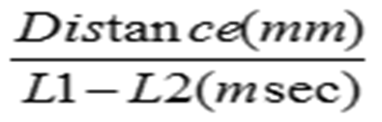
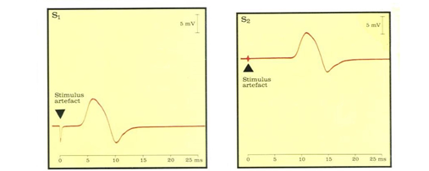

Example:
MNCV (m/sec) =
Distance= 24cm
MNCV =(24 $×$ 10)$÷($6.5-2.5)
MNCV = 240/4.0 = $\text{60 }\text{m}\text{/}\text{sec}$
Latency at wrist = 2.5 msec Latency at elbow = 6.5 msec

Slide 15
Electromyography
(EMG) is a technique for evaluating and recording physiologic properties of muscles at rest and while contracting.
A small-diameter needle is placed into a muscle to evaluate
  insertional activity,
  resting activity,
  voluntary recruitment,
  morphology,
  size of motor units,
  motor unit recruitment.
or by applying surface electrodes to the skin overlying muscle.
Notes:
The motor unit (MU) is a part of the neuromuscular system that contains an anterior horn cell, its axon, and all of the muscle fibers (MFs) that it innervates, including the axon's specialized point of connection to the MFs, the neuromuscular junction.
The needle electrode examination provides valuable information about the electrical characteristics of individual muscle fibers and motor units, as well as the integrity and innervation of muscle fibers.

Slide 16
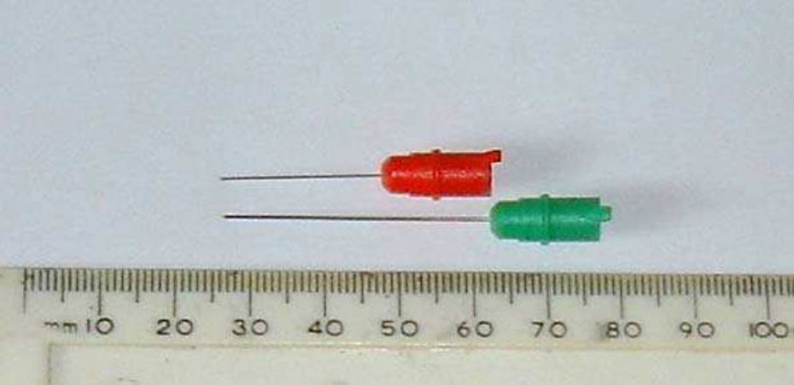

Slide 17
Insertional activity
The electrical activity present as the electrode is passed through muscle cells. These are discharge potentials provoked by the disruption of the cell membrane itself.
  -decreased in atrophied muscle or fatty tissue.
  - increased in many abnormal conditions that cause membrane instability, such as neuropathies, radiculopathies, and inflammatory myopathies.
Notes:
Careful attention is given to the duration and amount of electrical noise after each movement of the needle.

Slide 18
Spontaneous activity at rest
- Normal muscle should be silent after the needle is inserted
-The most common abnormal activities reported:
  Positive sharp waves (PSWs)
  Fibrillation potentials
Notes:
Resting or spontaneous activity is the electrical activity present when the muscle is at rest and the electrode is not being moved. This includes both normal and abnormal spontaneous activity.
Voluntary firing caused by incomplete relaxation can often be silenced by passively changing the posture of the limb or by slight activation of the antagonist. . Voluntary motor units never fire as single isolated discharges, a useful point in distinguishing them from fasciculations.

Slide 19
Fibrillation potentials:
Result from motor axonal loss not balanced by re-innervation.
- Low-amplitude fibrillation potentials suggest that denervation occurred in the remote past
High-amplitude fibrillation potentials suggest an ongoing active denervation process.
Fibrillations are not visible through the skin and are an electrical sign not a clinical sign.
Notes:
Conditions that cause this include any nerve disorder that affects the motor axon, inflammatory myopathies, and direct muscle injury.
Depending on the amplitude of the PSWs and/or fibrillation potentials, the electromyographer can determine how recently the injury to the nerve occurred.
After an acute nerve transection, nerve fibres degenerate from the site of the lesion distally. Muscle fibres themselves remain viable but after a period of 7–10 days become supersensitive and fibrillations will be detectable. Acutely denervated muscle fibres have acetylcholine receptors over the whole of the muscle fibre membrane rather than these being limited to the neuromuscular junction. The effect is to make the fibre supersensitive with the result that it discharges spontaneously. This is detected by the EMG needle as a single fibre discharge or fibrillation.

Slide 20
Positive sharp waves:
have the same origin & significance as fibrillations.
Fasciculations:
-Isolated discharges that recur at irregular intervals, usually in the order of several seconds.
-may be benign and they occur in motor neuron disease, radiculopathy and neuropathy.
Notes:
Fasciculations near the surface of a muscle may be visible at the skin; those deep within the muscle and detected by an EMG needle are not.
Fasciculations are not under voluntary control, a useful point in distinguishing them from motor units discharging due to poor relaxation.
fasciculations is judged by the company they keep in the muscle; benign fasciculations are not accompanied by denervation changes but malign fasciculations usually are.

Slide 21
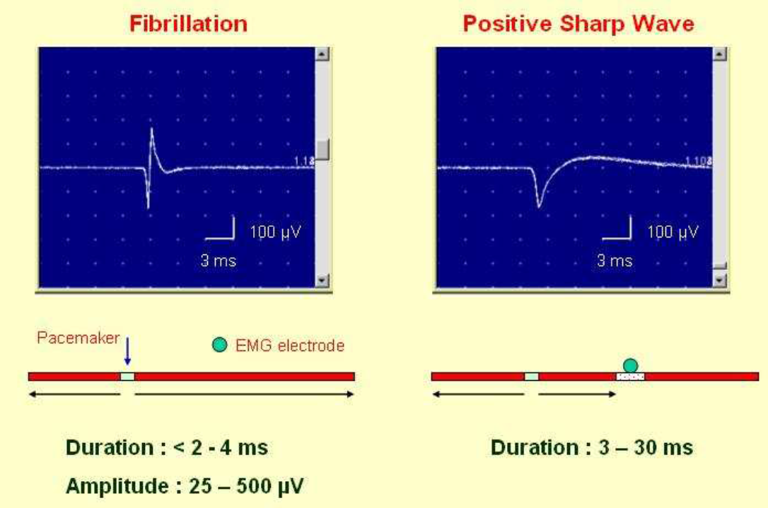

Slide 22
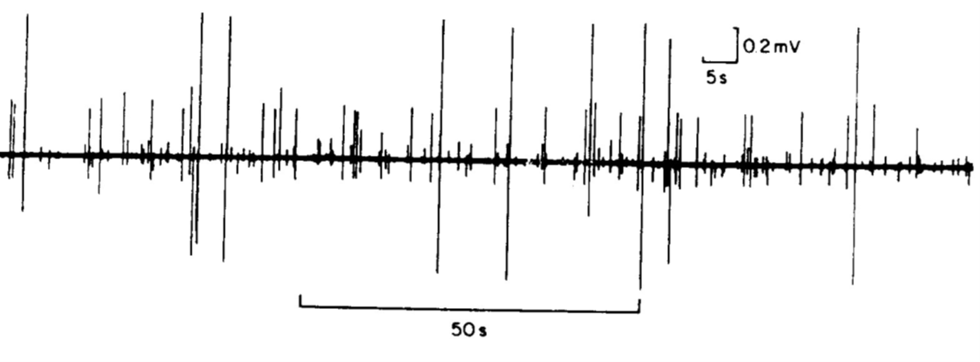
Fasciculations:

Slide 23
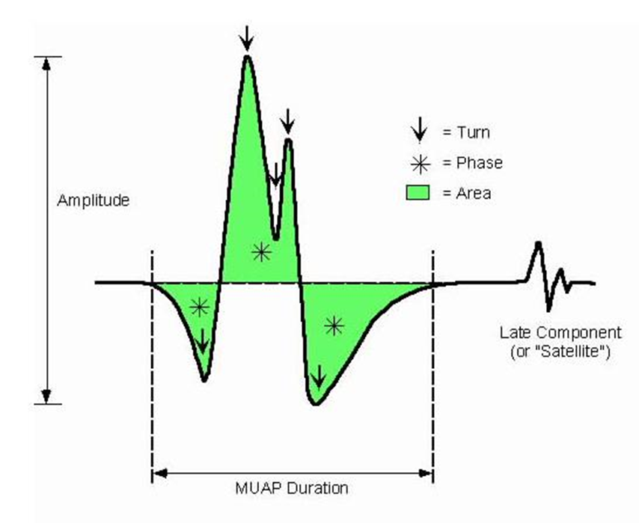
ELECTROMYOGRAPHY (EMG)
Voluntary Muscle contraction
  The potentials recorded on voluntary effort are derived from motor units of the muscle, hence known as motor unit potentials (MUPs).

Slide 24
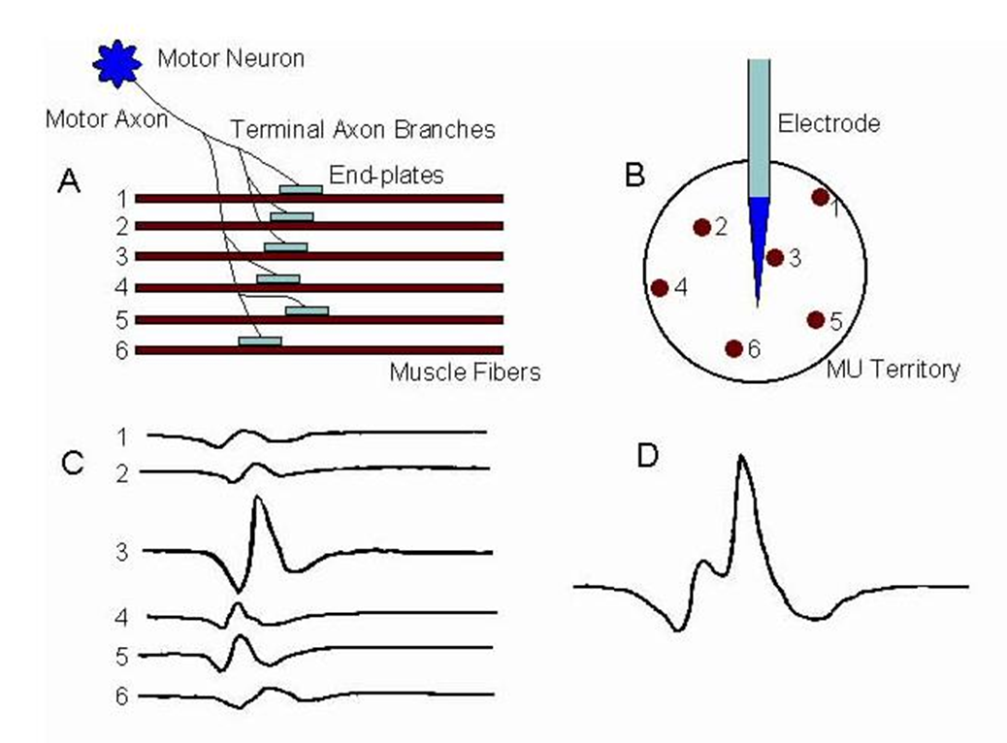
MUP
Notes:
Schematic showing the generation of the MU action potential (MUAP).
A, Motor-neuron (MN) generates an action potential (AP) that in turn excites the muscle fibers (MFs) by means of neuromuscular transmission. Propagation of the APs down the MF membranes is bidirectional away from the endplates.
B, Cross-section schematic emphasizes dispersion of the MFs of that MU in the MU territory and their relative position to the recording needle electrode. Recording electrode is positioned between the endplate zone and the end of the MFs (ie, away from the endplate zone).
C, Single MF APs recorded by the needle electrode (1-6 corresponding to the numbered MFs shown in A and B). AP recorded from MF 3 is largest because of its proximity to the electrode.
D, Summation of the individual MF APs as they form the MUAP.

Slide 25
MUP parameters
Motor units have a recruitment frequency of 6–10 Hz and are recognizable by the constancy of the waveform of each discharge.
Amplitude: (normal 300μV – 5 mV)
  Reflection of the total number of activated muscle fibres near the needle
  Very high amplitude in chronic neurogenic disorders
  Very low amplitude in myopathic disorders
Duration: (normal 3 – 15 mSec)
  Reflects the degree of synchrony of firing of the muscle fibres within the motor unit
  Very long duration MUPs in chronic neurogenic disorders
  Very short duration MUPs in myopathic disorders

Slide 26
Normal MUPs
Wave morphology:
  Bi / Tri-phasic in normal MUPs.
  Polyphasic in neurogenic and myopathic MUPs.
Recruitment (Interference) pattern:
  Normally number of MUPs activated and their frequency rises with increased exertion until it become full with maximal voluntary contractions.
  Reduced and incomplete (partial) recruitment signifies neurogenic lesion.
  Early and full recruitment with a small voluntary force can be seen in myopathy.

Slide 27
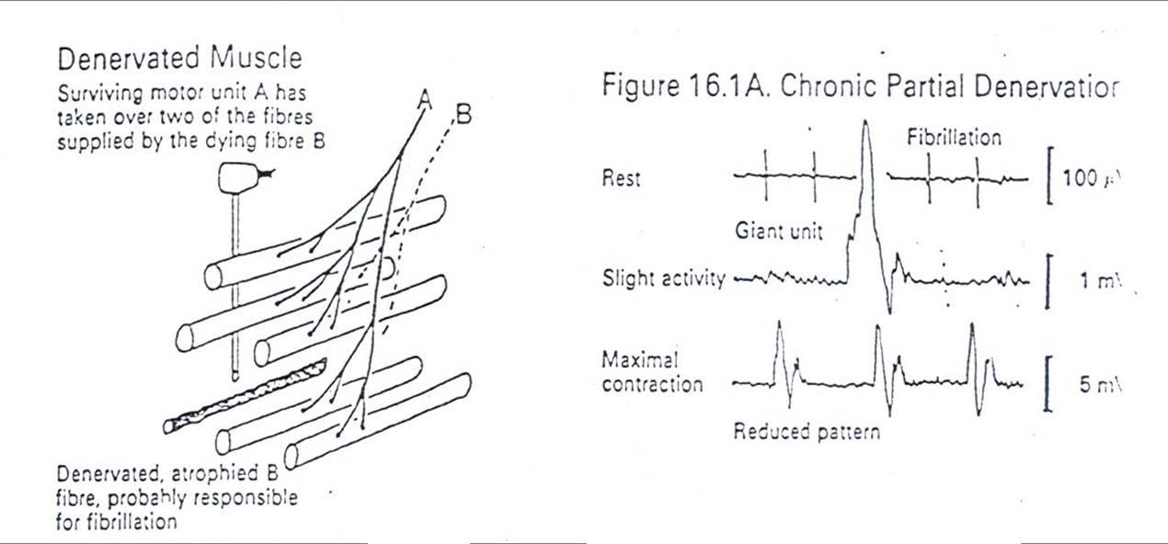
Neuropathic EMG changes

Slide 28
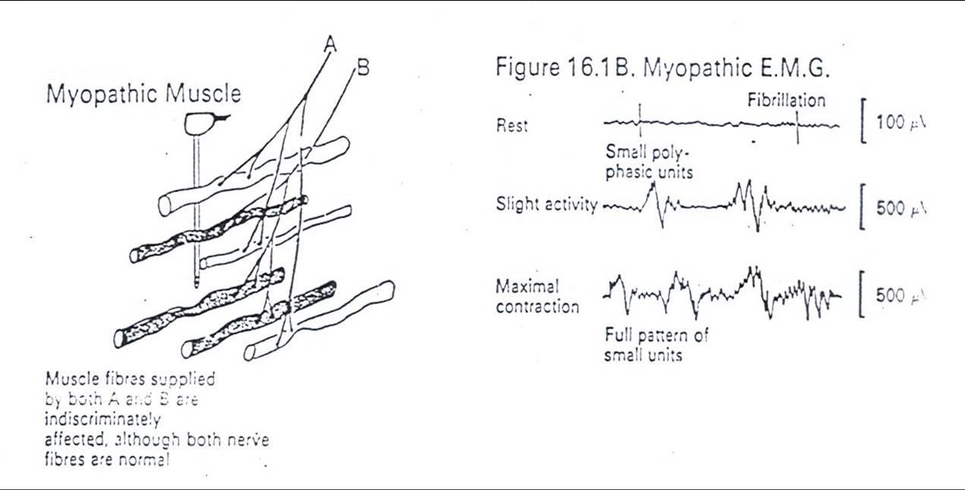
Myopathic EMG changes

Slide 29
Analysis of a motor unit potential (MUP)
MUP | NORMAL | NEUROGENIC | MYOPATHIC
Duration msec. | 3 – 15 msec | longer | Shorter
Amplitude | 300 – 5000 µV | Larger | Smaller
Phases | Biphasic / triphasic | Polyphasic | May be polyphasic
Resting Activity | Absent | Present | May be present
Interference pattern | full | partial | Full

Slide 30
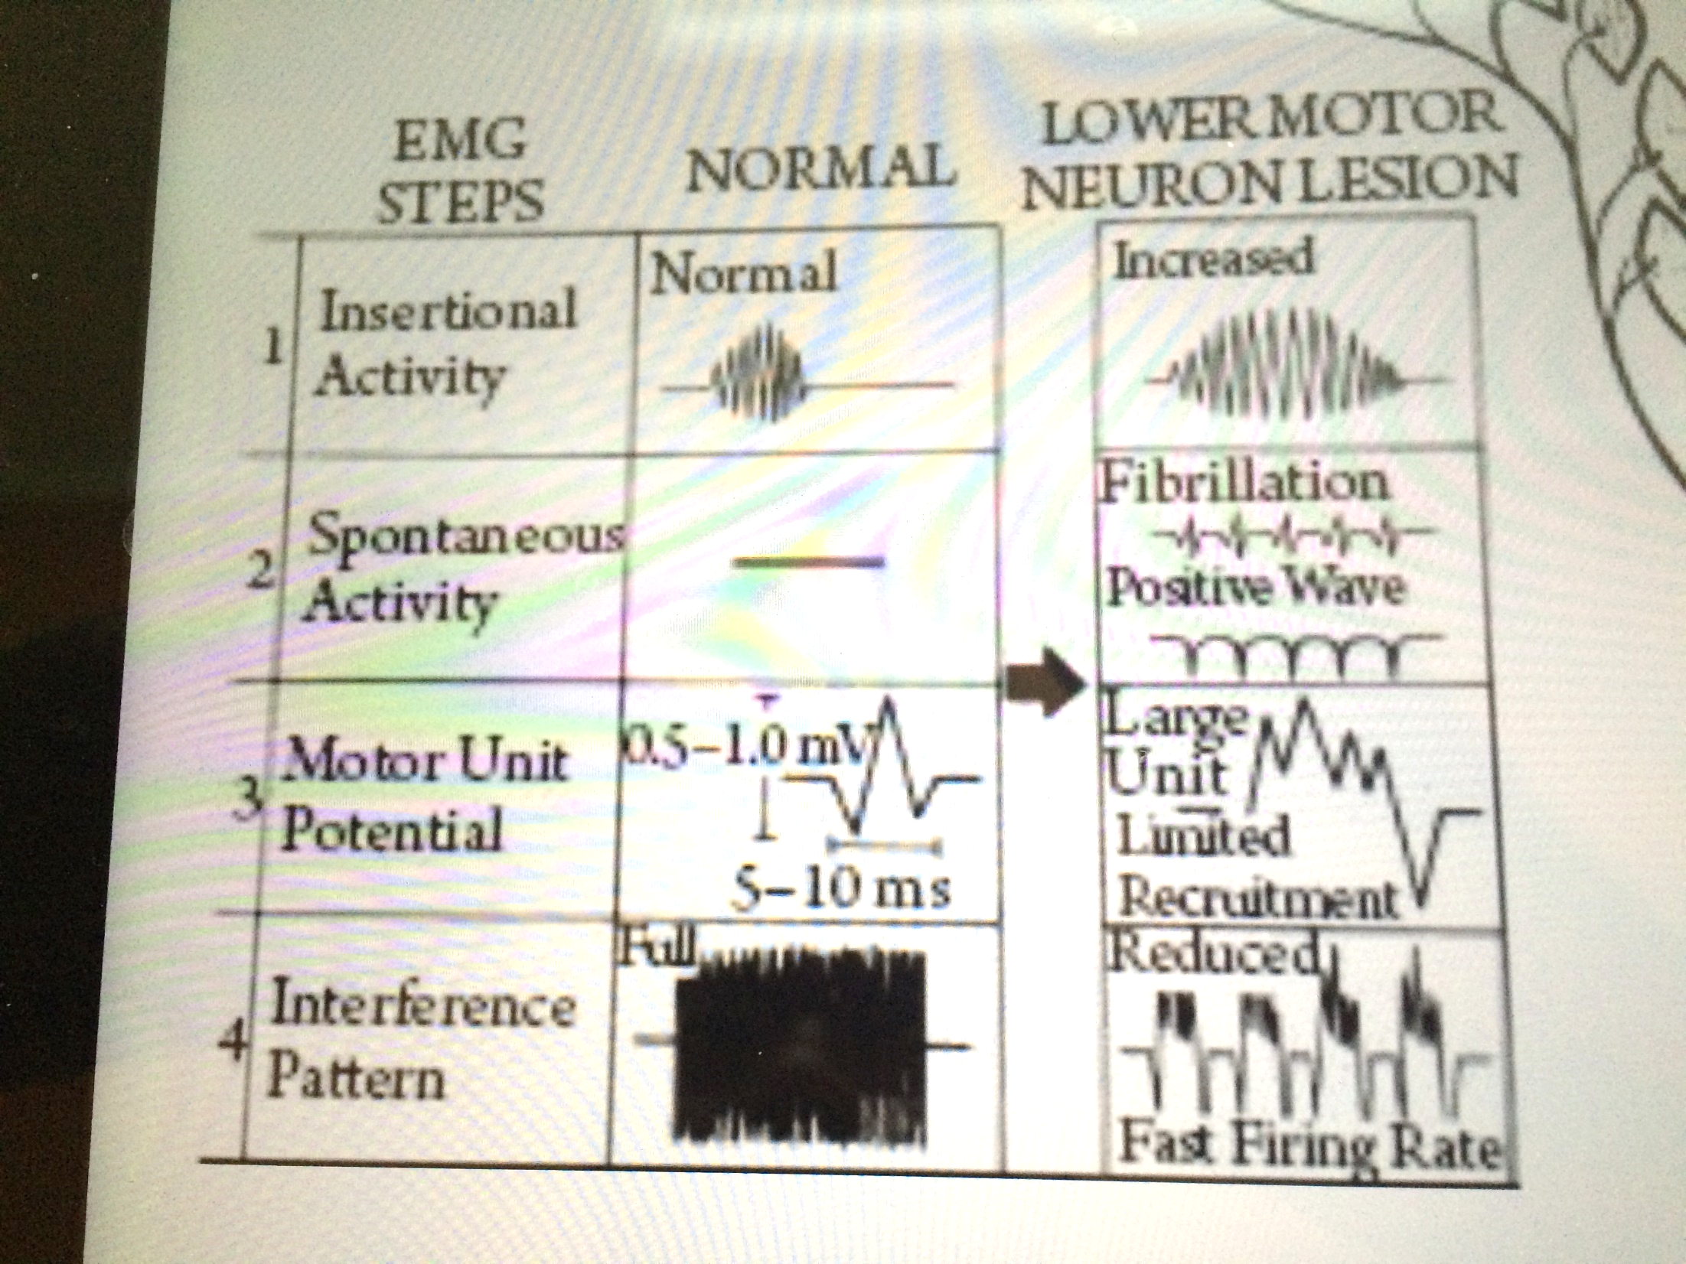

Slide 31
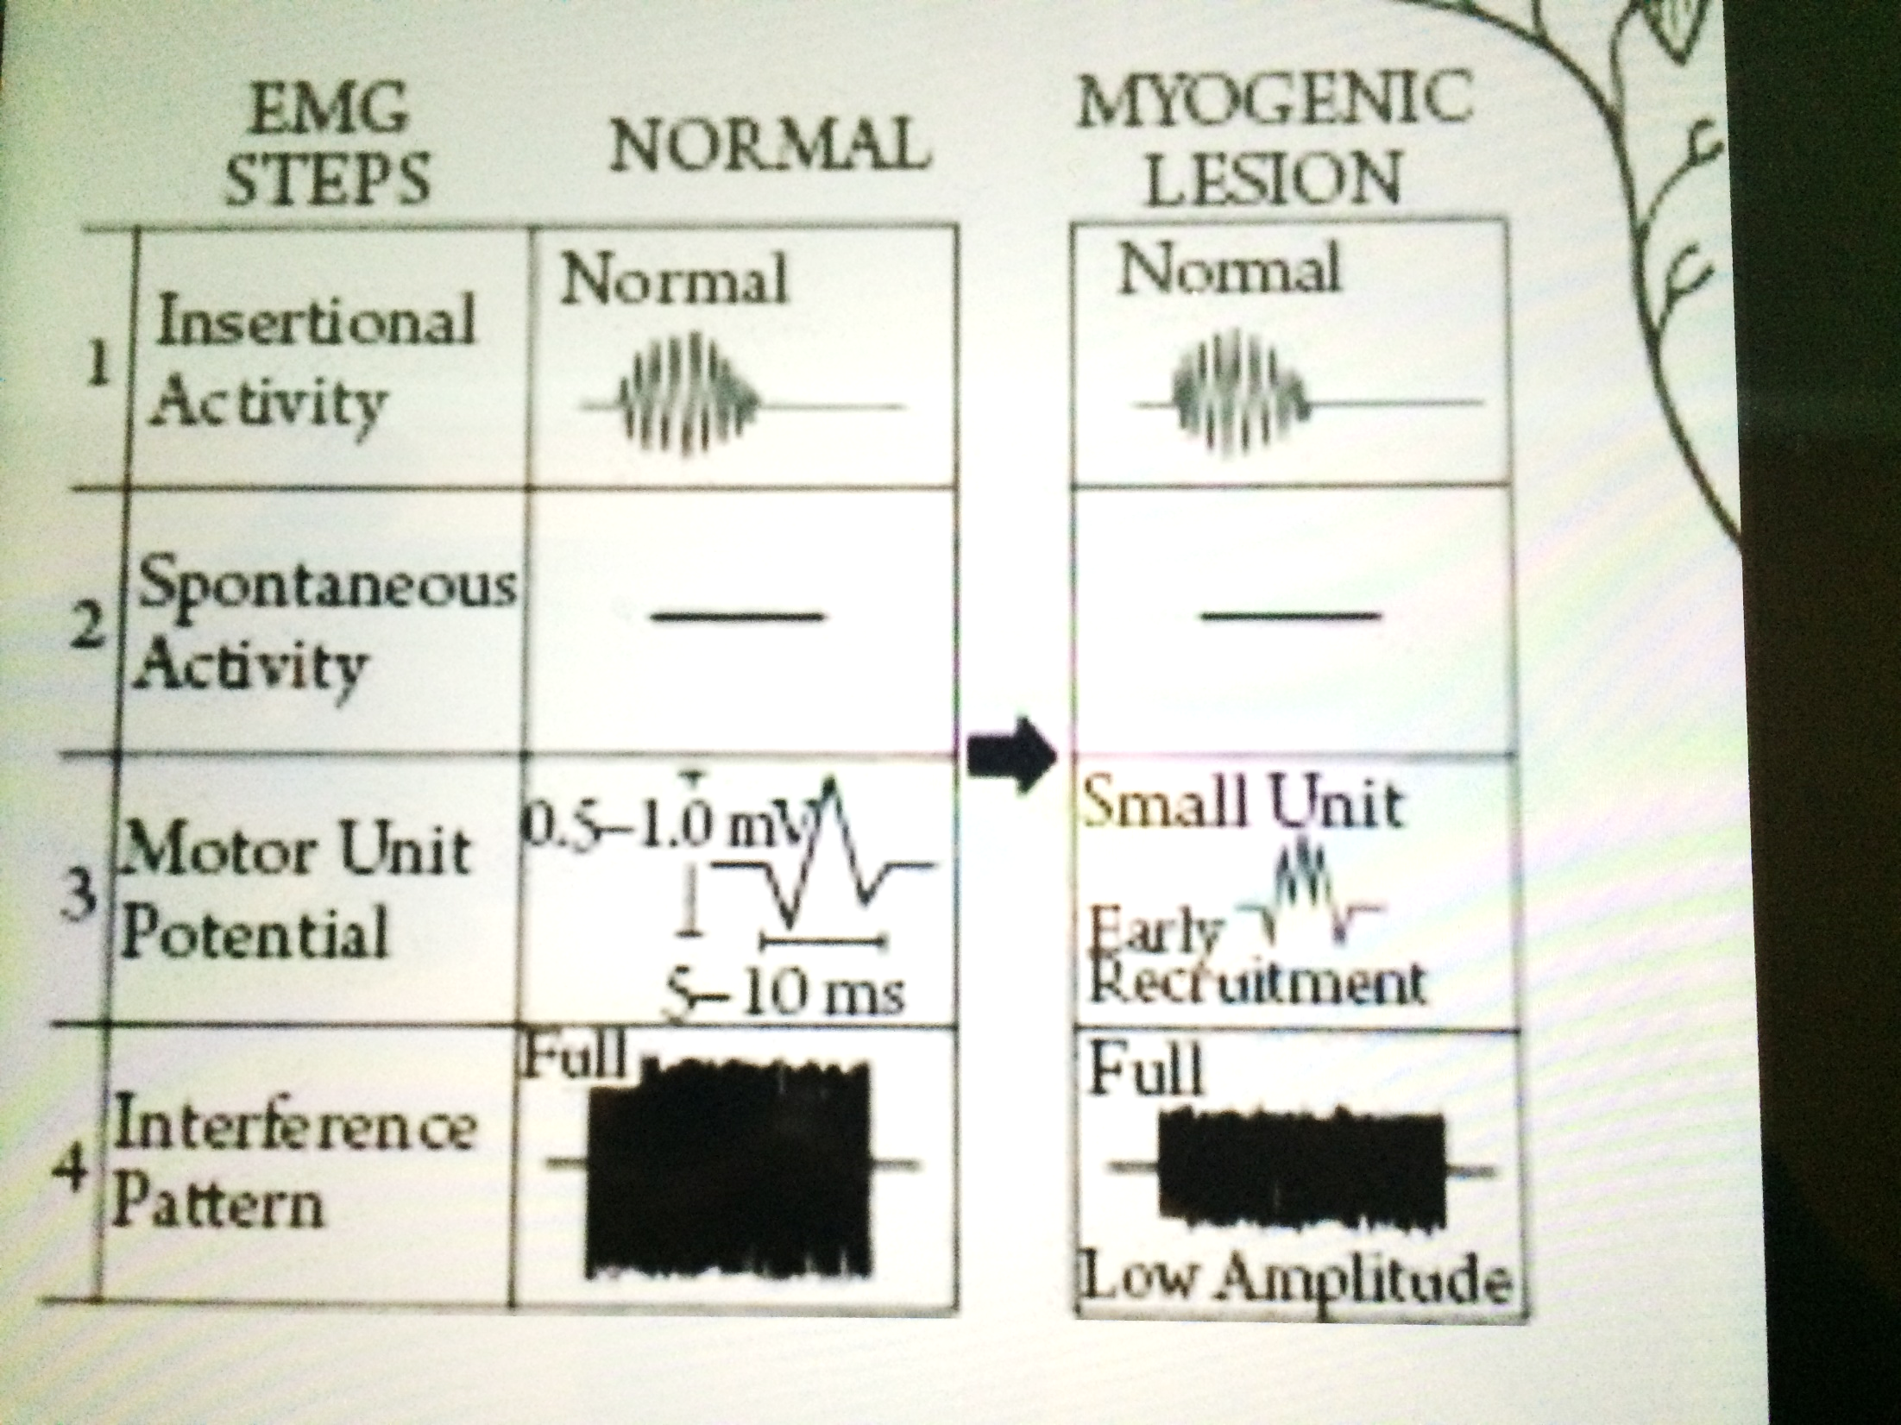

Slide 32
EMG case
Case 1: A 29 year old woman is referred for EMG studies because of difficulty in walking.
Her EMG reveals the following:
MUP amplitude reduced
Polyphasia present
Early recruitment
Fibrillations absent.
What is the diagnosis?
Myopathy (Muscle disease)

Slide 33
Thank you for attention and listening!!
Any Questions??
Any comments??

