Slide 1
VISUAL EXPERIMENTS
Dr. Mustafa Kamal

Slide 2
VISUAL ACUITY
TEST FOR FAR VISION
Equipment: Snellen’s Chart
Interpretation:
$$Visual Acuity (VA) =\frac{d}{D}$$
Where,
d = the distance from where the subject is reading the chart
D = the distance from which a normal subject can read that line.
Suppose the smallest letter that can be read by the subject is in the line along which the distance is mentioned “9 meter”, then the Visual Acuity of that eye is:
$$Visual Acuity (VA) =\frac{6}{9}$$
It means that the subject is able to read from 6 meters only, which a normal person can read from 9 meters, so his visual acuity for the far vision is disturbed. Normal Visual Acuity for far vision is 6/6 (in meters) or 20/20 (in feet).

Slide 3
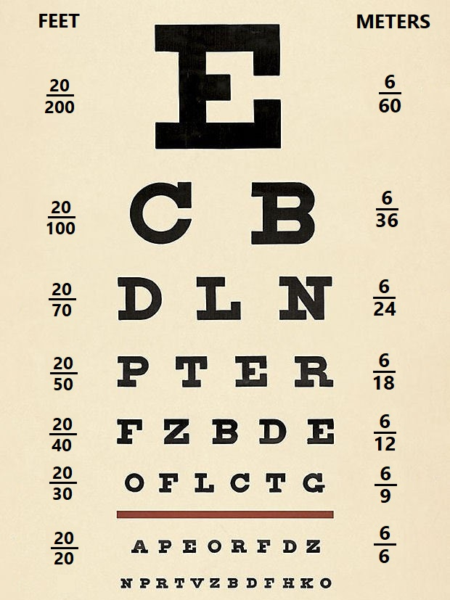

Slide 4
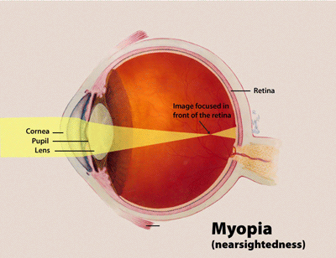
REFRACTIVE ERRORS:
MYOPIA

Slide 5
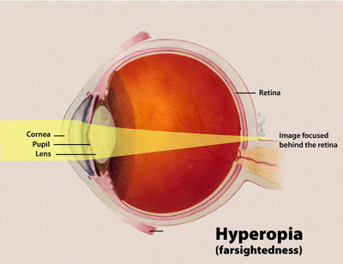
HYPERMETROPIA / HYPEROPIA

Slide 6
TEST FOR NEAR VISION
The near vision test is measuring your ability to read and see objects within an arm's distance from the body. This test is important if you have Hypermetropia or Presbyopia.
Equipment: Jaeger’s Chart

Slide 7
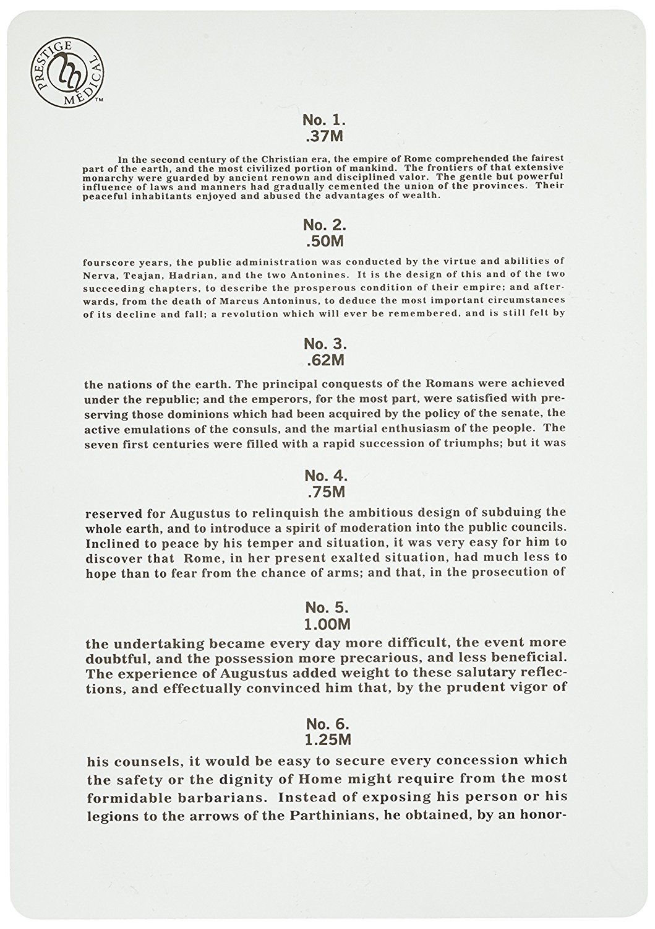

Slide 8
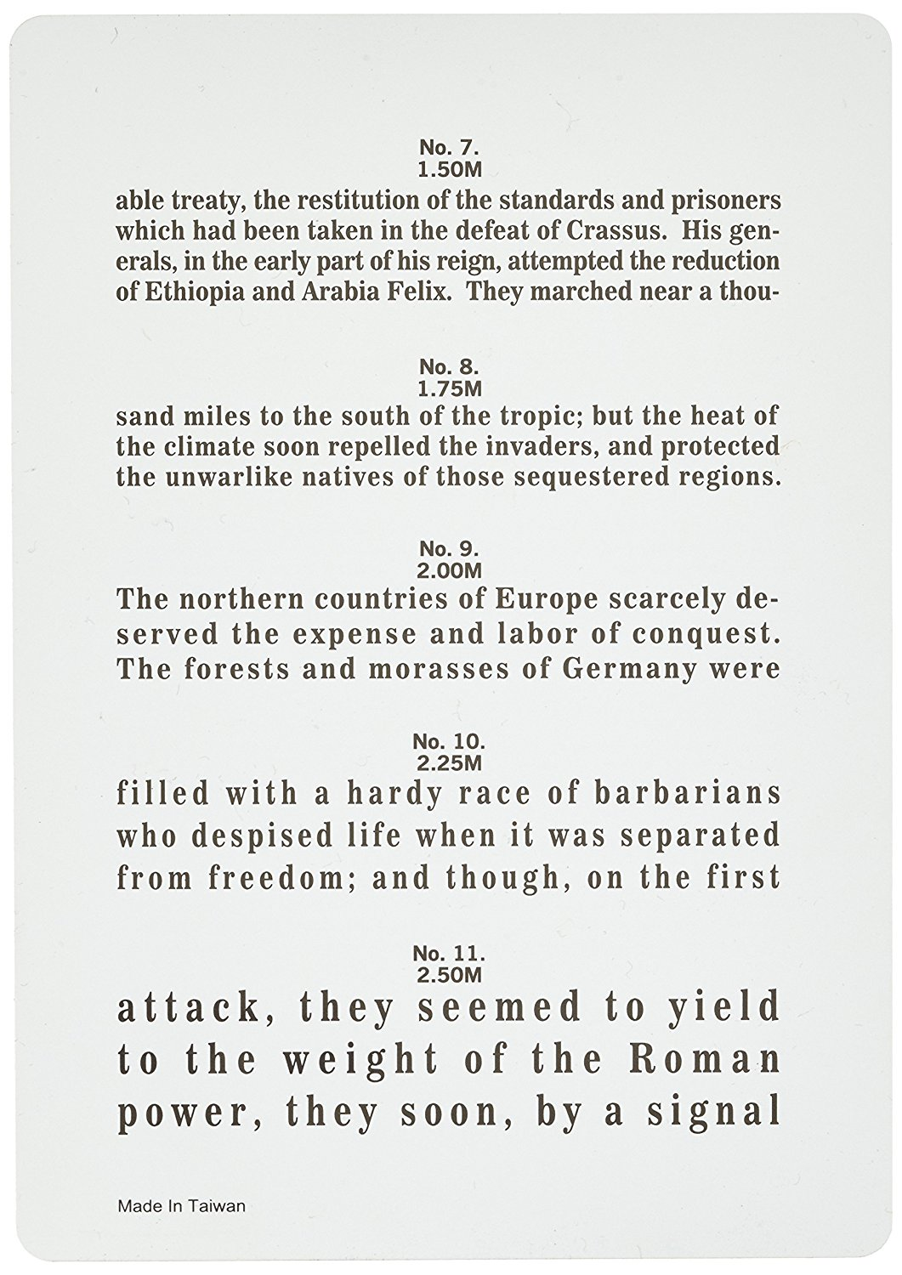

Slide 9
TEST FOR ASTIGMATISM
Astigmatism is a type of refractive error that causes blurred vision mainly due to the irregular shape of the cornea and sometimes uneven curvature of the lens inside the eye can also cause Astigmatism. Slight amounts of astigmatism usually don't affect vision and don't require treatment. However, larger amounts of astigmatism cause distorted or blurred vision, eye discomfort and headaches and need to be treated by adding cylindrical lenses in eyeglasses that will correct the astigmatism by altering the way light enters your eyes.
Equipment: Astigmatism Chart

Slide 11
DEMONSTRATION OF BLIND SPOT
Equipment: Blind Spot Card

Slide 12
DETERMINATION OF NEAR POINT
Near point is the nearest possible distance at which the near object can be clearly seen.
The near point of vision changes dramatically with age,
averaging about 8cm at the age of 10 and about 100 cm at the age of 70.
Equipment: Common Pin
AGE | NEAR POINT
10 YEARS | 8 cm
20 YEARS | 10 cm
30 YEARS | 12.5 cm
40 YEARS | 18 cm
50 YEARS | 40 cm
60 YEARS | 83 cm
70 YEARS | 100 cm

Slide 13
TEST FOR ACCOMMODATION
The process of accommodation can be tested by observing Purkinje-Sanson images in a dark room.
PURKINJE-SANSON IMAGES:
If a small bright light, usually a candle, is held in front of and a little to one side of the eye in a very dark room, three images are seen:
The first image comes from the cornea and it is small, bright and upright.
The second image comes from anterior surface of the lens. It is large, upright but less bright.
The third or last image comes from posterior surface of the lens and it is small, bright and inverted.

Slide 14
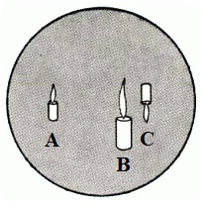
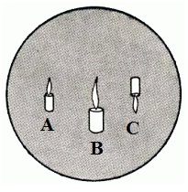
Equipment: A candle and a dark room
Before Accommodation
After Accommodation
A = First image from Cornea
B = Second image from anterior surface of lens
C = Third image from posterior surface of lens

Slide 15
TEST FOR COLOR VISION
Color vision is the function of the cones. There are three types of cones in our eyes; red, green and blue.
Relative lack or deficiency of one, two or all of them will lead to a defect in color vision.
Equipment: Ishihara’s Colored Plates

Slide 16
TYPE OF COLOR BLINDNESS | DEFINITION & PATHOLOGY
PROTANOPIA (RED BLINDNESS) | A form of colorblindness characterized by defective perception of red and confusion of red with green or bluish green due to the complete absence of red cones.
DEUTERANOPIA (GREEN BLINDNESS) | A form of colorblindness characterized by insensitivity to green, moderately affecting red–green hue discrimination due to the complete absence of green cones.
TRITANOPIA (BLUE BLINDNESS) | A very rare visual defect characterized by the inability to differentiate between blue and yellow due to the complete absence of blue cones.
PROTANOMALY | A type of anomalous trichromatic vision with defective perception of red due to less sensitivity of red cones.
DEUTERANOMALY | A type of anomalous trichromatic vision in which the green cones have decreased sensitivity, mildly affecting red–green hue discrimination.
TRITANOMALY | A rare type of anomalous trichromatic vision in which the blue cones have decreased sensitivity, affecting blue–yellow hue discrimination.

Slide 17
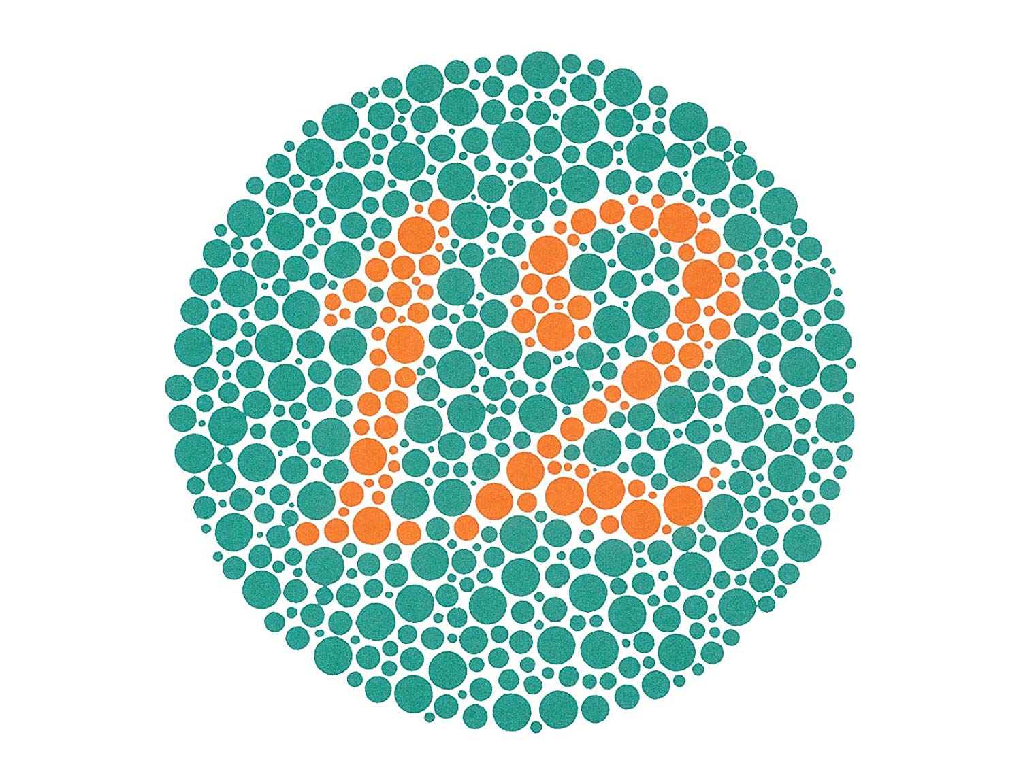
Both the normal and with all color deficiencies, read it as 12

Slide 18
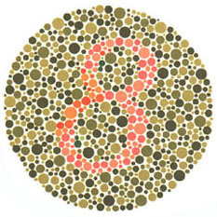
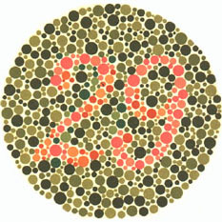
Normal People read them as 8 and 29
Those with red-green deficiencies read them as 3 and 70

Slide 19
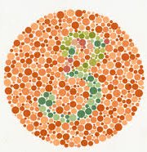
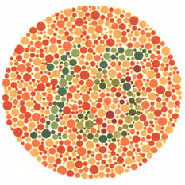
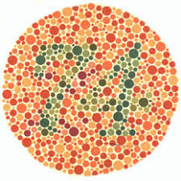
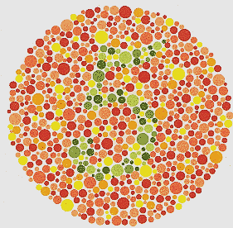
Normal People read them as 5, 3, 15 and 74
Those with red-green deficiencies read them as 2, 5, 17 and 21
Those with total color blindness cannot read any numerical.

Slide 20
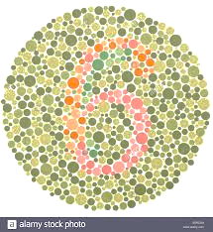
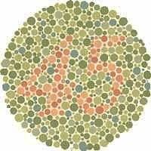
Normal People read them as 6 and 45
Majority of those with color vision deficiencies cannot read them at all or read them incorrectly.

Slide 21
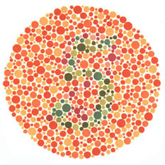
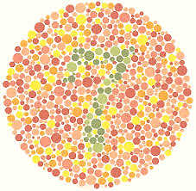
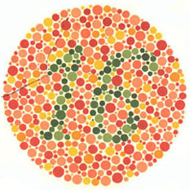
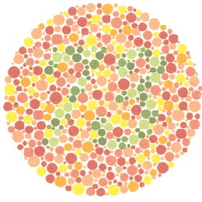
Normal People read them as 5, 7, 16 and 73
Majority of those with color vision deficiencies cannot read them at all or read them incorrectly.

Slide 22
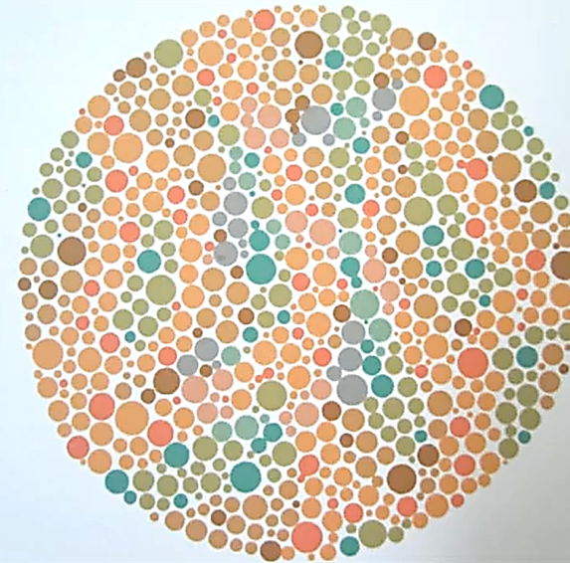
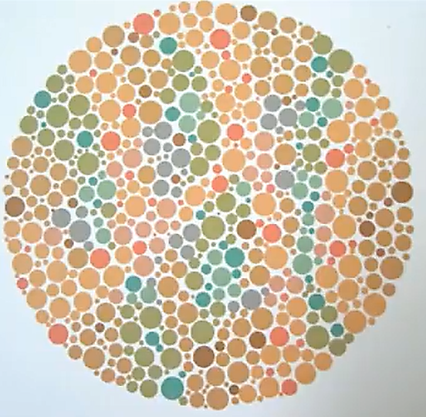
Majority of those with red-green deficiencies read them as 5 and 45.

Slide 23
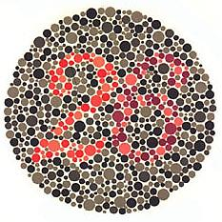
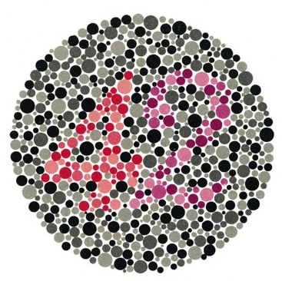
Normal People read them as 26 and 42
Those with protanopia and strong protanomalia read them as 6 and 2
Those with deuteranopia and strong deuteranomalia read them as 2 and 4

