Slide 1
Physiology of Proprioception in Balance
Dr. Salah Elmalik

Slide 2
Objectives
By the end of this lecture students are expected to:
Identify the major sensory receptors & pathways
Describe the components, processes and functions of the sensory pathways
Appreciate the dorsal column system in conscious proprioception
Describe the spinocerebellar tract pathway in unconscious proprioception
Differentiate between sensory and motor ataxia

Slide 3
Somatic Receptors
Somatic receptors are specialized structure present at the peripheral terminations of afferent fiberes.
Receptors are detectors and transducers which transduce different form of energy into action potential
They are found in many parts of the body including the skin (cutaneous receptors), skeletal muscles, bones and joints (proprioceptors)
They differ from specific receptors that mediate the special senses of vision, hearing, smell, taste and equilibrium.

Slide 4
Classification of Sensory Receptors-1
A/Based on their location (Sherrington 1906):
❶ Exteroceptors: concerned with the external environment
Found on the surface of the body
E.g. touch and temperature receptors
❷ Interoceptors: concerned with the internal environment e.g. chemoreceptors ,osmoreceptors .
❸ Proprioceptors: concerned with potion of the body in the space.
Are found in joint, tendons and muscles.

Slide 5
Classification of Sensory Receptors-2
B/Based on their adequate stimulus
(Adequate stimulus is the particular form of energy to which the receptors is most sensitive)
Mechanoreceptors :which detect mechanical compression or stretching of the receptor or of tissues adjacent to the receptor eg proprioceptors
Thermoreceptors which detect changes in temperature, some receptors detecting cold and others warmth.
Chemoreceptors, which detect taste in the mouth, smell in the nose, oxygen level in the arterial blood, osmolality of the body fluids, carbon dioxide concentration, and perhaps other factors that make up the chemistry of the body. e.g chemo R in carotid bodies
Electromagnetic receptors, which detect light on the retina of the eye eg rods and cones.
Nociceptors (pain receptors) , which detect damage occurring in the tissues, whether physical damage or chemical damage eg free nerve endings

Slide 6
Classification of Sensory Receptors-3
C. Based on their speed of adaptation
Adaptation means when a continuous sensory stimulus is applied, the receptor responds at a high impulse rate at first and then at a progressively slower rate until finally the rate of action potentials decreases to very few or often to none at all.
Accordingly receptors can be classified Into:
Slowly adapting (SA) or tonic receptors:
Muscle spindle, joint receptors, baroreceptors .
Pain receptors do not adapt at all.
Rabidly adapting (RA) or phasic receptors:
eg meissner’s corpuscles(touch), pacinian corpuscles(vibration)

Slide 8
Mechanisms by which Receptors Adapt
Is different for each type of receptor
In the eye , the rods and cones adapt by changing the concentrations of their light-sensitive chemicals .
The pacinian corpuscle is a viscoelastic structure so that after stimulation within few hundredths of a second, the fluid within the corpuscle redistributes, so that the receptor potential is no longer elicited.
The second mechanism of adaptation of the pacinian corpuscle, but a much slower one, results from accommodation, which occurs in the nerve fiber itself.
This probably results from progressive “inactivation” of the sodium channels in the nerve fiber membrane

Slide 9
Activation of Sensory Receptors: Generation of Receptor Potential (RP)
Stimuli (mechanical, thermal, chemical) cause deformation in the sensory receptors
This causes influx of positive ions and generation of RP
RP induces a local circuit of current flow that spreads along nerve fiber and generates APs when threshold is reached

Slide 10
Relation Between Stimulus Strength & Receptor Potential Amplitude
Receptor potential is directly related to stimulus strength

Slide 11
Generation of a Receptor Potential
PAIN RECEPTOR
Slowly adapting receptors detect presence of stimulus and its continuous strength
Rapidly adapting receptors detect stimulus movement

Slide 12
Examples of RA and SA Receptors
Muscle spindles & nociceptors are other examples of SA receptors
13

Slide 13
What Are the Stimulus Features That Are Mediated by Sensory Receptors?
Sensory receptors mediate 4 features of a stimulus:
Modality: is what we perceive after a stimulus
Many sensory modalities: vision, hearing, smell, taste, touch and temperature
Each modality has many sub-modalities (e.g. taste can be sweet, bitter, sour, salty), Temperature sub-modalities: cold and heat
Intensity: depends on the stimulus strength and is encoded by action potential frequency.
Location: the site on the body or space where the stimulus originated.
Duration: time from onset to offset of a stimulus.
If persists for long time, the perceived intensity diminishes (adaptation)

Slide 14
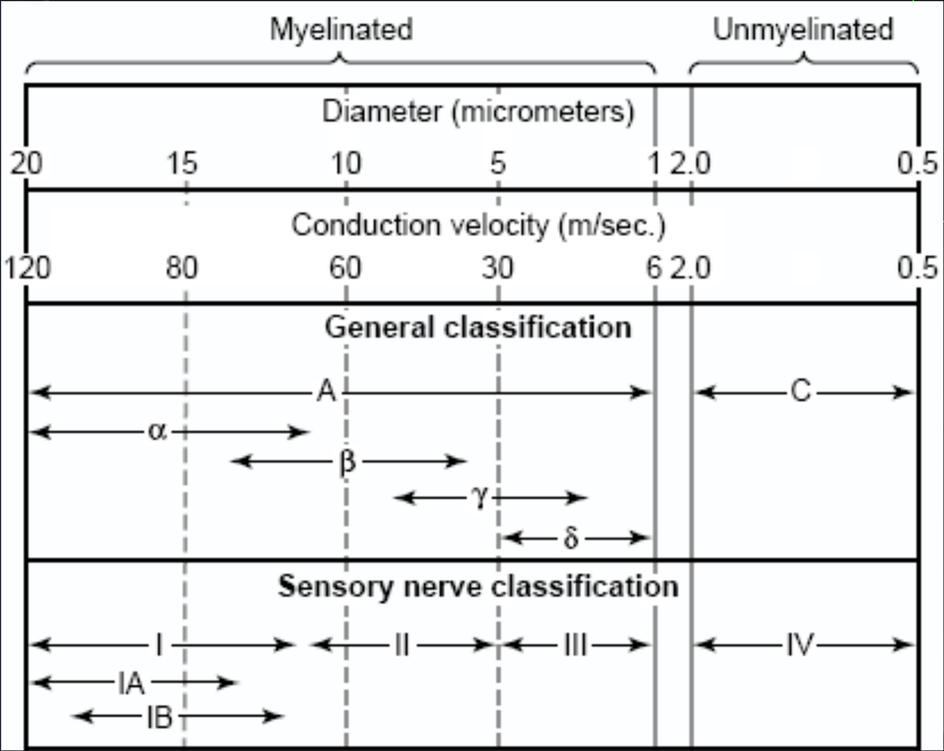
Classification of Nerve fibers
Myelinated (A-fiber)
Αα (thickly myelinated)
Aβ (intermediate m.)
Aδ (thinly myelinated)
Unmyelinated (C-fiber)

Slide 17
Ascending Sensory Tracts
There are several ascending sensory systems
Each system carries different types of sensations or
MODALITIES: touch, proprioception, pain, temperature, … etc.,
Main ascending sensory pathways
❶ Spinothalamic pathway: carries signals of pain, temperature, crude pressure, and crude touch.
❷ Dorsal column pathway: carries signals of fine touch, pressure, vibration, and proprioception.
❸ Posterior (dorsal) spinocerebellar pathway
❹ Anterior (ventral) spinocerebellar pathway
The latter pathways (3 &4) carry subconscious proprioception.
Objective: Identify the major sensory receptors & pathways

Slide 18
What is Proprioception ?
Proprioception stems from the Latin word proprius which means "one's own“ or "individual"
It is the sense of one`s own body position
It is also called proprioceptive/position sense
It is the awareness of body position and of movements of body parts
It can be divided into:
Static proprioception: conscious perception of the orientation of the different parts of the body with respect to one another,
Dynamic proprioception: rate of movement sense (also called kinesthesia)

Slide 19
Types of Proprioception
There are two types of proprioception:
❶ Conscious proprioception:
It reaches the level of sensory cerebral cortex (cerebrum) via the dorsal column-medial lemniscus pathway
❷ Unconscious proprioception:
is communicated to the cerebellum primarily via:
The dorsal spino-cerebellar tract (dSCT)
The ventral spino-cerebellar tract (vSCT)
These are main ascending sensory pathways for proprioception

Slide 20
Role of Proprioception
Proprioception informs us about:
The location of a body part in relation to other parts
The rate of movement of a body part when it is moving
The degree to which our muscle are being contracted or stretched
The amount of tension created in our tendons
The head orientation in relation to the ground and in response to movement
Proprioceptive information is carried from periphery to the CNS by proprioceptors and other somatic receptors

Slide 21
Types of Proprioceptors
❶ Muscle spindles
Detect how much a muscle is stretched
❷ Golgi tendon organs
Detect tension of a muscle on its
tendon
Provide information about the strength of contraction & tension
❸ Joint Kinesthetic receptors
Are mechanoreceptors in the joint capsules; they detect angle and movement of the joints.
Cutaneous receptors
Golgi T organ
ⱡ
Cutaneous & deep receptors also contribute to proprioception

Slide 22
Muscle Spindles & Golgi Tendon Organs
❶Muscle spindles
They detect changes in the length of muscle.
They convey length information to the CNS via group I and II afferent neurons
This information is important for determining the position of body part
❷ Golgi tendon organ
They detect changes in muscle tension

Slide 24
Dorsal Column–Medial Lemniscal System
Objective: Appreciate the dorsal column system in conscious proprioception
Fast conducting A α/β-fiber neurons
Fine Touch
Fine Pressure
Vibration
Position
22

Slide 25
Dorsal Column–Medial Lemniscal System
Touch sensations requiring a high degree of localization and high intensity of discrimination (i.e. fine)
Rapidly repetitive sensation such as vibration
Joints Position sensations (Proprioception)
Pressure sensations characterized by high intensity discrimination(i.e. fine pressure)

Slide 26
Anterolateral System
Ventral & lateral spinothalamic tracts
Pain
Thermal sensations, (warmth & cold)
Crude touch and pressure sensations capable only of crude localizing ability on the surface of the body
Tickle and itch sensations
Sexual sensations

Slide 27
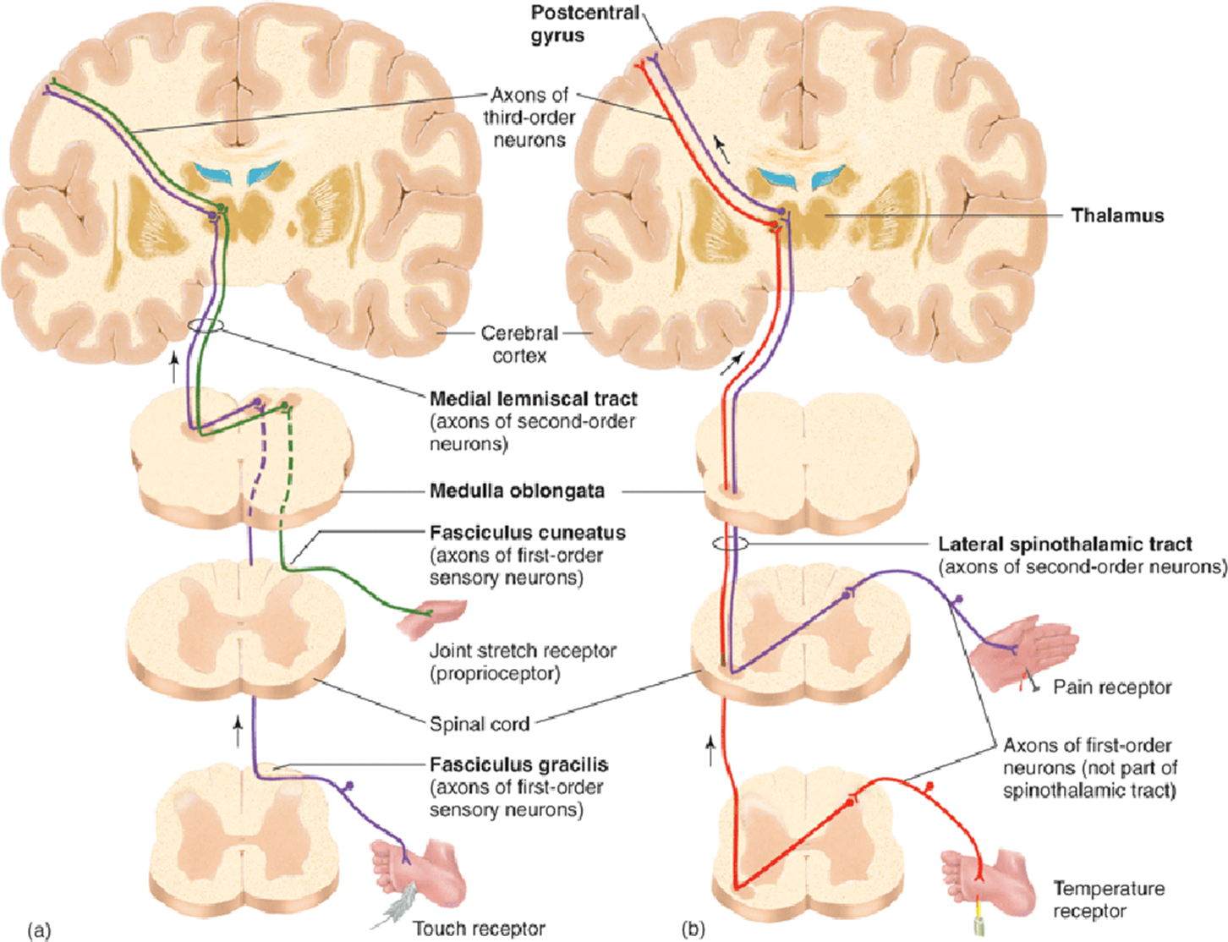
Nociceptive vs Non-nociceptive Pathways
Anterolateral System
Pain
Temperature
Crude touch
Tickle
Itch
Sexual
sensation
A α/β- fibres
Fine Touch
Pressure
Vibration
Position
Movement
Dorsal column System
C- & Aδ-
fibres
24

Slide 28
Sensory Homunculus (Little Man)
Body is represented upside-down, with large representation of hands & lips
The extent of representation is proportional to the density of sensory receptors
23

Slide 29
Dorsal column damage
Sensory ataxia
Patient staggers; cannot perceive position or movement of legs
Visual clues help movement
Positive Romberg test The test depends on the integrity of proprioception from the joints of the legs

Slide 30
The Dorsal & Ventral Spinocerebellar Tracts
They carry subconscious proprioception signals
❶ The Dorsal Spinocerebellar tract (dSCT)
Carry signals directly to cerebellum at a speed of up to 120 m/s mainly from muscle spindles, but also from GTO, skin receptors & joint receptors
Enter cerebellum through inferior cerebellar peduncle
Terminate in vermis & intermediate zone
Function of dSCT:
informs the cerebellum about:
Muscle length and contraction
Degree of tension on tendons
Position and rate movement of parts of body.
Forces acting on the body surfaces

Slide 31
The Dorsal & Ventral Spinocerebellar Tracts
The Ventral Spinocerebellar tract (vSCT):
Carry some signals from periphery (mainly from Golgi tendon organs) directly to cerebellum, but excited mainly by descending motor signals from brain (corticospinal & rubrospinal tracts) and from the spinal cord itself
Enter cerebellum through superior cerebellar peduncle and terminate on both sides of cerebellum
Function of vSCT:
informs the cerebellum about:
Which motor signals have arrived to the spinal cord.

Slide 32
Ataxia and Gait Disturbances-1
Ataxia:
inability to coordinate voluntary muscular movements that is due to nerve damage (CNS or PNS) and not due to muscle weakness (called also incoordination)
Types of Ataxia:❶Sensory ataxia ❷Motor ataxia
Pathophysiology of sensory ataxia:
PNS lesions (e.g. polyneuropathy)
injury to sensory receptors and afferent neurons
Dorsal column lesion
Loss of proprioception, vibration and touch
Ataxia is made worse in the dark or no vision
Lesion in thalamus & sensory cortex
Romberg's test. Ask the patient to close the eyes while standing with feet together.
The affected patient becomes unstable (+ Romberg's test)

Slide 33
Ataxia and Gait Disturbances-2
Motor Ataxia: caused by cerebellar disorders
Intact sensory receptors and afferent pathways
Integration of proprioception is faulty
Midline cerebellar lesions cause truncal ataxia
Lateral cerebellar lesions cause limb ataxia
Features of Cerebellar ataxia
Clumsy movements
Incoordination of the limbs
Reeling gait (unsteadiness, and irregularity of steps; often with a tendency to fall to one or other side, forward or backward)
Alcoholic intoxication produces similar effects!

Slide 34
THANK YOU

