Slide 1
Development of Spinal Cord & Vertebral Column
Neuroanatomy block-Embryology -Lecture 1
Editing file

Slide 2
Color guide :
Only in boys slides in Green
Only in girls slides in Purple
important in Red
Notes in Grey
Objectives
At the end of the lecture, students should be able to:
Describe the development of the spinal cord from the neural tube.
List the layers of the spinal cord and its contents.
List subdivisions of mantle & marginal zones
List meningeal layers and describe positional changes of spinal cord.
Describe development of vertebral column from sclerotomic portion of paraxial mesoderm.
Describe chondrification & ossification stages in vertebral development.
Describe spina bifida and its types

Slide 3
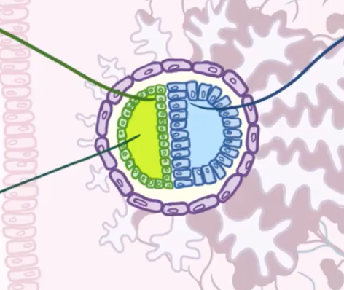
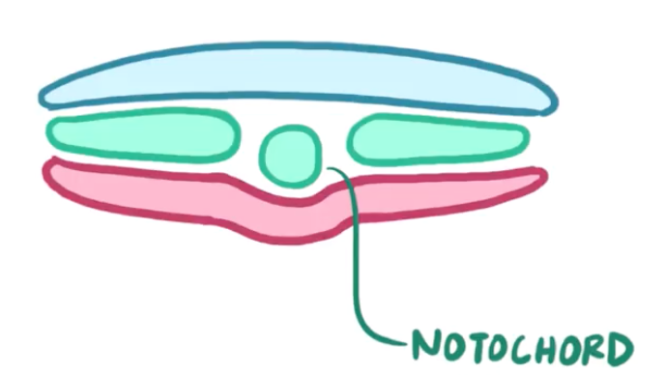
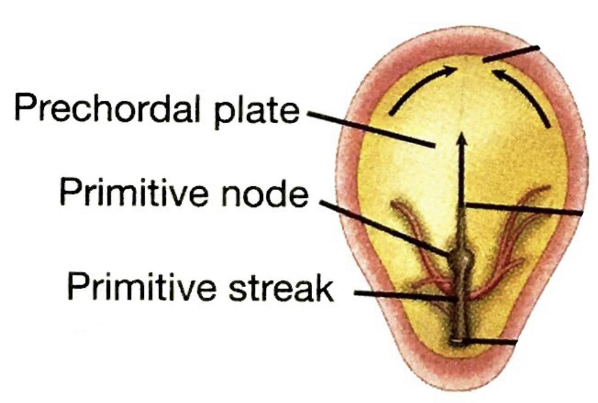
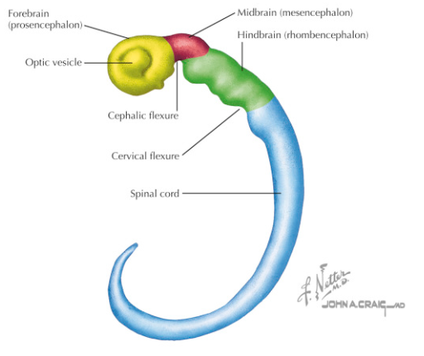
It forms Three Germ Layers
Introduction
Found only in girl’s slides
It has 4 components:
Third week
1-Hypoblast
3-Epiblast
Ectoderm
Mesoderm
Endoderm
2-Yolk sac cavity
4-Amniotic cavity
It has also
Second week
Primitive node
Primitive streak
Development of Neural Tube
The Neural Tube is a derivative of the ectoderm
Gives rise to the brain and the spinal cord
It has
1)Cervical flexure
2)Cephalic flexure

Slide 4
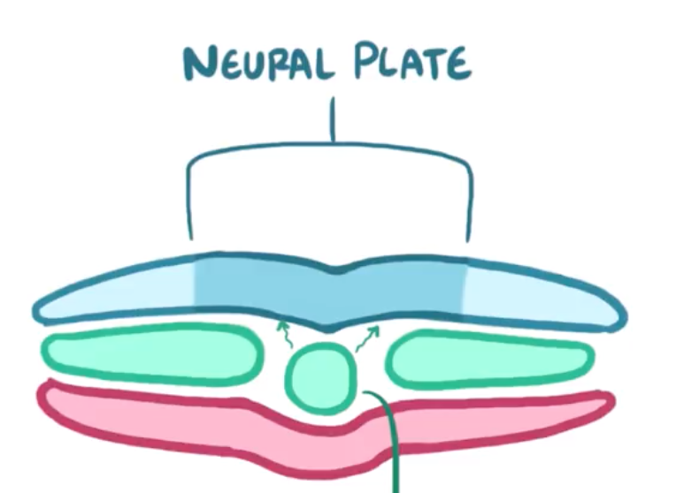
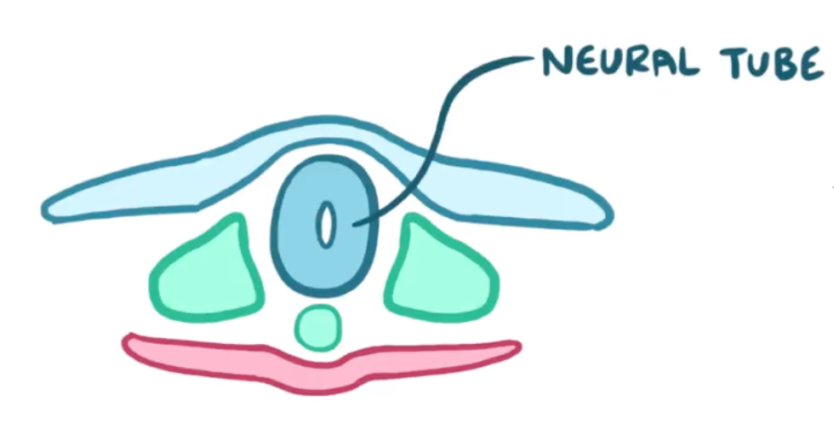
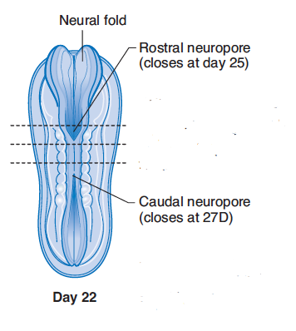
Development of Neural Tube
Stages of development:
1
2
3
4
▪ Notochord stimulates neural tube formation which in turn stimulates development of the vertebral column.
▪ Notochord induces the ectoderm above it which thickens to form the neural plate.
▪ Ectodermal cells dorsal to notochord thicken to form the neural plate.
▪ The neural plate folds to form longitudinal groove (neural groove)with prominent neural folds.
▪ The margins of the neural plate (neural folds) approach to each other and fuse to form the neural tube.
▪ The tube then separates
from the overlying ectoderm.
5
▪Closer of the neural tube begins in the future neck region (4th somite)
▪Then proceeds cranially and caudally
▪The most cranial and caudal ends of the tubes still open as
• Anterior neuropores ➔ will close at day 25 ➔ lamina terminalis
• Posterior neuropores ➔ will close at day 27
▪The lumen of the tube will give ventricles of the brain and central canal of spinal cord.
Somite

Slide 5
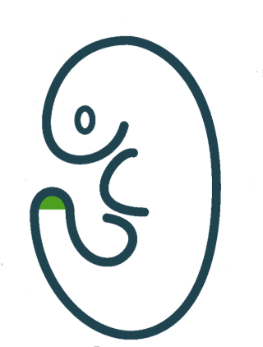
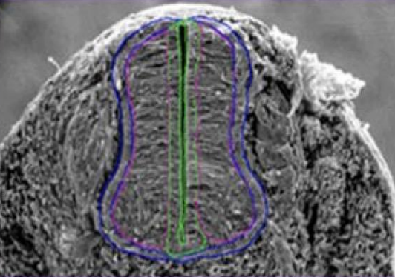
Development of the Spinal Cord
The spinal cord develops from the caudal 2/3 of the neural tube
The cells of the neural tube
are arranged in three layers
ventricular zone
mantle zone
marginal zone
alar plate
marginal zone
Inner
undifferentiated cells
Middle
cell bodies of neurons
(future gray matter)
Outer
nerve fibers or axons of neurons
(future white matter)
sulcus limitans
ventricular zone
mantle zone
Neurons of mantle layer differentiate into :
basal plate
ventral basal plate
(future ventral horn) containing motor neurons
dorsal alar plate
(future dorsal horn)
containing sensory neurons
The 2 areas are separated by a longitudinal groove (sulcus limitans).

Slide 6
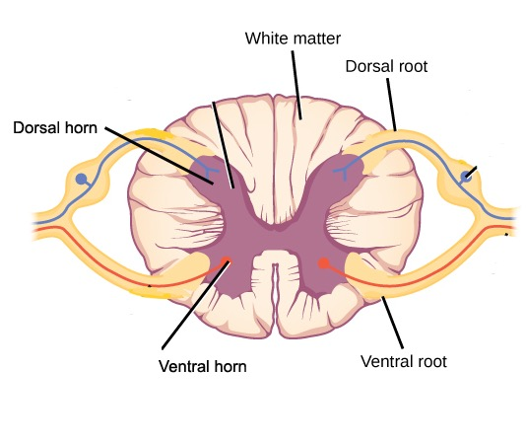
Mantle Layer of Spinal cord (future gray matter)
Proliferation and bulging of both alar & basal plates result in:
1
2
3
Formation of
dorsal median septum.
Formation of
ventral median fissure.
Narrowing of the lumen of the neural
tube to form a small central canal.
Marginal Layer of Spinal cord (future white matter)
dorsal funiculi
increases in size due to addition of ascending, descending & intersegmental nerve fibers.
it is divided into : dorsal, lateral and ventral funiculi (white column).
Myelination of nerve fibers starts at 4th month & continues during the 1st postnatal year.
Motor fibers myelinated before sensory fibers.
So, After a nerve injury, both motor and sensory axons have the ability to regenerate and, given a proper pathway.
lateral funiculi
ventral funiculi
the cells that are still in ventricular zone, became ependyma for the central canal.

Slide 7
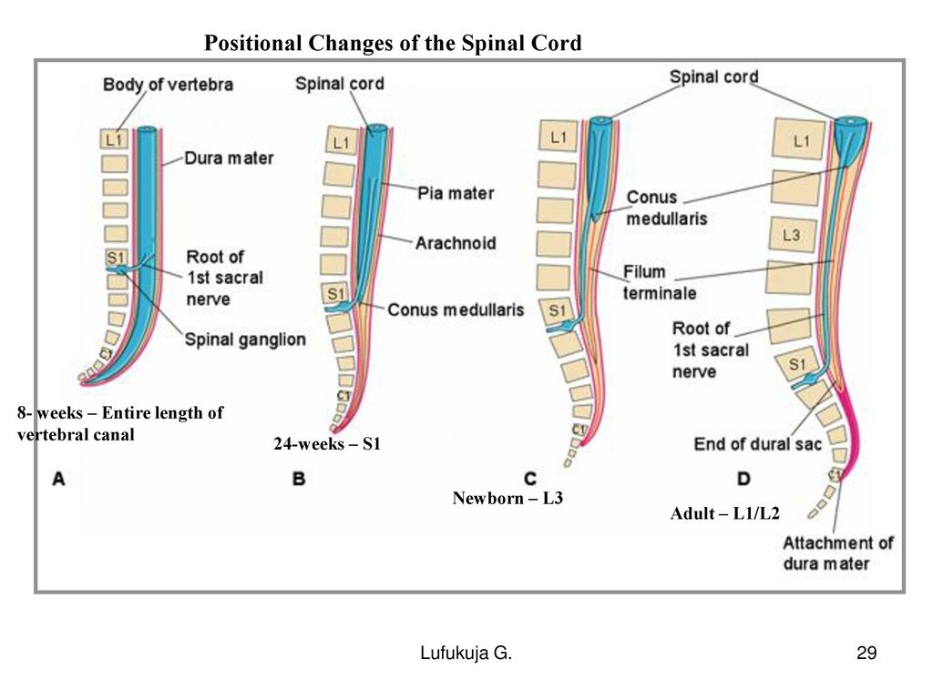
Meninges
These Are 3 Membranes covering the neural tube:
Outer thick dura mater
Origin:
Mesodermal
1
Middle arachnoid mater
origin:
Ectodermal
2
subarachnoid space: is a cavity appears between the arachnoid & the pia mater becomes filled with cerebrospinal fluid (CSF)
3
Inner thin pia mater
origin:
Ectodermal
4
Positional Changes of Spinal Cord
Initially, the spinal cord occupies the whole length of the vertebral canal.
As a result a faster growth of vertebral column, the caudal end of spinal cord (conus medullaris) shifts gradually to a higher level.
The spinal cord in 3rd month same length as vertebral canal
At birth spinal cord terminates at 3rd lumbar vertebra
In adult spinal cord terminates at L1
8 weeks

Slide 8
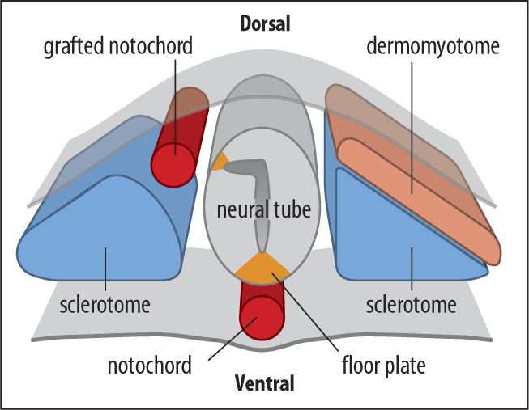
Specialization of Mesoderm
Appearance of the notochord (first sign)
Three collections of the mesoderm appear lateral to the notochord
Somites ➔ develop from the para-axial mesoderm.
Intermediate mesoderm
Double sheets of lateral plate mesoderm
Intraembryonic Mesoderm
Located: between Ectoderm & Endoderm EXCEPT in the central axis of embryo where NOTOCHORD is found.
Differentiates into 3 parts:
Dermatome
Paraxial mesoderm
Somite
Myotome
Divides into segments called ‘somites’.
Sclerotome
Intermediate mesoderm
Lateral mesoderm

Slide 9
Development of the Vertebral Column
The vertebral column develops from the ventromedial parts (sclerotomes) of the somites
Each one of somites divide into 3 parts:
• Sclerotome: form the vertebrae & ribs
• Dermatome: forms the dermis of the skin on the dorsal part of the body
• Myotome: forms the skeletal muscles of the neck, trunk & limbs
Formation of Body of Vertebra
1
At 4th week, each sclerotome becomes subdivided into two parts :
a cranial part, consisting of loosely arranged cells
a caudal part, of more condensed tissue.
cranial part
2
The caudal part of each somite fuses with the cranial part of the consecutive somite,around the notochord to form the body of the vertebra, called the centrum.
each centrum develops from 2 adjacent sclerotomes.
centrum
3
the bodies of the vertebrae are intersegmental in origin.
caudal part

Slide 10
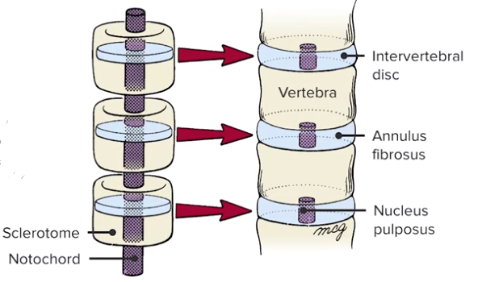
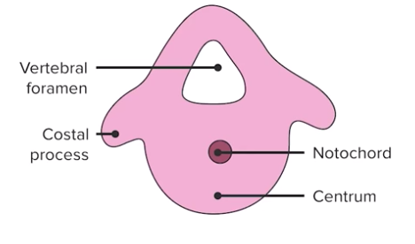
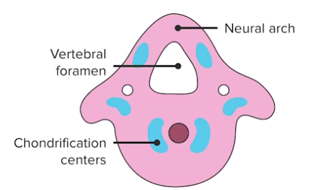
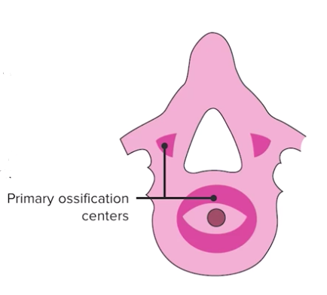
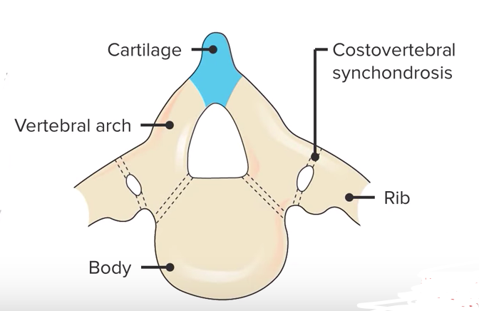
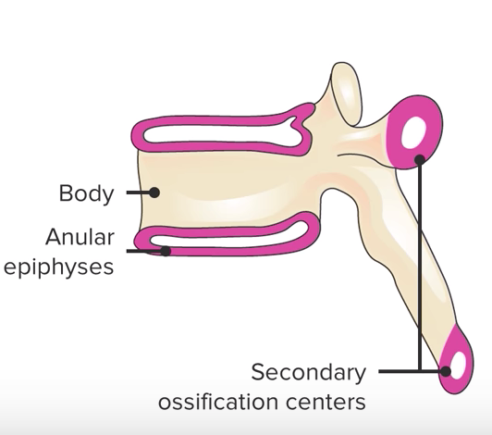
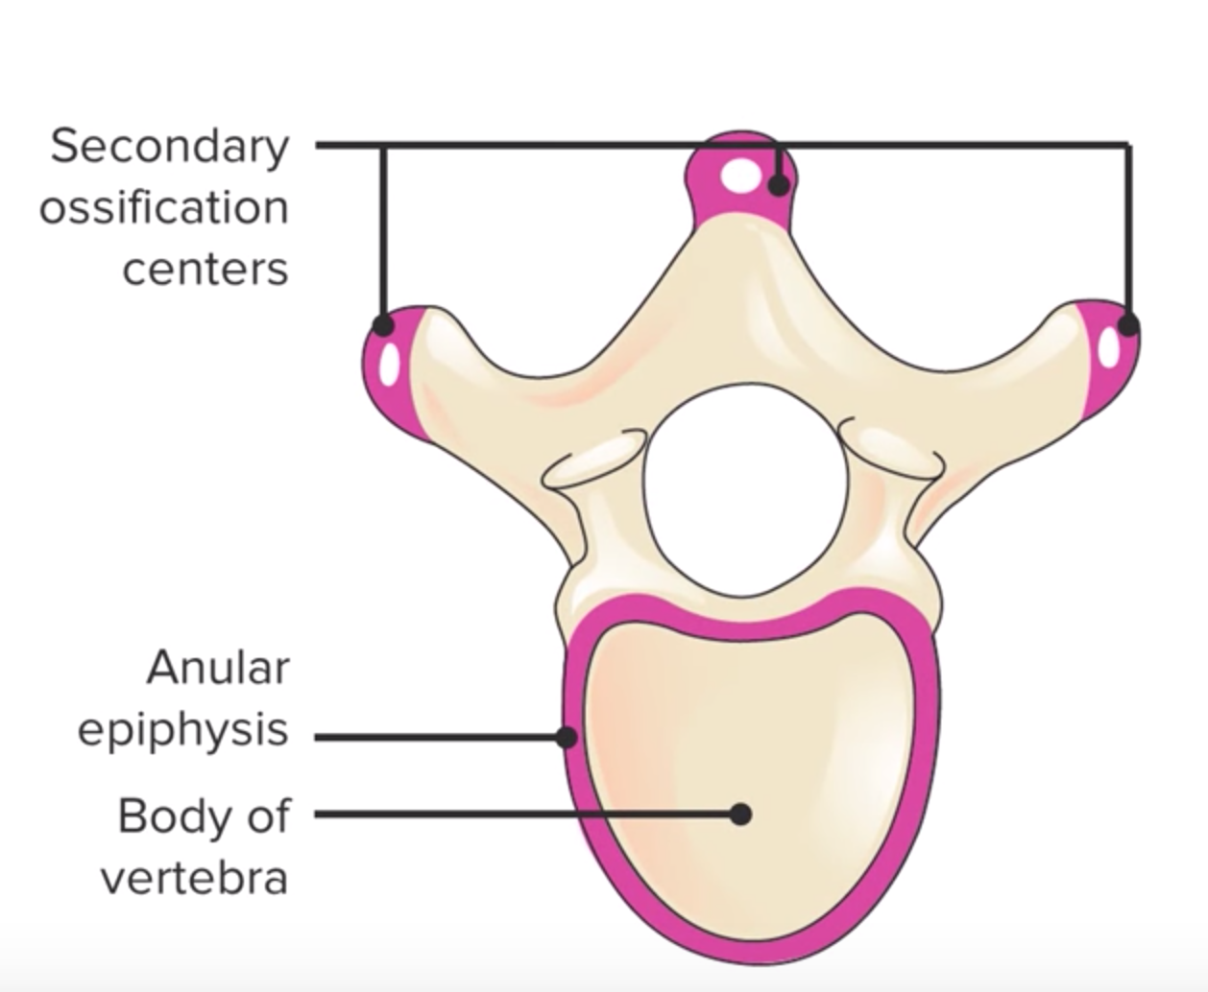
Fate of Notochord
In the region of the bodies of vertebrae: It degenerates.
Between bodies of vertebrae: It forms the central part, ’nucleus pulposus’ of the intervertebral discs.
Annulus fibrosus of the intervertebral discs is formed by the mesoderm surrounding the notochord.
Vertebral Development
vertebral arch.
The fused sclerotomes grow dorsally around the neural tube and form the vertebral (neural) arch.
Ventrolaterally, costal processes develop that give rise to ribs in thoracic region.
The development occurs in 5 stages:
All centers unite around 25 years
1) Mesenchymal | 2) Chondrification | 3) Primary Ossification (3 centers) | 4) Stage of Fusion (Fusion of 2 V.arches) | 5) Secondary Ossification
Fusion between halves of neural arch occurs at 3-5 years, between neural arch & body at 3-6 years
Appear at puberty
Appear at 6th week
Appear at the end of 8th week

Slide 11
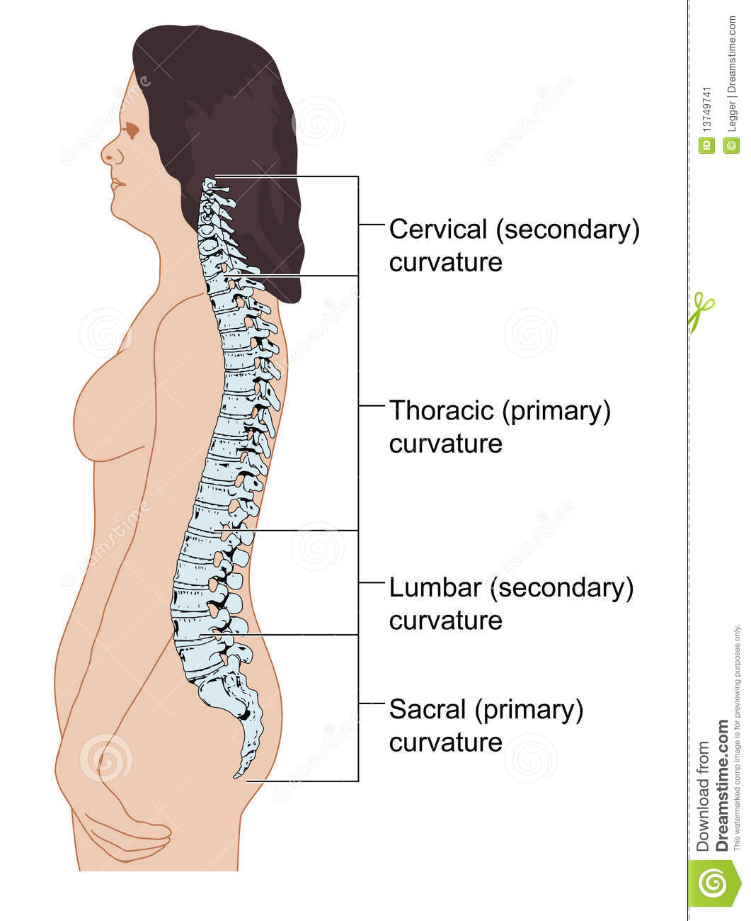
Curvatures of Vertebral Column
Curvatures of Vertebral Column
Primary
(concave anterior)
Secondary
(convex anterior)
develop prenatally
contains
develop postnatally
contains
Thoracic
Pelvic or Sacral
Cervical
Lumbar
concave posteriorly
as a result of lifting the head
concave posteriorly
as a result of walking
Help support trunk, upper body

Slide 12
Spinal Cord Anomalies
Spina Bifida
Failure of fusion of the halves of vertebral arches
Incidence: 0.04 - 0.15% Sex: more frequent in females
Has 2 types
Occulta 20%
1) Spinal dermal sinus
2)Tethered cord
Manifesta (cystic) 80%
Meningocele
Meningomyelocele
Myelochisis
Spina Bifida Occulta
The closed type
Only one vertebra is affected
No clinical symptoms
Skin overlying it is intact
Sometimes covered by a tuft of hair
Usually does not involve underlying neural tissue

Slide 13
B. Spina Bifida Cystica
Cystica is the most severe and complex form of spina bifida.
It usually involves serious neurological problems.
A portion of the nerves and the spinal cord are exposed outside the body
Neurological symptoms are present
It Subdivided into:
1. Spina bifida with meningocele | 2. Spina bifida with meningomyelocoele | 3. Spina bifida with myeloschisis
protrusion of sac containing meninges & cerebrospinal fluid. | protrusion of sac containing meninges with spinal cord and/or nerve roots. | spinal cord is open due to failure of neural folds to develop.

Slide 14
Practice
Q1: The neural tube is derivative from:
A. endoderm
B. mesoderm
C. intermediate mesoderm
D.ectoderm
Q2: Which one of the following regions of spinal cord contains cell bodies of motor neuron?
A. Alar plate
B. Basal plate
C. Mantle zone
D. Dorsal funiculus
Q3: Myelination of nerve fibers starts at ___and continues during ___________.
A. 2nd month - 1st postnatal year
B. 4th month - 1st postnatal year
C. 2nd month - 2nd postnatal year
D. 4th month - 2nd postnatal year
Q4: Dura mater originated from:
A. endoderm
B. mesoderm
C. intermediate mesoderm
D.ectoderm
Q5: Which part of mesoderm divides into segments called somites?
A. Paraxial
B. Intermediate
C. Lateral
D. Notochord
Q6: Each sclerotome becomes subdivided into cranial & caudal part at:
A. 5th week
B. 4th week
C. 4th month
D. 2nd month
Q7: The secondary curvature of spinal column is:
A. Concave anterior
B. Concave posterior
C. Convex anterior
D. Both B&C
Q8 : regarding spinal bifida which one of the statement is correct?
A. The closed type is more frequent than the open
B. The closed type presents with clinical symptoms
C. In cases of spina bifida with meningocele, the spinal cord is open.
D. Spina bifida is due to failure of fusion between the halves of vertebral arch.
Answers: Q1(D) Q2(B) Q3(B) Q4(B) Q5(A) Q6(B) Q7(D) Q8(D)

Slide 15
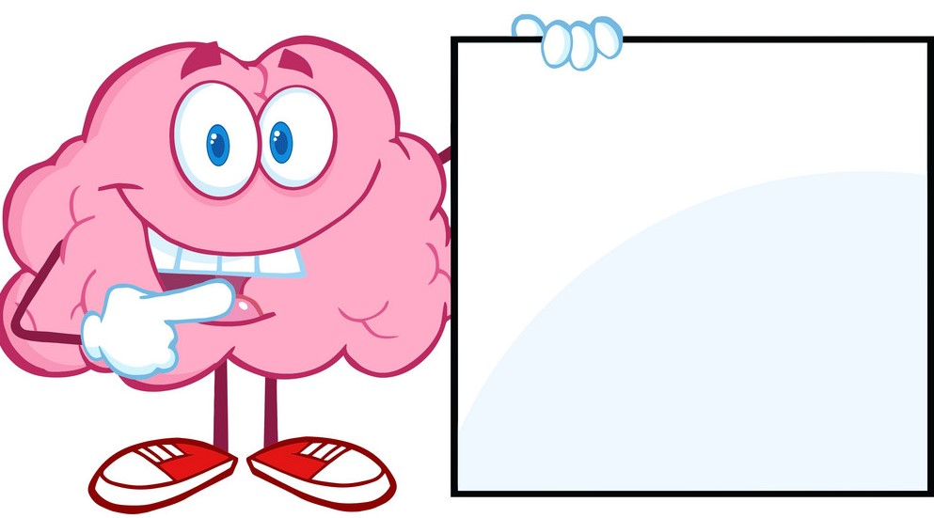
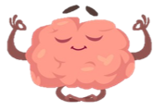
Members board
Team leaders
Abdulrahman Shadid
Ateen Almutairi
Boys team:
Mohammed Al-huqbani
Salman Alagla
Ziyad Al-jofan
Ali Aldawood
Khalid Nagshabandi
Omar Alammari
Sameh nuser
Abdullah Basamh
Alwaleed Alsaleh
Mohaned Makkawi
Abdullah Alghamdi
Girls team :
Ajeed Al Rashoud
‏Taif Alotaibi
‏Noura Al Turki
‏Amirah Al-Zahrani
‏Alhanouf Al-haluli
‏Sara Al-Abdulkarem
‏Renad Al Haqbani
‏Nouf Al Humaidhi
Jude Al Khalifah
Nouf Al Hussaini
Rahaf Al Shabri
Danah Al Halees
Rema Al Mutawa
Amirah Al Dakhilallah
Maha Al Nahdi
Razan Al zohaifi
Ghalia Alnufaei
Contact us:
Editing file
most probably you don't need this

