Slide 1
بسم الله الرحمن الرحيم

Slide 2
Role of Salivary Glands and Stomach
in Digestion
By
Rana Hasanato, MD, ksfcc
Clinical Biochemistry Unit, Path. Dept.
College of Medicine, King Saud University

Slide 3
Objectives:
Understand the principle and importance of digestion of dietary foodstuffs
Understand the role of salivary glands in digestion
Understand the role of stomach in digestion

Slide 4
Background:
Most of dietary foodstuffs are ingested in the form that cannot be readily absorbed from the digestive tract
Digestion: The breakdown of the naturally occurring foodstuffs into smaller, easily absorbable forms

Slide 5
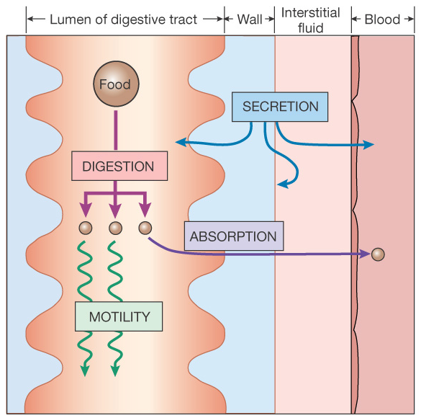
Processes of the digestive system
Motility
Secretion
Absorption
Elimination

Slide 6
Digestion:
Mechanical effects:
e.g., mastication
Enzymatic effects:
Digestive enzymes (hydrolases)

Slide 7
End Products of Digestion:
Carbohydrates Monosaccharides
Triacylglycerols (TAG) Fatty acids & monoacylglycerols
Proteins Amino acids

Slide 8
Role of Salivary Glands in Digestion
They secrete saliva
Saliva:
Acts as lubricant
Contains salivary α-amylase
Contains lingual lipase

Slide 9
Salivary α-Amylase
Secreted by: Parotid glands
Optimum pH: 6.6 – 6.8
Substrate: Starch and glycogen
Hydrolyzes: α(1,4) glycosidic bonds
Produces: Short oligosaccharides

Slide 12
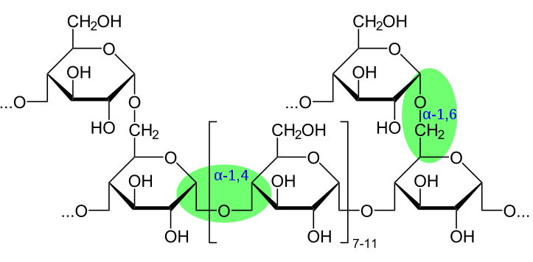

Slide 13
Digestion
Pre-stomach – Salivary amylase : α 1-4 endoglycosidase
G
G
G
G
G
G
Limit dextrins
G
G
G
G
G
G
G
amylase
G
G
G
G
G
G
α 1-6 link
G
G
G
G
G
maltotriose
G
G
α 1-4 link
G
G
G
G
G
G
maltose
G
G
isomaltose
Notes:
Key- We must breakdown these very large oligosaccharides into monosaccharides in order to absorb them.
Alpha amylase. – Cannot attack a1-4 linkase close to 1-6 branch points.

Slide 14
Hydrolysis of α(1,4) Glycosidic Bonds

Slide 15
Effect of α-Amylase on Glycogen
Hydrolysis of:
α(1,4) glycosidic bonds
Products:
Mixture of short oligosaccharides (both branched & unbranched)
Disaccharides: Maltose and isomaltose

Slide 16
Salivary α-Amylase
CONT’D
Its digestive action on the polysaccharides is of little significance because of the short time during which the enzyme can act on the food in the mouth
Salivary amylase is inactivated by the acidity of stomach (The enzyme is inactivated at pH 4.0 or less)

Slide 17
Salivary α-Amylase
CONT’D
Salivary α-amylase does not hydrolyze:
α(1,6) glycosidic bonds
(The branch points of starch and glycogen)
Salivary α-amylase cannot act on:
β(1,4) glycosidic bonds of cellulose
Salivary α-amylase does not hydrolyze disaccharides

Slide 18
Digestion of Carbohydrates in the Mouth

Slide 19
Lingual Lipase
Secreted by the dorsal surface of the tongue (Ebner’s glands)
Acts in the stomach for the digestion of TAG
Produces fatty acids and monoacylglycerols
Its role is of little significance in adult humans

Slide 20
Role of Stomach in Digestion
No further digestion of carbohydrates
Lipid digestion begins by lingual and gastric lipases
Protein digestion begins by pepsin and rennin

Slide 21
Lingual and Gastric Lipases (Acid-Stable Lipases)
Substrate: TAG molecules, containing medium- and short-chain fatty acids; such as found in milk fat
The end products are:
2-monoacylglycerols and fatty acids
The role of both lipases in lipid digestion is of little significance in adult human
(The lipids in the stomach is not yet emulsified. Emulsification occurs in duodenum)

Slide 22
Lingual and Gastric Lipases
CONT’D
Lipase
Target substrate for acid-stable lipases is TAG containing:
R1 – C – O and R3 – C – O as short- or medium-chain fatty acids
O
O
–
–
–
–

Slide 23
Lingual and Gastric Lipases
CONT’D
They are important in neonates and infants for the digestion of TAG of milk
They are also important in patients with pancreatic insufficiency where there is absence of pancreatic lipase

Slide 24
Digestion of Lipids in Stomach
In adults, no significant effects
because of lack of emulsification
that occurs in duodenum
In neonates and infants,
digestion of milk TAG and
production of short- and
medium-chain fatty acids

Slide 25
Pepsin
Secreted by chief cells of stomach as inactive proenzyme, pepsinogen
Activated by HCl and autocatalytically by pepsin
Acid-stable, endopeptidase
Substrate: denatured dietary proteins (by HCl)
End product: Smaller polypeptides

Slide 26
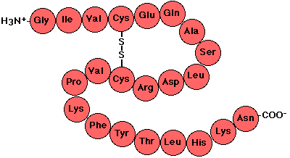

Slide 27
Endopeptidases and exopeptidases

Slide 28
Rennin
Secreted by chief cells of stomach in neonates and infants
Substrate: Casein of milk (in the presence of calcium)
End product: Paracasein with the formation of milk clot
Effect: It prevents rapid passage of milk from stomach, allowing more time for action of pepsin on milk proteins

Slide 29
Digestion of Dietary Proteins in Stomach
HCl:
Denatures proteins
Activates pepsin
Pepsin:
Cleaves proteins into
polypeptides
Rennin:
Formation of milk clot
& Rennin

Slide 30
Take Home Message
Digestion involves both mechanical and enzymatic processes
Digestion makes dietary foodstuffs readily absorbable by the digestive tract
Salivary α-amylase is of limited, but initial effect on digestion of starch and glycogen in the mouth
Salivary α-amylase converts starch and glycogen into short, branched oligosaccharides

Slide 31
Take Home Message
CONT’D
Limited digestion of TAG begins in the stomach by
both lingual and gastric lipases
producing 2-monoacylglycerols and fatty acids
Digestion of proteins begins in the stomach by pepsin
producing smaller polypeptides
In neonates and infants, digestion of milk occurs in stomach by:
Acid-stable lipases for digestion of milk fat
Rennin and pepsin for digestion of milk proteins

Slide 32
Questions?

