Slide 1
Salmonella & shigella
Prof. Ali Somily & Prof .Hanan Habib
Department of Pathology
College of medicine

Slide 2
Objectives
1- Develop an algorithm using biochemical tests to
identify and classify Salmonella and Shigella
2- Describe the antigenic structures and virulence factors of Salmonella and Shigella
3- Compare the pathogenesis of various species of Salmonella and Shigella
4-Describe the clinical features and risk factors for the infection with the two organisms
5- Describe the general concepts for the management of gastroenteritis caused by both organisms.

Slide 3
Salmonella

Slide 4
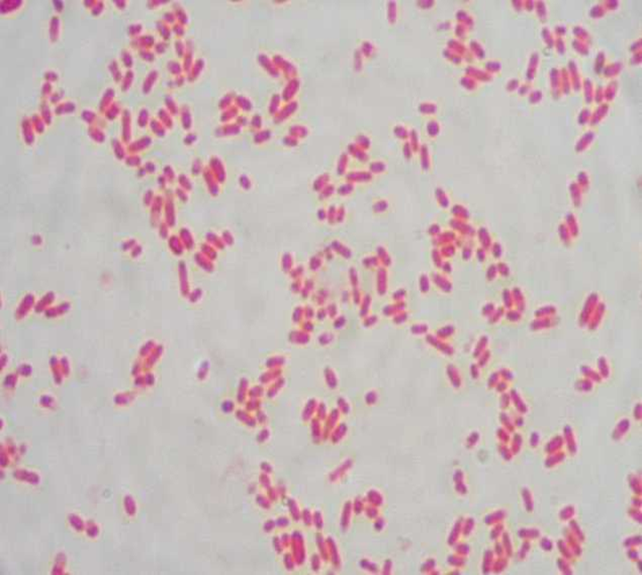
Salmonella
Gram negative ,motile ,facultative anaerobic bacilli
Non lactose fermenting colonies
highest during the rainy season in tropical climates and during the warmer months in temperate climates.

Slide 5
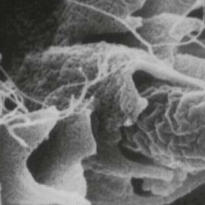
VIRULENCE FACTORS
Fimbria - Adherence
Endocytosis
SPI 1 T3SS
TLR
Replication in microphage
Enterotoxin

Slide 6
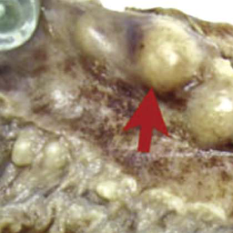
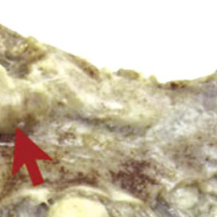
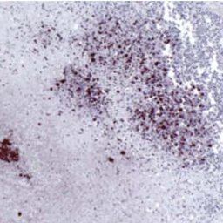
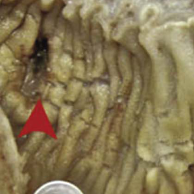
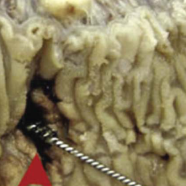
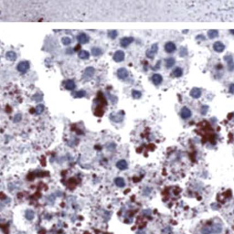
Histopathology
Notes:
A, The visualized mucosal surface of a surgically resected area demonstrates two perforations (arrowheads); the visualized serosal surface demonstrates significant enlargement of lymph nodes (arrows). B and C, Lower and higher magnification views demonstrate immunohistochemical staining for the Salmonella O:9 antigen in a necrotic lymph node.(From Neil KP, Sodha SV, Lukwago L, et al. A large outbreak of typhoid fever associated with a high rate of intestinal perforation in Kasese District, Uganda, 2008-2009. Clin Infect Dis. 2012;54:1096.)

Slide 7
Classification -Has two species s.enterica (six subspecies I, II, III, IV, V, VI) s.borgori (rare) -Cold blooded animal, birds, rodents, turtles, snake and fish
Two species of Salmonella :
S.enterica (six subspecies I, II, III, IV, V, VI)
S.borgori (rare)
Found in cold blooded animal, birds, rodents, turtles, snakes and fish

Slide 8
SALMONELLA SPECIES AND SUBSPECIES | NO. OF SEROTYPES WITHIN SUBSPECIES | USUAL HABITAT
S. enterica subsp. enterica (I) | 1504 | Warm-blooded animals
S. enterica subsp. salmae(II) | 502 | Cold-blooded animals and the environment*
S. enterica subsp. arizonae (IIIa) | 95 | Cold-blooded animals and the environment*
S. enterica subsp. diarizonae (IIIb) | 333 | Cold-blooded animals and the environment*
S. enterica subsp. houtenae (IV) | 72 | Cold-blooded animals and the environment*
S. enterica subsp. indica(VI) | 13 | Cold-blooded animals and the environment*
S. bongori (V) | 22 | Cold-blooded animals and the environment*
Total | 2541

Slide 9
Antigenic structures
O. Somatic antigen
H. Flagellar antigen
K. Capsular antigen

Slide 10
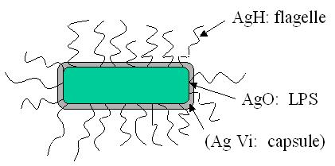
V_{I} in Salmonella serotype typhi (virulence heat-labile capsular homopolymer of N-acetyl-galactosamino-uronic acid) vs phagocytosis
O Antigen (Heat – stable) is lipopolysaccharide in the outer membrane A,B,C1,C2,D,E
H₋antigen (Heat labile)

Slide 11
Clinical diseases
Acute gastroenteritis
Typhoid fever
Nontyphoidal bacteremia
Carrier state following Salmonella infection

Slide 12
Source
Water, food and milk contaminated with human or animal excreta.
S.typhi and S.paratyphi : the source is human.

Slide 13
Salmonella gastroenteritis
Food poisoning through contaminated food
S. enterica subsp. enterica the common cause
Source :poultry, milk, egg & egg products and handling pets
Infective dose: 10⁶ bacteria
Incubation period : 8 – 36 hrs.
fever, chills, watery diarrhea and abdominal pain. Self limiting.
In sickle cell ,hemolytic disorders , ulcerative colitis, elderly or very young patients; the infection may be very severe.
Patients at high risk for dissemination and antimicrobial therapy is indicated.

Slide 14
Enteric fever (Typhoid fever)
Prolonged fever
Bacteremia
Involvement of the reticulo endothelial system (liver, spleen, intestines and mesentery)
Dissemination to multiple organs
Ingestion of contaminated food by infected or carrier individual
Caused by Salmonella serotype typhi or S. paratyphi A, B and C (less severe)
Common in tropical , subtropical countries, and travelers (sewage ,poor sanitation).
IP : 9 – 14 days.

Slide 15
First week: fever, malaise, anorexia, myalgia and a continuous dull frontal headache then,
Patient develops constipation
Mesenteric lymph node → blood stream liver, spleen and bone marrow
Engulfment of Salmonella by mononuclear phagocytes .
Bacteria released into the blood stream again and can lead to high fever . Blood culture is positive.

Slide 16
2nd and 3rd week
Sustained fever & prolonged bacteremia.
Invade gallbladder and Payer's patches
Rose spots 2nd week of fever
Billiary tract → GIT
Organism isolated from stool .

Slide 17
Management & Antibiotics
Enteric fever:
Ceftriaxone
Ciprofloxacin
Trimelhoprim – Sulfamethoxazole
Ampicillin
Azithromycin or Ceftriaxone for patients from India and SE Asia due to strains resistant to Ciprofloxacin. Ciprofloxacin can be used for patients from other areas.
Salmonella gastroenteritis:
Uncomplicated cases require fluid and electrolyte replacement only.

Slide 18
COMPLICATIONS
Necrotizing cholecystitis
Bowel hemorrhage and perforation
Pneumonia and thrombophlebitis
Meningitis, osteomyelitis, endocarditis and abscesses.

Slide 19
Shigella

Slide 20
Shigella is non lactose fermenting Gram negative bacteria.
Cause bacillary dysentery ( blood, mucus and pus in the stool)

Slide 21
ANTIGENIC STRUCTURES
Shigella has 4 species and 4 major O antigen groups:
All have O antigens , some serotypes has K antigen( heat labile removed by boiling)
Shigella are non motile , lack H antigen

Slide 23
CLINICAL INFECTION
S.sonnei (group D1) most predominant in USA ( fever, watery diarrhea)
S.flexneri (group B15) 2nd most common
Young adult ( man who have sex with man)
S. dysenteriae (group A 6 )and S. boydii (group C 20) are most common isolates in developing countries
S. dysenteriae type 1 associated with morbidity and mortality.
Human is the only reservoir

Slide 24
Person to person through fecal –oral route .
Flies, fingers ( have a role in spread).
Food and water.
Young children in daycare, people in crowded area and anal oral sex in developed countries.
Low infective dose < 200 bacilli
Penetrate epithelial cells ,leads to local inflammation, shedding of intestinal lining and ulcer formation.

Slide 25
SYMPTOMS
High fever, chill, abdominal cramp and pain accompanied by tenesmus , bloody stool with mucus & leukocytes.
Incubation period : 24 - 48 hrs
Can lead to rectal prolapsed in children
Complications: ileus, obstruction dilatation and toxic mega colon
Bacteremia in 4 % of severely ill patient
Seizures, HUS

Slide 26
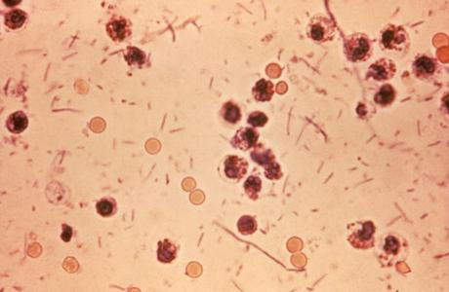
DYSENTRY STOOL

Slide 27
Laboratory diagnosis of Salmonella & Shigella from stool
-Both are Gram negative bacilli
-Culture on selective media ( Salmonella produce black colonies due to H2S)
-Biochemical tests
-Motility test
-Serology for serotypes.

Slide 28
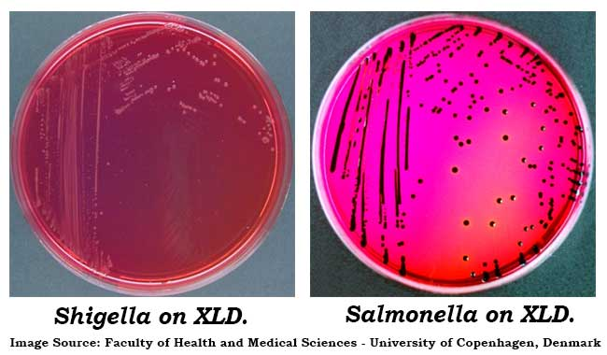

Slide 29
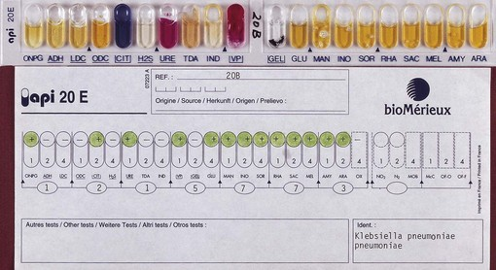
BIOCHEMICAL TESTS

Slide 31
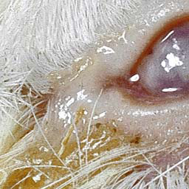
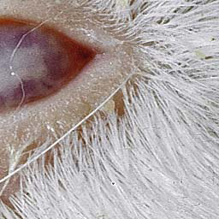
Diagnosis
Stool culture on selective selenite enrichment broth media MAC, SS and XLD,HEA BS
Sero-grouping based on O and H antigen
Sereny test

Slide 32
TREATMENT
Antibiotic s used to reduce duration of illness
IV ceftriaxone and ampicillin , oral TMP-SMX or
ciprofloxacin or doxycycline.

Slide 33
References
Ryan, Kenneth J.. Sherris Medical Microbiology, Seventh Edition. McGraw-Hill Education.
- Intestinal flora, part of chapter 1
- Enteric infections and food poisoning, part of the chapter on Infectious Diseases.
-Typhoid fever
- Dysentry

