Slide 1
MICROBIOLOGY
PRACTICAL
GI BLOCK; 2019

Slide 2
Objectives:
Understand the use of viral serological studies for the diagnosis of hepatitis A , B & C infections.
To know measures to prevent hepatitis A & B infections.
To know the viral serological tests used to screen blood donors.
Risk of transmission of HBV

Slide 3
Case 1
Mohammed Khan is a 20 year-old male who has recently arrived from India to work as a food handler in a restaurant in Riyadh. Three weeks after his arrival he was seen in A&E Dept. of KKUH because of repeated vomiting, abdominal pain and fever. On examination, his temperature was 38°C, his pulse rate 110/min and BP 120/80mmHg, he was jaundiced and had tenderness in the right upper quadrant of his abdomen.

Slide 4
Case 1
Mohammed Khan is a 20 year-old male who has recently arrived from India to work as a food handler in a restaurant in Riyadh. Three weeks after his arrival he was seen in A&E Dept. of KKUH because of repeated vomiting, abdominal pain and fever. On examination, his temperature was 38°C, his pulse rate 110/min and BP 120/80mmHg, he was jaundiced and had tenderness in the right upper quadrant of his abdomen.

Slide 5
QUESTIONS
What are the possible causes for his presentation?
What investigations would you like to order for him? Explain how these investigations would help you.

Slide 6
Test | How this investigation will help you?
1. CBC & ESR
2. Blood Film
3. Liver function test
4. Viral Hepatitis screening
5. Blood Culture

Slide 7
Test | How this investigation will help you?
1. CBC & ESR | Shows non-specific signs of infections or inflammation
2. Blood Film | To exclude malaria
3. Liver function test | To asses liver function
4.Viral Hepatitis Serology Panel | To exclude viral hepatitis
5. Blood Culture | To exclude typhoid fever

Slide 8
Investigation
CBC | LFTs
Hb 14.2 g/L WBCs 6100 mm³ Platelet 271 g/L ESR 4mm/h Malaria Blood film -ve. Blood culture is negative. | AST 1557 IU/L (12-37) ALT 1879 IU/L (20-65) ALP 441 IU/L (175-476) Albn 42.3 g/L (30-50) Bilirubin 86 µmol/L (3-17)

Slide 9
3. Based on these findings
what is the most likely diagnosis?
4. What further investigations would you like to order?

Slide 10
5. The serologic results were as follows:
TEST |  | RESULT
Anti-HAV-IgM |  | Positive
HBsAg |  | Negative
Anti-HCV |  | Negative
Anti-HEV IgM |  | Negative
6. Based on the serologic results,
what is the diagnosis?

Slide 11
Briefly outline the management of this
patient.

Slide 12
Case 2
Mohammed Abdullah is a 34 year old married Saudi male who has donated two units of blood at KKUH for a relative undergoing an operation. Two days later, the Blood Bank called him because of abnormal blood test results and advised him to see his physician.
On arrival to the blood bank, the doctor informed him that his blood is not suitable for transfusion because of the presence of infection.

Slide 13
QUESTIONS
What type of infectious agents can be transmitted through blood transfusion? (List 4 infections).

Slide 14
. The next day Mohammed came to see his general practitioner with a letter from the Blood Bank. The letter revealed the result shown below.
What is your interpretation?
What do you do next?
Test |  | Result
HBsAg |  | Negative
Anti-HBc |  | Negative
Anti-HCV |  | Positive
HIV-Ag/Ab |  | Negative
Anti-HTLV |  | Negative

Slide 15
How would you interpret the results ordered by the GP?
Normal Range | Patient Result | Lab. Test
20-65 IU | 49 | ALT
12-37 IU | 29 | AST
3-17 mol/L | 4 | Bilirubin
- | Negative | HIV-Ag/Ab
- | Positive | Anti-HCV
- | Negative | HBsAg
- | Negative | Anti-HBc
- | Negative | Anti-HBs

Slide 16
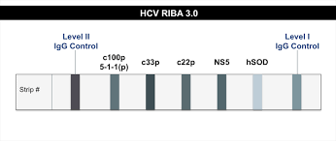
How do you diagnose HCV infection?
Serological assay
  Screening for (Anti-HCV) by ELISA
  Confirmatory test by
  recombinant immunoblot assay (RIBA)
Or Line Immunoassay INNO-LIA HCV
Molecular assay

Slide 18
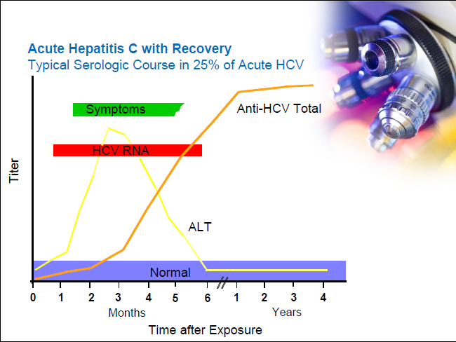

Slide 19
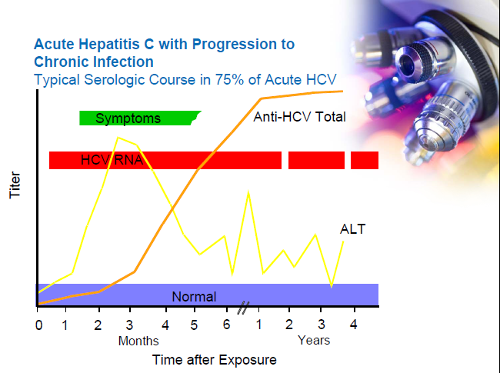

Slide 20
The General practitioner arrange for him to see hepatologist who examine him and review his results. He further added PCR with genotype for Hepatitis C.
What is the significance of these tests & how they can help in the management:

Slide 21
How it can help? | Significance | Test
Confirm the Dx Monitor response to Rx | 1-Qualitative: - or + (HCV-RNA) 2-Quantitative: viral load | 1. PCR
Guide the choice & duration of therapy. | Identify the genotype of HCV | 2. Genotype

Slide 22
HCV Infection Testing Algorithm for Diagnosis of Asymptomatic Persons
Screening Test for Anti-HCV
Negative
STOP
Positive
OR
RIBA for Anti-HCV
Negative
NAT for HCV RNA
Negative
Indeterminate
Positive
Positive
STOP
Additional Laboratory Evaluation (e.g. PCR, ALT)
Medical Evaluation
Negative PCR,
Normal ALT
Positive PCR,
Abnormal ALT
Source: MMWR

Slide 23
Case 3
A 15-weeks pregnant Saudi woman was seen for the first time at the antenatal clinic at KKUH. As part of the antenatal screening, the doctor arranged for blood screening for viral serology.

Slide 24
The results were as follows :
Test | Result
HBsAg | positive
HBeAg | negative
Anti-HBe | positive
Anti-HBc IgM | negative
Total Anti-HBc | positive
HIV Ag/Ab | negative
Anti-HCV | negative

Slide 25
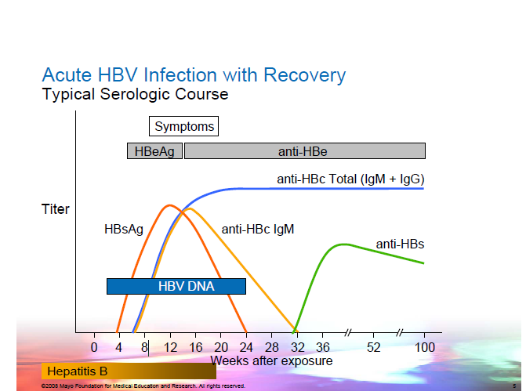

Slide 26
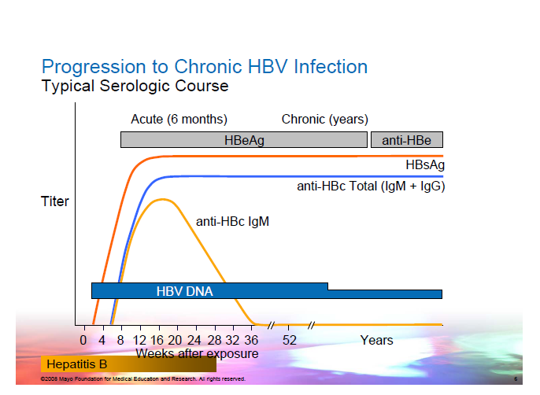

Slide 27
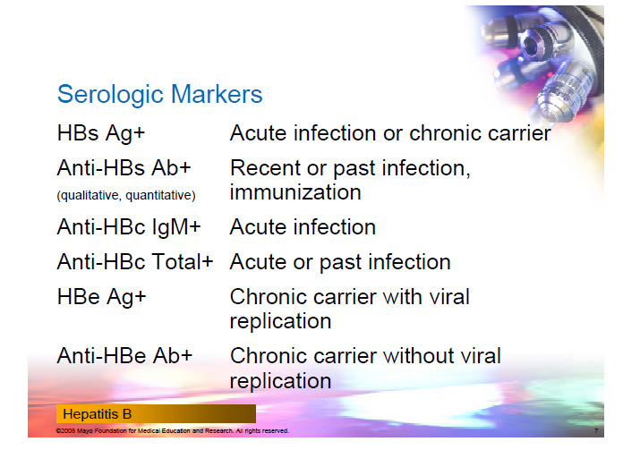

Slide 28
How would you interpret these results?
On the lights of these Laboratory results how would you manage the newborn?

Slide 29
3. Is there a risk of transmission of HBV to the newborn?

Slide 30
3. Is there a risk of transmission of HBV to the newborn?
HBsAg (+) mother 10-20%
HBeAg (-)
HBsAg (+) mother 90%
HBeAg (+)

Slide 31
4. What further management would you offer to the mother?

Slide 32
Pregnant Hepatitis B carriers should be
advised to
- Be seen at least annually by their regular
medical doctor.
- Obtain vaccination against hepatitis viruses A
as indicated.
      Discuss the risk for transmission with their
      partner and need for testing.
      Not donate blood, body organs, other tissue.
      Not share any personal items that may have
      blood on them (e.g., toothbrushes ).

Slide 33
Today the mother was admitted in labour and you were among the staff involved in the delivery.
During a repair of the episiotomy, you accidentally prick your finger with a needle stained by the patient blood.
What should you do?

Slide 34
1. What should you do?
  - Report occupational exposures immediately.
  The hepatitis B vaccination status and the vaccine-response status
  (if known) should be reviewed.
    HBsAg
    Anti-HBc
    Anti-HBs

Slide 35
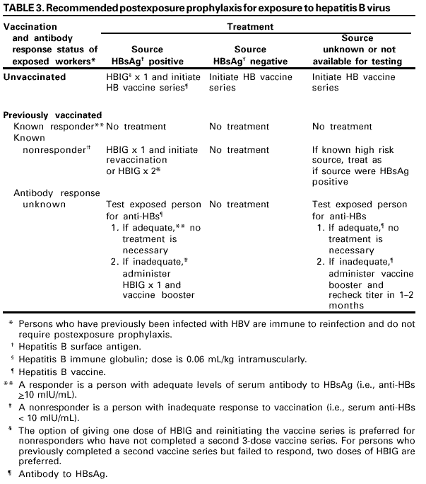

Slide 36
2. What is the risk of infection to you?
the risk of developing serologic evidence of HBV inf
if the blood (+) HBsAg
(+) HBeAg 37-62%
the risk of developing serologic evidence of HBV inf
if the blood (+) HBsAg
(-) HBeAg 23-37%

Slide 37
Tests | Results | Interpretation
HBsaG anti-HBc anti-HBs | negative negative negative
HBsAg anti-HBc anti-HBs
HBsAg anti-HBc anti-HBs
HBsAg anti-HBc IgM anti-HBc anti-HBs
HBsAg anti-HBc IgM anti-HBc anti-HBs
HBsAg anti-HBc anti-HBs

Slide 38
Tests | Results | Interpretation
HBsaG anti-HBc anti-HBs | negative negative negative | susceptible
HBsAg anti-HBc anti-HBs | negative positive positive
HBsAg anti-HBc anti-HBs
HBsAg anti-HBc IgM anti-HBc anti-HBs
HBsAg anti-HBc IgM anti-HBc anti-HBs
HBsAg anti-HBc anti-HBs

Slide 39
Tests | Results | Interpretation
HBsaG anti-HBc anti-HBs | negative negative negative | susceptible
HBsAg anti-HBc anti-HBs | negative positive positive | immune due to natural infection
HBsAg anti-HBc anti-HBs | negative negative positive
HBsAg anti-HBc IgM anti-HBc anti-HBs
HBsAg anti-HBc IgM anti-HBc anti-HBs
HBsAg anti-HBc anti-HBs

Slide 40
Tests | Results | Interpretation
HBsaG anti-HBc anti-HBs | negative negative negative | susceptible
HBsAg anti-HBc anti-HBs | negative positive positive | immune due to natural infection
HBsAg anti-HBc anti-HBs | negative negative positive | immune due to hepatitis B vaccination
HBsAg anti-HBc IgM anti-HBc anti-HBs | positive positive positive negative
HBsAg anti-HBc IgM anti-HBc anti-HBs
HBsAg anti-HBc anti-HBs

Slide 41
Tests | Results | Interpretation
HBsaG anti-HBc anti-HBs | negative negative negative | susceptible
HBsAg anti-HBc anti-HBs | negative positive positive | immune due to natural infection
HBsAg anti-HBc anti-HBs | negative negative positive | immune due to hepatitis B vaccination
HBsAg anti-HBc IgM anti-HBc anti-HBs | positive positive positive negative | acute hb
HBsAg anti-HBc IgM anti-HBc anti-HBs | positive positive negative negative
HBsAg anti-HBc anti-HBs

Slide 42
Tests | Results | Interpretation
HBsAg anti-HBc anti-HBs | negative negative negative | susceptible
HBsAg anti-HBc anti-HBs | negative positive positive | immune to hbv due to natural infection
HBsAg anti-HBc anti-HBs | negative negative positive | immune due to hepatitis B vaccination
HBsAg anti-HBc IgM anti-HBc anti-HBs | positive positive positive negative | acute hb
HBsAg anti-HBc IgM anti-HBc anti-HBs | positive positive negative negative | chronic hb
HBsAg anti-HBc anti-HBs | negative positive negative

Slide 43
Tests | Results | Interpretation
HBsAg anti-HBc anti-HBs | negative negative negative | susceptible
HBsAg anti-HBc anti-HBs | negative positive positive | immune due to natural infection
HBsAg anti-HBc anti-HBs | negative negative positive | immune due to hepatitis B vaccination
HBsAg anti-HBc IgM anti-HBc anti-HBs | positive positive positive negative | acute hb
HBsAg anti-HBc IgM anti-HBc anti-HBs | positive positive negative negative | chronic hb
HBsAg anti-HBc anti-HBs | negative positive negative | four interpretations possible *

Slide 44
*
May be recovering from acute HBV infection.
May be distantly immune and test not sensitive enough to detect very low level of anti-HBs in serum.
May be susceptible with a false positive anti-HBc.
May be undetectable level of HBsAg present in the serum and the person is actually a carrier.

Slide 45
