Slide 1
Complications of liver cirrhosis
GNT block
Dec 2019

Slide 2
Complications of liver cirrhosis Objectives
Recognize the major complications of cirrhosis
Understand the pathogenetic mechanisms underlying the occurrence of the complications
Recognize the clinical features inherent to the above mentioned complications
Describe the pathological findings of the different complications

Slide 3
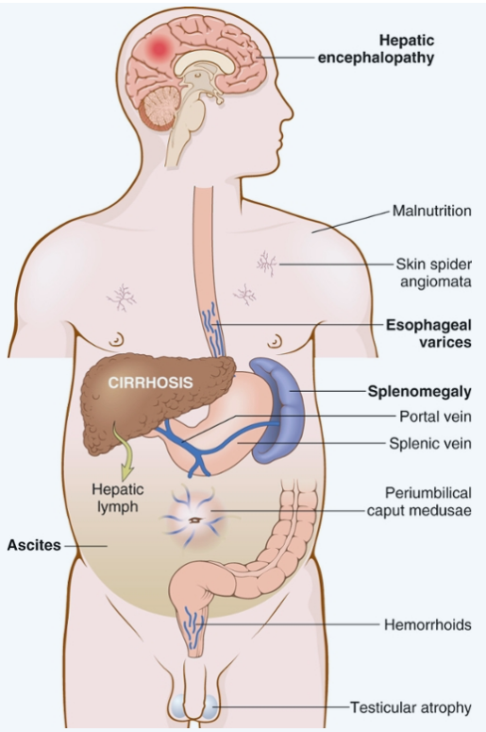
Complications of liver cirrhosis
.
1. Portal hypertension:
a. Splenomegaly
b. Variceal bleeding
c. Hemorrhoids
d. Periumbilical venous collaterals (caput medusa)
2. Hepatic failure
a. Coagulopathy
b. Hypoalbuminemia
c. Hepatic encephalopathy
3. Ascites
4. Spontaneous bacterial peritonitis
5. Jaundice and cholestasis
6. Hepatorenal syndrome
7. Hyperestrinism in males
8. Hepatocellular carcinoma

Slide 4
Complications of liver cirrhosis 1. PORTAL HYPERTENSION:
1. Splenomegaly
2. Portosystemic shunt: A. Variceal bleeding
B. Hemorrhoids
C. Periumbilical venous collaterals (caput medusa)

Slide 5
Complications of liver cirrhosis PORTAL HYPERTENSION:
Resistance to blood flow
prehepatic, intrahepatic, and posthepatic
The dominant intrahepatic cause is cirrhosis (This is accounting for most cases of portal hypertension)
Portosystemic shunts develop when blood flow is reversed from the portal to systemic circulation.
due to intrasinusoidal hypertension from regenerative nodule compression
Notes:
Increased resistance to portal blood flow may develop in a variety of circumstances

Slide 6
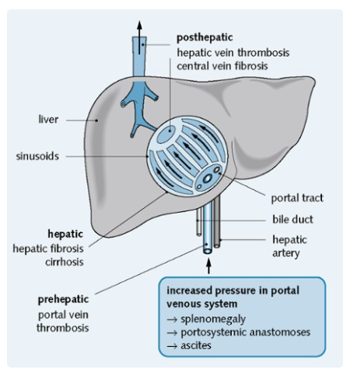
PORTAL HYPERTENSION

Slide 7
Complications of liver cirrhosis
Splenomegaly:
Long-standing congestion may cause congestive splenomegaly (spleen weight may reach up to 1000 gm)
The massive splenomegaly may induce hematologic abnormalities attributable to hypersplenism, such as thrombocytopenia or pancytopenia
Notes:
Splenomegaly Body_ID: HC018018 Long-standing congestion may cause congestive splenomegaly. The degree of splenic enlargement varies widely and may reach as much as 1000 gm, but it is not necessarily correlated with other features of portal hypertension. The massive splenomegaly may secondarily induce hematologic abnormalities attributable to hypersplenism, such as thrombocytopenia or even pancytopenia

Slide 8
Complications of liver cirrhosis Portosystemic shunt
Portal hypertention Portosystemic Shunt
Portal hypertention Portosystemic Shunt
Rectum ( hemorrhoids)
Abdominal wall collaterals (caput medusae)
Cardioesophageal junction ( esophagogastric varices)
Notes:
Abdominal wall collaterals appear as dilated subcutaneous veins extending outward from the umbilicus (caput medusae) and constitute an important clinical hallmark of portal hypertension.

Slide 9
Complications of liver cirrhosis ESOPHAGEAL VARICES:
Venous blood from the GI tract is delivered to the liver via the portal vein before reaching the inferior vena cava.
This circulatory pattern is responsible for the first-pass effect in which drugs and other materials absorbed in the intestines are processed by the liver before entering the systemic circulation.
Diseases that impede this flow cause portal hypertension and can lead to the development of esophageal varices, an important cause of esophageal bleeding

Slide 10
Complications of liver cirrhosis ESOPHAGEAL VARICES:
Pathogenesis
Portal hypertension results in the development of collateral channels at sites where the portal and caval systems communicate. Although these collateral veins allow some drainage to occur, they lead to development of a congested subepithelial and submucosal venous plexus within the distal esophagus (varices)
90% of cirrhotic patients develop varices most commonly in association with alcoholic liver disease
Hepatic schistosomiasis
Notes:
Portal hypertension results in the development of collateral channels at sites where the portal and caval systems communicate. Although these collateral veins allow some drainage to occur, they lead to development of a congested subepithelial and submucosal venous plexus within the distal esophagus. These vessels, termed varices, develop in 90% of cirrhotic patients, most commonly in association with alcoholic liver disease. Worldwide, hepatic schistosomiasis is the second most common cause of varices

Slide 11
Complications of liver cirrhosis ESOPHAGEAL VARICES
Morphology:
Varices can be detected by venogram: tortuous dilated veins lying primarily within the submucosa of the distal esophagus and proximal stomach. Venous channels directly beneath the esophageal epithelium may also become massively dilated.
Varices may not be grossly obvious in surgical or postmortem specimens, because they collapse in the absence of blood flow.
Variceal rupture results in hemorrhage into the lumen or esophageal wall, in which case the overlying mucosa appears ulcerated and necrotic.
If rupture has occurred in the past, venous thrombosis, inflammation, and evidence of prior therapy may also be present.
Notes:
Morphology. Varices can be detected by venogram (Fig. 17-8A) and appear as tortuous dilated veins lying primarily within the submucosa of the distal esophagus and proximal stomach. Venous channels directly beneath the esophageal epithelium may also become massively dilated. Varices may not be grossly obvious in surgical or postmortem specimens, because they collapse in the absence of blood flow (Fig. 17-8B) and, when they are not ruptured, the overlying mucosa is intact (Fig. 17-8C). Variceal rupture results in hemorrhage into the lumen or esophageal wall, in which case the overlying mucosa appears ulcerated and necrotic. If rupture has occurred in the past, venous thrombosis, inflammation, and evidence of prior therapy may also be present.

Slide 12
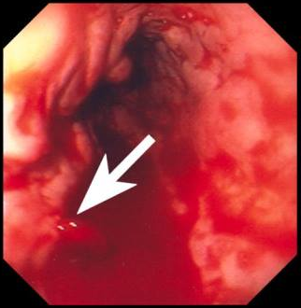
Complications of liver cirrhosis ESOPHAGEAL VARICES
massively dilated venous channels
Variceal rupture with hemorrhage

Slide 13
Complications of liver cirrhosis
ESOPHAGEAL VARICES:
Notes:
Esophageal varices. A, This angiogram shows several tortuous esophageal varices. B, Collapsed varices are present in this postmortem specimen corresponding to the angiogram in A. The polypoid areas represent previous sites of variceal hemorrhage that have been ligated with bands. C, Dilated varice beneath intact squamous mucosa.

Slide 14
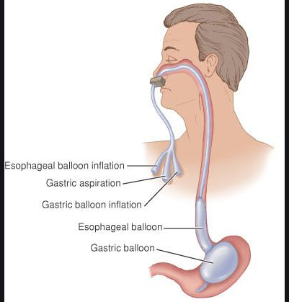
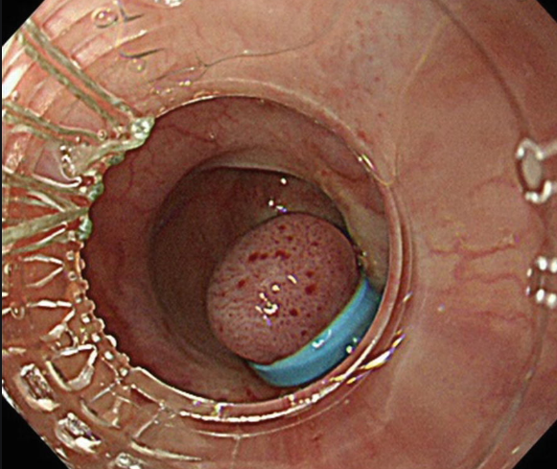
Complications of liver cirrhosis ESOPHAGEAL VARICES:
Clinical features:
Asymptomatic or rupture → massive hematemesis
Inflammatory erosion of thinned overlying mucosa
Increased tension in progressively dilated veins
Increased vascular hydrostatic pressure associated with vomiting are likely to contribute to medical emergency that is treated by any of several methods:
Sclerotherapy
Endoscopic balloon tamponade
Endoscopic rubber band ligation
Notes:
While varices are often asymptomatic, they may rupture, causing massive hematemesis.

Slide 15
Complications of liver cirrhosis ESOPHAGEAL VARICES:
Half of patients die from the first bleeding episode either as a direct consequence of hemorrhage or following hepatic coma triggered by hypovolemic shock.
Additional 50% within 1 year.
Each episode has a similar rate of mortality.
Over half of deaths among individuals with advanced cirrhosis result from variceal rupture.

Slide 16
2. Hepatic failure
Definition: end-point of progressive damage to the liver
a. Coagulopathy b. Hypoalbuminemia c. Hepatic encephalopathy

Slide 17
A. Coagulopathy
The liver is the source of a number of coagulation factors that decline in liver failure, leading to easy bruising and bleeding
Hypercoagulation state also may occur due to failure of the damaged liver to remove activated coagulation factors

Slide 18
B. Hypoalbuminemia
Hypoalbuminemia from decreased synthesis of albumin
Produces dependent pitting edema and ascites due to a decrease in plasma oncotic pressure

Slide 19
C. Hepatic encephalopathy
A spectrum of disturbances in consciousness ranging from subtle behavioral abnormalities, to confusion and stupor, to coma and death.
may develop over days, weeks, or a few months
Due to elevated ammonia levels in blood and the central nervous system and brain edema.
Protein from dietary sources or blood in gastrointestinal tract leads to increased bacterial conversion of urea into ammonia (cannot be metabolized in sick liver and with portosystemic shunts, ammonia go to brain)

Slide 20
Complications of liver cirrhosis 3. Ascites

Slide 21
Complications of liver cirrhosis
Ascites
is the accumulation of excess fluid in the peritoneal cavity:
85% of cases are caused by cirrhosis.
Serous: less than 3 gm/dL of protein
Pathogenesis:
Increase in portal vein hydrostatic pressure
Decreases oncotic pressure
Liver is unable to metabolize aldosterone
Notes:
The fluid is generally serous, having less than 3 gm/dL of protein Ascites is the accumulation of excess fluid in the peritoneal cavity. In 85% of cases, ascites is caused by cirrhosis

Slide 22
Complications of liver cirrhosis
4. Spontaneous bacterial peritonitis
Increased risk for spontaneous bacterial infection on top of ascites

Slide 23
Complications of liver cirrhosis 5. JAUNDICE AND CHOLESTASIS

Slide 24
Complications of liver cirrhosis JAUNDICE AND CHOLESTASIS:
Jaundice and icterus: a yellowish or greenish pigmentation of the skin and sclera of the eyes respectively due to high bilirubin levels.
Cholestasis, characterized by systemic retention of not only bilirubin but also other solutes eliminated in bile.
Notes:
JAUNDICE AND CHOLESTASIS Body_ID: HC018019 The common causes of jaundice are bilirubin overproduction, hepatitis, and obstruction of the flow of bile. Hepatic bile serves two major functions: (1) the emulsification of dietary fat in the lumen of the gut through the detergent action of bile salts, and (2) the elimination of bilirubin, excess cholesterol, xenobiotics, and other waste products that are insufficiently water-soluble to be excreted into urine. Alterations of bile formation become clinically evident as yellow discoloration of the skin and sclera (jaundice and icterus, respectively) due to retention of bilirubin, and as cholestasis, characterized by systemic retention of not only bilirubin but also other solutes eliminated in bile. To understand the pathophysiology of jaundice it is important first to become familiar with the major aspects of bile formation and metabolism. The metabolism of bilirubin by the liver consists of four separate but interrelated events: uptake from the circulation; intracellular storage; conjugation with glucoronic acid; and biliary excretion.

Slide 25
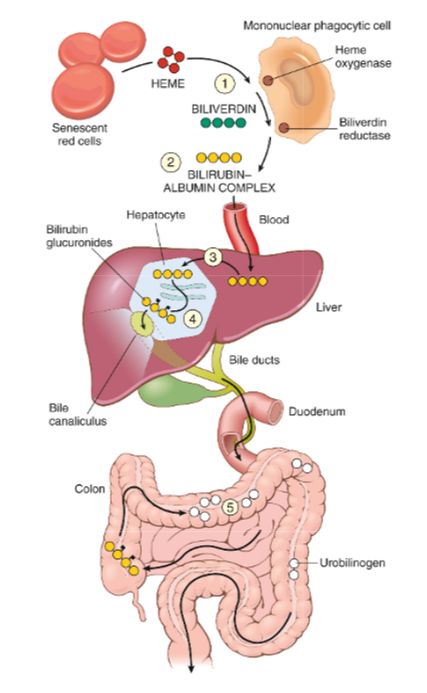
Bilirubin metabolism
and elimination

Slide 26
Complications of liver cirrhosis Cause of Jaundice
Prehepatic causes of jaundice: Bilirubin overproduction
Intrahepatic disorders
Posthepatic disorders (Obstruction of the flow of bile)
due to hemolysis and hematoma resorption, lead to elevated levels of unconjugated (indirect) bilirubin.
can lead to unconjugated or conjugated hyperbilirubinemia. The conjugated (direct) bilirubin level is often elevated by alcohol, infectious hepatitis, drug reactions, and autoimmune disorders.
can cause conjugated hyperbilirubinemia. Gallstone formation is the most common posthepatic process that causes jaundice; however, the differential diagnosis also includes serious conditions such as biliary tract infection, pancreatitis, and malignancies

Slide 27
Complications of liver cirrhosis 6. Hepatorenal syndrome:

Slide 28
Complications of liver cirrhosis Hepatorenal syndrome:
Appearance of renal failure in individuals with severe chronic liver disease - no intrinsic morphologic or functional causes for the renal failure.
The incidence of this syndrome is about 8% per year among patients who have cirrhosis and ascites
Main renal functional abnormalities:
Sodium retention, impaired free-water excretion, and decreased renal perfusion and glomerular filtration rate
Lead to drop in urine output and rising blood urea nitrogen and creatinine levels
Notes:
Hepatorenal syndrome refers to the appearance of renal failure in individuals with severe chronic liver disease in whom there are no intrinsic morphologic or functional causes for the renal failure.

Slide 29
Complications of liver cirrhosis Hepatorenal syndrome:
Causes:
Decreased renal perfusion pressure due to systemic vasodilation
Activation of the renal sympathetic nervous system with vasoconstriction of the afferent renal arterioles
Increased synthesis of renal vasoactive mediators (activation of the renin/angiotensin axis), that decrease glomerular filtration.
Notes:
Several factors are involved in its development, including decreased renal perfusion pressure due to systemic vasodilation, activation of the renal sympathetic nervous system with vasoconstriction of the afferent renal arterioles, and increased synthesis of renal vasoactive mediators, which further decrease glomerular filtration.

Slide 30
Complications of liver cirrhosis
7. Hyperestrinism in males
Pathogenesis:
Liver cannot degrade estrogen and 17-ketosteroids (Androstenedione)
Androstenedione is aromatized into estrogen in the adipose cells.
Clinical findings:
Gynecomastia
Spider telangiectasia
Female distribution of hair
Impotence (due to increased estrogen, there will be increases synthesis of sex hormone–binding protein, which increases binding of free testosterone)

Slide 31
Complications of liver cirrhosis
8. Hepatocellular Carcinoma

Slide 32
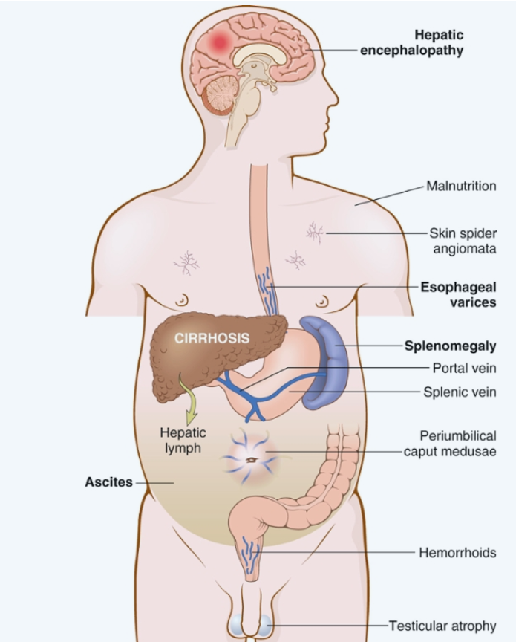
Complications of liver cirrhosis
Conclusion

