Slide 1
Pathology and pathogenesis of acute and chronic pancreatitis
GNT block
Nov 2019
Definition, epidemiology, pathogenesis, morphology, and clinical findings of acute and chronic pancreatitis

Slide 2
Objectives
Describe the epidemiology, pathogenesis, morphology, and clinical findings of acute pancreatitis, including the major laboratory tests used in diagnosing the disease.
Describe the epidemiology, pathogenesis, morphology, and clinical findings of chronic pancreatitis.

Slide 3
Pancreatitis: Definition
Pancreatitis encompasses a group of disorders characterized by inflammation of the pancreas. The clinical manifestations can range in severity from a mild, self-limited disease to a life-threatening acute inflammatory process.
Acute pancreatitis | Chronic pancreatitis
Glands can return to normal if underlying cause of the pancreatitis is removed | Irreversible destruction of exocrine pancreatic parenchyma

Slide 4
Acute pancreatitis
Definition
Epidemiology
Pathogenesis
Morphology
Clinical findings
Major laboratory tests

Slide 5
Acute pancreatitis Definition
Acute pancreatitis is characterized by reversible pancreatic parenchymal injury associated with inflammation (ranging in severity from edema and fat necrosis to parenchymal necrosis with severe hemorrhage)

Slide 6
Acute pancreatitis Epidemiology:
The annual incidence in Western countries is 10 to 20 cases per 100,000 people.
80% of cases in Western countries are associated with one of two conditions: biliary tract disease or alcoholism.
Gallstones are present in 35% to 60% of cases of acute pancreatitis
The male-to-female ratio is
1 : 3 in the group with biliary tract disease
6 : 1 in those with alcoholism

Slide 7
Acute pancreatitis Etiologic Factors
Metabolic:
Alcoholism
Hyperlipoproteinemia
Hypercalcemia
Drugs (e.g., azathioprine)
Genetic:
Mutations in genes encoding trypsin e.g. PRSS1, SPINK1 (Dysregulation of trypsinogen inactivation)
Infectious:
Mumps, Coxsackievirus, Mycoplasma pneumoniae
Mechanical:
Gallstones
Trauma (seat belt trauma, posterior penetration of duodenal ulcer)
Iatrogenic injury
Operative injury
Endoscopic procedures with dye injection
Vascular:
Shock
Atheroembolism
Vasculitis
recurrent severe acute pancreatitis often beginning in childhood

Slide 8
Acute pancreatitis: Pathogenesis
Autodigestion of the pancreatic substance by inappropriately activated pancreatic enzymes
Mechanisms protect the pancreas from enzymatic self-digestion:
Most digestive enzymes are synthesized as inactive proenzymes (zymogens), which are packaged within secretory granules.
Most proenzymes are activated by trypsin, which itself is activated by duodenal enteropeptidase (enterokinase) in the small bowel.
Acinar and ductal cells secrete trypsin inhibitors, including serine protease inhibitor Kazal type l (SPINK1), which further limit intrapancreatic trypsin activity.
Actions of activated pancreatic enzymes (trypsinogen activation)
Proteases damage acinar cell structure.
Lipases and phospholipases produce enzymatic fat necrosis.
Elastases damage vessel walls and induce hemorrhage
Activated enzymes also circulate in the blood.

Slide 9
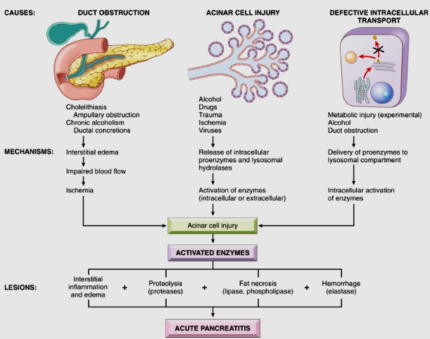
Three proposed pathways in the pathogenesis of acute pancreatitis:

Slide 10
Acute pancreatitis: Morphology
Fat necrosis in the peripancreatic fat
hemorrhage in the head of the pancreas
Fat necrosis in the peripancreatic fat
Fat necrosis results from enzymatic destruction of fat cells.
The released fatty acids combine with calcium to form insoluble salts that precipitate in situ
(appear as foci of yellow-white, chalky material)

Slide 11
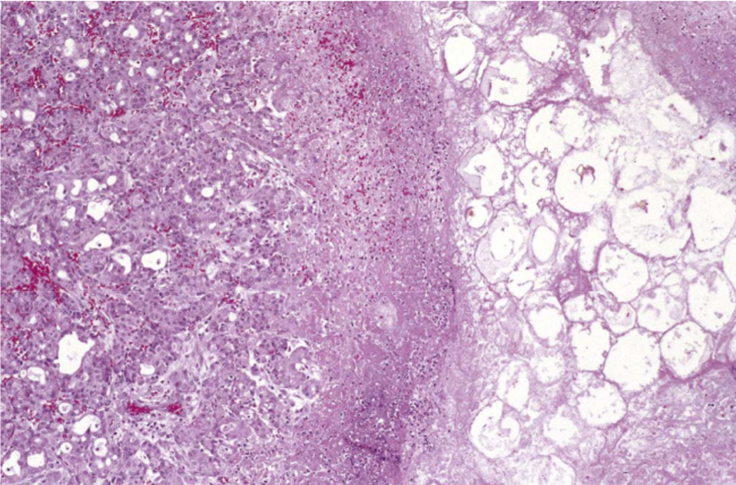
Acute pancreatitis Morphology
The morphology of acute pancreatitis ranges from inflammation and edema to severe extensive necrosis and hemorrhage
The basic alterations are:
(1) microvascular leakage causing edema
(2) necrosis of fat by lipolytic enzymes
(3) an acute inflammatory reaction
(4) proteolytic destruction of pancreatic parenchyma
(5) destruction of blood vessels with subsequent interstitial hemorrhage.

Slide 12
Acute pancreatitis: Clinical Features
Fever, nausea, and vomiting
Abdominal pain
is the cardinal manifestation of acute pancreatitis. Its severity varies from mild to severe.
Severe, boring (knife-like) midepigastric pain with radiation into the back
Hypovolemic shock
Due to peripancreatic collection of fluid
Hypoxemia
Hypoxemia in acute pancreatitis: circulating phospholipase destroys surfactant
Hemorrhage
Disseminated intravascular coagulation
(Due to activation of prothrombin by trypsin)
Tetany
(Calcium binds to fatty acids, which decreases ionized calcium leading to hypocalcemia). The worse the inflammation, the lower the calcium level. If persistent, it is a poor prognostic sign.
Full-blown acute pancreatitis is a medical emergency

Slide 13
Acute pancreatitis: Laboratory findings
Marked elevation of serum amylase levels during the first 24 hours, followed within 72 to 96 hours by a rising serum lipase level
Amylase in acute pancreatitis
Not specific for pancreatitis
Initial increase occurs at 2 to 12 hours; peaks over 12 to 30 hours
Returns to normal in 2 to 4 days
Present in urine for 1 to 14 days
Serum lipase in acute pancreatitis
More specific for pancreatitis
Initial increase occurs in 3 to 6 hours; peaks in 12 to 30 hours; returns to normal over 7 to 14 days
It is not excreted in urine.
Serum immunoreactive trypsin in acute pancreatitis
Increases 5 to 10 times normal
Remains increased for 4 to 5 days

Slide 14
Acute pancreatitis: Management
The key to the management is "resting" the pancreas by total restriction of food and fluids and by supportive therapy.

Slide 15
Acute pancreatitis: Prognosis
Most patients recover fully
About 5% die from shock during the first week of illness. Acute respiratory distress syndrome and acute renal failure are fatal complications.
In surviving patients, complications include:
sterile pancreatic abscess
pancreatic pseudocyst
Repeated episodes of pancreatitis, development of chronic pancreatitis.
Hereditary pancreatitis have a 40% lifetime risk of developing pancreatic cancer

Slide 16
Acute pancreatitis: Summary
is a form of reversible pancreatic parenchymal injury associated with inflammation.
Acute pancreatitis may be caused by
Excessive alcohol intake
Pancreatic duct obstruction (e.g., gallstones)
Genetic defects factors (e.g. PRSS1, SPINK1)
Traumatic injuries
Medications
Infections (e.g., mumps)
Metabolic disorders leading to hypercalcemia
Ischemia
The key feature of all of these causes is that they promote the inappropriate activation of digestive enzymes within the substance of the pancreas
Clinical features include acute abdominal pain, systemic inflammatory response syndrome, and elevated serum lipase and amylase levels

Slide 17
Chronic pancreatitis
Definition
Epidemiology
Pathogenesis
Morphology
Clinical findings

Slide 18
Chronic pancreatitis Definition
Prolonged inflammation of the pancreas associated with irreversible destruction of exocrine parenchyma, fibrosis
In the late stages, the destruction of endocrine parenchyma occur.

Slide 19
Chronic pancreatitis Epidemiology
The prevalence of chronic pancreatitis ranges between 0.04% and 5%
Most affected patients are middle-aged males.

Slide 20
Chronic pancreatitis Causes
Repeated bouts of acute pancreatitis (Long-standing obstruction of the pancreatic duct by calculi or neoplasms)
Chronic alcohol abuse (the most common cause)
Hereditary pancreatitis: Germline mutations in genes such as CFTR (the gene encoding the transporter that is defective in cystic fibrosis), particularly when combined with environmental stressors (up to 25% of chronic pancreatitis has a genetic basis)
Autoimmune injury to the gland (IgG-related disease)

Slide 21
Chronic pancreatitis Pathogenesis
Most often follows repeated episodes of acute pancreatitis (it initiates a sequence of perilobular fibrosis, duct distortion, and altered pancreatic secretions)
Chronic pancreatic injury leads to local production of inflammatory mediators that promote fibrosis and acinar cell loss
e.g. transforming growth factor β (TGF-β) and platelet-derived growth factor (PDGF) induce the activation and proliferation of periacinar myofibroblasts (pancreatic stellate cells), resulting in the deposition of collagen and fibrosis

Slide 22
Pathogenesis
Acute pancreatitis Acinar injury results in release of proteolytic enzymes, leading to activation of the clotting cascade, acute inflammation, vascular injury, and edema.
In most patients, complete resolution of the acute injury with restoration of acinar cell
Chronic pancreatitis
Repeated episodes of acinar cell injury lead to the production of TGF-β and PDGF, resulting in proliferation of myofibroblasts, secretion of collagen and irreversible loss of acinar cell mass, fibrosis, and pancreatic insufficiency

Slide 23
Chronic pancreatitis Morphology
Chronic pancreatitis is characterized by parenchymal fibrosis, reduced number and size of acini with relative sparing of the islets of Langerhans, and variable dilation of the pancreatic ducts.
Grossly: gland is hard, sometimes with extremely dilated ducts and visible calcification

Slide 24
Chronic pancreatitis: Morphology
Extensive fibrosis and atrophy has left only residual islets and ducts, with a sprinkling of chronic inflammatory cells and a few islands of acinar tissue.
Acinar loss is a constant feature
Dilated ducts with inspissated eosinophilic ductal concretions in case of alcoholic chronic pancreatitis.

Slide 25
Chronic pancreatitis: Clinical Features
Silent or repeated attacks of abdominal pain, or persistent abdominal and back pain. Attacks may be precipitated by alcohol abuse, overeating (which increases demand on the pancreas), or the use of opiates and other drugs.
may be entirely silent until pancreatic insufficiency and diabetes mellitus develop due to destruction of the exocrine and endocrine pancreas.

Slide 26
Chronic pancreatitis: Diagnosis
Requires a high degree of suspicion.
Mild-to-moderate elevations of serum amylase
Gallstone-induced obstruction may be evident as jaundice or elevations in serum levels of alkaline phosphatase
Calcifications within the pancreas by computed tomography and ultrasonography

Slide 27
Chronic pancreatitis: Diagnosis
Amylase in chronic pancreatitis
Less reliable than in acute disease
Values are variable: either normal, borderline, or slightly increased
Lipase in chronic pancreatitis:
Not clinically useful
Serum immunoreactive trypsin in chronic pancreatitis
Decreased concentration

Slide 28
Chronic pancreatitis Prognosis
Not an immediately life-threatening condition
The long-term outlook for individuals with chronic pancreatitis is poor, with a 20- to 25-year mortality rate of 50%.
Problems:
Pancreatic exocrine insufficiency
Chronic malabsorption
Diabetes mellitus In other patients severe chronic pain is a dominant problem.
Pancreatic pseudocysts develop in about 10% of patients.
Patients with hereditary pancreatitis, have a 40% lifetime risk of developing pancreatic cancer

Slide 29
Chronic pancreatitis Summary
Chronic pancreatitis is characterized by irreversible injury of the pancreas leading to fibrosis, loss of pancreatic parenchyma, loss of exocrine and endocrine function, and high risk of developing pseudocysts
Chronic pancreatitis is most often caused by
Repeated bouts of acute pancreatitis
Chronic alcohol abuse
Germline mutations in genes such as CFTR (the gene encoding the transporter that is defective in cystic fibrosis), particularly when combined with environmental stressors
Clinical features include intermittent or persistent abdominal pain, intestinal malabsorption, and diabetes

