Slide 1
Gastrointestinal Block
Pathology lecture
2019
Pathophysiology and mechanisms of diarrhea
Dr. Maha Arafah
Dr. Ahmed Al Humaidi

Slide 2
DIARREAHA
Objectives
Define diarrhea
Understand the four categories of diarrheal diseases, and list the major causes in each category.
List the causes of acute and chronic diarrhea

Slide 3

Page 611 - 615

Slide 4
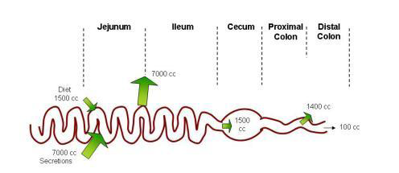
Physiology of Fluid and small intestine

Slide 5
DIARREAHA
DEFINITION
Define diarrhea
World Health Organization
3 or more loose or liquid stools per day
Abnormally high fluid content of stool
  200-300 gm/day
  (more than 250 g of stool per day)

Slide 6
Why important?
Define diarrhea
The loss of fluids through diarrhea can cause dehydration and electrolyte imbalances
Easy to treat but if untreated, may lead to death especially in children

Slide 7
Why important?
Define diarrhea
More than 70 % of almost 11 million child deaths every year are attributable to 6 causes:
Diarrhea
Malaria
neonatal infection
Pneumonia
preterm delivery
lack of oxygen at birth.
UNICEF

Slide 8
CLASSIFICATION
Define diarrhea
Acute …………….if 2 weeks,
Persistent ……. if 2 to 4 weeks,
Chronic ………..if 4 weeks in duration.

Slide 9
Pathophysiology
Categories of diarrhea
Pathogenesis of different types of diarrhea
Secretory
Osmotic
Exudative
Motility-related
Secretory diarrhea: loss of isotonic fluid
Osmotic diarrhea: loss of hypotonic fluid
inflammatory
Stool osmotic gap: distinguishes secretory from osmotic diarrhea

Slide 10
Fecal osmolarity
As stool leaves the colon, fecal osmolality is equal to the serum osmolality i.e. 290 mosm/kg
Under normal circumstances, the major osmoles are Na⁺, K⁺, Cl–, and HCO₃–
Stool osmotic gap =
Stool osmolality - 2 x (stool Na + stool K)
Normal fecal fluid values:
Osmolality: ~290 mOsm/kg
Na+: ~30 mmol/L
K+: ~75 mmol/L

Slide 11
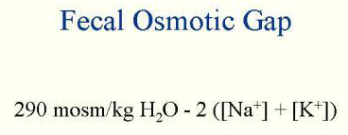
Stool osmotic gap
Pathogenesis of different types of diarrhea
is a calculation performed to distinguish among different causes of diarrhea.
A normal gap is between 50 and 100 mosm/kg
A low stool osmotic gap (<50 mosm/kg) can imply secretory diarrhea
A high gap (>125 mosm/kg) can imply osmotic diarrhea
The reason for this is that secreted sodium and potassium ions make up a greater percentage of the stool osmolality in secretory diarrhea, whereas in osmotic diarrhea, molecules such as unabsorbed carbohydrates are more significant contributors to stool osmolality.

Slide 12
Secretory Diarrhea
Pathogenesis of different types of diarrhea
There is an increase in the active secretion of water
High stool output
Lack of response to fasting
Stool osmotic gap < 100 mOsm/kg
The most common cause of this type of diarrhea is a bacterial toxin (E. coli, cholera) that stimulates the secretion of anions. May lead to life threatening fluid loss
Other causes:
  Enteropathogenic virus e.g. rotavirus and norwalk virus
      Also seen in neuroendocrine tumours ( carcinoid tumor, gastrinomas)
      Rectal villous adenoma

Slide 13
Osmotic Diarrhea
Pathogenesis of different types of diarrhea
Excess amount of poorly absorbed substances that exert osmotic effect………water is drawn into the bowels……diarrhea
Stool output is usually not massive
Fasting improve the condition
Stool osmotic gap is high, > 125 mOsm/kg (loss of hypotonic fluid)
Can be the result of
Malabsorption in which the nutrients are left in the lumen to pull in water e.g. lactose intolerance, chronic pancreatitis, celiac disease (associated with steatorrhea)
Osmotic laxatives e.g. Lactulose (non-absorbable sugar)
Hexitols (poorly absorbed): sorbitol, mannitol, xylitol)

Slide 14
Exudative (inflammatory) Diarrhea
Pathogenesis of different types of diarrhea
Results from the outpouring of blood protein, or mucus from an inflamed or ulcerated mucosa
Presence of blood and pus in the stool.
Persists on fasting
Occurs with inflammatory bowel diseases, and invasive infections e.g. E. coli, Clostridium difficile and Shigella

Slide 15
Exudative (inflammatory) Diarrhea
Pathogenesis of different types of diarrhea
Some bacterial infections cause damage by invasion of the mucosa. Many cause diarrhea with blood and pus in the stool (bacterial dysentery)
  The main organisms of bacterial dysentry are:
    Campylobacter invades mucosa in the jejunum, ileum and colon, causing ulceration and acute inflammation.
    Salmonella typhi, S. paratyphi A, B, and C
    Shigella infections are mainly seen in young children.
    Enteroinvasive and enterohemorrhagic E. coli

Slide 16
Motility-related Diarrhea
Pathogenesis of different types of diarrhea
Caused by the rapid movement of food through the intestines (hypermotility).
Irritable bowel syndrome (IBS) – a motor disorder that causes abdominal pain and altered bowel habits with diarrhea predominating
Increased serotonin: carcinoid syndrome
  Serotonin increases bowel motility
  No inflammation in bowel mucosa

Slide 17
SCREENING TESTS | CAUSES | CHARACTERISTICS | TYPE
Stool osmotic gap < 50 mOsm/kg Fecal smear for leukocytes: negative | Laxatives: melanosis coli with use of phenanthracene laxatives Production of enterotoxins: Vibrio cholerae Enterotoxigenic E. coli | Loss of isotonic fluid High-volume diarrhea Mechanisms:Laxatives Enterotoxins stimulate Cl⁻ channels regulated by cAMP and cGMP | Secretory
Fecal smear for leukocytes:negative Stool osmotic gap > 125 mOsm/kg | Disaccharidase def. pancreatitis Giardiasis, Celiac Dis. Ingestion of poorly absorbable solutes | Osmotically active substance is drawing hypotonic salt solution out of bowel High-volume diarrhea No inflammation in bowel mucosa | Osmotic
Fecal smear for leukocytes: positive in most cases Stool culture and for O&P | Shigella spp. Campylobacter jejuni Entamoeba histolytica, can cause liver amebic abscess | Pathogens invade enterocytes Low-volume diarrhea Diarrhea with blood and leukocytes (i.e., dysentery | Invasive
Increased 5-HIAA | Irritable bowel syndrome (IBS) – a motor disorder Increased serotonin: carcinoid syndrome | Rapid movement of food through the Intestines Serotonin increases bowel motility No inflammation in bowel mucosa | Motility-related
Inflammatory

Slide 18
Entamoeba histolytica
Pathogenesis of different types of diarrhea

Slide 19
Acute diarrhea

Slide 20
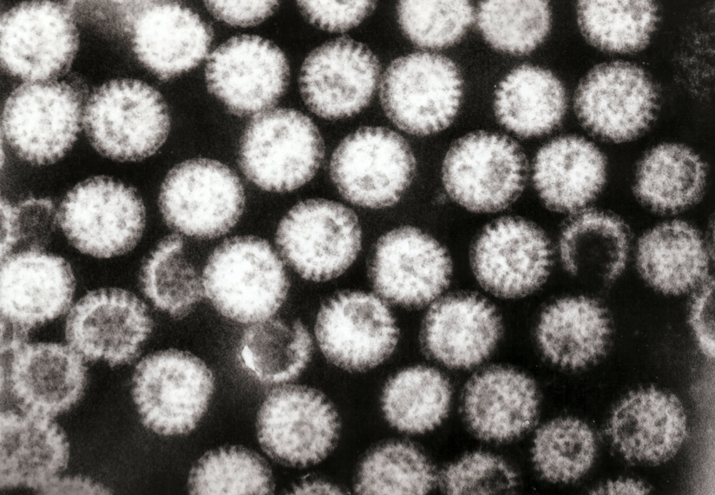
Acute diarrhea
Causes of acute diarrhea
Infection: Approximately 80% of acute diarrheas (viruses, bacteria, helminths, and protozoa).
Viral gastroenteritis (viral infection of the stomach and the small intestine) is the most common cause of acute diarrhea worldwide.
Preformed toxin, enterotoxin, cytoxin or invasive
Food poisoning
Drugs: antibiotic,NSAID, antiacid,
bronchodilaters, antiarrythmics
Others: occlusive colitis, ischemia, toxin (insecticides)
Rotavirus
Rotavirus the most common cause of severe childhood diarrhea and diarrhea-related deaths worldwide
The cause of nearly 40% of hospitalizations from diarrhea in children under 5
Rotaviruses cause 50% of acute diarrhea in infants
Clinically person become dehydrated with electrolyte disturbance and low bicarbonate in blood
Mild self limited , need rehydration

Slide 21
Antibiotic-Associated Diarrheas
Causes of acute diarrhea
Diarrhea occurs in 20% of patients receiving broad-spectrum antibiotics; about 20% of these diarrheas are due to Clostridium difficile
Leading to pseudomembranous colitis

Slide 22
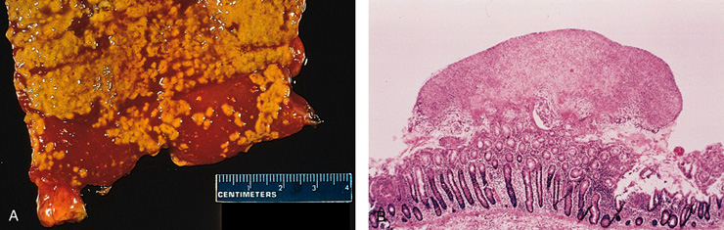
Causes of acute diarrhea
Pseudomembranous colitis
patients received broad-spectrum antibiotics
Caused by Clostridium difficile

Slide 23
Clostridium species. Gram-positive rods
Causes of acute diarrhea

Slide 24
Chronic diarrhea

Slide 25
Chronic diarrhea
Aetiology
Causes of chronic diarrhea
Most of the causes of chronic diarrhea are noninfectious
Infection e.g. Giardia lamblia . AIDS often have chronic infections of their intestines that cause diarrhea.
Post-infectious Following acute viral, bacterial or parasitic infections
Malabsorption
Inflammatory bowel disease (IBD)
Endocrine diseases: e.g. carcinoid, gastrinoma
Colon cancer
Irritable bowel syndrome

Slide 26
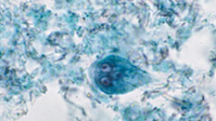
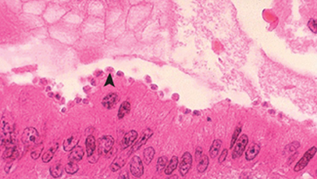
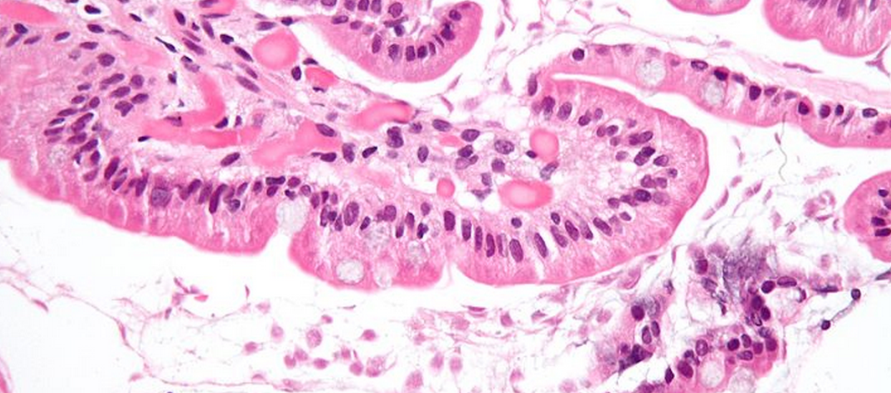
Causes of Chronic Diarrhea
Causes of acute diarrhea
Giardia lamblia
Cryptosporidiosis in AIDS
Parasitic and protozoal infections affect over half of the world's population on a chronic or recurrent basis.

Slide 27
Complications
Chronic diarrhea
Fluids ………………Dehydration
Electrolytes …………….. Electrolytes imbalance
Low Sodium bicarbonate in blood……. Metabolic acidosis
If persistent ……Malnutrition

Slide 28
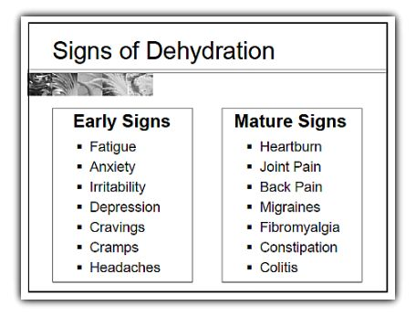
Chronic diarrhea

Slide 29
Tests useful in the evaluation of diarrhea
Acute diarrhea
Fecal leukocytes
present
not present
Inflammatory Diarrhea
Noninflammatory Diarrhea
Suggests colonic mucosa damage caused by invasion
shigellosis, salmonellosis, Campylobacter or Yersinia infection, amebiasis)
toxin (C difficile, E coli O157:H7).
Inflammatory bowel diseases
Suggests a small bowel source
Or colon but without mucosal injury

Slide 30
Chronic diarrhea
Infection
+
Stool analysis
Ova, parasites
-
Secretory or
Noninfectious
inflammatory diarrhea
-
Stool fat test
(normal <20%)
+
Malabsorption
Quantitative stool for fat
  (1) Best screening test
  (2) 72-hour collection of stool
  (3) Positive test > 7 g of fat/24 hours.
Do serum Anti-tissue transglutaminase antibodies
Anti-endomysial IgA antibodies
Antigliadin antibodies to check for celiac disease
Duodenal biopsy

Slide 31
A
B
Fasting improve the condition
inflammatory bowel diseases
High stool output
Presence of WBC in stool
Irritable bowel syndrome
bacterial toxin
Malabsorption
High fecal osmotic gap
Secretory
Osmotic
Exudative (inflammatory )
Motility-related

Slide 32
A
B
Irritable bowel syndrome
Giardia lamblia
Viral gastroenteritis
Inflammatory bowel disease
Food poisoning
Antibiotic-Associated Diarrheas
Malabsorption
Acute diarrhea
Chronic diarrhea

