Slide 1
GNB Pathology 2019
Benign Tumors of Intestine
Dr. Maha Arafah
Dr. Ahmed Al Humaidi

Slide 2
Learning Objectives
Know the classification of intestinal tumors (small intestine and colon)
Know the definition of a polyp.
Compare adenomatous/neoplastic polyps and non neoplastic polyps (hyperplastic polyps, inflammatory polyp and hamartomatous polyp) with respect to pathology (gross and microscopic features).
Know the three subtypes of adenomatous polyps, eg, tubular adenoma, villous adenoma, tubulovillous adenoma.
Describe the adenomatous polyp-cancer sequence and the features associated with risk of malignancy, eg, polyp size, histologic architecture, and severity of epithelial dysplasia.
Describe the classification of the hereditary syndromes involving the GI tract and the syndromes associated with an increased risk of cancer (Peutz-Jeghers syndrome, familial adenomatous polyposis, and hereditary nonpolyposis colorectal carcinoma)

Slide 3
Tumors of the small and large intestines
Polyps
Carcinoma
Carcinoid tumor
Lymphoma

Slide 4
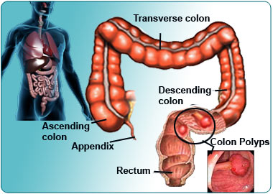
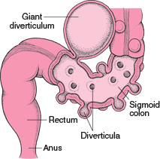
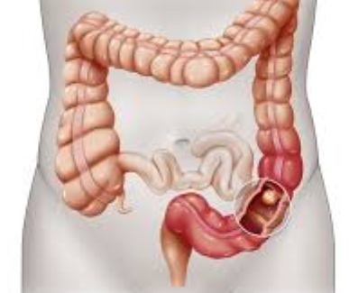
Sigmoid colon: Most common site GI polyps, diverticula and cancer
cancer

Slide 5
Polyps
Non-neoplastic polyps 90%
Hyperplastic polyps
Hamartomatous polyps (Juvenile & Peutz-Jeghers polyps)
Inflammatory polyps
Lymphoid polyps
Neoplastic polyps 10%
Adenoma

Slide 6
Polyps

Slide 7
Non-Neoplastic Polyp
1. Hyperplastic Polyp
Asymtomatic
> 50% are located in the rectosigmoid
Most common type in adults
Sawtooth surface
Star shaped crypts
Composed of well-formed glands and crypts lined by differentiated goblet or absorptive cells.
No malignant potential or polyposis syndromes

Slide 8
2. Hamartomatous polyps
Non-Neoplastic Polyp
Juvenile polyps Peutz-Jeghers Retention polyp polyps

Slide 9
2. Hamartomatous polyp
Non-Neoplastic Polyp
Juvenile Polyps (retention polyp)
Developmental malformations affecting the glands and lamina propria
Commonly occur in children under 5 years old in the rectum.
In adult called retention polyp
no malignant potential
Autosomal dominant
TGF-β signaling pathway abnormalitides
Juvenile polyps; risk of gastric, small intestinal, colonic, and pancreatic adenocarcinoma
Cowden syndrome
Abnormality in PTEN
Hamartomatous polyps, lipomas, ganglioneuromas, inflammatory polyps; increased risk for colon cancer and cancer of thyroid and breast
Juvenile polyposis
Cronkhite-Canada syndrome
Nonhereditary polyposis syndrome
Polyps plus ectodermal abnormalities (Nail atrophy, hair loss, abnormal skin pigmentation) cachexia, and anemia
Notes:
4

Slide 10
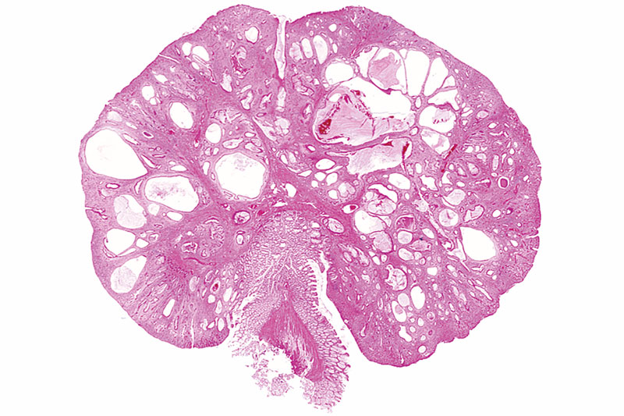
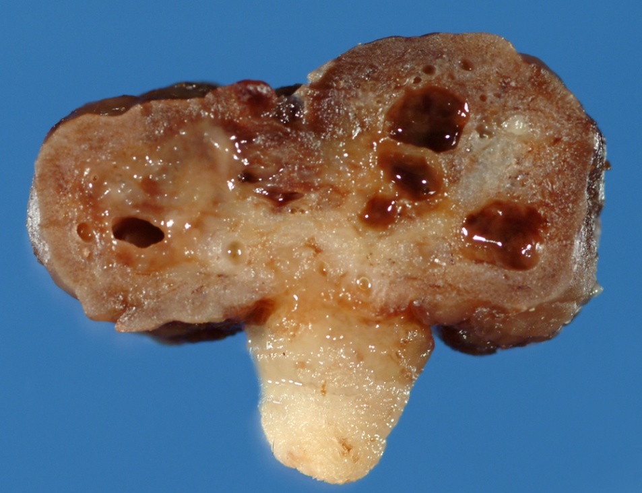
Hamartomatous polyp
Non-Neoplastic Polyp
Juvenile Polyps (retention polyp)
Smooth eroded surface with numerous mucus retention cysts, typical of sporadic juvenile polyps.
Notes:
4

Slide 11
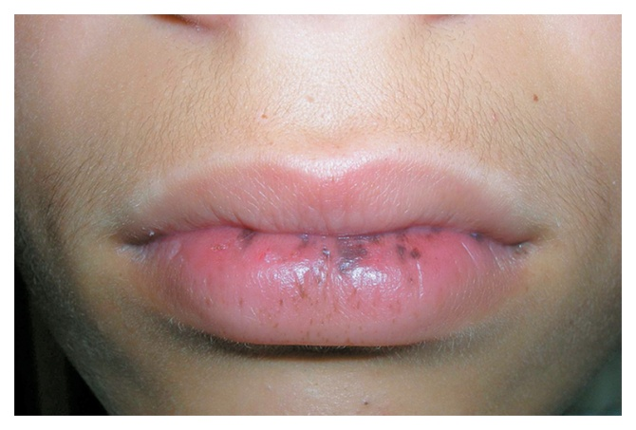
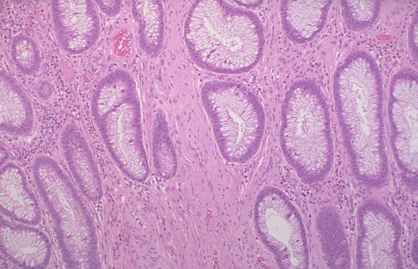
2. Hamartomatous Polyps
Non-Neoplastic Polyp
Peutz-Jehgers syndrome
Rare, autosomal dominant
hamartomatous polyps accompanied by mucosal and cutaneous pigmentation around the lips, oral mucosa, face and genitalia, present with red blood in stool.
Polyps tend to be large and pedunculated.
Increased risk of developing carcinoma of the pancreas, breast, lung, ovary and uterus.
Notes:
5

Slide 12
Peutz-Jehgers syndrome
LKB1/STK11 encodes a tumor suppressive protein kinase that regulates cellular metabolism

Slide 13
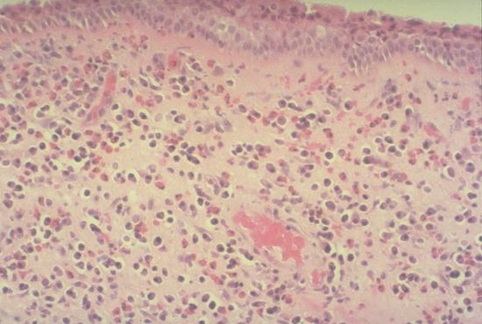
Non-Neoplastic Polyp
3. Inflammatory Polyps
longstanding IBD, especially in chronic ulcerative colitis.
Represent an exuberant reparative response to longstanding mucosal injury called pseudopolyps
Notes:
6

Slide 14
4. Inflammatory Polyps Lymphoid polyps
Non-Neoplastic Polyp

Slide 15
Neoplastic Polyps (Adenomas)
Neoplastic Polyp
Adenomatous Polyp ( adenoma )
Occur mainly in large bowel
Sporadic and familial
Vary from small pedunculated to large sessile
Epithelium proliferation and dysplasia
Notes:
7

Slide 16
Neoplastic Polyps (Adenomas)
Neoplastic Polyp
Adenomatous Polyp ( adenoma )
Divided into:
Tubular adenoma: less than 25% villous architecture
Villous adenoma: villous architecture over 50%
Tubulovillous adenoma: villous architecture between 25 and 50%.
Notes:
7

Slide 17
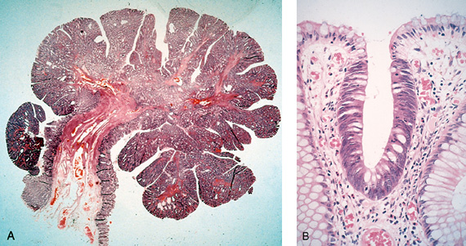
Neoplastic Polyps 1. Tubular adenoma
Neoplastic Polyp
Represents 75% of all neoplastic polyps.
75 % occur in the distal colon and rectum
Sigmoid colon most common site.
Notes:
8

Slide 18
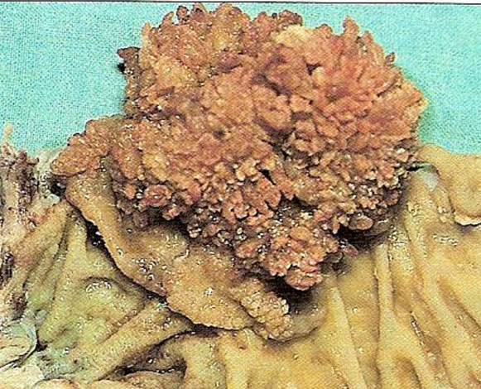
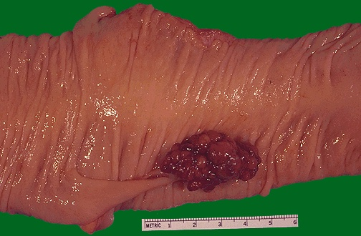
2. Villous Adenoma
Neoplastic Polyp
The least common, largest and most ominous of epithelial polyps (most likely to undergo malignant transformation).
Age: 60 to 65 years, 75% located in rectosigmoid area
Present with rectal bleeding or anemia, large ones may secrete copious amounts of mucoid material rich in protein and potassium
Large tumors can produce hypoalbuminemia and hypokalemia.
Notes:
10

Slide 19
Neoplastic Polyps
Neoplastic Polyp
3] Tubulovillous adenoma
20%–30% of polyps
Intermmediate in size, degree of dysplasia and malignant potential between tubular and villous adenomas.

Slide 20
Neoplastic Polyp

Slide 21
Relationship of Neoplastic Polyps to Carcinoma
Neoplastic Polyp
Adenoma to carcinoma sequence is documented by several genetic alterations.
Notes:
12

Slide 22
Adenoma to Carcinoma Pathway
Neoplastic Polyp
Normal
Adenoma
Cancer
APC
loss
K-ras
mutation
Chrom 18
loss
p53
loss
Normal
Epithelium
Hyper-
proliferation
Early
Adenoma
Intermediate
Adenoma
Late
Adenoma
Cancer
Notes:
Polyp removal leads to CRC prevention
Polyp is surrogate marker

Slide 23
Relationship of Neoplastic Polyps to Carcinoma
Neoplastic Polyp
The probability of carcinoma occuring in a neoplastic polyp is related to:
1. The size of the polyp.
2. The relative proportion of its villous features.
3. The presence of significant cytologic atypia (dysplasia) in the neoplastic cells.
4. Multiple polyps
Notes:
12

Slide 24
Familial Polyposis Syndrome
Patients have genetic tendencies to develop neoplastic polyps.
Familial polyposis coli (FPC)
Gardener’s syndrome
Turcot syndrome
Notes:
13

Slide 25
Familial Polyposis Syndrome
Neoplastic Polyp
Familial polyposis coli (FPC)
Genetic defect of Adenomatous polyposis coli (APC).
APC gene located on the long arm of chromosome 5 (5q21).
APC gene is a tumor suppressor gene
Innumerable neoplastic polyps in the colon (500 to 2500)
Polyps are also found elsewhere in alimentary tract
The risk of colorectal cancer is 100% by midlife.
Notes:
13

Slide 26
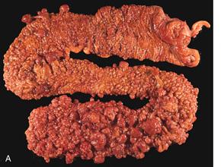
Neoplastic Polyp
Familial polyposis coli (FPC)
Familial polyposis coli

Slide 27
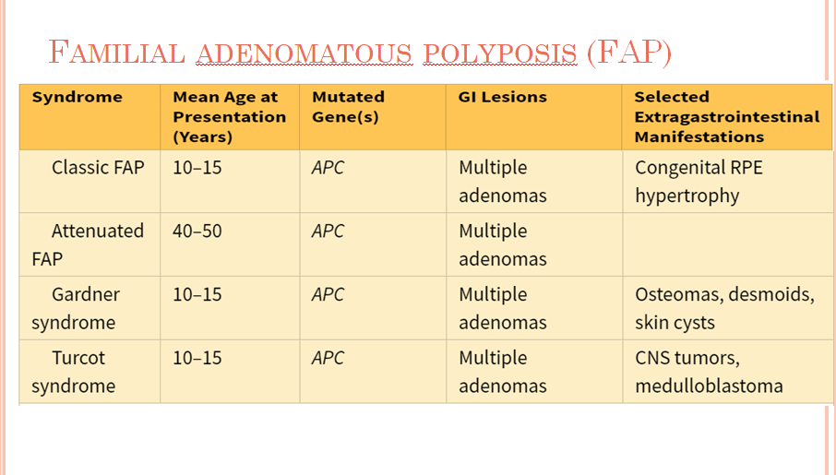

Slide 29
A
B
Crypt abscess
Smooth muscle in lamina propria
Star-shaped crypts
Peutz-Jeghers disease
Turcot syndrome
Dysplasia
Juvenile polyp
Mucocutaneous pigmentation
Neoplastic polyp
APC mutation
K RAS mutation
Developmental malformation
retention cysts
Hyperplastic polyps
Hamartomatous polyps
Inflammatory polyps
Adenomatous polyp

Slide 30
Colon, pedunculated adenomatous polyp
Did this patient have familial polyposis syndrome?
No. there are two isolated polyps. Patients with familial adenomatous polyposis syndrome have at least 100 polyps, and usually many more polyps, carpeting their colonic mucosa.
Can isolated polyps like the ones illustrated develop into colonic ca?
Yes. Although all polyps do not progress to carcinoma, it is thought that most colonic carcinomas start as polyps.

Slide 31
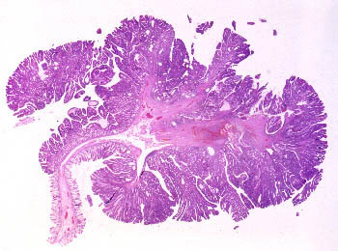
Colon, pedunculated adenomatous polyp
Are all polyps neoplastic? No. Polyps can result from focal hyperplasia of the mucosa. Hyperplastic polyps do not have malignant potential
What variables determine the likelihood of malignant change in a polyp? Three interrelated features determine the risk of cancerous transformation: polyp size, histologic architecture, and severity of dysplasia.
(1) Cancer is rare in tubular adenomas less than 1 cm in diameter.
(2) The likelihood of cancer is high (about 50%) in sessile villous adenomas that are greater than 4 cm in diameter.
(3) Severe dysplasia is likely to progress to cancer. Such dysplasias are found in villous areas. Of all these, size is the most important factor.

Slide 32
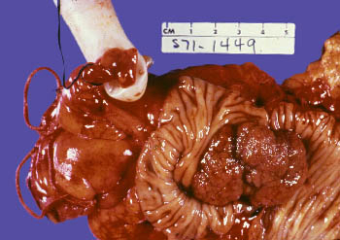
What types of mutations are likely to be present in such a lesion? There is progressive accumulation of mutations during the conversion of adenomas to carcinomas. In this scheme, mutations of the APC gene (resulting in homozygous loss of this tumor suppressor gene) are believed to occur first. (Patients with familial adenomatous polyposis syndrome are born with loss of one copy of the APC gene in all somatic cells.) As the adenomas enlarge, mutations in the RAS proto-oncogene and LOH 18q (Smad4) tumor suppressor genes occur. Eventually, mutations of TP53 and several other genes are superimposed.
In this large sessile villous adenoma, it is likely that the APC, LOH 18q, and RAS genes have been affected.

