Slide 1
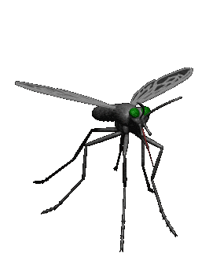
Antiprotozoal /Antimalarial drugs
Dr. Osama
Dr. Aliah
Notes:
Antiprotozoal, more specifically drugs to treat MALARIA

Slide 2
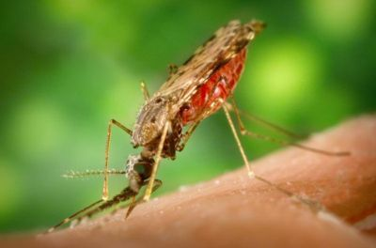
Antimalarial drugs
ilos
Classify the main antimalarial drugs depending on their goal of therapy
Detail the pharmacokinetics & dynamics of main drugs used to treat attack or prevent relapses
State the WHO therapeutic strategy for treatment
Hint on the CDC recommendations for prophylaxis in travelers to endemic areas.

Slide 3
According to WHO:
212 million cases of malaria worldwide in 2015 & 429,000 deaths.
90% of malaria cases & deaths occur in Africa.
Children under 5 are most at risk.
Four species of plasmodium typically cause human malaria:
Plasmodium falciparum,
P vivax,
P malariae, and
P ovale.
Notes:
There were
Although disease burdens have been lowered in the last 5 years, malaria remains endemic in over 100 countries. So it is the most important parasitic disease of humans & causes hundreds of millions of illnesses per year.
Malaria is an acute infectious disease caused by 4 species of plasmodium
Although all of the latter species may cause significant illness, P falciparum is responsible for the majority of serious complications & deaths.
P falcip is the most dangerous species
Vivax cause milder form of the disease
P malaria is common to many tropical regions (The tropics are the region of the Earth near to the equator) like N, central & S America, Carabean, central Africa
Ovale rarely
Malaria common areas:
large areas of Africa and Asia.
Central and South America.
Haiti & the Dominican Republic.
parts of the Middle East.
some Pacific islands.

Slide 4
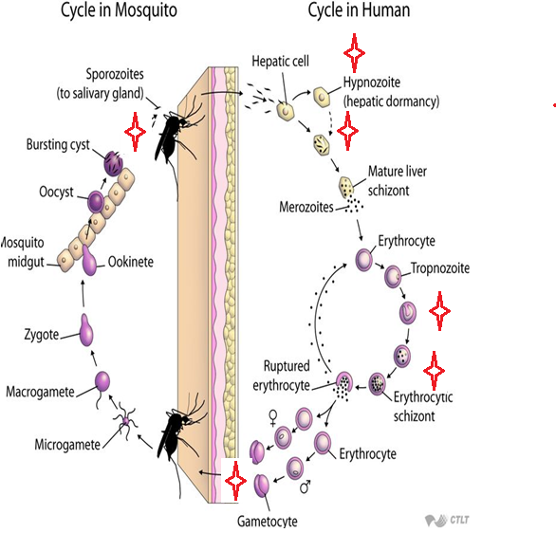
Cycle & Drugs site
of action
Causal
prophylaxis
Radical
cure
Clinical
cure
Supressive
prophylaxis
Sporozoitocides
Gametocides
Notes:
Mosquito is the main cause of plasmodium transmission, or blood transfusion & organ transplant.
Plasmodium parasite has 2 hosts
1- An infected mosquito inject sporozoites present in its salivary gland
The parasite’s life cycle in humans occurs in 2 stages (liver & blood)
2- Circulating sporo rapidly invade liver cells (A) to initiate human infection. Parasites multiply in hepatocytes & eventually cause them to rupture
schizonts mature in the liver
It stays dormant for several weeks & sometimes months
3- Merozoites are subsequently released from the liver & invade erythrocytes (B). Fever, chills muscle pain
Only erythrocytic parasites cause clinical illness. In erythrocytes meroz become tropn w multiplicate into schiz causing rupture of RBCs then into gametocytes either m or f in erythrocytes which are taken up by another mosquito, where they develop zygote into infective sporozoites.
Then again mosquito can take blood meal & ingest gametocytes during blood meal.
(C) Sporogonic cycle microgametocytes mature into oocyst ….> rupture ….> infective sporozoites.

Slide 5
Antimalarial drugs
Therapeutic classification:
Causal prophylaxis
Destroys parasite in liver cells & prevent invasion of erythrocytes
Primaquine
Suppressive prophylaxis
Suppresses the erythrocytic phase & thus attack of malaria fever
Chloroquine, mefloquine, doxycycline
Notes:
Causal prophylaxis: These act early on the liver stage & prevent the hypnozoite formation.
Blood stage prophylaxis are drugs that act only on parasites within the RBCs. Suppressive can be used as prophylactics
Several classes of antimalarial drugs are available. Drugs that eliminate developing or dormant liver forms are called tissue schizonticides;
Those that act on erythrocytic parasites are blood schizonticides;
& those that kill sexual stages & prevent transmission to mosquitoes are gametocides.
No single available agent can reliably effect a radical cure, ie, eliminate both hepatic & erythrocytic stages.
Few available agents are causal prophylactic drugs, ie, capable of preventing erythrocytic infection.
However, all effective chemoprophylactic agents kill erythrocytic parasites before they increase sufficiently in number to cause clinical disease.

Slide 6
Antimalarial drugs
Therapeutic classification:
Radical cure
Clinical cure (Erythrocytic schizonticide)
Used to terminate an episode of malarial fever
Eradicate all forms of vivax from the body
Suppressive drug + hypnozoitocidal
Chloroquine, quinine, mefloquine, artemisinin
Fast acting high efficacy
Destroys gametocytes & prevent transmission
Chloroquine, quinine against vivax
Gametocidal
Primaquine, all species
Pyrimethamine, proguanil, sulfonamides
Slow acting low efficacy
Destroys sporozoites
Proguanil, pyrimethamine
Sporozoitocides
Notes:
Proguanil is a prophylactic antimalarial drug, which works by stopping the malaria parasite, Plasmodium falciparum & Plasmodium vivax, from reproducing once it is in the RBCs. It does this by inhibiting the enzyme, dihydrofolate reductase, which is involved in the reproduction of the parasite.
Pyrimethamine is an antiparasitic compound commonly used as an adjunct in the treatment of uncomplicated, chloroquine resistant, P. falciparum malaria. Pyrimethamine is a folic acid antagonist.
Chloroquine, quinine NOT gametocidal against P falciparum

Slide 7
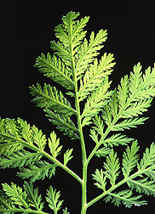
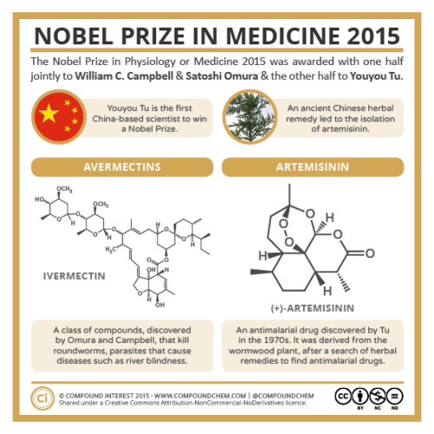
artemesinin
  Artemisinin is the active principle of the plant Artemisia annua (qinghaosu)
  Fast acting blood Schizontocide
Affect all forms including multi-drug resistant P. falciparum
  Short duration of action
  High recrudescence rate after short-course therapy
  Poorly soluble in water & oil, can only be used orally.
Notes:
herbal medicine that has been used as an antipyretic in China for over 2000 years.
The term for recurrence of infection with other species, P. falciparum, P. malariae and P. knowlesi, which lack hypnozoites, is "recrudescence", meaning that the infection (unless a new infection) has recurred from persistent blood stages of the malaria parasite. This, therefore, means that "recrudescence" can also occur with P.vivax and P.ovale infections when such parasites have also persisted in the blood. P. malariae can persist as a low-level, normally asymptomatic erythrocytic infection in humans for up to 40 or 50 years.
unacceptably high recrudescence rates after short-course therapy, which were reversed by inclusion of longer-acting drugs. Combination therapy also helps to protect against the selection of artemisinin resistance.

Slide 8
pharmakokinetics
Rapidly biotransformed in liver into di-hydroartesimininactive metabolite
Artemisinin, artesunate, artemether are prodrugs
Derivatives are rapidly absorbed orally & Widely distributed
Artemisinin t½  4 hrs
Artesunate t½ 45 min (water-soluble; oral, IV, IM, rectal administration)
Artemether t½ 4-11 hrs, (lipid-soluble; oral, IM, & rectal administration). Induce its own CYP-mediated metabolism→ ↑ clearance 5 fold.
Notes:
Analogs have been synthesized to increase solubility & improve antimalarial efficacy.
The most important of these analogs are artesunate (water-soluble; oral, IV, IM, & rectal administration),
artemether (lipid-soluble; oral, IM, & rectal administration), &
dihydroartemisinin (water-soluble; oral administration).
Recommended by who in acute uncomplicated resistant P falciparum malaria.

Slide 9
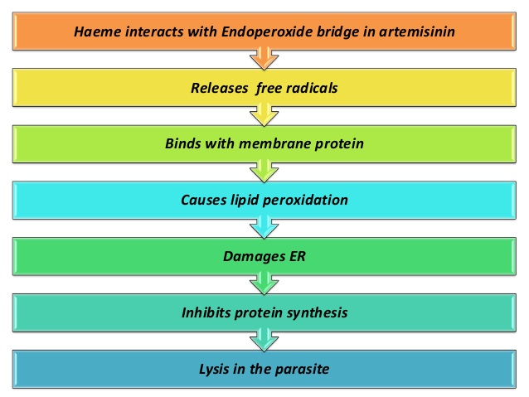
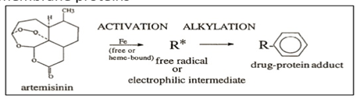
Artemesinin & its derivatives
mechanism
Artemisinin & its analogs are very rapidly acting blood schizonticides against all human malaria parasites. No effect on hepatic stages.
They have endoperoxide bridges
Haem iron cleaves this bridge to yield carbon- centered free radicals in parasite, that will
Alkylate membranes of parasite’s food vacuole & mitochondria no energy
Irreversibly bind & inhibit sarco-endoplasmic reticulum Ca²⁺-ATPase of the parasite, thereby inhibiting its growth
Inhibiting formation of transport vesicles no food vacuoles.
Notes:
It has a uniqe chemical str bec of the 2 O2 attached to each other
Iron in the blood cause reduction of the 2 O2 causing carbon centered free radical
Attack the food vacule itsef
& here attack the transport vesicles

Slide 10
artemesinin
Clinical uses
Because artemisinin derivatives have short t½,
Monotherapy should be extended beyond disappearance of parasite to prevent recrudescence or
by combining the drug with long- acting antimalarial drugs (Ex. mefloquine)
preparations
Artesunate IV or IM preparations for severe complicated cases as cerebral malaria (24 h) followed by complete course of ACT.
Notes:
24 h only

Slide 11
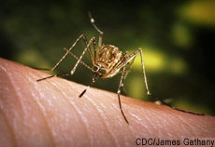
artemesinin
preparations
Artemisinin-based combination therapies (ACTs):
  Artemether + lumefantrine
  Artemether + amodiaquine
  Artemether + mefloquine
  Artemether + sulfadoxine- pyrimethamine.
Notes:
co-formulated artemisinin-based combination therapies are recommended to
1- improve efficacy & 2- prevent the selection of artemisinin resistant parasites.
Lumefantrine is an antimalarial drug. It is only used in combination with artemether. Lumefantrine has a much longer half-life compared to artemether & so is therefore thought to clear any residual parasites that remain after combination treatment.
Amodiaquine is a medication used to treat malaria, including P falciparum malaria when uncomplicated. It is recommended to be given with artesunate to reduce the risk of resistance. Due to the risk of rare but serious side effects, it is not generally recommended to prevent malaria.
Sulfadoxine/pyrimethamine, sold under the brandname Fansidar, is a combination medication used to treat malaria. It contains sulfadoxine (a sulfonamide) & pyrimethamine (an antiprotozoal). For the treatment of malaria it is typically used along with other antimalarial medication such as artesunate. But there is high resistance.

Slide 12
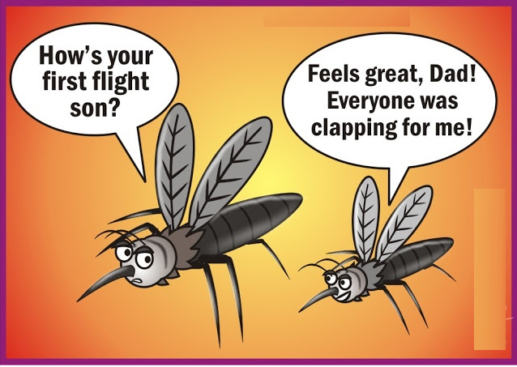
artemesinin
ADRs
Transient heart block
↓ Neutrophil count (rare)
Brief episodes of fever
Resistance  was reported recently in Cambodia- Thailand border.
Notes:
Neutropenia: is an abnormally low level of neutrophils.. Neutrophils are a common type of WBCs important to fighting off infections — particularly those caused by bacteria. For adults, counts of less than 1,500 neutrophils /uL of blood are considered to be neutropenia.

Slide 13
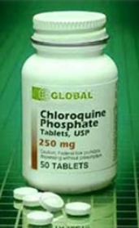
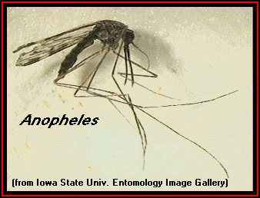
Antimalarial drugs
chloroquine
Potent blood Schizontocide
Active against all forms of the schizonts (exception is chloroquine-resistant P.f. & P.v.)
Not active against tissue shizonts
  Gametocide:-Against all species except P. falciparum.
Notes:
Cheap, safe & good efficacy
It was the drug of choice in tr of malaria since the 1940s
Only central America is not resistant
chloroquine is a highly effective blood schizonticide

Slide 14
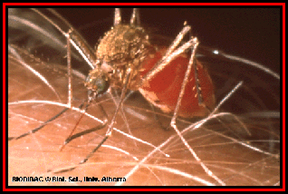
chloroquine
pharmacokinetics
  Rapidly & completely absorbed from the GIT, given po
  Has high volume of distribution (100-1000 L/kg); Released slowly from tissues & metabolized in liver
Concentrated into parasitized RBCs
  Excreted in the urine 70% unchanged
  Initial t½ = 2-3 days & terminal elimination t½=1-2 months.
Notes:
Stays in tissues
It has 2 compartment model, distributed from high perfused tissue into low perfused like muscle/bone.

Slide 15
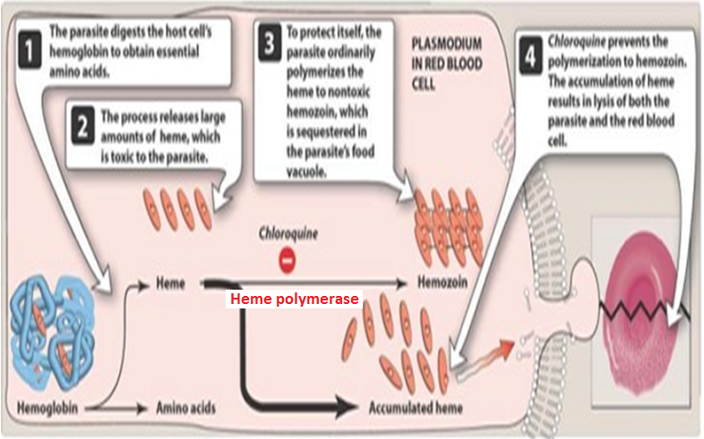
chloroquine
Mechanism of action
Malaria Parasite digest host cell’s Hb to utilize globin & obtain amino acids
Heme is released  Toxic
So parasite detoxifies it by heme polymerase  Hemozoin (NonToxic) & traps it in food vacuoles.
Notes:
The drug probably acts by concentrating in parasite food vacuoles, preventing the biocrystallization of the hemoglobin breakdown product, heme, into hemozoin, & thus eliciting parasite toxicity due to the buildup of free heme.
3 drugs : Chloroquine, Quinine, & mefloquine (-) heme polymerase

Slide 16
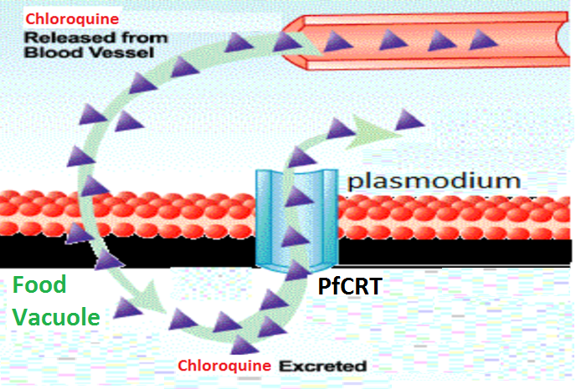
chloroquine
resistance
Resistance against the drug develops as a result of mutation of the chloroquine resistance transporter (PfCRT)
PfCRT enhances the efflux of chloroquine from the food vacuole.
Notes:
Transporter inside the parasite
So this will clear the drug out of the parasite
CCB are drugs inhibit this transporter experimentally only

Slide 17
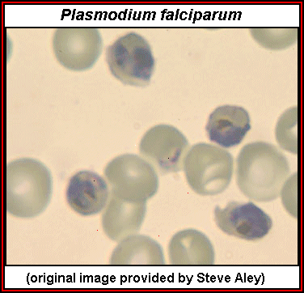
chloroquine
Therapeutic uses
Used to eradicate blood schizonts of Plasmodium. It is given in loading dose to rapidly achieve effective plasma conc.
Hepatic amebiasis
Rheumatoid arthritis.
Notes:
It rapidly terminates fever (in 24–48 hours) & clears parasitemia (in 48–72 hours) caused by sensitive parasites.
Chloroquine has been replaced by other drugs, principally ACTs, as the standard therapy to treat f malaria in most endemic countries. Chloroquine does not eliminate dormant liver forms of P vivax and P ovale, & for that reason primaquine must be added for the radical cure of these species.
Against all types of plasmodium except resistant strains
Other uses:
Chloroquine reaches high liver concentrations & may be used for amebic abscesses that fail initial therapy with metronidazole.
Chloroquine & hydroxychloroquine are nonbiologic drugs mainly used for malaria & in the rheumatic diseases.
The following mechanisms have been proposed: suppression of T-lymphocyte responses to mitogens, inhibition of leukocyte chemotaxis, stabilization of lysosomal enzymes, processing through the Fc-receptor, inhibition of DNA & RNA synthesis, & the trapping of free radicals.
Pharmacokinetics: Antimalarials are rapidly absorbed & 50% protein-bound in the plasma. They are very extensively tissue bound, particularly in melanin-containing tissues such as the eyes. The drugs are deaminated in the liver & have blood elimination half-lives of up to 45 days.

Slide 18

chloroquine
adrs
Mild headache & visual disturbances
GIT upsets; Nausea, vomiting
Pruritus, urticaria.
Prolonged therapy & high doses:
Ocular toxicity: Loss of accommodation, lenticular opacity, retinopathy
Ototoxicity
Weight loss
Bolus injection→ hypotension & dysrrhythmias
Safe in pregnancy
Notes:
Has high volume of distribution (100-1000 L/kg); Released slowly from tissues especially in the eye (SE)
Pruritus means itching (and not necessarily a rash) while urticaria (hives) refers to an itchy rash that is raised, red, round to oval lesions that come & go.
Prolonged tr as in the case of rhematoid arthritis
Opacity is the measure of impenetrability to electromagnetic or other kinds of radiation, especially visible light. lenticular opacity: cataract, opacity is confined to the lens. So monitoring of eyes q 6 months is important
تعتيم عدسة العين
Bolus is not recommended
To tr malaria it is used usually for 3 days

Slide 19
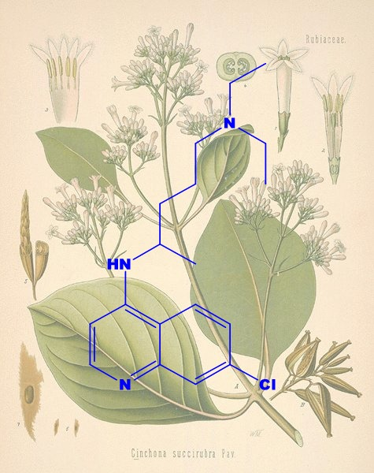
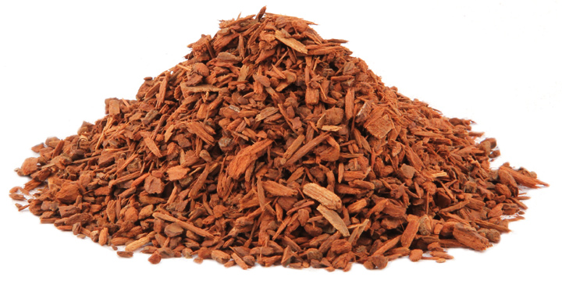
QUININE
  The main alkaloid in cinchona bark
  Potent blood Schizontocide of ALL malarial parasites & gametoside for P vivax & ovale but not falciparum. It is Not active against liver stage parasites.
  Depresses the myocardium, reduce excitability & conductivity
  Mild analgesic, antipyretic, stimulation of uterine smooth muscle, curare mimetic effect.
Notes:
Quinine is derived from the bark of the cinchona tree, a traditional remedy for intermittent fevers from South America
Curare is an example of a non-depolarizing muscle relaxant that blocks the nicotinic acetylcholine receptor (nAChR), one of the 2 types of acetylcholine (ACh) receptors, at the neuromuscular junction.
Quinidine (D) isomer of quinine used in arrhythmia

Slide 20
QUININE
pharmacokinetics
  Rapidly & completely absorbed from the GIT
  Peaks after 1-3 hours
  Metabolized in the liver & excreted in urine
  5-20% excreted in the urine unchanged
  t½ = 10 hrs but longer in sever falciparum infection (18 hrs)
  Administered: orally in a 7 day course or by slow IV for severe P. falciparum infection.
Notes:
Individuals with malaria develop higher plasma levels of the drug than healthy controls, but toxicity is not increased,
apparently because of increased protein binding.

Slide 21
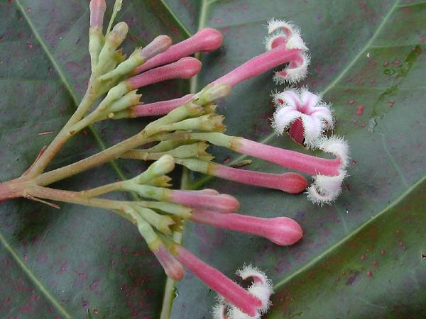
quinine
Mechanism
Same as chloroquine
Mechanism of resistance
Like chloroquine, by mutation of chloroquine resistance transporter, also increased expression of P-glycoprotein transporter.
Notes:
Quinine resistance appears to share common characteristics with chloroquine resistance.
P-glycoprotein 1 in parasite and human (permeability glycoprotein is an important protein of the cell membrane that pumps many foreign substances out of cells. While decreased efflux activity may promote disease susceptibility & drug toxicity, increased efflux activity may confer resistance to therapeutic drugs

Slide 22
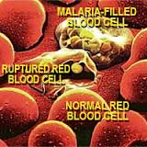
quinine
Clinical uses:
Parenteral treatment of severe falciparum malaria
Oral treatment of falciparum malaria
Nocturnal leg cramps.
Notes:
Quinidine can be administered in divided doses or by continuous IV infusion; treatment should begin with a loading dose to achieve effective plasma concentrations promptly. Because of its cardiac toxicity & the relative unpredictability of its PKs, IV quinidine should be administered slowly with cardiac monitoring. Therapy should be changed to an effective oral agent as soon as the patient has improved & can tolerate oral medications.
Can be given before sleeping but its effect is controversial. Nocturnal leg cramps are painful involuntary muscle contractions. Quinidine 1- reduces the excitability of the motor end plate to nerve stimulation & 2- increases the refractory period of skeletal muscle contraction. It has been used to treat leg cramps since 1940, usually as quinine sulphate.
?? Not very effective/ variable

Slide 23
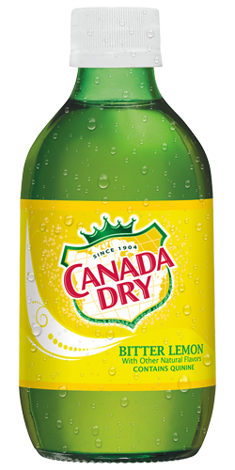
quinine
adrs
With therapeutic dose  poor compliance  bitter taste
Higher doses 
  Cinchonism  (tinnitus, deafness, headaches, nausea & visual disturbances)
  Abdominal pain & diarrhea
  Rashes, fever, hypersensitivity reactions
  Hypotension & arrhythmias, hypoglycemia
  Blood dyscarasis; anaemia, thrombocytopenic purpura & hypoprothrombinaemia (mild)
  Blackwater fever, a fatal condition in which acute haemolytic anaemia is associated with renal failure due to a hypersensitivity reaction to the drug
IV  neurotoxicity  tremor of the lips & limbs, delirium, fits, stimulation followed by depression of respiration & coma.
Safe in pregnancy
Notes:
Added to soft drinks
A constellation of symptoms termed cinchonism …
With prolonged therapy abdominal …..
Severe hypotension can follow too-rapid IV infusions of quinine or quinidine. Electrocardiographic abnormalities (QT interval prolongation) are fairly common with IV quinidine, but dangerous arrhythmias are uncommon when the drug is administered appropriately in a monitored setting.
Hypoglycemia thru stimulation of insulin release
Dyscrasias: blood disorder. Drug-induced immune thrombocytopenia (DITP) is a relatively common, sometimes life-threatening disorder, characterized by drug-dependent antibodies (DDAbs) that bind to platelets & cause their destruction when the responsible drug is ingested or injected. Less often, drug-induced antibodies target erythrocytes or neutrophils & cause immune hemolytic anemia or neutropenia.
Thrombocytopenia: platelet destruction
Blackwater fever is a complication of malaria infection in which red blood cells burst in the bloodstream (hemolysis), releasing hemoglobin directly into the blood vessels and into the urine, frequently leading to kidney failure. Quinine can stimulate uterine contractions, especially in the third trimester. However, this effect is mild, and still safe

Slide 24
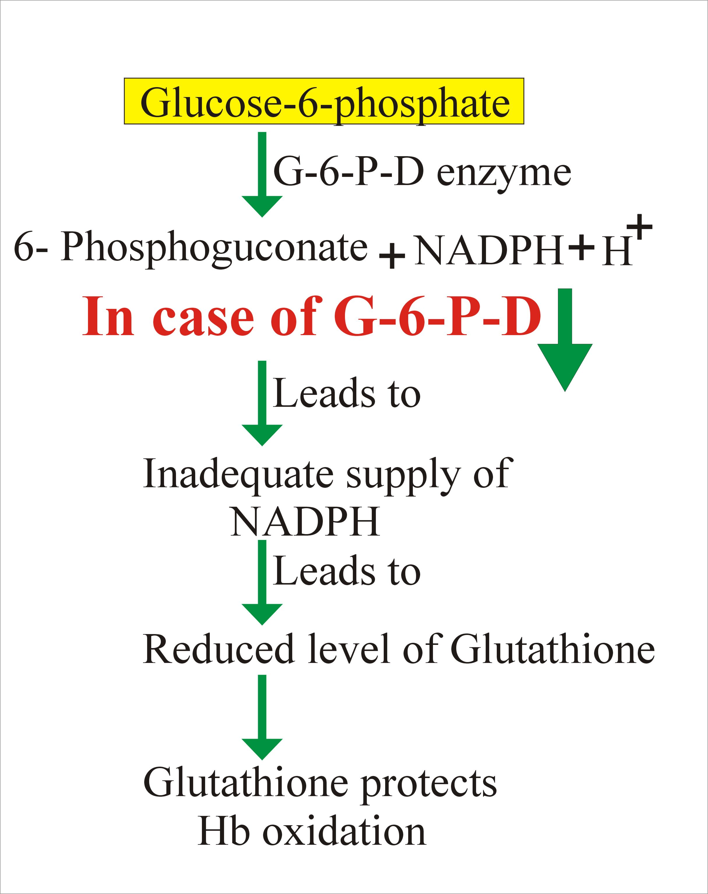
quinine
contraindications
Prolonged QT Interval
Glucose-6-Phosphate Dehydrogenase deficiency & pregnancy
Myasthenia Gravis
Hypersensitivity
Optic Neuritis, auditory problems
Dose should be reduced in renal insufficiency.
Notes:
It must be used with great caution in those with underlying cardiac abnormalities. Q can not be used in patient with cardiac abnormality because of quin can cause dysrhythmia
Hematologic abnormalities include hemolysis (especially with G6PD deficiency), leukopenia, agranulocytosis, & thrombocytopenia.
Q should be discontinued if signs of severe cinchonism, hemolysis, /hypersensitivity occur. It should be avoided if possible in patients with optic neuritis underlying visual /auditory problems, because it can exacerbate these conditions.
G6P + NADP by G6P dehydrogenase form NADPH. The NADPH in turn maintains the level of glutathione in these cells that helps protect the RBCs against oxidative damage from compounds like hydrogen peroxide.
Glucose-6-PD deficiency is a genetic disorder occurs almostly in males. This condition mainly affects RBCs. In affected individuals, a defect in an enzyme called glucose-6-PD causes RBCs to break down prematurely. This destruction of RBCs is called hemolysis. Patients with G6PD deficiency have higher risk of developing hemolytic anemia.
Q has neuromuscular blocking effect. Myasthenia gravis is a chronic autoimmune neuromuscular disease that causes weakness in the skeletal muscles, which are responsible for breathing & moving parts of the body, including the arms & legs. Myasthenia gravis, which is Latin and Greek in origin, means "grave, or serious, muscle weakness."
The hallmark of myasthenia gravis is muscle weakness that worsens after periods of activity & improves after periods of rest. Q is CI because it decreases the excitability of the motor end-plate region, thereby reducing responses to repetitive nerve stimulation by Ach, & inducing muscle weakness that may lead to respiratory distress.

Slide 25
quinine
Drug interactions
Antacids: Antacids containing aluminum &/or magnesium may delay or decrease absorption of quinine
Mefloquine
Quinine can raise plasma levels of warfarin & digoxin.
Notes:
Mefloquine is effective therapy for many chloroquine-resistant strains of P falciparum & against other species. Although toxicity is a concern, mefloquine is one of the recommended chemoprophylactic drugs for use in most malaria-endemic regions with chloroquine resistant strains.
DI with meflo because it also increase & prolong QT interval like Quin.
3- Q displace warfarin & digoxin of plasma protein & inh their excretion.

Slide 26
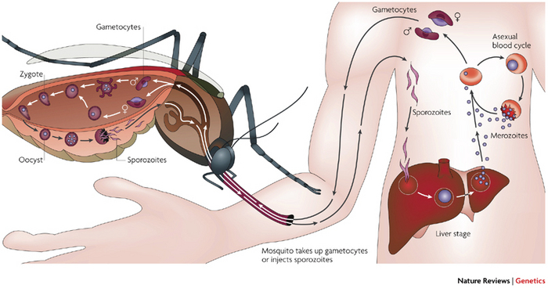
primaquine
  Hypnozoitocides against liver hypnozoites & gametocytocides against the 4 human malaria species
  Radical cure of P. ovale & P. vivax
  Prevent spread of ALL forms (chemoprophylaxis)
pharmacokinetics
  Well absorbed orally
Rapidly metabolized to etaquine & tafenoquine  more active forms
t½  3-6 h.
Notes:
Primaquine is active against hepatic stages of all human malaria parasites. It is the only available agent (drug of choice) active against the dormant hypnozoite stages of P vivax and P ovale. The drug is also gametocidal against the four human malaria species & it has weak activity against erythrocytic stage parasites.
Primaquine is the drug of choice for the eradication of dormant liver forms of P vivax & P ovale & can also be used for chemoprophylaxis against all malarial species.

Slide 27
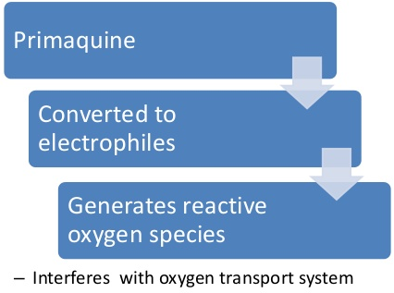
primaquine
mechanism
Not well understood, It may be acting by:-
Generating ROS  can damage lipids, proteins & nucleic acids in the parasite
Interfering with the electron transport  no energy
Inhibiting formation of transport vesicles no food vacuoles
Resistance;  Rare when primaquine & chloroquine are combined.
Notes:
Primaquine is an oxidative agent
an electrophile is free radicle, a reagent attracted to electrons. The electrophiles are attacked by the most electron-populated part of one nucleophile. The electrophiles frequently seen in the organic syntheses are cations such as H⁺ & NO⁺, polarized neutral molecules such as HCl, alkyl halides, acyl halides, & carbonyl compounds, polarizable neutral molecules such as Cl₂ and Br₂, oxidizing agents such as organic peracids, chemical species that do not satisfy the octet rule such as carbenes and radicals, and some Lewis acids such as BH₃ and DIBAL. attracted to electrons

Slide 28
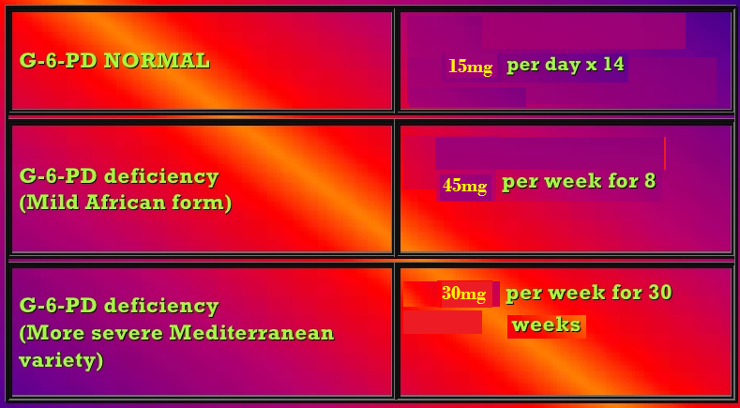
Antimalarial drugs
primaquine
Clinical uses
Radical cure of relapsing malaria, 15 mg/day for 14 days
In falciparum malaria: a single dose (45 mg) to kill gametes & cut down transmission
Should be avoided in pregnancy (the fetus is relatively G6PD-deficient & thus at risk of hemolysis) & G6PD deficiency patients
Notes:
Therapy (radical cure) of acute vivax and ovale malaria—Standard therapy for these infections includes: START with chloroquine to eradicate erythrocytic forms & primaquine to eradicate liver hypnozoites & prevent a subsequent relapse. Chloroquine is given acutely, & therapy with primaquine is withheld until the G6PD status of the patient is known. If the G6PD level is normal, a 14-day course of primaquine is given. Prompt evaluation of the G6PD level is helpful, since primaquine appears to be most effective when instituted before completion of dosing with chloroquine.
G-6PD deficiency >> decrease in NADPH & GSH synthesis, making the cells > sensitive to oxidative agents such as primaquine this casue hemolysis.

Slide 29
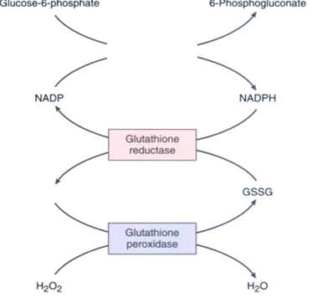
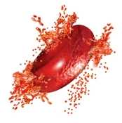
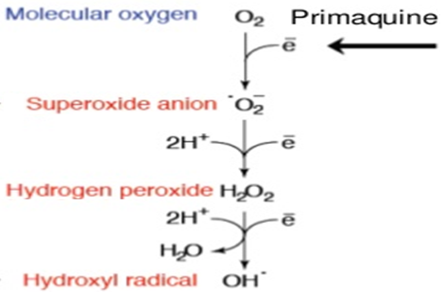
primaquine
adrs
At regular doses  patients with G-6-PD deficiency  hemolytic anemia.
Oxidation of primaqune produces free radicals
G6PD
Free radicals will cause oxidative damage of RBCs →Hemolysis
At larger doses 
Epigastric distress & abdominal cramps
H₂O₂ oxidizes GSH
Mild anemia, cyanosis & methemoglobinemia
GSH
Severe methemoglobinemia  rarely in patients with deficiency of NADPH methemoglobin reductase
Maintains integrity of RBCs
Granulocytopenia & agranulocytosis  rare.
Notes:
G6PD is important to to protect GSH in reduced form which is imp for RBCs integrity
Abdominal cramps especially if taken on empty stomach
Cyanosis is defined as the bluish or purplish discolouration of the skin or mucous membranes due to the tissues near the skin surface having low oxygen saturation.
Methemoglobin is a form of the oxygen-carrying metalloprotein hemoglobin, in which the iron in the heme group is in the Fe³⁺ (ferric) state, not the Fe²⁺ (ferrous) of normal hemoglobin. Methemoglobin cannot bind oxygen, unlike oxyhemoglobin. Methemoglobinemia (congenital or acquired) occurs when RBCs contain methemoglobin at levels higher than 1%. This results in a decreased availability of oxygen to the tissues. Methemoglobin reductase, also called "diaphorase," and more properly called cytochrome b5 reductase, is the enzyme within the erythrocyte that maintains hemoglobin in the reduced (non-methemoglobin) state.
Granulocytopenia: A marked decrease in the number of granulocytes. Granulocytes are a type of wBC filled with microscopic granules that are little sacs containing enzymes that digest microorganisms.

Slide 30
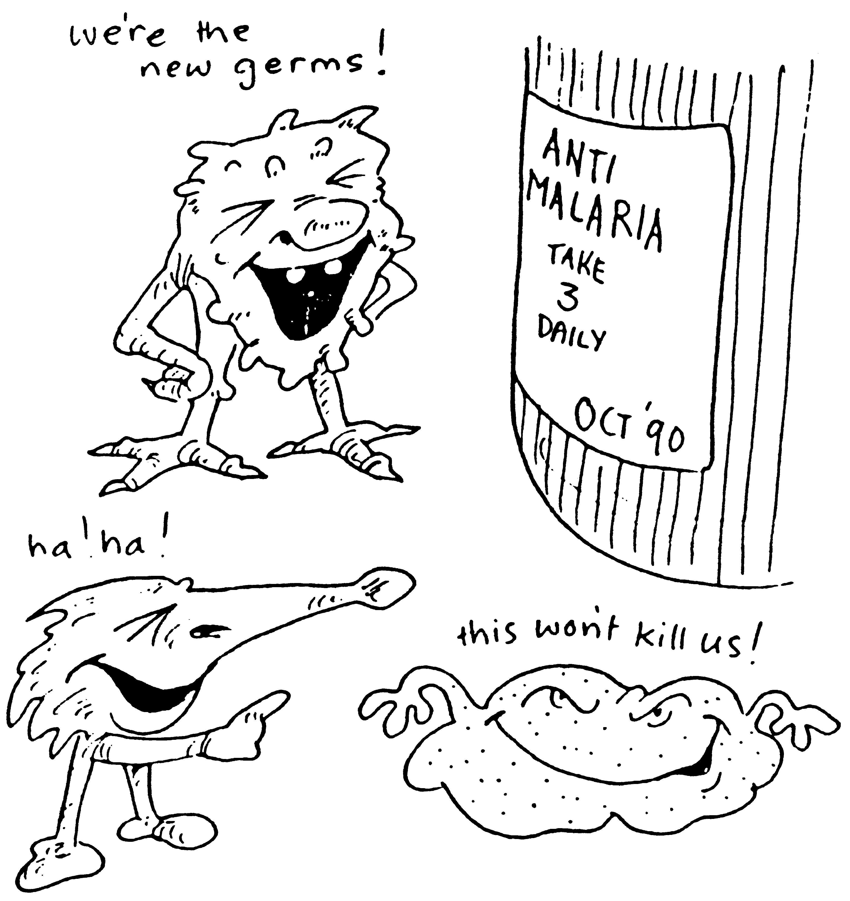
Who treatment guidelines
In P vivax
sensitive
Chloroquine for 3 days followed by Primaquine for 14 days
In P falciparum
All show Resistance
resistant
ACT / 3 days followed by Primaquine for 14 days
uncomplicated
ACT
complicated
IV Artesunate for 24 hrs followed by ACT
Or Artemether + [Clindamycin / doxycycline]
Or Quinine + [Clindamycin / doxycycline]

Slide 31
Who treatment guidelines
In falicparum
Special risk groups
Pregnancy; 1st trimester
Quinine + Clindamycin (7 days)
Pregnancy; 2nd & 3rd trimester
Lactating women
Infants & young children
ACT

Slide 32
Prophylaxis in travellers
Cdc recomendations
Chloroquine
Areas without resistant P falciparum
Mefloquine
Areas with chloroquine-resistant P falciparum
Doxycycline
Areas with multidrug-resistant P falciparum
Begin 1-2 weeks before departure (except for doxycycline 2 days) & continue for 4 weeks after leaving the endemic area.
Notes:
When patients are counseled on the prevention of malaria, it is imperative to emphasize measures to prevent mosquito bites (eg, with insect repellents, insecticides, & bed ets), because parasites are increasingly resistant to multiple drugs & no chemoprophylactic regimen is fully protective.
Current recommendations from the Centers for Disease Control & Prevention (CDC) include the use of chloroquine for chemoprophylaxis in the few areas infested by only chloroquine-sensitive malaria parasites (principally Hispaniola & Central America west of the Panama Canal), & mefloquine, Malarone,* or doxycycline for most other malarious areas, with doxycycline preferred for areas with a high prevalence of multidrug-resistant falciparum malaria (principally border areas of Thailand).
CDC recommendations should be checked regularly (Phone: 770-488-7788; after hours 770-488-7100; Internet: http://www.cdc.gov/malaria), because these may change in response to changing resistance patterns & increasing experience with new drugs. In some circumstances, it may be appropriate for travelers to carry supplies of drugs with them in case they develop a febrile illness when medical attention is unavailable.
TCN is slow but potent action on erythrocytic stage of all malaria parasites & preerythrocytic stage of P falciparum. Always used in combination with Q or in chroq resistant malaria.
So if the patient is in sensitive areas (south east Asia & central America) we tr with Chloroq. Areas with multidrug resistant : Africa

Slide 33
