Slide 1
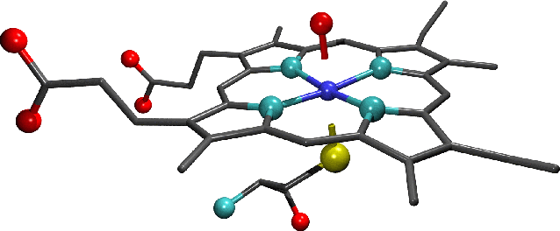
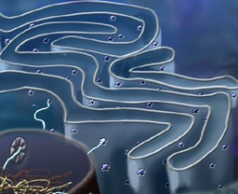
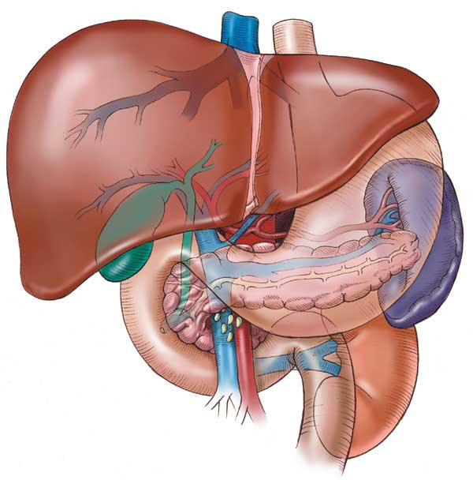
CYTOCHROME SYSTEM
&
DRUG METABOLISM

Slide 2
CYTOCHROME SYSTEM
&
DRUG METABOLISM
Revise the aim & phases of drug metabolism
Define the role of cytochrome system in relation to drug metabolism
Expand on the nature, location, nomenclature, structure, distribution & function of CYT P450
Focus on its regulation; directly & indirectly, its induction & inhibition its relevance to drug interactions
Interpret the molecular mechanism of interactions by CYT P450
Classify its different isoforms, their substrates, inducers & inhibitors
Delineate some of its genetic variations.

Slide 3
RENAL Elimination
Being mostly lipophylic ➔ The liver subjects them to chemical transformation (METABOLISM) ➔ to become inactive & easily EXCRETED.
Polar product
Non-Polar product
Identified as foreign substances that body must get rid of
BILIARY Elimination
?
DRUG METABOLISM
Occurs mainly in the
“METABOLIC CLEARING HOUSE"

Slide 4
Inactive product
Active metabolite;
Similar to parent
More active than parent
A product with different effect
Toxic metabolite
“ Cytochrome P450“ “ CYT 450” superfamily is the terminal rate limiting oxidase of this system
?
Phase II
CONjUGATION
Create a conjugation site
Phase I
OXIDATION /Reduction/Hydrolysis
Its enzymes are part of a cascade
➔ transfers electrons from molecular oxygen to oxidize the drugs
CYTOCHROME SYSTEM
DRUG METABOLISM

Slide 5
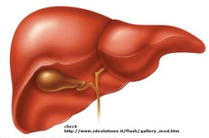
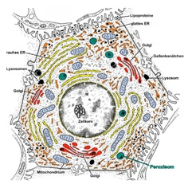
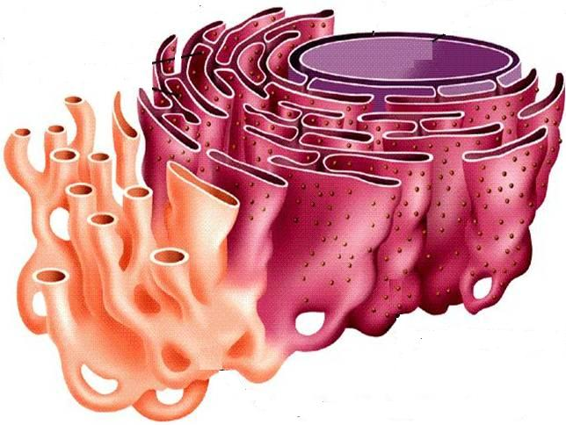
CYTOCHROME P450 FAMILY OF ENZYMES.
They are located mainly attached to the smooth endoplasmic reticulum (SER) of hepatocytes.
“Cytochrome" = colored cells
They color the liver cells dark red as they contain iron
"P450“ absorbs a very characteristic wavelength (450 nm) of UV light when it is exposed to carbon monoxide.
They are isolated in the subcellular fraction termed the MICROSOMES
➔ Liver microsomal enzymes

Slide 6
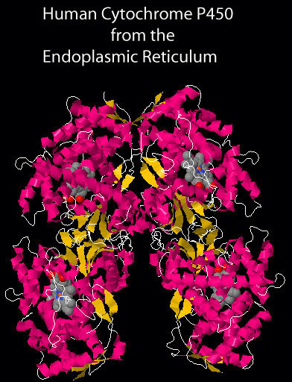
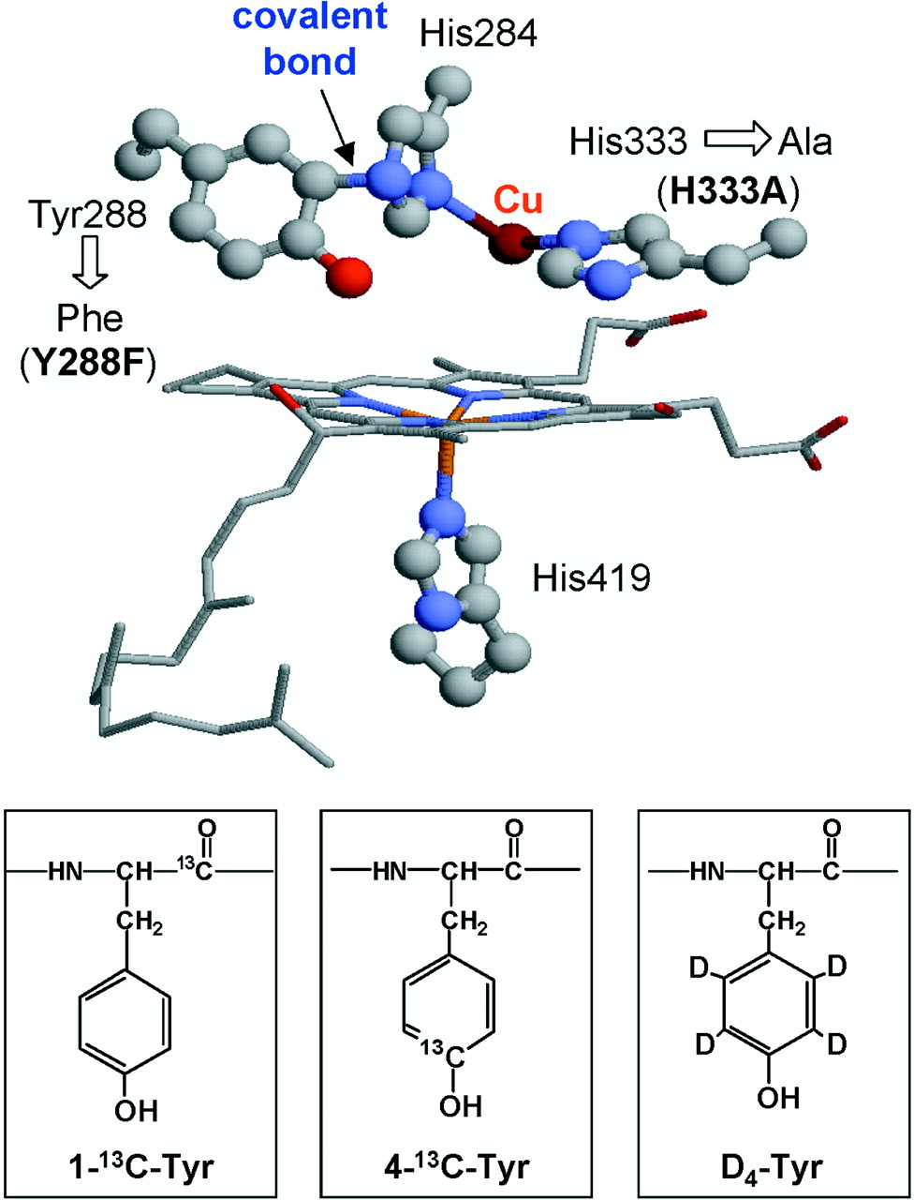
STRUCTURE
They are heme-containing isoenzymes
O₂
N₃
Su
Fe
haem
DISTRIBUTION
Highly concentrated in hepatocytes
Enterocytes of the small intestine present their principal extra-hepatic source
Very small quantities in kidneys, lungs & brain.

Slide 7
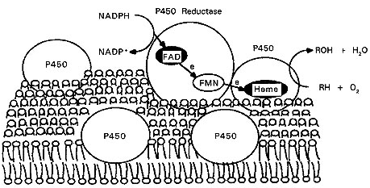
Function
Responsible for most of the OXIDATIVE METABOLISM of:
Endogenous substances: steroid hormones, prostaglandins, lipids, & fatty acids
Exogenous compounds: diet (food & beverages) / Drugs/ environmental xenobiotics.
Substrates
P450 Reductase
CYT P450 Oxidase

Slide 8
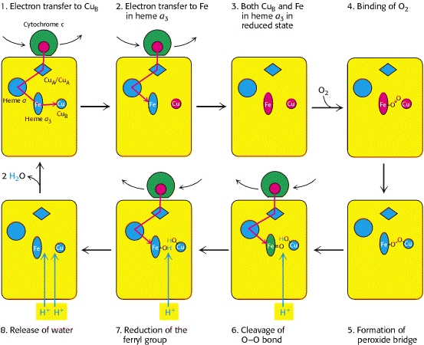
ABCDEFG HIJKLMNOP

Slide 9
Regulation
Activation or Inactivation of the CYT P450 can be achieved either
A: Directly
B : Indirectly by expression or repression of its relevant genes by
activation or inhibition of the
responsible transcription factors
Activation or Inactivation can be
processed be any food, intrinsic products or extrinsic xenobiotics as drugs (usually the lipophylic ) that have to be metabolized.

Slide 10
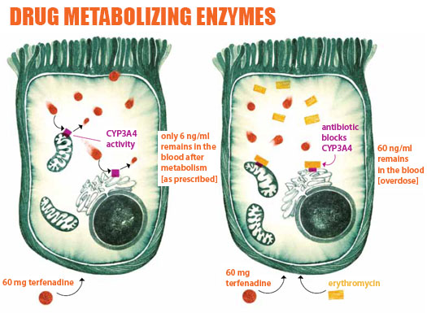
Regulation
When drugs play a role in regulation of the CYT P450 they are termed
Enzyme Inducers if Activate the enzyme
Enzyme Inhibitors if Inactivate the enzyme
PHARMACOKINETIC DRUG-DRUG INTERACTION
?

Slide 11
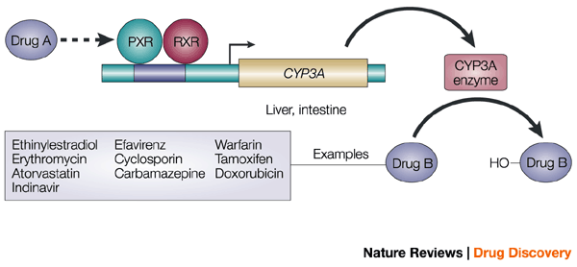
Molecular Basis Of Drug–drug Interaction
Regulation
The orphan nuclear receptor PXR is a TRANSCRIPTION FACTOR that regulates the expression of the CYP P450 genes.
If Drug A is INDUCER  it binds & activates PXR  which translocates in nucleus dimerize with RXR  the heterodiamer PXR / RXR will induce EXPRESSION of CYT P450 isoenzymes to metabolism of Drug B
If Drug A is an INHIBITOR, its binding will prevent activation  REPRESSION of CYT P450 isoenzymes to metabolism of Drug B
PXR, pregnane X receptor
RXR, retinoid X receptor.

Slide 12
Outcome Of Drug-drug Interactions Mediated By CYT P450
Regulation
IN RELATION TO ENZ INDUCERS
metabolism of the inducer +  its pharmacological action.
Tolerance or complete nullification
 metabolism of co-administered drugs
◉ EFFICACY
IN RELATION TO ENZ INHIBITORS
/ Retard metabolism & excretion of inhibitor & co-administered drugs.
 / prolong action of the inhibitor & co-administered drugs.
TOXCICITY

Slide 13
Classification
CYT P450 has been classified into
Families designated by Numbers
Sub families designated by Letters
Distribution of
different CYPs isoforms
in the liver.

Slide 14
Major Contributor to Phase I Metabolism

Slide 15
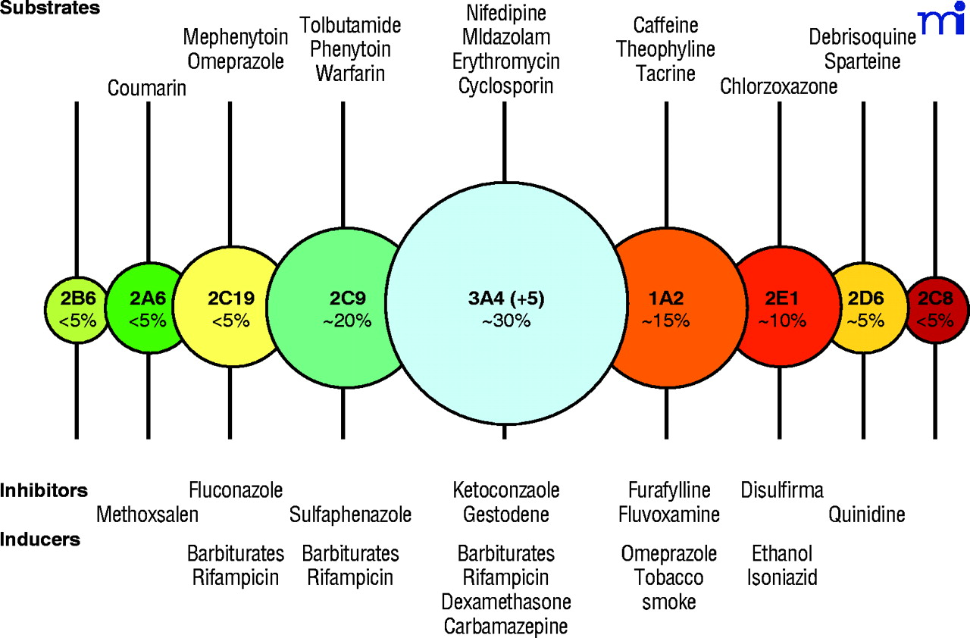
Substrate
Inhibitors
Inducers

Slide 16
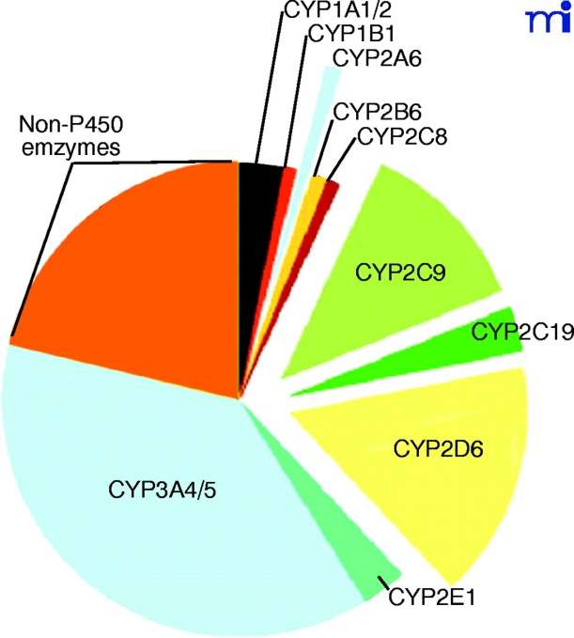
Cytochrome P450 3A4

Slide 17
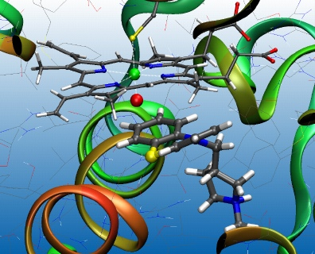
Cytochrome P450 2D6

Slide 18
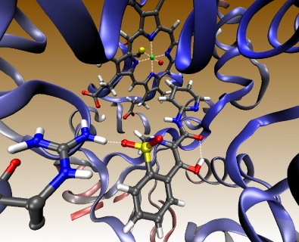
Cytochrome P450 2C9

Slide 19
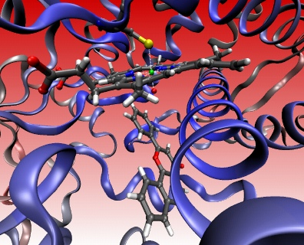
Cytochrome P450 1A2

Slide 20
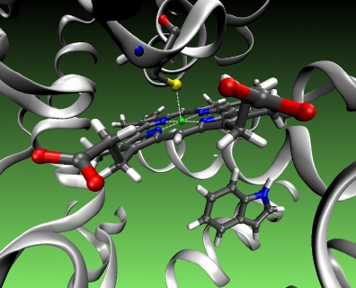
Cytochrome P450 2C 19

Slide 21
CYT P450 3A4
Substrates
Immunosuppressants
Cyclosporine
Azole Antifungals
Fluconazole
Antibiotics
Erythromycin, Clarithromycin
Ca channel blockers
Amlodepine, Verapamil
Statins; Atorvastatin
Amidarone
Cancer Chemotherapy:
Cyclophosphamide, Tamoxifen
Non-Sedating Antihistaminics
Astamizole
Benzodiazipines
Midazolam, Clonazepam
Inducers
Protease Inhibitors
Ritonavir
Cimetidine
Chloramphenicol
Nefazadone
Grape Fruits
Inhibitors
Phenytoin
Carbamazepine
Barbiturates
Rifampicin
Dexamethazone
Progestins

Slide 22
“A 50 years old, patient was treated for the last 3 years by the hypocholestrolemic agent; atorvastatin. Yesterday he began to complain of severe muscle pains, weakness & reddish discoloration of urine
He receives daily multivitamins & his lab results last week, proved that he has become diabetic, for which he was prescribed metformin. He was also started on a course of fluconazole for a concomitant fungal infection.
From drug history, the diagnosis of his current state was likely rhabdo-myositis (severe muscloskeletal toxicity) & was verified by the lab finding of severe elevation in creatinine phosphokinase. “
Which one of the following drug-drug interaction on CYT 3A4 is the likely cause of his current state?
Metformin + Atrovastatin
Atrovastatin + Fluconazole
Metformin + Fluconazole
Fluconazole+ Multivitamins

Slide 23
Genetic Variation
Genetic polymorphisms in CYT P450 isoenzymes have been observed & are reasons behind the ALTERED RESPONSE to drug therapy
CYP2D6
This isoenzyme has the most frequent polymorphisms in all CYT P450
When polymorphism occurs   metabolizing capacity of CYP2D6
i.e those who exhibit the polymorphism become poor metabolizers:
1. Metabolism of some neuroleptics, tricyclic antidepressants, antianginals agent ( perihexiline), antiarrhythmics (propafenone & metoprolol) is suppressed  so side effects & toxicity develop. i.e.
Neuropathy after therapeutic doses of perihexiline
Bradycardias & arrhythmias on therapeutic dose of propafenone or metaprolol
2. The pro-drugs cannot be converted to their therapeutically active metabolite; e.g poor analgesia with codeine & tramadol because they are not transformed into active forms

Slide 24
Genetic Variation
CYP2C9.
Warfarin, phenytoin, & tolbutamide are examples of drugs with narrow therapeutic index that are metabolized by CYP2C9.
Clearance of these drugs is impaired in genetic variation of the enzyme
CYP2C19
Polymorphism in CYP2C19 shows increased & prolonged action of its substrates as omeprazole
This has been an advantage as in those variants   cure rates in peptic ulcer patient with Helicobacter pylori.
Benefit

Slide 25
G
O
O
D
L
U
C
K
CYTOCHROME SYSTEM
&
DRUG METABOLISM

