Slide 1
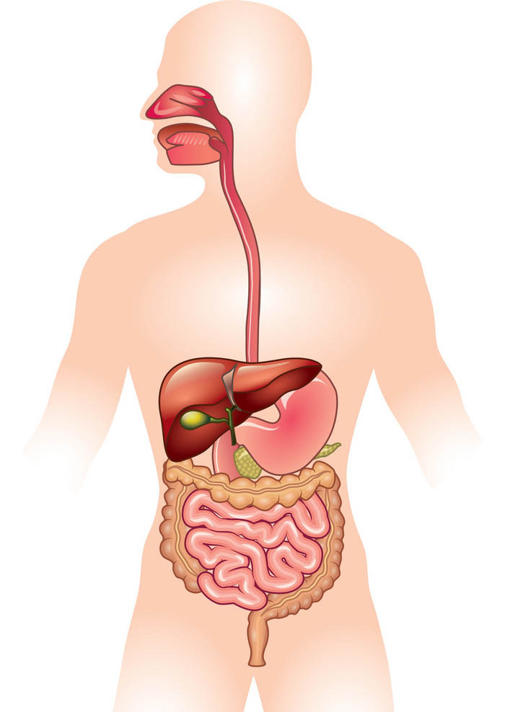
Organization and General Principles of Gastrointestinal Physiology
Dr. Maha Saja
Msaja@ksu.edu.sa

Slide 2
Objectives
Physiologic anatomy of gastrointestinal wall
The general characteristics of smooth muscle
The specific characteristics of smooth muscle
Control of gastrointestinal function (ENS)
Types of neurotransmitters secreted by enteric neurons
Functional types of movements in the gastrointestinal tract
Gastrointestinal blood flow (Splanchnic circulation)
Effects of gut activity and metabolic factors on GI blood flow

Slide 3
Introduction
What is the GI system?
What is the importance of the
GI system?

Slide 4
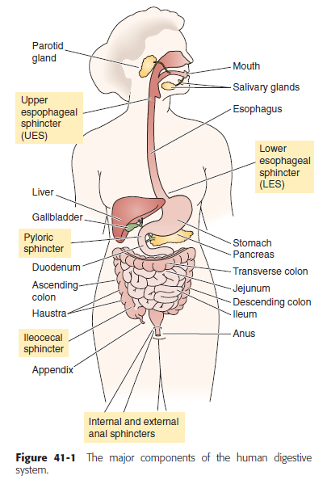
What is the GI System?
A hollow tube from mouth to anus + accessory glands and organs.
Hollow organs are separated from each other at key locations by sphincters.
(Medical physiology: a cellular & molecular approach. Edited by Walter Boron and Emile Boulpaep. 2nd Ed.

Slide 5
Functions of the GI System
The sedentary human body requires ≈ 30 kcal/Kg BW per day.
This nutrient requirement is acquired through the GI system.
The food we consume is not in a form that can be directly absorbed by the small intestine.
(Medical physiology: a cellular & molecular approach. Edited by Walter Boron and Emile Boulpaep. 2nd Ed.)

Slide 6
Functions of the GI System
The GI system processes consumed food mechanically & chemically to facilitate absorption.
Dietary nutrient | Consumed form | Absorbed form
Fat (lipids) | Triglycerides | Fatty acids Monoglycerides
Proteins | Proteins Large peptides | Amino acids
Carbohydrates | Starch Disaccharides Monosaccharides | ??

Slide 7
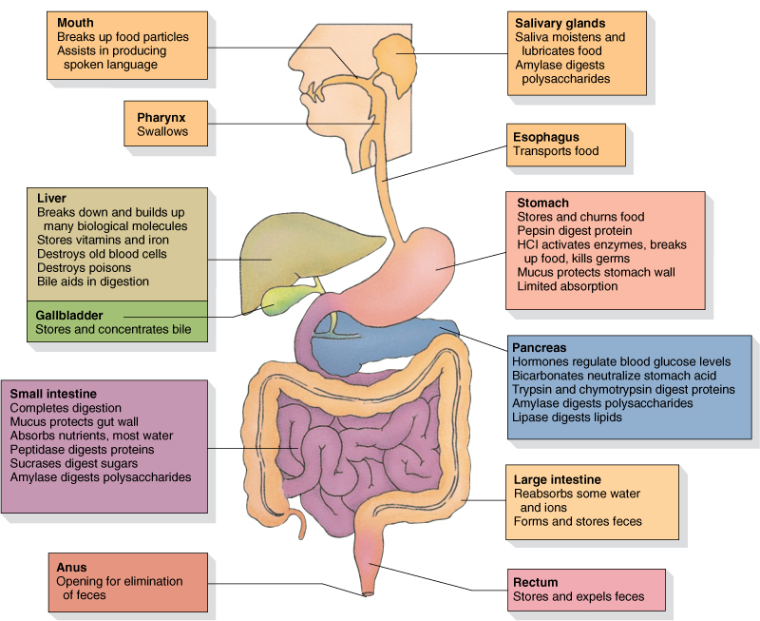

Slide 8
Functions of the GI System
Excretion of waste material.
  Non-digested non-absorbed dietary products.
  Colonic bacteria & their products.
  Heavy metals (iron & copper).
  Organic cations & anions (e.g. drugs)
Regulation of water & electrolyte balance.
Immunity.

Slide 9
Functional Anatomy of the Wall of the GIT

Slide 10
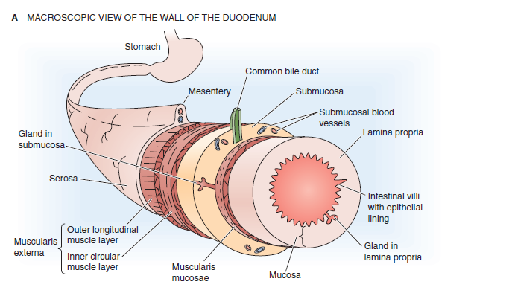
The Wall of the GI tract
The anatomy of the wall varies but there is a common general theme.

Slide 11
To understand the characteristics of the wall of the GIT, we must talk about the general characteristics of smooth muscles.
https://youtu.be/yzQAgfivX74

Slide 12
Smooth Muscle

Slide 13
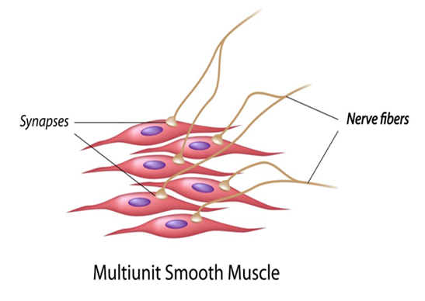
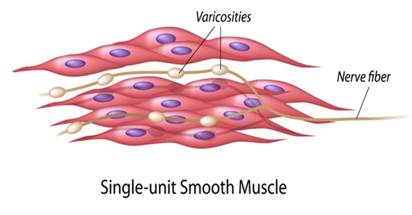
Types of Smooth Muscle
Two major types
Multi-unit
Smooth Ms
Single-unit
Smooth Ms

Slide 14
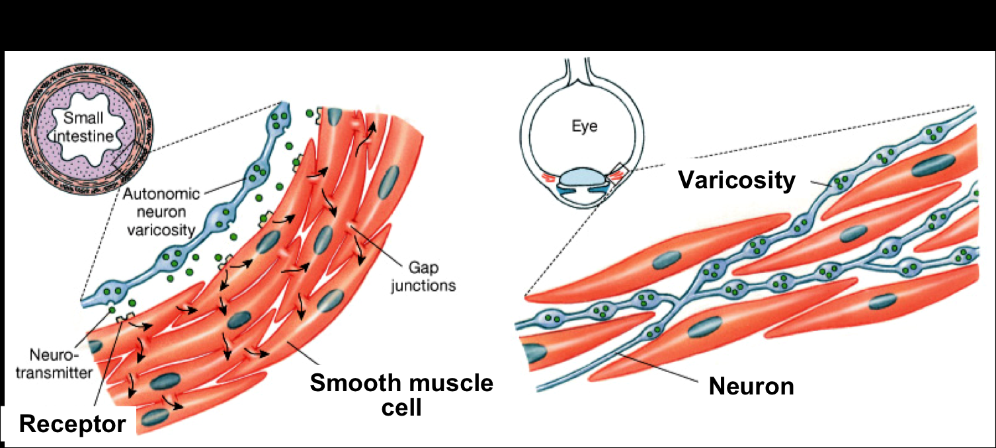
Examples of the Different Types of Smooth Muscle

Slide 15
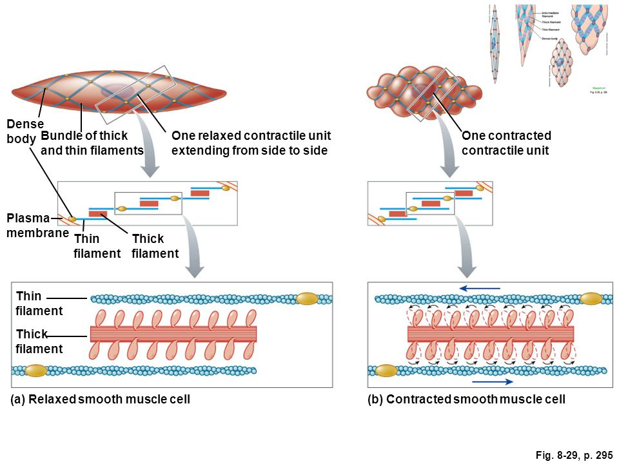
Contractile Mechanism of Smooth Muscle

Slide 16
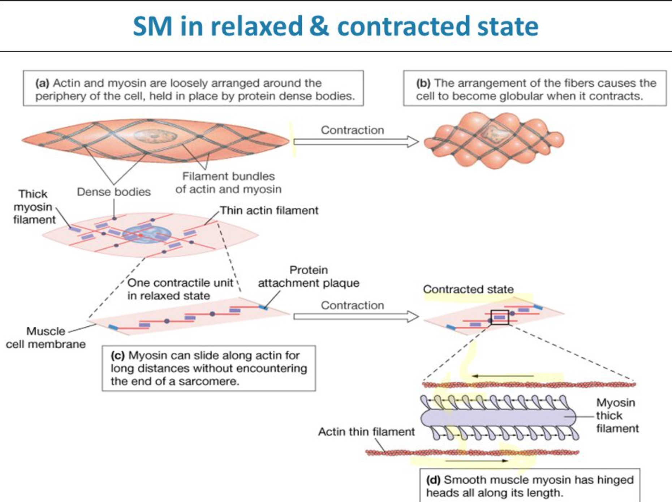

Slide 17
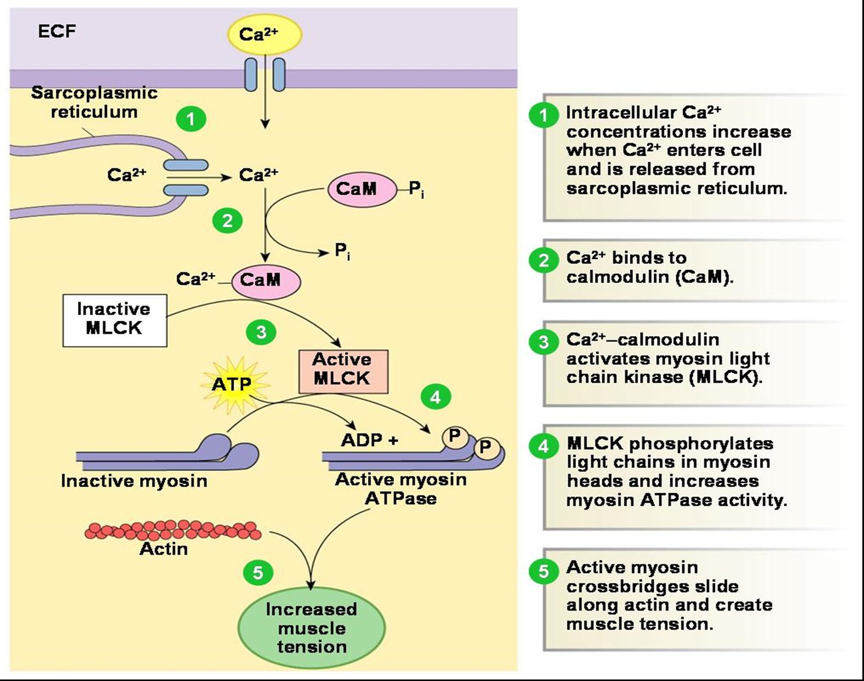
Molecular Basis of Smooth Muscle Contraction

Slide 18
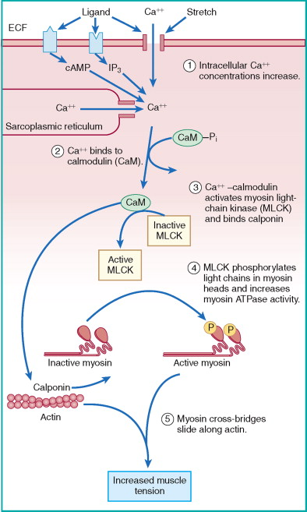
↑ [Ca⁺²]_{i}
Phosphorylates Myosin head increasing the activity of ATPase
Ca-CaM complex activates MLCK
Ca⁺² binds to calmodulin
Myosin head attaches to actin causing sliding of the filaments

Slide 19
How Does Smooth Muscle Contraction Stop?
A drop in [Ca⁺²]_{i} deactivates MLCK.
In addition, the phosphorylated myosin heads need to be dephosphorylated (deactivated) by Myosin Phosphatase
Relaxation

Slide 20
Types of Smooth Muscle Contraction
Types of smooth muscle activity pattern
Phasic
Tonic
Smooth muscle cells contract rhythmically or intermittently.
Contraction followed by relaxation.
e.g. walls of the GI tract.
Smooth muscle cells continuously active maintaining a “tone”.
Continuous partial contraction.
e.g. vascular & respiratory smooth muscle, sphincters.

Slide 21
Control of Smooth Muscle Contraction
Unlike skeletal muscle, smooth muscle can be stimulated to contract by many types of signals;
  Nervous signals.
  Hormonal signals.
  Mechanical signals (e.g. stretch).
  Pacemaker activity.

Slide 22
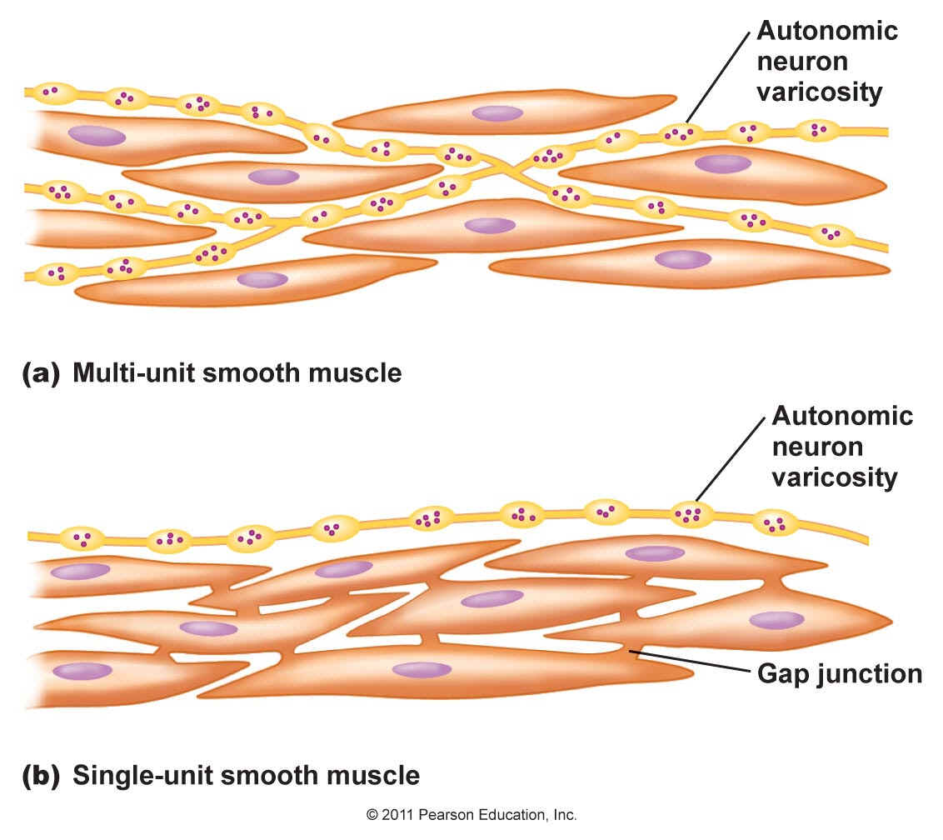
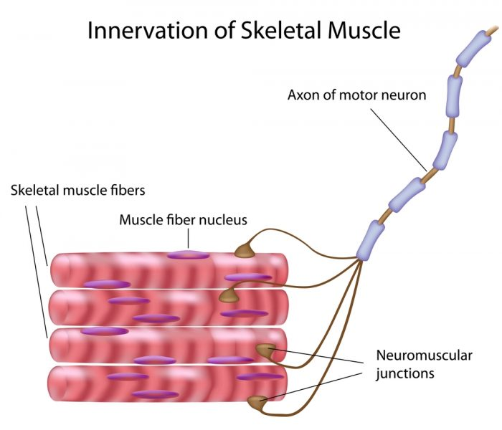
Nervous Control of Smooth Muscle Contraction
Somatic neuron.
Branching end feet.
Ach.
Autonomic neuron.
Axons have multiple varicosities.
Ach & NA.

Slide 23
Control of Smooth Muscle Contraction
In smooth muscle contraction can happen in the absence of an action potential.

Slide 24
Gastrointestinal Motility
Now that we discussed the general characteristics of smooth muscles, lets go back to GI smooth muscles.

Slide 25
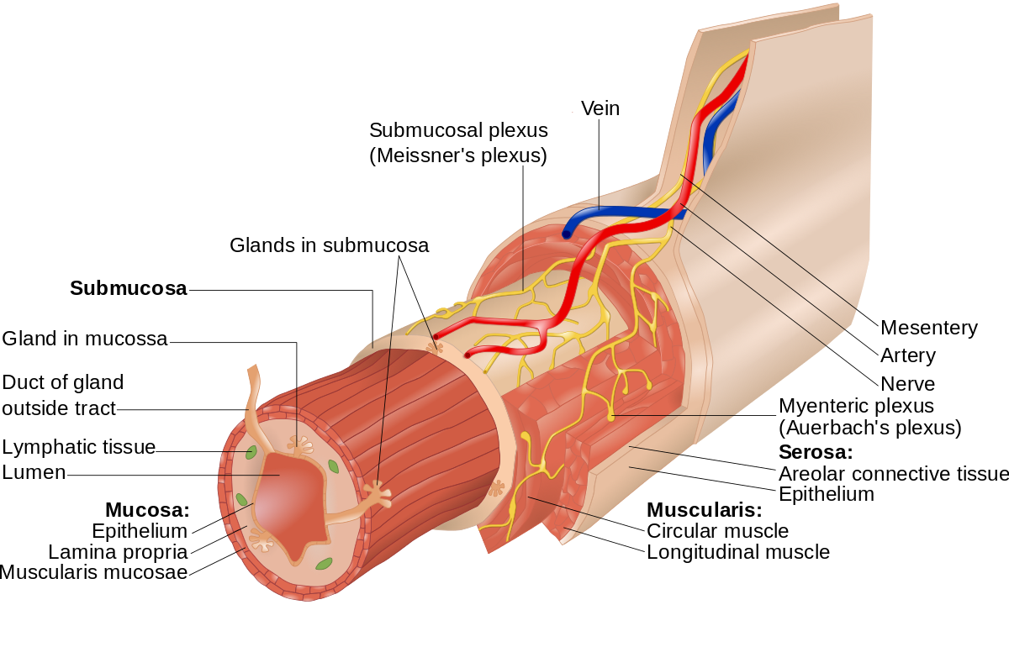
GI Smooth Muscle
Each muscle layer functions as a syncytium.
A few connections exist between circular & longitudinal muscle layers.

Slide 26
Electrical Activity of GI Smooth Muscle
What is the Resting membrane potential for smooth muscle cells? And at what level is the threshold?
Two basic types of electrical waves are seen in the GIT
Slow waves
Spike potentials
Rhythmic oscillations in RMP of 5-15mv with variable frequency depending on region.
Stomach = 3/min
Duodenum = 12/min
Ileum = 8-9/min
Are true action potentials.
The frequency of spike potentials depends on the extent of increase in slow wave potential above the level of threshold.

Slide 27
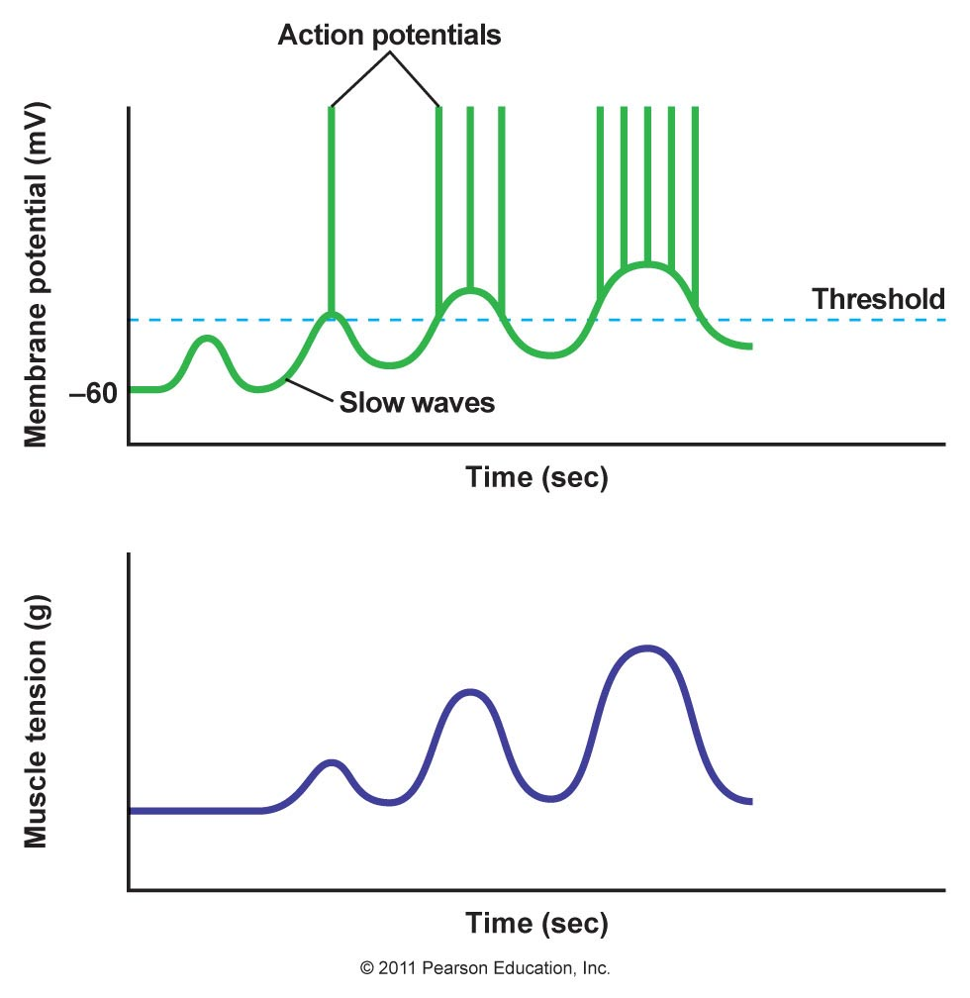
Slow Waves vs Spike Potential
What do you notice from the graph?
And what is the cause of;
Slow waves.
Spike potentials.

Slide 28
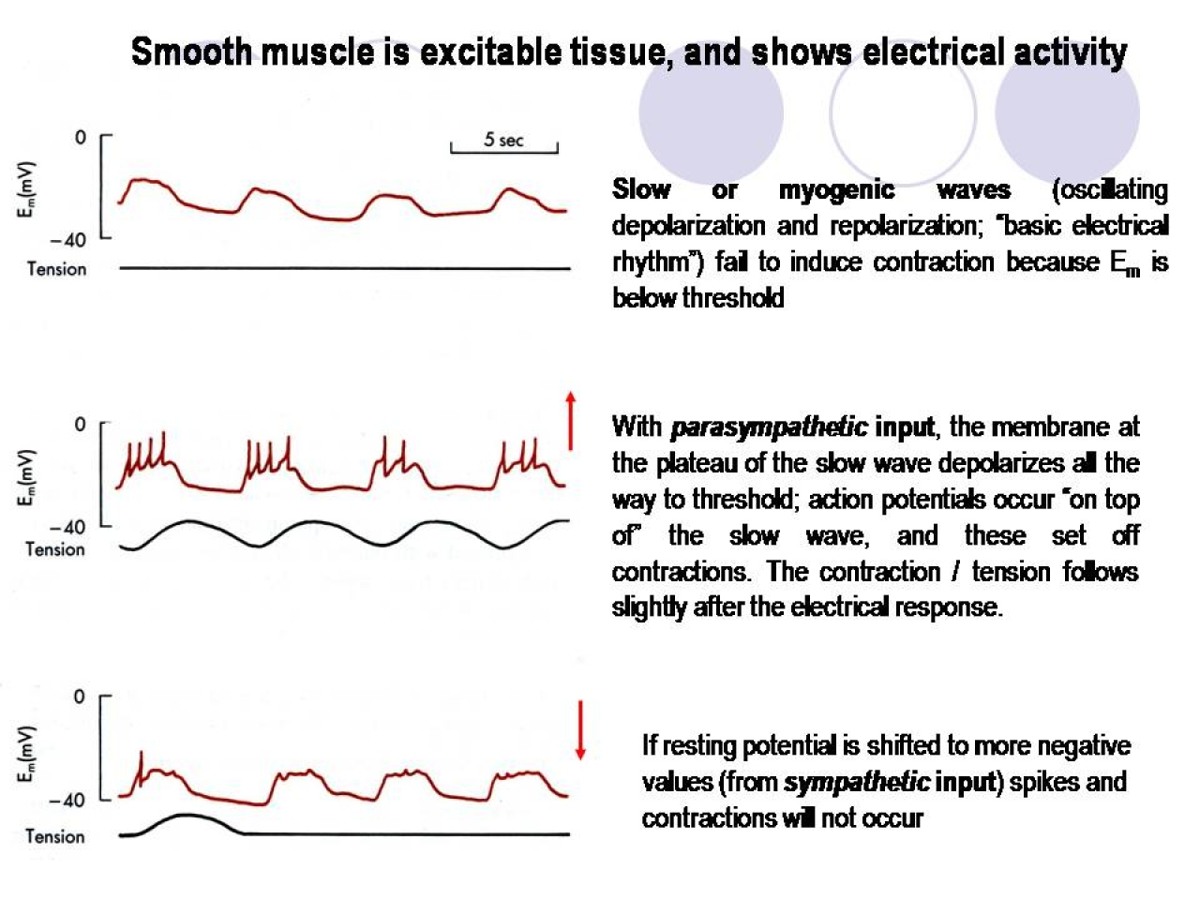
What Happens if the RMP is Changed?
Factors that cause the RMP to become less negative (stretch, Ach, some GI hormones)
Norepinephrine & Epinephrine.

Slide 29
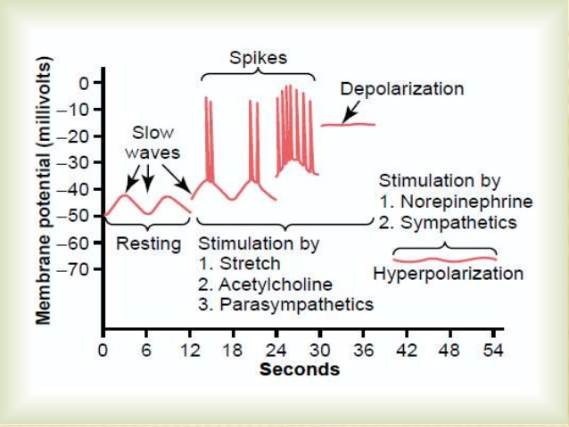

Slide 30
Control of GI Function
Neural control;
  Enteric nervous system (ENS).
  Autonomic nervous system.
Hormonal control.
GI contents.

Slide 31
Neural Control of GI Function
“The Enteric Nervous System”
The GIT has a nervous system of it own → “Enteric nervous system”.
Its function is largely independent of the extrinsic nervous system → “mini-brain”.
Composed of 2 main plexuses
Myenteric
“Auerbach’s” Plexus
Submucosal “Meissner’s” Plexus

Slide 32
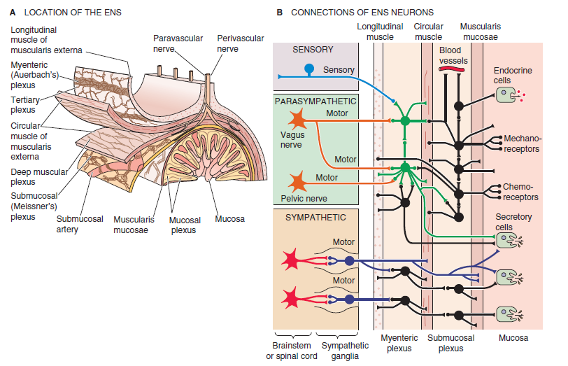
“The Enteric Nervous System”

Slide 33
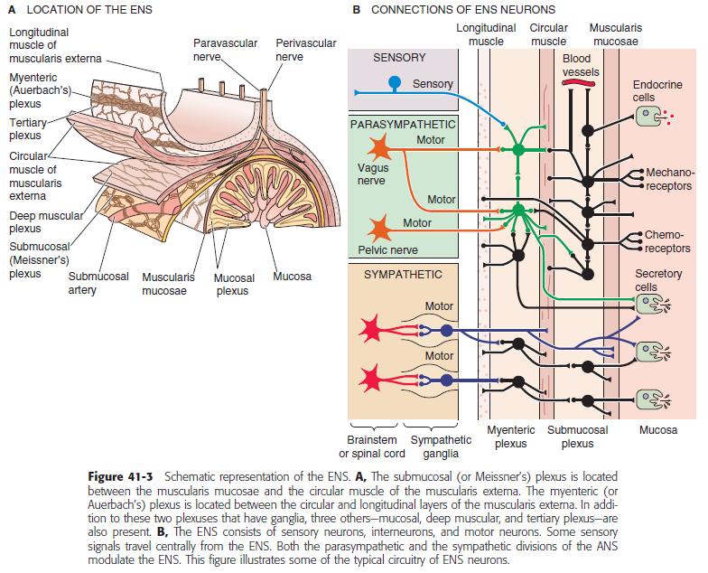

Slide 34
Myenteric vs Submucosal Plexus
Myenteric plexus
Submucosal plexus
Located in the muscle layer between longitudinal & circular muscle layers.
Controls GI movement.
Found throughout the GIT.
Located in the submucosa.
Controls GI secretion & local blood flow.
Only in the small & large intestine.

Slide 35
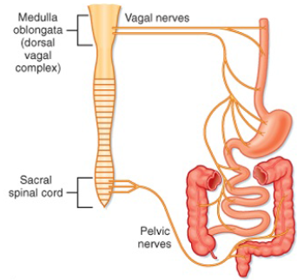
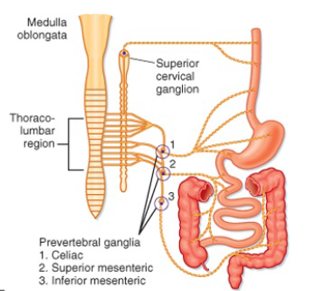
Autonomic Control of GIT
Parasympathetic
Sympathetic

Slide 36
GI Reflexes
3 types of reflexes
Integrated within the ENS
Integrated at Sympathetic ganglia
Integrated at spinal cord/brain stem
Control local effects;
GI secretion
Peristalsis
Mixing movement
Gastro-colic reflex
Entero-gastric reflex
Colono-ileal reflex
Pain reflexes
Defecation reflex

Slide 37
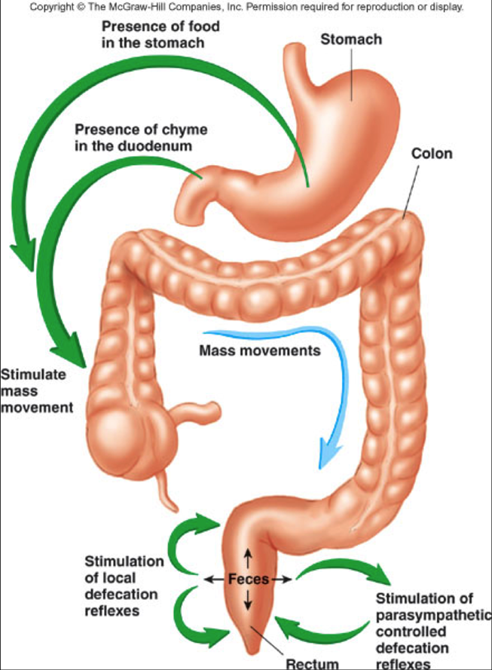

Slide 38
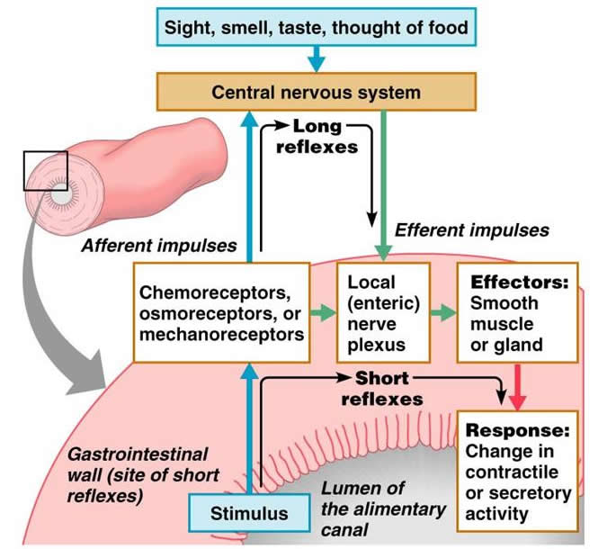

Slide 39
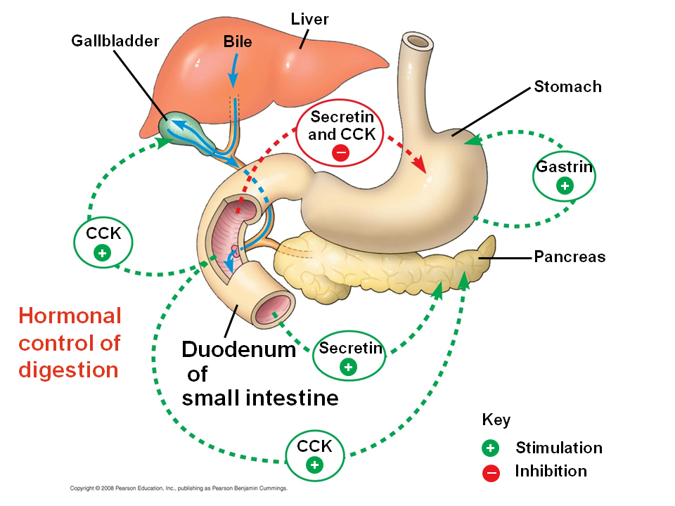
Hormonal Control of GI Function
https://www.sciencelearn.org.nz/resources/1836-hormonal-control-of-digestion

Slide 40
Types of Movement in the GIT
Motor activity of the GIT
Propulsive movement
“Peristalsis”
Mixing movement
“Segmentation”
Progressive wave of contraction & relaxation.
Move GI content in a caudal direction.
“Law of the Gut”
Distension of bowel → contraction of circular muscle & relaxation of longitudinal ms in upstream segment + the opposite in the downstream segment.
Non-propulsive segmental contractions.
Cause mixing and chopping of intestinal content.
Due to contraction of circular muscle + relaxation of receiving segment.

Slide 41
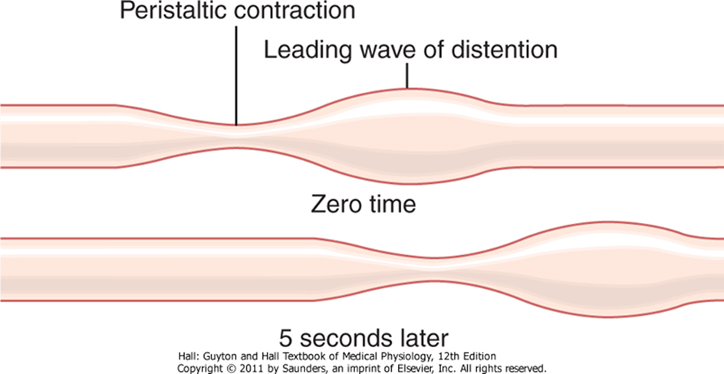
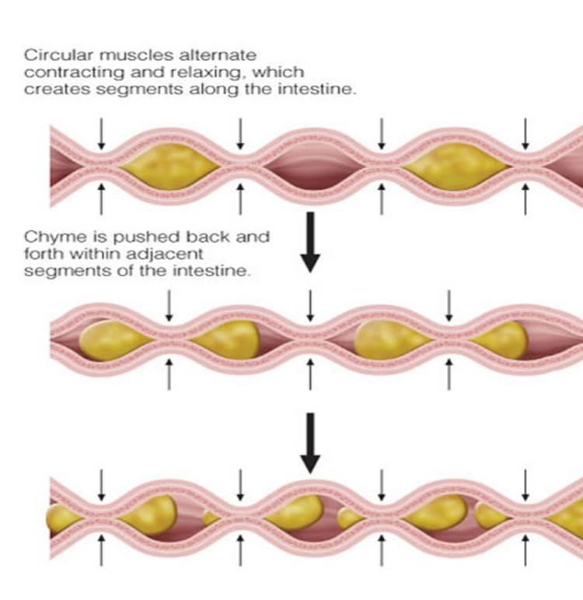
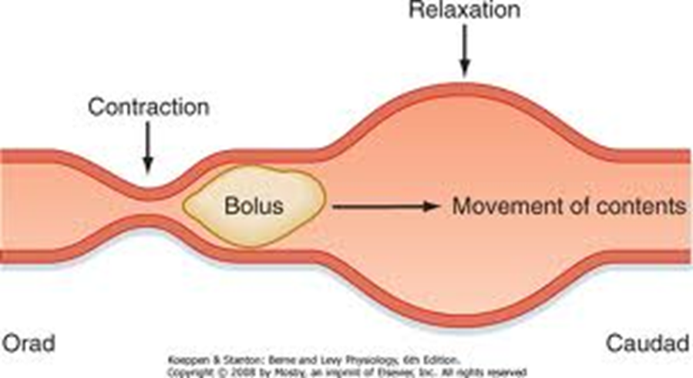
Types of Movement in the GIT
Peristalsis
Segmentation

Slide 42
Does the Bowel Move in the Fasting State?
Migrating motor complexes (MMC).
Every 90-120min.
4 phases.
What hormone is implicated and what is the purpose of it?

Slide 43
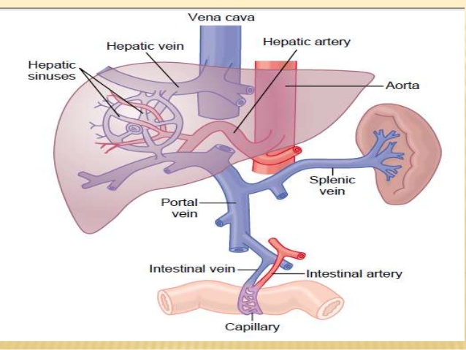
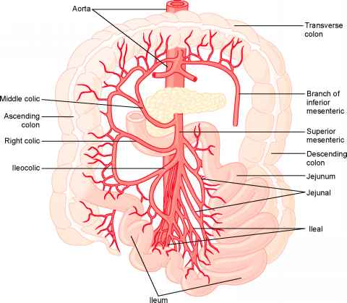
Splanchnic Circulation
Read from Guyton & Hall Textbook of Medical Physiology. Chapter 62. 12th ed.

Slide 44
Thank you

Slide 45
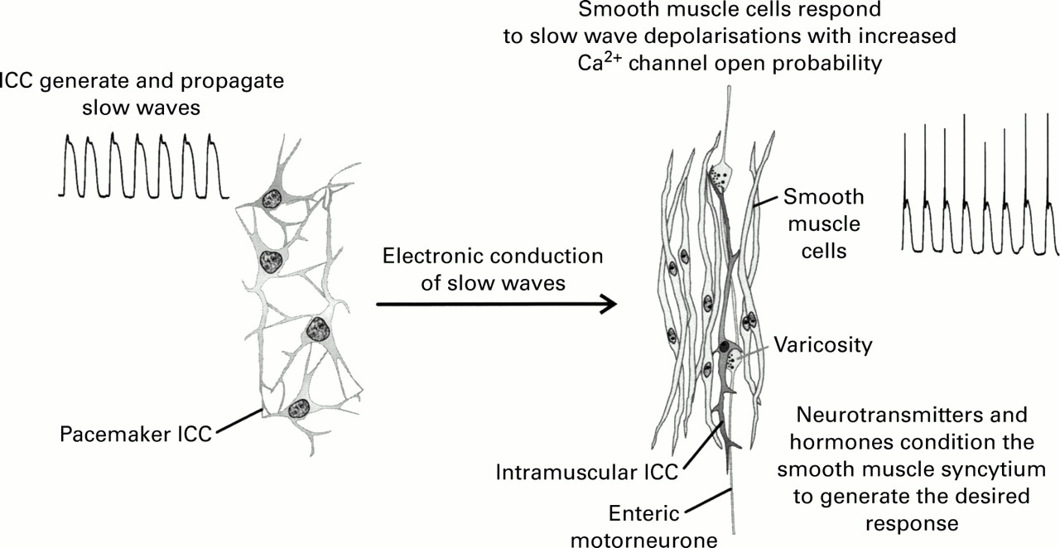

Slide 46
