Slide 2
The Concept of Communication Skills in Medicine
DR. KAMRAN SATTAR
MBBS, FAcadMEd AoME (UK)
MMedEd UoD (UK)
Dept. of Medical Education,
King Saud University.
https://www.skillpro.com/webinar/communicating-to-reduce-misunderstanding-and-conflict-7/

Slide 3
OBJECTIVES
At the end of today’s session students should be able to;
Define communication, its theory and types.
Describe the importance of communication in medicine.
Demonstrate effective communication in day to day practice.
Overcome barriers to effective communication.
Apply the principles of communication and collaboration skills in PBL sessions

Slide 4
Communication Skills
There is substantial evidence indicating that communication skills are crucial in the development of satisfactory health care provider-patient relationships. [1-4]
In the 21st century, teaching and assessment of communication skills in medical schools are well recognized [5].
Effective communication is considered to be one of the most important skills of a physician [6].

Slide 5
SaudiMEDS
ABMS
ACGME
WFME
GMC
AAMC
COMMUNICATION
(An essential competency)
Saudi MEDS: Saudi MEDs Framework, ACGME: Accreditation Council for Graduate Medical Education , ABMS: American Board of Medical Specialties, AAMC: Association of American Medical Colleges, GMC::General Medical Council, WFME: World Federation for Medical Education (7-11)

Slide 6
What is Communication?
The act by which information is shared.
It is the process by which we relate and interact with other people.
It includes listening & understanding with passion & respect as well as expressing views, ideas and passing information to others in a clear manner.

Slide 7
COMMUNICATION THEORY
Communication is a learned skill based on 3 pillars:
Accuracy
Efficiency
Supportiveness
All of the above combine to contribute to the effectiveness of good communication

Slide 8
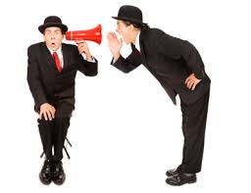
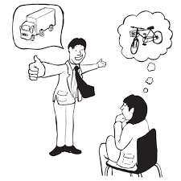
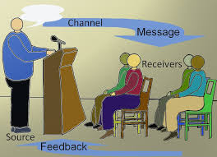
Non-Verbal Verbal

Slide 9
WRITTEN COMMUNICATION
Clarify your thoughts and the purpose
Identify the key points, facts and themes
Decide on a logical order
Use short paragraphs and sentences
Compose a strong introduction and ending
/http://www.learndirect.com/store/business-workplace/communication-skills http://www.englishgrammar.org/effective-business-writing

Slide 10
Verbal (mainly focuses on questioning)
Open (broad) – gives control to respondent, allows disclosure.
e.g. explain how you felt on the 1st day of college?
Open (focused) – gives control to respondent within a given area, encourages disclosure of feelings.
e.g. Did you have a good day at school
Closed – control is with interviewer, checks information.
e.g. Do you smoke? ‘Yes’ or ‘No’
Leading – control with interviewer, suggests desired response. e.g. What year in the 15th century did Columbus arrive in the Americas?

Slide 11
Verbal Communication
Speaking to the person
Look straight in the eye
make eye contact
Show respect
Clear message
Relevant
Use understandable language
Support by illustrations if needed
Good listener
Allow others to understand the message and reply
Listen carefully
Make a dialogue ant not one way instruction

Slide 12
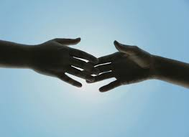
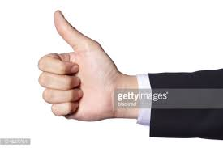
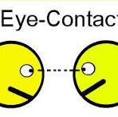
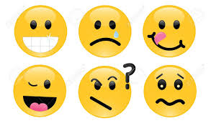
NON VERBAL
Listening (active and passive)
Silence
Touch
Hand gestures
Eye contact
Posture
Facial expression

Slide 13
Effective Communication Specifically, effective communication skills have been shown to improve providers’ interviewing skills, facilitate information-gathering, and decrease malpractice claims [12]
Interviewing skill
information-gathering
Malpractice claims

Slide 14
Communication: Why?
Effective communication is the basis of mutual understanding & trust.
Poor communication causes a lot of misunderstanding & hinders work & productivity.

Slide 15
Communication: Why? Cont.
Good Communication is needed to:
Develop relationships
Increase our knowledge
Make our feelings and thoughts known
Find out about people
Find out information

Slide 16
Communication & Medicine
Historically the emphasis was on the biomedical model in medical training which places more value on technical proficiency than on communication skills.
Recently learning communication skills & evidence based practice become the corner stones of modern medicine.

Slide 17
Communication in medicine
Increases patient satisfaction and health outcomes (Barlett, Grayson et al., 1984)
Reduces the risk of complaint and litigation (Beckmam 1994)
Higher levels of job satisfaction (Kramer et al., Suchman et al., 1993)

Slide 18
From the doctors What is required Towards the patients
Listen to patients and respond to their concerns and preferences.
Give patients information in way they can understand
Taking patient’s views into consideration when assessing their condition
Respond to patients questions , keep them informed & share information .
.

Slide 19
From the doctors What is required (cont: ) Towards your patients
You must make sure, wherever practical, that arrangements are made to meet patient’s language and communication needs.
You must be considerate to relatives, carers and partners in providing information and support

Slide 20
From the doctors What is required (cont: ) Towards your colleagues
Communicate effectively with colleagues within and outside the team
Make sure your colleagues understand your role and responsibilities in the team and who is responsible for each aspect of patient care
You must treat your colleagues fairly and with respect

Slide 21
Why do the doctors need to practice good communication?
Doctors need to learn essentials of good communication more than other professionals because patients are humans with sensitive needs.
Doctors cannot practice medicine without effective communication skills.
Poor communication causes a lot of medico-legal and ethical problems.

Slide 22
Communication: With whom?
Patients & care-givers
Nurses & auxiliary staff
Colleagues
Administrators
Reporting research findings
Talking to the media
Public & legislature

Slide 23
Where to apply our Communication skills ?
The medical interview is the usual communication encounter between the doctor and the patient
It can be classified according to the purpose of the interview into 4 types:
1. History taking 2. Consultations
3.Obtaining informed 4. Breaking bad news
Consent

Slide 24
Effective communication
Ensures good working relationship
Increases patients satisfaction
Increases patients understanding of illness & management
Improves patients compliance with treatment
Reduce medico-legal problems
Reduce uncertainty

Slide 25
Principles of effective communication
Planning
Interaction rather than a direct transmission
Flexibility in relation to different individuals and contexts.
Ability to handle emotional outbreaks

Slide 26
Communication with peers
Mutual trust & respect
Exchange information
Ask your seniors

Slide 27
Communication & Medical care
Good communication should be established between the patient , the family and the treating multidisciplinary team.
Patient & family should be encouraged to participate and verbalize in the ward round discussion about:
Offered medical care & treatment
Rehabilitation
Follow- up/re-admission plans
Doubts & worries.
Proper information to patient and family regarding services available and how they can utilize them.

Slide 28
Communication skills: Some techniques
PRACTICE- fluent dialogue with patient
USE- silence effectively, allowing patient enough time to express thoughts or feelings
ENCOURAGE- patients with your supportive words
UTILIZE - non-verbal communication

Slide 29
Listening vs Hearing
Hearing - a passive activity; no effort
Listening
Attention
Active involvement,
Full understanding
Takes time and effort

Slide 30
Barriers to effective communication
Personal attitudes
Ignorance
Human failings (tiredness, stress)
Language
Poor time management
Strenuous working environment

Slide 31
Conclusion
Effective communication is the key to success in professional career.
Good communication is essential for proper doctor-patient relationship and help avoids problems of misunderstanding.

Slide 32
Further reading
Effective Interact Interaction with Patients.
Faulkner, A (2001), 2nd Ed. Churchill Livingstone, London.
Clinical Communication in Medicine
Editors(s): Dr Jo Brown, Dr Lorraine M. Noble, Dr Alexia Papageorgiou, Dr Jane Kidd.
Print ISBN:9781118728246 |Online ISBN:9781118728130 |DOI:10.1002/9781118728130
The Complete Guide to Communication Skills in Clinical Practice (pdf).
Walter F. Baile, M.D
https://www.mdanderson.org/documents/education-training/icare/pocketguide-texttabscombined-oct2014final.pdf

Slide 33
References
1. Hochman O, Itzhak B, Mankuta D, Vinker S. The relation between good communication skills on the part of the physician and patient satisfaction in a military setting. Mil Med 2008;173(9):878–81.PubMedGoogle Scholar
2. Leite R, Makuch M, Petta C, Morais S. Women’s satisfaction with physicians’ communication skills during an infertility consultation. Patient Educ Counsel 2005;59(1):38–45.CrossRefPubMedGoogle Scholar
3. Greco M, Spike N, Powell R, Brownlea A. Assessing communication skills of GP registrars: a comparison of patient and GP examiner ratings. Med Educ 2002;36(4):366–76.CrossRefPubMedGoogle Scholar
4. Jackson JL, Chamberlin J. Predictors of patient satisfaction. Soc Sci Med 2001;52(4):609–18.CrossRefPubMedGoogle Scholar
5. Hausberg MC, Hergert A, Kröger C, Bullinger M, Rose M, Andreas S (2012) Enhancing medical students' communication skills: Development and evaluation of an undergraduate training program. BMC Medical Education 12: [PMC free article] [PubMed]
6. Baig LA, Violato C, Crutcher RA (2009) Assessing clinical communication skills in physicians: Are the skills context specific or generalizable. BMC Medical Education 9: [PMC free article] [PubMed]
7. Accreditation Council for Graduate Medical Education (ACGME) (2007) Common program requirements. Available: https://www.acgme.org/acgmeweb/Portals/0/PFAssets/ProgramRequirements/CPRs_07012015.pdf Accessed 15 Oct 2015.
8. American Board of Medical Specialties (ABMS) (2014) Standards for the ABMS Program for Maintenance of Certification (MOC). Available: http://www.abms.org/media/1109/standards-for-the-abms-program-for-moc-final.pdf Accessed 15 Oct 2015.
9. Association of American Medical Colleges (AAMC) (1998) Report I. Learning objectives for medical student education. Guidelines for medical schools. Available: https://members.aamc.org/eweb/upload/Learning%20Objectives%20for%20Medical%20Student%20Educ%20Report%20I.pdf Accessed 16 Oct 2015.
10. General Medical Council (GMC) (2009) Tomorrow’s doctors. Outcomes and standards for undergraduate medical education. Available: http://www.gmc-uk.org/Tomorrow_s_Doctors_1214.pdf_48905759.pdf Accessed 15 Oct 2015.
11. World Federation for Medical Education (WFME) (2015) Basic medical education. WFME global standards for quality improvement. The 2015 revision. Available: http://wfme.org/standards/bme/78-new-version-2012-quality-improvement-in-basic-medical-education-english/file Accessed 15 Oct 2015.
12.. Smith RC, Lyles JS, Mettler J, et al. The effectiveness of intensive training for residents in interviewing. Ann Intern Med 1998;128(2):118–26.PubMedGoogle Scholar

Slide 34
THANK YOU VERY MUCH
& &

