Slide 1
Leadership and management skills
Professionalism course (skl-221)
Lulu Alnuaim & mohammed alnaami
Notes:
Glenda

Slide 2
general Goals
To sharpen students awareness of additional skills in leadership and related areas of organization and management
To develop leaders at all levels of studentship
To encourage the ability to work effectively as a leader in a healthcare team
Notes:
Paula

Slide 3
Specific Session objectives
At the end of the session, the student will be able to:
Define leadership
Explain the concepts of leadership and management
Understand leadership theories
Identify the traits and skills of an effective leader
Explain the major approaches to leadership
Describe the various types/styles of leadership
Recognize the many challenges ahead facing leaders in modern healthcare systems
Notes:
Paula

Slide 4
Proposed definitions
Leadership is:
A function of knowing yourself, having a vision that is well communicated, building trust among colleagues, and taking effective action to realize your own leadership potential (Warren Bennis 1997).
Often considered as the ability to influence a group of people towards the achievement of goals.
Notes:
Paula

Slide 5
Concepts of leadership and management
Both leadership and management involve influence, working with people, and working to achieve common goals. However, there are some differences:
Management | Leadership
Unidirectional authority relationship | Multi-directional influence relation
Focus on system and structure; Processes, policy, procedures | Focus on people motivation and inspiration
Short-range perspectives | Long-term view and goals
Relies on control of people | Create trust among people
Managers does things right | Leaders does right things
Task–oriented | Vision-oriented
Administration | Relies on envision and innovation
Model roles/Do things right | Role-models/do right things
Exercise power over people | Develop power with people
Ensures that rules are followed | Empowers and inspires people

Slide 6
Leadership Theories
Great Man Theory. Leaders are exceptional people, born with innate qualities, destined to lead.
Trait Theory. Qualities associated with leadership e.g. Honesty.
Functional Theory. Interaction of task, team, and individuals
Behaviourist Theory. Leaders behavior and actions, rather than their traits and skills, e.g. Persuasive, consultative, democratic.
Situational/Contingency Theory. Leadership style changes according to the 'situation‘ and in response to the individuals being managed – according to their competency and motivation.
Transformational Theory. Leaders inspire individuals, develop trust, and encourage creativity and personal growth. Individuals develop a sense of purpose to benefit the group, organization or society. This goes beyond their own self-interests and an exchange of rewards or recognition for effort or loyalty.
Notes:
Paula

Slide 7
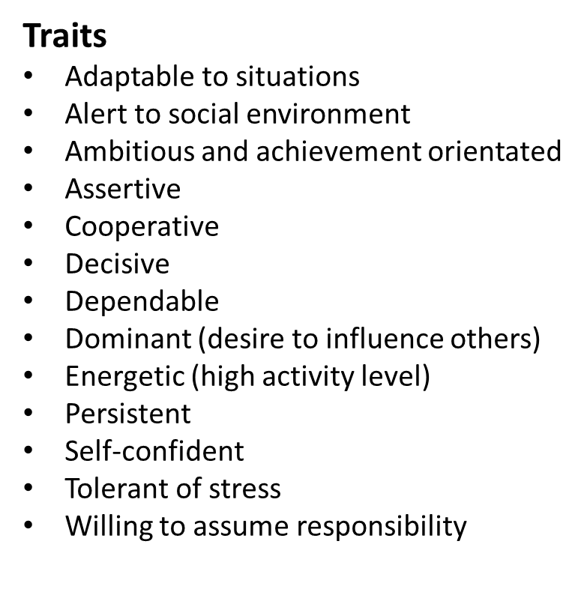
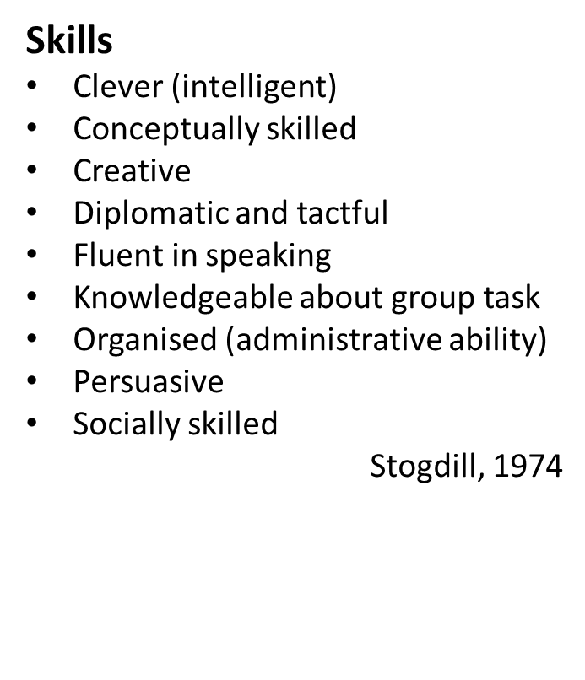
Leadership Traits and Skills
Notes:
Paula

Slide 8
Approaches to Leadership
The Trait Approach
Links a number of qualities to effective leadership
The ability to build effective learning
The ability to listen
The capability to make own decision
The ability to retain good people
The ability to be surrounded and supported by good people
Notes:
Paula

Slide 9
Approaches to Leadership…continue
Attitudinal Approach
Consideration, showing concern for members of the group
E.G. Giving recognition, nurturing self-esteem, developing mutual trust, inviting participation, etc.
Initiation of structure
Is a behavior that organizes the group to define relationship, specify task and how it is to be done, emphasize the need to hit deadlines and maintaining qualities, define lines of responsibilities and clarify roles
Notes:
Paula

Slide 10
Types/styles of leadership
Visionary Leader. Has a long-term perspective form: mission statements, vision and value.
Integration Leader. Has medium term perspective. Focus on own organization.
Fulfillment Leader. Has short-term perspective.
Transactional Leader. Sets clear goals, understand needs of employees, motivates and rewards.
Transformational Leader. Involves mutual trust and relationship, shared values and shared vision
Charismatic Leader. Attractive character(s) that he/she is distinguished with! e.g. Attractive when he/she talks
Is there a best style of leadership?
Answer: Those who are able to adapt their style to fit the requirement of situations encountered are best leaders.
Notes:
Paula

Slide 11
Recognizing the Challenges of Leadership
When are the challenges of leadership most obvious?
When something new is about to start
When something is about to end
When times are tough
During transitions
Notes:
Donna

Slide 12
External challenges to leadership
Public criticism
Flare-ups of others' interpersonal issues
Crises
Opposition and/or hostility from powerful forces
A financial or political windfall
Collaboration failures
Notes:
Donna

Slide 13
internal challenges to leadership
Insecurity
Defensiveness
Lack of decisiveness
Inability to be direct when there's a problem
Inability to be objective
Impatience - with others and with situations
Notes:
Donna

Slide 14
How can leaders cope with these challenges?
Be proactive
Be creative
Face conflict squarely
Always look for common ground
Retain your objectivity
Look for opportunities to collaborate
Listen
Ask for 360-degree feedback...and use it
Notes:
Donna

Slide 15
How can leaders cope with these challenges? (continue)
Look at what's going on around you?
Reach out for help in facing internal challenges
Create mechanisms to revisit your vision
Share the burden
Find an individual or group with whom you can discuss the realities of leadership
Make sure you have personal time
Notes:
Donna

Slide 16
references
1. Bennis, W.and Goldsmith, J. Learning to Lead: A Workbook on Becoming a Leader, updated Ed., Addison Wesley, Reading, MA 1997.
2. Bennis, W. G., and Nanus, B. Leaders: The strategies for taking charge. New York, NY: HarperCollins 2007.
3. Coleman, D. leadership that get results. Harvard Business Review. 2000.
4. Katz, R. L. Skills of an effective administrator. Harvard Business Review, 1955; 33(1), 33.
5. Kotterman, J.P. “Leadership vs Management: What’s the difference?” Journal for Quality & Participation, 2006; Vol. 29 Issue 2, p.13-17.
6. Kotterman, J. P. “What leaders really do?“, Harvard Business Review, 2007; Vol. 79 Issue 11, p.85-96.
7. Heifetz, RA. and Laure, DL. The work of leadership, Harvard Business Review. 2006.
8. Holland, JH. Hidden Order: How adaptation Builds Complexity. NY: Basic books 1992.
9. Mulford, B. The Leadership Challenge: Improving Learning in Schools. Camber well Vic. Australian council for educational Research. 2008.
Notes:
Donna

