Slide 1
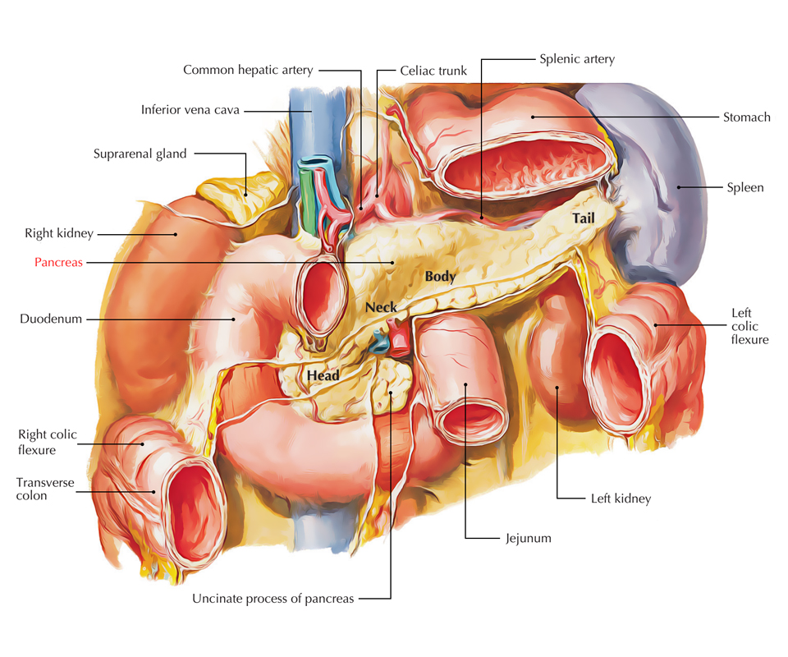
ANATOMY OF PANCREAS AND BILIARY SYSTEM
(1440-41)
DR. ZAHID ALI KAIMKHANI
M.D; M.Phil; Ph.D

Slide 2
Objectives
At the end of this discussion, we will be able to describe:
Topographical anatomy of the pancreas & the biliary system:
Location, parts, relations & peritoneal reflection
Blood supply, nerve supply and lymphatic drainage
Course of each of common hepatic, cystic and common bile duct and pancreatic ducts
Clinical Correlations

Slide 3
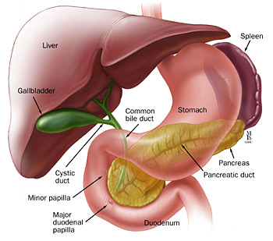
The Pancreases “All Flesh”
Lies in the upper abdomen behind the stomach
Both exocrine and endocrine functions
Exocrine component
makes and secretes digestive enzymes into the intestine (Exocrine pancreas)
comprise more than 95% of the pancreatic mass
Endocrine component
makes and secretes hormones (insulin, glucagon, somatostatin)
control energy metabolism and storage throughout the body (Endocrine pancreas Islet's of Langerhans).
comprise 1-2% of pancreatic mass.

Slide 4
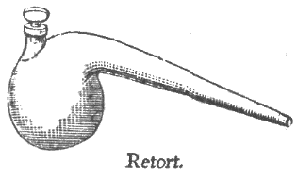
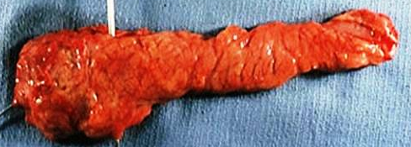
The Pancreases “All Flesh”
LOCATION
In the epigastric and left hypochondriac regions.
(from concavity of the duodenum to the hilum of spleen opposite the level of T12– L3 vertebrae).
PERITONEUM
The greater part is retroperitoneal behind the lesser sac.
SHAPE
The pancreas is “J”-shaped or RETORT shaped being set obliquely.
SIZE
Length: 12–15 cm(6-10 inch).
Weight: 60–100 g.
NECK
BODY
HEAD
TAIL

Slide 5
The Pancreases “All Flesh”
PARTS (SUBDIVISIONS)
Head (with one process— uncinate process).
Neck.
Body (with one process—tuber omentale).
Tail.
HEAD OF THE PANCREAS
is the enlarged, disc-shaped right end of the pancreas.
lies in the concavity of the C-shaped duodenal loop in front of the L2 vertebra
Anterior surface is related from above downward to:
The gastroduodenal artery,
transverse colon,
root of the transverse mesocolon and
jejunum.
Posterior surface is related to:
IVC,
left renal vein,
bile duct and
right crus of diaphragm.
Uncinate process is related to:
anteriorly to superior mesenteric vessels and
posteriorly to the abdominal aorta.

Slide 6
The Pancreases “All Flesh”
NECK OF THE PANCREAS
Best defined as “narrow band of pancreatic tissue that Lies in front of superior mesenteric and the portal vein”
Its antero-superior surface supports/related to the pylorus
The superior mesenteric vessels emerge from its inferior border

Slide 7
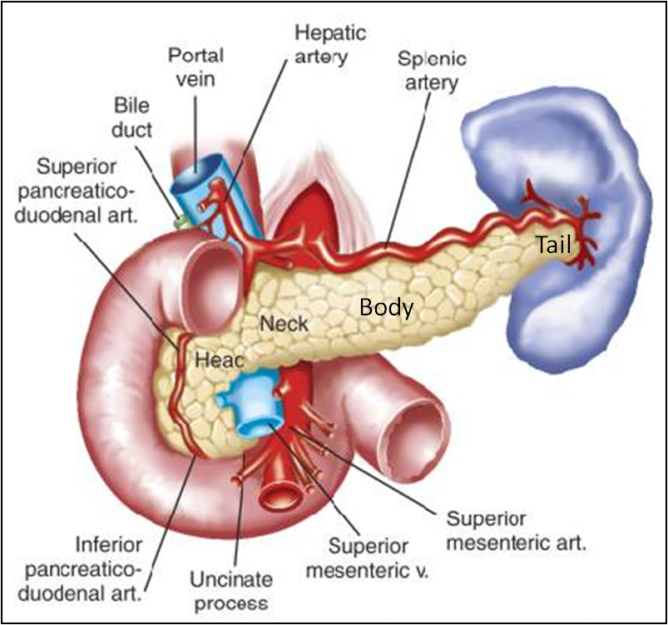
The Pancreases “All Flesh”
BODY OF THE PANCREAS
It runs upward and to the left.
lies in front of the vertebral column at or just below the transpyloric plane.
One process: Tuber omentale (a part of the body projects above the lesser curvature of the stomach and comes in contact with the lesser omentum across the lesser sac).
It is triangular in cross section.
The splenic vein is embedded in its posterior surface
The splenic artery runs over its upper border

Slide 8
The Pancreases “All Flesh”
TAIL OF THE PANCREAS
Narrow, short segment, ending at the splenic hilum
It is mobile unlike the other major retroperitoneal parts of the gland.
contains the largest number of islets of Langerhans
Lies in the splenicorenal (lienorenal) ligament (may get injured during splenectomy) along with splenic vessels, at the level of the T12 vertebra
Anteriorly, related to splenic flexure of colon

Slide 9
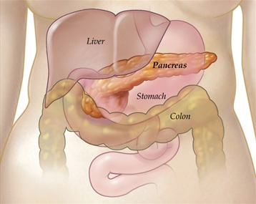
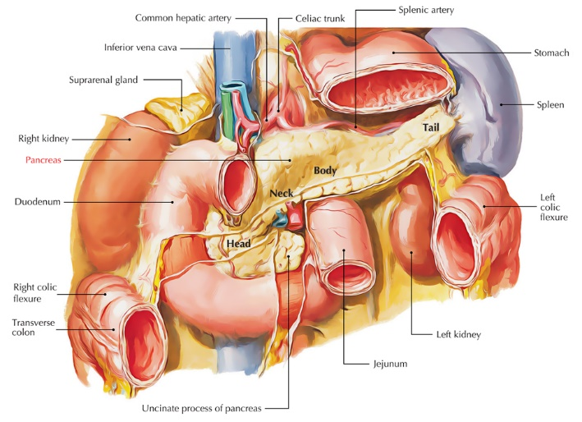
The Pancreases “All Flesh”
Posterior Relations (from right to left)
Bile duct, portal & splenic veins,
inferior vena cava,
aorta & origin of SMA
Left psoas muscle,
Left adrenal gland,
left renal vessels & upper 1/3rd of left kidney
Hilum of the spleen.
RELATIONS OF THE PANCREAS
Anterior Relations
Stomach separated by lesser sac
Transverse colon &
transverse mesocolon

Slide 10
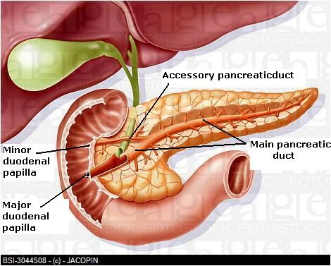
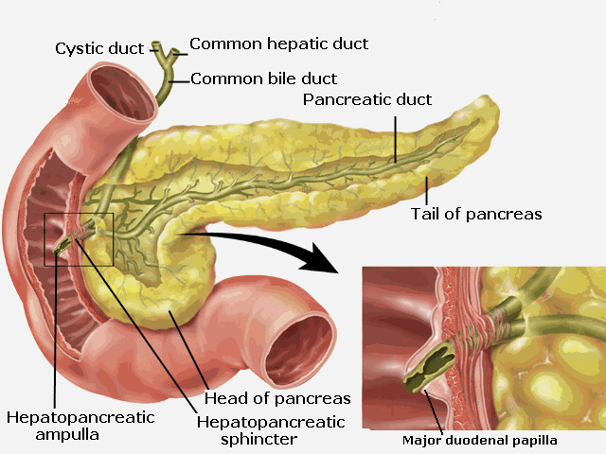
The Pancreases “All Flesh”
Accessory duct (of Santorini)
drains superior portion of the head
It empties separately into 2nd part of duodenum at (minor duodenal papilla) about 2–3 cm above the opening of main pancreatic duct (6–8 cm distal to pylorus)
PANCREATIC DUCTS
Main duct (of Wirsung)
Accessory duct (of Santorini)
Main duct (of Wirsung)
runs the entire length of pancreas beginning from the tail.
It drain whole pancreas except upper portion of the head i.e.( tail, body, neck, inferior portion of head & uncinate process.
Joins common bile duct & together they open into a small hepatopancreatic ampulla (Ampulla of Vater) in the 2nd part of the duodenum.
The ampulla opens by a narrow mouth on the summit of major duodenal papilla 8–10 cm distal to the pylorus.

Slide 11
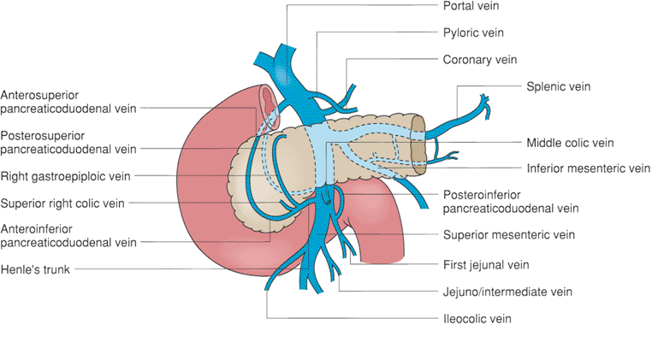
The Pancreases “All Flesh”
Venous Drainage
BLOOD SUPPLY OF THE PANCERAS
Head & Neck
Drained by anterior and posterior venous arcades that form the superior & inferior pancreaticoduodenal veins which follow the corresponding arteries.
Body and tail:
Drained by the splenic vein, which is a tributary of the portal vein
Arterial Supply
Head & Neck
Supplied by branches from:
Superior pancreatico-duodenal artery br of gastroduodenal artery (GDA), branch of hepatic artery branch of Celiac trunk
Inferior pancreatico-duodenal artery branch of Superior mesenteric artery
Body and tail:
Supplied by Splenic artery (main artery) through 8- 10 branches
Celiac trunk
Hepatic artery
Gastroduodenal A (GDA)
Superior pancreatico-duodenal A

Slide 12
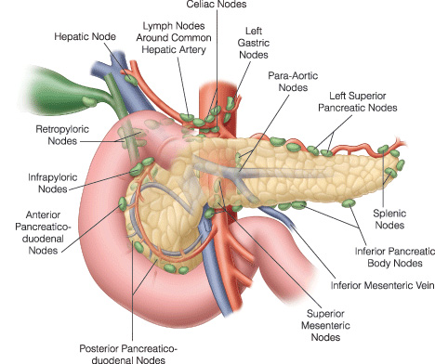
The Pancreases “All Flesh”
LYMPHATIC DRAINAGE
INNERVATION
Rich network that drains into:
Pyloric
Hepatic &
Splenic nodes
Ultimately the efferent vessels drain into:
the celiac &
superior mesenteric lymph nodes.
Sympathetic fibers
from the thoracic splanchnic nerves.
have a predominantly inhibitory effect
Parasympathetic fibers
from the Vagus.
stimulate both exocrine and endocrine secretions

Slide 13
The Pancreases “All Flesh”
CLINICAL ANATOMY
Carcinoma of the head of pancreas
Is common.
Compresses the bile duct leading to persistent obstructive jaundice.
May press the portal vein or may involve the stomach due to close vicinity of these structures to the head of pancreas.
Acute pancreatitis
Is the acute inflammation of the pancreas.
Occurs due to obstruction of pancreatic duct, ingestion of alcohol, viral infections (mumps), or trauma.
It is serious condition because activated pancreatic enzymes leak into the substance of pancreas and initiates the autodigestion of the gland.
Clinically, it presents as very severe pain in the epigastric region radiating to the back, fever, nausea, and vomiting.

Slide 14
Biliary System

Slide 15
Biliary System
The biliary system consists of
ducts and organs (bile ducts, liver & gallbladder) that are involved in the
production,
storage &
transportation of bile.
Bile
is secreted by the liver cells
at a constant rate of about 40 ml per hour.
in between digestion, it is stored and concentrated in the gallbladder;
later, it is delivered to the duodenum.

Slide 16
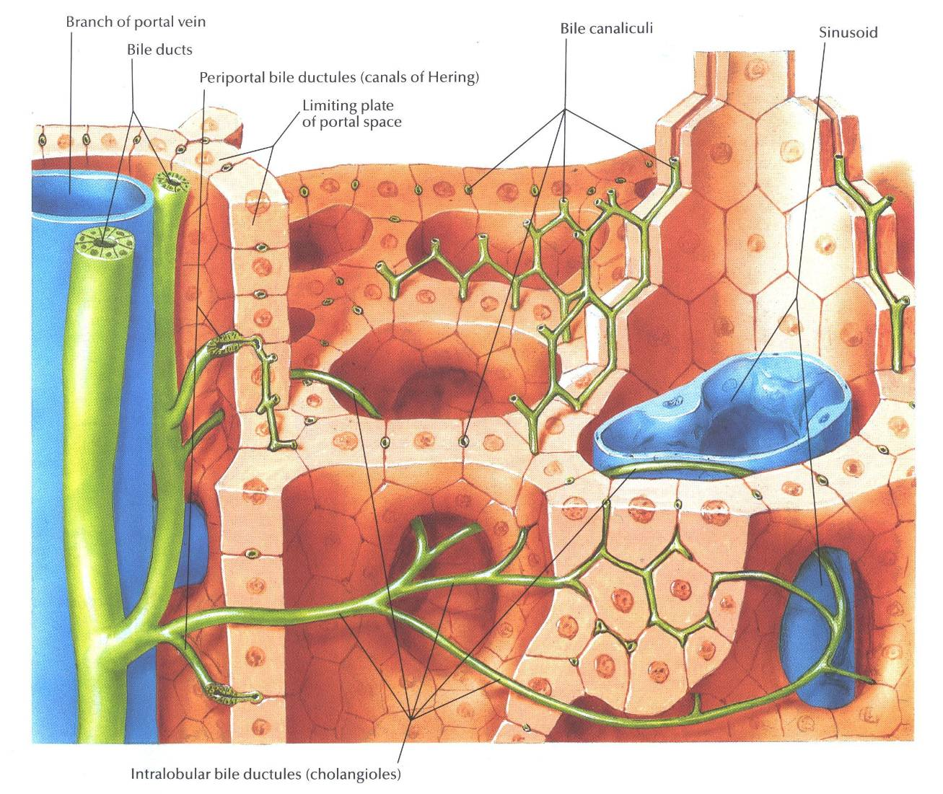
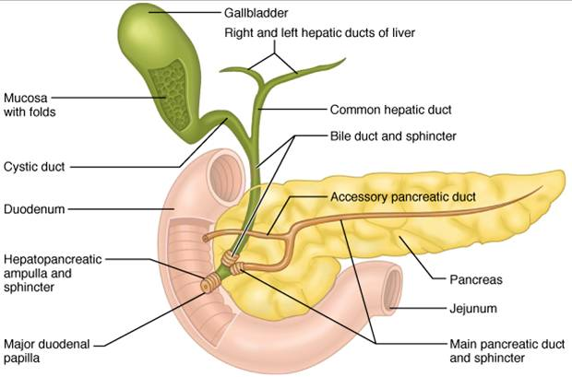
Biliary System
The Bile Duct
The Bile Duct consists of
Bile canaliculi
Interlobular ducts
Intrahepatic ducts
Right and left hepatic ducts
Common hepatic duct
Cystic duct
Common bile duct (Bile duct)

Slide 17
Biliary System
The Bile Duct
The Bile Duct consists of
Bile canaliculi
The smallest tributaries of the bile ducts; situated in the portal canals of the liver
Receives bile from the hepatocytes
The interlobular ducts join one another to form progressively larger ducts and, eventually, at the porta hepatis, form the right and left hepatic ducts.

Slide 18
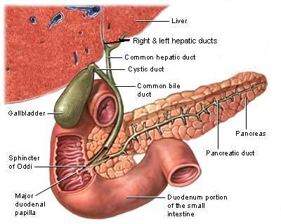
Biliary System
The Bile Duct
The right hepatic duct drains the right lobe of the liver
the left hepatic duct drains the left lobe, the caudate lobe, & quadrate lobe.
After a short course, the hepatic ducts unite to form the common hepatic duct
the common hepatic duct
is about 1.5 in. (4 cm) long
descends within the free margin of the lesser omentum.
is joined on the right side by the cystic duct from the gallbladder to form the common bile duct

Slide 19
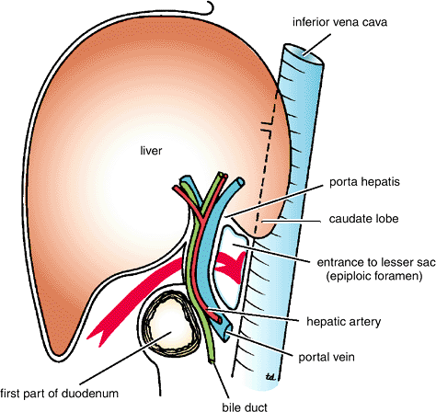
Biliary System
The Bile Duct
The common bile duct
is about 3 inches (8 cm) long.
Course:
First it lies in the right free margin of the lesser omentum.
Then it runs behind the first part of the duodenum.
Lastly it lies in a groove on the posterior surface of the head of the pancreas. Here, the bile duct comes into contact with the main pancreatic duct

Slide 20
Biliary System
The Bile Duct
The common bile duct
ends below by piercing the medial wall of the second part of the duodenum about halfway down its length.
is usually joined by the main pancreatic duct, and together they open into a small ampulla in the duodenal wall, called the hepatopancreatic ampulla (ampulla of Vater).
The ampulla opens into the lumen of the duodenum by means of a small papilla, the major duodenal papilla.
The terminal parts of both ducts and the ampulla are surrounded by circular muscle, known as the sphincter of the hepatopancreatic ampulla (sphincter of Oddi).
Occasionally, the bile and pancreatic ducts open separately into the duodenum.

Slide 21
Biliary System
The Gall Bladder
The Gall Bladder
is a pear-shaped sac lying on the undersurface of the liver.
has a capacity of 30 to 50 ml
stores and concentrate the bile
The gallbladder is divided into:
Fundus
Body, and
Neck.
The fundus is rounded and projects below the inferior margin of the liver, where it comes in contact with the anterior abdominal wall at the level of the tip of the ninth right costal cartilage.
The body lies in contact with the visceral surface of the liver and is directed upward, backward, and to the left.
The neck becomes continuous with the cystic duct, which turns into the lesser omentum, joins the common hepatic duct, to form the bile duct

Slide 22
Biliary System
The Gall Bladder
The peritoneum completely surrounds the fundus of the gallbladder and binds the body and neck to the visceral surface of the liver.
Relations of the Gall Bladder
Anterior Relations
The anterior abdominal wall and the inferior surface of the liver
Posterior Relations
The transverse colon and the first and second parts of the duodenum
Function of the Gallbladder
concentrates & stores bile
selectively absorbs bile salts
keeps the bile acid
excretes cholesterol
secretes mucus.
To aid in these functions, the mucous membrane is thrown into permanent folds that unite with each other, giving the surface a honeycombed appearance.

Slide 23
Biliary System
The Gall Bladder
Surface Anatomy of the Gall Bladder
The Fundus comes in contact with the anterior abdominal wall at the level of the Tip of the Right Ninth costal cartilage.

Slide 24
Biliary System
The Gall Bladder
Blood Supply of the Gall Bladder
The cystic artery, a branch of the right hepatic artery.
The cystic vein drains directly into the portal vein.
Note:
Several very small arteries and veins also run between the liver and gallbladder.
Nerve Supply
Lymph Drainage
The lymph drains into a cystic lymph node situated near the neck of the gallbladder. From here, the lymph vessels pass to the hepatic nodes along the course of the hepatic artery and then to the celiac nodes.
Sympathetic and parasympathetic vagal fibers form the celiac plexus.
Note:
The gallbladder contracts in response to the hormone cholecystokinin, which is produced by the mucous membrane of the duodenum on the arrival of fatty food from the stomach

Slide 25
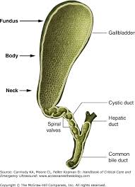
Biliary System
The Gall Bladder
Cystic Duct
is about 1.5 in. (3.8 cm) long
connects the neck of the gallbladder to the common hepatic duct to form the bile duct.
is usually somewhat S-shaped and descends for a variable distance in the right free margin of the lesser omentum.
mucous membrane of the cystic duct is raised to form a spiral fold that is continuous with a similar fold in the neck of the gallbladder.
The fold is commonly known as the “spiral valve.”
The function of the spiral valve is to keep the lumen constantly open.

